Slide 1
IEEE CONFERENCE PRESENTATION
UniBus Live
A Real-Time Bilingual University Bus Tracking System
with Resilient Dual-Source GPS Acquisition
Md. Shishir Hossain Md. Sajib Hassan Md. Showkat Hossen
Supervisor: Mahbubur Rahman Chowdhury, Senior Lecturer
Department of Computer Science and Engineering
NPI University of Bangladesh, Manikganj, Dhaka

Slide 2
AGENDA
Outline
01
Problem & Motivation
why campus riders wait blind
02
Our Approach & Contributions
hardware-first tracking, geometric ETA, bilingual UX
03
System Architecture & Implementation
acquisition, filtering, ETA, realtime delivery
04
Pilot Evaluation
seven weeks of operational data
05
Findings, Limitations & Future Work
the 98% discovery and its fix
UniBus Live · NPI University of Bangladesh
2

Slide 3




PROBLEM & MOTIVATION
Riders Wait Without Information
No visibility
A student at the stop cannot tell whether the bus left five minutes ago or is fifteen minutes away.
Did it already leave?
How much longer?
… still waiting.
Timetables alone fail
Dhaka–Manikganj traffic makes printed schedules unreliable; uncertainty causes missed buses and long waits.
Existing products don't fit
Commercial fleet trackers are costly, operator-facing, and English-only — they never answer the rider's question.
“When does my bus reach my stop?”
UniBus Live · NPI University of Bangladesh
3

Slide 4
RELATED WORK
What Exists, and the Gap We Fill
PRIOR WORK
LIMITATION FOR OUR SETTING
Campus tracking systems
single on-board source; English-only
Sharif et al. ’18 · Premkumar et al. ’20
Crowdsourced positioning
depends on passenger participation; coverage gaps
Zhou et al. (MobiSys ’12) · Wepulanon et al. ’18
Learned ETA prediction
needs large historical data a new campus lacks
SVR/Spark · deep networks · BusTr (Google, KDD ’20)
Map matching
heavier than needed for a small fixed-route fleet
Newson & Krumm (SIGSPATIAL ’09)
UniBus Live: a deployed, low-cost system — autonomous hardware tracking, a training-data-free ETA estimator,
and a bilingual passenger experience — evaluated on a real campus fleet.
UniBus Live · NPI University of Bangladesh
4

Slide 5




THIS PAPER
Contributions
Tracking that never depends on the driver
Arrival times without training data
An autonomous fixed GT06S tracker is the primary source — no driver device, action, or connectivity required. An optional smartphone fallback is arbitrated automatically by source health.
Live position projected onto the route polyline; per-stop arrival times from a rolling-average speed, each labelled HIGH / MEDIUM / LOW confidence. Works from day one.
Pre-trip awareness
Deployed bilingual system
Riders see the bus state (parked, approaching, at origin) before departure; trips auto-start from the origin geofence. The map is never blank.
React Native passenger app (English / Bangla) and a Next.js operations console, evaluated in a seven-week pilot on a real fleet.
UniBus Live · NPI University of Bangladesh
5

Slide 6
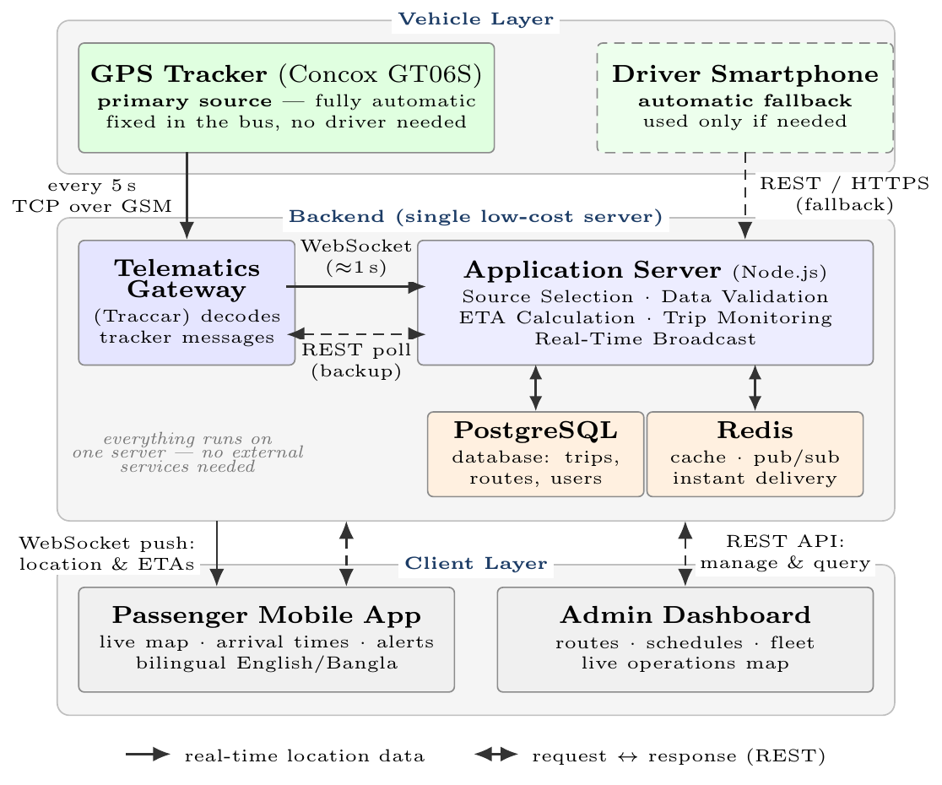
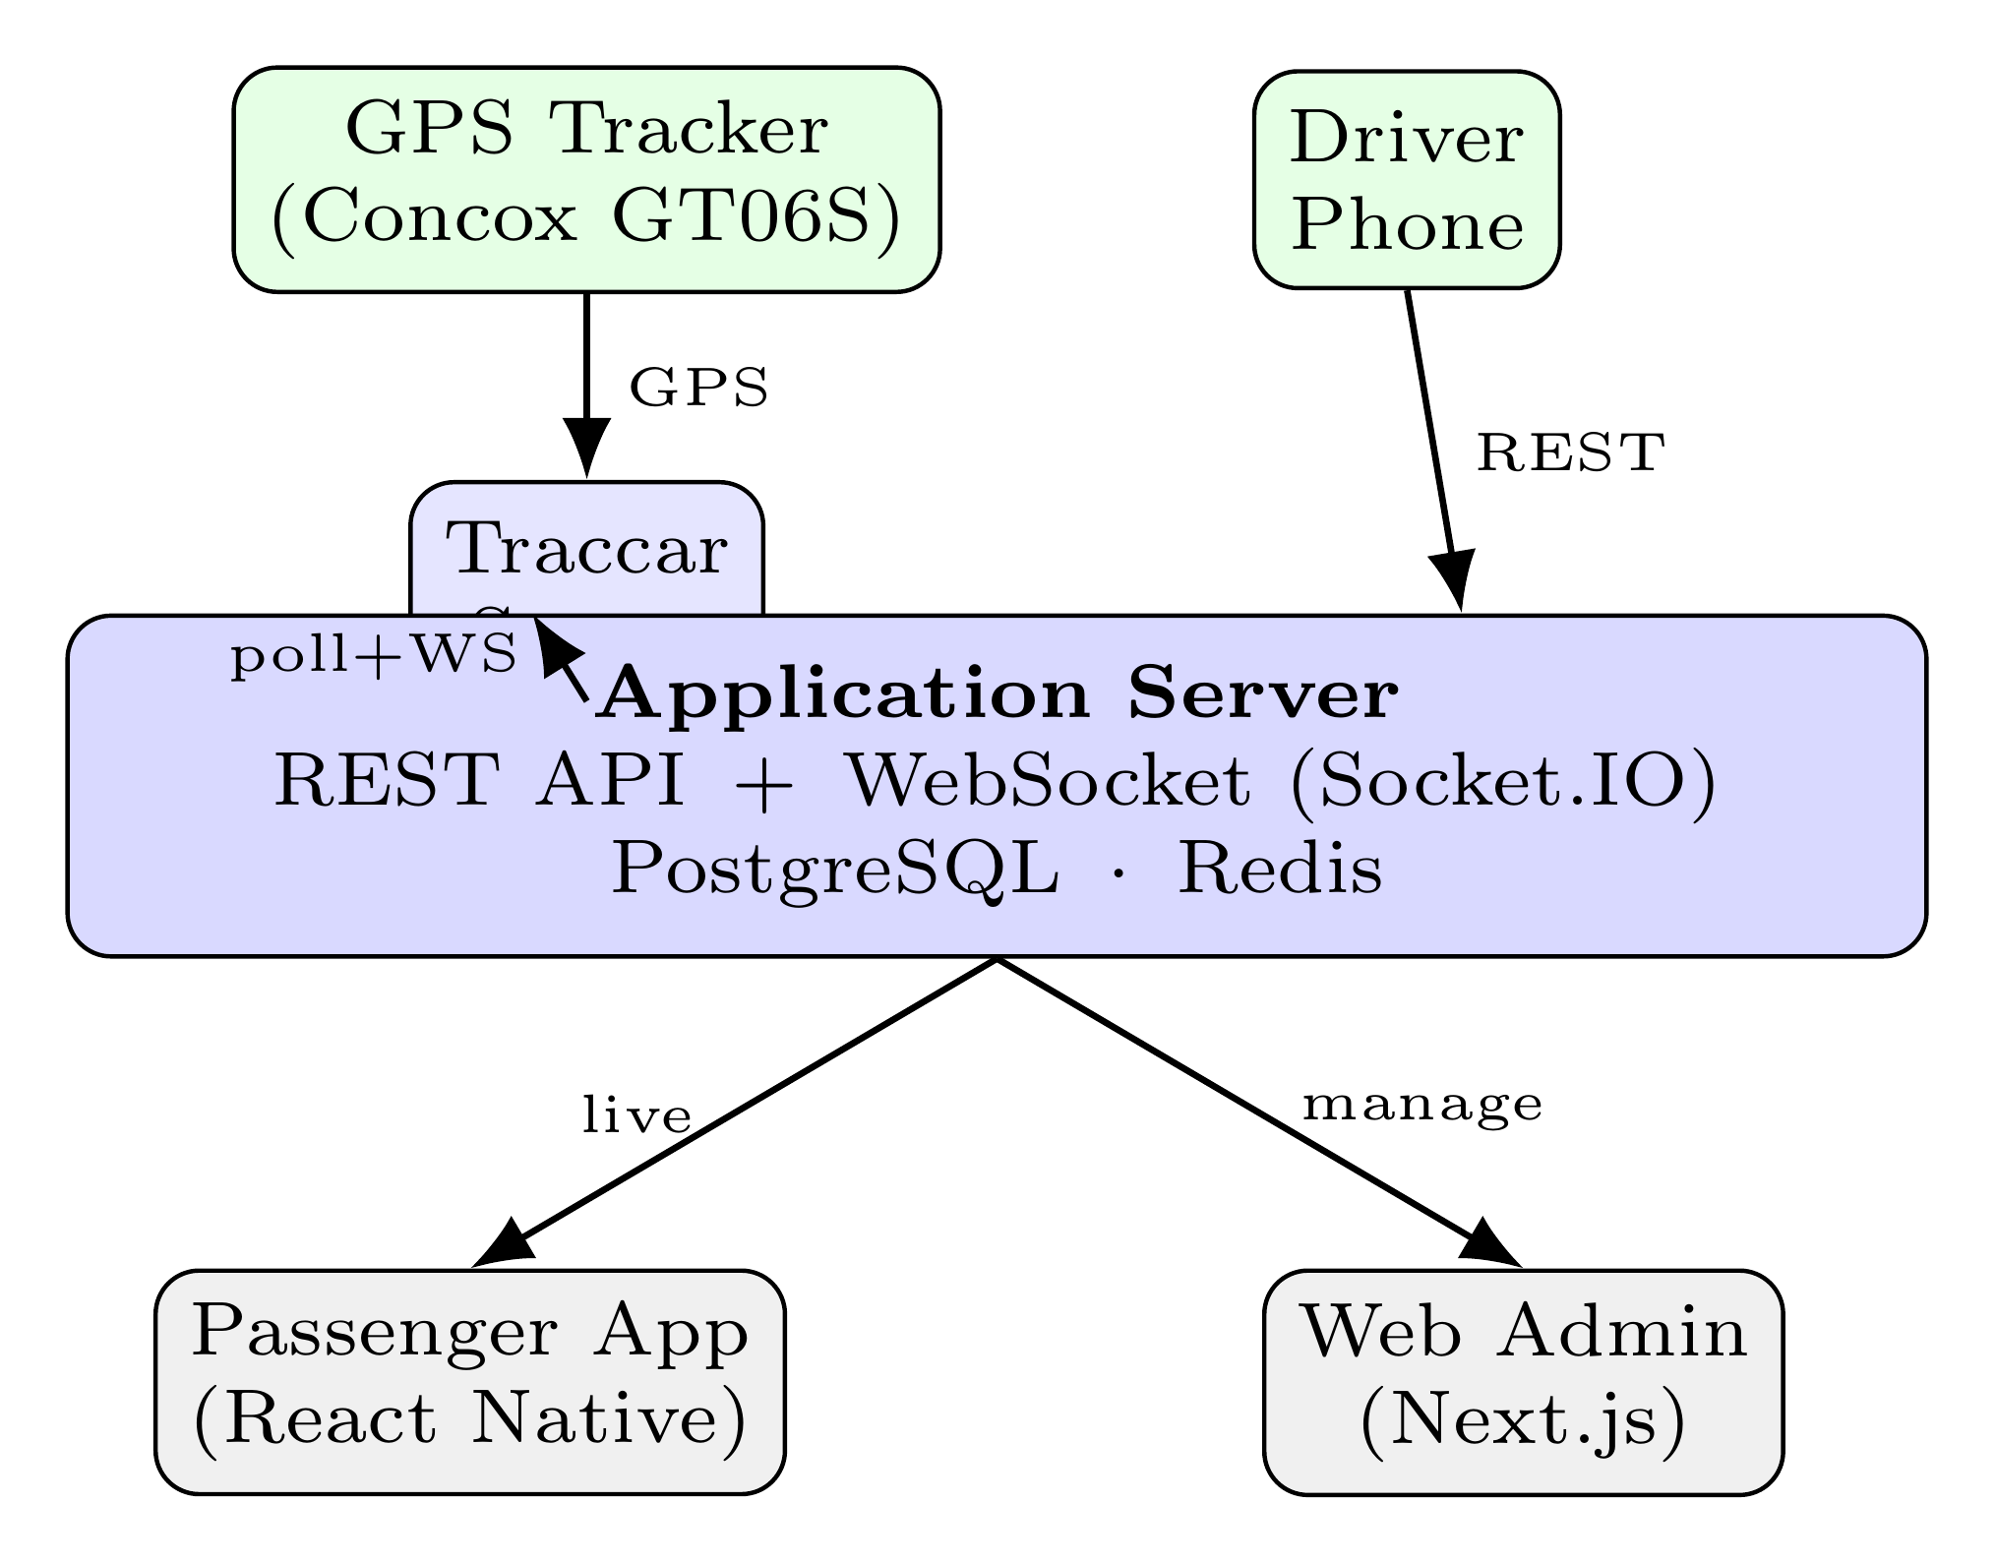
SYSTEM ARCHITECTURE
Three Tiers, One Live Pipeline
Two communication styles
Stateless REST for command/query; a persistent WebSocket channel pushes live vehicle state.
Push-first ingestion
Traccar's WebSocket delivers each fix in about a second; an 8 s REST poll acts only as the safety net.
One room per trip
Socket.IO rooms bound per-client traffic to the single bus being watched; Redis fans events out across server processes.
Self-hosted, low cost
Traccar and the application server run on one low-cost VPS — within a student-project budget.
UniBus Live · NPI University of Bangladesh
6

Slide 7
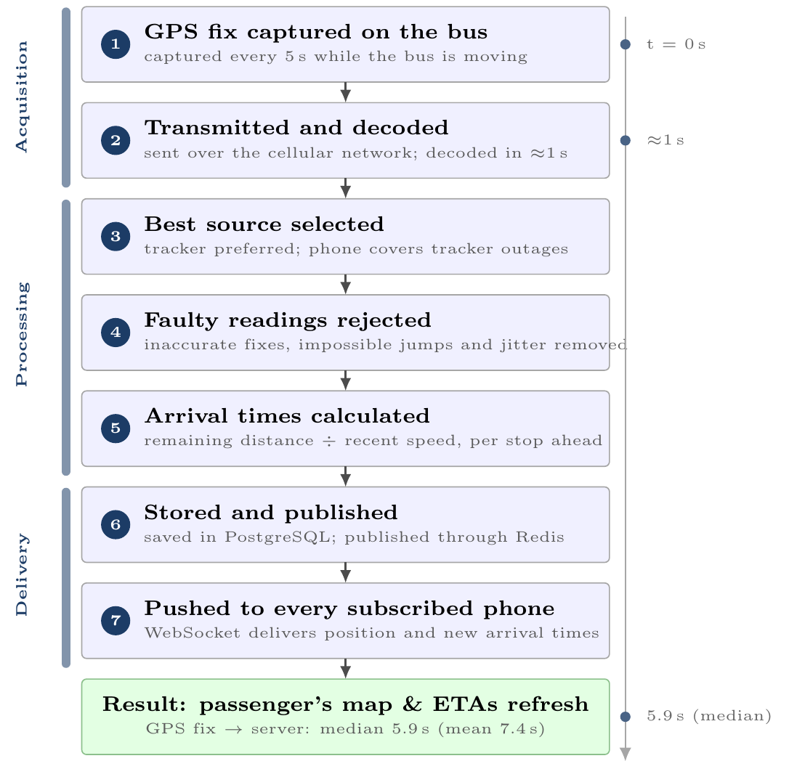
REAL-TIME DATA FLOW
One Position Report, Start to Finish
Typical delay: 5.9 seconds
Half of all 46,286 reports reached the server within 5.9 s of the GPS fix; the average was 7.4 s.
Cleaned before it counts
Inaccurate readings, impossible jumps and GPS jitter are dropped before they can move the map.
Every stop, every rider
Each accepted update refreshes the arrival time for every stop still ahead, so riders see their own stop.
Pushed, not polled
Phones receive each update instantly over WebSocket — the app never has to ask for it.
UniBus Live · NPI University of Bangladesh
7

Slide 8
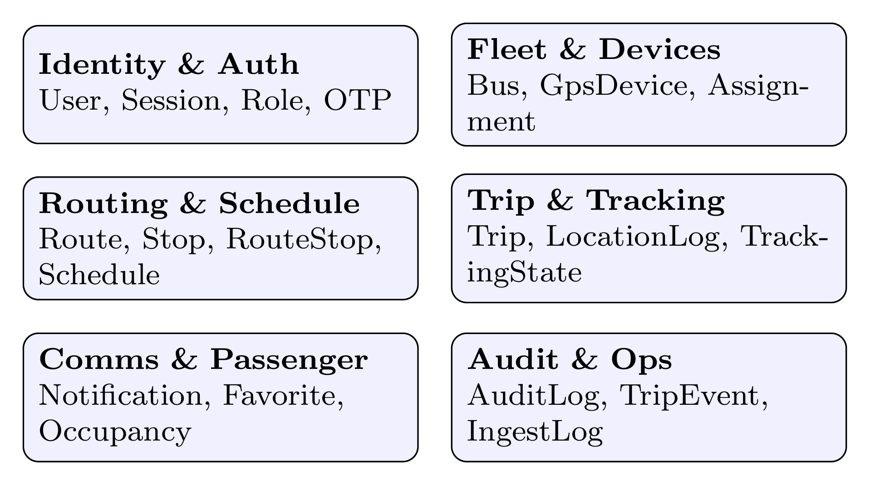
APPLICATION SERVER
Node.js · PostgreSQL · Redis
Typed, auditable persistence
Every trip, fix, notification, and admin action has a schema home — including per-trip trajectory logs used for later analysis.
Redis in two roles
A short-lived cache for hot reads, and the pub/sub back-plane that lets the realtime tier scale horizontally.
Authenticated realtime
Socket connection and room join are both authenticated; per-trip rooms keep client traffic minimal.
31 relational models in six functional domains (Prisma / PostgreSQL)
UniBus Live · NPI University of Bangladesh
8

Slide 9



GPS ACQUISITION
Hardware-First by Design
PRIMARY — AUTONOMOUS
SOURCE ARBITRATION
Concox GT06S, hard-wired to the bus
Reports to a self-hosted Traccar server over GSM. Requires no driver action, no driver-owned device, and no driver data connection — it simply runs.
Every fix tagged with source, device time, and server time
Ingestion: WebSocket push (~1 s) + 8 s REST polling as fallback
Health score + priority rank select one canonical position
OPTIONAL — FALLBACK ONLY
Driver's smartphone (authenticated REST)
A healthy tracker always wins; hand-over is per-fix and invisible to riders
Used only when no hardware fix is available. Normal operation depends on no phone at all — it supplements the system, it never carries it.
Filters, arbitration and thresholds are operator-configurable at runtime.
UniBus Live · NPI University of Bangladesh
9

Slide 10




DATA QUALITY
Four Gates Before a Fix Moves the Map
Accuracy gate
→
Teleport guard
→
Jitter suppressor
→
Freeze / release
soft-reject worse than 120 m;
hard-reject worse than 250 m
reject implied inter-fix speeds
above 120 km/h
below 4 m of movement the bus
is treated as stationary
marker holds under poor accuracy;
resumes on confident displacement
Thresholds are deliberately conservative — 120 km/h exceeds any plausible route speed and 4 m sits above the tracker's
urban scatter — so legitimate motion is never suppressed. Accepted speeds feed a per-trip rolling average: the ETA input.
UniBus Live · NPI University of Bangladesh
10

Slide 11
ARRIVAL-TIME ESTIMATION
A Geometric Estimator That Needs No Training Data
bus, projected onto the route polyline
stop 1
stop 2
stop 3
stop 4
remaining along-path distance
ETA to each stop = remaining distance ÷ rolling-average speed
Speed guard
Arrival detection
Honest confidence
rolling average used when ≥ 5 km/h;
otherwise a configurable 20 km/h default
a stop is reached inside an 80 m radius —
subscribed riders get a push notification
every estimate carries a HIGH / MEDIUM / LOW
label from speed-signal quality
UniBus Live · NPI University of Bangladesh
11

Slide 12
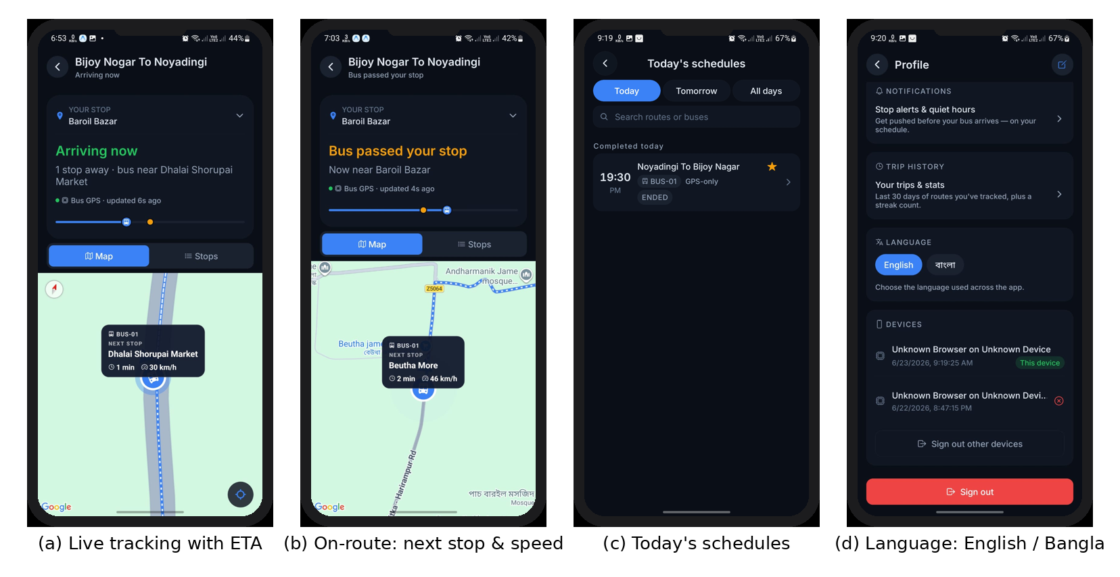
PASSENGER EXPERIENCE
One App, Two Languages
Live tracking with per-stop ETA · on-route status and speed · today's schedules · English / Bangla toggle
UniBus Live · NPI University of Bangladesh
12

Slide 13
EVALUATION
A Seven-Week Pilot on a Real Fleet
PILOT DEPLOYMENT SUMMARY
METHODOLOGY
Deployment span
7 weeks (6 May – 23 Jun 2026)
All metrics come from the production database — no simulation, no synthetic data.
Routes / buses
9 / 3 (one fitted with the hardware tracker)
Registered passengers
38
Latency: device timestamp vs. server receipt, per fix
Completed trips
71
Fallback usage: canonical source recorded per trip
Raw GPS reports ingested
46,548
In-trip fixes retained
864
ETA: every prediction logged against recorded stop arrivals
Mean GPS fixes per trip
37.6
UniBus Live · NPI University of Bangladesh
13

Slide 14
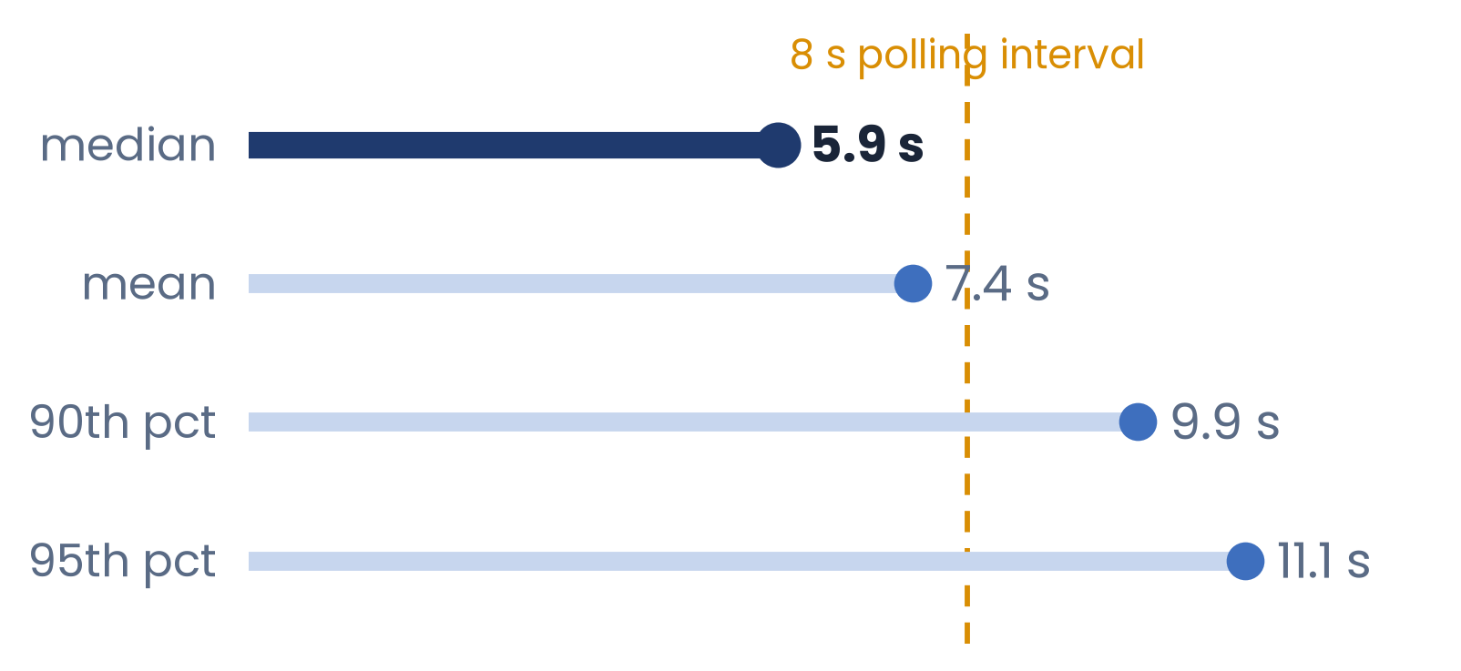
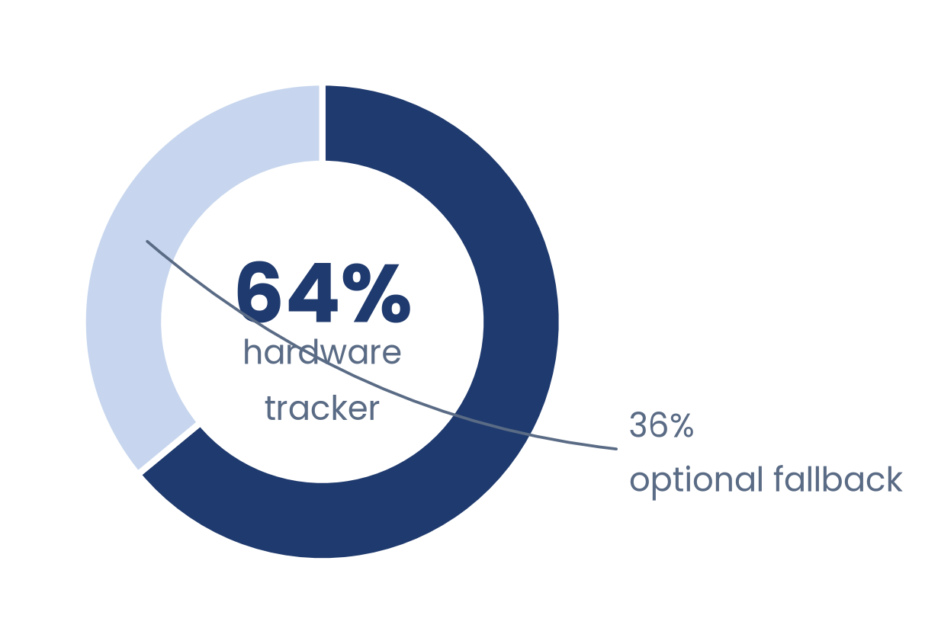
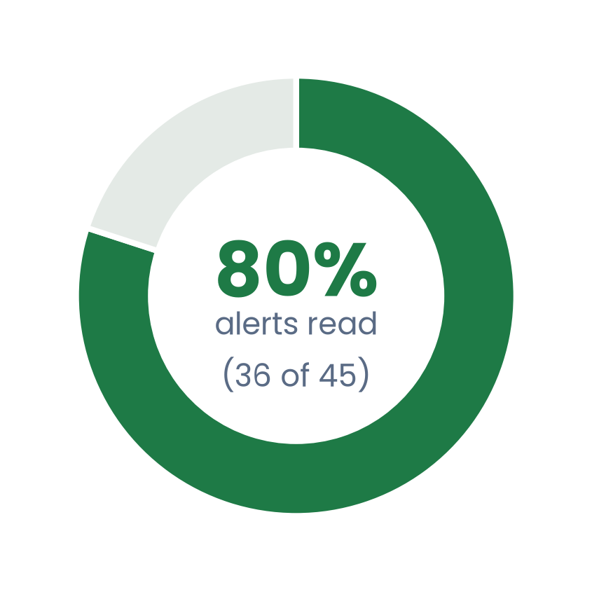
RESULTS
What the Operational Data Shows
POSITION-ACQUISITION LATENCY (46,286 fixes)
TRIPS BY CANONICAL SOURCE (70 trips)
The 36% largely reflects the two buses not yet fitted with trackers — the design stays hardware-first; no driver device is needed in normal operation.
ARRIVAL-ALERT ENGAGEMENT
ETA ACCURACY — MEASUREMENT IN PROGRESS
36 of 45 notifications delivered during the pilot were read — the passenger-facing alerts were genuinely used.
Every prediction is logged against the recorded stop arrival, so mean absolute error can be measured as operational data accumulates.
We publish the mechanism — not an invented number.
UniBus Live · NPI University of Bangladesh
14

Slide 15
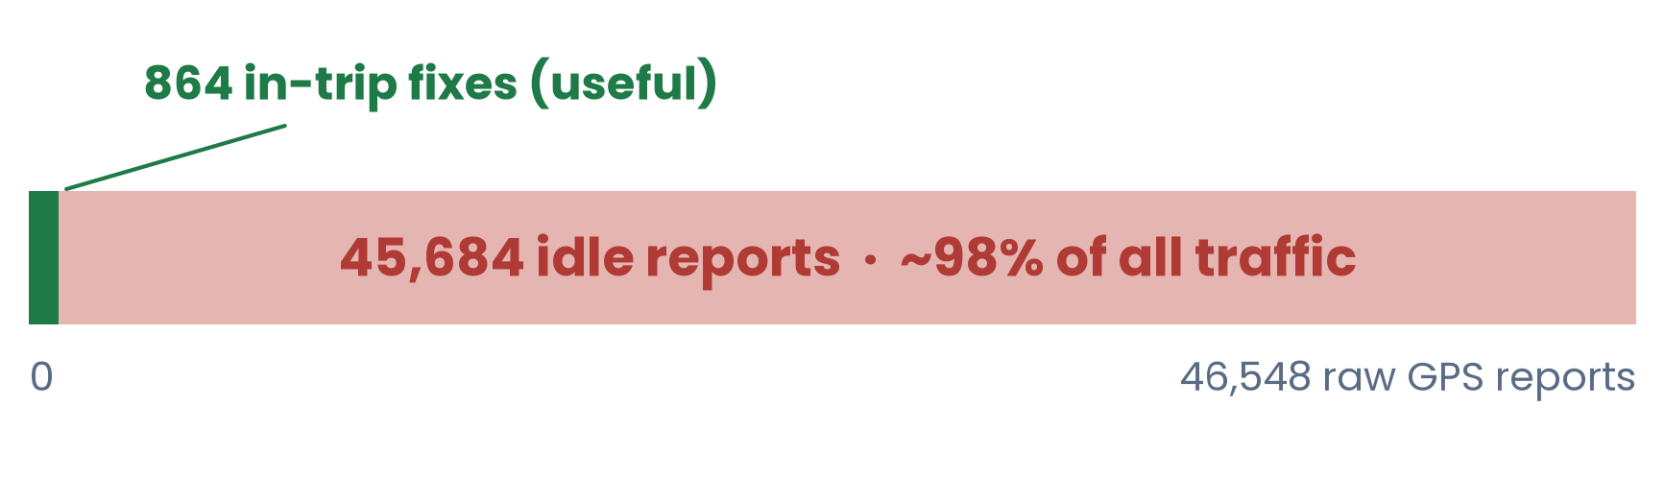
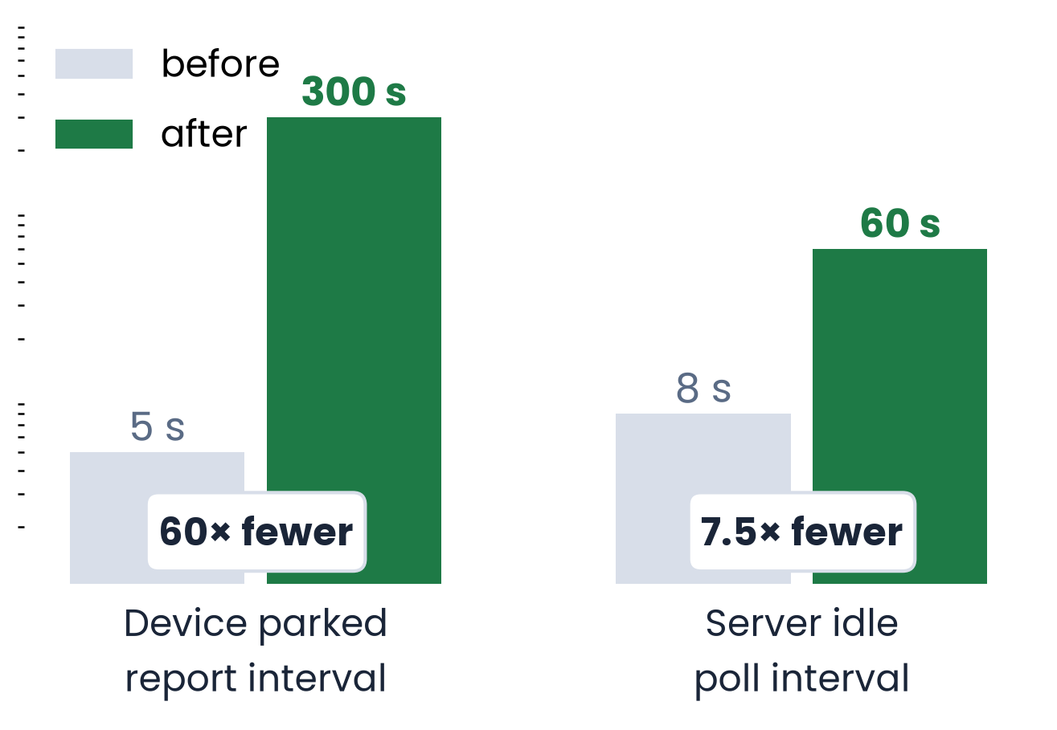
A FINDING WE DID NOT HIDE
98% of Reports Were Idle Waste — So We Fixed It
The fixed-interval tracker kept transmitting every 5 s while buses sat parked — overnight and across weekends.
TWO-SIDED OPTIMIZATION (TABLE II)
AFTER THE FIX
Set on the device itself over SMS (TIMER,5,300#); verified from two independent logs — Traccar positions and the server's own ingest records.
The server now ingests dense fixes only during active trips, plus a sparse five-minute parked heartbeat per bus.
On-trip tracking and the WebSocket push path were unaffected.
UniBus Live · NPI University of Bangladesh
15

Slide 16
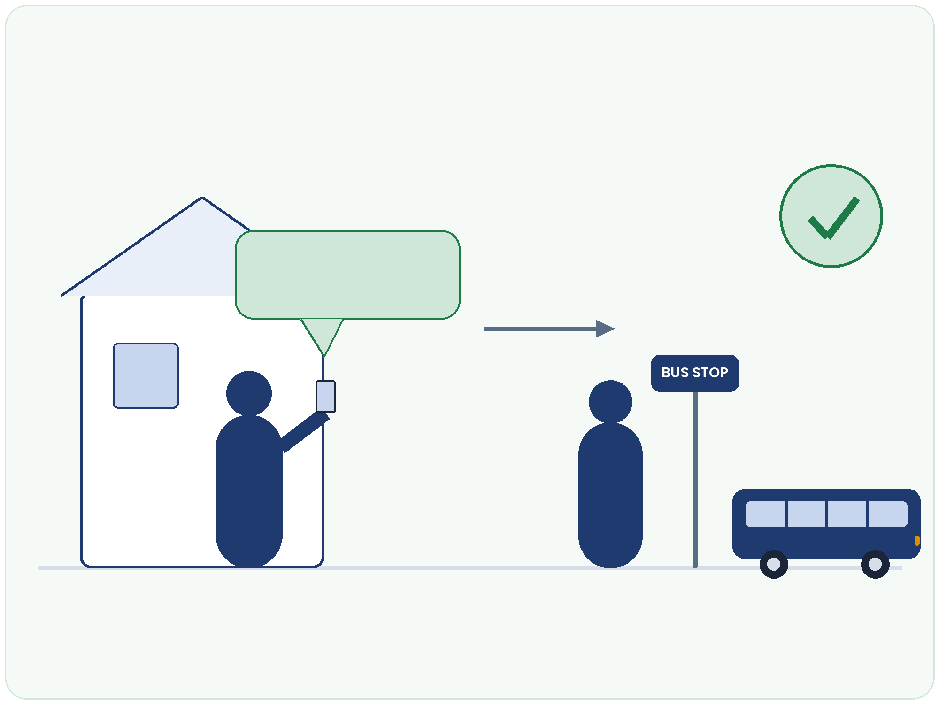
WHAT CHANGES FOR A STUDENT
From Guessing to Knowing
1
Check from home
The live map and per-stop ETA answer the question before leaving the house — even before the trip starts, the bus state is visible.
Bus is 6 min
from my stop
2
Leave at the right moment
No more guessing at the stop: the countdown is to the rider's own stop, with an honest confidence label.
3
Board on time
An 80 m arrival alert nudges the rider as the bus approaches — during the pilot, 80% of these alerts were read.
No guessing · no missed bus · the map is never blank
UniBus Live · NPI University of Bangladesh
16

Slide 17
READ HONESTLY
Limitations
Small pilot
One campus, three buses, one hardware tracker, seven weeks — a feasibility demonstration, not a city-scale claim.
Per-fix accuracy unavailable
The GT06S does not report a per-fix accuracy value, so quality filtering is evaluated at the trip level.
ETA error still accumulating
The measurement pipeline is deployed; the mean absolute error is reported as operational data grows.
Limited schedule analysis
Incomplete timetable association during the pilot restricted schedule-adherence analytics.
Stating these plainly is deliberate — the paper reports what was measured, not what was hoped.
UniBus Live · NPI University of Bangladesh
17

Slide 18
CLOSING
Conclusion & Future Work
WHAT WE SHOWED
FUTURE WORK
Resilient, low-cost, real-time campus tracking is feasible — demonstrated on a live fleet, not in simulation.
Learned ETA from the accumulating trajectory history
An autonomous hardware tracker can carry the system with zero driver dependence; the optional fallback degraded gracefully when needed.
Full timetable integration and schedule-adherence analytics
Crowd-sourced occupancy at larger scale
A geometric, training-free ETA serves a new deployment from day one, while logging the data a learned model will need.
Ignition-aware device sleep; distance-based reporting
Idle-reporting waste (98%) was measured, then eliminated: 60× fewer parked transmissions.
Wider deployment with a formal usability study
UniBus Live · NPI University of Bangladesh
18

Slide 19
Thank you
Questions & discussion welcome
UniBus Live — A Real-Time Bilingual University Bus Tracking System
with Resilient Dual-Source GPS Acquisition
Department of Computer Science and Engineering · NPI University of Bangladesh

