Slide 1

B.SC. THESIS DEFENSE · DEPARTMENT OF CSE · NPI UNIVERSITY OF BANGLADESH
UniBus Live
A Real-Time Bilingual University Bus Tracking System
with Reliable Dual-Source GPS Acquisition
Md. Shishir Hossain
Md. Sajib Hasan
Md. Showkat Hossen
ID 0852220005101005 · Batch 12th
ID 0852220005101008 · Batch 12th
ID 0852220005101009 · Batch 12th
Supervisor: Mahbubur Rahman Chowdhury, Senior Lecturer, Dept. of CSE, NPIUB
18 July 2026

Slide 2
THE PROBLEM
Waiting for a bus you cannot see
A student at the stop has no way to know: did the bus leave 5 minutes ago — or is it 15 minutes away?
⏱
🌧
💸
Missed buses
Long, uncertain waits
No usable product
The bus passed early; the student finds out too late.
Standing in heat or rain for time that could be saved.
Commercial trackers: costly, operator-facing, English-only.
Our goal: let every student see their bus live, with the arrival time at their own stop — in their own language.
UniBus Live · Thesis Defense
2

Slide 3
OUR SOLUTION
UniBus Live — one platform, four parts
PRIMARY SOURCE
FOR STUDENTS
BACKUP SOURCE
FOR TRANSPORT OFFICE
GPS Tracker
Passenger App
Driver App
Admin Console
Concox GT06S fixed in the bus.
Live map · per-stop arrival times ·
Opt-in backup publisher —
Routes · schedules · fleet ·
Fully automatic — no driver needed.
alerts · English + বাংলা
used only when needed.
live operations map.
Everything runs on one low-cost server — Node.js · PostgreSQL · Redis · Traccar · Socket.IO. No paid cloud services.
UniBus Live · Thesis Defense
3

Slide 4
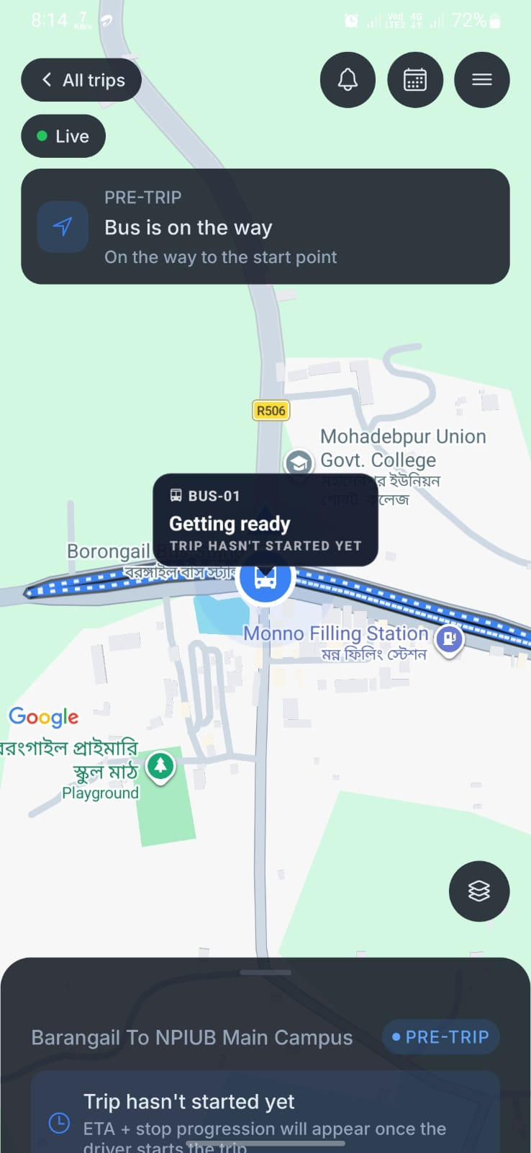
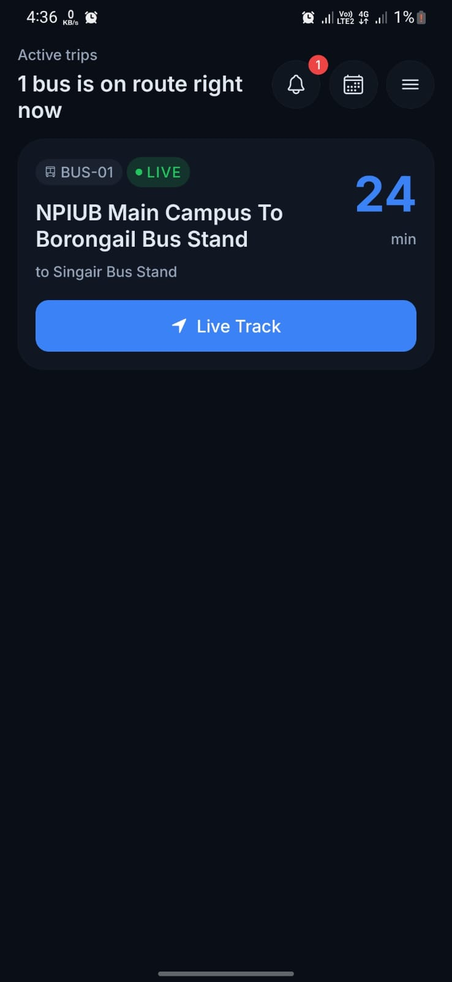
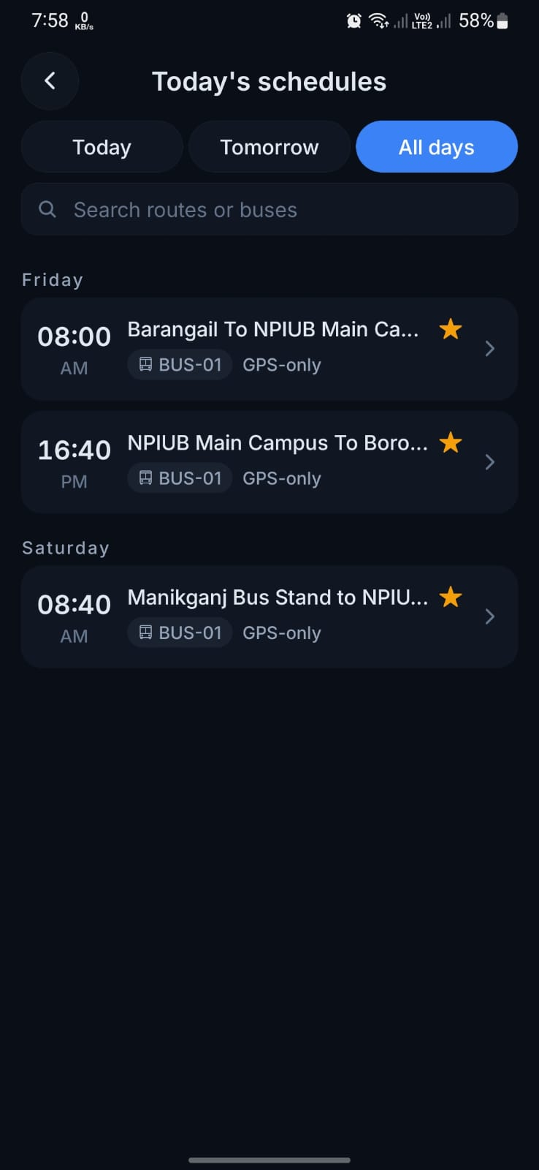
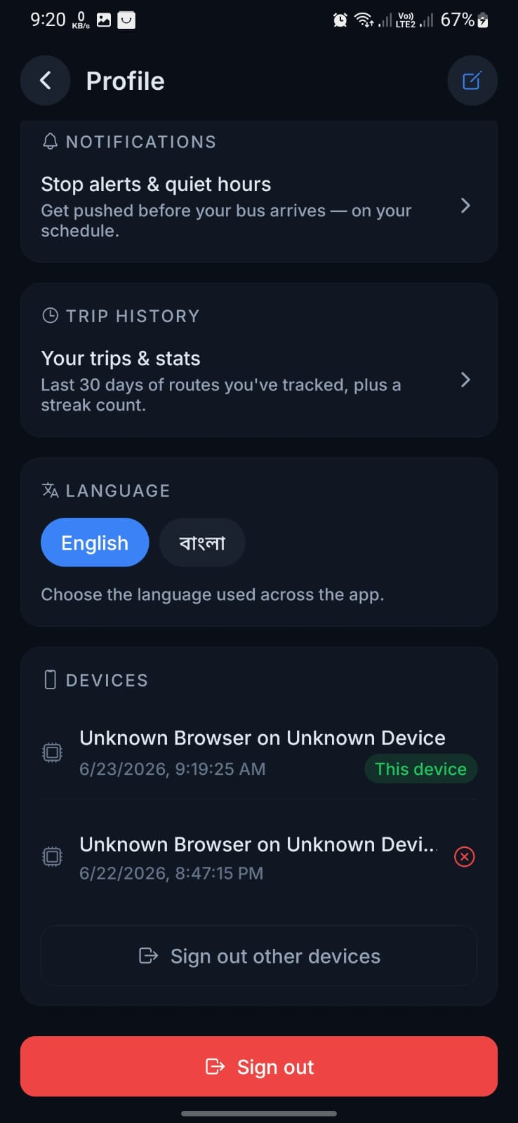
THE PASSENGER EXPERIENCE
The map is never blank
Before departure
Bus visible at the depot — "getting ready", not a blank map.
On route, live
Next stop and minutes away, updated in seconds.
Today's schedules
Every route and departure at a glance.
English + বাংলা
The whole app in the rider's language.
Get-off alert: a push notification when the bus is within 80 m of your stop — even if the app is closed.
UniBus Live · Thesis Defense
4

Slide 5
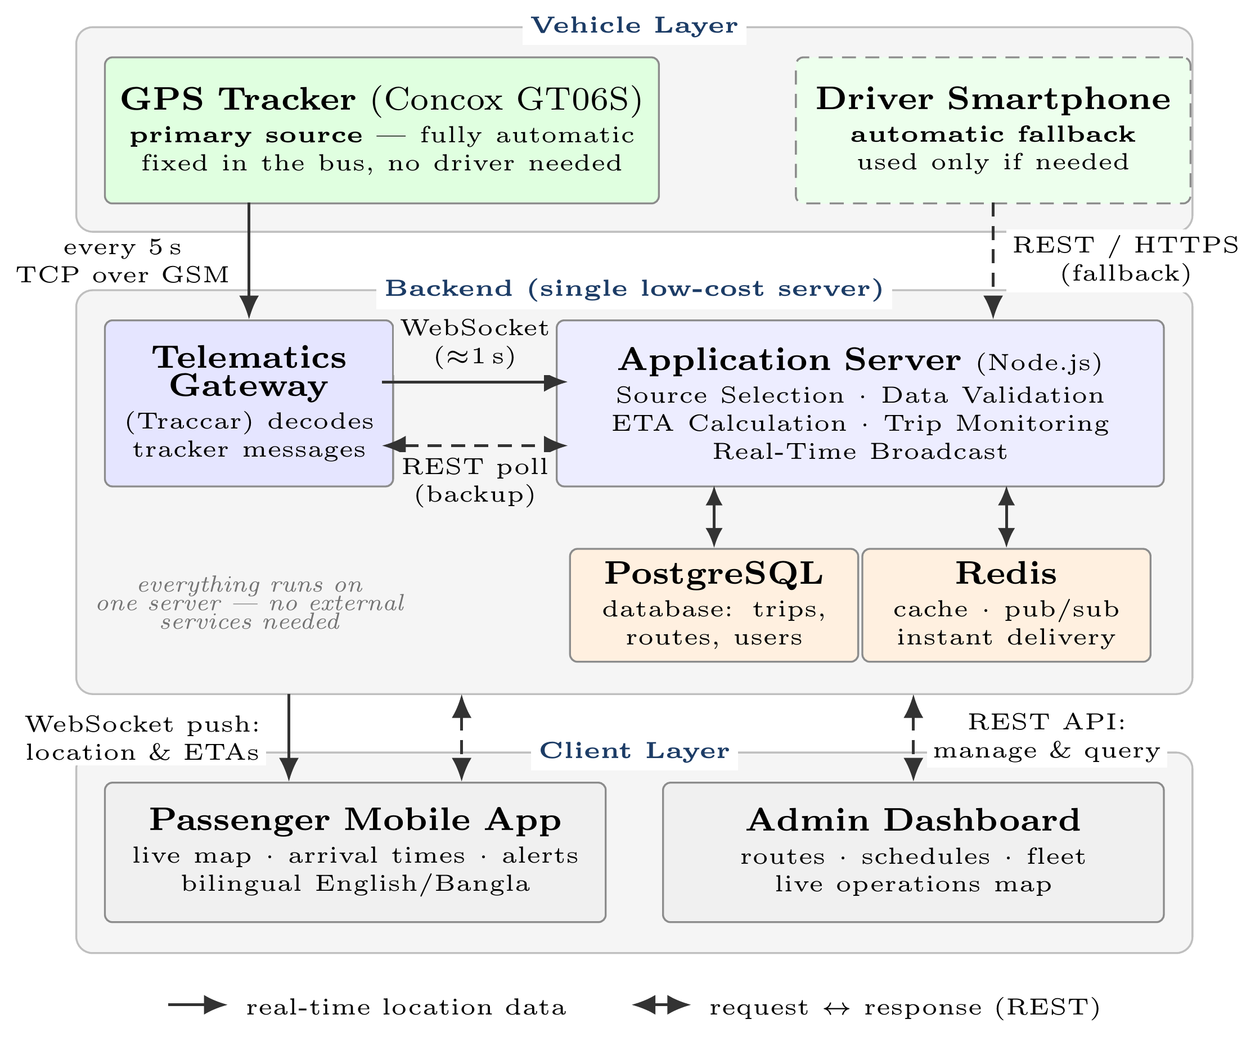
SYSTEM ARCHITECTURE
Three layers, one low-cost server
Vehicle layer
Tracker reports every 5 s over GSM; driver phone is only a fallback.
One backend server
Traccar decodes · Node.js validates, computes ETAs, broadcasts · PostgreSQL + Redis.
Client layer
Passenger app and admin console — pushed over WebSocket, not polled.
UniBus Live · Thesis Defense
5

Slide 6
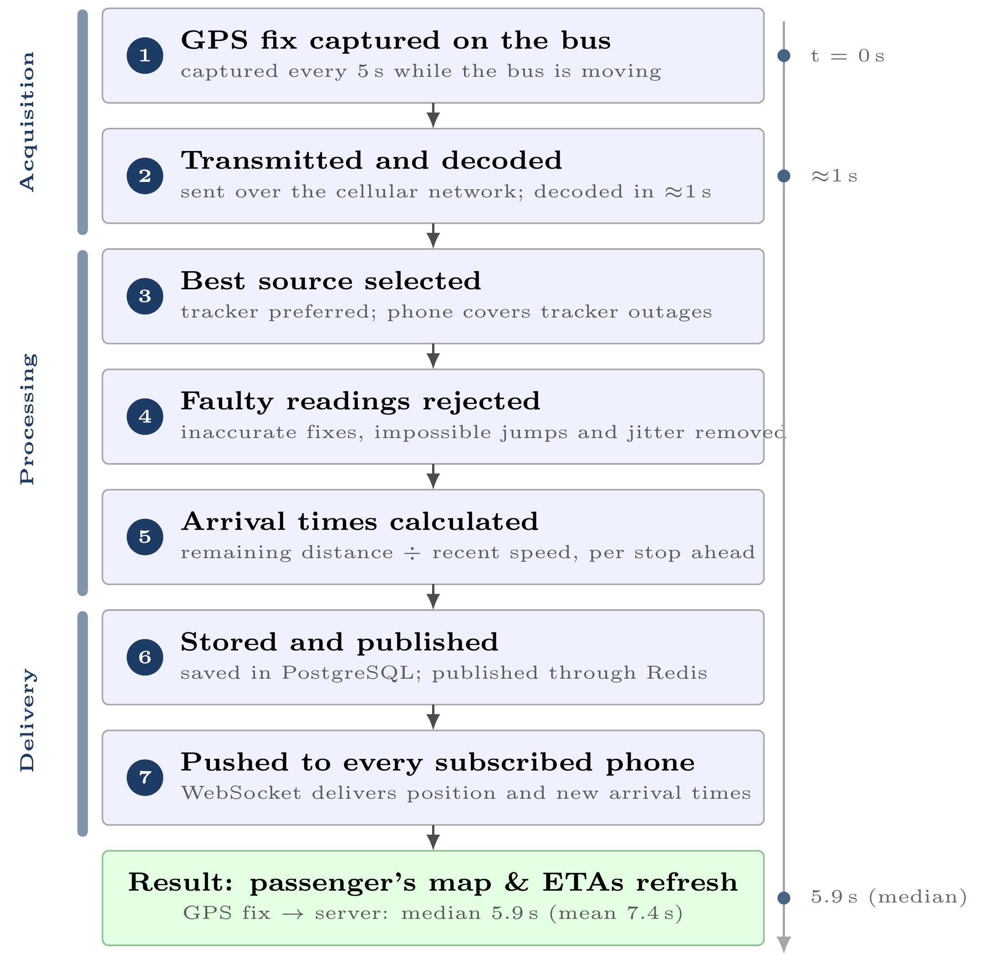
REAL-TIME DATA FLOW
From GPS fix to the student's screen
5.9 s median
from GPS fix on the bus to the server — measured over 46,286 real fixes.
1–2
Capture & decode — every 5 s, decoded in ≈1 s
3–4
Pick best source · reject faulty readings
5
Compute the ETA for every stop ahead
6–7
Store, publish, push to every subscribed phone
UniBus Live · Thesis Defense
6

Slide 7
RELIABLE BY DESIGN
Two independent sources, one automatic choice
PRIMARY — GPS TRACKER
BACKUP — DRIVER'S PHONE (OPT-IN)
Works completely on its own
Only when a trip needs it
• Hard-wired in the bus, reports every 5 s
• Driver must be assigned and start sharing
• Trip starts automatically from its data
• Covers buses without a tracker yet
• No driver action, phone, or data plan needed
• Normal operation never depends on it
The server scores both sources on every fix and picks the best one automatically
tracker preferred when healthy · switches mid-trip with no visible jump · what is automatic is the selection
UniBus Live · Thesis Defense
7

Slide 8
SMART ARRIVAL TIMES
A simple estimator that works from day one
ETA = remaining distance along the route ÷ recent average speed
computed for every stop ahead, on every accepted GPS fix
Route-aware
Honest confidence
No training data
The fix is projected onto the route line, so sideways GPS error doesn't break the estimate.
Every estimate is labeled High / Medium / Low from the quality of the speed signal.
Works from the first day — while logging every prediction so an ML model can come later.
Arrival radius 80 m — reaching it marks the stop and fires the rider's get-off alert.
UniBus Live · Thesis Defense
8

Slide 9
THE PILOT
Seven weeks on the real fleet — zero simulation
7
9
3
weeks live
6 May – 23 Jun 2026
routes
buses (1 with
hardware tracker)
38
71
46,548
registered riders
completed trips
GPS reports ingested
Every number in this defense comes from the production database of this pilot.
UniBus Live · Thesis Defense
9

Slide 10
RESULT · SPEED
The map reflects reality within seconds
5.9 s
Latency across 46,286 fixes (seconds)
Median
5.9 s
median latency, GPS fix → server
Mean
7.4 s
Bounded mainly by the 8 s polling interval — push delivery itself takes ≈1 s. A further 1.2 s (median) to persist each fix.
90th percentile
9.9 s
95th percentile
11.1 s
UniBus Live · Thesis Defense
10

Slide 11
RESULT · RELIABILITY & ENGAGEMENT
The backup carried real weight
Which source tracked the 70 sourced trips?
64% GPS tracker (45 trips)
36% phone backup (25)
The 36% were mostly the two buses not yet fitted with trackers — coverage never stopped. Fleet-wide trackers will shrink this to a rare safety net.
80%
80 m
0
of arrival & service notifications were read by riders (36 of 45)
arrival radius that triggers the get-off alert
passenger-visible jumps during mid-trip source handovers
UniBus Live · Thesis Defense
11

Slide 12
A HIDDEN PROBLEM — FOUND & FIXED
The pilot's most valuable discovery
98%
60×
→
of 46,548 GPS reports were pure waste
buses kept transmitting every 5 seconds even while parked overnight — only 864 reports fell inside a real trip
less parked-time reporting after our fix
device: 5 s → 300 s when parked (one SMS: TIMER,5,300#) · server polling: 8 s → 60 s when idle
Invisible in design, unmistakable in real data — and fixed at both the device and the server without touching live tracking.
UniBus Live · Thesis Defense
12

Slide 13
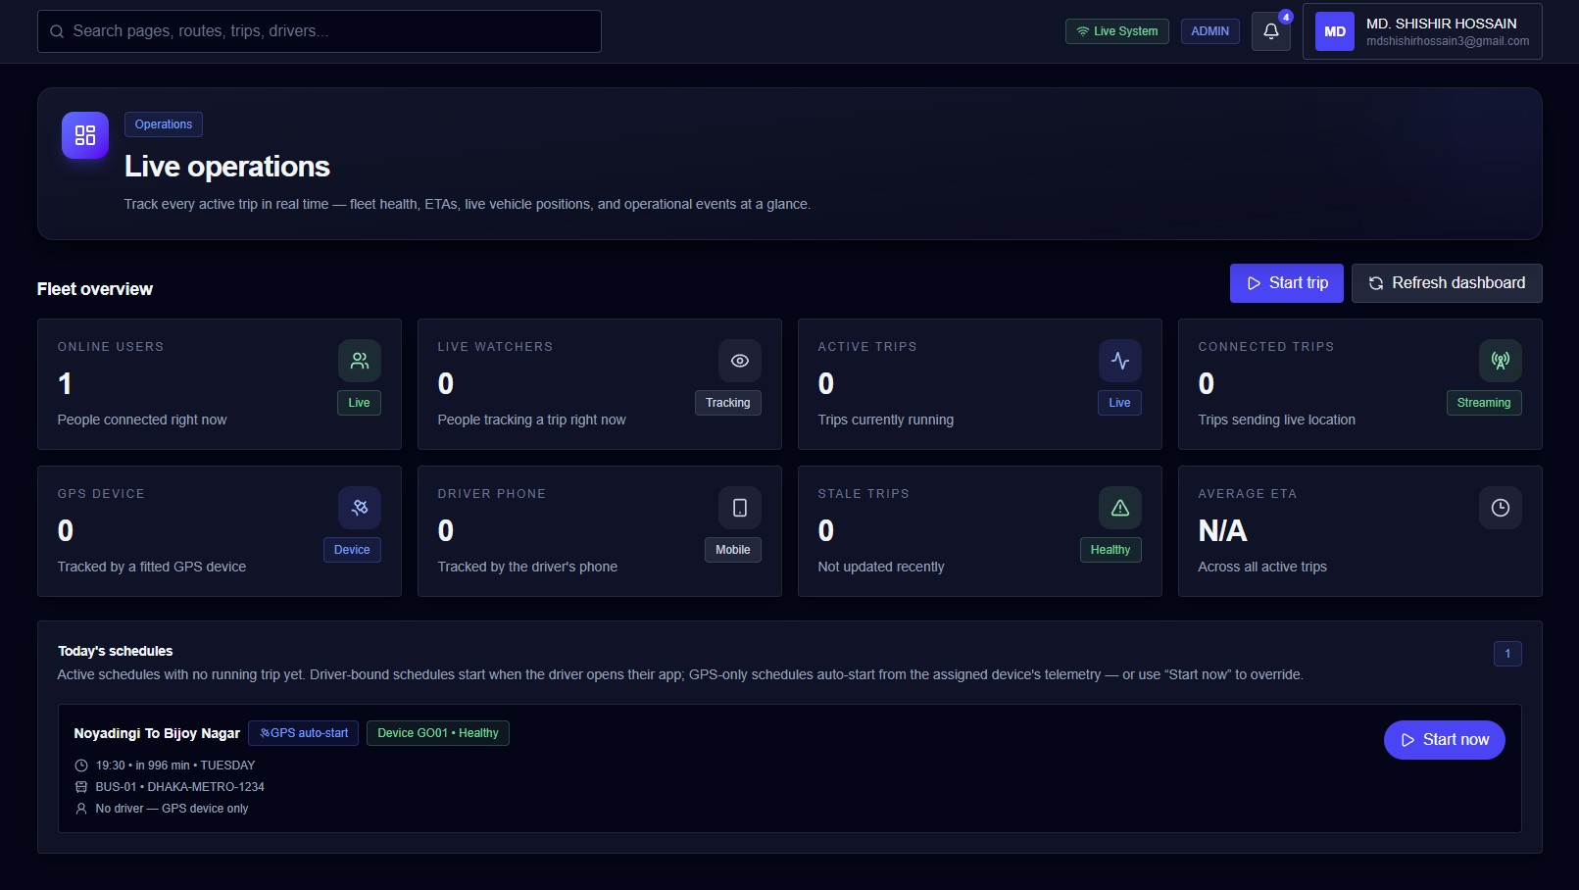
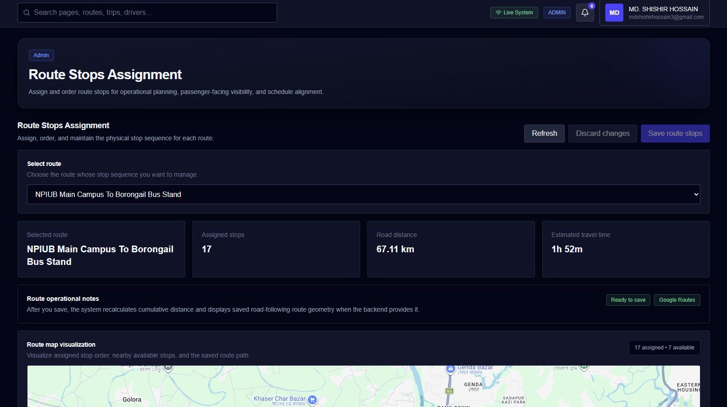
THE ADMIN CONSOLE
The transport office sees everything
Live operations — whole fleet at a glance
Route builder — stops, distance, travel time on the map
Also: buses, GPS devices, schedules, stops, users, analytics — one web console, same API as the apps.
UniBus Live · Thesis Defense
13

Slide 14
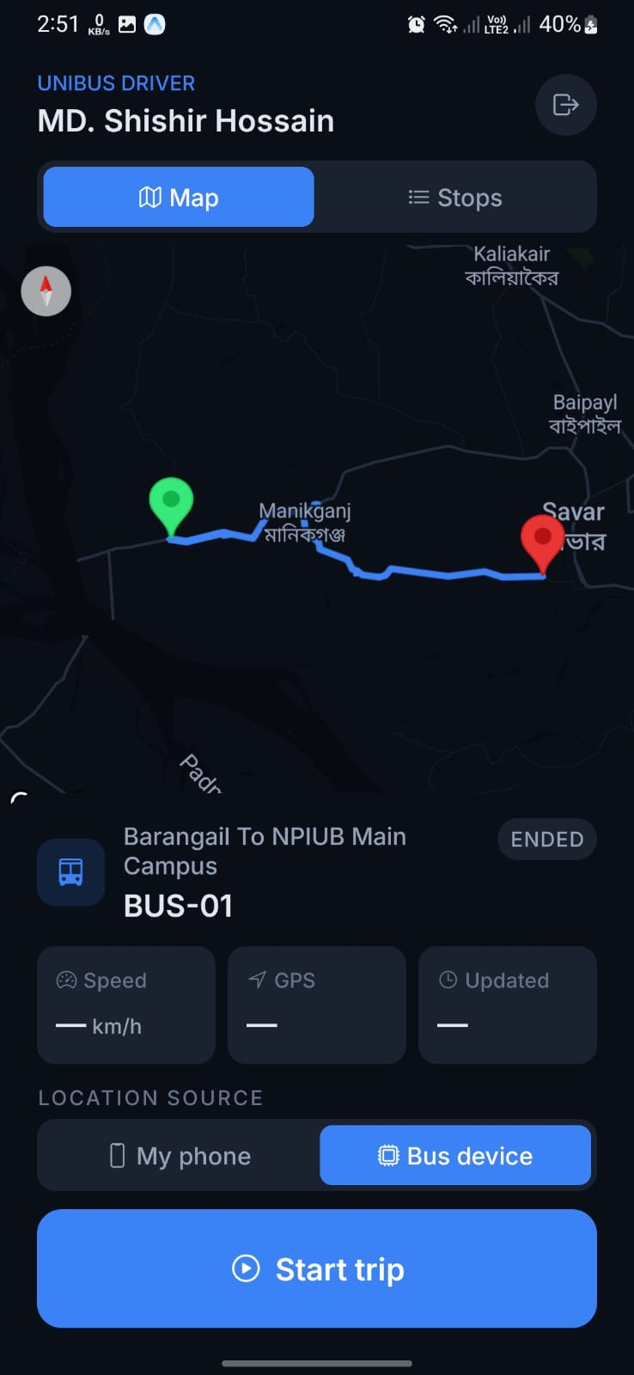
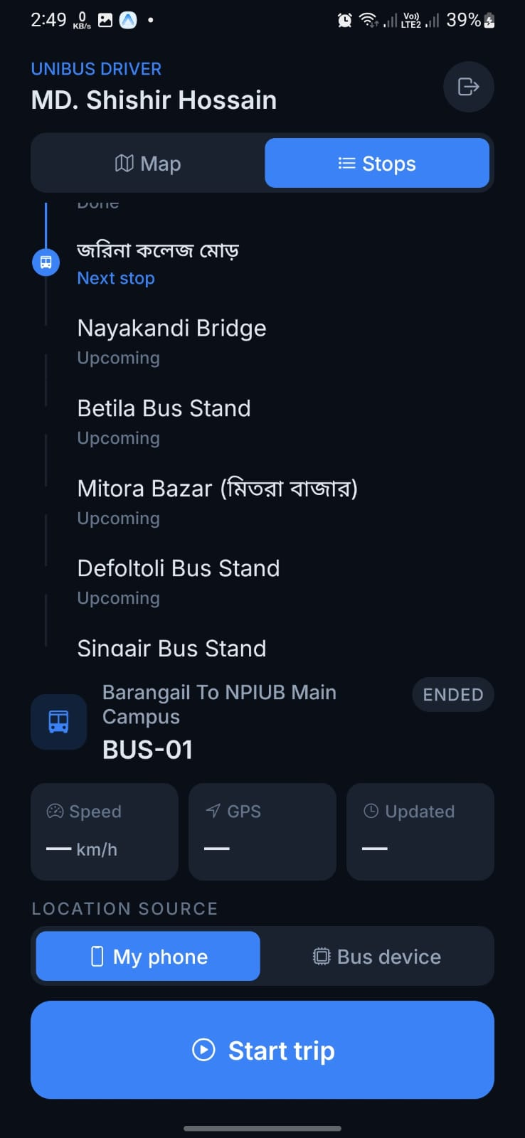
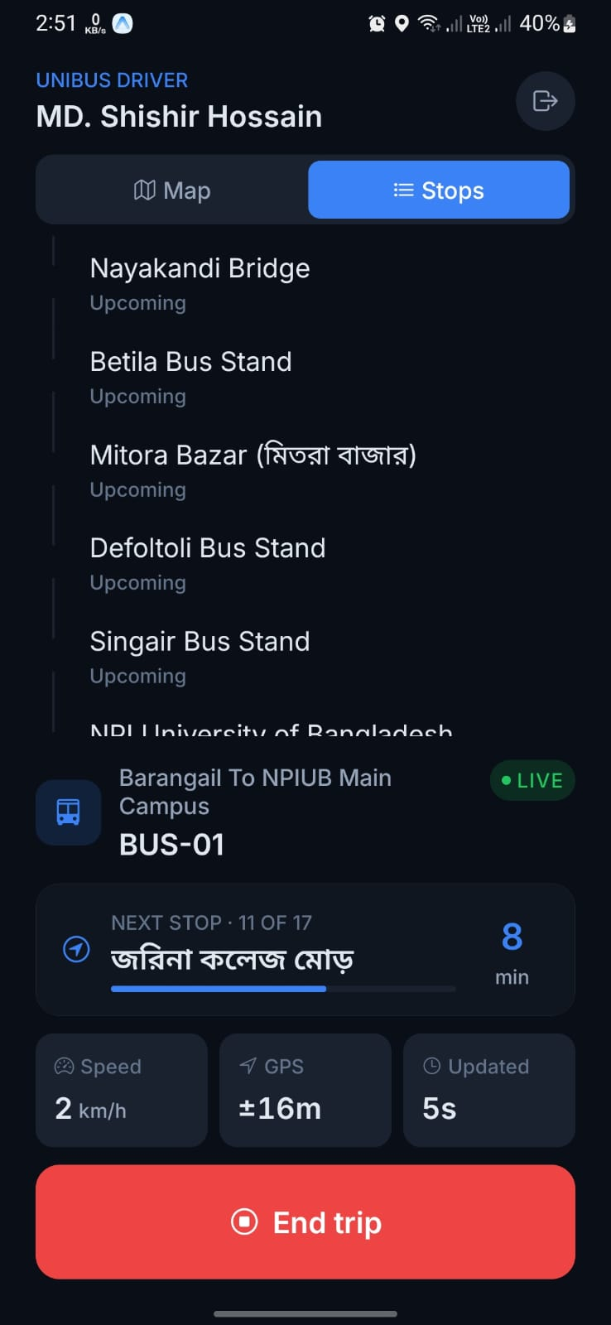
THE DRIVER APP
The opt-in backup, kept deliberately simple
Shares nothing by default
Location goes out only between Start trip and End trip.
Choose the source
Bus device or my phone — visible on screen.
Live self-check
Driver sees speed, GPS accuracy and update age while publishing.
Drivers only
Assigned driver + driver role required — an authorization boundary.
UniBus Live · Thesis Defense
14

Slide 15
HONEST LIMITS & WHAT'S NEXT
A feasibility pilot, and a roadmap
LIMITATIONS
FUTURE WORK
• Small pilot: 7 weeks, 3 buses, 38 riders
• ML arrival prediction trained on our logged trip history
• Only one bus carried the hardware tracker
• Trackers on every bus — phone becomes a rare safety net
• ETA error (MAE) still accumulating — every prediction is logged for it
• Ignition-wired (ACC) reporting: device sleeps with the engine
• Timetable linkage incomplete during the pilot
• Occupancy info and a formal usability study at larger scale
UniBus Live · Thesis Defense
15

Slide 16
Thank you
Questions welcome — every number is from our production database.
5.9 s
46,548
71
64 / 36
60×
80%
median latency
GPS reports
real trips
tracker vs phone
idle waste cut
alerts read
UniBus Live · Team UniBus · Dept. of CSE · NPI University of Bangladesh

