Slide 1

Financial Analysis
By Md Shoaib

Slide 2

Introduction
I've given a data of some companies with there
market capital and their sales proﬁt.
My task is to analyze the trend of that

Slide 3

Problem Statement
Without analyzing the competition, it is difﬁcult
for a business to survive. You are tasked to
analyze the competition for the management to
provide better results. This data set has
information on the market capitalization of the
top 500 companies in India. Name of Company,
Market Capitalization in Crores, Quarterly Sale in
crores. Find key metrics and factors and show the
meaningful relationships between attributes. Do
your own research and come up with your
ﬁndings.

Slide 4
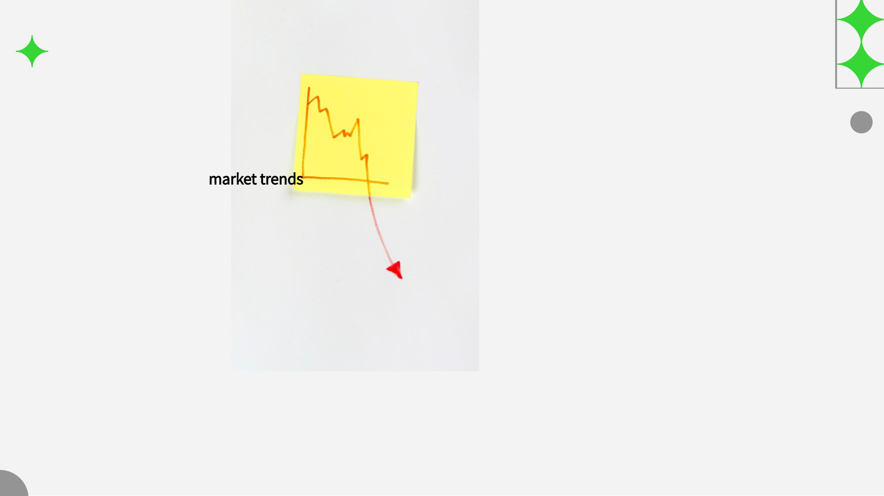
Market Trends
Analyzing the latest market trends is crucial for
understanding the dynamics of the ﬁnancial
landscape. We will explore the impact of global
events and economic shifts on various asset
classes and investment opportunities.

Slide 5

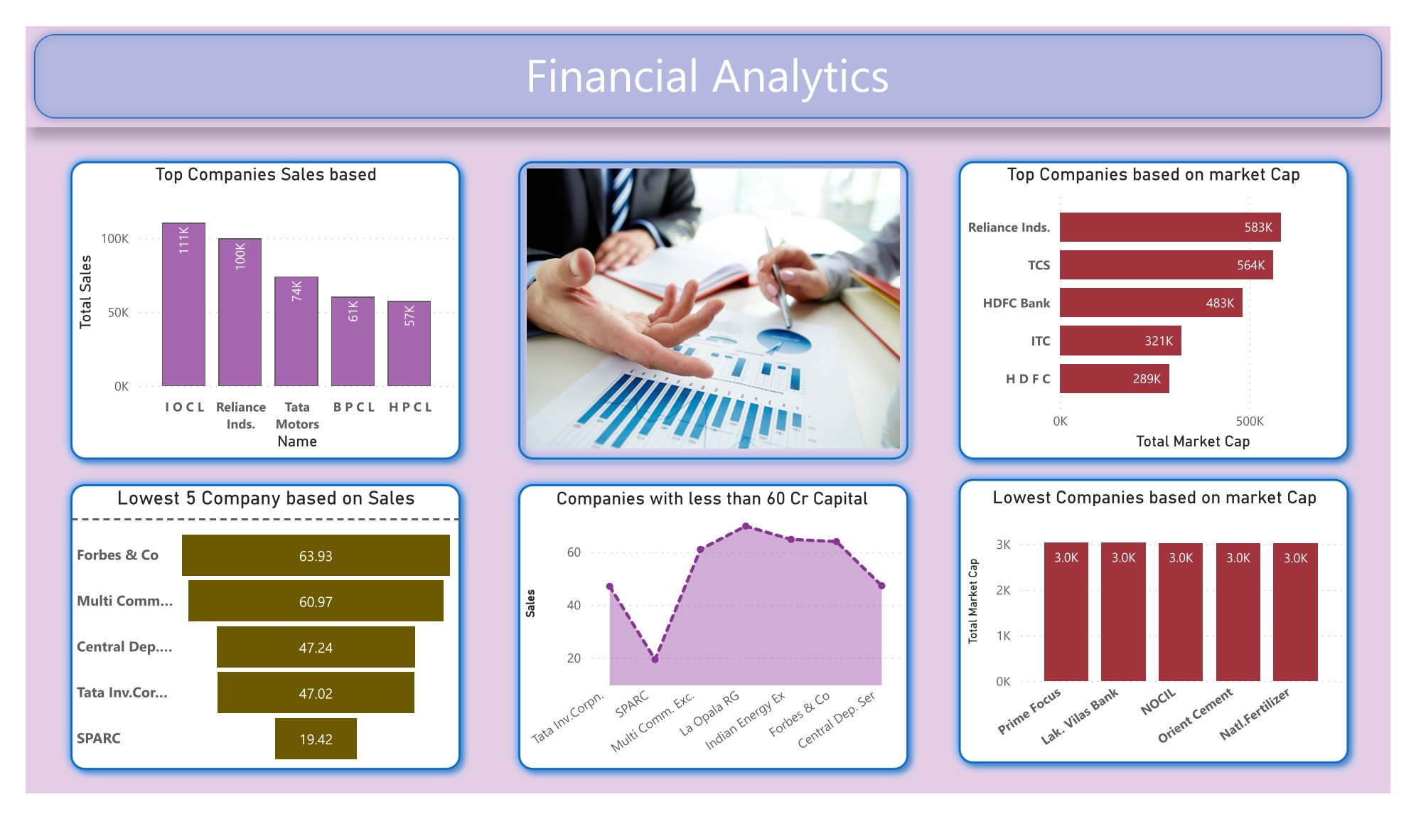

Slide 6

Explanation
According to my analysis I've listed
1. Top 5 companies based on Sales
2. Top 5 Companies based on Market Capital
3. 5 Companies with lowest Sales
4. 5 Companies with lowest Market capital
5. Companies with less than 60 CR market Cap

Slide 7

Economic Indicators
Key economic indicators provide valuable insights into the
overall health of the economy and potential investment
opportunities. We will analyze indicators such as GDP growth,
inﬂation rates, and employment data to gauge economic
performance.

Slide 8

Data Analysis
Harnessing the power of data analysis tools and techniques is
essential for extracting meaningful ﬁnancial insights. We will
explore the use of statistical methods, regression analysis, and
data visualization to interpret complex ﬁnancial data.

Slide 9

CONCLUSION
In conclusion, our comprehensive analysis has
provided valuable ﬁnancial insights that can
guide informed decision-making in the dynamic
world of ﬁnance. Stay tuned for future updates as
we continue to unravel the complexities of the
ﬁnancial landscape.

Slide 10

Thanks!
ANY QUESTIONS?

