Slide 1
engineering-memory
sdlc-agent · prototype
01 · WHAT IT IS // PROTOTYPE
ENGINEERING
Memory
Ask “why is this code like this?” and get an answer from your team’s GitHub, Jira and chat history, with a word-for-word quote for every claim, or an honest “Not established.”
Try the demo
All workspaces
sdlc-agent-five.vercel.app · github.com/mdshreyas003/sdlc-agent
Next → 02 · The mental model
01
Notes:
Engineering Memory is a prototype. Ask “why is this code like this?” and get an answer stitched together from your team’s GitHub, Jira and chat history. Every sentence comes with a word-for-word quote from where it was said, or you get an honest “Not established.”
Repo: github.com/mdshreyas003/sdlc-agent
App: sdlc-agent-five.vercel.app

Slide 2
engineering-memory
sdlc-agent · prototype
02 · THE MENTAL MODEL
A librarian who only answers with exact quotes
THE SHELVES
THE STRINGS
EVERY ANSWER
NO PROOF?
Your team’s history
Links people wrote
Points to a quote
“Not established.”
commits, PRs, tickets, chat threads
only links a person wrote down
points to a real, word-for-word quote
“Not established”, never a guess
The AI may suggest an answer. Plain code checks it and makes the final call.
Next → 03 · Architecture
02
Notes:
Mental model: a librarian who only answers with exact quotes from the shelves.
- Shelves = your team’s history: commits, pull requests, tickets, chat threads.
- Strings between books = links a person actually wrote down, like a ticket number in a chat message. The librarian never adds strings by guessing.
- When you ask, the librarian follows the strings, reads, and answers. Every sentence must point to a quote that really exists, word for word.
- If no quote proves the point, the answer is “Not established.” It never guesses to fill the gap.
The AI model may suggest an answer; plain code checks it and makes the final call.

Slide 3
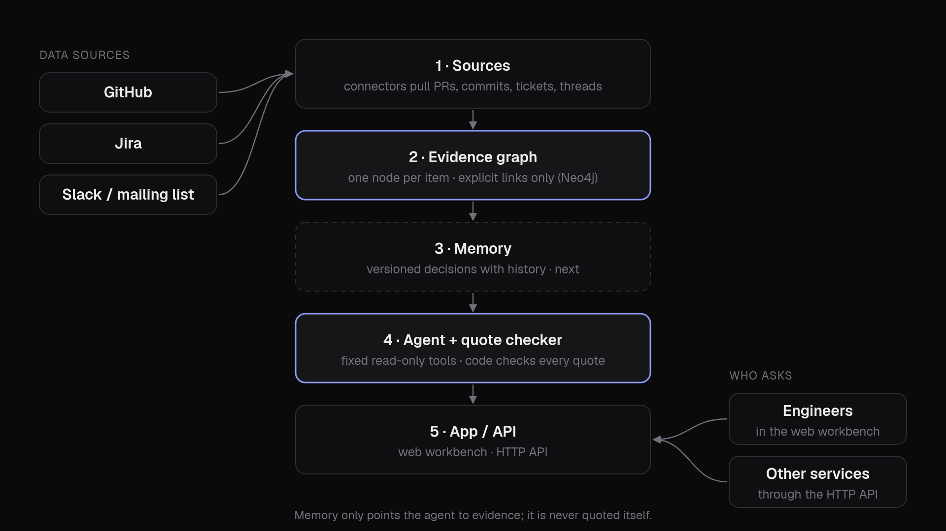
engineering-memory
sdlc-agent · prototype
03 · ARCHITECTURE
Five layers, one platform
Sources plug in on one side; people and services ask on the other.
Next → 04 · How data gets linked
03
Notes:
Five layers, one platform:
1. Sources: connectors pull pull requests, commits, Jira tickets and comments, and Slack threads.
2. Evidence graph: each item becomes one node in a graph database (Neo4j). A link exists only where a source says so.
3. Memory: repeated evidence becomes a decision with a history. A newer version replaces an older one without deleting it. Memory only points the agent to evidence; the agent never quotes memory itself.
4. Agent: answers why / debug / is-it-safe-to-change questions with fixed read-only graph tools, then a checker verifies every quote.
5. App and API: use it as a web app (the workbench) or call the same thing as a service over HTTP.

Slide 4
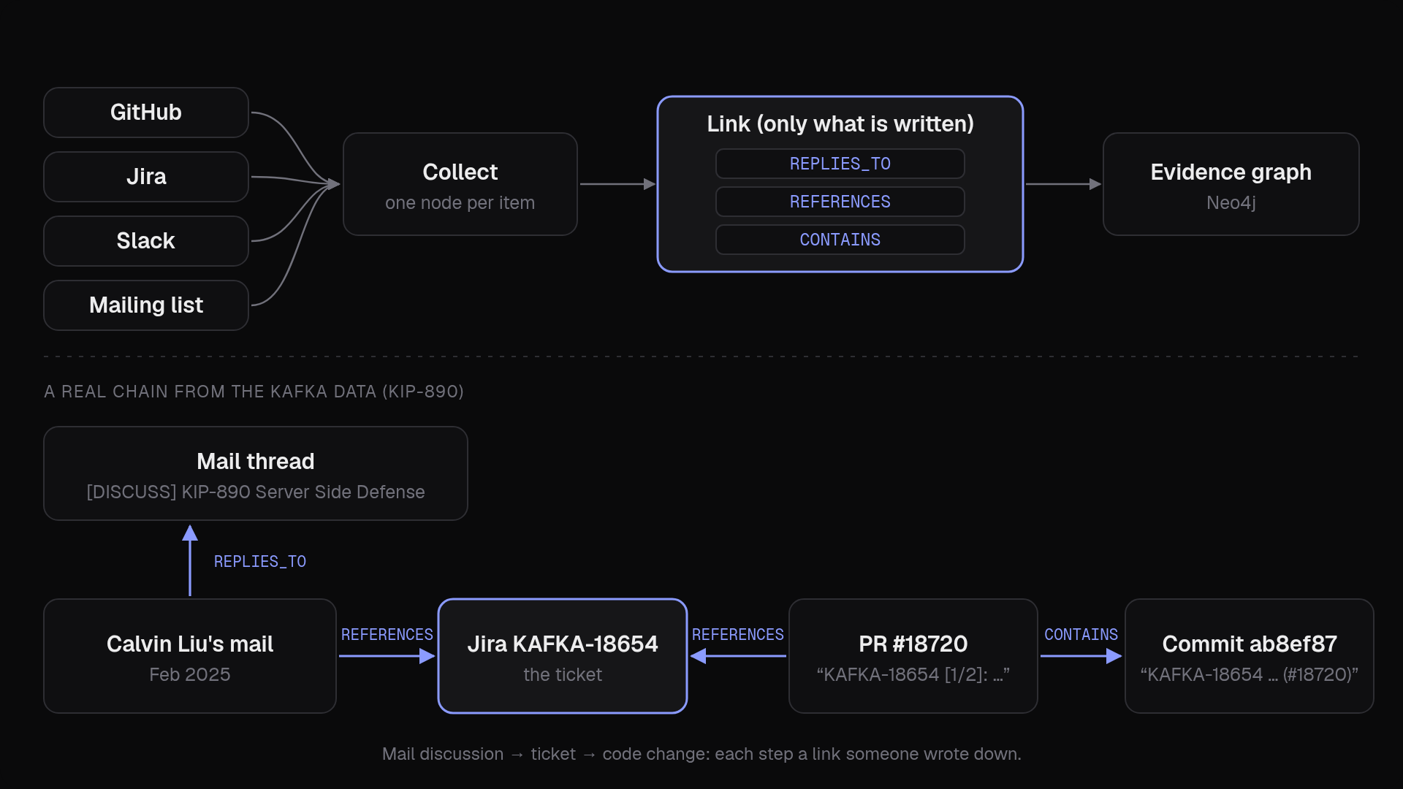
engineering-memory
sdlc-agent · prototype
04 · HOW DATA GETS LINKED
Linked only by what is written
Three link types, never guessed from similar words or timing. A real chain from the Kafka data (KIP-890).
Next → 05 · The agent’s flow
04
Notes:
Three kinds of link, each from something written in the source:
- REPLIES_TO: a reply belongs to its thread (Slack thread_ts, GitHub in_reply_to_id).
- CONTAINS: a pull request contains a commit (GitHub’s PR-commits list).
- REFERENCES: one item mentions another: the source’s own structure, or an identifier typed in the text (a Jira key like KAFKA-18654, a GitHub PR or commit URL, #123 inside GitHub, a Slack permalink).
Never by similar words, meaning or timing. UTF-8, SHA-256 and #333 are ignored; each text link records the exact field and character position (e.g. $.title#0-11).
Real example (Kafka, KIP-890), run through the real extraction code: Calvin Liu’s mail (Feb 2025) replies to the [DISCUSS] KIP-890 thread and mentions KAFKA-18654. PR #18720 has KAFKA-18654 in its title and contains commit ab8ef87, whose message also mentions KAFKA-18654. So a question about why the broker retries on its own can travel from the mailing list to the ticket to the code change. (The Kafka mailing list is stored in the Slack format, as a stand-in for chat.)

Slide 5
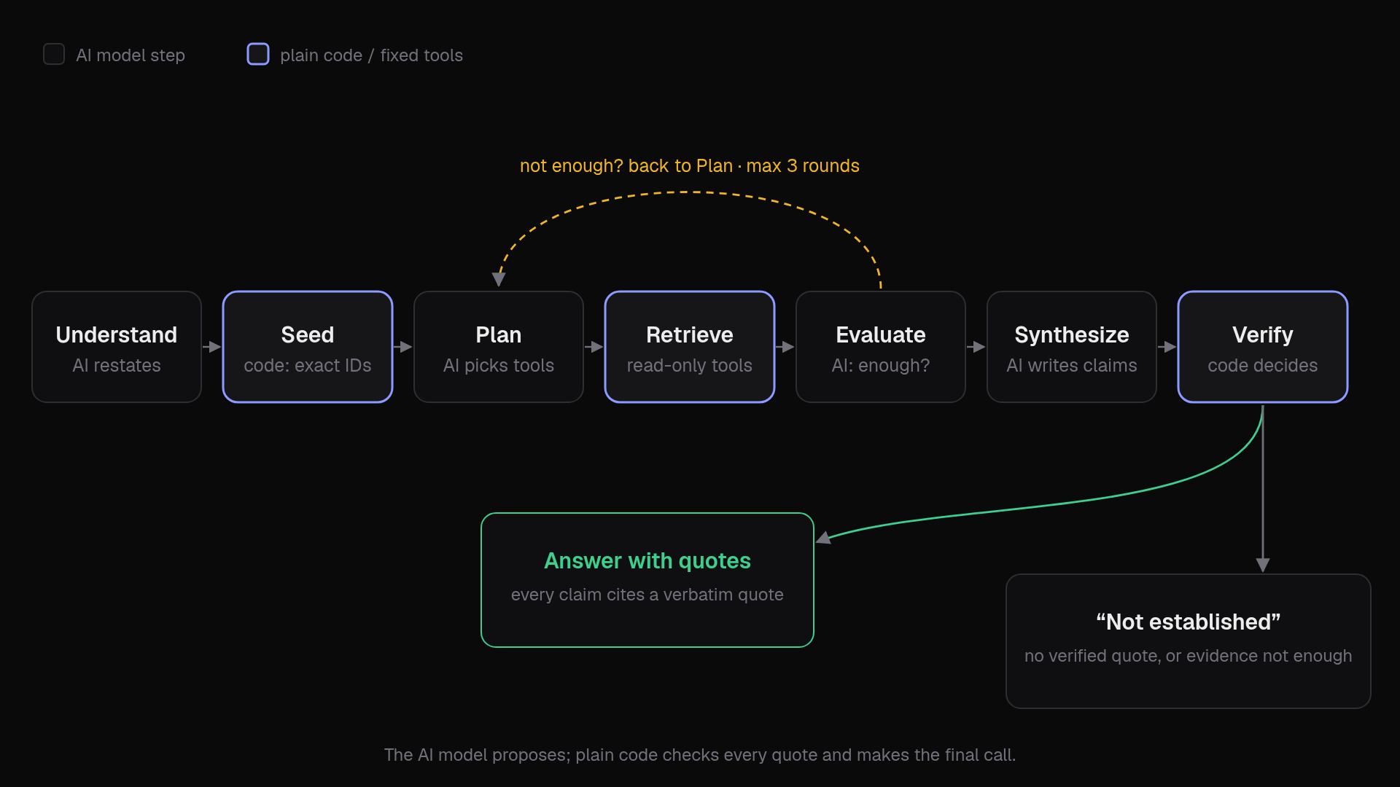
engineering-memory
sdlc-agent · prototype
05 · THE AGENT’S FLOW
Seven steps; code has the last word
If the evidence isn’t enough it plans again, at most 3 rounds.
Next → 06 · Does and refuses
05
Notes:
- Understand: the AI model restates what is being asked and which things it names.
- Seed: code (no AI) pulls exact IDs out of the question (ticket keys, PR numbers, commit hashes, file paths) and looks them up directly.
- Plan: the AI model picks which fixed graph tools to call next (up to 5 per round).
- Retrieve: the tools run read-only searches; code follows one hop of links from the best hits (expand).
- Evaluate: the AI model judges whether the evidence is enough; if not, back to Plan, at most 3 rounds.
- Synthesize: the AI model writes claims, each with a source ID and a word-for-word quote.
- Verify: code checks every quote against the full source text, drops anything that fails, then decides established or Not established.

Slide 6
engineering-memory
sdlc-agent · prototype
06 · DOES AND REFUSES
Read-only, and it never guesses
DOES
Read-only searches through 5 fixed tools (find_text, file_history, neighbors, evidence_chain, get), plus one guarded escape hatch that may only find IDs.
REFUSES
No writes
No invented IDs
Write words blocked in code; read-only route; every query time-limited.
Only items already seen in evidence or named in the question.
No paraphrased quotes
No guessing
A quote survives only if it is word for word in that item’s text.
Established only if evidence is enough and a verified quote remains.
Next → 07 · Why it stands out
06
Notes:
Does: read-only searches through 5 fixed tools (find_text, file_history, neighbors, evidence_chain, get). One guarded escape hatch (cypher_query) whose generated query may only find IDs; the rows are then re-read through a fixed template.
Refuses:
- Writing to the database: write words (CREATE, DELETE, SET…) blocked in code, queries go through a read-only route, every query template is test-run with EXPLAIN at startup, each query times out after 30 s.
- Using an ID it hasn’t seen: only items that came back in evidence or appear in the question. An invented or malformed ID never reaches the database.
- Paraphrased quotes: a citation survives only if its quote appears word for word in that item’s own text. Quotes copied from a reply’s quoted parent, made-up IDs, cut-off quotes, and quotes from a different person than the claim names are dropped.
- Guessing: established only if the final evidence check says enough AND at least one claim still has a verified quote. Otherwise “Not established”, whatever the model wrote.

Slide 7
engineering-memory
sdlc-agent · prototype
07 · WHY IT STANDS OUT
Proof you can check, not a guess
 | Engineering Memory | Mem0 · Zep/Graphiti · GraphRAG | Coding agents
Links | Only links a person wrote down | Extracted or inferred by an AI model | Not about team history
Proof | Word-for-word quote, checked in code | Source IDs; quotes not checked | Tests and linters check code edits
When unsure | “Not established”, enforced in code | Prompt-level or not measured | Not documented
Database access | Fixed read-only tools + ID guard | Not their focus | Sandbox or permission rules
1 Written links only
2 Quotes checked by code
3 “Can’t prove it” is built in
4 Tests with traps
Next → 08 · How we test it
07
Notes:
Comparison from story.md:
- Links: Engineering Memory uses only links a person wrote down. Mem0, Zep/Graphiti and GraphRAG use relations extracted or inferred by an LLM. Coding agents (Claude Code, SWE-agent, OpenHands) are not about team history.
- Proof: word-for-word quote, checked in code, vs source traceable or record IDs (not checked quotes). Coding agents: tests and linters check code edits.
- When unsure: “Not established”, enforced in code, vs prompt-level or not measured. Coding agents: not documented.
- Database access: fixed read-only tools plus an ID guard, vs not their focus (memory layers). Coding agents: sandbox or permission rules.
Fourth differentiator: a test set with traps: questions where the evidence was removed, or where two things look related only because they happened close together. The right answer is “Not established.”

Slide 8
engineering-memory
sdlc-agent · prototype
08 · HOW WE TEST IT
Three kinds of test, small to real
UNIT TESTS · EVERY CHANGE
REAL AI MODEL
REAL KAFKA HISTORY
3 real examples
7-question gate
75 gold questions
E.g. “UTF-8” or “#333” in a PR must never become a link; unseen IDs never reach the database.
A made-up company: 4 answerable, 2 must say “Not established”, 1 checks another workspace sees nothing.
Each with the exact quotes that answer it:
A16
B24
C20
T10
N
A B answerable
C T N must say “Not established”
19 for tuning · 56 held back
EXAMPLE · Q050
“Why does the broker retry AddPartitionsToTxn on its own…?” The gold answer quotes Calvin Liu’s mail and Jira KAFKA-18654: the chain from section 04.
Next → 09 · Results so far
08
Notes:
Automated tests run a piece of the code on a known input and check the result every time the code changes. Examples:
- test_pr_body_links_jira_slack_and_pr: a PR body with “Fixes PAY-412 … see #190 and UTF-8, SHA-256, OTHER-9; color: #333” must yield exactly 3 links (PAY-412, the Slack thread, PR #190), not UTF-8, SHA-256 or #333.
- test_unseen_or_malformed_ids_never_reach_db: an unseen ID, or “x}) DETACH DELETE (n //”, is refused before the database is touched.
- test_fabricated_id_and_non_verbatim_quote_are_dropped_and_confidence_low: the made-up ID and the misquote are dropped; only “Fixes PAY-412” survives; confidence goes to low.
The 7-question gate: a real AI model, end to end, on a made-up demo company (Acme). 4 answerable (why are retries capped at 3? why is the session TTL 15 minutes? can I raise MAX_RETRIES to 10? a logged-out-mid-checkout traceback), 2 must come back Not established (why Redis? why Kafka?), 1 check that another workspace sees nothing.
The 75 gold questions over real Apache Kafka history, five tiers: A (16) answer in one item; B (24) needs several linked items; C (20) same as A/B with evidence removed, right answer Not established; T (10) traps, close in time but not linked; N (5) nothing in the data answers it. Split: 19 for tuning, 56 held back for the final test.
Q050 (tier B): “Why does the broker retry AddPartitionsToTxn on its own when it hits CONCURRENT_TRANSACTIONS, with separate backoff settings, instead of just returning the error to the producer to retry?” The gold answer quotes Calvin Liu’s mail, Jira KAFKA-18654 and a follow-up reply.

Slide 9
engineering-memory
sdlc-agent · prototype
09 · RESULTS SO FAR
Early results on real Kafka history
Early numbers: one run each, on a question set not yet human-checked.
1,191 · 1,786
5 / 7
5/5 · 26/27
real Kafka items and written links, across 10 design proposals (KIPs)
real-model gate passed (Sarvam model); the 2 misses answered with low confidence
quotes kept on Kafka questions Q030 · Q050
Q006
6/33 → 19/33
445 passed
no answer in the data: correctly “Not established”
gold sources reachable; questions fully reachable 1/18 → 9/18; 0 regressions (no AI)
automated tests (7 skipped)
Benchmark on all 75 questions: next.
Next → 10 · Status and what’s next
09
Notes:
Early numbers: one run each, on a question set not yet human-checked.
- Data: 1,191 real Kafka items joined by 1,786 explicit links across 10 Kafka design proposals (KIPs).
- Real-model gate: 5 of 7 passed (commit 916922e, Sarvam model). The 2 misses still answered, but with low confidence.
- Real Kafka questions: Q030 kept 5 of 5 quotes. Q050 kept 26 of 27 quotes. Q006, which has no answer in the data, correctly said Not established.
- Finding the right evidence (no AI involved): gold sources reachable went from 6/33 to 19/33, and fully reachable questions from 1/18 to 9/18, with 0 regressions.
- Tests: 445 passed, 7 skipped (commit 9574dae).
- Benchmark on all 75 questions: next.

Slide 10
engineering-memory
sdlc-agent · prototype
10 · STATUS AND WHAT’S NEXT
Running today, and what comes next
RUNNING TODAY
Sources
Evidence graph
Agent + quote checker
API + web workbench
plus the benchmark harness
NEXT
Memory
Two new links
Live sync
Full benchmark
versioned decisions with history
“decides” and “supersedes”
resume, no full re-pull
all 75, human-checked, vs keyword search and Graphiti
Later: more sources (wikis, CI logs, incidents), one identity per person, access for other agents.
Next → 11 · Glossary
10
Notes:
The prototype runs end to end today: sources, evidence graph with written links, guarded agent and quote checker, API and web workbench, plus the benchmark harness.
Next:
- Memory: versioned decisions with history (design accepted, ADR-003).
- Two more link types: decides and supersedes.
- Live sync: resume from a saved position instead of a full re-pull (built on a branch, paused).
- Benchmark: human-check all 75 questions, then compare against no-retrieval, keyword search (BM25) and an outside system (Graphiti).
- Later: more sources (wikis, CI logs, incidents), one person = one identity across tools, access for other agents over the API.
Repo: github.com/mdshreyas003/sdlc-agent · App: sdlc-agent-five.vercel.app

Slide 11
engineering-memory
sdlc-agent · prototype
11 · GLOSSARY · APPENDIX
Eight words, in plain terms
Agent
an AI program that takes steps (search, read, decide) to answer a question
Test
a small automatic check that the code still does what it should
Graph
a map of items (dots) and the links between them (lines)
Gold question
a question whose answer and quotes were written in advance
Link
a connection a person actually wrote down, like a ticket number
Citation
the exact source and word-for-word quote behind a sentence
Commit
one saved change to the code
Abstain
to say “Not established” instead of guessing
Try the demo
sdlc-agent-five.vercel.app/w/acme-demo · github.com/mdshreyas003/sdlc-agent
End of the guided path
11
Notes:
Glossary (from story.md):
- Agent: an AI program that takes steps (search, read, decide) to answer a question.
- Graph: a map of items (dots) and the links between them (lines).
- Link: a connection between two items that a person actually wrote down, like a ticket number in a message.
- Commit: one saved change to the code.
- Test: a small automatic check that the code still does what it should.
- Gold question: a question whose correct answer and supporting quotes were written in advance, used to grade the system.
- Citation: the exact source and word-for-word quote behind a sentence.
- Abstain: to say “Not established” instead of guessing.
Try the demo: sdlc-agent-five.vercel.app/w/acme-demo · All workspaces: /workspaces · Repo: github.com/mdshreyas003/sdlc-agent

