Slide 1
INTELLIGENT SYSTEMS AND EMERGING TECHNOLOGIES
From One-Off Cleaning to a Trustworthy Pipeline
Turn your Week 4 steps into a repeatable data pipeline, test it, and show the result in charts that tell the truth.
Week 5 · Pipelines & Visualisation

Slide 2








In This Session
1. The problem: new data arrives every minute, who re-runs your notebook?
2. What a pipeline is, and how to build one from your Week 4 steps
3. Testing a pipeline: validation, a data-health report, assertions
4. scikit-learn Pipeline and why it prevents data leakage
5. Visualisation: charts that show what the numbers hide
6. Honest charts: how axes and colour can mislead
7. Lab: build the pipeline and a one-page data-health dashboard
8. How this feeds your portfolio and the Week 9 integration
Intelligent Systems and Emerging Technologies | Week 5 · Pipelines & Visualisation
1

Slide 3


You Already Know → New Today
You already know (Week 4)
New today
Why raw sensor data is dirty: gaps, glitches, drift
Range check, short-gap fill, interpolation, drift correction
Edge vs cloud: where each step should run
Measuring cleaning against the truth (MAE 5.08 → 2.93)
Joining those steps into one repeatable, testable system
Proving the system still works when the data changes
Catching errors your numbers hide, using charts
Spotting charts that mislead, and building ones that don’t
vs
Today’s question: how do you trust a system that runs without you watching it?
Intelligent Systems and Emerging Technologies | Week 5 · Pipelines & Visualisation
2

Slide 4
The Problem With a Notebook
It runs once, by hand
Last Monday you clicked “Run all”. The wearable sends a new reading every minute, and nobody is clicking.
KEY POINT
An intelligent system is not a model. It is a model plus everything that feeds it, checks it, and shows its results, running without you.
Steps depend on hidden order
Run the drift cell before the gap cell and the answer changes. Nothing in a notebook stops you.
Nobody can tell if it broke
If the sensor starts sending 999, a notebook happily cleans it into a believable-looking wrong answer.
Nobody else can reuse it
Your teammate needs the same cleaning for the smart-building sensor. Copy and paste is how bugs spread.
Intelligent Systems and Emerging Technologies | Week 5 · Pipelines & Visualisation
3

Slide 5
Core Idea
Data Pipeline
DEFINE
EXAMPLE
EXPLAIN
A series of steps that moves data from where it is collected to where it is used. Each step takes data in, changes it, and passes it on.
Heart-rate readings arrive, impossible values are removed, gaps are filled, drift is corrected, and the clean result goes to the model.
Think of a water-treatment plant: water goes through fixed stages in a fixed order, and every drop gets the same treatment. A pipeline does the same for data, so the output is consistent and you can run it again tomorrow.
Sources: IBM, “What is a data pipeline?”; scikit-learn User Guide, “Pipelines and composite estimators”.
Intelligent Systems and Emerging Technologies | Week 5 · Pipelines & Visualisation
4

Slide 6




The Smart Vitals Pipeline
1
2
3
4
5
6
Ingest
Validate
Clean
Correct
Features
Output
Receive raw readings. Line them up on the expected timeline so missing minutes show up as gaps.
Remove impossible values (HR outside 30–220, SpO2 outside 70–100). Runs on the edge.
Fill short gaps, then interpolate longer gaps. Short gaps on the edge, long gaps in the cloud.
Remove slow sensor drift using a rolling median. Needs history, so it runs in the cloud.
Build 5-minute averages and change rates that a model can learn from.
Send results to the model and to a chart or dashboard a person can read.
Intelligent Systems and Emerging Technologies | Week 5 · Pipelines & Visualisation
5

Slide 7
Step 1: Each Cleaning Step Becomes a Function
Run in: Colab
Same logic as Week 4, but named, reusable and testable on its own
import numpy as np, pandas as pd
def check_range(df):
df = df.copy()
df.loc[~df["heart_rate"].between(30, 220),
"heart_rate"] = np.nan
df.loc[~df["spo2"].between(70, 100),
"spo2"] = np.nan
return df
def fill_short_gaps(df):
return df.ffill(limit=2)
def interpolate_gaps(df):
return df.interpolate(
limit_direction="both")
def remove_drift(df):
df = df.copy()
base = df["heart_rate"].iloc[:10].median()
trend = df["heart_rate"].rolling(
60, min_periods=10).median()
df["heart_rate"] -= (trend - base).fillna(0)
return df
OUTPUT
Intelligent Systems and Emerging Technologies | Week 5 · Pipelines & Visualisation
6

Slide 8
Core Idea
Chaining with .pipe()
DEFINE
EXAMPLE
EXPLAIN
A pandas method that passes a DataFrame into a function and returns the result, so several functions can be linked in a readable top-to-bottom chain.
df.pipe(check_range).pipe(fill_short_gaps) means: run check_range on df, then run fill_short_gaps on whatever came out.
It reads like a recipe, and the order is written down in one place. Move a step and you can see you moved it. That is what a notebook cannot give you.
Sources: pandas documentation, “DataFrame.pipe”.
Intelligent Systems and Emerging Technologies | Week 5 · Pipelines & Visualisation
7

Slide 9
Step 2: Chain the Steps Into One Pipeline
Run in: Colab
One function, run_pipeline(), takes raw readings and returns clean ones
expected = pd.date_range(
"2026-10-12 08:00", periods=240, freq="min")
def run_pipeline(raw):
df = raw.set_index("timestamp")
df = df.reindex(expected)
return (df.pipe(check_range)
.pipe(fill_short_gaps)
.pipe(interpolate_gaps)
.pipe(remove_drift))
clean = run_pipeline(noisy)
print(clean.shape)
print("Missing:", int(clean.isna().sum().sum()))
print(clean["heart_rate"].describe().round(1))
OUTPUT
(240, 2)
Missing: 0
count 240.0
mean 74.5
std 12.1
min 59.3
25% 70.0
50% 70.4
75% 71.2
max 101.1
Name: heart_rate, dtype: float64
Intelligent Systems and Emerging Technologies | Week 5 · Pipelines & Visualisation
8

Slide 10
Trusting the Output
Data Validation
DEFINE
EXAMPLE
EXPLAIN
Automatic checks that data meets rules you decided in advance, such as “heart rate is between 30 and 220” or “no missing values”.
After the pipeline runs, a check confirms 240 rows and no impossible heart rates. If the check fails, the system stops instead of passing bad data on.
A pipeline running unattended must be able to say “something is wrong”. Validation is the alarm. Without it, a broken sensor produces confident but wrong results.
Sources: Python documentation, “assert statement”; Google, “Rules of Machine Learning” (monitor your inputs).
Intelligent Systems and Emerging Technologies | Week 5 · Pipelines & Visualisation
9

Slide 11
Step 3: A Data-Health Report
Run in: Colab
Count what arrived, what was broken, and what is still missing
def data_health(raw, clean):
r = raw.set_index("timestamp").reindex(expected)
return {
"readings expected": len(expected),
"never arrived": int(r["heart_rate"].isna().sum()),
"impossible HR": int((~r["heart_rate"]
.dropna().between(30, 220)).sum()),
"still missing": int(clean["heart_rate"]
.isna().sum()),
}
for k, v in data_health(noisy, clean).items():
print(f"{k:18s}{v:>5}")
OUTPUT
readings expected 240
never arrived 24
impossible HR 2
still missing 0
Intelligent Systems and Emerging Technologies | Week 5 · Pipelines & Visualisation
10

Slide 12
Step 4: Tests That Stop Bad Data
Run in: Colab
An assert fails loudly. Here we feed it a bad reading to prove the alarm works
def test_pipeline(clean):
assert clean["heart_rate"].between(30, 220).all()
assert clean["spo2"].between(70, 100).all()
assert clean.isna().sum().sum() == 0
assert len(clean) == 240
return "all 4 checks passed"
print(test_pipeline(clean))
bad = clean.copy()
bad.iloc[5, 0] = 999
try:
test_pipeline(bad)
except AssertionError:
print("caught the bad reading")
OUTPUT
all 4 checks passed
caught the bad reading
Intelligent Systems and Emerging Technologies | Week 5 · Pipelines & Visualisation
11

Slide 13
Step 5: Features for the Model
Run in: Colab
Turn clean readings into inputs; the label is “was the wearer exercising?”
feat = pd.DataFrame(index=clean.index)
feat["hr"] = clean["heart_rate"]
feat["hr_avg_5min"] = feat["hr"].rolling(
5, min_periods=1).mean()
feat["hr_change"] = feat["hr"].diff().fillna(0)
feat["spo2_avg_5min"] = clean["spo2"].rolling(
5, min_periods=1).mean()
y = pd.Series(activity > 0, index=clean.index).astype(int)
print(feat.shape, "| exercising:", int(y.sum()),
"of", len(y), "minutes")
OUTPUT
(240, 4) | exercising: 50 of 240 minutes
Intelligent Systems and Emerging Technologies | Week 5 · Pipelines & Visualisation
12

Slide 14

A Classic Trap
Data Leakage
DEFINE
EXAMPLE
EXPLAIN
When information from the test data sneaks into training, so the model looks better than it really is.
If you scale the data (compute the mean and spread) using all 240 minutes before splitting, the model has already “seen” the test minutes through that mean.
The result is a great score in the notebook and a disappointing one in real use. A scikit-learn Pipeline learns scaling from training data only, then applies it to test data, so leakage cannot happen by accident.
Sources: Kaggle Learn, “Data Leakage”; scikit-learn User Guide, “Common pitfalls: data leakage”.
Intelligent Systems and Emerging Technologies | Week 5 · Pipelines & Visualisation
13

Slide 15
Step 6: A scikit-learn Pipeline
Run in: Colab
Scaling and the classifier travel together; train on the first 3 hours, test on the last hour
from sklearn.pipeline import Pipeline
from sklearn.preprocessing import StandardScaler
from sklearn.linear_model import LogisticRegression
cut = 180 # train 08:00-10:59
X_tr, X_te = feat.iloc[:cut], feat.iloc[cut:]
y_tr, y_te = y.iloc[:cut], y.iloc[cut:]
model = Pipeline([
("scale", StandardScaler()),
("clf", LogisticRegression(max_iter=500)),
])
model.fit(X_tr, y_tr)
print("Train accuracy:",
round(model.score(X_tr, y_tr), 3))
print("Test accuracy :",
round(model.score(X_te, y_te), 3))
OUTPUT
Train accuracy: 0.994
Test accuracy : 1.0
Intelligent Systems and Emerging Technologies | Week 5 · Pipelines & Visualisation
14

Slide 16
Reading That Result Honestly
Test accuracy 1.0 on the last hour
Looks perfect, but the test hour holds only 10 exercise minutes, and the data is simulated with clean bursts.
KEY POINT
Evaluation is part of the pipeline. A score you cannot explain is a score you cannot trust.
A perfect score is a warning, not a prize
Ask: is the task easy, is the test set tiny, or has something leaked? Here it is easy data and a small test.
We split by time, not at random
The model is tested on the future, as it would be in real use. Random splitting would mix neighbouring minutes and flatter the score.
What would make it a fair test?
More wearers, real noise, several days of data, and measuring false alarms as well as accuracy.
Intelligent Systems and Emerging Technologies | Week 5 · Pipelines & Visualisation
15

Slide 17
Section: Visualisation
Data Visualisation
DEFINE
EXAMPLE
EXPLAIN
Showing data as a picture (a line, bar or map) so that patterns, gaps and errors are easy to see.
Plotting raw and cleaned heart rate on one chart shows at a glance where the cleaning helped and where it did not.
A table of 240 numbers hides the story. A chart lets a nurse, a manager or a marker see the story in seconds. But a chart is an argument: the choices you make about it can help or mislead the reader.
Sources: UK Government Analysis Function, “Data visualisation: charts”; Alberto Cairo, “How Charts Lie”.
Intelligent Systems and Emerging Technologies | Week 5 · Pipelines & Visualisation
16

Slide 18
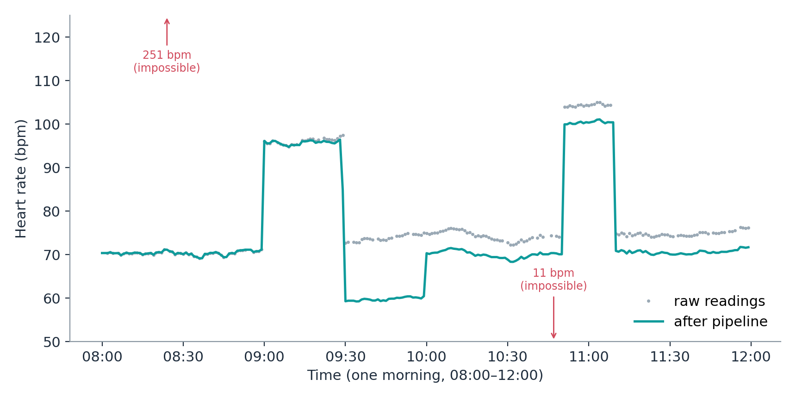
Raw vs Cleaned Heart Rate
What worked
The 251 and 11 bpm glitches are gone. The 24 missing minutes are filled in.
What is still wrong
Between 09:30 and 10:00 the cleaned line dips to about 60 bpm. The true value is about 70.
Why check by eye
This dip is invisible in an average. The chart finds it in two seconds.
Real output from the Week 4 lab data (Python, matplotlib). Grey: raw readings. Teal: after the pipeline.
Intelligent Systems and Emerging Technologies | Week 5 · Pipelines & Visualisation
17

Slide 19
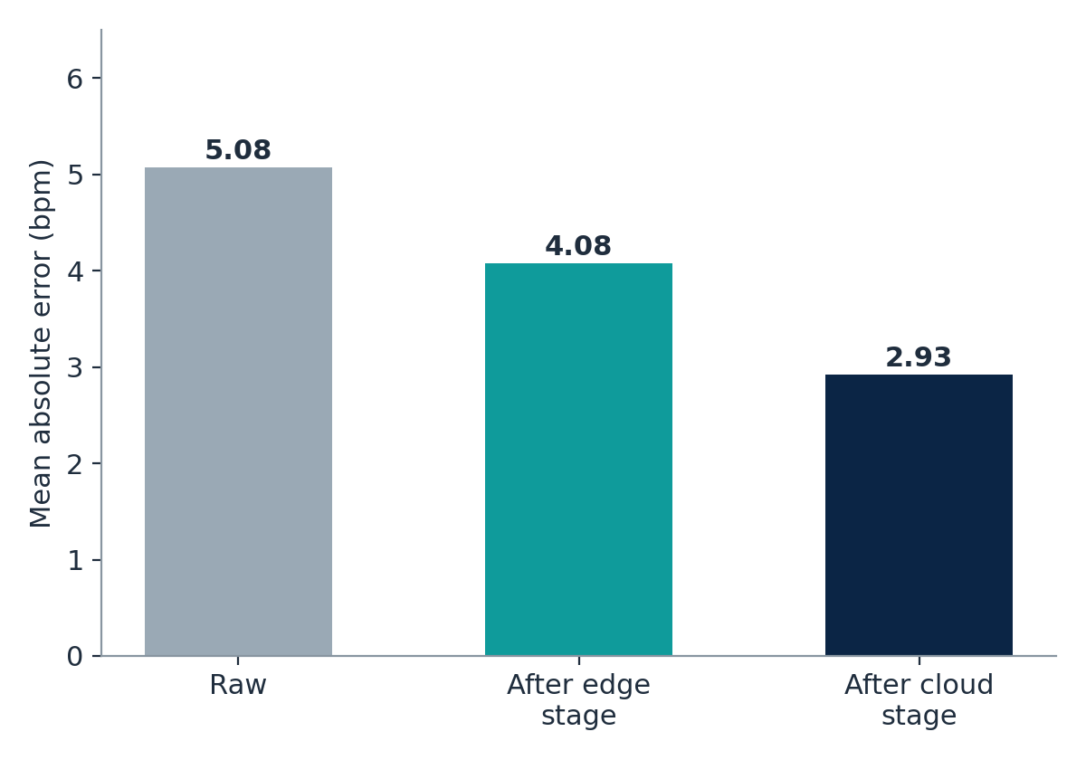
Numbers Said “Better”. The Picture Said “Look Closer”
The numbers
Error falls from 5.08 to 4.08 to 2.93 bpm. Every stage helps, on average.
The cause of the dip
Drift correction uses a 60-minute rolling median. After a 30-minute walk the median is inflated, so too much is subtracted.
The lesson
A pipeline can introduce a new error while fixing an old one. Report both: the score and the chart.
Mean absolute error against the known truth: lower is better.
Intelligent Systems and Emerging Technologies | Week 5 · Pipelines & Visualisation
18

Slide 20
Honest Charts
Truncated Axis
DEFINE
EXAMPLE
EXPLAIN
A chart whose vertical axis starts above zero, which makes small differences look big.
Two bars of 5.08 and 2.93, drawn from 2.5 upwards, make the second bar look almost empty, as if the error had nearly vanished.
For bars, the length is the message, so the axis must start at zero. For lines, a non-zero start is acceptable if it is clearly labelled, because the message is the shape, not the length.
Sources: UK Government Analysis Function, “Data visualisation: charts”; Alberto Cairo, “How Charts Lie”.
Intelligent Systems and Emerging Technologies | Week 5 · Pipelines & Visualisation
19

Slide 21
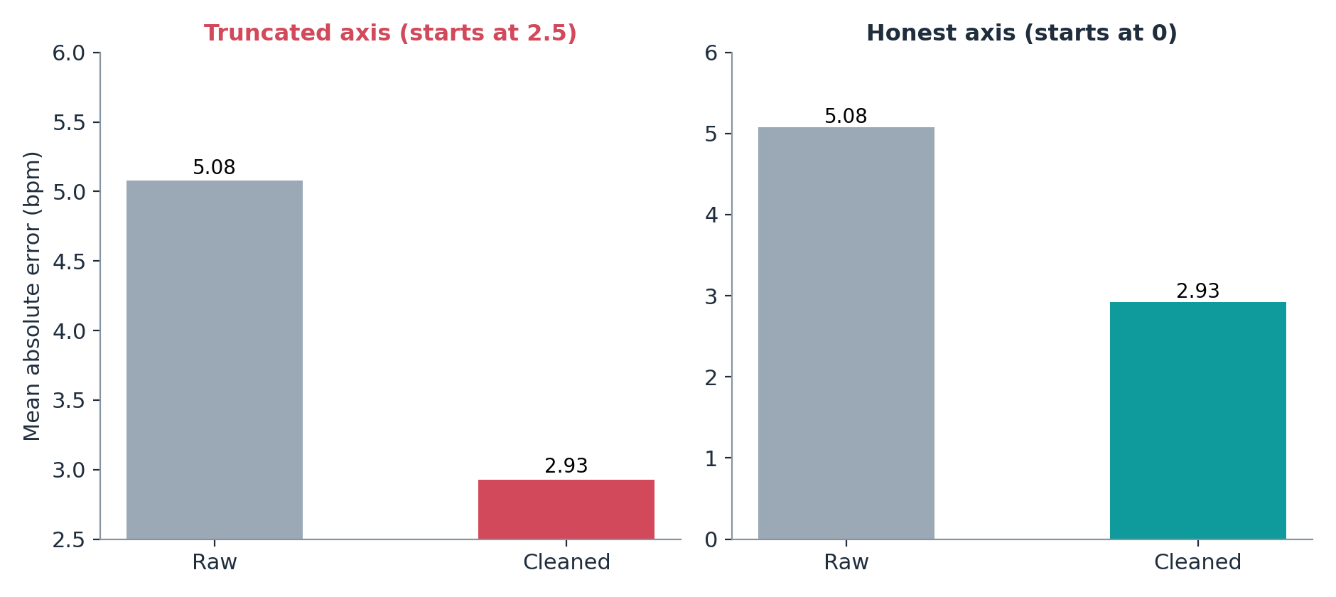
Same Data, Two Stories
Left: misleading
Cleaned error looks more than 80% smaller. The real reduction is 42%.
Right: honest
Bars start at zero, so lengths match the numbers. The improvement is clear, and not exaggerated.
Ask yourself
Would I be comfortable if the reader saw the data table next to this chart?
Both charts use exactly the same two numbers. Only the axis start differs.
Intelligent Systems and Emerging Technologies | Week 5 · Pipelines & Visualisation
20

Slide 22




Six Rules for a Chart You Can Defend
1. Start bars at zero
2. Label units and axes
3. Show the raw data
Length encodes the value. Line charts may zoom, if the axis is clearly labelled.
Say “Heart rate (bpm)”, not “Value”. A chart with no units cannot be checked.
Plot the raw points beside the smoothed line, so readers see what you changed.
4. Mark problems
5. Use colour with purpose
6. Write for your reader
Annotate glitches, gaps and thresholds. Hiding them is not cleaning them.
One colour for “raw”, one for “cleaned”, red only for warnings. Never rely on colour alone.
A nurse needs “Is the patient above 100 bpm?”. An engineer needs the error. Choose one message.
Intelligent Systems and Emerging Technologies | Week 5 · Pipelines & Visualisation
21

Slide 23
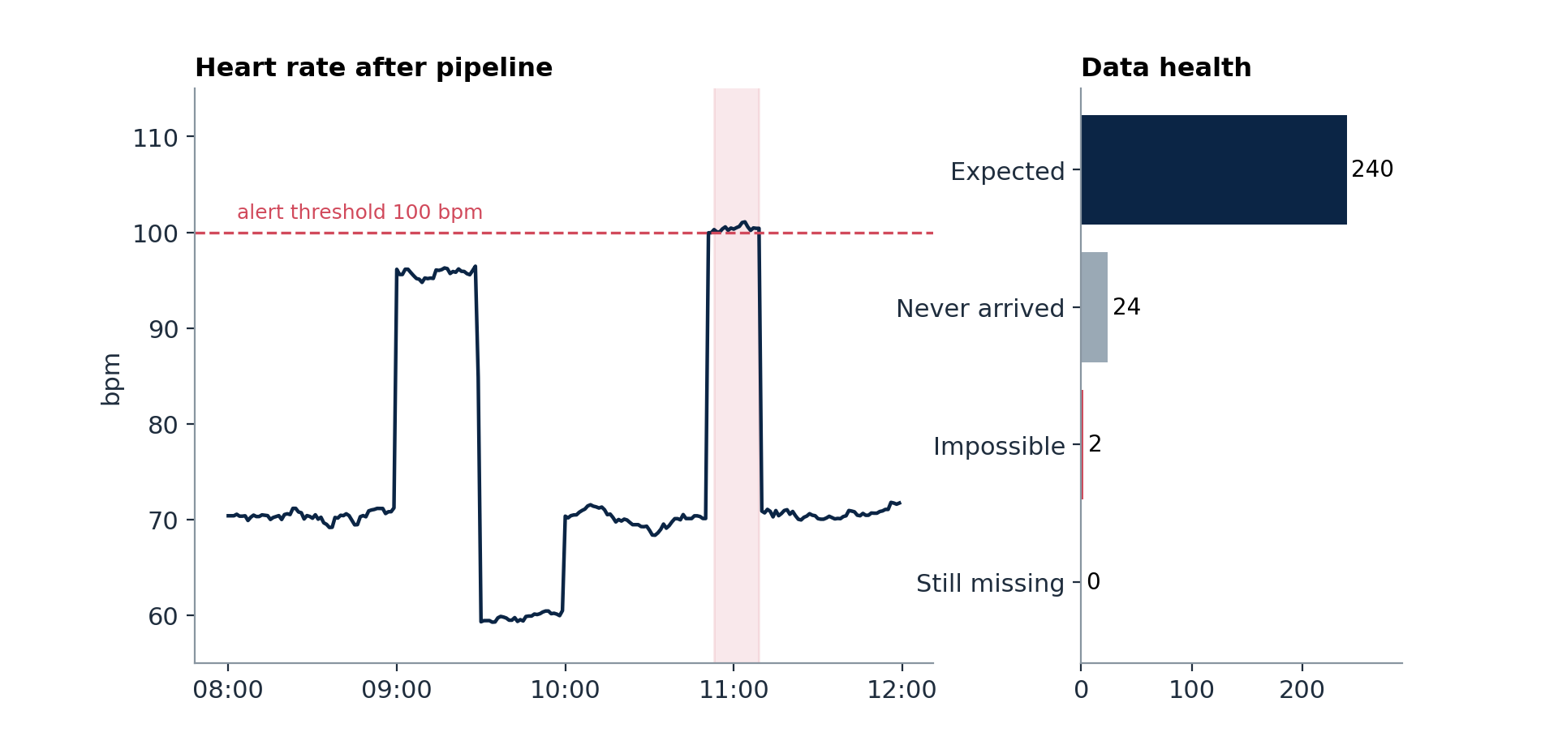
Your Lab Output: A One-Page Data-Health Dashboard
Left: the signal
Cleaned heart rate with the 100 bpm alert line. Shaded area: 17 minutes above the threshold.
Right: the health
24 readings never arrived and 2 were impossible. After the pipeline, none are missing.
Why both
The signal shows what the patient did. The health panel shows whether to trust it.
Your lab output: the cleaned signal with an alert threshold, beside a count of data-quality problems.
Intelligent Systems and Emerging Technologies | Week 5 · Pipelines & Visualisation
22

Slide 24

Common Mistakes
Cleaning in one giant cell
No checks after the pipeline
Scaling before splitting
You cannot test or reuse it. Write one small function per step.
Add assertions. A pipeline that cannot fail is a pipeline you cannot trust.
Fit scalers on training data only. Use a Pipeline to make that automatic.
Reporting only the average
Truncated bar axes
Overwriting the raw data
Plot the result. One number can hide a 10 bpm dip.
Start bars at zero, or say clearly why you did not.
Keep the raw file. You may need to re-run with a better method.
Intelligent Systems and Emerging Technologies | Week 5 · Pipelines & Visualisation
23

Slide 25
Today’s Lab: Pipeline and Dashboard
Step | What you do | What you hand in
1 | Load the Smart Vitals notebook and run the Week 4 data generator. | Raw data in memory
2 | Write the four cleaning functions and chain them with .pipe(). | run_pipeline() works
3 | Add the data-health report and four assert tests. | Report and “all checks passed”
4 | Plot raw vs cleaned. Find the dip. Say why it happens. | Chart plus two sentences
5 | Stretch: change the drift window from 60 to 120. Does the dip shrink? | Before and after chart
6 | Build the one-page dashboard. Add an alert threshold and a title that states the message. | Dashboard PNG
Save your notebook and PNGs to GitHub. They go straight into your Week 9 integration and your portfolio.
Intelligent Systems and Emerging Technologies | Week 5 · Pipelines & Visualisation
24

Slide 26
Where This Goes in Your Assessment
Artefact & Technical Portfolio (60%)
Your pipeline code, tests and dashboard are evidence of a working, repeatable intelligent system.
KEY POINT
Aim for a pipeline you can explain, test and defend, not a complicated one.
Critical Evaluation / Report (40%)
The dip, the 100% test score and the truncated axis are all material for honest evaluation and limitations.
Week 9: System Integration Studio
Your run_pipeline() becomes one component, connected to an API and a container.
Weeks 10 and 11: Trust and Ethics
Misleading charts and unvalidated data are trust problems. You have started on them today.
Intelligent Systems and Emerging Technologies | Week 5 · Pipelines & Visualisation
25

Slide 27
Take-Home Messages
A pipeline is repeatable, ordered and testable. A notebook is none of these.
Validate the output. An unattended system must be able to say “something is wrong”.
Fit scalers on training data only; a scikit-learn Pipeline does this for you.
Plot your results. A chart found a 10 bpm error that the average hid.
Choose axes and colours so your chart can be defended to a sceptical reader.
Next week (Week 6): where does this pipeline run? IoT architectures and edge computing.
Week 5 · Pipelines & Visualisation

