Slide 1



SIP PANJI
Tanggal Presentasi diisi Manual

Slide 2
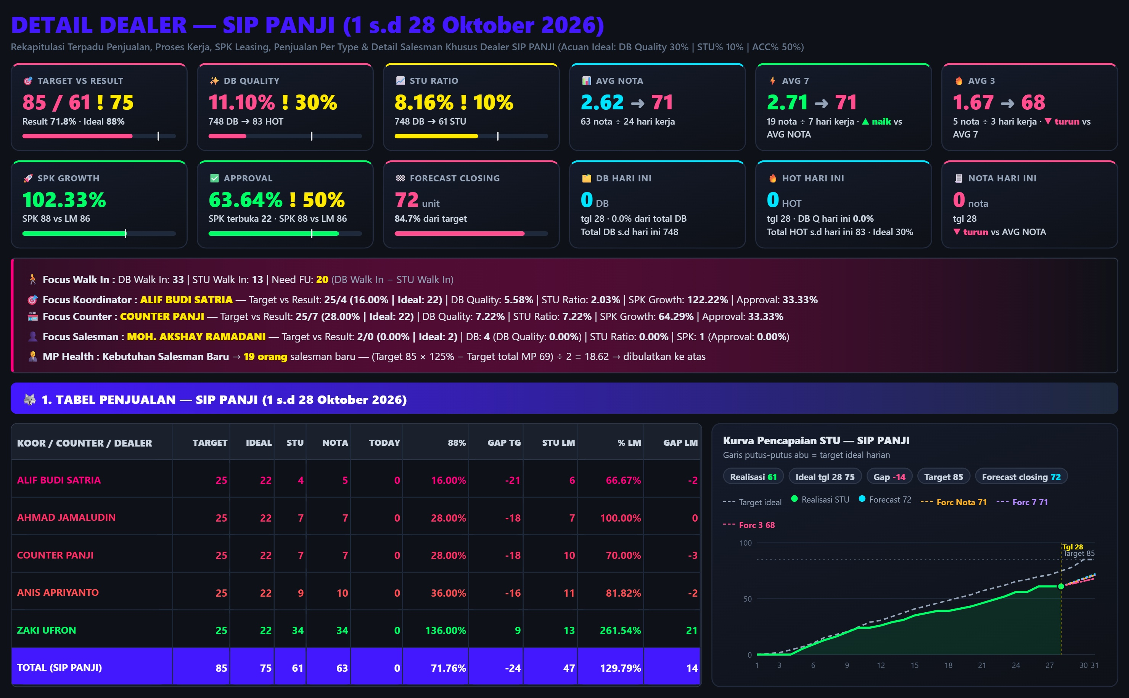

Slide 3
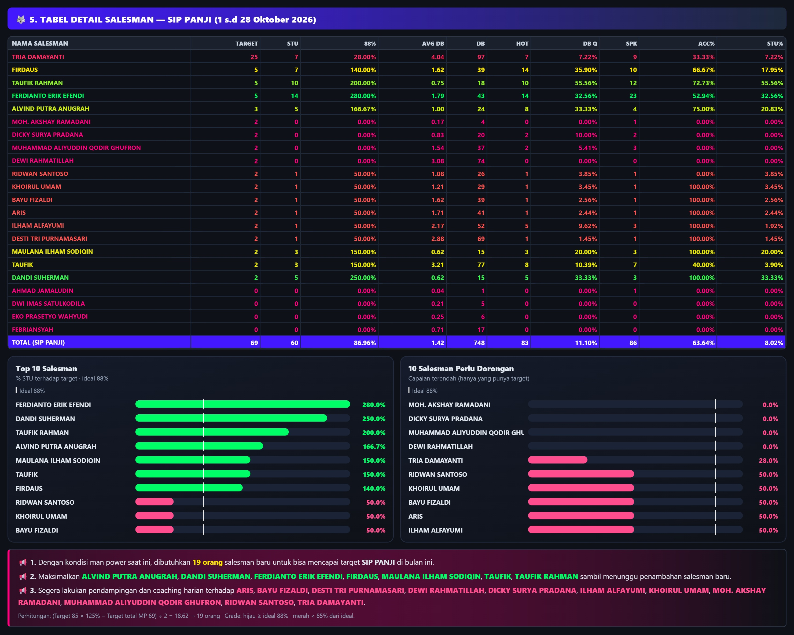
MAN POWER DEALER REVIEW

Slide 4
RECRUITMENT
RECRUITMENT 4 HARI TERAKHIR
1. TOTAL POSTING LOKER :
2. TOTAL RESPONDEN :
3. JUMLAH SURAT LAMARAN MASUK :
4. JUMLAH INTERVIEW :
5. JUMLAH SALESMAN DITERIMA :
PERBAIKAN RECRUITMENT
1. Tambah 19 salesman baru
2.
3.
TARGET PERBAIKAN :

Slide 5
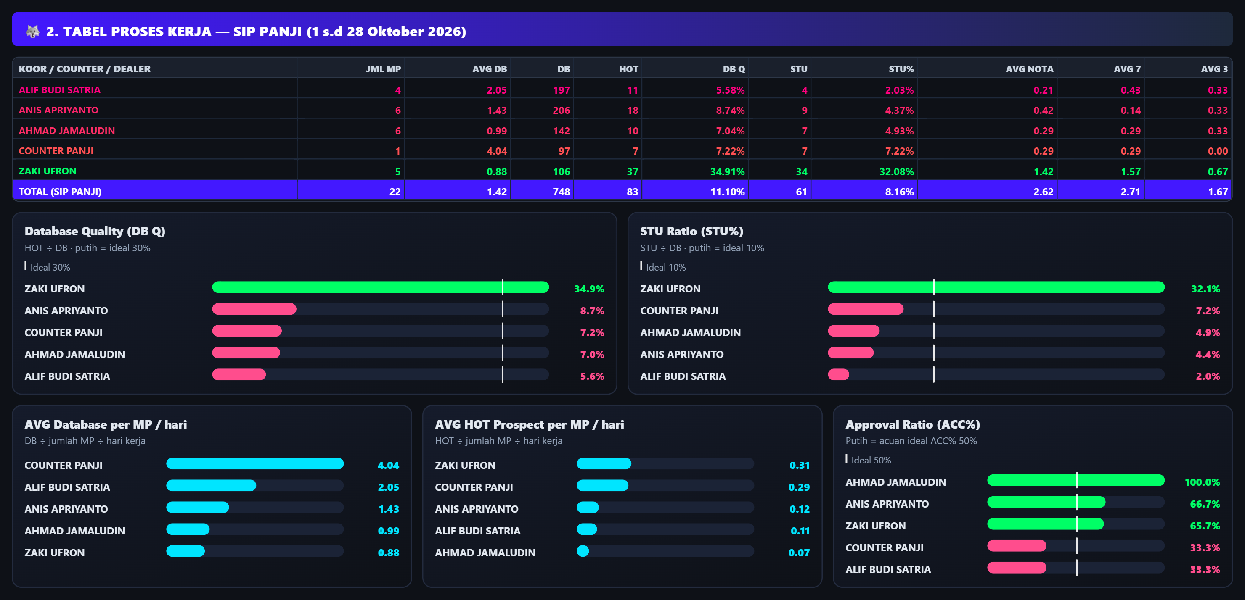
WORK PROCESSES DEALER REVIEW

Slide 6
WORK PROCESSES DEALER REVIEW
CONDITION | PROBLEM | PERBAIKAN | TARGET PERBAIKAN | TIME LINE
DB QUALITY: DB 748 dengan HOT 83 → DB Q 11.1% (ideal 30%); STU 61 → STU% 8.2% (ideal 10%); input 1.4 DB/MP/hari oleh 22 MP.

Slide 7
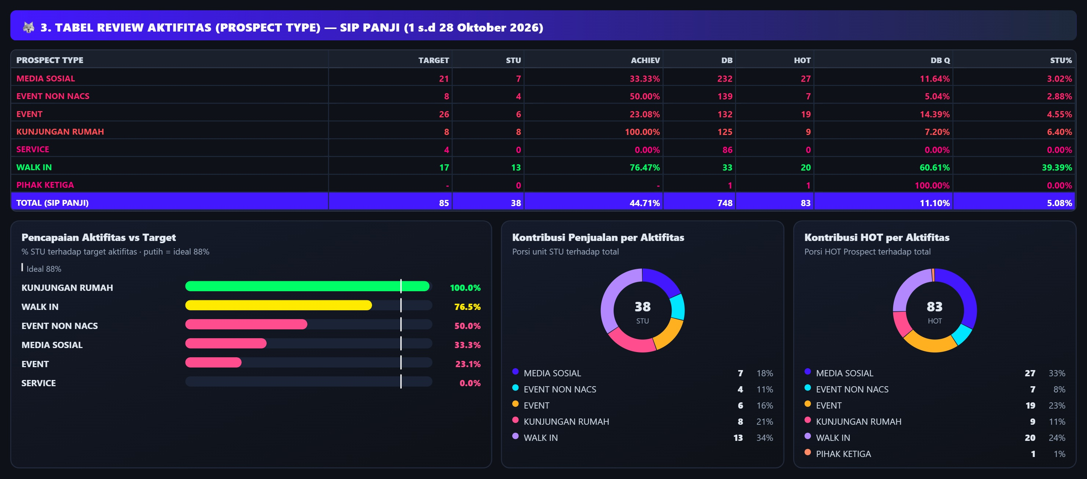
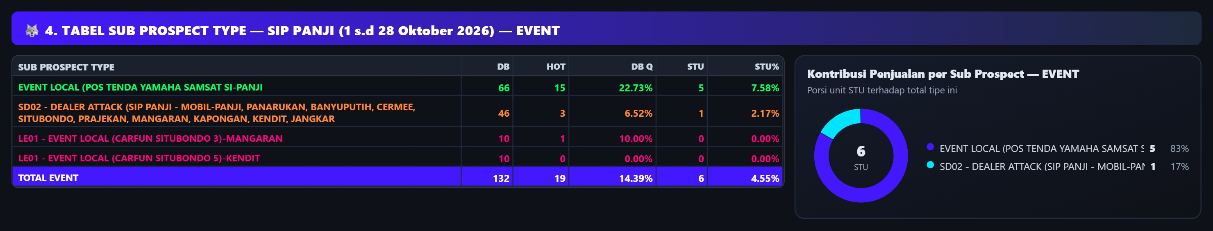
DEALER ACTIVITY REVIEW

Slide 8
DEALER ACTIVITY REVIEW
CONDITION | PROBLEM | PERBAIKAN | TARGET PERBAIKAN | TIME LINE
SUB PROSPECT 1: EVENT › SD02 - DEALER ATTACK (SIP PANJI - MOBIL-PANJI, PANARUKAN, BANYUPUTIH, CERMEE, SITUBONDO, PRAJEKAN, MANGARAN, KAPONGAN, KENDIT, JANGKAR: DB 46, HOT 3 (DB Q 6.5%), STU 1 (STU% 2.2%).
SUB PROSPECT 2: EVENT › EVENT LOCAL (POS TENDA YAMAHA SAMSAT SI-PANJI: DB 66, HOT 15 (DB Q 22.7%), STU 5 (STU% 7.6%).
SUB PROSPECT 3: EVENT › LE01 - EVENT LOCAL (CARFUN SITUBONDO 3)-MANGARAN: DB 10, HOT 1 (DB Q 10.0%), STU 0 (STU% 0.0%).
MEDIA SOSIAL: Media Sosial: target 21 STU, realisasi 7 (33.3%); DB 232, HOT 27 (DB Q 11.6%), STU% 3.0%.

Slide 9
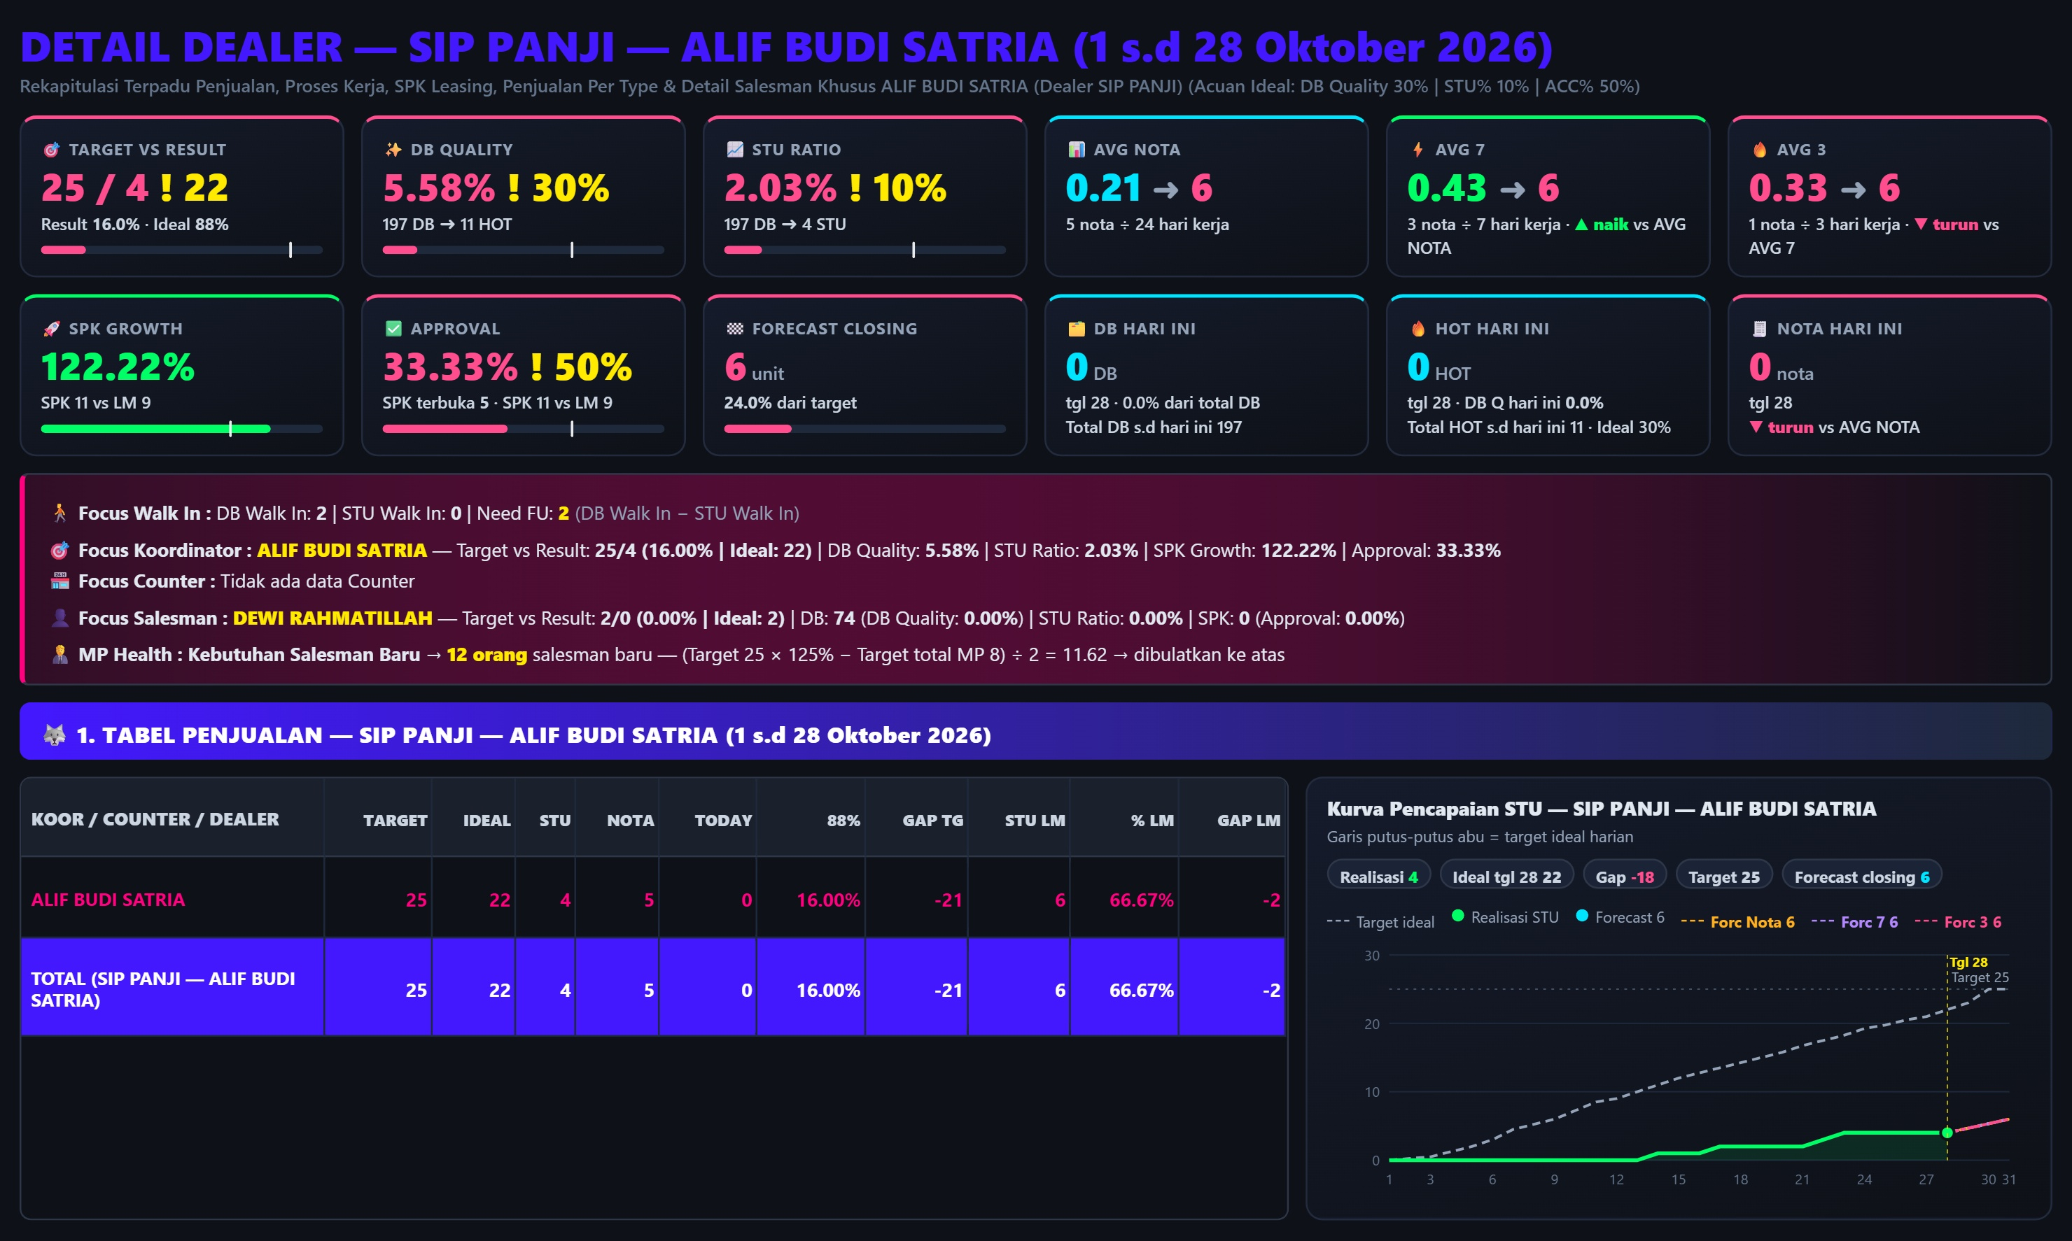
LOW PERFORM COORDINATOR

Slide 10
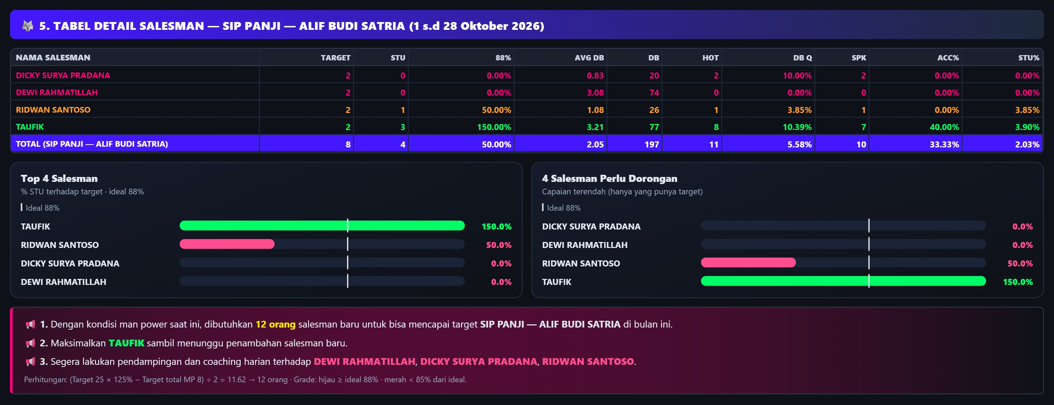
MAN POWER BY LOW PERFORM COORDINATOR

Slide 11
MAN POWER BY LOW PERFORM COORDINATOR
CONDITION | PROBLEM | PERBAIKAN | TARGET PERBAIKAN | TIME LINE
SALESMAN TERBURUK 1: DICKY SURYA PRADANA: STU 0/2 (0.0%), DB 20, HOT 2 (DB Q 10.0%), SPK 2, ACC 0%, STU% 0.0%.
SALESMAN TERBURUK 2: DEWI RAHMATILLAH: STU 0/2 (0.0%), DB 74, HOT 0 (DB Q 0.0%), SPK 0, ACC 0%, STU% 0.0%.
SALESMAN TERBURUK 3: RIDWAN SANTOSO: STU 1/2 (50.0%), DB 26, HOT 1 (DB Q 3.8%), SPK 1, ACC 0%, STU% 3.8%.

Slide 12
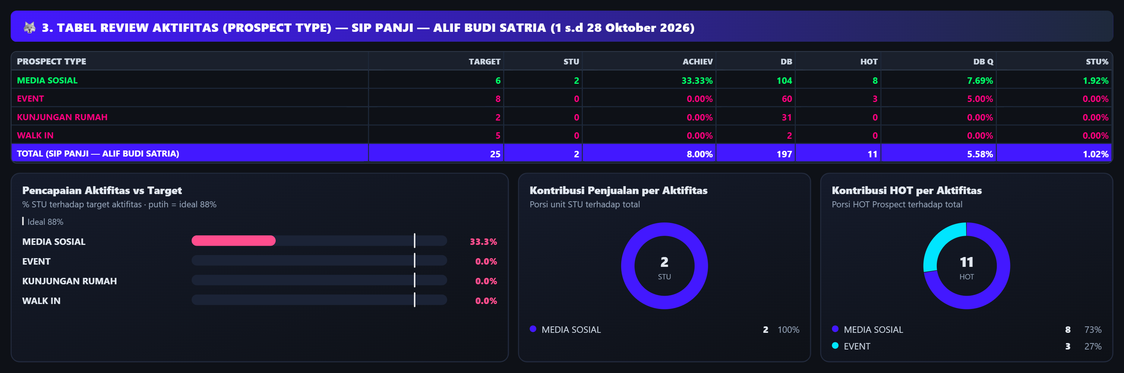
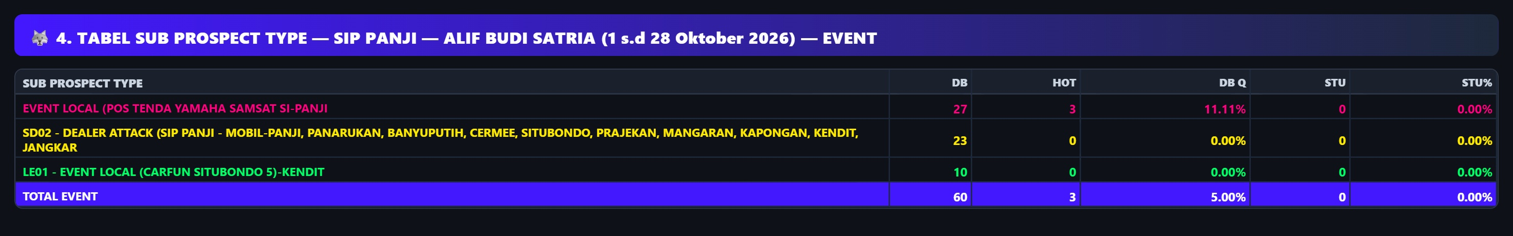
ACTIVITY BY LOW PERFORM COORDINATOR

Slide 13
ACTIVITY BY LOW PERFORM COORDINATOR
CONDITION | PROBLEM | PERBAIKAN | TARGET PERBAIKAN | TIME LINE
SUB PROSPECT 1: EVENT › EVENT LOCAL (POS TENDA YAMAHA SAMSAT SI-PANJI: DB 27, HOT 3 (DB Q 11.1%), STU 0 (STU% 0.0%).
SUB PROSPECT 2: EVENT › SD02 - DEALER ATTACK (SIP PANJI - MOBIL-PANJI, PANARUKAN, BANYUPUTIH, CERMEE, SITUBONDO, PRAJEKAN, MANGARAN, KAPONGAN, KENDIT, JANGKAR: DB 23, HOT 0 (DB Q 0.0%), STU 0 (STU% 0.0%).
SUB PROSPECT 3: EVENT › LE01 - EVENT LOCAL (CARFUN SITUBONDO 5)-KENDIT: DB 10, HOT 0 (DB Q 0.0%), STU 0 (STU% 0.0%).

Slide 14
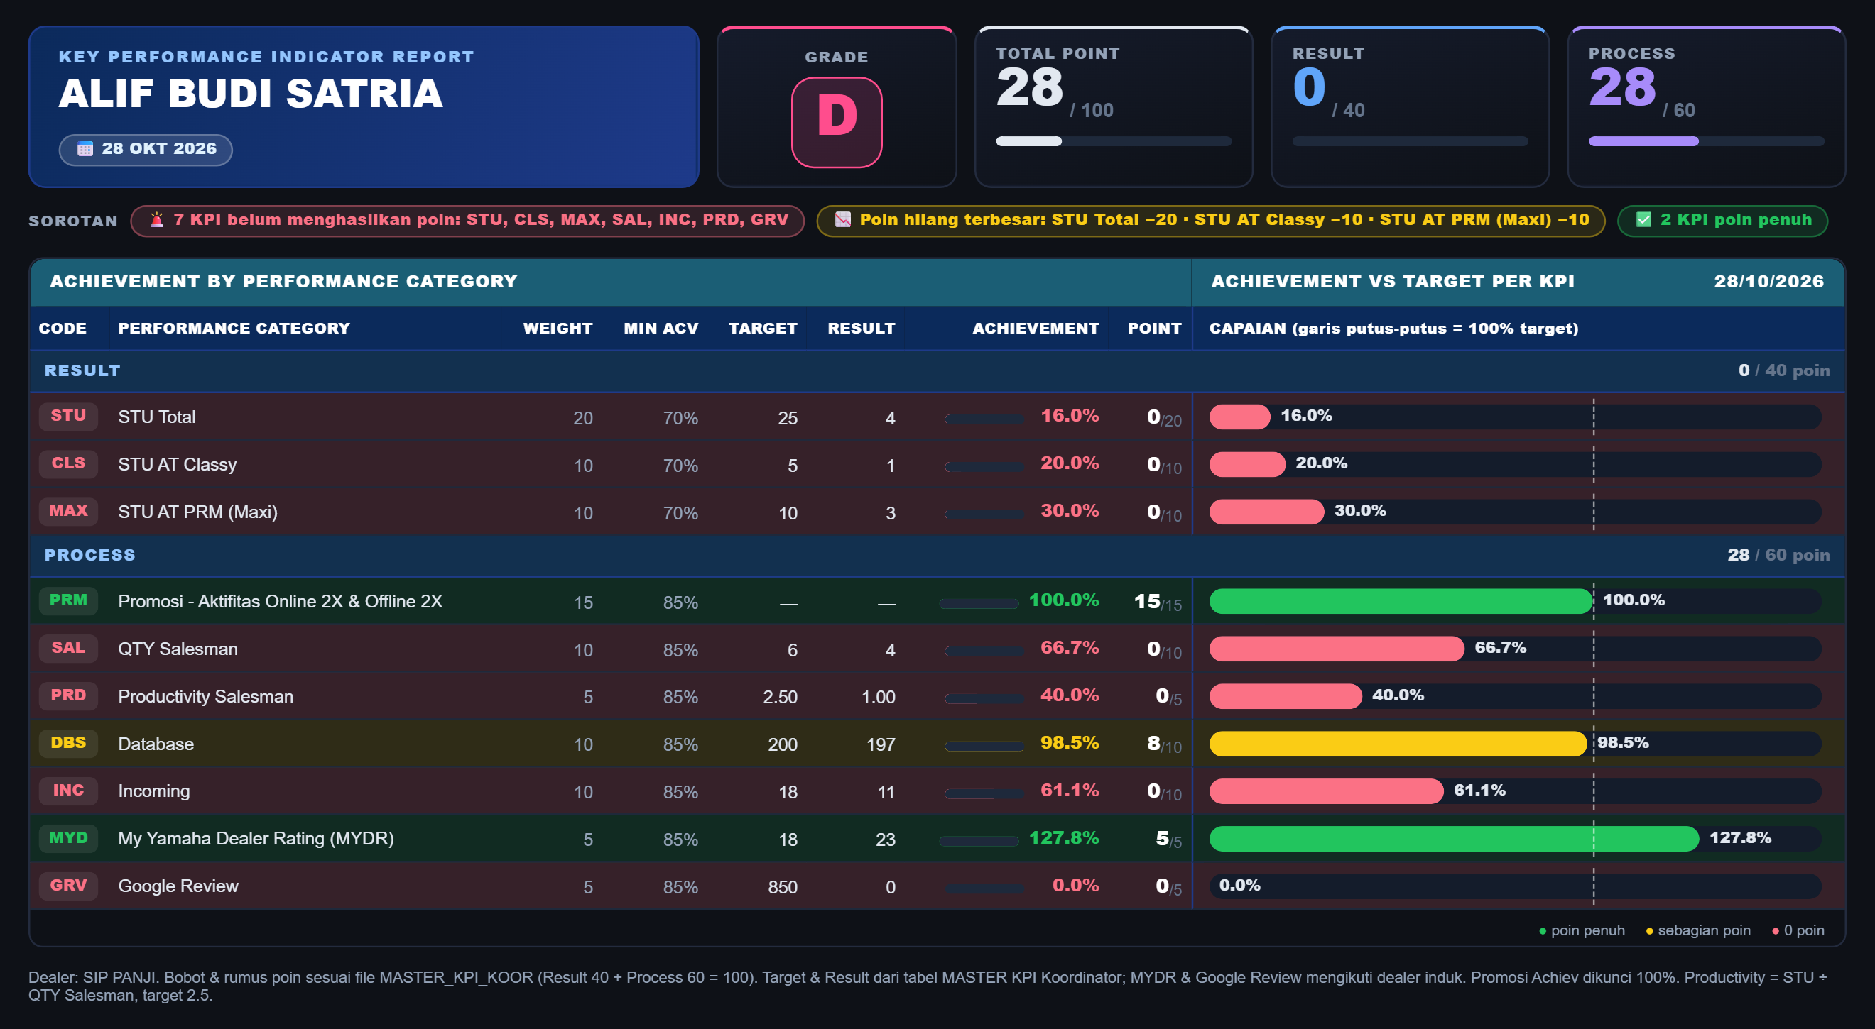
KPI BY LOW PERFORM COORDINATOR

Slide 15
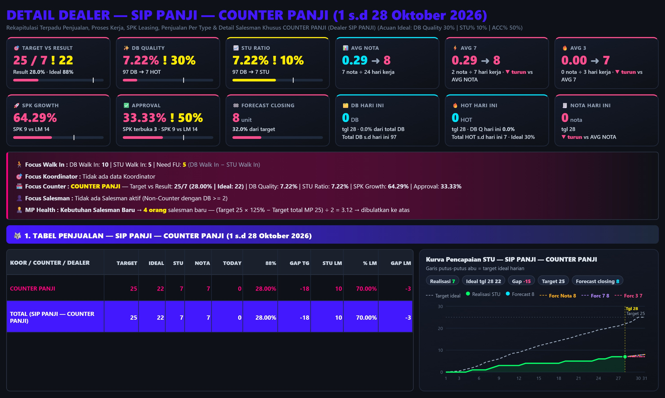
SALES COUNTER

Slide 16
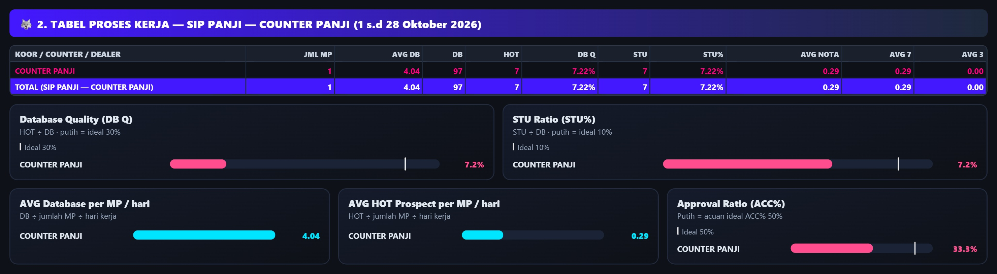
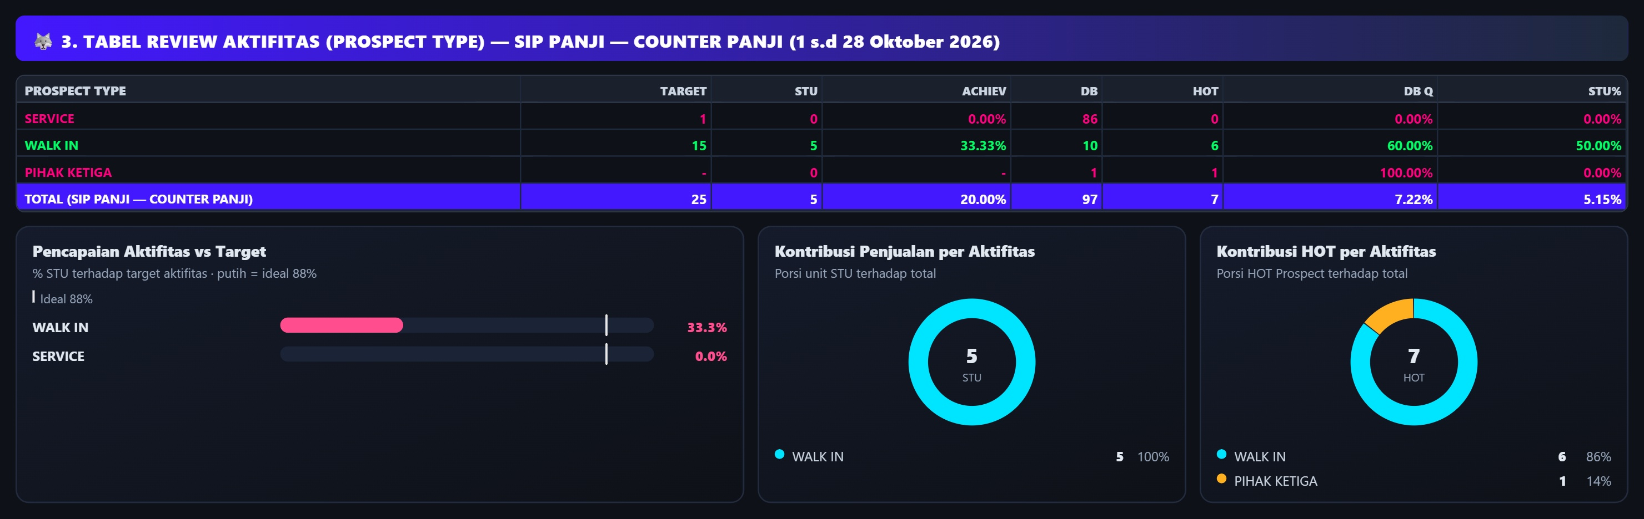
SALES COUNTER REVIEW

Slide 17
SALES COUNTER REVIEW
CONDITION | PROBLEM | PERBAIKAN | TARGET PERBAIKAN | TIME LINE
DB QUALITY: DB 97 dengan HOT 7 → DB Q 7.2% (ideal 30%); STU 7 → STU% 7.2% (ideal 10%); input 4.0 DB/MP/hari oleh 1 MP.
AKTIFITAS 1: SERVICE: DB 86, HOT 0 (DB Q 0.0%), STU 0 (STU% 0.0%); capaian 0/1 (0%) dari target aktivitas.
AKTIFITAS 2: PIHAK KETIGA: DB 1, HOT 1 (DB Q 100.0%), STU 0 (STU% 0.0%).
AKTIFITAS 3: WALK IN: DB 10, HOT 6 (DB Q 60.0%), STU 5 (STU% 50.0%); capaian 5/15 (33%) dari target aktivitas.

Slide 18
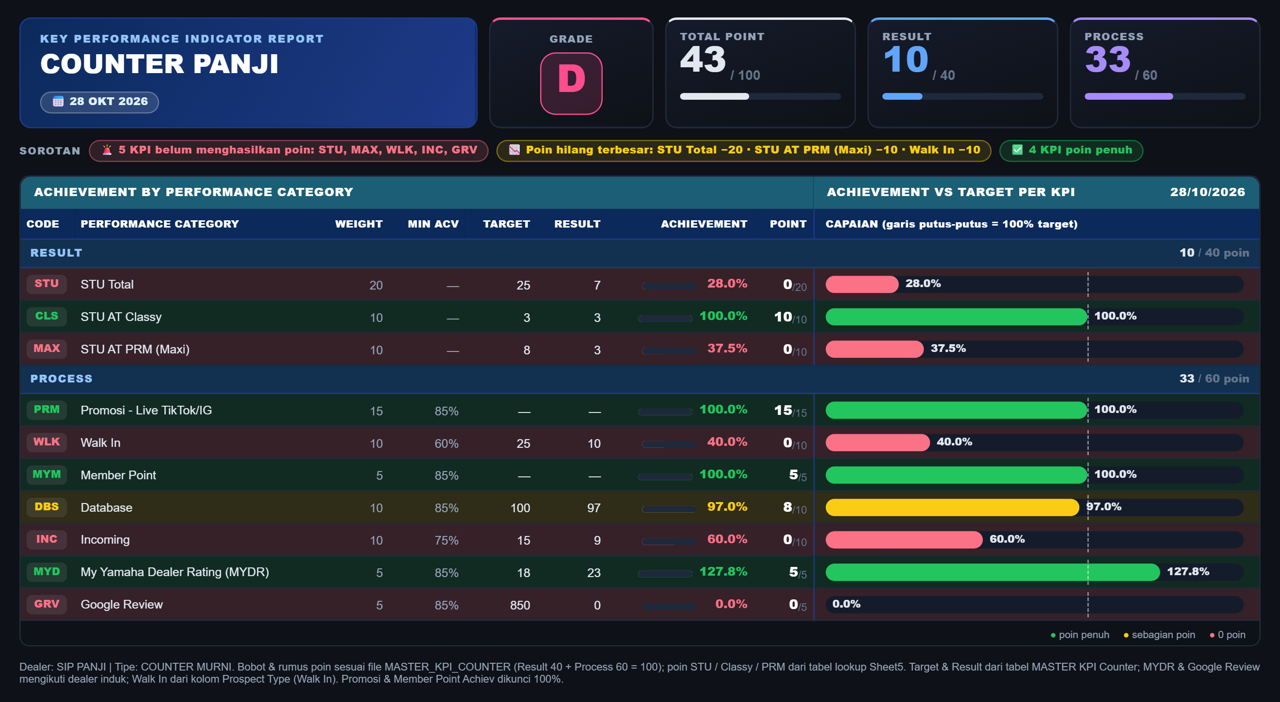
KPI SALES COUNTER

Slide 19
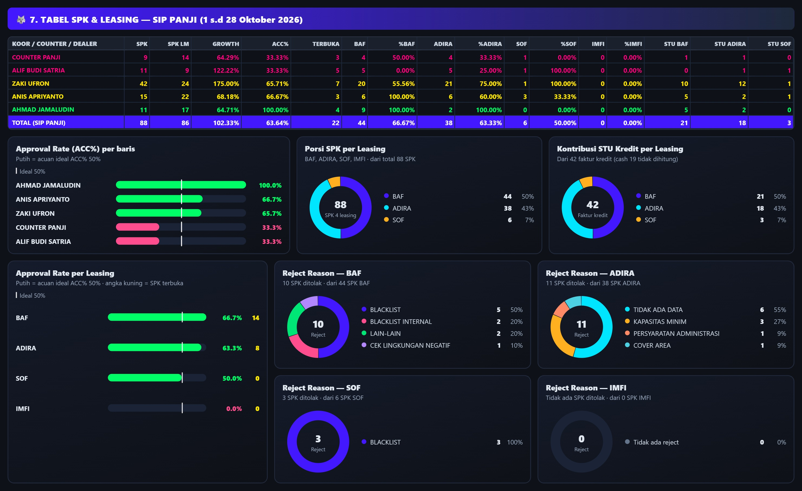
SPK & LEASING DEALER REVIEW

Slide 20
SPK & LEASING DEALER REVIEW
CONDITION | PROBLEM | PERBAIKAN | TARGET PERBAIKAN | TIME LINE
LEASING BAF: SPK 44, ACC% 66.7% (ideal 50%), STU kredit cair 21 unit (50% dari STU kredit); total SPK dealer 88 (LM 86), SPK terbuka 22.
LEASING ADIRA: SPK 38, ACC% 63.3% (ideal 50%), STU kredit cair 18 unit (43% dari STU kredit); total SPK dealer 88 (LM 86), SPK terbuka 22.
LEASING SOF: SPK 6, ACC% 50.0% (ideal 50%), STU kredit cair 3 unit (7% dari STU kredit); total SPK dealer 88 (LM 86), SPK terbuka 22.

Slide 21
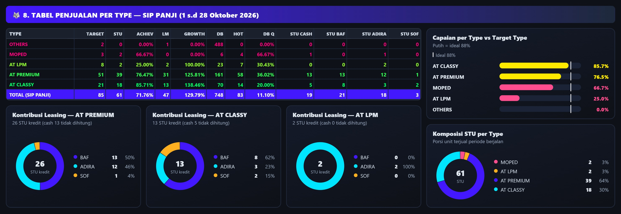
STU BY TYPE DEALER REVIEW
CONDITION | PROBLEM | PERBAIKAN | TARGET PERBAIKAN | TIME LINE
AT PREMIUM: STU 39/51 (76.5%), LM 31 (growth 126%), DB 161, HOT 58 (DB Q 36.0%), SPK 55, ACC 62%.
AT CLASSY: STU 18/21 (85.7%), LM 13 (growth 138%), DB 70, HOT 14 (DB Q 20.0%), SPK 25, ACC 72%.
AT LPM: STU 2/8 (25.0%), LM 2 (growth 100%), DB 23, HOT 7 (DB Q 30.4%), SPK 7, ACC 40%.

Slide 22
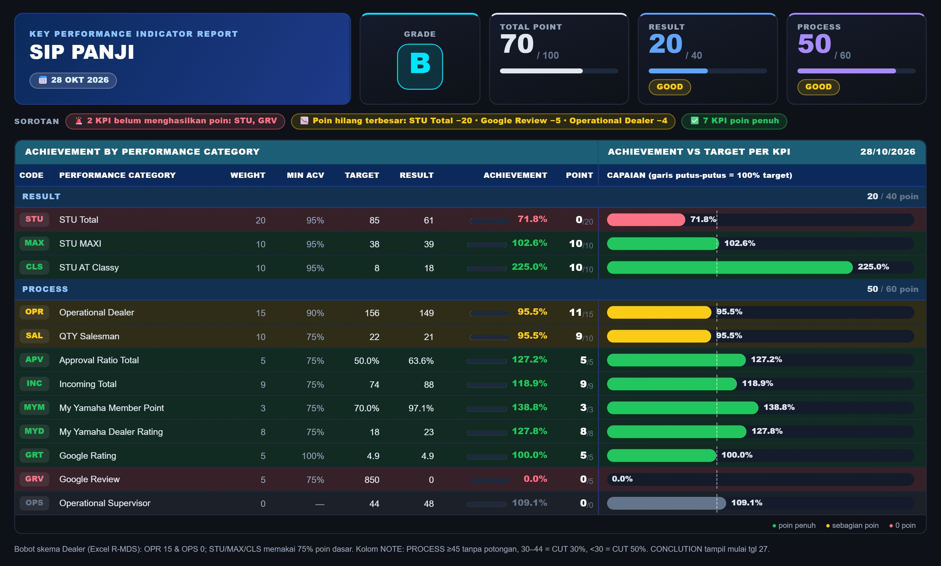

Slide 23
DOCUMENTATION

Slide 24
Thank You!

