Slide 1
In Stride Analysis for
Project Convergence 21
MORSS 2022
MAJ Matt Smith, TRAC Monterey

Slide 2
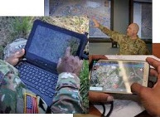
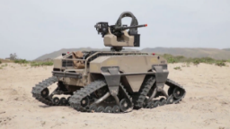
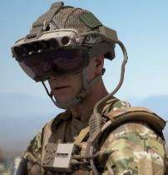



Project Convergence Overview
UNCLASSIFIED
Project Convergence (PC) is an annual Army experiment to test the impact of Artificial Intelligence (AI) and other emerging technologies.
PC Goals:
Understand impact of AI
Set modernization direction
Inform investment decisions
Build trust in technologies
PC22: Multi-National
PC20: Army Only
PC21: Joint
OCT-NOV
PC aims to connect and integrate systems from all Services and allied partners into a single network, a concept known as Combined Joint All Domain Command and Control (CJADC2).
Other CJADC2 Efforts
Project Overmatch
US Navy
Global Analytics Platform
US Marine Corps
Air Battle Management System
US Air Force
CJADC2 Impact: Enable faster and better decisions on a future battlefield.
MORSS – PC21 In Stride Analysis

Slide 3
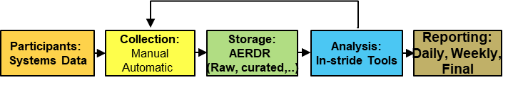
In-Stride Analysis for PC21
UNCLASSIFIED
Purpose for In-Stride Analysis: Develop near real-time data analysis and visualization tools to track exercise events and provide insights on systems, issues, and operational effectiveness.
Potential Objectives and Benefits:
  Support daily reports and execution syncs.
  Provide preliminary insights on system performance.
  Assess progress toward addressing learning demands.
  Highlight possible refinements to data collection strategy.
  Enable discussion about emerging issues or concerns, helping technicians to make on-the-spot fixes and improve performance in the field.
Challenges:
  Large volumes (TBs) of daily network traffic; took days/weeks to process in PC20.
  Many unstructured and non-standardized data formats.
  Time sync across systems.
  Over 90 stakeholder learning demands and over 100 technologies under evaluation.

Slide 4
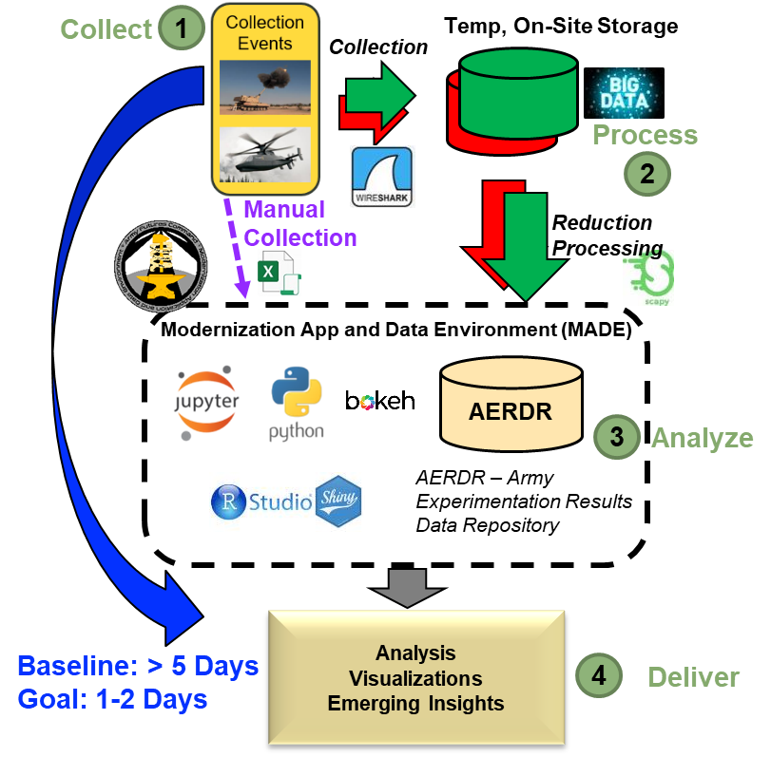
Project Convergence In Stride Analysis
In Stride Analysis Methodology:
Collect – Many TBs per day of network traffic, augmented by manual collection and data tagging.
Process – Use modern tools to reduce raw field data to consumable data product.
Analyze – Aggregate data and extract insights.
Deliver – Deliver key observations and insights via web applications during experiment execution.
Value for Project Convergence:
Understand system performance.
Identify issues or collection gaps.
Ensure successful execution.
Enhanced data collection and processing methods enable insights within hours that previously took days or weeks.

Slide 5
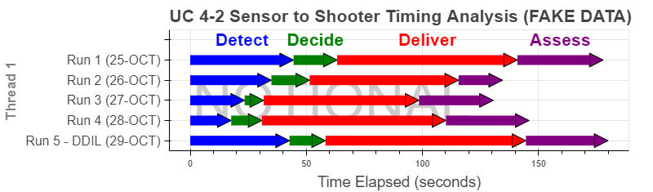
Timing Analysis “Arrow Charts”
UNCLASSIFIED
How well do AI and other technologies speed up tactical decision making?
PC modifies traditional Detect-Decide-Deliver-Assess (D3A) targeting framework:
Traditional Army Targeting Process (ATP 3-60):
Decide
Detect
Deliver
Assess
Project Convergence (PC) Framework:
Detect
Decide
Deliver
Assess
Receive and disseminate target info.
Generate CFF.
Process fire order.
Attack target.
Perform BDA.
ATP – Army Training Publication
CFF – Call For Fire
BDA – Battle Damage Assessment
Arrow Charts yield intuitive and interactive displays of timing for each Sensor to Shooter Engagement.
Use Case 4-2: AI-Enabled Air Assault
Value:
  Understand how AI speeds up tactical decision making.
  Evaluate impact of DDIL environment.
  Identify exercise trends or issues.
  Available within 1 hour of PC events.
NOTIONAL
DDIL = Denied, Disrupted, Intermittent, and Limited-Bandwidth.

Slide 6
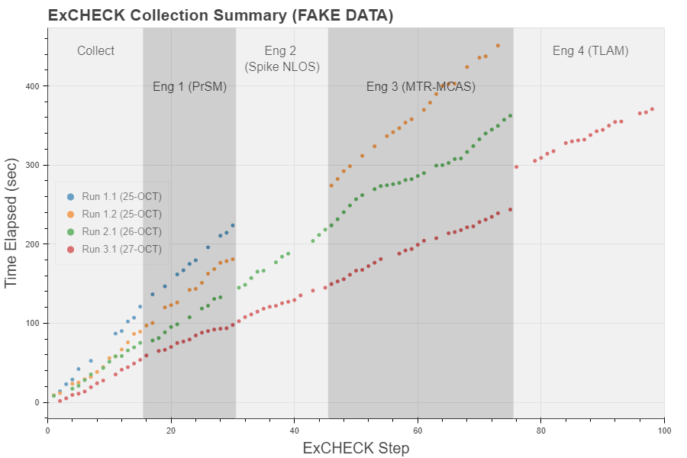
Execution Checklist Tracker
UNCLASSIFIED
How well were the daily PC use cases executed compared to the plan?
PC, as with most warfighting experiments, uses an Execution Checklist (ExCheck) to plan and execute events.
Collection of timestamps for ExCheck steps enables richer analysis of use case execution.
Value:
  Highlight issues or gaps in execution or collection.
  View trends within and between use case runs.
  Available within 1 hour of PC events.
NOTIONAL

Slide 7
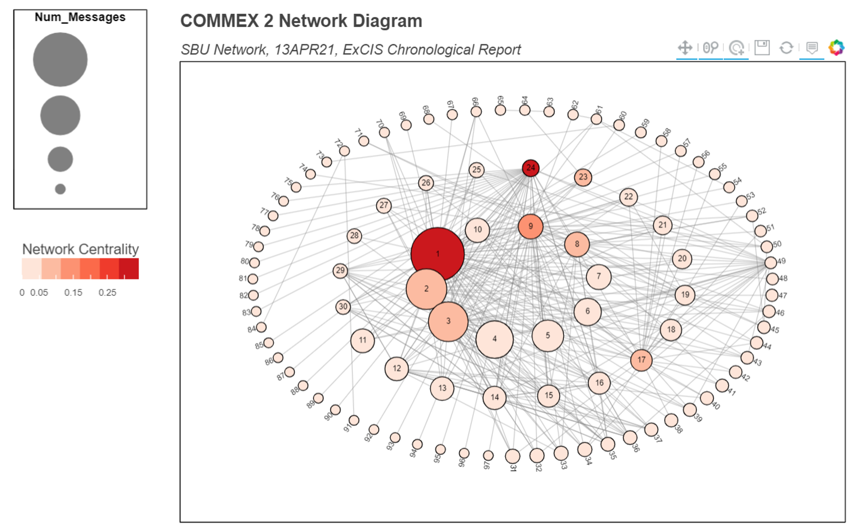
Network Criticality Graphics
UNCLASSIFIED
Network centrality graphics give indication of each node’s criticality in terms of enabling data flow across the network.
Graphic measures two aspects of node criticality:
  Node Size = number of messages.
  Node Color = network betweenness centrality.
Value:
  Understand network health and performance.
  Identify critical nodes in AI-enabled battlefield.
  Understand impact of AI/ML on network bandwidth.
NOTIONAL

Slide 8
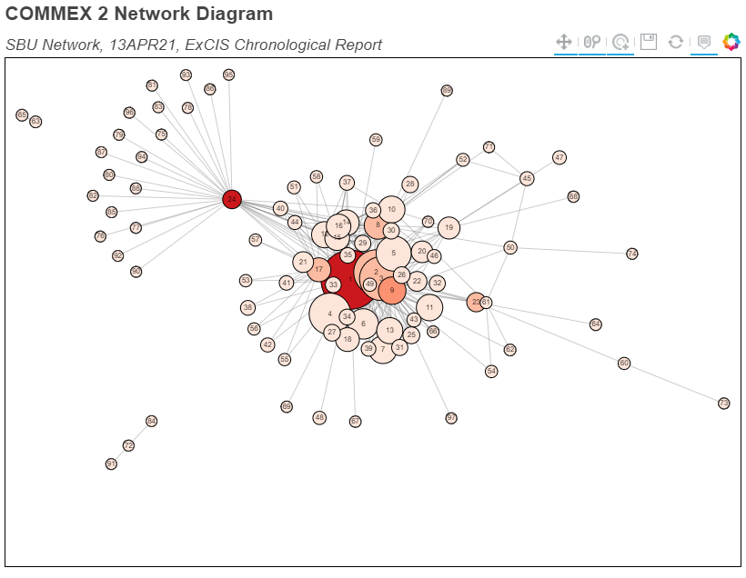
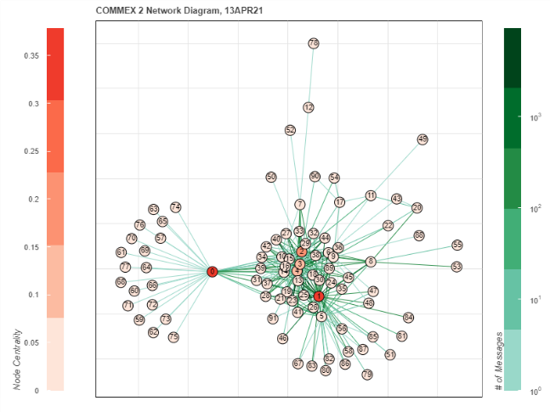
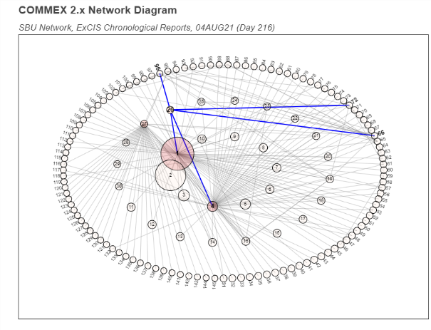
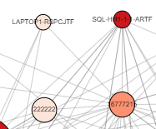
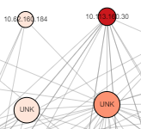
Network Criticality Graphics
UNCLASSIFIED
Interactive web-based graphics enable deeper inspection into variety of node and network metrics.
View alternate network layouts
View amount of traffic along each edge
Highlight node and its connections
Lable nodes by Name, IP, or URN
NOTIONAL

Slide 9
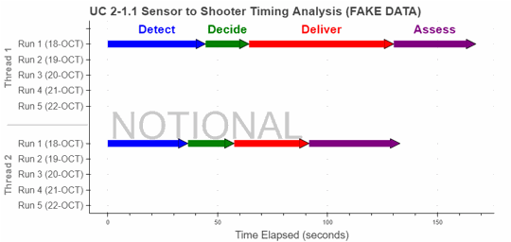
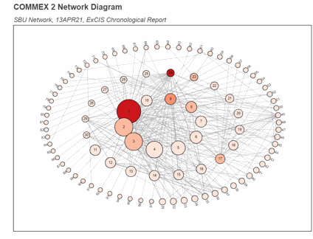
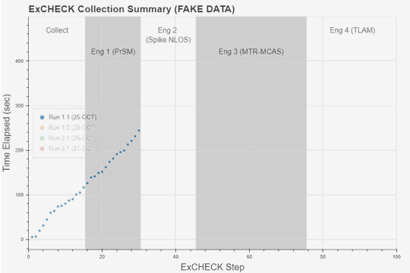
In Stride Analysis Dashboards
UNCLASSIFIED
Interactive web applications provide powerful means to share analytic results with community of interest.
Web applications hosted on Project Convergence Intelshare sites:
  NIPR Dashboard: https://intelshare.intelink.gov/sites/projectconvergence → Click “In Stride Dashboard”
  SIPR Dashboard: https://intelshare.intelink.sgov.gov/sites/ProjectConvergence → Click “In Stride Dashboard”
Majority of interactive dashboards built with python bokeh library. See bokeh documentation for helpful references, or see Army ORSA python data analysis tutorial for python tutorial covering python basics and bokeh visualizations.
NOTIONAL
NOTIONAL
NOTIONAL
View task and phase completion times for each Sensor to Shooter Engagement through Detect-Decide-Deliver-Assess phases.
View topology of tactical network and identify nodes most critical to enabling data flow across the network.
Illustrate the issues and pain points for each use cases, and view trends within and between the use case runs.

Slide 10

Summary
UNCLASSIFIED
Enhanced data collection and analysis methodologies allow key observations and operational insights within hours rather than days during PC21.
In stride analysis products are tailored to deliver the types of insights needed to ensure successful execution of the warfighting experiment.
Interactive python-built web applications created provide flexible and powerful means of communicating results to key stakeholders.
POC: MAJ Matt Smith, TRAC-Monterey, matthew.d.smith255.mil@army.mil
Contact us at:
Director
LTC Brian Wade
brian.wade@nps.edu
(831) 656-3086
Admin Support
Ms. Sandra Lackey
sdlackey@nps.edu
(831) 656-3086
Mil. Personnel S1
MAJ Candice Farney
Candice.Farney@nps.edu
(831) 656-7575

