Slide 1
Retail Sales Data Analysis
Season, Promotion & Product Insights
Presented by:
Sohail
Role:
Aspiring Data Analyst
Tools Used:
Python, Pandas, Matplotlib, Seaborn

Slide 2
Problem Statement:
Retail businesses generate large volumes of sales data across different seasons, promotions, and product categories.
However, without proper analysis, it becomes difficult to understand sales patterns, customer behavior, and the impact of promotions.
Objectives:
Analyze sales data across different seasons
Study the impact of promotions on product sales
Identify high-performing and low-performing product categories/sections
Generate business insights using data visualization

Slide 3
Dataset Overview
The dataset contains retail business sales data.
It includes information about:
  Product category / material
  Store section (Men’s & Women’s)
  Season (Winter, Autumn, Spring, Summer)
  Sales quantity / count
The data is used to analyze sales trends and customer preferences.

Slide 4
Tools & Technologies
Python – Data analysis and processing
Pandas – Data cleaning and manipulation
Matplotlib & Seaborn – Data visualization
Jupyter Notebook – Analysis environment
MS PowerPoint – Presentation of insights

Slide 5
Data Cleaning
Checked for missing and null values
Removed duplicate records
Standardized column names
Corrected inconsistent category values
Ensured data types were correct for analysis

Slide 6
Exploratory Data Analysis
Analyzed sales distribution across seasons
Compared sales between Men’s and Women’s sections
Identified popular materials and products
Used bar charts and grouped plots for comparison

Slide 7
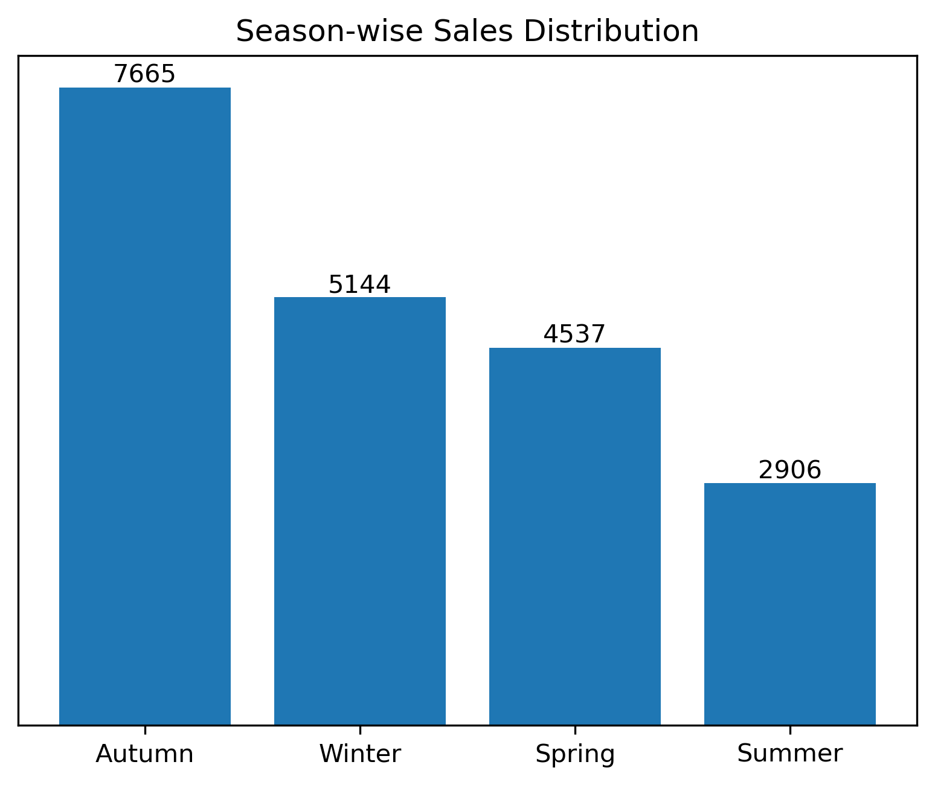
Sales Distribution by Season
Winter and Autumn show the highest sales
Spring records moderate sales performance
Summer sales are comparatively low
Seasonal demand significantly impacts overall sales

Slide 8
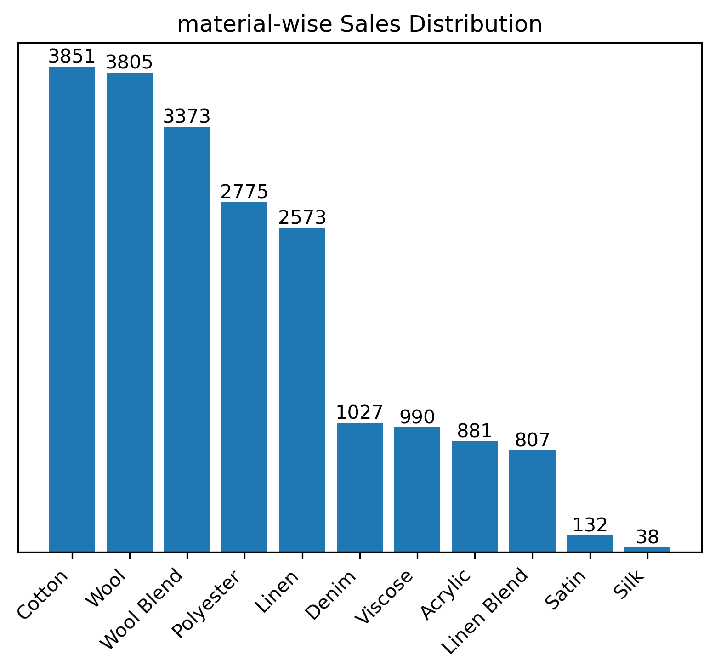
Material Distribution Analysis
Cotton and Wool are the most popular materials
Polyester shows consistent demand across seasons
Satin and Silk have lower sales volumes
Material preference varies by season and section

Slide 9
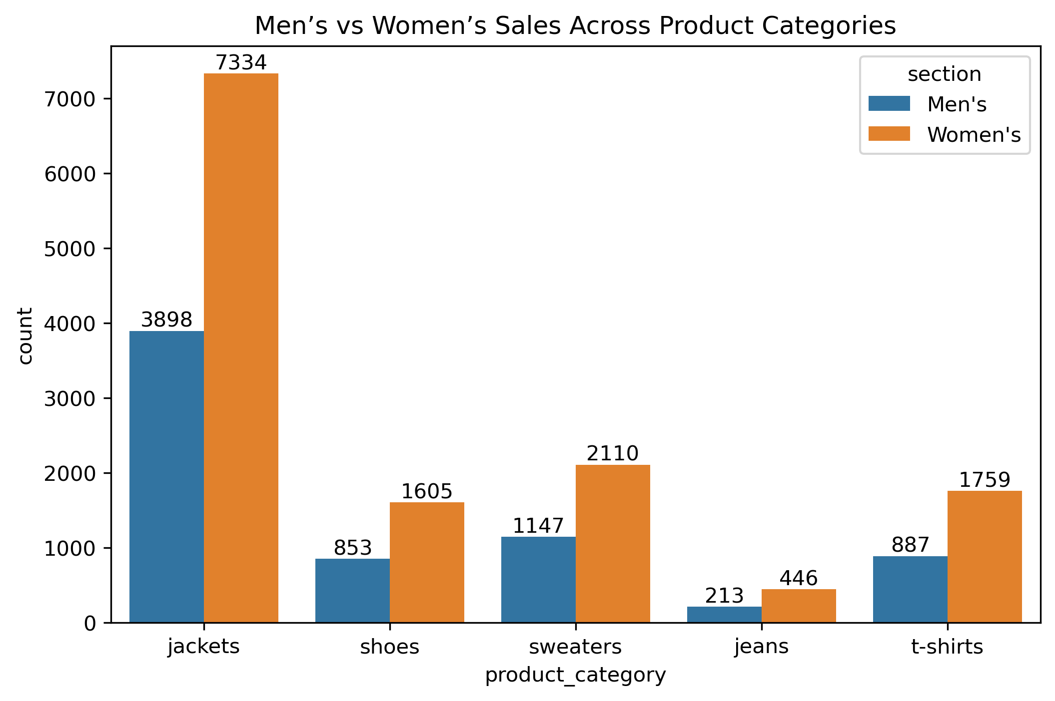
Section-wise Analysis
Women’s section shows higher overall sales
Men’s section performs strongly in Winter season
Certain materials perform differently across sections
Visual comparison helps identify section-based trends
Women’s section dominates overall sales across most
product categories

Slide 10
Key Insights
Clear seasonal demand patterns observed
Winter & Autumn show highest sales
Women’s section outperforms Men’s section
Jackets & Sweaters are top-selling products
Business Recommendations
Increase inventory during Winter & Autumn
Focus marketing on Women’s section
Promote jackets & sweaters in peak seasons
Optimize stock for low-performing categories

