Slide 1
Major Depressive Disorder (MDD)
Marissa D’Souza & Catherine Waldron
Notes:
Otherwise known as MDD

Slide 2
Financial Disclosures
We have no disclosures.
Cat has some money
Mar has none

Slide 3
Outline
Overview & epidemiology
Pathogenesis & neurobiology
Assessment & diagnosis
Treatment

Slide 4
Overview & Epidemiology
1

Slide 5
Depressive Disorders (briefly)
Major Depressive Disorder (MDD) or unipolar major depression
Loss of interest
Overwhelming feeling of sadness
Persistent Depressive Disorder (dysthymia)
Low, dark or sad mood for most days for at least 2 years, not asx for >2 consecutive months
Premenstrual Dysphoric Disorder (PMDD)
~ Extension of PMS
Depressive disorder due to another medical condition
Hypothyroidism, Parkinson’s, Cushing’s, etc.
Adjustment Disorder with Depressed Mood
Triggered within 3 months of onset of stressor
Resolves within 6 months of stressor end
Seasonal Affective Disorder (SAD)
Usually winter → light therapy
Atypical symptoms
Notes:
We will talk about MDD

Slide 6
Depression is…
“A period of at least two weeks when a person experienced a depressed mood or loss of interest or pleasure in daily activities, and had a majority of specified symptoms, such as problems with sleep, eating, energy, concentration, or self-worth.”
- DSM-5
Notes:
“That’s the thing about depression: A human being can survive almost anything, as long as she sees the end in sight. But depression is so insidious—and it compounds daily—making it impossible to ever see the end. That fog is like a cage without a key.”
This famous quote was taken from the best-selling memoir by Elizabeth Wurtzel, Prozac Nation: Young and Depressed in America (1994). It perfectly describes the utter hopelessness of enduring what feels like endless blackness. Human beings need hope to lift themselves up. If your thoughts tell you there is no possibility of ever feeling better, the chances of recovering are dimmed. Then there is little motivation or ability to work in therapy or partake in any pleasurable activities. Expecting the worst helps create a self-fulfilling prophecy.
Here’s the good news: The cage can be opened when you begin challenging those hobbling negative thoughts. For instance, when you think, Nothing good ever happens to me remind yourself, Not true. I found a wonderful person to marry.

Slide 7

Depression is…
“the constant feeling of being numb. Being numb to emotions, being numb to life. You wake up in the morning just to go to bed again. I’m tired means a permanent state of exhaustion that sleep doesn’t fix. Sleep just isn’t sleep anymore – it’s escape.”
“feeling like you’ve lost something but having no clue when or where you lost it.”
“insidious—and it compounds daily—making it impossible to ever see the end. That fog is like a cage without a key.”
“When you’re depressed, you don’t control your thoughts,
your thoughts control you.”
Notes:
“That’s the thing about depression: A human being can survive almost anything, as long as she sees the end in sight. But depression is so insidious—and it compounds daily—making it impossible to ever see the end. That fog is like a cage without a key.”
This famous quote was taken from the best-selling memoir by Elizabeth Wurtzel, Prozac Nation: Young and Depressed in America (1994). It perfectly describes the utter hopelessness of enduring what feels like endless blackness. Human beings need hope to lift themselves up. If your thoughts tell you there is no possibility of ever feeling better, the chances of recovering are dimmed. Then there is little motivation or ability to work in therapy or partake in any pleasurable activities. Expecting the worst helps create a self-fulfilling prophecy.
Here’s the good news: The cage can be opened when you begin challenging those hobbling negative thoughts. For instance, when you think, Nothing good ever happens to me remind yourself, Not true. I found a wonderful person to marry.

Slide 8

Coupled with anxiety?
“Having anxiety and depression is like being scared and tired at the same time.
It’s the fear of failure, coupled with no urge to be productive.
It’s wanting friends but hating socializing.
It’s wanting to be alone but not wanting to be lonely.
It’s feeling everything at once, yet being paralyzingly numb.”
Notes:
Major depression and anxiety disorders often go hand in hand. Indeed, one study postulates that 85% of people who suffer from major depression also have generalized anxiety disorder (GAD), with 35% showing signs of panic disorder. There are similarities in symptomology (i.e. irritability) between the two illnesses. However other symptoms are diametrically opposed, such as having no energy to try to make a friend, versus being too terrified of rejection to reach out to someone appealing. The treatments used for these conditions are often the same. For example, cognitive behavioral therapy (CBT) works on the response patterns for depression and anxiety, and serotonin reuptake inhibitors (SSRIs) are also often used for both.

Slide 9
Data provided by the Georgia Department of Public Health Online Analytical Statistical Information System

Slide 10
#1
Psychiatric disorder
in the general population
17%
Lifetime prevalence
of MDD in the US
200%
Prevalence in females
compared to males in the US
$210.5B
Economic burden
of depression in the US
Notes:
210.5B = economic burden
21.5% increase from $173.2 billion per year in 2005.
What’s interesting is that a little less than half of these costs is attributed to losts costs in the workplace including not showing up and not being productive when at work
Another 45-57% due to direct medical costs (e.g., outpatient and inpatient medical services, pharmacy costs), which are shared by employers, employees, and society.
About 5% of the total expenditures are related to suicide.

Slide 11
Pathogenesis & Neurobiology
2

Slide 12
Risk Factors
Internalizing
Genetics
Neuroticism
Low self-esteem
Early-onset anxiety disorder
Past history of major depression
Externalizing
Genetics
Substance misuse
Conduct disorder
Adversity
Trauma during childhood or adulthood
Stressful life events in past year
Parental loss
Low parental warmth
Marital problems
Low social support
Depressed network
Low education
37-50% concordance rate in monozygotic twins
Notes:
Pharmacogenetics — Genetic factors in patients with unipolar depression may influence response to antidepressants:
●A meta-analysis of five studies (n = 544 Caucasian patients) reported that polymorphisms related to expression of the serotonin transporter gene (5-HTTLPR, located on chromosome 17) were significantly associated with remission of depression in patients treated with selective serotonin reuptake inhibitors (SSRIs) (odds ratio [OR] 2.4, 95% CI 1.6-3.6) [50].
●A subsequent meta-analysis found that besides 5-HTTLPR, two genes located on chromosome 11 were significantly associated with efficacy of antidepressant treatment [51]. These were TPH1 (seven studies, 754 patients of mixed ancestry, OR 1.6), which is involved in serotonin synthesis, and brain-derived neurotrophic factor (four studies, 490 patients, OR 1.6). There were also significant associations between polymorphisms of different genes and side effects.

Slide 13
Contributors to Major Depression
Drugs and Poison
Alcohol, beta blockers, steroids, opiates, barbiturates, withdrawal from cocaine and amphetamines, heavy metal poisoning, cholinesterase inhibitors, cimetidine, chemotherapy agents
Metabolic/endocrine
Hyper- and hypothyroidism, severe anemia, hyperparathyroidism, hypokalemia, hyponatremia, Cushing disease, Addison disease, uremia, hypopituitarism, porphyria, Wilson Disease, Wernicke-Korsakoff syndrome
Infectious diseases
TB, EBV, HIV, pneumonia, postinfluenza, tertiary syphilis, encephalitis, and postencephalitic states
Neurodegenerative and demyelinating diseases
Alzheimer disease, multiple sclerosis, Parkinson disease, Huntington disease
Other neurologic
Subdural hematoma, normal pressure hydrocephalus, strokes, posttraumatic brain injury syndromes, cerebral tumors
Neoplasia
Carcinomatosis, cancers of the pancreas, lung, breast, and others
Others
Systemic lupus erythematosus, other collagen vascular disorders, other chronic inflammatory or autoimmune disorders, heart failure

Slide 14
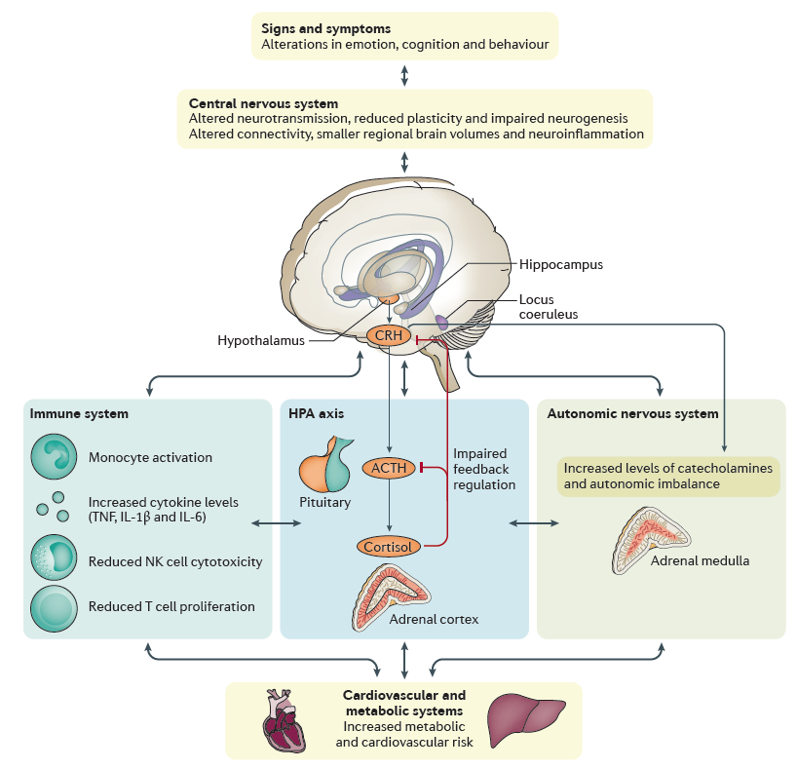
Neurobiology
HPA axis
↑ corticotropin-releasing hormone (CRH)
Excess HPA axis activity → suppressed neurogenesis and hippocampal atrophy
Immune system:
↑ inflammation
↓ immune response
Otte C, Gold SM, Penninx BW, et al. Major depressive disorder. Nat Rev Dis Primers. 2016;2:16065. Published 2016 Sep 15. doi:10.1038/nrdp.2016.65
Notes:
Hyperconnectivity within the default mode network, which may be lead to self-referential thoughts
●Hypoconnectivity within the frontoparietal network, which may lead to rumination and depressive biases towards internal thoughts
●Abnormal connectivity between different networks

Slide 15
Neural networks
Affective-salience network: guides motivation behaviors
↑ connectivity/activation of the amygdala, dorsal anterior insula in MDD
↑ salience for negative thoughts
Default mode network: guides activity in “resting states” (mental activity is directed internally)
↑ connectivity of default mode network in MDD
↑ self-rumination thoughts
Frontoparietal cognitive circuit: guides many cognitive tasks
↓ connectivity in MDD (especially in dorsolateral prefrontal cortex)
↓ goal-directed attention behaviors
Notes:
Hyperconnectivity within the default mode network, which may be lead to self-referential thoughts
●Hypoconnectivity within the frontoparietal network, which may lead to rumination and depressive biases towards internal thoughts
●Abnormal connectivity between different networks
The frontoparietal cognitive control network is engaged across many cognitive tasks103. A recent meta-analysis found evidence for frontoparietal hypoconnectivity in MDD, especially of the dorsolateral prefrontal cortex, implicating it in goal-directed attention deficits in MDD104. Moreover, decreased frontoparietal connectivity has been shown both at rest and in response to negative stimuli, but not in response to positive stimuli, suggesting that this network may contribute to inappropriate cognitive appraisals of negative events105,106.

Slide 16
Assessment & Diagnosis
3

Slide 17
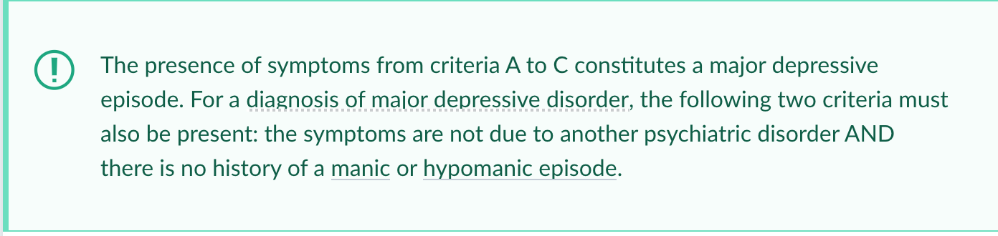
DSM-5 Diagnostic Criteria for MDD
Five or more of the following in a 2-week period:
Sleep (insomnia or hypersomnia)
Interest loss (anhedonia)
Guilt (low self-esteem, feelings of worthlessness)
Energy (fatigue or loss of energy)
Concentration (poor concentration or difficulty making decisions)
Appetite (↓ or ↑)
Psychomotor agitation or retardation
Suicidal ideation
One symptom has to be either:
Depressed mood
Anhedonia
Distress or impaired functioning
Not due to psychoactive substance, another psychiatric disorder, or another medical condition
No history of manic or hypomanic episode

Slide 18
Current Screening Tools
 | Populations | Sensitivity | Specificity | Literacy level | Time to administer
PHQ-9 | Adults | 88% | 88% | Average | <2 mins
PHQ-2 | Adults | 83% | 90% | Average | <1 min
BDI | Adults | 90% | 79% | Easy | 2-5 mins
WHO-5 | Adults | 93% | 64% | Easy | <2 mins
EPDS | Pregnant or postpartum | 81% | 78% | Easy | <2 mins
GDS-5 | Elderly (>65) | 97% | 85% | Easy | <1 min
PHQ: Patient Health Questionnaire; BDI: Beck Depression Inventory; WHO: World Health Organization Well being Index; EPDS: Edinburg Postnatal Depression Scale; GDS: Geriatric Depression Scale
Notes:
Limited evidence as to what tool is best
Follow up GDS with PHQ-9 or the 15Q GDS

Slide 19
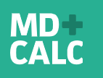

PHQ-9
How often have you been bothered by in the last two weeks?
SIG E CAPS + feeling down
Scale:
0: Not at all
1: Several days
2: More than ½ the days
3: Nearly every day
Total points: 3 x 9 = 27 points
Diagnosis: 5/27
Score | Severity | Treat?
0-4 | Minimal or none | Monitor; may not require treatment
5-9 | Mild | Use clinical judgement (duration of sx, functional impairment)
10-14 | Moderate
15-19 | Moderately severe | YES
20-27 | Severe

Slide 20
PHQ-2
During the last month, have you often been bothered by feeling down, depressed, or hopeless?
During the last month, have you often been bothered by having little interest or pleasure in doing things?

Slide 21
Specifiers
With atypical features
Mood reactivity - brightening of mood in response to positive events
2 or more are present:
↑ appetite
Hypersomnia
Leaden paralysis
Interpersonal rejection sensitivity
With psychotic features
Atypical antipsychotics
With seasonal pattern
Atypical features (weight gain, ↑ sleep)
light therapy
With anxious distress
Requires at least 2 of the following
Being tense
Unusual restlessness
Trouble concentrating secondary to worry
Fear that something awful will happen
Worry about losing self-control
With melancholic features
Despair
Depression worse in the morning
Waking up early in the morning
Weight loss
Excessive guilty thoughts

Slide 22
Labs
Thyroid function tests
R/o hypothyroidism
Urine toxicology
r/o benzo withdrawal, amphetamine use, cocaine “crash”
Neuroimaging
If structural brain disease is suspected

Slide 23
Treatment
4

Slide 24
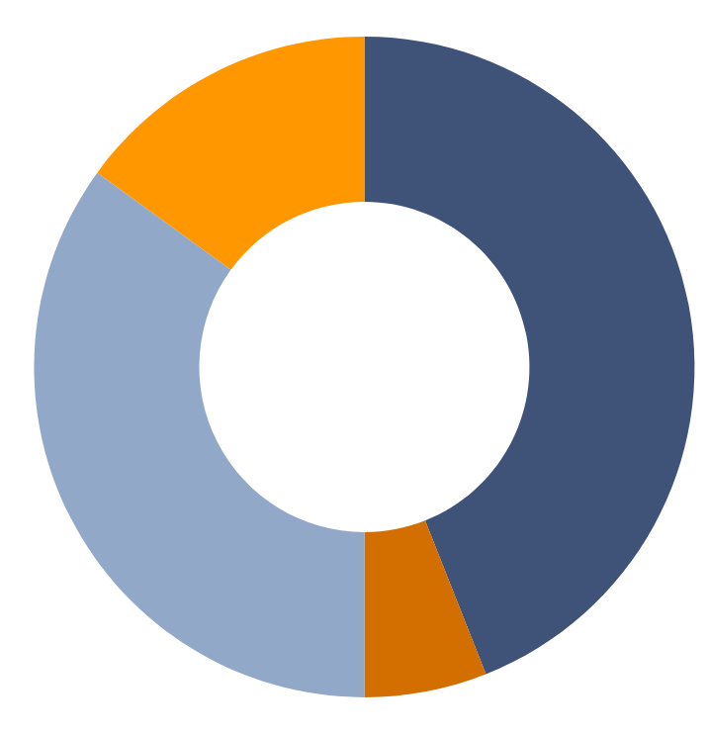
Treatment of Depression
In Adults
HEALTH PROFESSIONAL ONLY
15%
HEALTH PROFESSIONAL AND MEDICATION
44%
NO TREATMENT
35%
MEDICATION ONLY
6%
Data provided by the National Institute of Mental Health (NIMH)
Notes:
44% of those diagnosed with MDD recieve treatment with a health professional and medication
whiile 35% do not recieve any treatment

Slide 25
Therapeutic Principles
Comparable efficacy, different side effects
Require >4 weeks to take effect
Start with lowest dose & titrate up
Initial treatment: 6-12 weeks
Maintenance: if chronic (>2 years) or 3+ prior major depressive episodes/severe episodes (eg, suicide attempt) → continue for 1-3 months
Can consider next steps if there is <25% improvement in symptoms after 4-6 weeks
No MAOI + SSRI/SNRI
First line: SSRI (eg, escitalopram, sertraline)

Slide 26
Treatment Regimens
Initial Management
Combination of pharmacotherapy and psychotherapy
Clinical trials have not established the best specific medication/psychotherapy combination
Pharmocotherapy alone
More available and convenient for the patient given low adherence ot psychotherapy
Psychotherapy alone
Cognitive Behavioral Therapy (CBT)
National Institute for Health and Care Excellence (NICE) guidelines recommend psychotherapy for mild depression based on the risk benefit ratio of pharmacotherapy

Slide 27
Pharmacotherapy Options
First-generation antidepressants
Tricyclic antidepressants (TCAs)
Monoamine Oxidase Inhibitors (MAOIs)
Second-generation antidepressants
Selective Serotonin Reuptake Inhibitors (SSRIs)
Serotonin-norepinephrine Ruptake Inhibitors (SNRIs)
Atypical Antidepressants

Slide 28
Choosing an Antidepressant
SSRIs are good FIRST CHOICE based on efficacy compared with tolerability
Based on randomized trials
Reasonable alternatives such as SNRIs, atypical antidepressants, and serotonin modulators have comparable efficacies.
TCAs and MAOIs are typically NOT used as first line treatment
Adverse effects and concerns for overdose
Given the lack of a superior evidence-based treatment regimen, selecting a drug is based on:
Safety
Side Effects
Specific Depressive symptoms
Comorbidities
Potential Drug-drug Interactions
Ease of Use
Patient Preferences
Cost

Slide 29
Side Effects
Diarrhea occurs more often with sertraline
than bupropion, citalopram, fluoxetine, fluvoxamine, mirtazapine, nefazodone, paroxetine, and venlafaxine
Nausea and vomiting occurs more often with venlafaxine than SSRIs
Sexual dysfunction occurs less often with bupropion
than escitalopram, fluoxetine, paroxetine, sertraline
Somnolence occurs more often with trazadone
than bupropion, fluoxetine, mirtazapine, paroxetine, and venlafaxine
Weight gain occurs more often with mirtazapine
than fluoxetine, paroxetine, trazadone, and venlafaxine
Notes:
Diarrhea occurs more often with sertraline
>> bupropion, citalopram, fluoxetine, fluvoxamine, mirtazapine, nefazodone, paroxetine, and venlafaxine
Nausea and vomiting occurs more often with venlafaxine
>> SSRIs
Sexual dysfunction occurs less often with bupropion
<< escitalopram, fluoxetine, paroxetine, sertraline

Slide 30
Treatment-Resistant Depression
Varying definitions
Form of MDD that has not responded adequately to at least one antidepressant
Following first antidepressant drug treatmetn, 50-60% of patients do not have an adequate response.
Degree of resistance varies greatly among the patient population
Old Age
Marital Status
Duration of depressive episode
Suicide risk
Psych comorbidities
Number of hospitalizations

Slide 31
Electroconvulsive Therapy (ECT)
Most widely-used and effective non-pharmacologic biological treatment for TRD
Short anesthesia is administered and a small electric current ellicits a seizure
Neurptrophic/tropic hypothesis suggests that ECT induces neurogenesis and increased neurotrophic signaling
Increases release of dopamine, serotonin, and norepinephrine
Number of treatments
No standard number
Most remit with 6-12
Can vary from 3 to 20+
Frequency
Three times a week (MWF)
Acute course: Treatments administered weekly for 1-3 weeks
Taper or increase the interval gradually over 3 months

Slide 32
Future Advancements
Repetitive transcranial magnetic stimulation (rTMS)
Deep TMS (dTMS)
Magnetic Seizure Therapy (MST)
Transcranial Direct Current Stimulation (tDCS)
Low-field magnetic stimulation (LFMS)
Vagus Nerve Stimulation (VNS)
Deep Brain Stimulation (DBS)
Focus on the ”electrical” activity rather than chemical
Mechanisms not completely elucidated

Slide 33
Thanks!

Slide 34



References
https://oasis.state.ga.us/trendingtool/index.html?redirectto=Mortality
Greenberg PE, Fournier AA, Sisitsky T, Pike CT, Kessler RC. The economic burden of adults with major depressive disorder in the United States (2005 and 2010). J Clin Psychiatry. 2015;76(2):155–162. doi:10.4088/JCP.14m09298
Disner SG, Beevers CG, Haigh EA, Beck AT. Neural mechanisms of the cognitive model of depression. Nat Rev Neurosci. 2011;12(8):467–477. Published 2011 Jul 6. doi:10.1038/nrn3027
Otte C, Gold SM, Penninx BW, et al. Major depressive disorder. Nat Rev Dis Primers. 2016;2:16065. Published 2016 Sep 15. doi:10.1038/nrdp.2016.65
Thank you to our sponsors:

Slide 35
Evidence-based medicine
A meta-analysis of 13 randomized trials (n >15,000 patients with heart failure) compared beta blockers with placebo and found that depression occurred less often in patients who received beta blockers

