Slide 1
DEPRESSION SCREENING
Marissa D’Souza
Notes:
Going to be speaking about depression
I chose this topic because it is very personal to me.
People might feel uncomfortable speaking about it because it is so stigmatized against - and that is changing, which is good, but it’s our job to be able to have open and frank conversations about it
Underlying cause to DM, smoking, HLD? Why are people eating more, and smoking more, and not motivated to lose weight?

Slide 2
OUTLINE
Overview and statistics
Rationale for early screening
Screening tools
Recommendations

Slide 3
MAJOR DEPRESSIVE DISORDER (MDD)
Notes:
So im specifically talking about major depressive disorder
Obviously there are other types of depression, including dysthymia and bipolar depression

Slide 4
#1
Psychiatric disorder in general population
Cause of disability in the US for ages 15-44.3

Slide 5
#1
Psychiatric disorder in general population
Cause of disability in the US for ages 15-44.3

Slide 6
7%
17%
$210,500,000,000
Annual US prevalence of MDD
Lifetime prevalence of MDD
Economic burden of MDD
Notes:
Diabetes prevalence in the US in 2015 was 9.5%

Slide 7
7%
17%
$210,500,000,000
Annual US prevalence of MDD
Lifetime prevalence of MDD
Economic burden of MDD
Notes:
Something else to consider for MDD and mental health disorders in general is that those affected by these disorders severely and not being treated are less likely to fill out the surveys
So these numbers might be underestimating what the true prevalence and incidence rates and what not are
Adults and adolescents with major depressive episode may disproportionately fall into these non-response categories.

Slide 8
7%
17%
$210,500,000,000
Annual US prevalence of MDD
Lifetime prevalence of MDD
Economic burden of MDD
Notes:
210.5B = economic burden
21.5% increase from $173.2 billion per year in 2005.
What’s interesting is that a little less than half of these costs is attributed to losts costs in the workplace including not showing up and not being productive when at work
Another 45-57% due to direct medical costs (e.g., outpatient and inpatient medical services, pharmacy costs), which are shared by employers, employees, and society.
About 5% of the total expenditures are related to suicide.

Slide 9
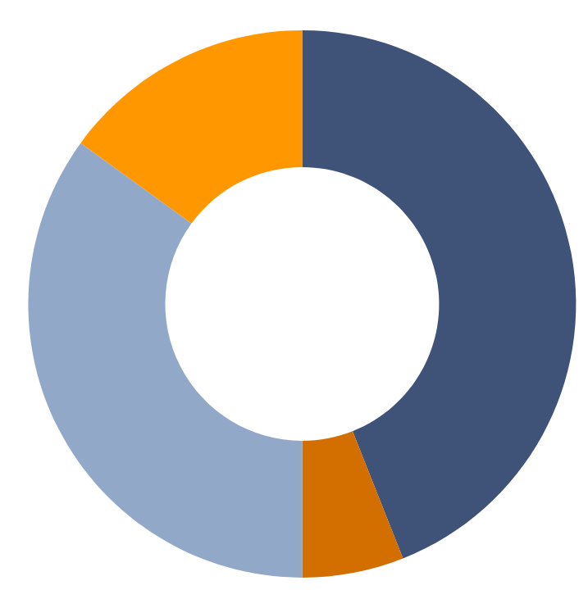
TREATMENT OF DEPRESSION
IN ADULTS
HEALTH PROFESSIONAL ONLY
15%
HEALTH PROFESSIONAL AND MEDICATION
44%
NO TREATMENT
35%
MEDICATION ONLY
6%
Data provided by the National Institute of Mental Health (NIMH)
Notes:
44% of those diagnosed with MDD recieve treatment with a health professional and medication
whiile 35% do not recieve any treatment

Slide 10
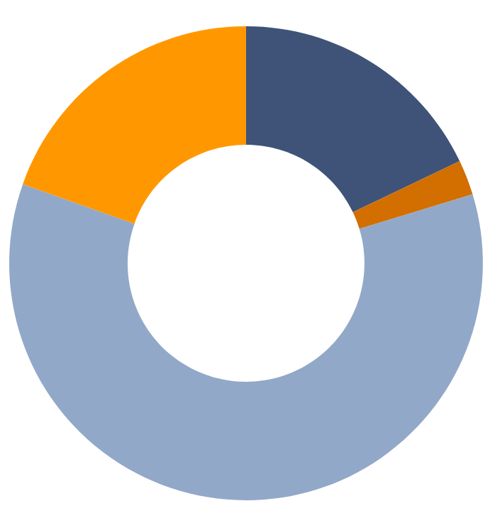
TREATMENT OF DEPRESSION
IN CHILDREN/ADOLESCENTS
HEALTH PROFESSIONAL ONLY
18%
HEALTH PROFESSIONAL AND MEDICATION
20%
MEDICATION ONLY
2%
NO TREATMENT
60%
Data provided by the National Institute of Mental Health (NIMH)
Notes:
71% severely impaired in this age group versus 64% in adults

Slide 11
RATIONALE FOR EARLY SCREENING
Difficult to detect depression
Patients present with somatic symptoms
Screening tests accurately detect identify depression in adolescents and adults
Untreated → decreased QoL, increased mortality, increased economic burden
Cost effective
Threshold of ≤$50,000 per QALY for interventions to be considered cost-effective
Studies have found screenings costs between $9,478 and $36,467 per QALY
Notes:
Only 2 RCTs have looked at screening vs no screening and they found conflicting results
Not confirmed whether screening leads to patient outcomes that outweight the potential harms of false positive test results and unnecessary treatment

Slide 12
RATIONALE FOR EARLY SCREENING
Intervention patients more likely to show significant improvement in depressive symptoms than control; improvements persist up to 5 years
Decreased clinical morbidity in adults/elderly when treated w/ antidepressants, psychotherapy, or both
Improved clinical outcome in pregnant/postpartum women when treated w/ CBT
No adverse events attributed to screening in adolescents or adults
Depression treatment more effective when started early
Notes:
Only 2 RCTs have looked at screening vs no screening and they found conflicting results
Not confirmed whether screening leads to patient outcomes that outweight the potential harms of false positive test results and unnecessary treatment

Slide 13
CURRENT SCREENING TOOLS
 | Populations | Sensitivity | Specificity | Literacy level | Time to administer
PHQ-9 | Adults | 88% | 88% | Average | <2 mins
PHQ-2 | Adults | 83% | 90% | Average | <1 min
BDI | Adults | 90% | 79% | Easy | 2-5 mins
WHO-5 | Adults | 93% | 64% | Easy | <2 mins
EPDS | Pregnant or postpartum | 81% | 78% | Easy | <2 mins
GDS-5 | Elderly (>65) | 97% | 85% | Easy | <1 min
PHQ: Patient Health Questionnaire; BDI: Beck Depression Inventory; WHO: World Health Organization Well-being Index; EPDS: Edinburg Postnatal Depression Scale; GDS: Geriatric Depression Scale
Notes:
Limited evidence as to what tool is best
Follow up GDS with PHQ-9 or the 15Q GDS

Slide 14
PHQ-2
During the last month, have you often been bothered by feeling down, depressed, or hopeless?
During the last month, have you often been bothered by having little interest or pleasure in doing things?
Notes:
Advantage: yes or no

Slide 15
WHO TO SCREEN AND WHEN TO SCREEN?
 | WHO? | HOW OFTEN?
AAFP | Adults in general population, including postpartum women (B) | ?
USPSTF | Above + adults and adolescents 12-18 y.o. (B) Screening must be implemented with adequate systems in place to ensure accurate diagnosis, effective treatment, and appropriate follow-up. Insufficient evidence: screening for depression in children 7-11 y.o. or for suicide risk in the general population (C) | ?
AAP | Above + those ≥ 10 at high risk + mothers to newborns | Annually At infants 1-, 2-, 4- mo. visit
ACOG | Women in the perinatal period | At least once
USPSTF: United States Preventive Services Task Force; AAFP: American Academy of Family Practitioners; AAP: American Academy of Pediatrics
Notes:
Limited evidence as to what tool is best
There is insufficient evidence to balance the benefits and harms of depression screening in children seven to 11 years of age. There is adequate evidence that treatment with selective serotonin reuptake inhibitors, psychotherapy, or both decreases depression symptoms in adolescents. Similar evidence is lacking in children.¹⁸

Slide 16
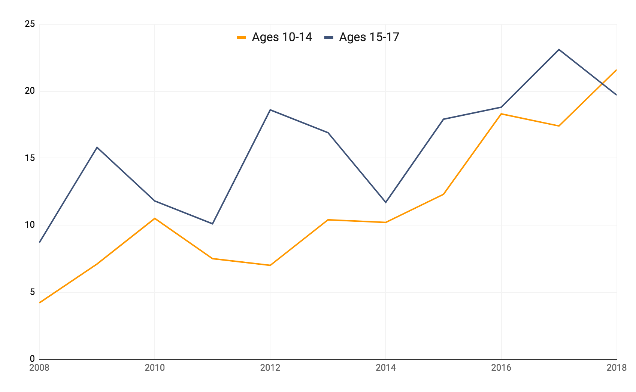
SUICIDE RATES
IN CHILDREN/ADOLESCENTS (AGES 10-17)
21.6%
19.7%
Percent of Total Deaths
8.7%
4.2%
Data provided by the Georgia Online Analytical Statistical Information System
Notes:
SUICIDE: #1 cause of death in GA for 10-14 y.o. from 2014-2018
• White males, ages 15 to 17: 11
• White females, ages 15 to 17: Seven
• Black males, ages 15 to 17: Five
• White males, ages 10 to 14: Five
• White females, age 10 to 14: Three.
• Hispanic males, ages 15 to 17: Two
• Black females, ages 10 to 14: Two
• Asian females, ages 15 and 17: One
• Black male, ages 10 to 14: One
• Hispanic male, ages 5 to 9: One

Slide 17
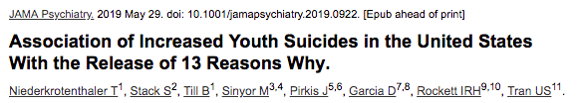

CHILDREN AND ADOLESCENTS
“High risk” children:
Personal or family history of depression, bipolar disorder, suicidality, substance use, or psychiatric illness
Significant psychosocial stressors
Frequent somatic complaints
Foster care or adopted
AAP recommends discussing safe-media use among school-aged children and adolescents

Slide 18
UP FOR DEBATE
What screening tools are best to use (for any population)?
How often should screening be done?
Do screening tests accurately identify depression in children?
Is treatment beneficial in children?
Only fluoxetine efficacious in reducing MDD symptoms in children
Is screening and/or treatment harmful to children?
Notes:
Only 2 RCTs have looked at screening vs no screening and they found conflicting results
Not confirmed whether screening leads to patient outcomes that outweight the potential harms of false positive test results and unnecessary treatment
Although SSRIs (e.g., fluoxetine) reduce MDD symptoms in children, the USPSTF concluded that only limited data are available on the benefits of psychotherapy and the benefits of psychotherapy plus SSRIs for children.

Slide 19
MY RECOMMENDATIONS
All patients ages 12+ with the PHQ-2 during routine visits
At least once a year
PHQ-A if PHQ-2 (+)
Women in perinatal period at least once
PHQ-9 or EPDS
“High-risk” children ages 10-12 in practices with adequate systems in place for accurate diagnosis, comprehensive care, and constant follow-up
Monitor responses to treatment especially carefully
Notes:
Only 2 RCTs have looked at screening vs no screening and they found conflicting results
Not confirmed whether screening leads to patient outcomes that outweight the potential harms of false positive test results and unnecessary treatment
Although SSRIs (e.g., fluoxetine) reduce MDD symptoms in children, the USPSTF concluded that only limited data are available on the benefits of psychotherapy and the benefits of psychotherapy plus SSRIs for children.

Slide 20
RESOURCES
PHQ-9 in Spanish
Adolescent Health Screening and Counseling
AAFP: Treatment of Childhood and Adolescent Depression
USPSTF: Depression Screening in Adults
USPSTF: Depression Screening in Children/Adolescents
AAP: HEADS4: Social Media Screening in Adolescent Primary Care
13 Things Pediatricians Should Know about 13 Reasons Why
NIMH: Major Depression
Anxiety and Depression Association of America | Facts and Statistics
Georgia Online Analytical Statistical Information System
Journal of Clinical Psychiatry - Economic Burden of MDD

Slide 21
QUESTIONS?

