Slide 1

R Tools for spatio-temporal ecosystem data
Michael Sumner
Australian Antarctic Division

Slide 2
Overview
R spatial-temporal tools
AAD data repository and tools
Specific issues
Extensibility of the tools
Map projections, often ignored
Prospects

Slide 3
R spatial and temporal data
Time-series gridded data (satellite oceanography, SST, sea ice, etc.)
“Vector” (GIS geometry) data – polygons, lines, points
Formats: NetCDF, shapefiles, raw binary, web services
Mapping, projections, resampling, aggregation, geometry clipping/intersections etc.
AAD tools builds on this community resource

Slide 4
AAD Data Repository
Long time-series of standard products (sea ice, chlorophyll-a, SST, surface currents/winds, ...)
GIS mapping layers (coastal boundaries, surface definitions, administrative boundaries, study transects, sample points, ...)
R AAD tools make these accessible for users (not just programmers)

Slide 5
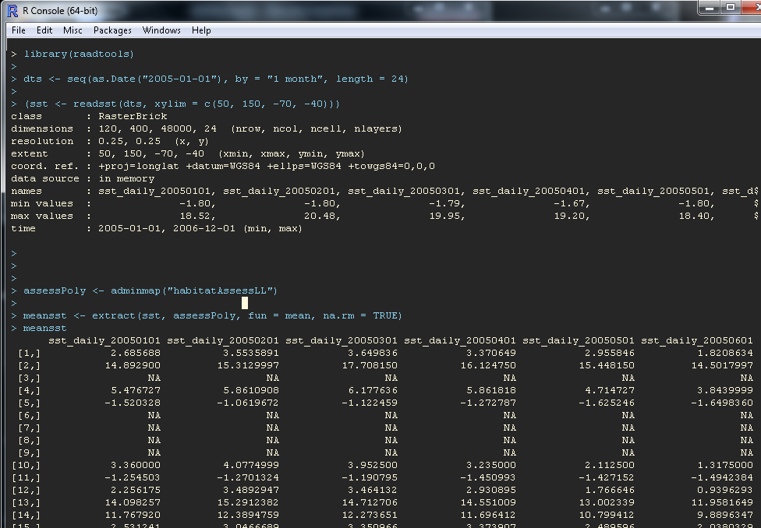

Slide 6
R AAD Tools – Guiding Principles
Work with native formats, avoid or delay unnecessary transformation, regridding, resampling
Build on consistent, metadata-rich data structures (Spatial* and Raster* classes, GDAL-linkage)
Contribute back to the R ecosystem – reduces cost of ongoing maintenance
Easy to use, easy to maintain, identify patterns of repetition for improvement
Incorporate (rescue) data from where ever

Slide 7
General methods for “extract”
Raster in R uses this a lot:
extract(grid, query, options)
raadtools provides a suite of “read[datatype]” functions with the following extract model
extract(readx, query, options)
This is very extensible, new read[x] functions can be added and the general engine already works

Slide 8
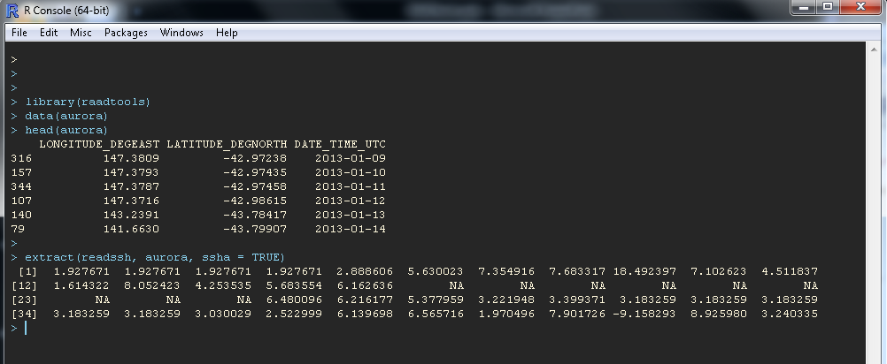

Slide 9
Difficulties
minutiae of data types (log values, units, vectors, unique map projections, curvilinear gridsma)
Patchy coverage in time / space
vector/raster reprojection has some vagaries (look out for adaptive resampling approaches)
operating system compatibilities (some things easy in Windows, hard in Linux and vice versa)

Slide 10
Aspirations
Tools provided as services
Integration with animal tracking, voyage data
Administration tools to populate / synchronize data repository outside of AAD
General institutional Database services for the tools

Slide 12
R is also pretty flexible
Sometimes the formal data tools aren’t flexible enough
Examples of custom read functions in R, to produce formal raster objects:
Read NSIDC sea ice, binary files, Polar Stereographic projection
Read AVISO surface currents (U,V), NetCDF files, Mercator projection
(Useful to customize the existing formal process which doesn’t always work, often modelling data frameworks do not marry cleanly with GIS)

Slide 13
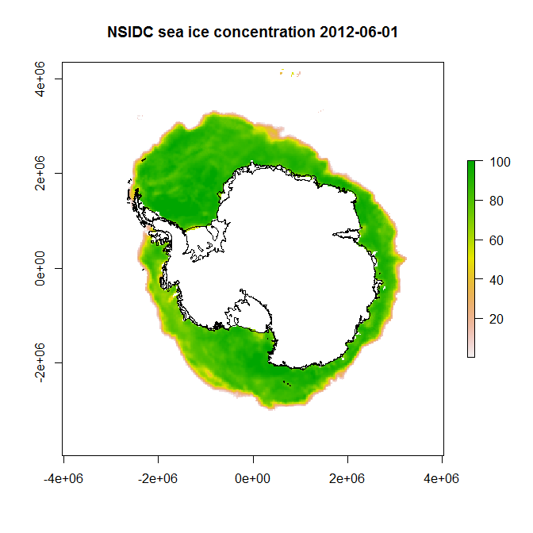

Slide 14
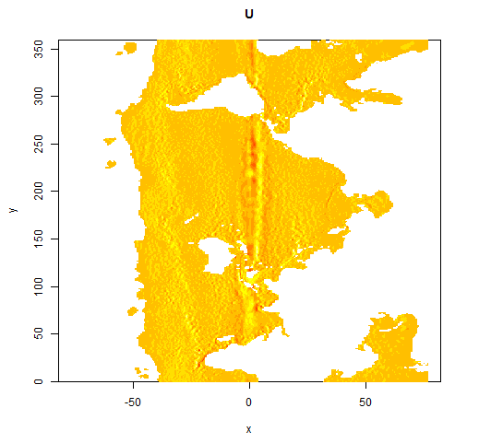
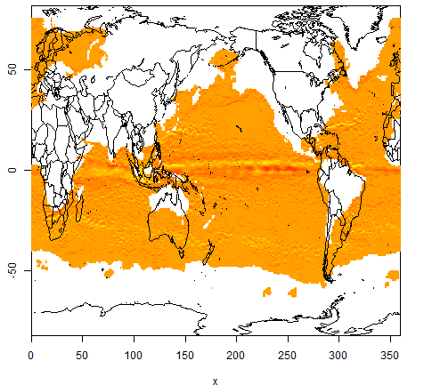
Read AVISO surface currents (U,V), NetCDF files, Mercator projection
These sort of problems can be confusing, when physical models meet GIS:

Slide 15
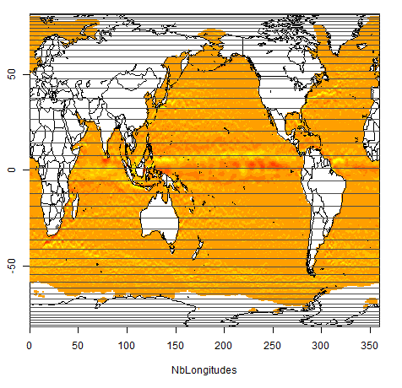
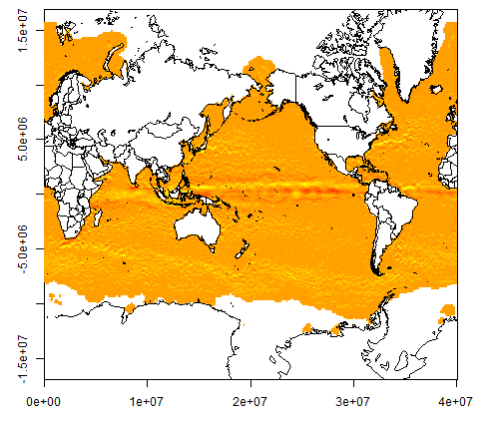
The grid is irregular in Latitude, or more simply it is the Mercator projection on WGS84 (Pacific view)

Slide 16
Identify the native projection:
Grid georeference needs only 4 transform values (offset and scale), no need for longitude/latitude arrays
Extraction of data is very simple (standard GIS tools)
Can transform points, lines, polygons to these grids with standard libraries, this is far more efficient than vice versa

Slide 17
R “Toolbox”
I’m working on R tools data input to ecosystem models:
Read gridded data in convenient form (chl-a, currents, fronts, ice, ssh, sst, wind, ...)
Read/load/derive commonly used maps: topography, coastlines, management polygons, contours, fronts, ...
Derive spatial/temporal summaries
Provide easy access to a wide variety of data, visualization,“overlay” techniques, map projections
I’m also interested in:
Spatial temporal data stored in databases (not shapefiles!)
R packages, CRAN, GitHub, literate programming with Sweave/knitr, Roxygen
Python / Pandas / SpatialLite / Javascript / D3 ☺
Animal tracking, Argos/GPS tools, light-level geo-location

