Slide 1

Shiny, R and raadtools
Michael Sumner
Australian Antarctic Division

Slide 2


Slide 3
Overview
Shiny
AAD data repository and tools
Specific issues
Extensibility of the tools
Prospects

Slide 4
Shiny
Very simple we application deployment
A website consists of:
ui.R – web page components
server.R – R code to do stuff
Various controls for R code
file chooser, input/output
sliders, specify values
dropdown menus
text entry
and more . . .

Slide 5
Shiny “hello world”
The tools are built with R functions in package “shiny”:
help.search("panel", package = "shiny")
http://rstudio.github.io/shiny/tutorial/#hello-shiny

Slide 6
Shiny server
AAD has a test shiny server:
http://147.66.192.52/shiny/
\\147.66.192.52\shiny-apps\mdsumner\
RStudio server
http://spark.rstudio.com:8787/
Deployment is easy!
make new folder, ui.R and server.R
build UI component
associate R function with that component

Slide 7
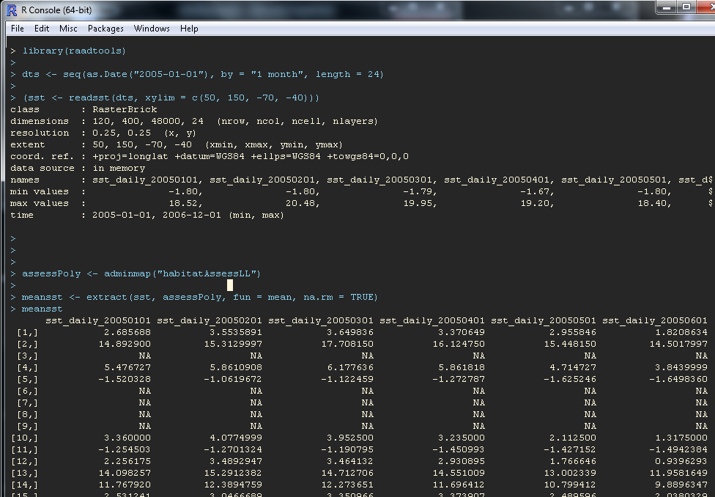

Slide 8
General methods for “extract”
Raster in R uses this a lot:
extract(grid, query, options)
raadtools provides a suite of “read[datatype]” functions with the following extract model
extract(readx, query, options)
This is very extensible, new read[x] functions can be added and the general engine already works

Slide 9
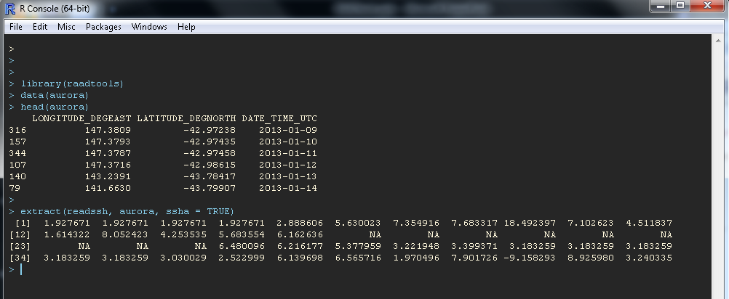

Slide 10
Aspirations
Tools provided as services
Integration with animal tracking, voyage data
Administration tools to populate / synchronize data repository outside of AAD
General institutional Database services for the tools
Shiny? http://147.66.192.52/shiny/mdsumner/attribute06/

Slide 11


Slide 13
R is also pretty flexible
Sometimes the formal data tools aren’t flexible enough
Examples of custom read functions in R, to produce formal raster objects:
Read NSIDC sea ice, binary files, Polar Stereographic projection
Read AVISO surface currents (U,V), NetCDF files, Mercator projection
(Useful to customize the existing formal process which doesn’t always work, often modelling data frameworks do not marry cleanly with GIS)

Slide 14
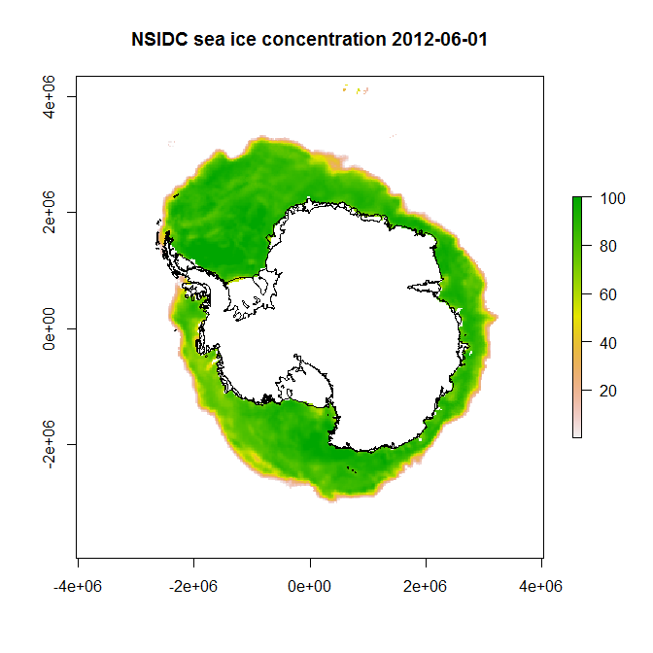

Slide 15
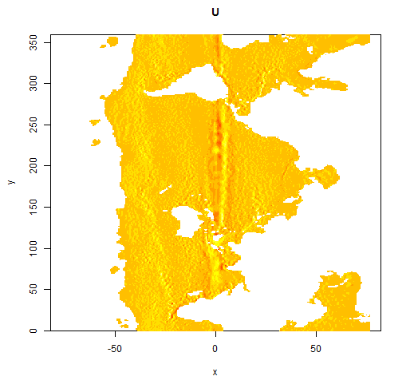
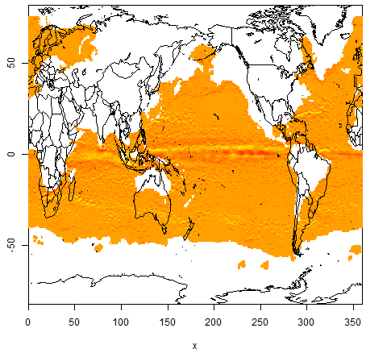
Read AVISO surface currents (U,V), NetCDF files, Mercator projection
These sort of problems can be confusing, when physical models meet GIS:

Slide 16
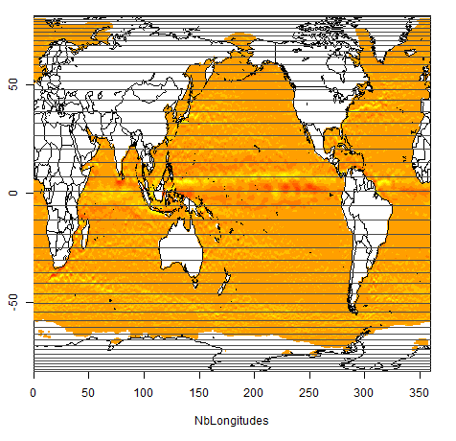
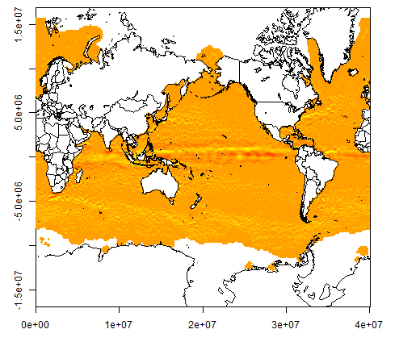
The grid is irregular in Latitude, or more simply it is the Mercator projection on WGS84 (Pacific view)

Slide 17
Identify the native projection:
Grid georeference needs only 4 transform values (offset and scale), no need for longitude/latitude arrays
Extraction of data is very simple (standard GIS tools)
Can transform points, lines, polygons to these grids with standard libraries, this is far more efficient than vice versa

Slide 18
R “Toolbox”
I’m working on R tools data input to ecosystem models:
Read gridded data in convenient form (chl-a, currents, fronts, ice, ssh, sst, wind, ...)
Read/load/derive commonly used maps: topography, coastlines, management polygons, contours, fronts, ...
Derive spatial/temporal summaries
Provide easy access to a wide variety of data, visualization,“overlay” techniques, map projections
I’m also interested in:
Spatial temporal data stored in databases (not shapefiles!)
R packages, CRAN, GitHub, literate programming with Sweave/knitr, Roxygen
Python / Pandas / SpatialLite / Javascript / D3 ☺
Animal tracking, Argos/GPS tools, light-level geo-location

