Slide 1
Modern data accessibility
and virtualization
Cloud native: Zarr, chunks and virtualization
in Python, GDAL, and R
Michael Sumner · Australian Antarctic Division
Notes:
what Zarr is, why chunks matter, and the work bridging everything-was-Python to R and GDAL. Start by saying: most of our data lives in HDF5/NetCDF files on disk or in the cloud. Zarr is the evolution of that idea.

Slide 2
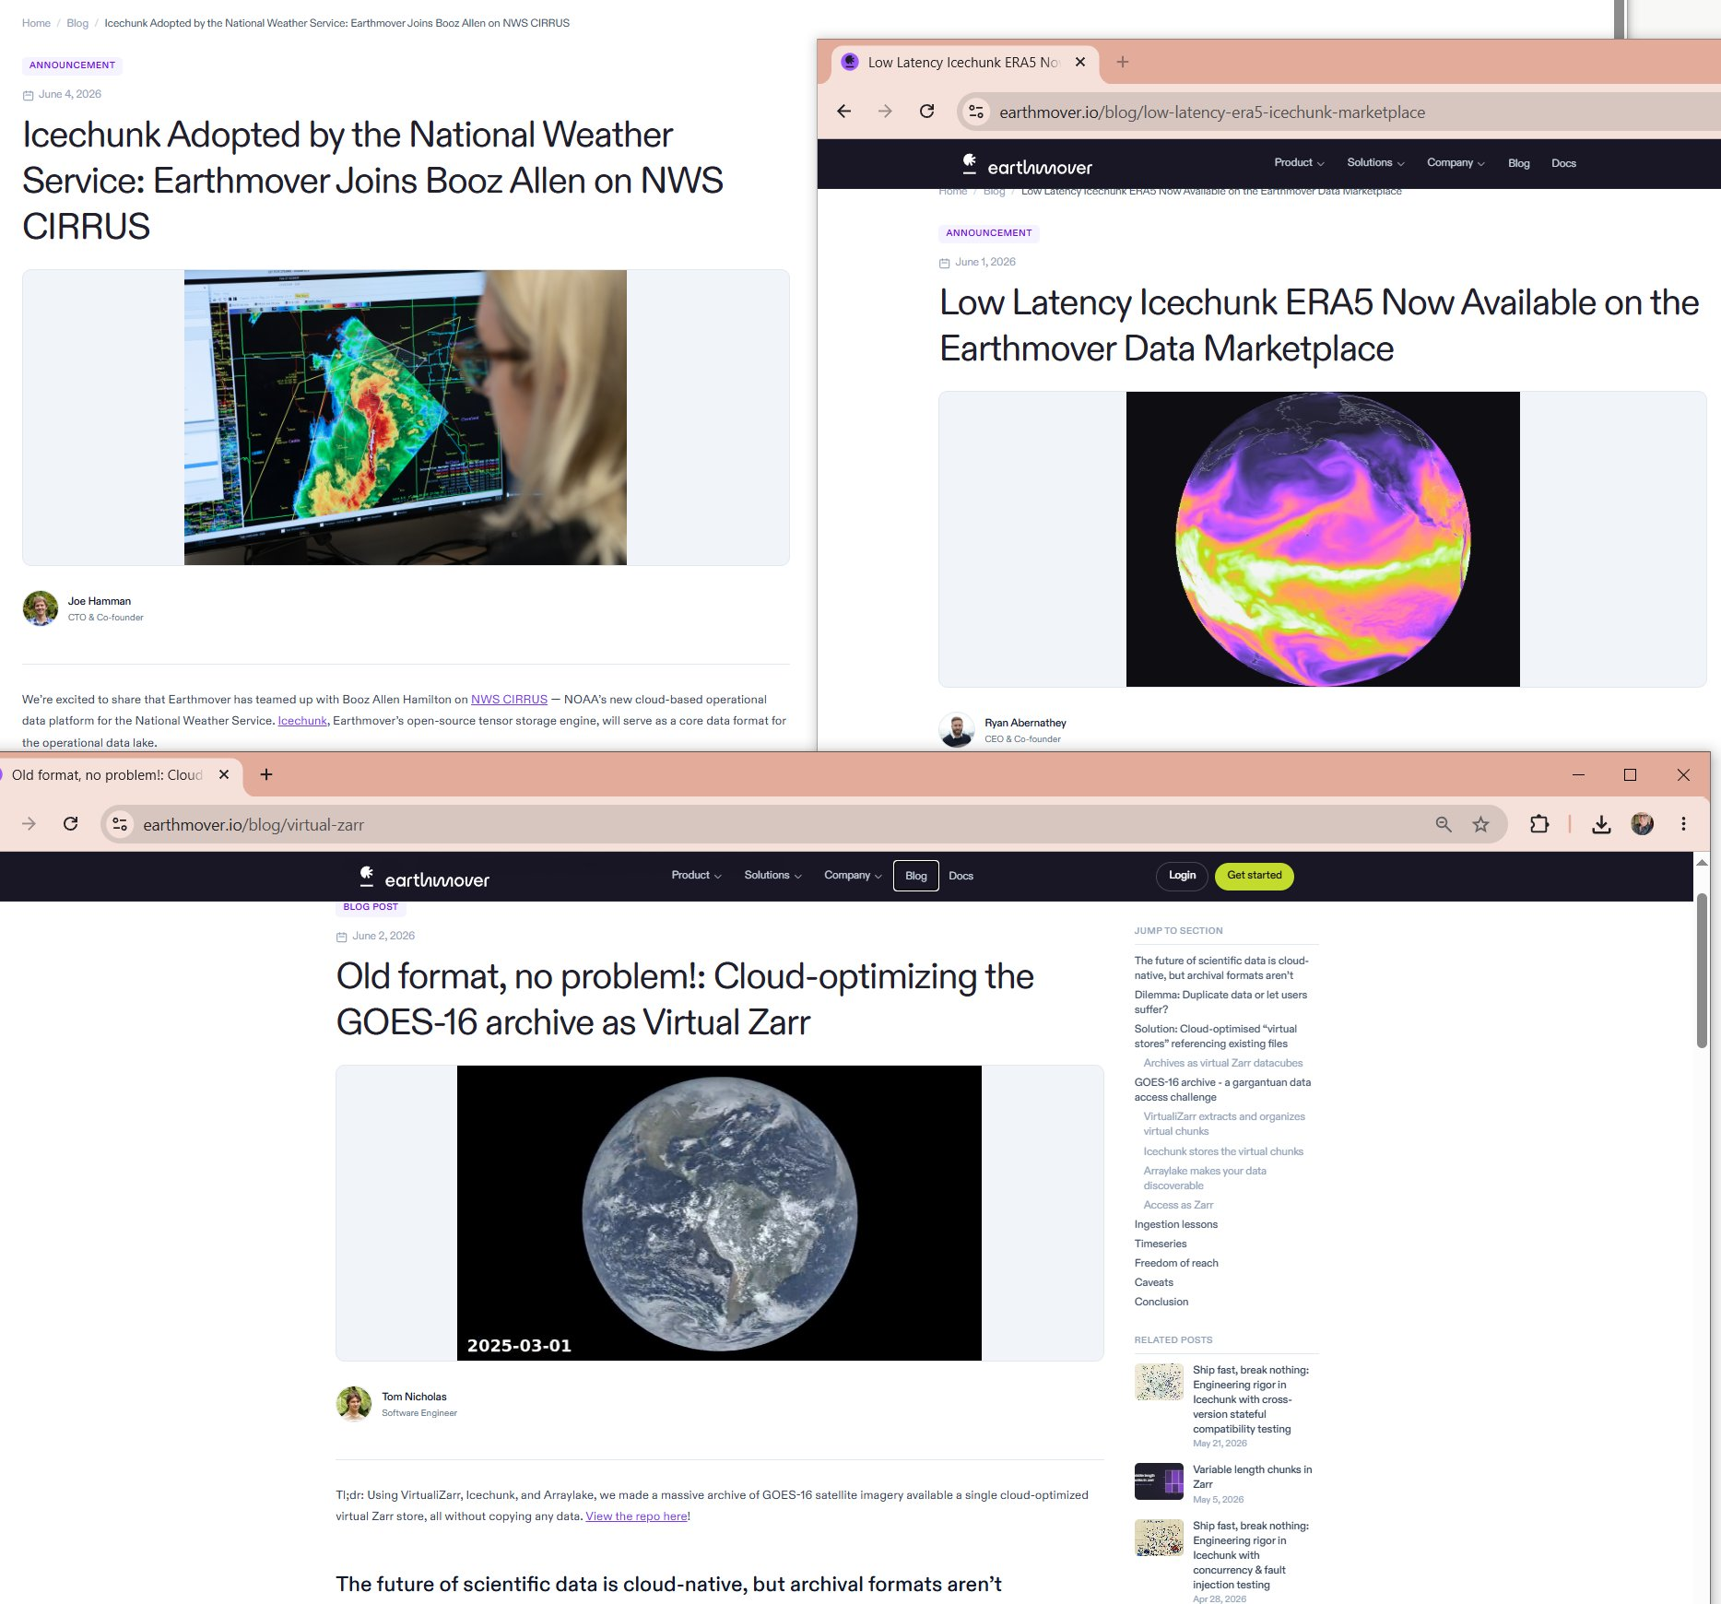
June 2026 — the Zarr ecosystem is moving fast
earthmover.io
Notes:
three headlines from the past two weeks. NWS CIRRUS: Icechunk adopted as core format for US national weather service operational data. Low Latency ERA5: global reanalysis on the Earthmover marketplace. 'Old format, no problem': GOES-16 archive virtualized as Virtual Zarr without copying data. This is the momentum. Zarr and Icechunk are consolidating into production infrastructure — and almost all of it assumes you're running Python.

Slide 3
What is Zarr?
time →
Chunked, compressed, N-dimensional arrays
Each array is split into rectangular chunks — small tiles stored as independent files/objects
Reads only fetch the chunks you touch → no full-file download
Each chunk is compressed, opaque bytes — meaningless without the metadata
Works online
s3:// gs:// http:// /vsicurl
Metadata stored separately (.zarray) — describes shape, chunk shape, compression details
✓
✓
✓
✓
↑ depth
Notes:
Zarr is the modern format for multi-dimensional scientific arrays. The key idea: instead of one monolithic file, data is split into chunks — independent tiles. A query for one time-step of one depth range fetches only 2-3 chunks, not the whole archive. This is why it works so well on cloud object stores.

Slide 4
VZarr: virtualization at the chunk level
HDF5 / NetCDF
Kerchunk / Parquet refs
Virtual Zarr store
chunk 0,0
chunk
path
offset
size
xarray / zarr-python
see native Zarr
No data moved.
No copy made.
Data stays in
original files.
0,0
data.nc
4096
8192
chunk 0,1
→
0,1
data.nc
12288
8192
→
chunk 1,0
byte offset
+ size
1,0
data.nc
20480
8192
looks like
Zarr
chunk 1,1
…
…
…
…
…
a reference is just (path, byte-offset, byte-length)
Notes:
Virtualization means building an index of where each chunk lives — its file path, byte offset, and size. The original HDF5/NetCDF files stay untouched. We build a Parquet table of references. Tools like xarray, zarr-python then read this as if it were a native Zarr store. This is the kerchunk / VirtualiZarr approach. blocklist does this from R using GDAL + rhdf5.

Slide 5
VRT: virtualization at the file level
Original
HDF5 files
GDAL VRT
kerchunk
Parquet refs
Zarr store
→
→
→
fully material
file-level virtual
chunk-level virtual
virtual or material
A GDAL VRT is an XML recipe — mosaic
16 years of NetCDF into one logical array,
without copying data.
…looks a lot like
xarray → logical array
VirtualiZarr / kerchunk → refs
a pivot point — GDAL already knows where every subfile chunk lives. virtualization is another step:
xarray + Icechunk → user access
gdal mdim mosaic
→ VRT over all files
Same outcome:
Virtual Zarr stores readable by Python, R, and GDAL
rhdf5 chunk iter
→ byte offset + size per chunk
Parquet refs
→ VirtualiZarr/Icechunk-compatible store
Notes:
The VRT is the key idea that makes blocklist possible. gdal mdim mosaic builds a single virtual array over all HDF5 files (e.g., 16 years of BRAN2023 daily ocean data). rhdf5 then iterates over the physical HDF5 chunks to get byte offsets. These are joined to give chunk references that xarray/zarr-python can use as a native Zarr store. Importantly, VRT allows intermediate forms — you're not forced to go all the way to full virtualization.

Slide 6
Multi-language support
Python-centric
R and GDAL
Kerchunk / DMRpp — original reference builders
VirtualiZarr — modern, Xarray-native virtualization
Icechunk — transaction-robust, version-able Zarr
powered by Rust
One pathway: run Python, use xarray
gdal mdim get-refs — new GDAL CLI subcommand
extracting chunk refs to Parquet/GPKG
GDAL + Icechunk — on the radar:
/vsiicechunk/ VSI handler
gdalraster — R GDAL package + multidim
pizzarr — R Zarr package (Icechunk-enabled)
zaro — pure-R Zarr reader via Arrow FS
Not just Python
Notes:
The Python ecosystem built kerchunk and VirtualiZarr, which are excellent. But Icechunk — the next-generation transactional store — is heavily Python/Rust-native and narrows interoperability. blocklist, zaro, and the new gdal mdim get-refs CLI subcommand bring this workflow to R and GDAL. Concrete result: BRAN2023 ocean reanalysis — 11 variables, 16 years of daily data — is now virtualized on Pawsey Acacia and accessible from R without downloading anything.

Slide 7
What this enables
📦 No data movement
⚡ Partial reads
Data in original files, access by reference within urls
Fetch only the chunks needed from existing files in a single store.
🌊 BRAN2023
4D ocean model · 11 vars · ~6.5 TB/var · ~70 TB total
🔗 Interoperable
🌡️ GHRSST
Sea surface temp · daily L4 · ~2 TB/variable
Same store accessed by Python (xarray/zarr), R (pizzarr, zaro), or GDAL (Python, R, QGIS, cli).
🧊 SEA ICE
NSIDC (25km) + AMSR2 (3.125km) · daily 1978–now · ~20 GB
🏗️ Intermediate forms
✓ Altimetry
Already native Zarr · CMEMS
VRT is *intermediate* between array files and a virtual store, a text-based lazy-xarray
github.com/mdsumner · hypertidy.org · blocklist / zaro / gdalraster
Notes:
Left column: no data movement — data stays where it lives. The four stores we're actually working with: BRAN2023 ocean reanalysis (done), GHRSST SST (in progress), NSIDC-0803 sea ice, and altimetry which is already native Zarr. Right column: partial reads — fetch only what you need; interoperable — same reference files work in Python, R, and GDAL; intermediate forms — VRT means you don't have to go all the way to full virtualization.

Slide 8
digital integration working group
how we compute in science
laptops · servers · Nectar · HPC (Pawsey / NCI) · EC2 · Docker · AADC
data access and delivery
connection of data access to monitoring and paths to impact
Michael Sumner
Research Software Engineer, IDEA
(-> Terrestrial and Nearshore Biodiversity and Conservation program)
github.com/mdsumner · hypertidy.org
Notes:
diversity of computing environments at AAD means no single tool or pipeline fits everyone.

