Slide 1
THE QUESTION
Companies are buying intelligence with no meter on the wall.
We meter electricity, water, and cloud servers down to the unit. AI work? No gauge, no unit, no line on the budget.
So — what would it even mean to put a number on it?
Managing Intelligence · Experiment 1
Notes:
We meter everything we buy — power, water, cloud. AI work is the first big purchase with no gauge on it. This deck asks whether you can actually put it on a budget.

Slide 2
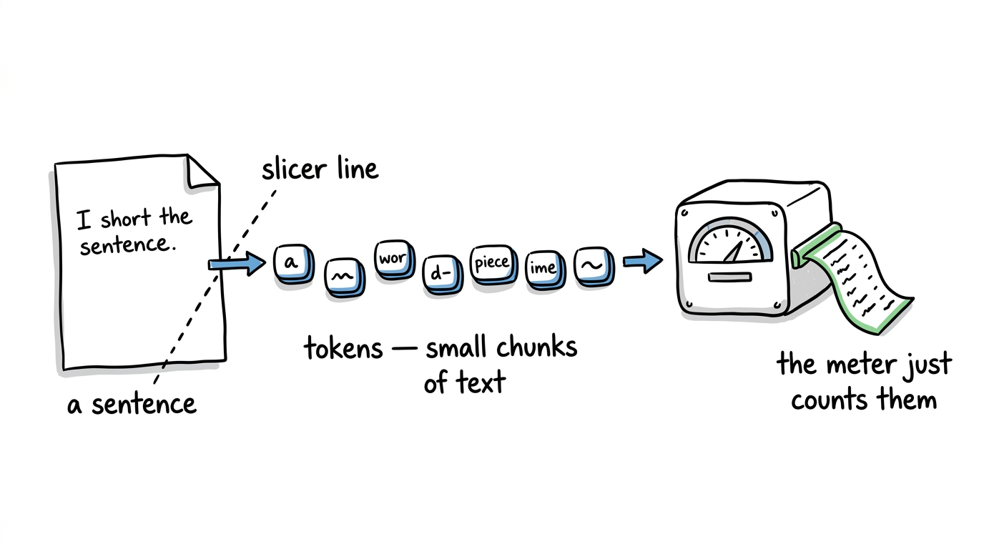
15-SECOND EXPLAINER
What's a token?
A token is a small chunk of text — about a short word, or a piece of one — that an AI reads or writes. It's the unit the work is sold in.
ANALOGY — not the data
AI work is metered in tokens the way electricity is metered in kilowatt-hours.
You pay per unit — per token in, per token out. The meter just counts units.
Notes:
Fifteen seconds. A token is a small chunk of text. AI work is sold by the token, in and out — the way power is sold by the kilowatt-hour. That's the whole unit of this talk.

Slide 3
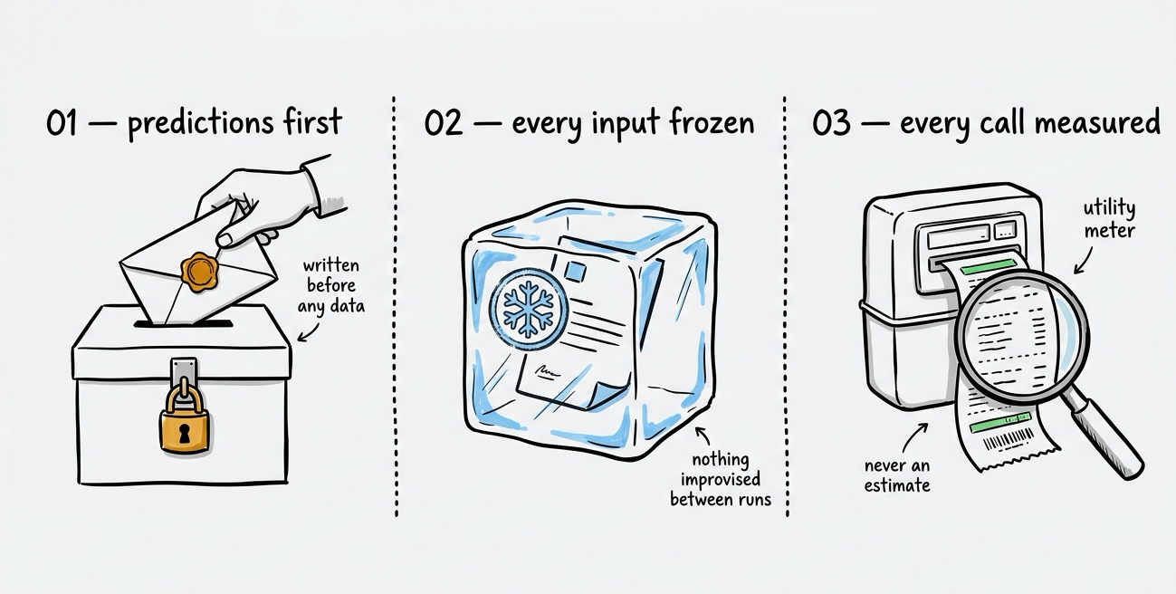
METHOD
We ran it like a lab, not a demo.
Notes:
This wasn't a demo. Three disciplines: we wrote our predictions down first, we froze every input, and we read the real meter on every call instead of estimating.

Slide 4
FINDING 01
The same task costs about the same, every time.
Run one everyday task 20 times and the bill barely moves. 62 of 67 task setups — a task, at a size, on a model — landed in a tight, budgetable band.
4.5%
typical run-to-run wobble — the middle of the pack, across 20 runs
62 setups — budgetable
5 — meter these instead
Scope: single-shot office tasks — not long agent runs. Those are the next experiment.
ANALOGY
Like a monthly utility bill — steady enough to plan around.
Budget this
Notes:
Run one everyday task 20 times and the bill barely moves. 62 of 67 tasks landed in a tight band; the middle task wobbled just 4.5% run to run. That's budgetable.

Slide 5
THE LIMIT
Some tasks you can only meter.
The bill wobbles more the more freedom the AI has over how much it writes. Pinned tasks (i.e. translating, sorting) barely move. Open-ended thinking (i.e. strategy, deep analysis) is the wild card.
Run-to-run wobble, by how much the AI writes
And it isn't the model's fault.
Translate, sort
~0.5%
4.8%
3.9%
4.6%
Everyday tasks
4.5%
Haiku
Sonnet
Opus
Open-ended thinking
15% – 20%
Typical wobble, run to run is flat across tiers. No slot-machine model to blame.
under 15% — budget it
past ~20% — meter it
ANALOGY
Like fuel economy — steady on the highway, all over the place in stop-and-go traffic.
Meter this
Notes:
Not everything is budgetable. The bill wobbles more the more freedom the AI has over how much it writes — pinned tasks barely move, open-ended thinking is the wild card that can swing up to 20%. And you can't blame the model: across Haiku, Sonnet, and Opus the typical wobble is about the same.

Slide 6
FINDING 02
24 / 24
Instructions come with a price tag you can read in advance.
predictions, all correct
We called the direction of the effect — cheaper or dearer — before running a single task , for every task on every model.
Templates that cap output → every task got cheaper
Templates that demand more → every task got dearer
Marketing copy
−57.4% to −71.6%
Spec draft
+79.4% to +738.0%
Field extraction
−48.6% to −53.7%
Strategy brief
+85.5% to +414.0%
Email reply
−39.6% to −52.1%
Decision memo
+12.1% to +137.4%
Meeting recap
−39.8% to −49.9%
Status report
+17.1% to +52.4%
ANALOGY
Like a meal-prep plan — portion the recipe and you know the grocery bill before you shop.
Notes:
Instructions carry a price you can call in advance. Templates that cap output made every task cheaper; templates that demand more made every task dearer. 24 predictions, 24 hits — every task on every model.

Slide 7
FINDING 03
Structure beats pep talks.
Telling the AI to "do genuinely good work" bought almost no consistency. Giving it an actual template bought nearly all of it.
"Pep talk"
Template
In 15 of 17 tasks measured, the pep talk delivered less than a third of the template's consistency.
essentially none (median −2.6%)
nearly all of it (the full tightening)
Bars: share of the template's run-to-run consistency each approach reproduced. The template is the reference.
Notes:
Telling the AI to be careful and thorough bought almost no consistency. Giving it an actual template bought nearly all of it. Structure, not vibes.

Slide 8
THE CATCH
But structure isn't a free upgrade.
We took one task and tightened it on purpose — then handed a budget model and a premium model the very same template.
What the template bought the budget model
What it didn't buy: quality
✓
Cheaper — 65% fewer tokens on short copy
12 – 1
graded blind, head-to-head by a first AI judge — a sibling of the premium model — the premium model's writing still won on short copy
✓
Steadier — 64% less run-to-run wobble
On long-form work, the budget model could hold the template just 5% of the time.
Structure buys consistency — not capability. And that head-to-head grade came from an AI judge. So — can you trust an AI to grade AI?
Notes:
We took one task and tightened it on purpose, then gave a budget model and a premium model the very same template. It made the budget model cheaper and far steadier — but head-to-head, the premium model's writing was still preferred 12 to 1 on short copy. Structure buys consistency, not capability. And note who did that grading: an AI judge.

Slide 9
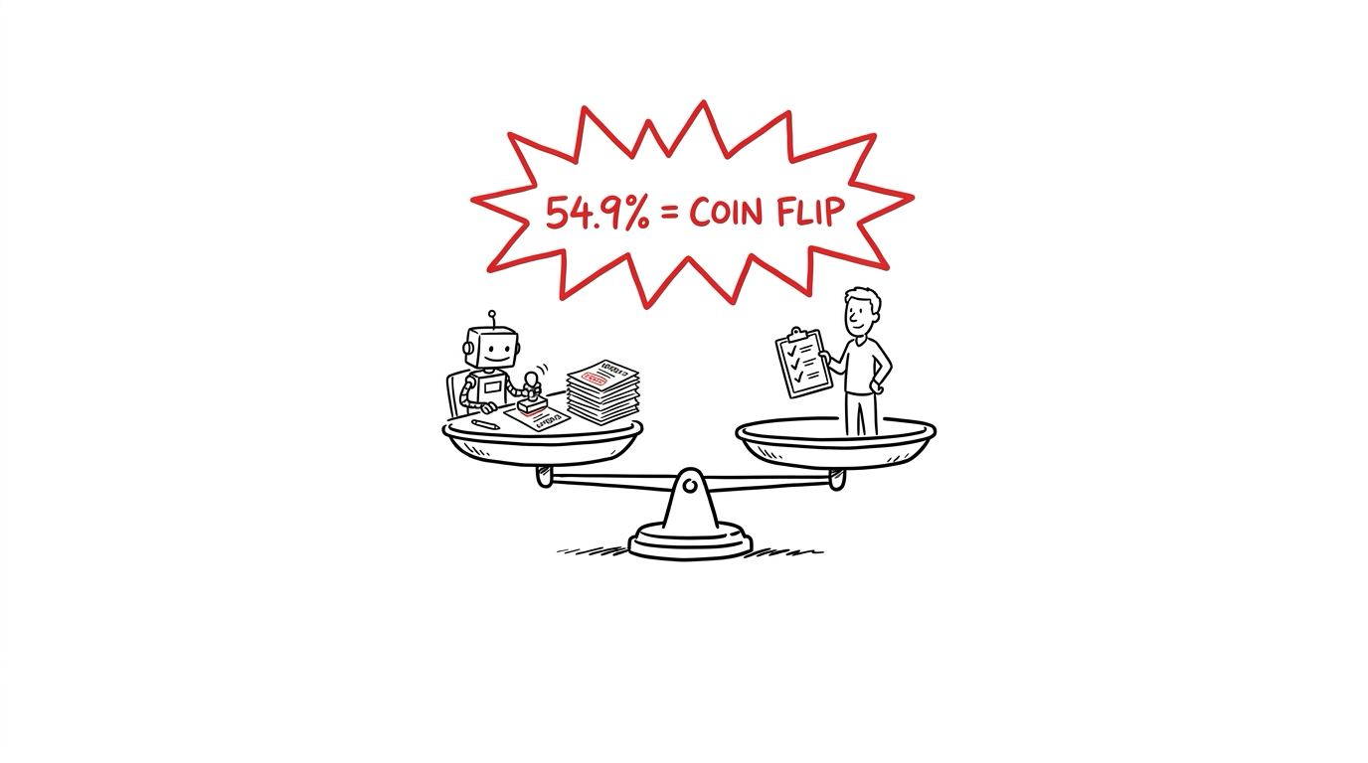
THE TWIST
We hired an AI to grade the AI's work.
It was confident, consistent, and unanimous with itself — and it agreed with the human owner 54.9% of the time.
Notes:
The twist. We hired an AI to grade the AI's work. It was confident, consistent, and unanimous with itself — and it agreed with the human owner 54.9 percent of the time. A coin flip.

Slide 10
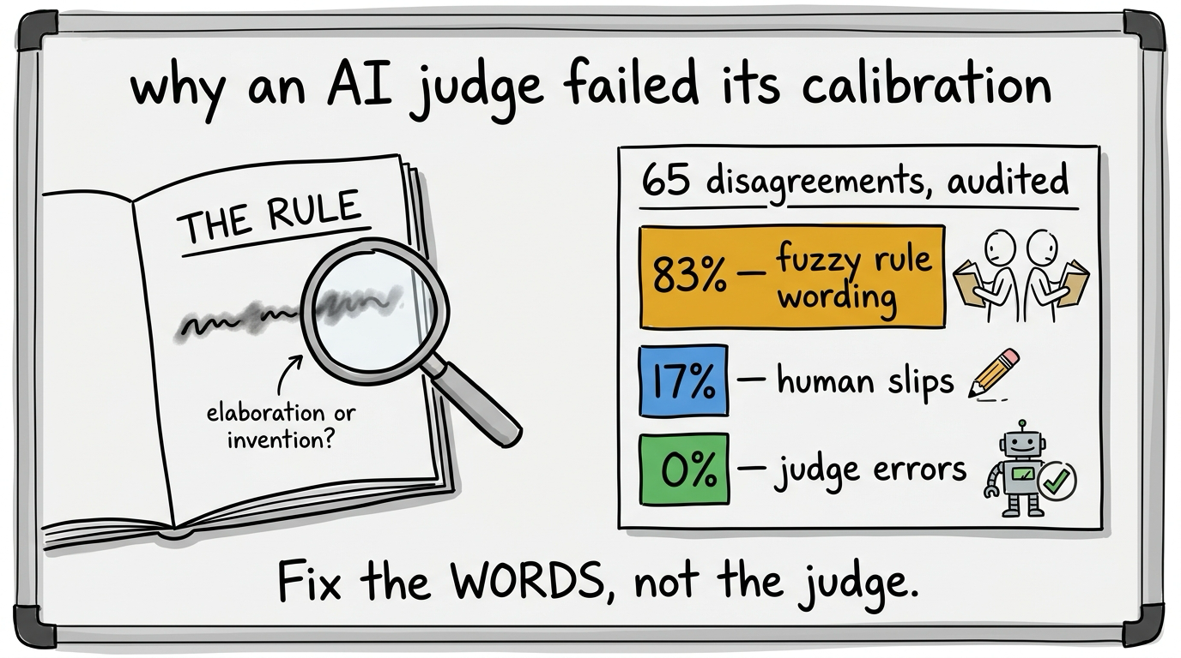
THE POST-MORTEM
The judge wasn't bad — the rules were fuzzy.
We audited all 65 disagreements. 83% traced to rule-wording two careful readers could each read differently.
And 0% were the judge misapplying its instructions. The problem was the words, not the reader.
Notes:
Not a bad judge — fuzzy rules. We audited all 65 disagreements. 83 percent traced to rule-wording two careful readers could each read differently. Zero were the judge misapplying its instructions. Fix the words.

Slide 11
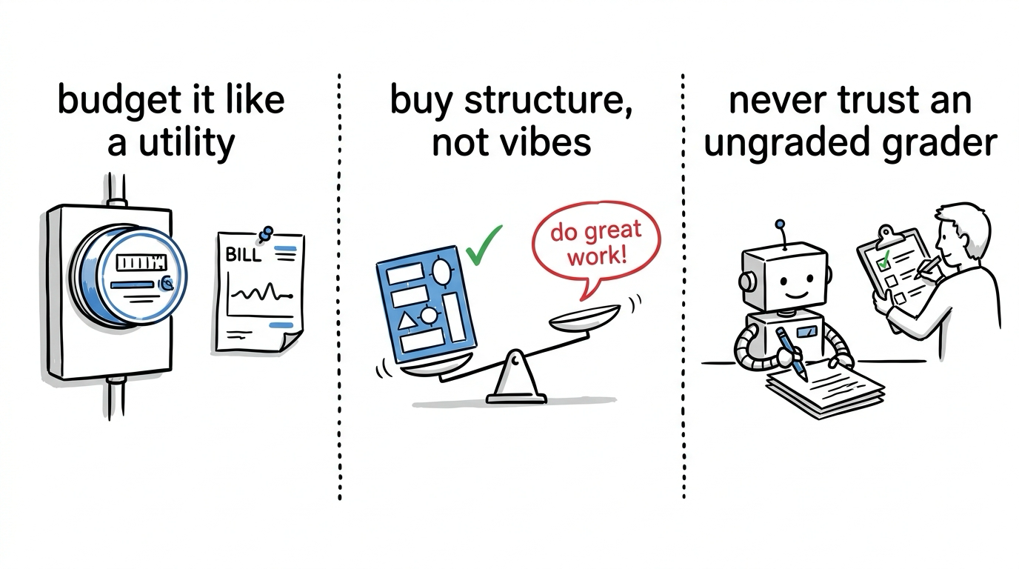
WHAT TO TAKE AWAY
Three rules for anyone buying AI.
Most everyday tasks cost a steady, plannable amount, run to run.
Templates change both cost and consistency. Pep talks don't.
An AI judge can be confident, consistent, and still wrong. Check it against a person.
Notes:
Three rules for anyone buying AI. Budget it like a utility. Buy structure, not vibes. And never trust an ungraded grader.

Slide 12
THE PRICE OF THE ANSWER
What it cost to find all this out.
The decisive experiment — the one behind findings 2 and 3 and the twist — ran on ≈$49 of a $100 self-imposed ceiling.
≈$212
0.3%
of API spend — the entire program, read off the providers' own billing meters.
how far our number sat from the providers' own meters. Measured, not estimated — right down to the receipt.
Notes:
The whole program ran on about 212 dollars of API spend, read straight off the providers' own billing meters — 190.34 dollars to Anthropic plus 21.18 to the judge. The decisive experiment — the one behind findings 2 and 3 and the twist — was about 49 dollars of a 100-dollar ceiling. And harness and provider meters agreed to within 0.3 percent.

Slide 13
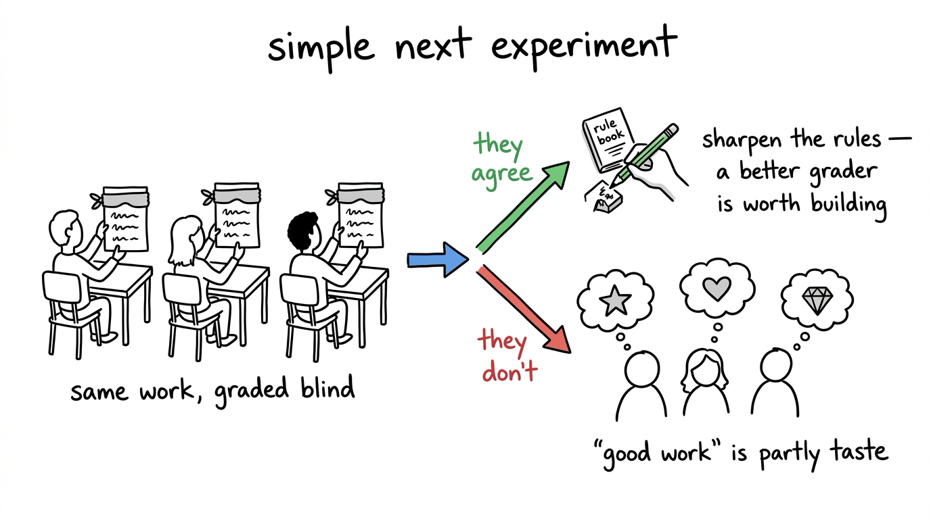
WHAT'S NEXT
Fixable rules, or genuine taste?
The test is simple: have two or three people grade the same work, blind, and see whether they agree with each other.
Notes:
What's next: can the fuzzy rules be sharpened, or is good work genuinely in the eye of the beholder? The test is simple — have two or three people grade the same work, blind, and see whether they agree.

Slide 14
SEE IT YOURSELF
Every number is public — and re-checkable.
github.com/mdsweatt/managing-intelligence-experiments
All data and analysis are open. Every figure in this deck re-derives from the raw records — no AI account required.
Notes:
Everything is public. All data and analysis are open, and every number in this deck re-derives from the raw records — no AI account required.

Slide 15
APPENDIX
Where every number comes from.
Same task, same cost
62 of 67 task setups in a tight band; median wobble 4.5% (20 runs each)
docs/phase1a-report.md · analysis/output/h1_cov.csv
Some tasks you can only meter
open-ended thinking ~15%–20%; model medians 4.8% / 3.9% / 4.6% (Haiku / Sonnet / Opus)
docs/phase1a-report.md · analysis/output/h1_cov.csv
Price of instructions
24 of 24; caps −40% to −72%, mandates +12% to +738%
analysis/output/phase1d/h7_sign.csv · docs/phase1d-report.md
Structure beats pep talks
pep talk reproduced a median −2.6% of the tightening; 15 of 17 under a third
analysis/output/phase1d/h8_neutral.csv · docs/phase1d-report.md
Structure isn't a free upgrade
template cut short-copy tokens 65% and wobble 64%; premium model still preferred 12–1; budget model held long-form 5%
docs/phase1c-report.md
The AI judge
54.9% agreement with the human owner, across 144 graded items
docs/phase1d-report.md
Why the judge failed
65 disagreements: 83% rule-wording, 17% human slips, 0% judge error
docs/phase1d-report.md
What it cost
program total $211.52 — Anthropic $190.34 + judge $21.18, read off the providers' billing meters (2026-06-18 → 07-05); the final experiment ≈$49 of a $100 ceiling; harness and provider meters agreed to 0.3%
analysis/output/phase1d-judge-run-note.md · provider billing export (Console)
Full source: github.com/mdsweatt/managing-intelligence-experiments (public release v1.0)
Notes:
Appendix. Where every number in the deck comes from, mapped to its source file in the pack.

