Slide 1

Employee Management System

Slide 2


Prepared By
1. Md. Tahmidul Huque (19202103158)
2. Jafreen Jafor Godhuli 19202103227)
3. Rajiur Rahman Pushon (19202103214)
4. Fabia Zaman Ekah (19202103225)
5. Ehtashamul Haque (19202103130)
Supervised By
TM Amir Ul Haque Bhuiyan
Assistant Professor
Department of Computer Science and Engineering
Bangladesh University of Business & Technology

Slide 3
Table of Content
Introduction
Features of project
System Requirement
Problem Statement
Diagram
Outcomes
Future Work

Slide 4

Introduction
Manual system needs lot of time, manpower etc. But being a web based application, it’s very easy to maintain the accuracy.
Data and records are stored in database.
Information can be viewed in real.
Reduces searching time.
Reduces the complexity of employee management.

Slide 5
Features Of The Project
Admin Panel:
Login System
View details
Add records
Assign Project
Project Status
Manage Salary
Manage Leave Application
User Panel:
Login System
View details
My Projects
View salary
Apply for leave

Slide 6

System Requirements
Hardware Requirements:
Memory minimum of 4GB RAM
Operating System: Windows 10 64Bit
Hard disk of 30 GB
Monitor
Mouse
Keyboard
Software Requirements:
Visual Studio Code
XAMPP
Language:
PHP
CSS, JScript

Slide 7
Problem Statement
Need Faster Computer for Start Project
Inconsistency in data entry, room for errors
Duplication of data entry
System is dependent on good individuals
Lack of security of data

Slide 8
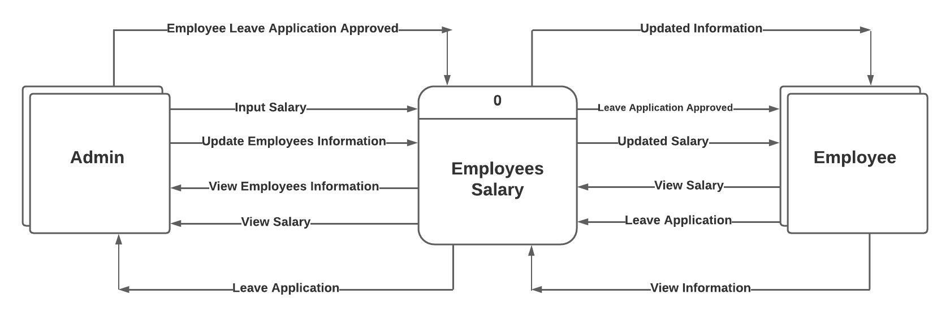
Diagram
Data Flow Diagram:
Management
System

Slide 9
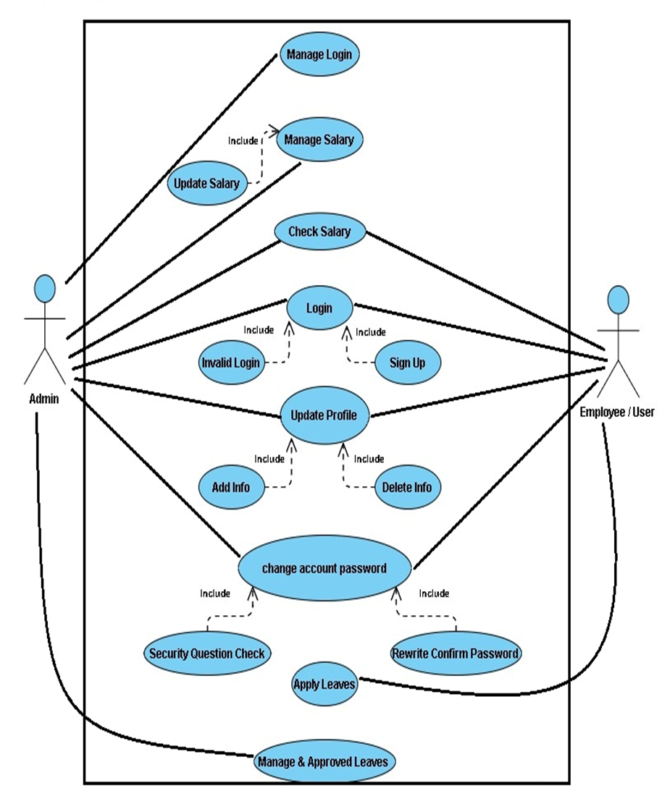
Diagram
Use Case Diagram:

Slide 10
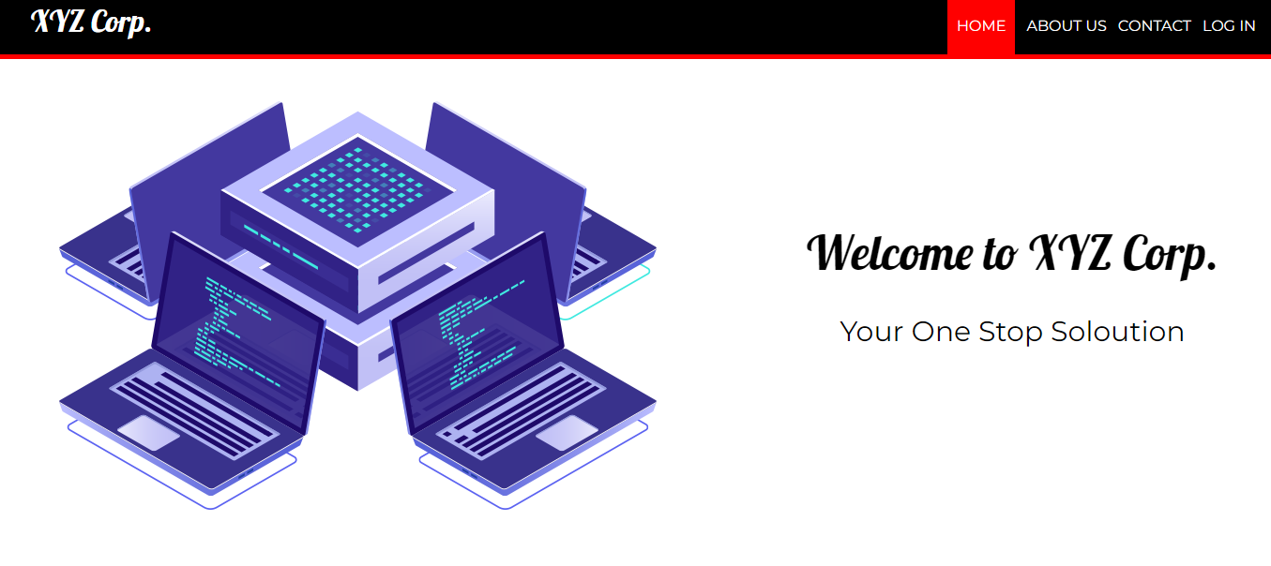
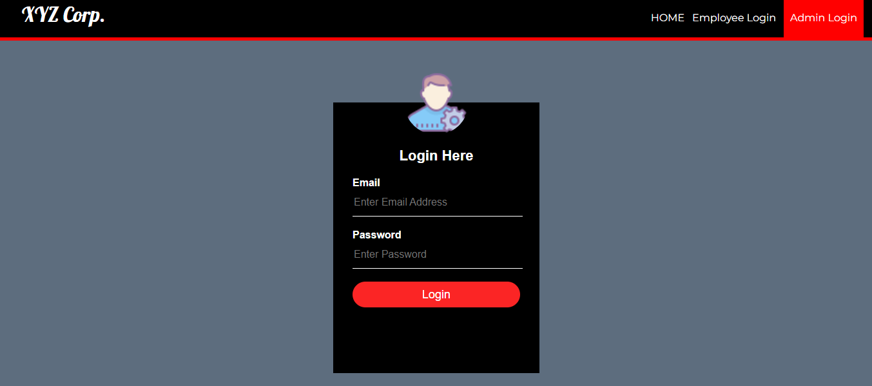
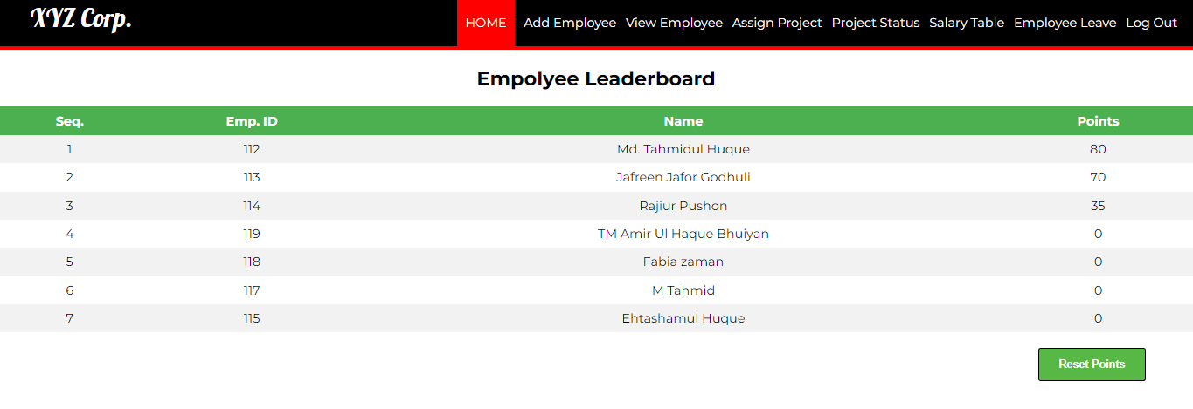
Outcome
Index: This is the first interface of the system
Admin login: This is the admin login page
Admin dashboard: This is the admin dashboard where all module under admin panel is shown.

Slide 11
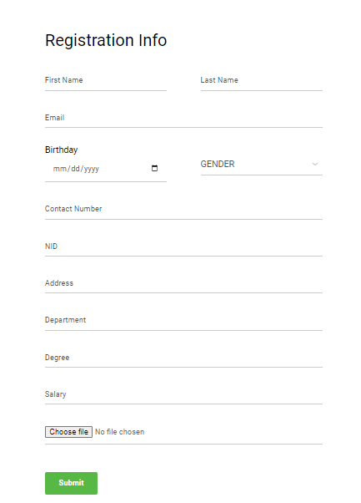
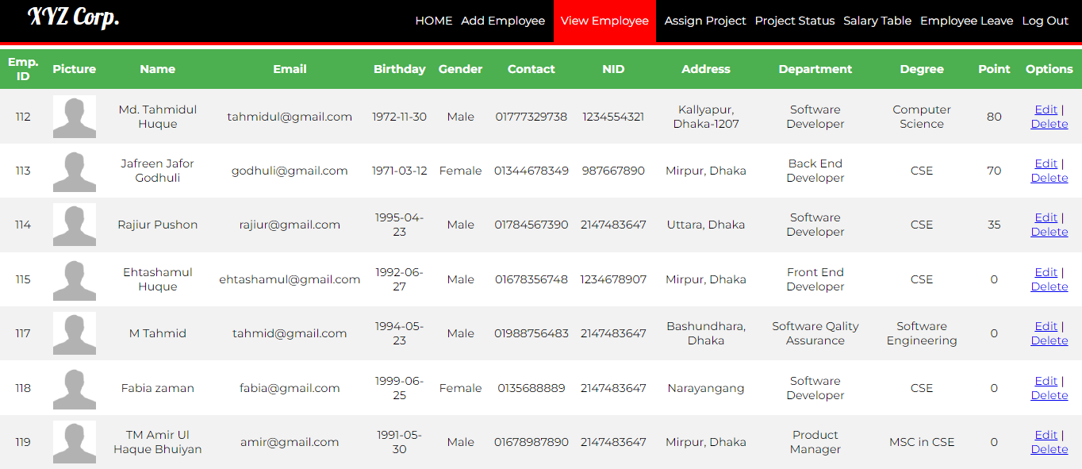
Outcome (cont.)
View details: Here admin will be able to view any employee’s details.
Add employee: Admin can add new employee in the database from here.

Slide 12
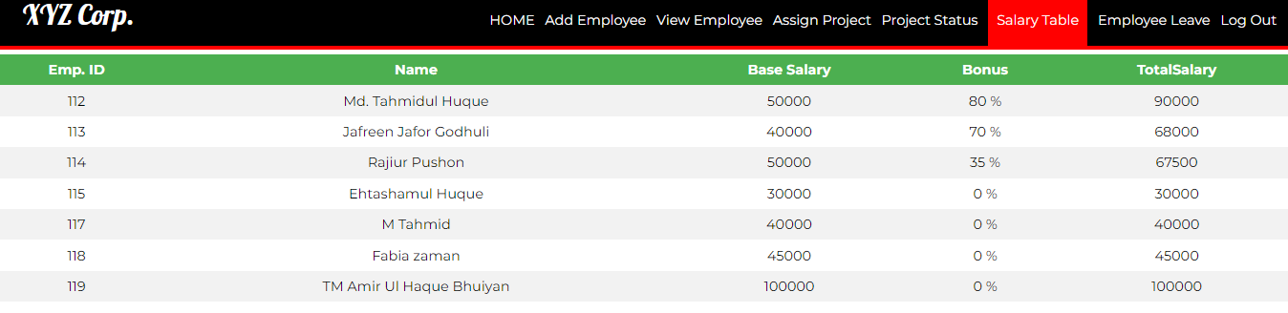
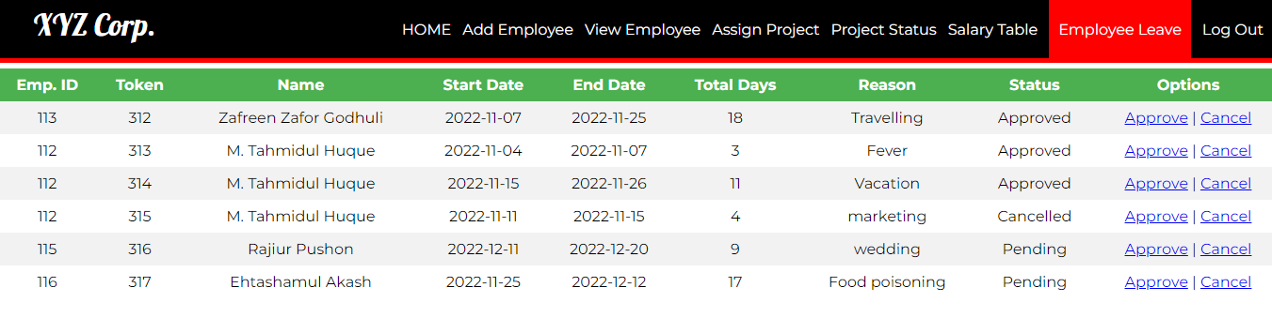
Outcome (cont.)
Salary: Admin see salary details of every employee from here.
Applications: Application made my user will be shown here and admin can change the status to approved or cancel.

Slide 13
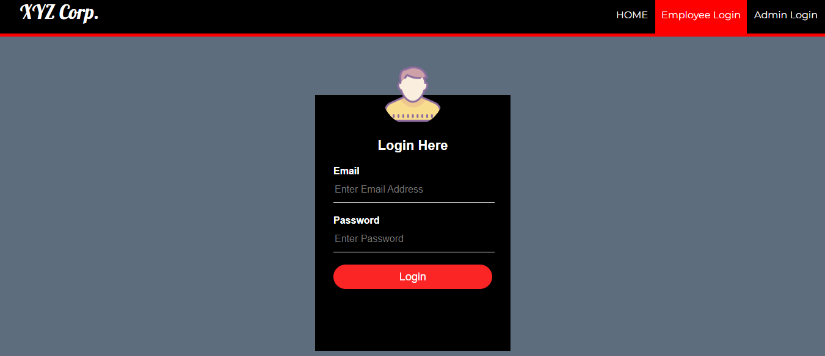
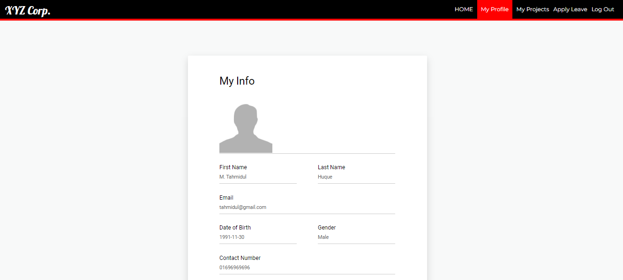
Outcome (cont.)
User login: This is the user/employee login page.
View details: Here user will be able to see only his details stored in the application.

Slide 14
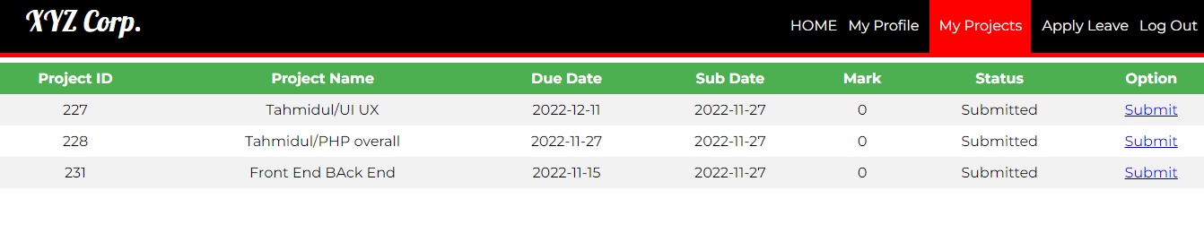
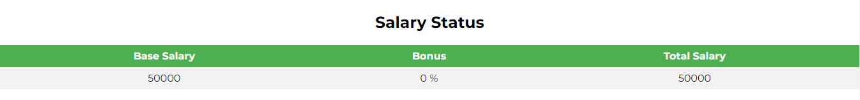
Outcome (cont.)
My Projects: Employee can submit their assigned projects from this module.
Salary: Employee see his/her salary from here

Slide 15
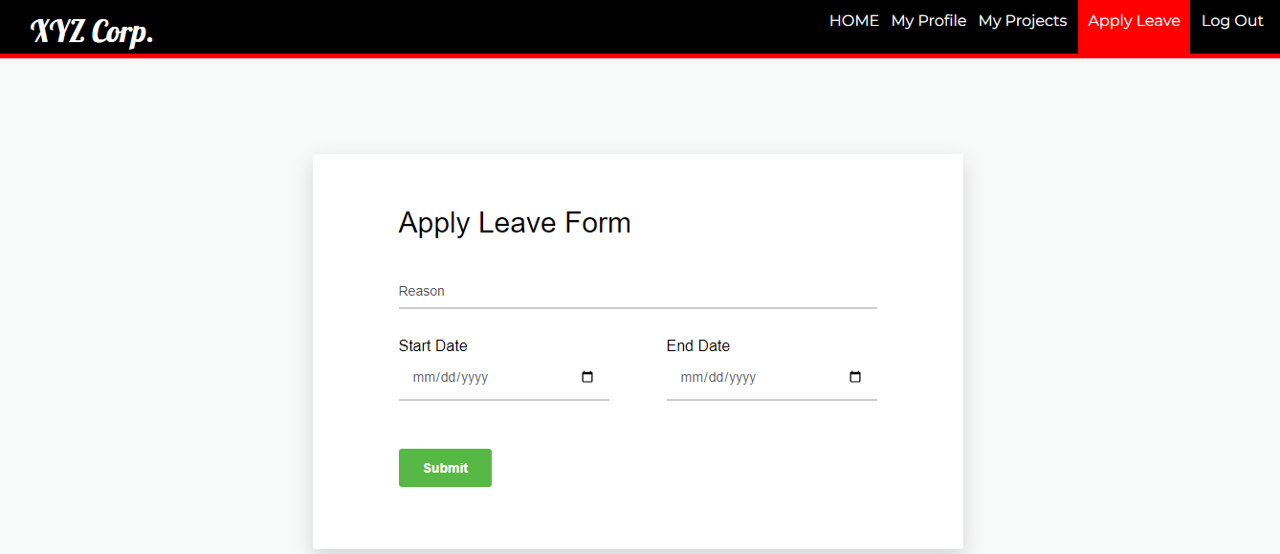
Outcome (cont.)
Apply Leave : Employee can apply for a leave with this option.

Slide 16

Conclusion
It is designed to replace an existing manual record system.
The system is strong enough to withstand regressive daily operations under conditions where needed.
The database is maintained and cleared over a certain time of span.
It’s a user-friendly system that anyone managing it can easily use the features of it.

Slide 17

Future Work
Release mobile version.
Add domain and hosting to make accessible online
Add payroll and attendance option
Better interface
Maintain and make it up-to date

Slide 18

Thank You

