Slide 1

AI-Based Accessibility Tool for Dyslexic Students
Team Members:
1. Arunima Banerjee 2023BCSE07AED039
  2. Angiras Venugopal 2023BCSE07AED021
  3. Daphne Grace Backiam Nathaniel 2023BCSE07AED066
  4. MD Taksir Alam 2023BCSE07AED081
Name of the Mentor: Dr. S.Prabagar
5CS1990 Design Project -1

Slide 2

Agenda
Introduction
Review of literature (Refer minimum of 5 Recent Journal / Conference papers)
Observations from the literature review (Brief description as points)
Limitations from the literature review (Brief description as points)
Problem Definition & Proposed Methodology
  Problem Statement
  Proposed Research / Methodology
  Hardware Requirements
  Software Requirements
References ( Min. of 10 papers)
Plagiarism Report

Slide 3
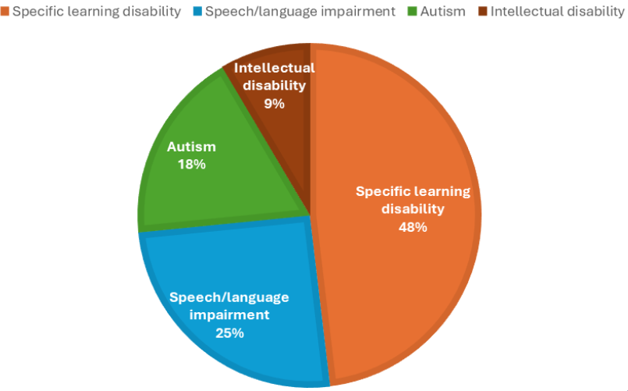
Introduction
Dyslexia – What is it?
A specific learning disorder affecting reading, writing, and spelling abilities.
Rooted in difficulties with language processing and phonological awareness.
Independent of intelligence—students may be bright but still face challenges.
Dyslexia in India
10M students affected.
Mostly undiagnosed, low awareness.
Struggle with text-heavy study material.
Why Students Struggle
Hard to decode words.
Slow reading speed.
Poor retention of text.
Stress, low confidence
Domain: Agentic AI & ML

Slide 4
Research Papers
S.No | Author Name, Journal, Publication Year | Research/ Methodology | Performance Metrics | Advantages | Disadvantages
1. | Sheetal Phatangare, Sneha Jain, Proceedings of the International Conference on Trends in Material Science and Inventive Materials (ICTMIM-2025) | LexiEase AI : An AI Powered Dyslexic Support System | DistilBERT 85%, Stable Diffusion 92%, DeepSpeech 91%, WaveNet 95% accuracy. | Personalized learning paths, multimodal support (text, audio, images), holistic dyslexia assistance. | Requires internet/cloud for AI models, limited current language support.
2. | Elham Madjidi, Christopher Crick, Towards Inclusive Reading Proceedings (2024) | Neural text generation framework for dyslexia accessibility | Text simplification accuracy, user engagement | Automates customization of text, adaptive to needs | High computational demand, complexity in evaluation
3. | Dr. Kiran P, Venumadhava H, G Pranathi, Navya D N, IJARCCE (2024) | AI-powered assistive technologies survey for dyslexia | Summary of state-of-art techniques, adoption rate | Comprehensive overview, identifies research gaps | No direct experimental validation
4. | SchoolAI, Dyslexic.ai newsletters (2025) | Emotion-aware AI tutors adapting to learners’ emotional states | Emotional recognition accuracy, learning outcome | Personalized, empathetic learning approach | Privacy and data sensitivity issues
5. | Seyed Ali Bahrainian, Jonathan Dou, Carsten Eickhoff, ACL Anthology (2024) | Adaptive teaching algorithms for text simplification | Comprehension improvement rates | Personalized learning, adaptive methods | Requires ongoing adaptation, language-specific models

Slide 5
Observations
Recent research focuses heavily on AI-driven personalization to support dyslexic learners.
Multimodal learning systems (text, audio, visuals) are becoming common for better comprehension.
Models like DistilBERT, DeepSpeech, and WaveNet show strong accuracy in text, speech, and visual assistance.
Studies emphasize adaptive learning and emotional intelligence to enhance engagement and comfort.
There is a clear trend toward combining NLP, speech recognition, and emotional AI for holistic dyslexia support.

Slide 6
Limitations
High computational and cloud dependency makes real-time offline use difficult.
Limited language and regional support restricts accessibility for non-English users.
Data privacy concerns arise with emotion and speech-based AI models.
Complex evaluation metrics make it hard to measure effectiveness consistently.
Many studies are conceptual or lack large-scale experimental validation

Slide 7
Problem Statement / Scope of the Project
Dyslexic students face difficulties in reading, comprehension, and learning with traditional text-based materials.
Existing AI assistive tools lack personalization and adaptability and language support to individual needs.
Current solutions are either limited to single modalities (e.g., handwriting, text-to-speech) or lack usability in real classroom contexts.
A gap exists in creating a customizable, adaptive, and inclusive AI tool that empowers dyslexic students to control their own learning experience.
Scope of Project
Develop an AI-based accessibility tool tailored for dyslexic learners.
Integrate Agentic AI to adapt to each student’s unique preferences (Language , font, color, summaries, TTS/STT).
Provide interactive features: text-to-speech, speech-to-text, NLP-based summarization, and simplification, meanings.
Allow students to customize settings for comfort and improved accuracy.
Prototype stage: focus on usability testing with sample study texts (English only).
Not covering medical diagnosis, therapy, or multilingual support (first version)

Slide 8
Proposed Idea / Solution
Build an AI-based accessibility tool specifically for dyslexic students.
Integrate Agentic AI that adapts dynamically to each learner’s needs.
Provide customization options (Language, fonts, colors, text size, highlighting, annotation)
Use NLP-based summarization & simplification to make study materials easier.
Focus on improving reading comfort, comprehension, and learning confidence.

Slide 9
Objectives of the Idea / Solution as Design Project
Enhance Learning Accessibility
Adaptive AI Assistance
Personalisation
Improve reading for all​
AI personalizes learning experience
Tailored interface for students with preferred Language Selection

Slide 10
Proposed Research / Methodology
User Study
Data Collection
AI Model
Techniques
Evaluation
Feedback Loop
Integration
Dyslexic students, preference survey
Educational platforms, intuitive UI​
Reading samples, interaction logs​
Agentic AI and RL techniques adjustment based on user data​
Agentic adaptive learning, personalization​
Accuracy, reading speed, comprehension, engagement
NLP, text-to-speech, font &layout adaptation​

Slide 11
Identified Use Case for Implementation
•Real-World Context: Dyslexic students face challenges in reading, comprehension, and focus when using traditional text materials.
• Identified Use Case:
– AI-based accessibility assistant that leverages RASA (Agentic AI)
– Converts text ↔ speech for flexible learning
– Uses NLP to simplify and summarize content – Adapts to each learner’s pace and comfort level
• Implementation Scope: – Build a multimodal learning assistant combining text, audio, and visuals
– Add customizable features
– Include progress tracking and adaptive feedback
– RASA Agent for adaptive dialogue management and user interaction
• Target Users: – Primary: Dyslexic students – Secondary: Teachers and parents for learning support

Slide 12
Proposed Modules
1. User Interface & Personalization Module
• Dyslexia-friendly fonts
• Background color customization
• Adjustable text size & spacing
• Highlighting, annotation, and easy-read mode
• Personalized theme retention (memory-based)
2. RASA Agentic AI Module (Core Brain)
• Intent detection
• Dialogue management
• Reasoning and decision making
• Memory storage for personalization
• Adaptive level progression (easy → intermediate → hard)
• Controls and triggers all backend APIs
3. Text Processing Module
• DistilBERT-based text simplification
• DistilBERT-based summarization
• Keyword extraction
• Meaning/definition generation
• Context-aware follow-up questioning

Slide 13
4. Speech Interaction Module
• Text-To-Speech (TTS) using Wavenet / Chrome Web Speech
• Speech-To-Text (STT) using Mozilla DeepSpeech
• Voice adaptation based on user preference
• Read-aloud for text, notes, and PPT content
5. Learning Material Input Module
• Document Reader
-> Reads text directly from the chatbot
-> Reads content from PPT slides
-> Reads uploaded text or pasted notes
->Optional OCR support for extracting text from images
6. Accessibility & Assistive Support Module
• Real-time reading assistance
• Word decoding help
• Meaning lookup with examples
• Adaptive difficulty based on progress
• Confidence-building feedback
7. Data Handling & Memory Module
• User profile memory
• Font and theme preference storage
• Progress tracking
• Adaptive recommendations

Slide 14
8. Future Scope Module (Planned Enhancements)
• Offline mode
• Multilingual support
• Broader subject integration
• Extended accessibility features

Slide 15
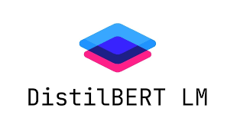

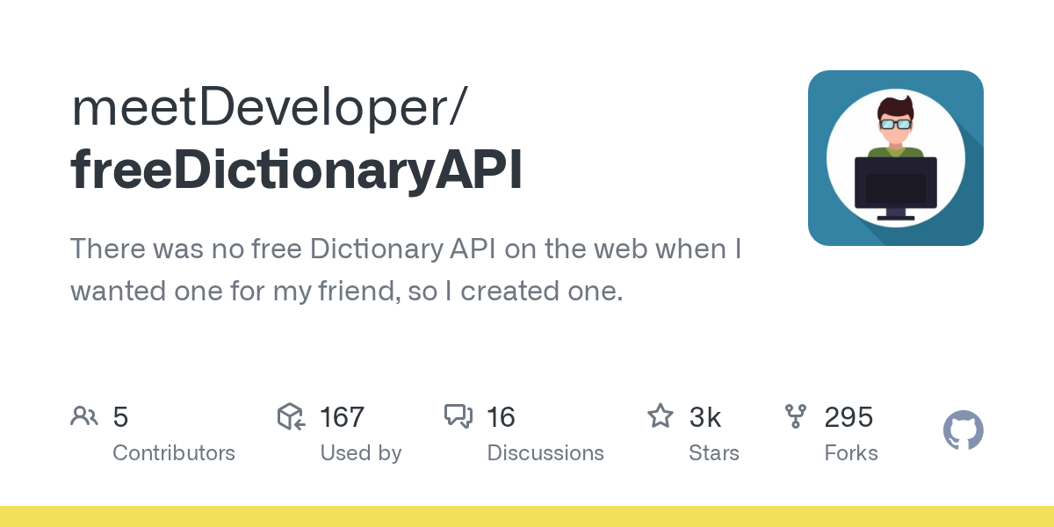

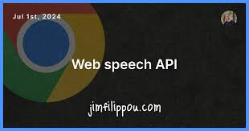

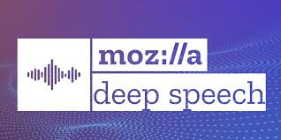
Software Requirements
Passage Generation
Text-to-Audio Generation
Word Meanings
Conversational Agent
Customizable Listening Options
User Audio Recording
Fluency Analysis

Slide 16
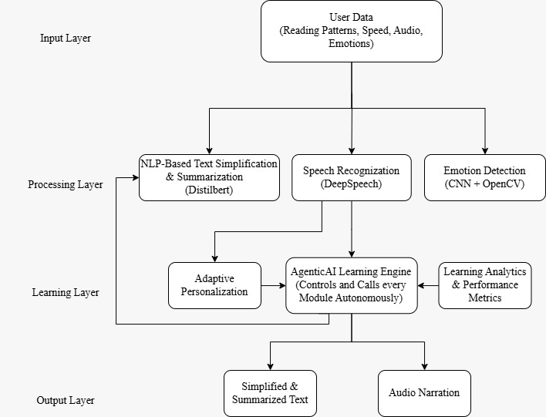
Process / Flow / Design Diagram
Input
AI/NLP Engine: Simplifies and summarizes content
Speech Module: Text ↔ Speech conversion
User interacts (listens, reads, responds)
Personalization Layer: Custom fonts, colors, voice speed
– Learning Analytics: Tracks user progress
– UI: Simple, accessible interface
Agentic AI adapts difficulty and updates personalization
Output
A personalized, adaptive reading and learning experience tailored to each dyslexic student through AI-driven text simplification, speech assistance, and progress tracking.
Input
Processing
Personalization
Feedback
Learning
Output

Slide 17
Feasibility Study and Requirements
Technical Feasibility
Uses existing AI/NLP frameworks (like TensorFlow, Hugging Face)
Operational Feasibility
Supports independent learning for dyslexic students
Simple interface, minimal training needed
Usable by both students and teachers
Economic Feasibility
Low-cost development with open-source tools
Easily scalable for schools and learning centres.
Legal & Ethical Feasibility
Ensures data privacy & accessibility compliance (WCAG, GDPR)
Promotes inclusive education practices
Functional Requirements
Text ↔ Speech conversion
Simplification & summarization (NLP)
Customizable fonts, colours, voice speed
Progress tracking & feedback
Non-Functional Requirements
High usability & accessibility
Fast performance and secure data
Multi-device compatibility

Slide 18
Novelty of the Proposed Idea / Project
A self-learning, agentic AI tool that dynamically adapts reading content, speech, and interface to each dyslexic student’s unique learning style.
RASA-based agentic intelligence
Integrates RASA-based agentic intelligence for continuous personalization
Enables independent learning
Helping dyslexic students study at their own pace.
Real-time adaptation
Offers real-time adaption based on users feedback and performance
Bridges the gap
Bridges the gap between AI technology and inclusive education

Slide 19
Conclusion
The proposed AI-based accessibility tool offers a personalized, adaptive learning experience for dyslexic students, integrating text simplification, speech assistance, and real-time analytics. By leveraging an agentic AI layer, the system continuously learns from each student’s performance, adapting content, interface, and feedback to their unique needs. This empowers students to study independently, improves reading comprehension and fluency, and bridges the gap between AI technology and inclusive education, making learning more accessible, engaging, and effective.
The proposed AI-based accessibility tool offers a personalized, adaptivelearning experience for dyslexic students, integrating text simplification,speech assistance, and real-time analytics. By leveraging an agentic AI layer,the system continuously learns from each student’s performance, adaptingcontent, interface, and feedback to their unique needs. This empowersstudents to study independently, improves reading comprehension andfluency, and bridges the gap between AI technology and inclusive education,making learning more accessible, engaging, and effective.

Slide 20
Comprehensive Report
Category | Details
Project Title | AI-Based Accessibility Tool for Dyslexic Students
Objective | To develop an adaptive AI tool that simplifies reading, improves comprehension, and supports independent learning for dyslexic students.
Problem Statement | Existing assistive tools lack personalization, adaptability, and usability in real classroom contexts.
Proposed Solution | • AI-powered Text ↔ Speech conversion • NLP-based simplification & summarization • Personalized learning interface (fonts, colors, voice speed) • Progress tracking and adaptive feedback
Methodology | • Data collection & preprocessing • Model building using NLP & Speech modules • Prototype development (Web/Mobile) • Usability and learning outcome evaluation
Expected Outcome | • Enhanced reading comfort and comprehension • Greater independence in learning • Promotion of inclusive education

Slide 21
References
[1] Sheetal Phatangare, Sneha Jain, “LexiEase AI: An AI-Powered Dyslexic Support System,” ICTMIM-2025, 2025.
[2] A. Pino, A. Rodríguez, “Text Simplification for Dyslexic Students Using NLP Techniques,” J. Educ. Tech. Soc., 2024.
[3] S. Kumar et al., “AI-Assisted Reading Support for Dyslexic Learners Using TTS and NLP,” IEEE Access, 2024.
[4] M. L. López, T. R. Carvalho, “Intelligent Tutoring Systems for Inclusive Education,” Computers & Education, 2023.
[5] L. Ferrer, N. Patel, “Agentic AI in Personalized Learning Environments,” IJAIED, 2024.
[6] R. Deshmukh, P. Jain, “Accessibility with Speech-to-Text and TTS for Dyslexic Students,” Procedia Comp. Sci., 2023.
[7] H. Zhang, J. Xu, “RL-Based Adaptation in Educational Assistive Tools,” IEEE TLT, 2023.
[8] C. S. Varma, P. Gupta, “AI-Powered Language Simplification,” IHCI, 2024.
[9] B. Kapoor, S. Rao, L. Mehta, “Comparative Study of TTS Models,” iJET, 2025.
[10] S. Sharma, M. Roy, T. Kaur, “Adaptive AI Tools for Dyslexia,” Edu. Info. Tech., 2024.

Slide 22
Survey Paper (If any)
AI tools designed for dyslexic students provide text simplification, personalized reading support, and real-time feedback using advanced NLP and machine learning techniques.
Innovations include text-to-speech, emotion-adaptive interfaces, and customizable visual aids that enhance comprehension and engagement.
These systems show strong results in improving reading accuracy, attention, and motivation, but face challenges such as language limitations, internet dependency, and privacy concerns.
Future directions include adding multilingual support, enabling offline use, and ensuring secure handling of user data.
SurveyPaper.PDF

Slide 23
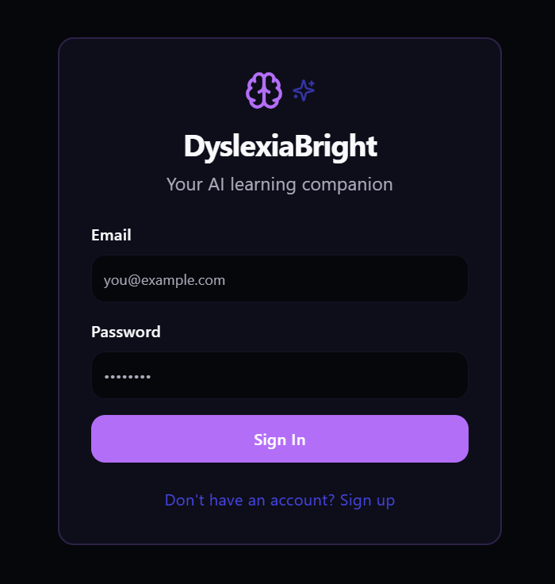
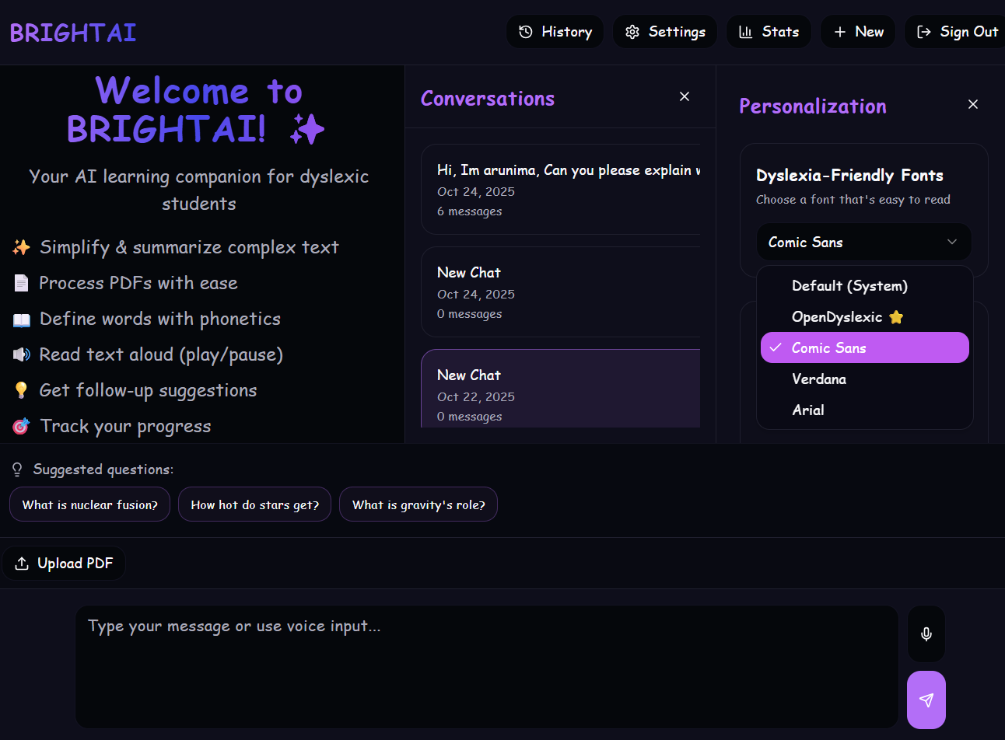
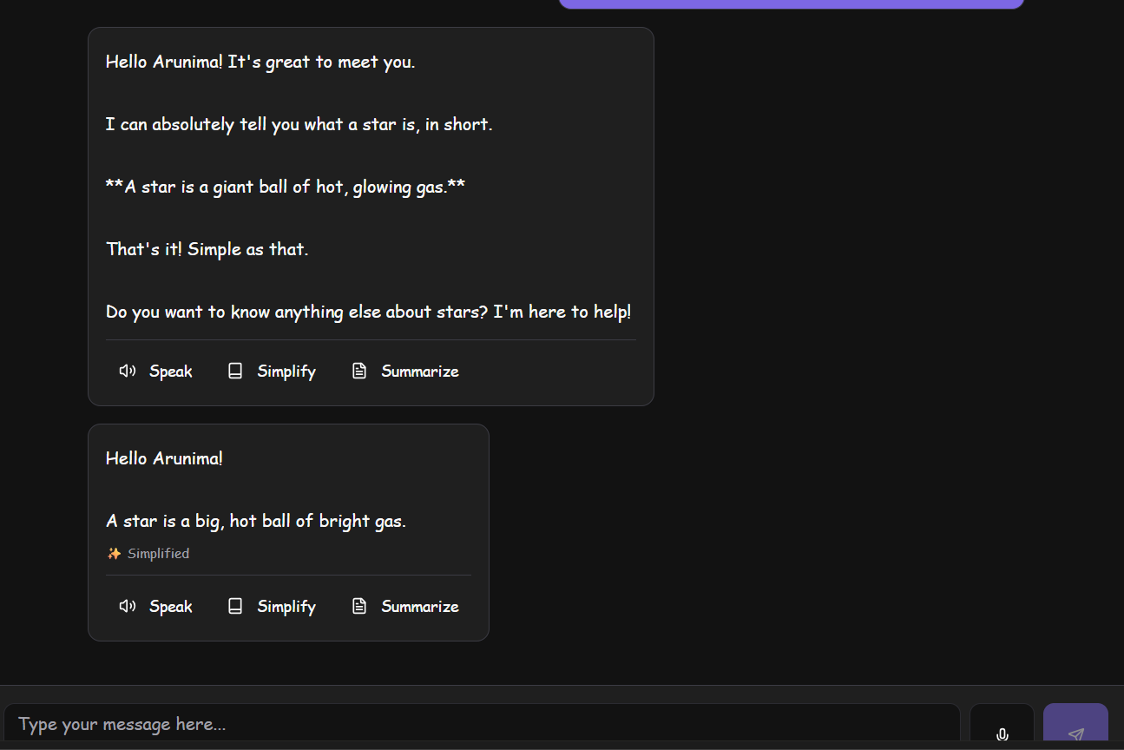
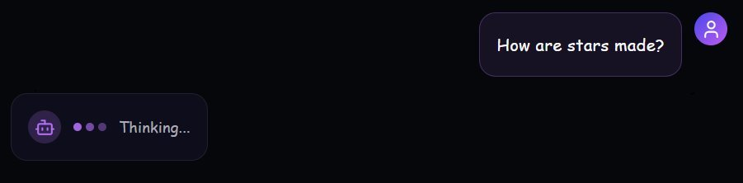
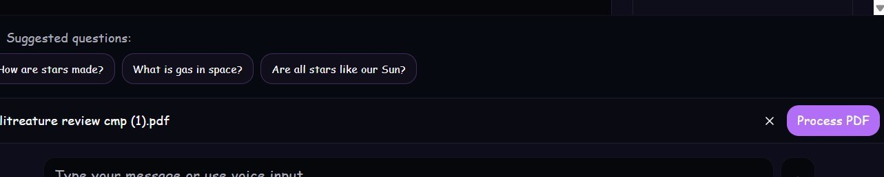
Partial Implementation (If any)
Sample Planned Designs: (No code)

Slide 24
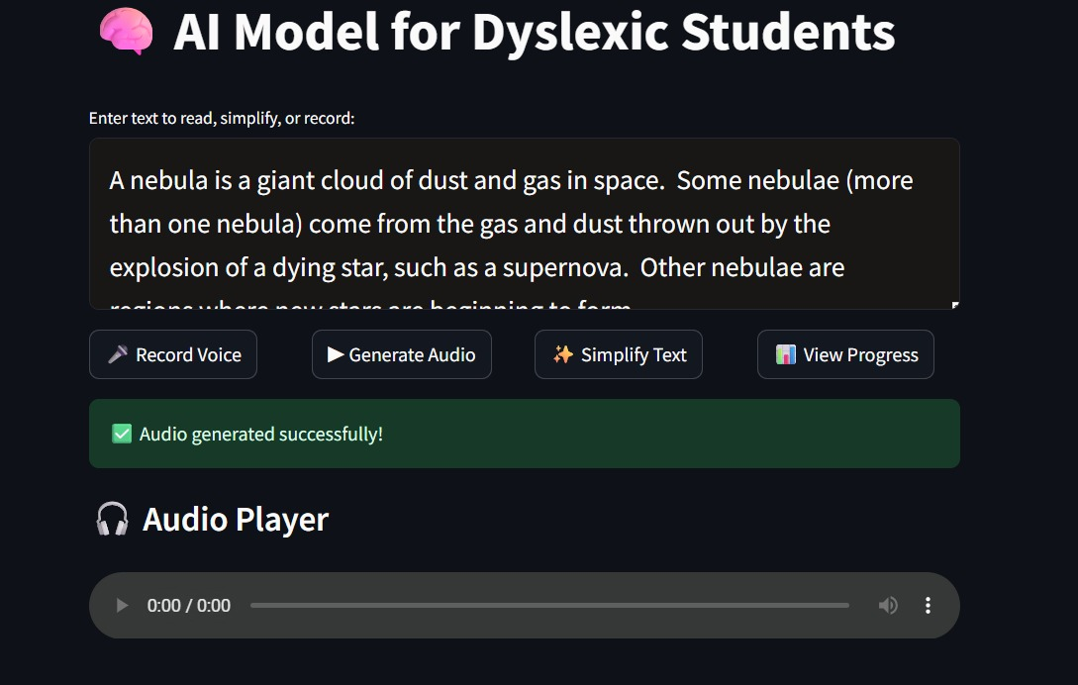
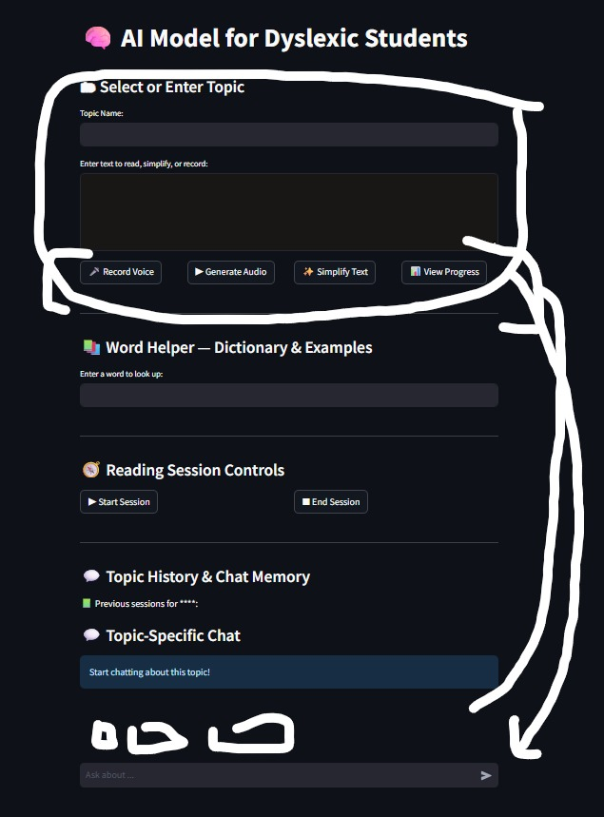
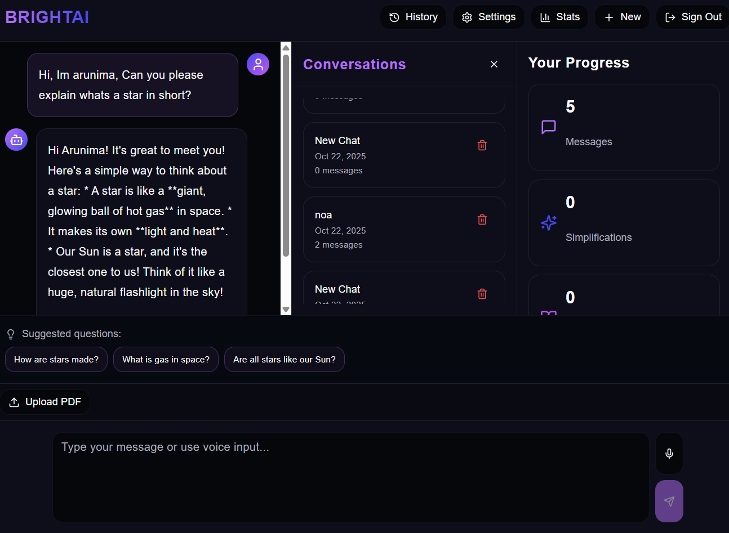
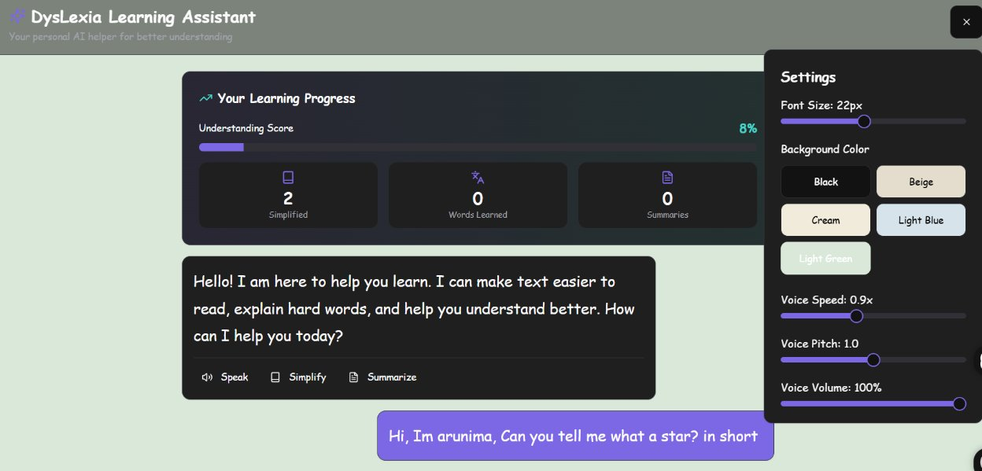
Partial Implementation (If any)

Slide 25
Plagiarism Report

