Slide 1
Long Short-Term Transformer for Online Action Detection
1
Team: 1
Id: 15301110
Name: Mohammad Tanjil Islam
ST: Mustakin
RA: Mehedi

Slide 2
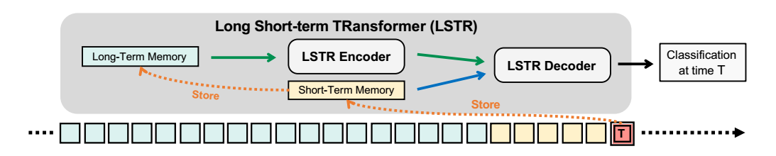
Introduction
2
Using fewer heuristics;
An effective and efficient technique;
Three online action detection benchmarks;
It directly stores the past and divides long-term memories from short-term memories;
Allowing for condensing the long-term history without sacrificing fine-scale data;
Encoder-decoder architecture;

Slide 3
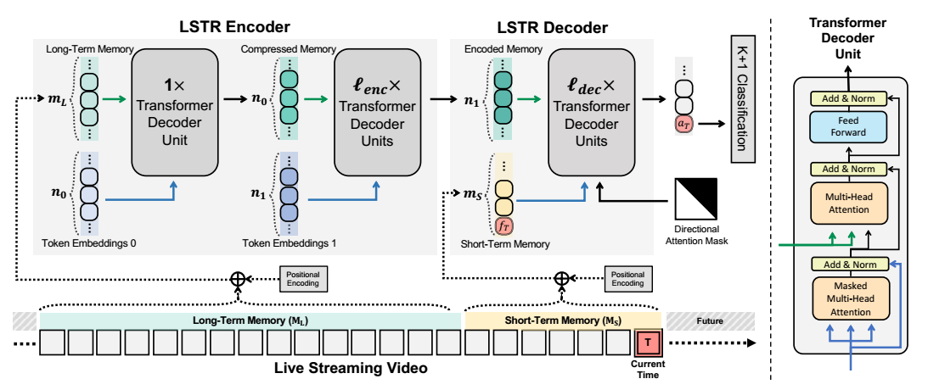
Related Work
3
Online Action Detection
Temporal/Sequence Modeling
Transformers for Action Understanding
Long Short-Term Transformer

Slide 4
Experiments
4
Datasets
Feature Encoding
Implementation Details
Evaluation Protocols
Comparison with the State-of-the-art Methods
Design Choices of LSTR

Slide 5
LSTR combines long- and short-term information for online inference tasks, but requires simultaneous spatial and temporal modeling.
5

Slide 6
Acknowledgments
6
[1] http://pytorch.org/.
[2] https://github.com/xumingze0308/TRN.pytorch.
[3] Anurag Arnab, Mostafa Dehghani, Georg Heigold, Chen Sun, Mario Luciˇ c, and Cordelia ´
Schmid. Vivit: A video vision transformer. arXiv:2103.15691, 2021.
[4] Gedas Bertasius, Heng Wang, and Lorenzo Torresani. Is space-time attention all you need for
video understanding? arXiv:2102.05095, 2021.
[5] Shyamal Buch, Victor Escorcia, Chuanqi Shen, Bernard Ghanem, and Juan Carlos Niebles.
SST: Single-stream temporal action proposals. In CVPR, 2017.
[6] Mikhail S Burtsev, Yuri Kuratov, Anton Peganov, and Grigory V Sapunov. Memory transformer.
arXiv:2006.11527, 2020.

