Slide 1
Lexicon-based Sentiment Analysis in German: Systematic Evaluation of Resources and Preprocessing Techniques
1
Team: 1
Id: 15301110
Name: Mohammad Tanjil Islam
ST: Mustakin
RA: Mehedi

Slide 2
Introduction
2
Analyzed 20 sentiment-annotated corpora and 19 sentiment lexicon resources;
SentiWS and SentiMerge;
Improved performance on average by 6%;
Domain-specific variations, suggestions for choosing lexicons, preprocessing, and adjustments;
Sentiment analysis focuses on identifying and analyzing human sentiment and emotions across a range of application domains.
First paper to systematically evaluate lexicon based techniques for sentiment analysis for the German language.
Offers a thorough listing of sentiment lexicon datasets and sentiment-annotated corpora in German

Slide 3
Resources
3
The ACM Digital Library,
ACL Anthology,
IEEE, Springer Verlag,
KONVENS,
Interest Group on German Sentiment Analysis.

Slide 4
Experiments
4
General Data Cleaning
Preprocessing and other Modifications
Part-of-Speech-Tagging
Stemming or Lemmatization
Lowercasing
Emoticons
Stop Words Removal
Valence Shifters

Slide 5
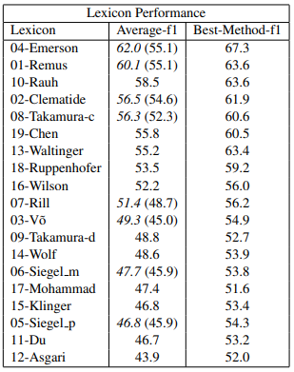
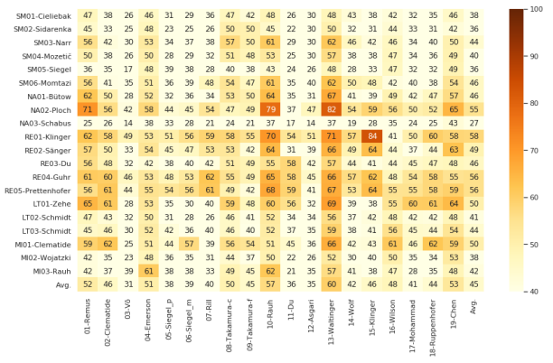
Results
4
Lexicon Performance without modifiers
Modifications
Lexicon Performance with Modifications

Slide 6
German resources often lack size and suffer from strong class imbalances resulting in the sometimes fairly poor results reported in this paper.
5

Slide 7
Acknowledgments
6
[1]Mahmoud Al-Ayyoub, Abed Allah Khamaiseh, Yaser Jararweh, and Mohammed N Al-Kabi. 2019. A comprehensive survey of arabic sentiment analysis. Information processing & management, 56(2):320– 342.
[2] Cecilia Ovesdotter Alm and Richard Sproat. 2005. Emotional Sequencing and Development in Fairy Tales. In Affective Computing and Intelligent Interaction, Lecture Notes in Computer Science, pages 668–674, Berlin, Heidelberg. Springer.
[3] Ehsaneddin Asgari, Fabienne Braune, Benjamin Roth, Christoph Ringlstetter, and Mohammad RK Mofrad. 2019. Unisent: Universal adaptable sentiment lexica for 1000+ languages. arXiv preprint arXiv:1904.09678.
[4] Khin Zezawar Aung and Nyein Nyein Myo. 2017. Sentiment analysis of students’ comment using lexicon based approach. In 2017 IEEE/ACIS 16th international conference on computer and information science (ICIS), pages 149–154. IEEE.
[5] Florian Butow, Andreas Lommatzsch, and Danuta ¨ Ploch. 2016. Creation of a german corpus for internet news sentiment analysis.
[6] Branden Chan, Stefan Schweter, and Timo Moller. 2020. ¨ German’s Next Language Model. arXiv:2010.10906 [cs]. ArXiv: 2010.10906.
[7] Yanqing Chen and Steven Skiena. 2014. Building sentiment lexicons for all major languages. In Proceedings of the 52nd Annual Meeting of the Association for Computational Linguistics (Volume 2: Short Papers), pages 383–389.

