Slide 1
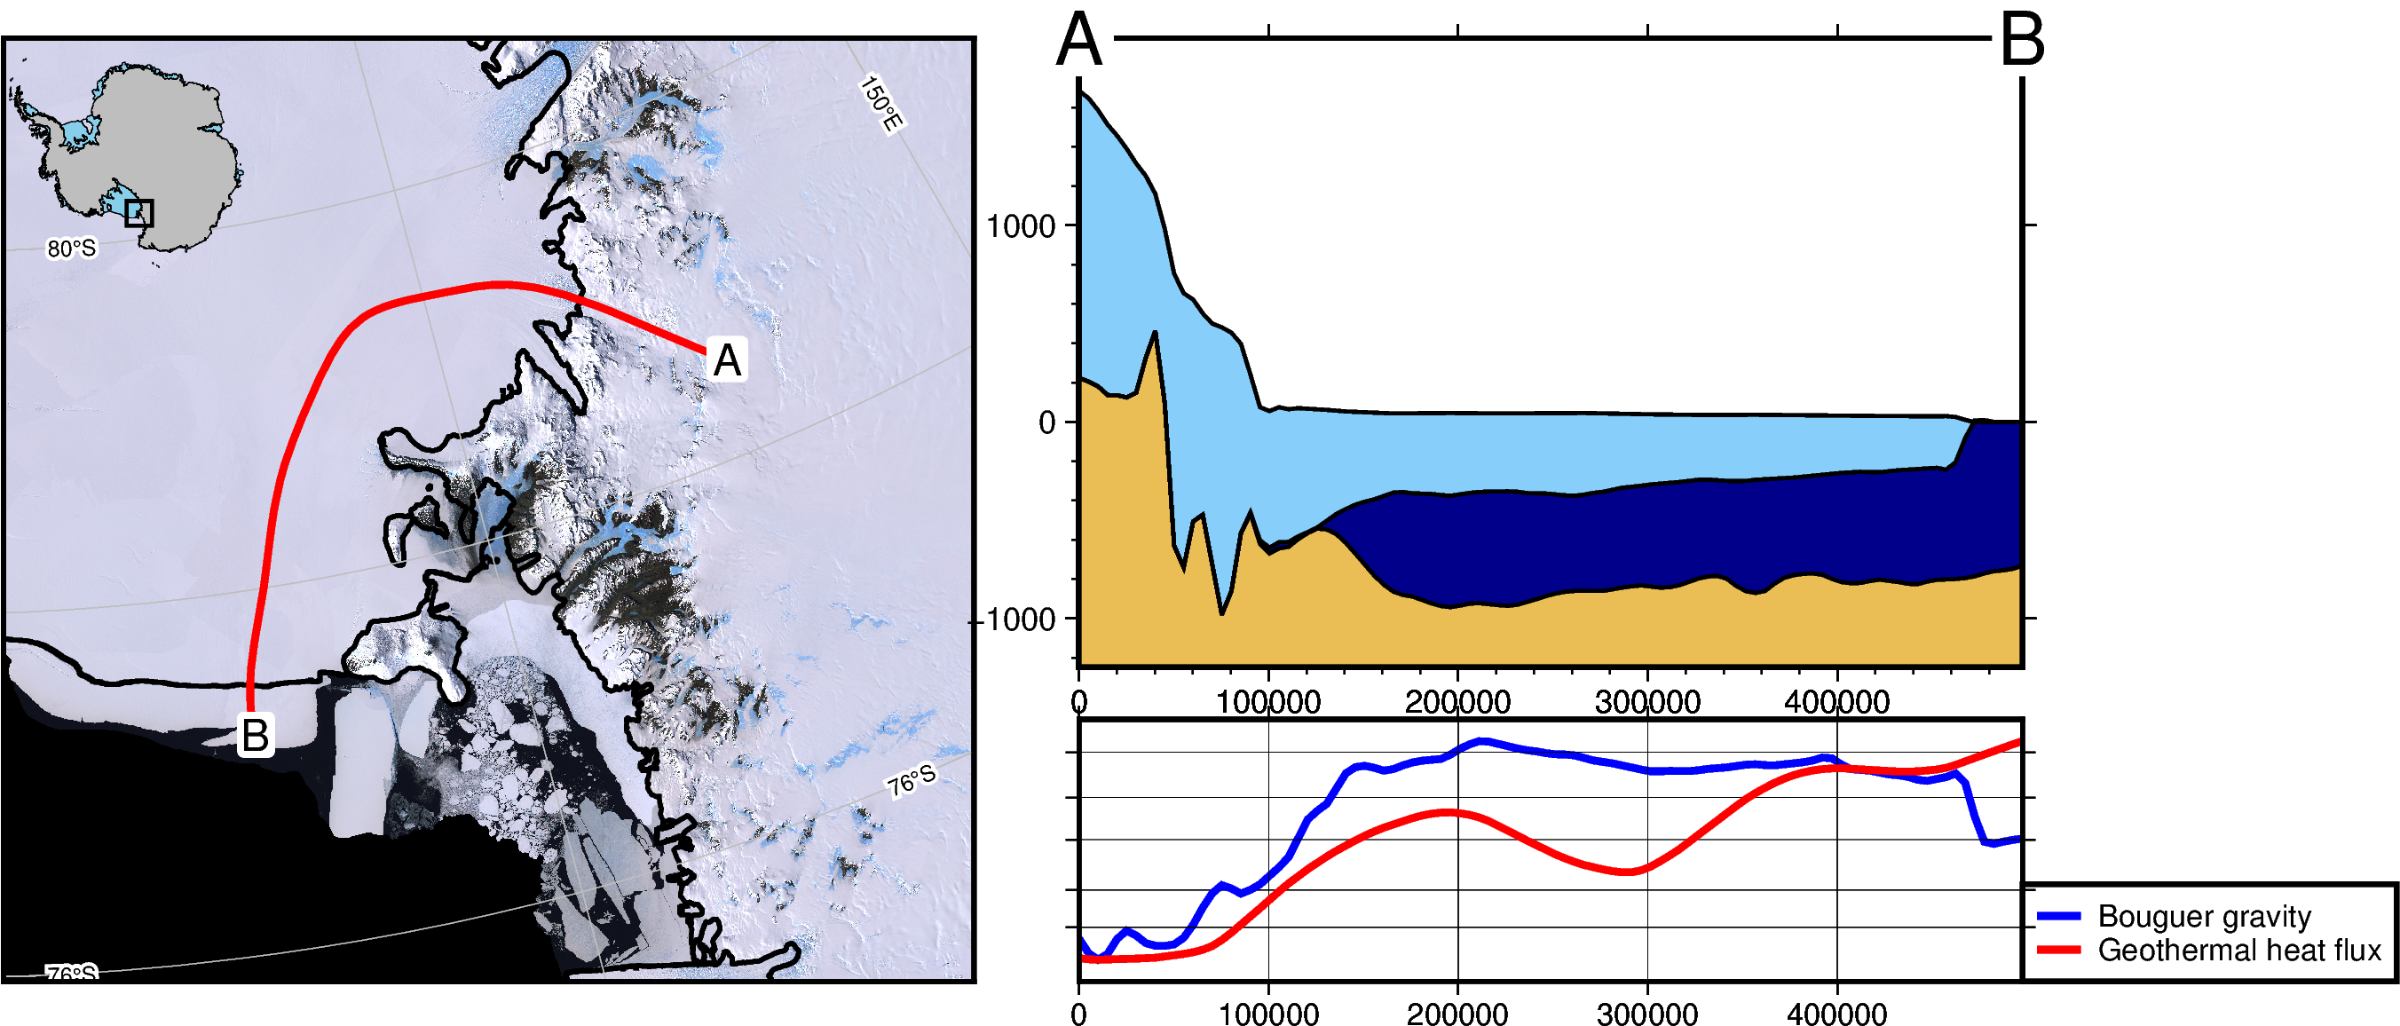

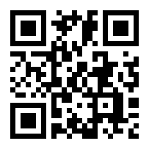


Antarctic-Plots
A Python package to help download, visualize,
and present Antarctic datasets
# download data
gravity = fetch.gravity('BA')
GHF = fetch.geothermal('losing-ebbing-2021’)
# set properties
data = profile.make_data_dict(
["Bouguer gravity", "Geothermal heat flux"],
[gravity, GHF],
["blue", "red"])
# draw profile location on interactive map
lines = maps.draw_lines()
line = utils.shapes_to_df(lines)
# plot
profile.plot_profile(
method = "polyline",
polyline = line,
num = 100,
data_dict = data,
add_map = True)
Matthew Tankersley^{1,2}
¹Antarctic Research Centre, Victoria University of Wellington, NZ ²GNS Science, NZ
Try it on your phone:
Open a Binder environment
https://bndr.it/b5dn7
Notes:
1 min intro:

