Slide 1
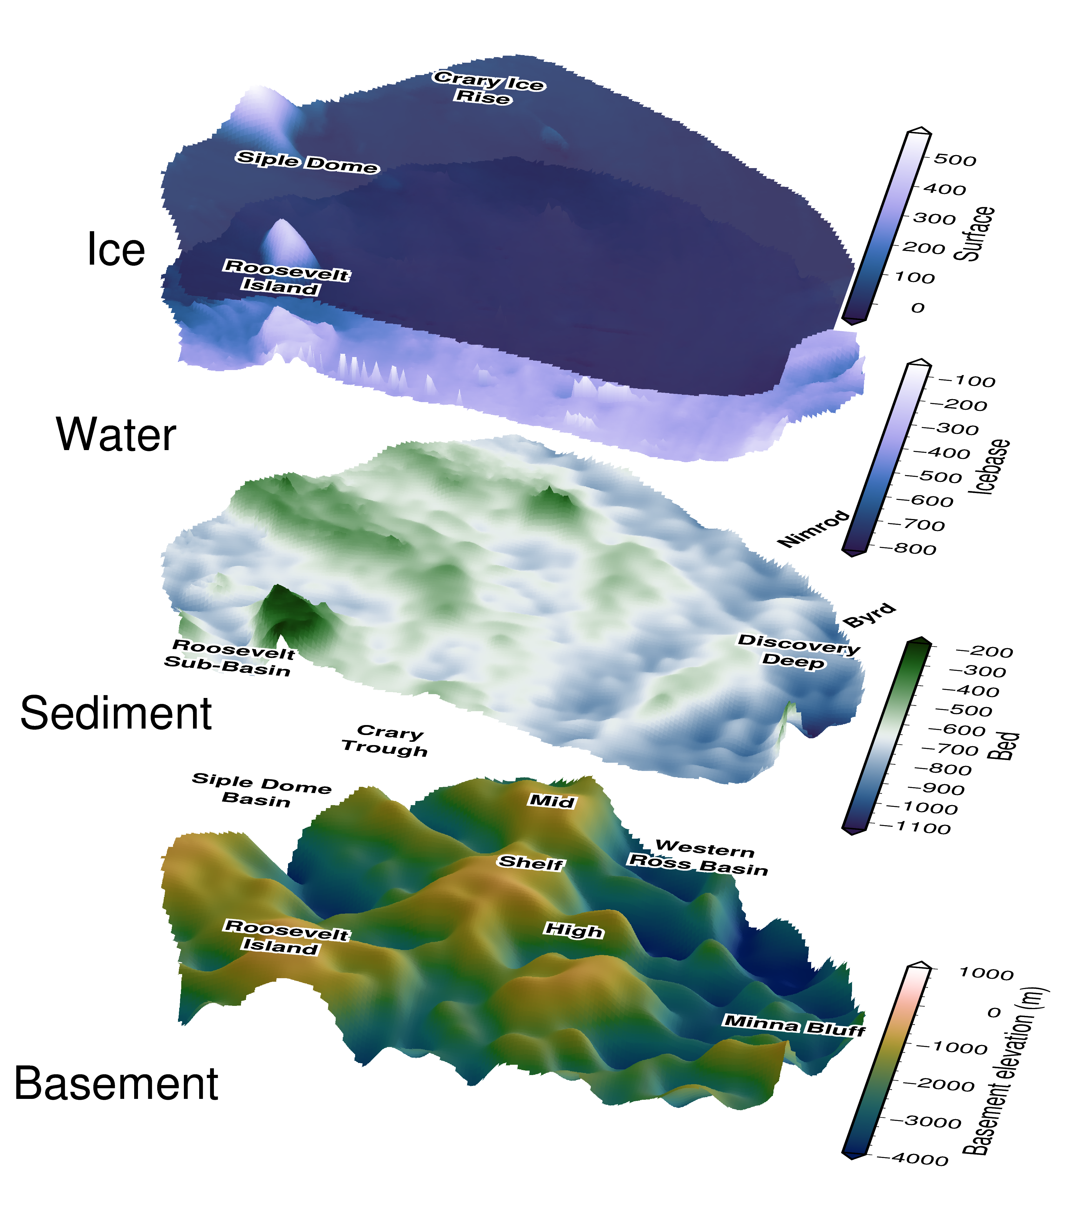





Revealing sub-ice shelf sediment basins with airborne magnetics implications for solid-earth-ice interactions
Matthew Tankersley^{1,2}, Christine Siddoway³, Huw Horgan¹, Fabio Caratori Tontini^{2,4}, Kirsty Tinto⁵
¹Antarctic Research Centre, Victoria University of Wellington, NZ ²GNS Science, NZ ³Colorado College, USA ⁴University of Genova, Italy ⁵Lamont-Doherty Earth Observatory, USA
Notes:
Hi everyone, I’ll be presenting a poster focused on the solid-earth – cryosphere interactions of the Ross Ice Shelf region.
For the Ross Ice Shelf, as you can see in this 3D plot, the underlying solid-earth is hidden by 100’s to 1000’s of meters of sedimentary deposits, and then seawater, and finally by the floating ice shelf.
Our research here has used airborne magnetics data to try and strip away those layer to discover the shape of the underlying basement rock.
From this basement surface, as you can see on the bottom of the plot, we’ve identified large, fault bound, sedimentary basins, up to 3 km thick,
which likely have a strong influence on important boundary conditions for the ice sheet, such as geothermal heat flow and ground water transport.
If you’re interested in hearing more about this, please come by my poster.

