Slide 1
WELCOME TO MY PRESENTAION PRESENTED BY:md.tarek miah TRAINEE ID: 08 BAtCH : IS -10 PROGRAM : EDGE COURESE : IT SUPPORT FOR OFFICE MANAGEMENT
SUBMITTED TO:
MD: FAHMIDUR RAHMAN SAKIB
LECTURER AT DEPARTMENT OF COMPUTER
SCIENCE AND ENGINEERING
METROPOLITAN UNIVERSITY

Slide 2
How to Clear Search History on Windows 11
An in-depth guide for clearing the Search history, File Explorer search history, recommended history, and Windows activity on Windows 11.

Slide 3
Disable recent search history on Windows 11
Clear Windows 11 search history via Settings
Clear search history from the cloud
Clear File Explorer search history on Windows 11
Disable File Explorer search history in Windows 11
Clear activity history on Windows 11
Clear recommended history from Windows 11 Start menu

Slide 4
Disable recent search history on Windows 11
Preventing Windows from saving your search history is an effective way to safeguard your privacy. By disabling the recent search history feature, you ensure that your searches are not recorded. Here's how to do it:
Press Windows + I to open the Settings app.
In the Settings window, select Privacy & security from the left-hand menu.
On the right, click on Search permissions under the Windows permissions section.

Slide 5
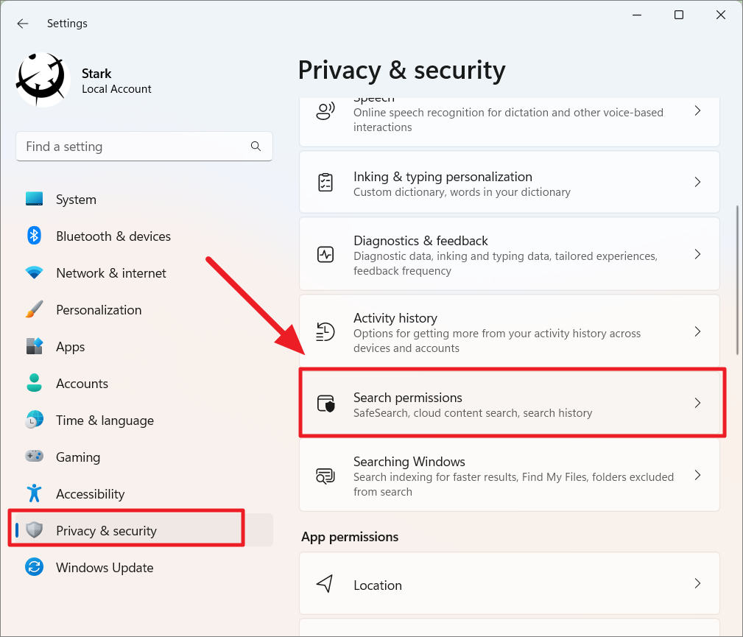

Slide 6
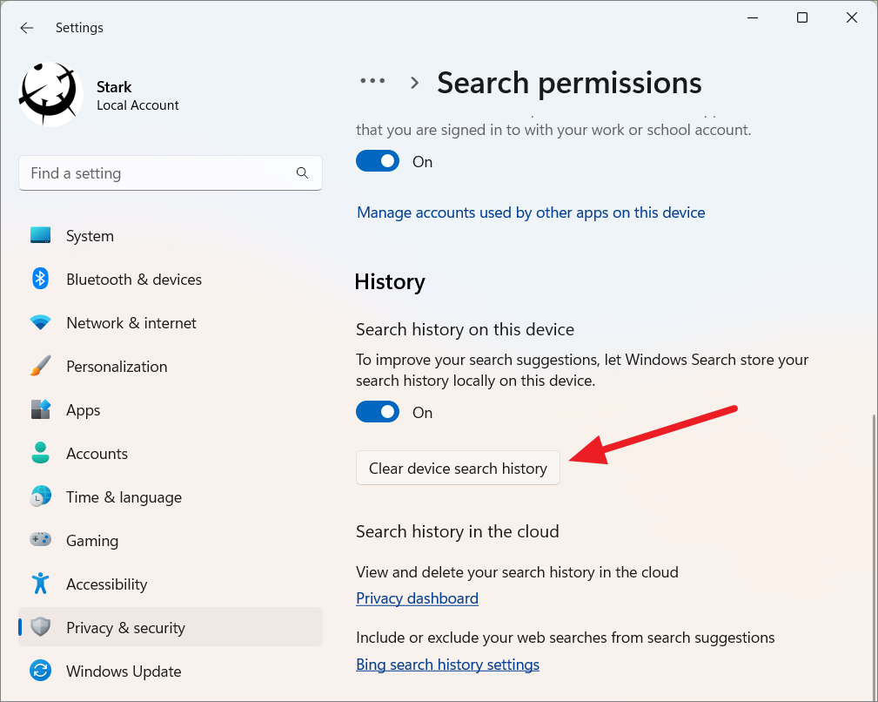

Slide 7
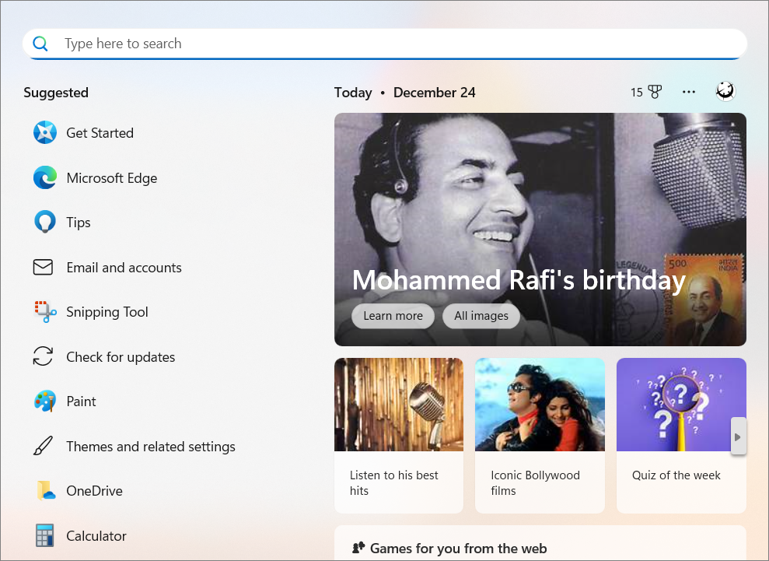
Once disabled, Windows will no longer store your search history. The Search menu will only display suggested apps and settings, keeping your search activities private.

Slide 8
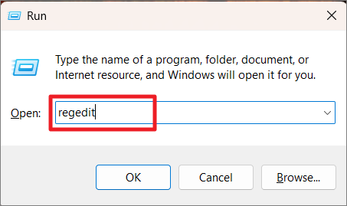
Disable recent search history via Registry Editor
If you prefer using the Registry Editor, you can also disable search history through it. Follow these steps carefully:
Press Windows + R to open the Run dialog box.
Type regedit and press Enter to launch the Registry Editor.

Slide 9
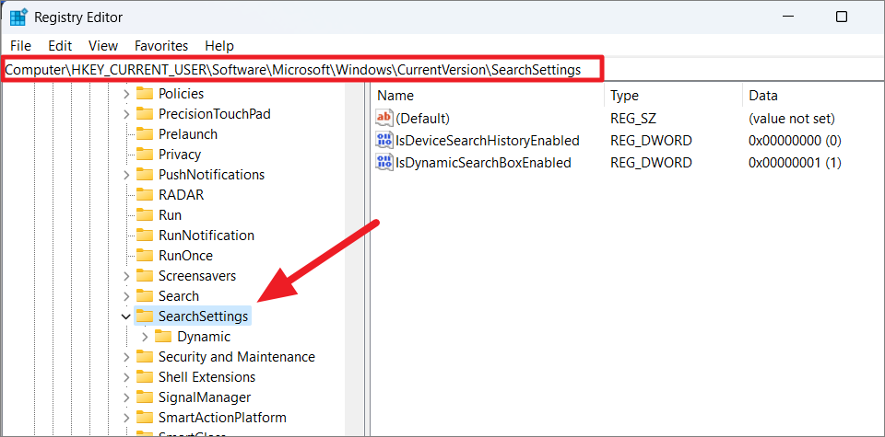

Slide 10
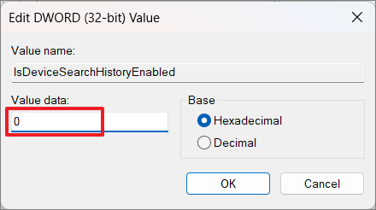
In the right pane, double-click on IsDeviceSearchHistoryEnabled. If it doesn't exist, right-click in the pane, select New > DWORD (32-bit) Value, and name it IsDeviceSearchHistoryEnabled.
Set the Value data to 0 and click OK.

Slide 11
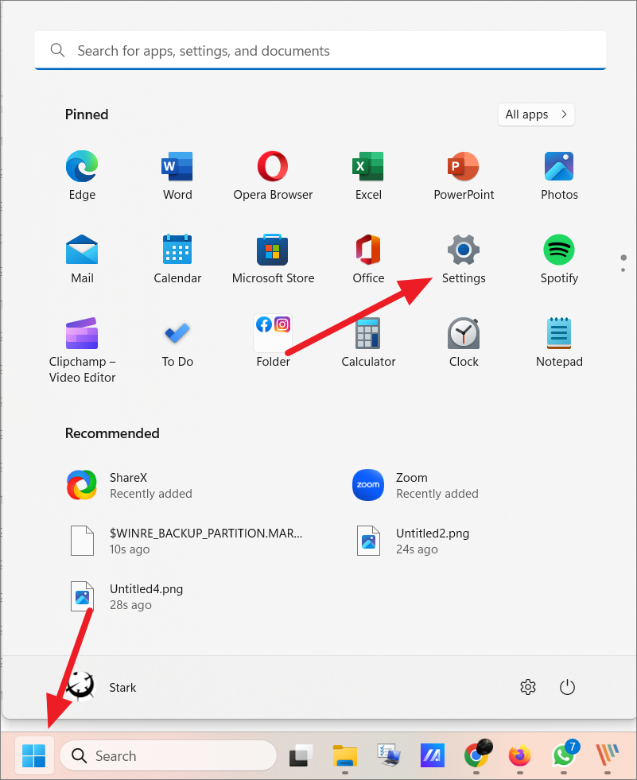
Close the Registry Editor and restart your computer for the changes to take effect.
Clear Windows 11 search history via Settings
If you prefer to clear your existing search history without disabling the feature entirely, you can do so through the Settings app:
Click the Start button and select Settings, or press Windows + I.

Slide 12
In Settings, choose Privacy & security from the left menu. Click on Search permissions on the right.

Slide 13
Under the History section, click on Clear device search history.

Slide 14
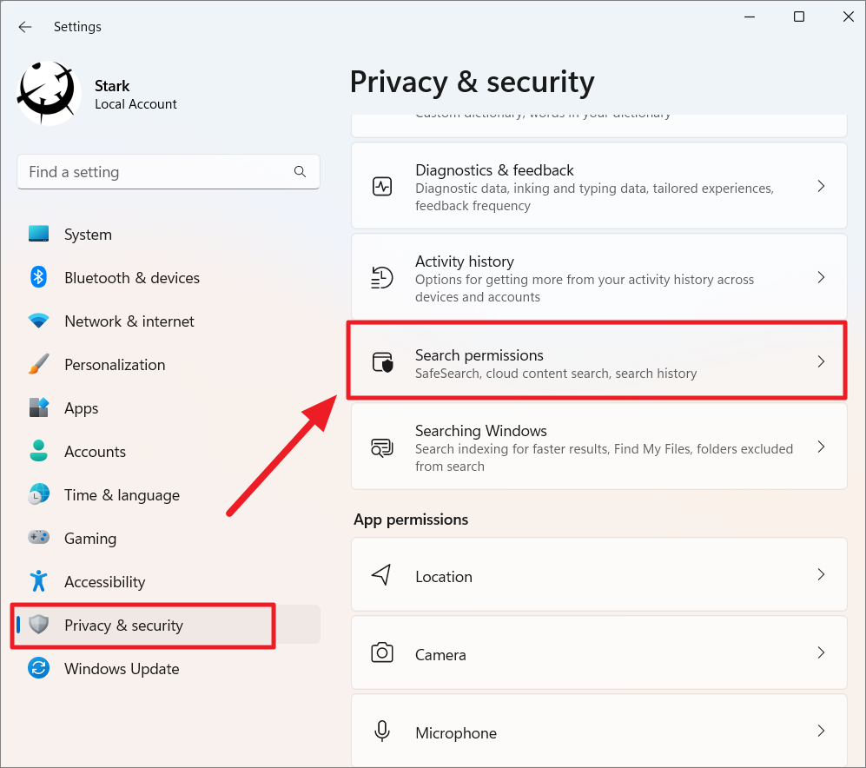
Clear search history from the cloud When using Windows Search to look up information on the web, your queries are stored in your Microsoft account. Clearing this data ensures that your search history isn't used for suggestions or targeted ads. Follow these steps: Open Settings and select Privacy & security. Click on Search permissions.

Slide 15
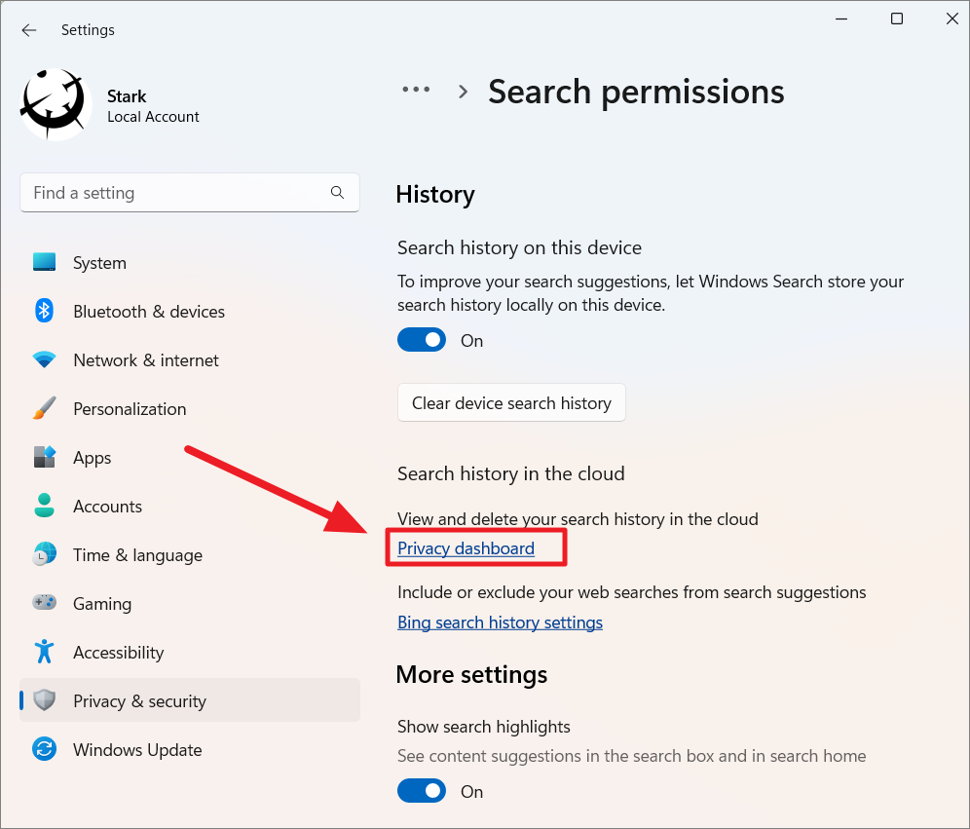
In the History section, click the Privacy dashboard link.

Slide 16
Thanks

