Slide 1
Chapters 10 & 11
Matthew Turner (2016)
CC BY-NC-SA 4.0

Slide 2
Linear Algebra
Underlying all of applied math is the subject of Linear Algebra
It is just the extension of algebra to other sorts of objects
You begin by defining what +, -, and * (multiplication) mean
The first two tend to be easy, the last one is where you get into trouble
Vectors (the basic objects) are often just ordered lists of numbers
But not really

Slide 3


Slide 4
Dot Products
AKA:
Dot product
Scalar product
Inner product
The dot product is a single number
It can be thought of as a weighted sum (one vector is the set of numbers to be summed, the other the weights)
It is the length of the projection of one vector onto the (dimension of) the other vector
It also represents a similarity measure

Slide 5
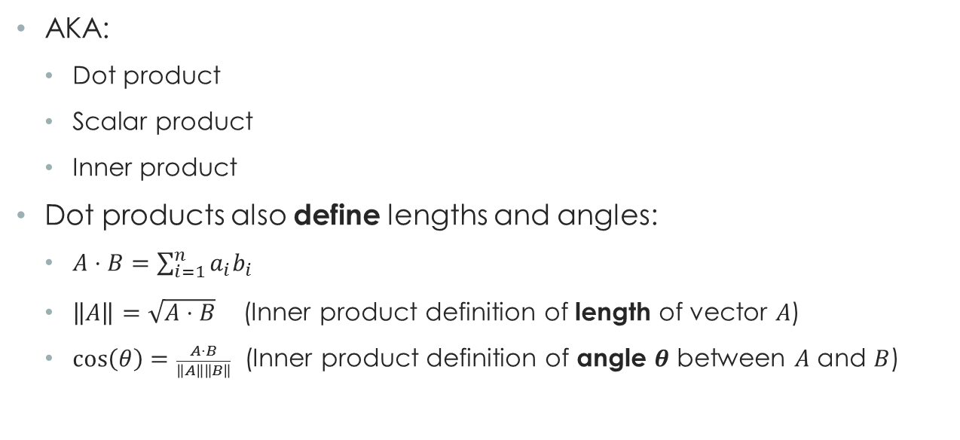
Dot Products
AKA:
Dot product
Scalar product
Inner product
Dot products also define lengths and angles:
$A⋅B=\sum_{i=1}^{n}{a_{i}b_{i}}$
$\left\|A\right\|=\sqrt{A⋅B}$ (Inner product definition of length of vector $A$)
$\cos\left(θ\right)=\frac{A⋅B}{\left\|A\right\|\left\|B\right\|}$ (Inner product definition of angle $θ$ between $A$ and $B$)

Slide 6
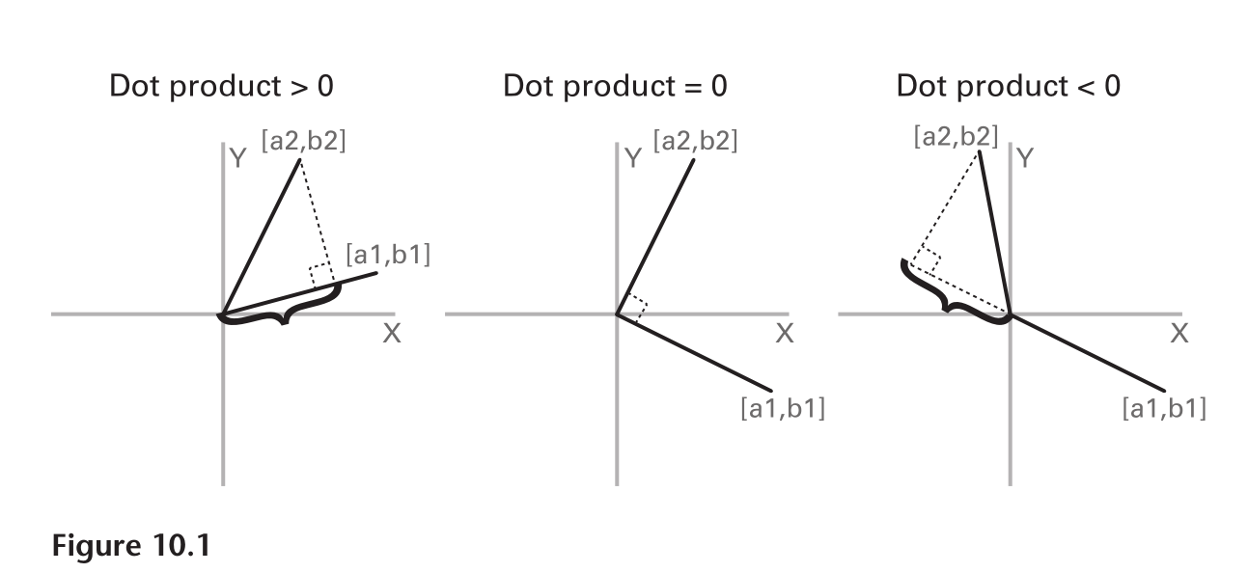
Orthogonal Case
The dot product can be thought of as the length along one of the vectors of the projection of the other vector.

Slide 7
Orthogonal Case
The dot product can be thought of as the length along one of the vectors of the projection of the other vector.

Slide 8
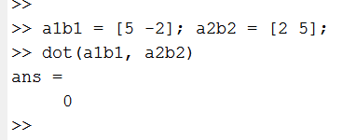
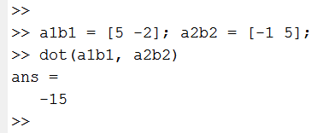
Orthogonal Case

Slide 9
Weird at First
It takes some getting used to, but our vectors live in a high dimensional space:
A vector of length 2 is a point in 2-space (the Cartesian plane)
A vector of length 3 is a point in 3-D space
A vector representing a 2 second sample of EEG (for one electrode) with a sampling rate of 512 Hz is a vector of length 1024
It lives as a single point in a 1024-dimensional space
Each number in the vector is one coordinate of the 1024-dimensional point

Slide 11
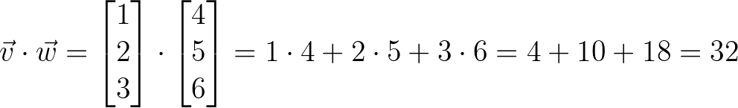
How to Compute It In MATLAB
Given two vectors (lists of numbers):

Slide 12
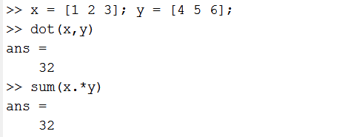
How to Compute It In MATLAB
Given two vectors (lists of numbers):
In MATLAB:
The “dot” before * means do something “elementwise”

Slide 13
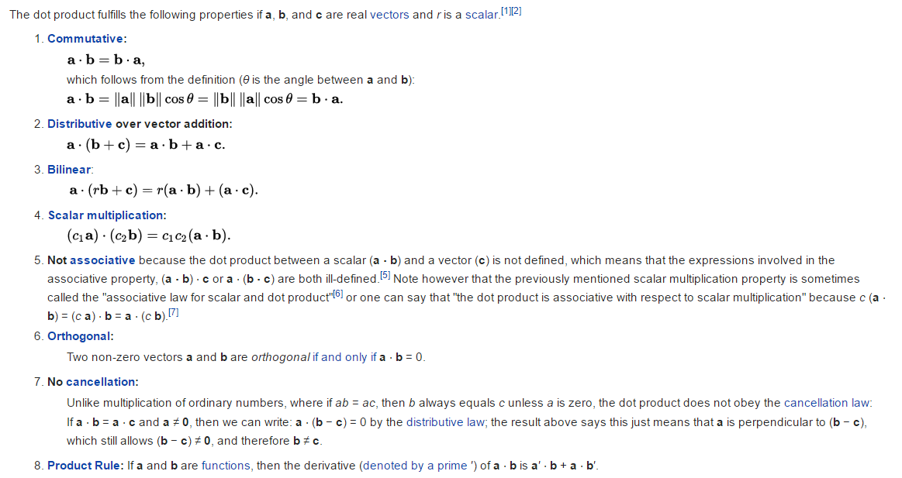
Properties of Dot Products

Slide 14
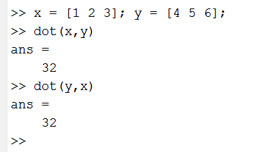
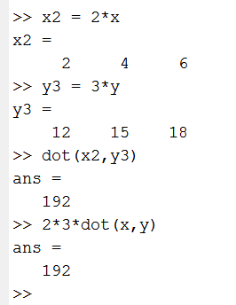
Properties of Dot Products (MATLAB)

