Slide 1
Chapters 10 & 11
Matthew Turner (2016)
CC BY-NC-SA 4.0

Slide 2
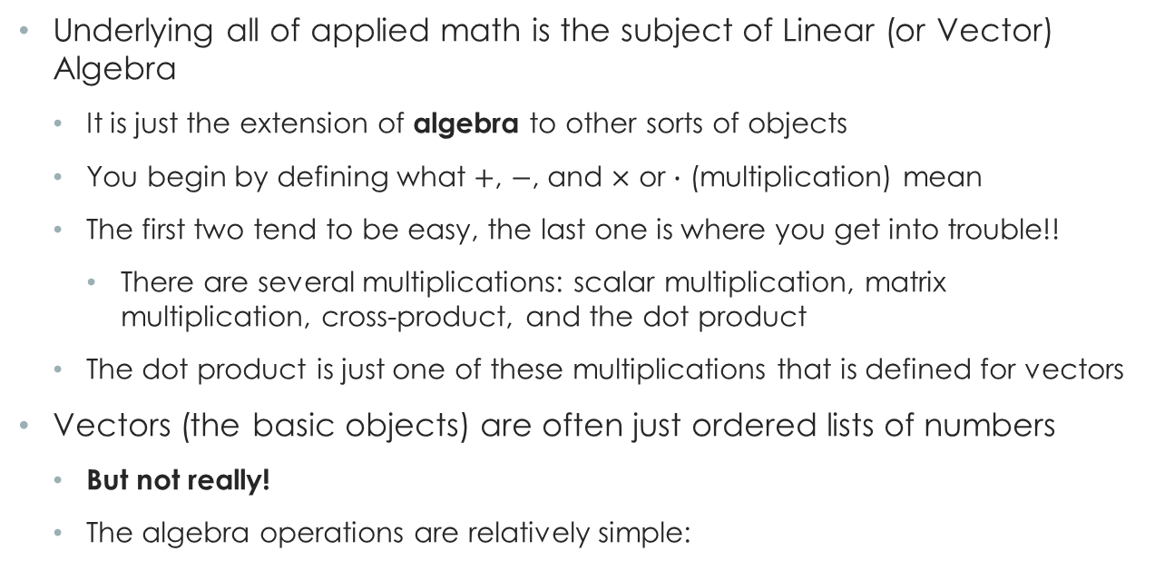
Linear Algebra
Underlying all of applied math is the subject of Linear (or Vector) Algebra
It is just the extension of algebra to other sorts of objects
You begin by defining what $+$, $−$, and $×$ or $∙$ (multiplication) mean
The first two tend to be easy, the last one is where you get into trouble!!
There are several multiplications: scalar multiplication, matrix multiplication, cross-product, and the dot product
The dot product is just one of these multiplications that is defined for vectors
Vectors (the basic objects) are often just ordered lists of numbers
But not really!
The algebra operations are relatively simple:

Slide 3
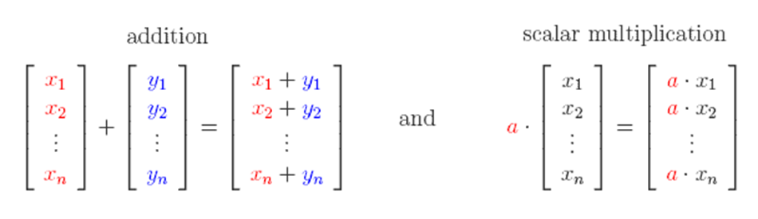

Linear Algebra
Vector addition (and subtraction) are easy (and obvious) with “scalar multiplication” being a useful if not immediately obvious idea:
Let $a=−1$ to get subtraction!
Vectors!

Slide 4
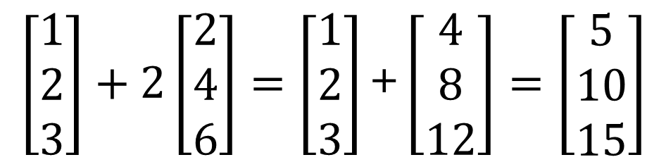
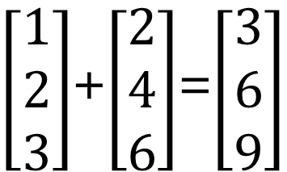
$\left[\begin{matrix}1 \\ 2 \\ 3\end{matrix}\right]$+$\left[\begin{matrix}2 \\ 4 \\ 6\end{matrix}\right]$=$\left[\begin{matrix}3 \\ 6 \\ 9\end{matrix}\right]$
$$\left[\begin{matrix}1 \\ 2 \\ 3\end{matrix}\right]+2\left[\begin{matrix}2 \\ 4 \\ 6\end{matrix}\right]=\left[\begin{matrix}1 \\ 2 \\ 3\end{matrix}\right]\text{+}\left[\begin{matrix}4 \\ 8 \\ 12\end{matrix}\right]=\left[\begin{matrix}5 \\ 10 \\ 15\end{matrix}\right]$$

Slide 5
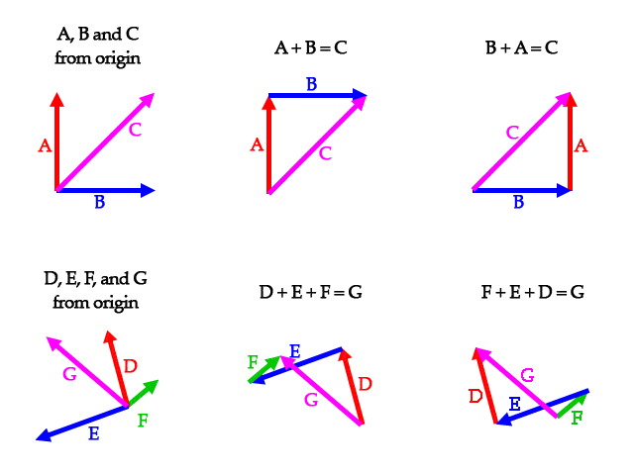
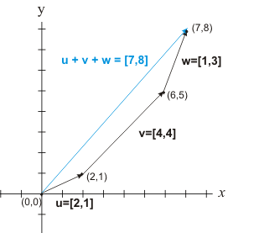

Slide 6
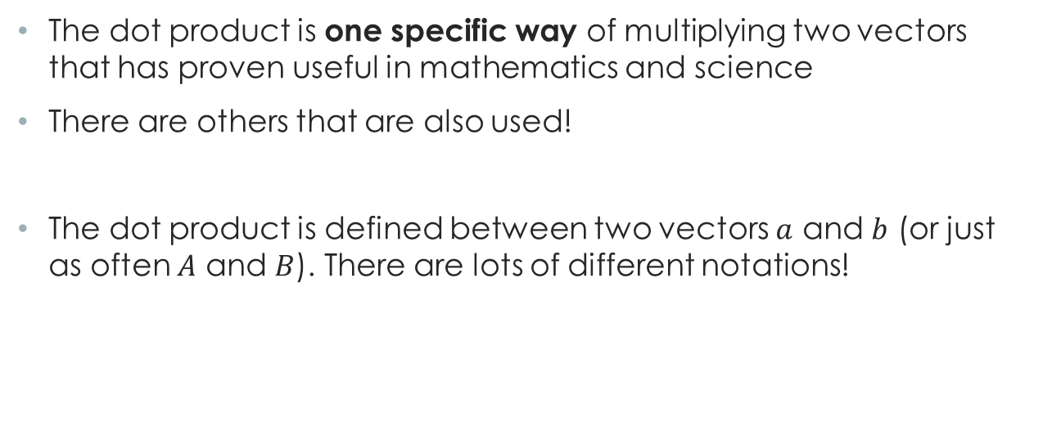
Dot Product
The dot product is one specific way of multiplying two vectors that has proven useful in mathematics and science
There are others that are also used!
The dot product is defined between two vectors $a$ and $b$ (or just as often $A$ and $B$). There are lots of different notations!

Slide 7
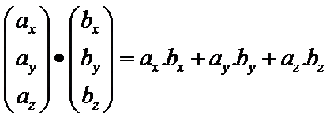
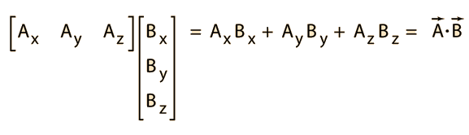
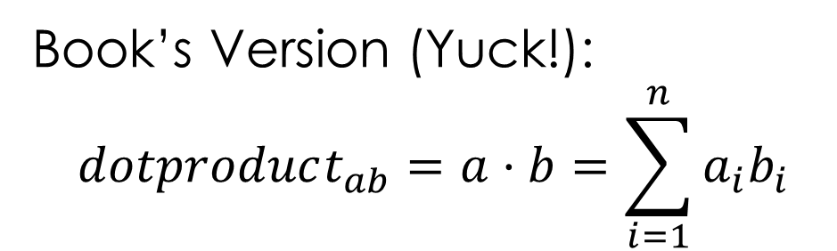
Dot Product Formula
Book’s Version (Yuck!):
$$dotproduct_{ab}=a⋅b=\sum_{i=1}^{n}{a_{i}b_{i}}$$

Slide 8
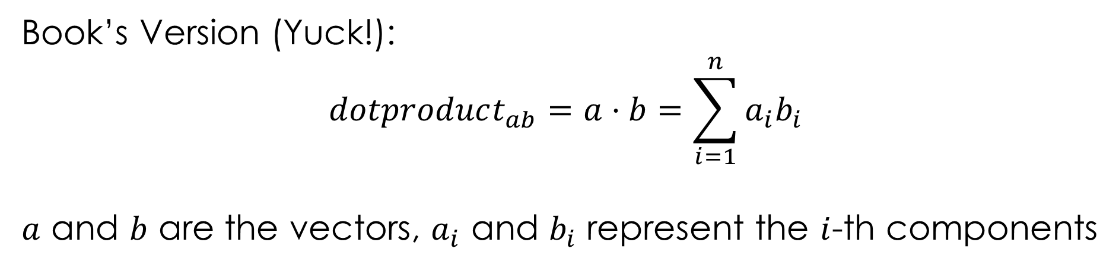
Dot Product Formula
Book’s Version (Yuck!):
$$dotproduct_{ab}=a⋅b=\sum_{i=1}^{n}{a_{i}b_{i}}$$
$a$ and $b$ are the vectors, $a_{i}$ and $b_{i}$ represent the $i$-th components

Slide 9
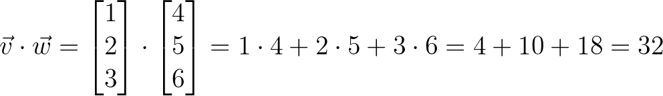
How to Compute the Dot Product
Given two vectors (lists of numbers):

Slide 10
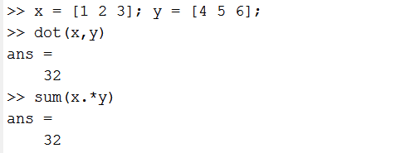
How to Compute It In MATLAB
Given two vectors (lists of numbers):
In MATLAB:
The “dot” before * means do something “elementwise” not “linear algebrawise” ☺

Slide 11
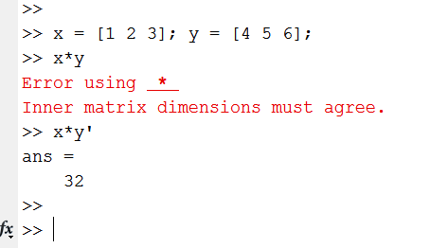
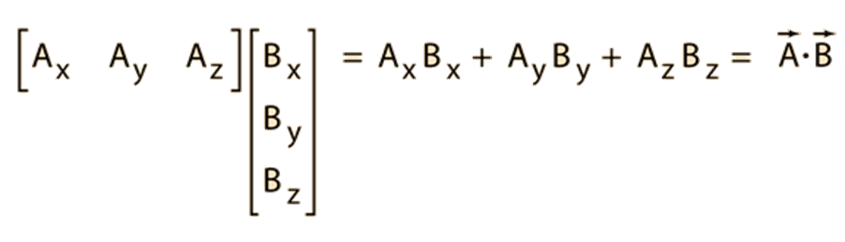
If you know a little bit about linear algebra, it seems like the dot product should just be multiplication.
It is.
Sort of…
You have to “transpose” the second vector, that is, stand it up:

Slide 12
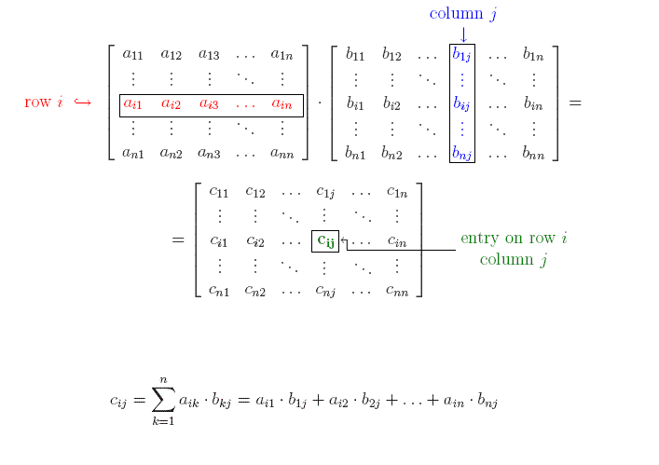
General multiplication is much harder—the obvious choice of just multiplying corresponding elements in matrices does not have useful mathematical properties.
Instead:

Slide 13
Dot Products
AKA:
Dot product
Scalar product
Inner product
The dot product is a single number
It can be thought of as a weighted sum (one vector is the set of numbers to be summed, the other the weights)
It is the length of the projection of one vector onto the (dimension of) the other vector
It also relates to a similarity measure

Slide 14
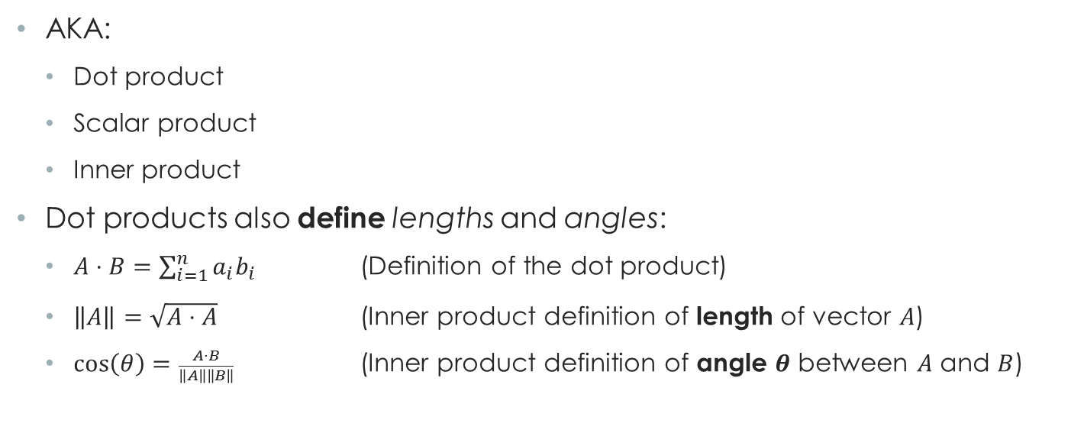
Dot Products
AKA:
Dot product
Scalar product
Inner product
Dot products also define lengths and angles:
$A⋅B=\sum_{i=1}^{n}{a_{i}b_{i}}$ (Definition of the dot product)
$\left\|A\right\|=\sqrt{A⋅A}$ (Inner product definition of length of vector $A$)
$\cos\left(θ\right)=\frac{A⋅B}{\left\|A\right\|\left\|B\right\|}$ (Inner product definition of angle $θ$ between $A$ and $B$)

Slide 15
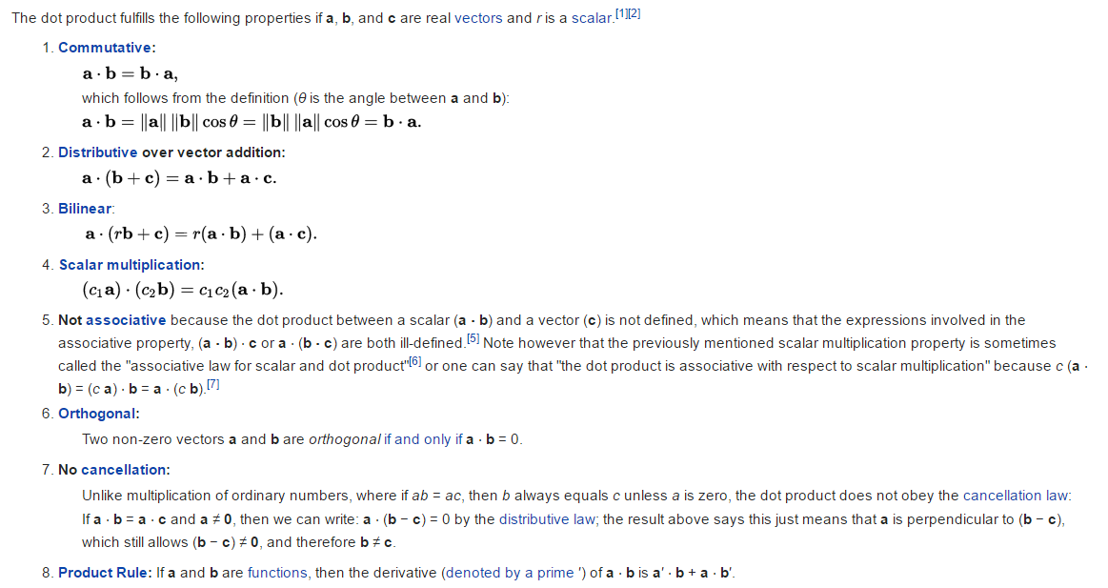
Properties of Dot Products

Slide 16
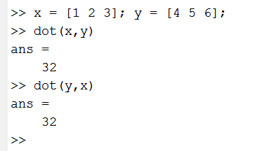
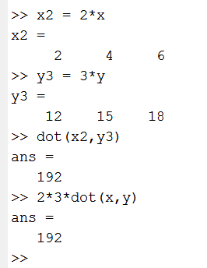
Properties of Dot Products (MATLAB)

Slide 17
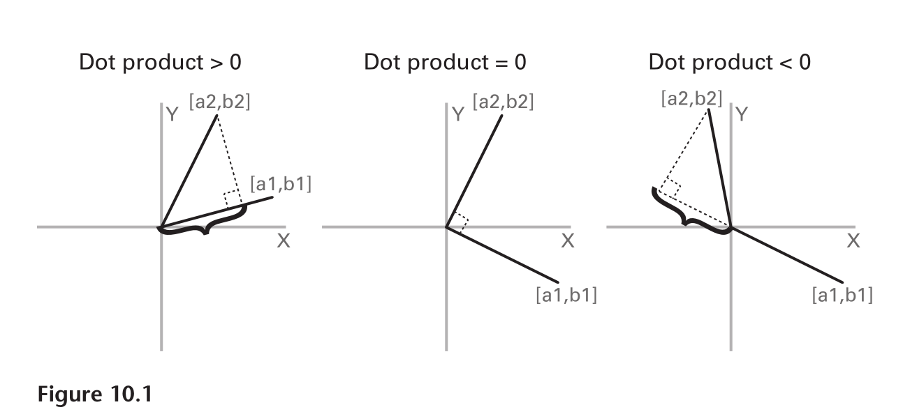
Orthogonal Case
The dot product can be thought of as the length along one of the vectors of the projection of the other vector.

Slide 18
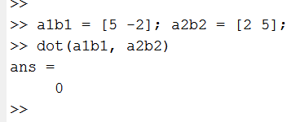
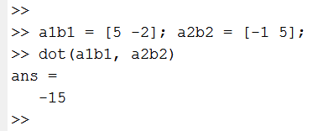
Orthogonal Case

Slide 19
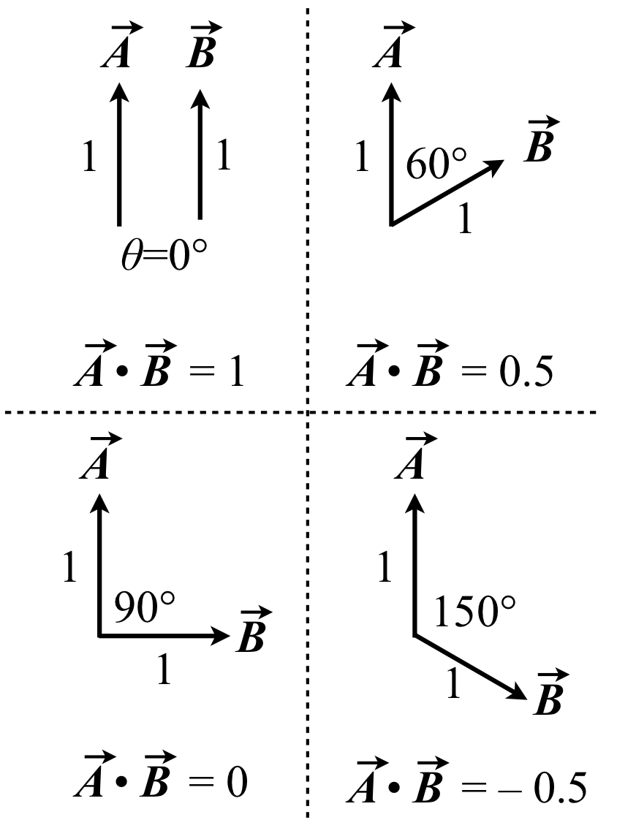
Vectors in the same direction: 1
Vectors perpendicular (orthogonal): 0
Acute Angles: Positive
Obtuse Angles: Negative
http://textbook.scotthill.us/01-Vectors/04-Dot.php See also the vector sections of: http://textbook.scotthill.us/ more generally.

Slide 20
Weird at First
It takes some getting used to, but our vectors live in a high dimensional space:
A vector of length 2 is a point in 2-space (the Cartesian plane)
A vector of length 3 is a point in 3-D space
A vector representing a 2 second sample of EEG (for one electrode) with a sampling rate of 512 Hz is a vector of length 1024
It lives as a single point in a 1024-dimensional space
Each number in the vector is one coordinate of the 1024-dimensional point

Slide 21
Convolution
Has been called a “rolling together” of two vectors (or functions or signals)
Think of it as smearing and shifting the signal

Slide 22
http://bmia.bmt.tue.nl/education/courses/fev/course/notebooks/triangleblockconvolution.gif

Slide 23

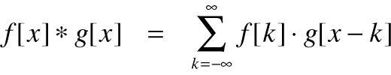
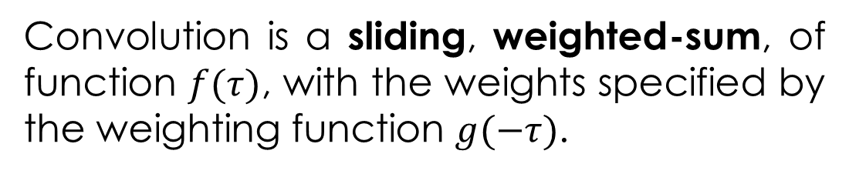

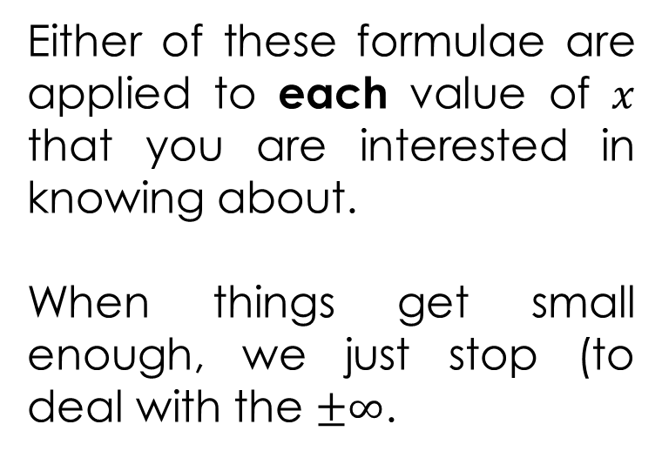
Formula for convolution for a point $x$:
Either of these formulae are applied to each value of $x$ that you are interested in knowing about.
When things get small enough, we just stop (to deal with the $±∞$.
Convolution is a sliding, weighted-sum, of function $f(τ)$, with the weights specified by the weighting function $g(−τ)$.
Sorry! The book calls my “x” here “k”!!

Slide 24
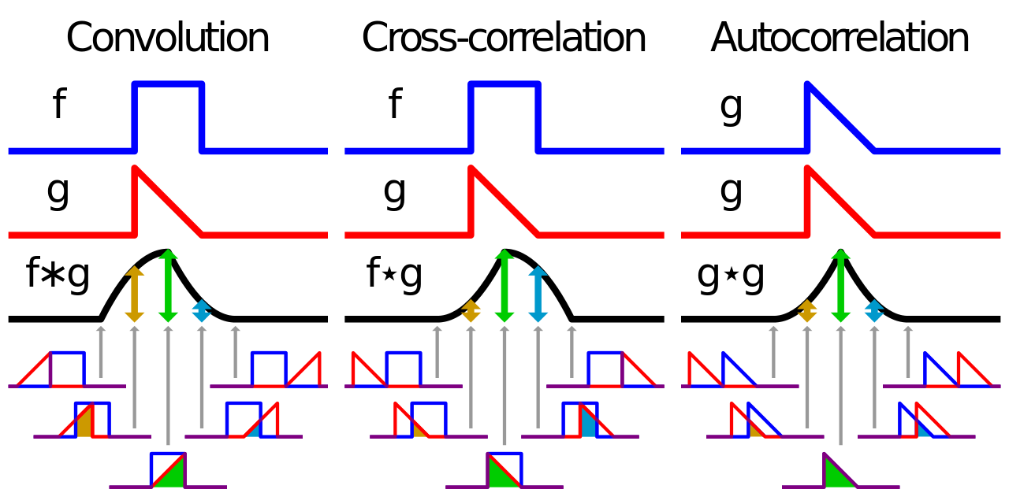

Slide 25
Convolution
Has been called a “rolling together” of two vectors (or functions or signals)
Think of it as smearing and shifting the signal
What about the end points?
Zero padding
Trim excess points at the end (p. 115)

Slide 26
Why Convolve?
Convolution is how you apply a filter to a data signal
It can show the action of a physical system: the system’s effect is called the “impulse response” and this is convolved with the input signal
In EEG, this is used in modeling the effect of the skull on the EEG, for instance
We will use it to pick out frequency band specific activity from the EEG signal

