Slide 1
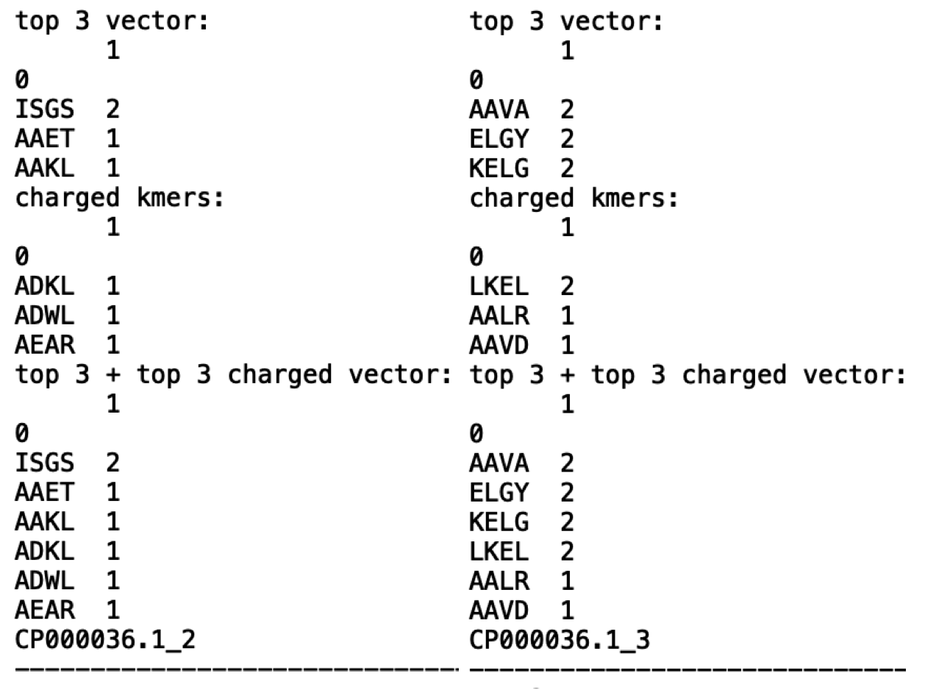

Slide 2
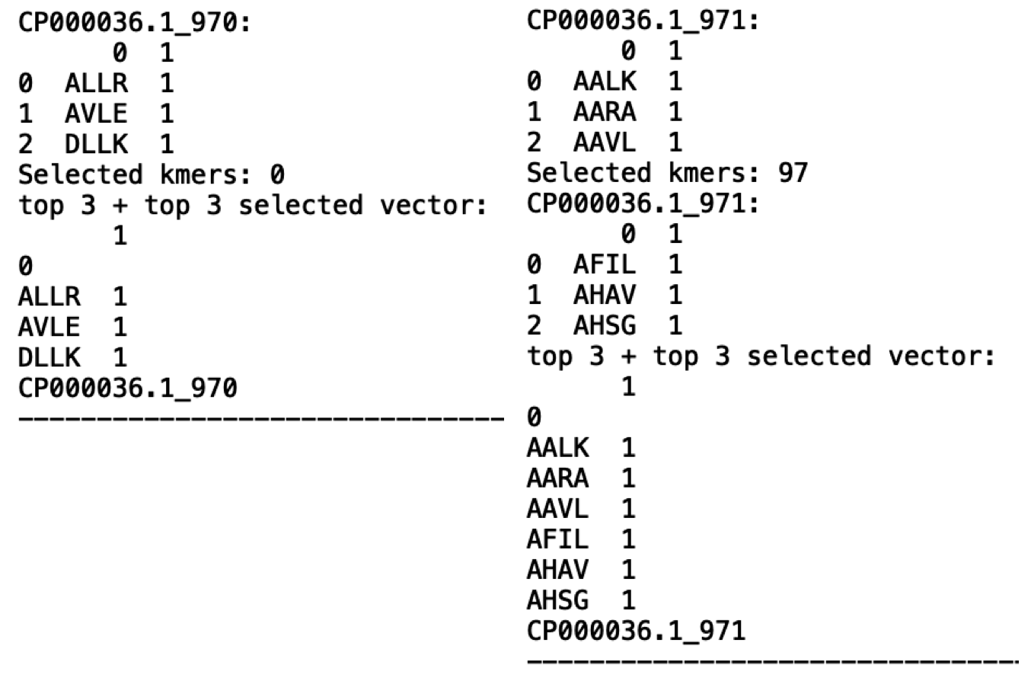

Slide 3
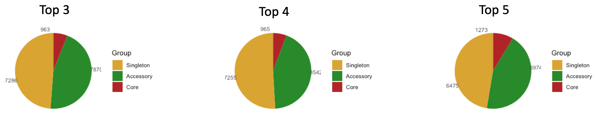
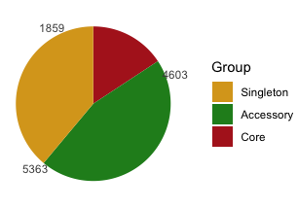





4mers (all)
4mers (all)
4mers (all)
Top 3 4mers (all) + top 3 FYWH 4mers (100% core)
Top 3 4mers (all) + top 3 CM 4mers (100% core)
Top 3 4mers (all) + top 3 FYWH 4mers + top 3 CM 4mers (100% core)
Top 3 4mers (all) + top 3 FYWH 4mers (90% core)
Top 3 4mers (all) + top 3 CM 4mers (90% core)
Top 3 4mers (all) + top 3 FYWH 4mers + top 3 CM 4mers (90% core)

