Slide 1
Are States with Larger Low-Income Populations More Sensitive to Price Increases?
GEOG 4300 Final Sprint

Slide 2
Research Question
Are states with higher percentages of low-income households more sensitive to price increases during the COVID-19 pandemic?

Slide 3
Measurement
Low-Income: measured by percentage of households making less than $25,000 a year
Price-Change Sensitivity:
percent noting an increase in prices
percent “very stressed” by increase in prices

Slide 4
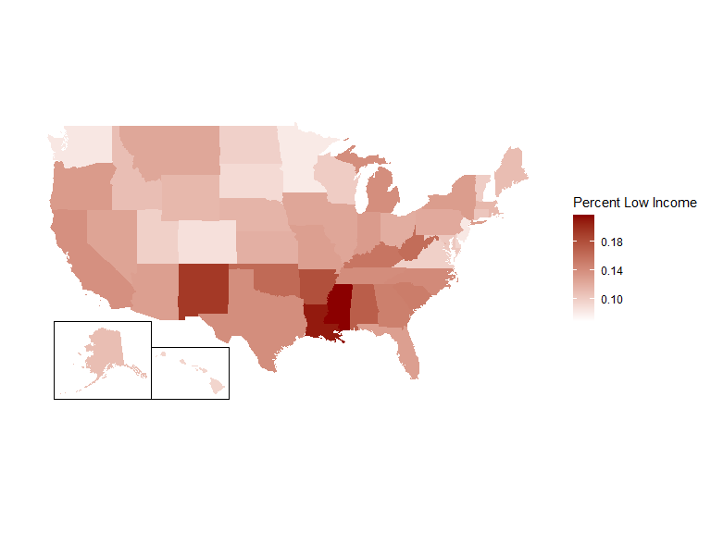
The US Low-Income Landscape

Slide 5
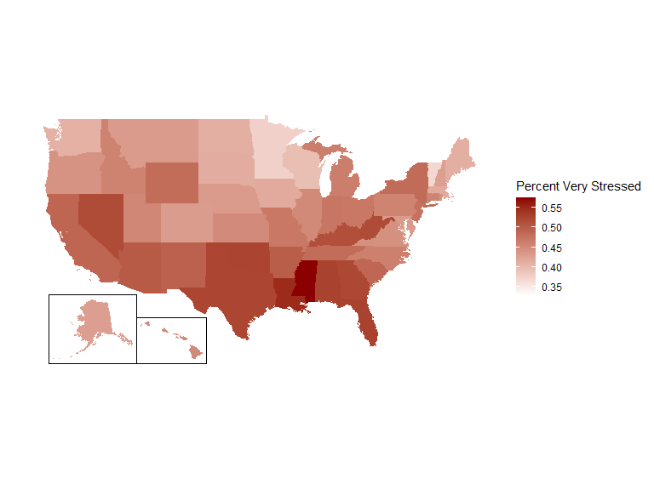
The Most Stressed States

Slide 6
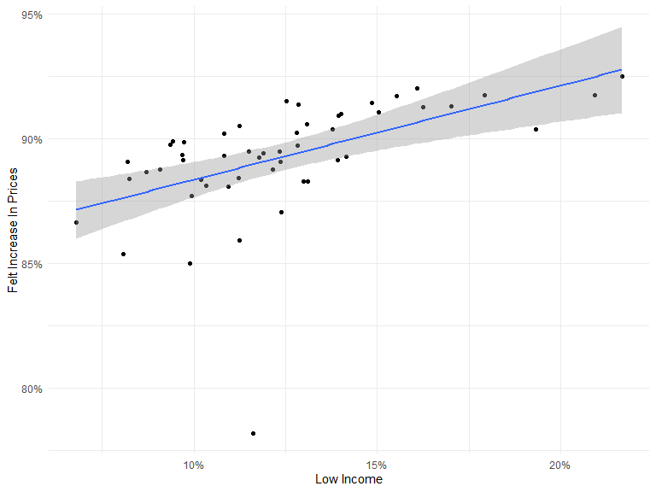
Sensitivity to Change: Notice
Intercept: 0.8458627
Effect: 0.3777932
Adj. R-Squared: 0.2570236
Model P-Value: 8.7276546^{-5}

Slide 7
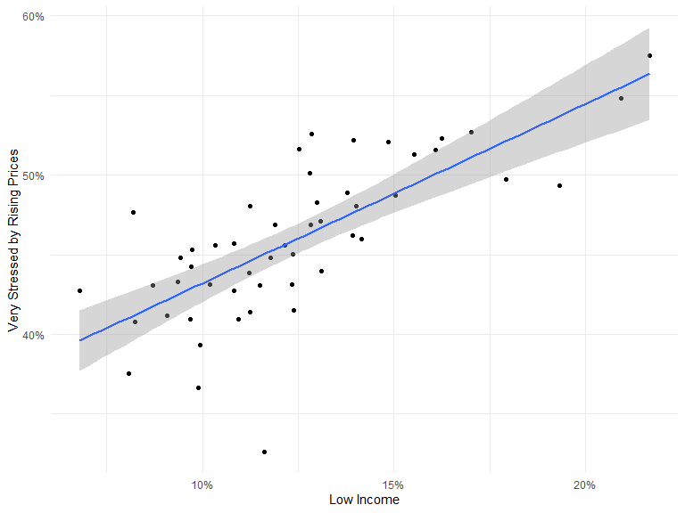
Sensitivity to Change: Stress
Intercept: 0.3194771
Effect: 1.1261788
Adj. R-Squared: 0.5334505
Model P-Value: 7.1357101^{-10}

Slide 8
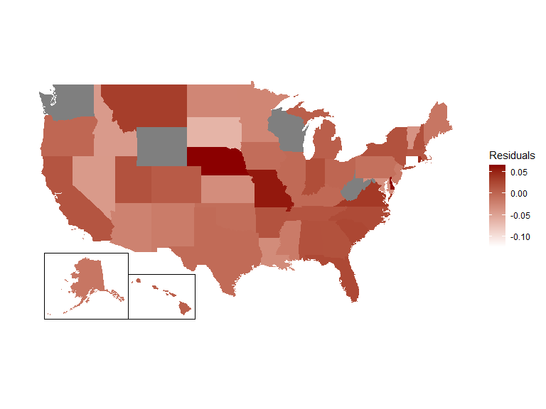
Looking at Outliers

Slide 9
Conclusions
Higher shares of low-income households in a state were associated with significantly higher rates of stress resulting from price increases
Higher shares of low-income households in a state were associated with slightly higher rates of noticing price increases, although the overall level remained high during the survey period

Slide 10
Further Research
Could include other variables in the survey, like changes in consumption behavior, to measure sensitivity/responsiveness
Could include more income levels

Slide 11
Questions?

