Slide 1
Are States with Larger Low-Income Populations More Sensitive to Price Increases?
GEOG 4300 Final Sprint

Slide 2
Research Question
Are states with higher percentages of low-income households more sensitive to price increases during the COVID-19 pandemic?

Slide 3
Measurement
Low-Income: measured by percentage of households making less than $25,000 a year
Price-Change Sensitivity:
percent noting an increase in prices
percent “very stressed” by increase in prices

Slide 4
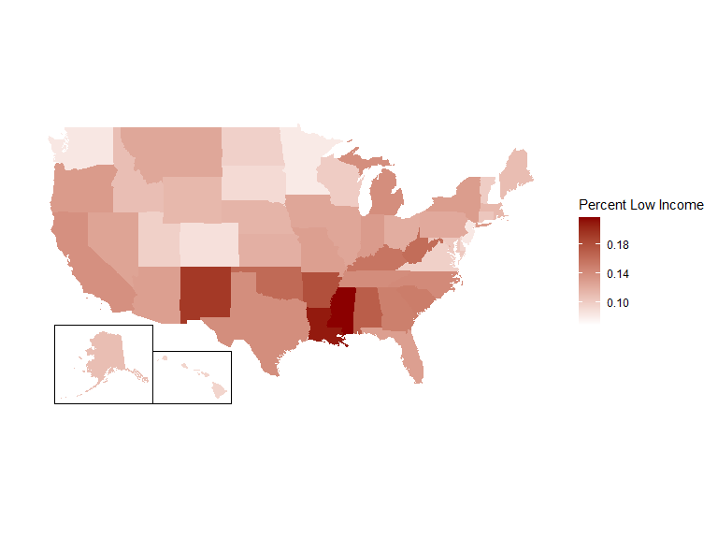
The US Low-Income Landscape

Slide 5
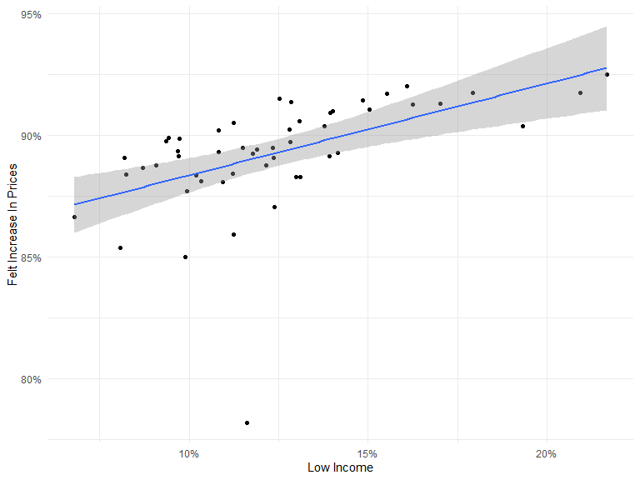
Sensitivity to Change: Notice
Intercept: 0.8458627
Effect: 0.3777932
Adj. R-Squared: 0.2570236
Model P-Value: 8.7276546^{-5}

Slide 6
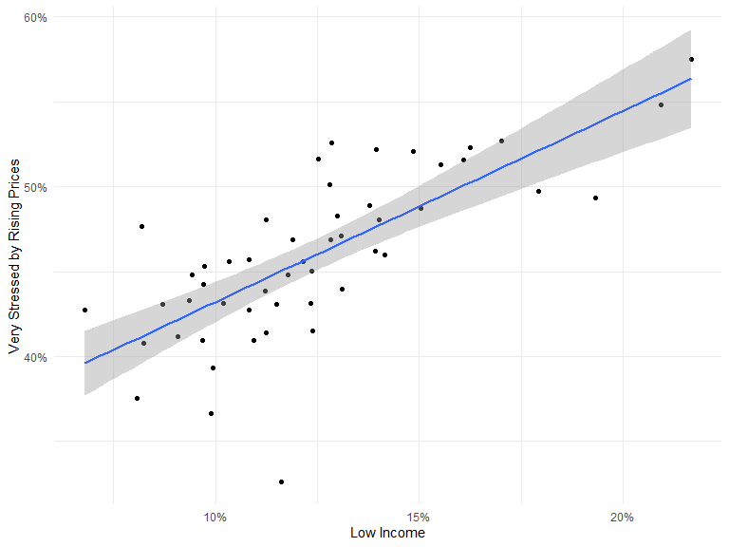
Sensitivity to Change: Stress
Intercept: 0.3194771
Effect: 1.1261788
Adj. R-Squared: 0.5334505
Model P-Value: 7.1357101^{-10}

Slide 7
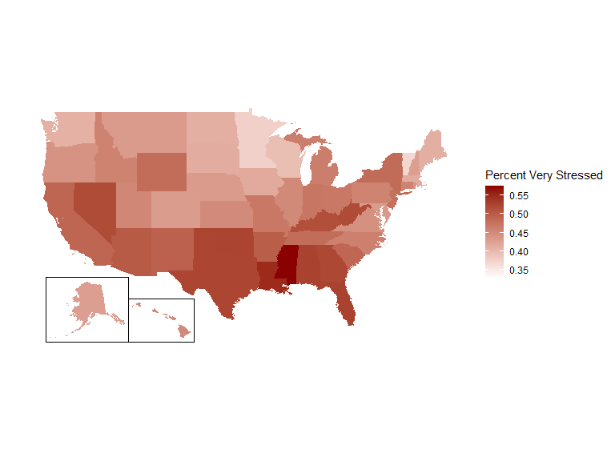
The Most Stressed States

Slide 8
Conclusions
Higher shares of low-income households in a state were associated with significantly higher rates of stress resulting from price increases
Higher shares of low-income households in a state were associated with slightly higher rates of noticing price increases, although the overall level remained high during the survey period

Slide 9
Further Research
Could include other variables in the survey, like changes in consumption behavior, to measure sensitivity/responsiveness
Could include more income levels

Slide 10
Questions?

