Slide 1
Modeling hospital-acquired infections
Mar-10-2016
Iwo Dubaniowski
Tianyin Sun

Slide 2
Outline
Introduction
Motivation
Objective
Model description
General assumptions
Mechanisms
Summary

Slide 3
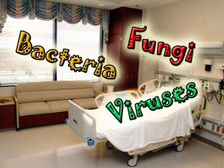
Introduction
In 2011, 75’000 patients died in the US due to hospital-acquired infections.
1 out of 25 hospital patients in the US ends up with hospital-acquired infections
Contraction of hospital-acquired infections depends on hospital bedding arrangements
1, 2, or 3 bed wards exist in hospitals
Currently there is no robust way of preventing hospital-acquired infections epidemics
(Source: mercola.com)

Slide 4
Motivations
Better understanding of spread of the infections
Facilitating better hospital systems design and management to insure safer hospital environment

Slide 5
Objectives
To design and implement an agent-based model to simulate spreading of hospital-acquired infections
To obtain the optimal ratio between patients and staff
To obtain sufficient number of sanitary facilities given number of staff and patients

Slide 6
Model description
A model based on the SIRS(Susceptible, Infectious, Recovered, Susceptible) model
To include a stochastic approach addressing uncertainty involved in data for model parameterization

Slide 7
Hospital set-up and general assumptions
Hospital is modelled as a grid of rooms containing 1, 2 or 3 patients and varying number of staff
Infection spreads to susceptible patients or staff through interaction
Staff moves between rooms, patients stay immobilized
No interaction of patients between separate rooms
Recovered patients become susceptible eventually
Staff carries infections
Staff should attempt to go through sanitary process
Sterilizing room

Slide 8
Mechanisms in model
Contract the disease (transfer to infected state) with a given probability
Recovery takes place on time-dependent basis with a given probability
Become susceptible after recovery on time-dependent basis with a given probability
If staff get cleaned in sterilizing room, they don’t infect the others

Slide 9
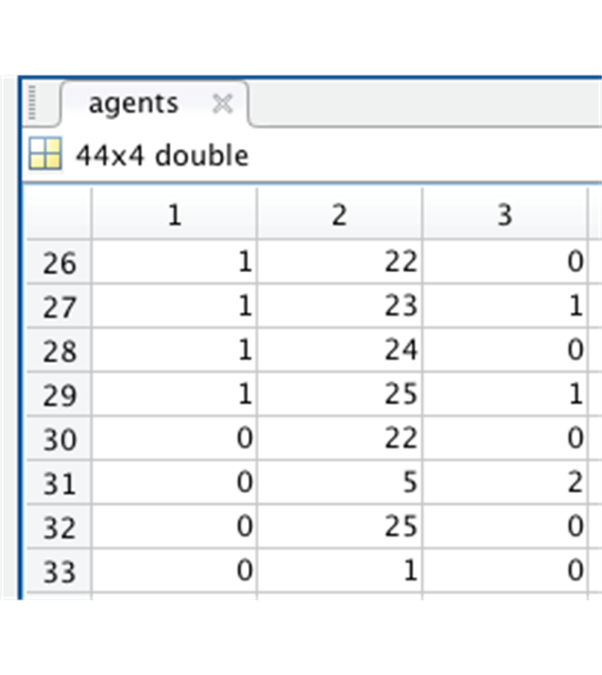
Methods
Data structure keeping track of agents
1 – agent type (staff or patient)
2 – room number
3 – agent status (susceptible, infected, recovered)
The program iterates over time, over agents, and updates agents
Probability of state transitions for different types of agents is given
Probability of state transitions could be stochastic

Slide 10
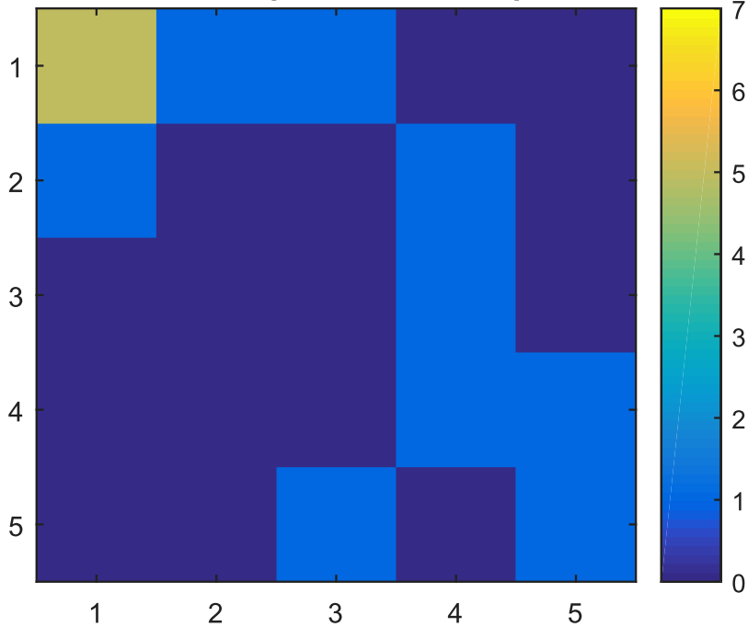
Results
Heatmap shows distribution of infected patients across rooms in a hospital
Each square represents one room in a hospital
The map updates in real time while the simulation is running

Slide 11
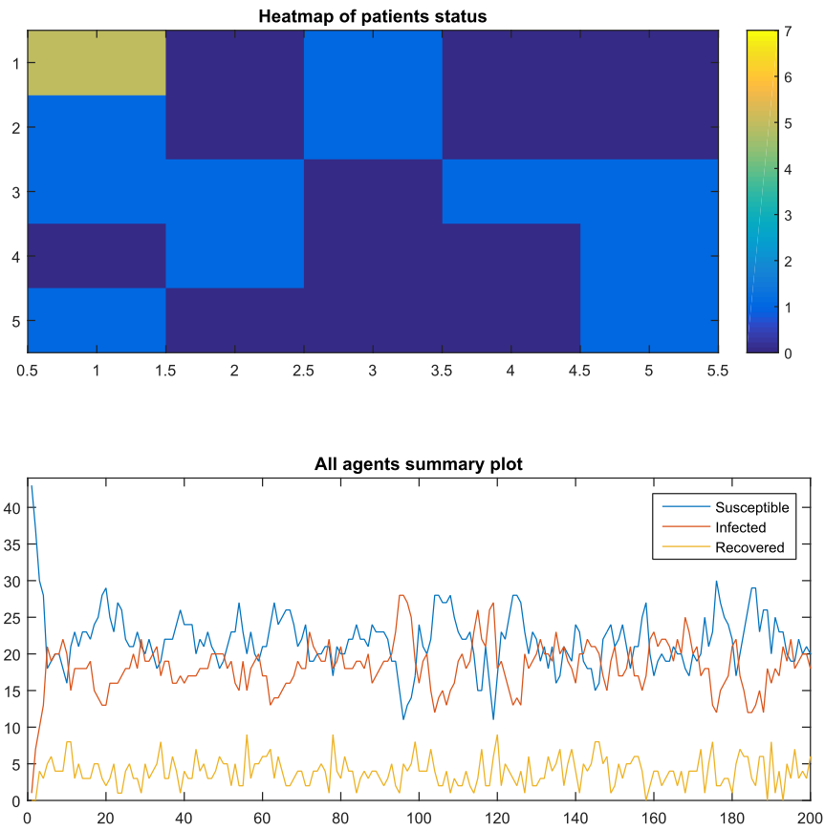
Results

Slide 12
Summary
Hospital-acquired infections are a serious problem of hospitals.
We developed a model to better understand the spreading of hospital-acquired infections
The approach we used is the SIRS model
The model developed is able to simulate infections spreading throughout a hospital and to see the variations of by different setting-up of a hospital

