Slide 1
Modeling US power grid network disruptions
Mateusz Dubaniowski

Slide 2
Outline
Introduction – problem
Task objective
Solution
Methodology
Populating network
Balancing methodology
Statistics reported
Results
Summary

Slide 3
Problem
Electricity is an important part of our lives
Used by businesses, individuals, governments…
Electrical grids consist of many various components
Potential targets of hostile attacks
Environmental conditions could also result in a compromise
Identifying the most critical elements of power grid systems
How we could mitigate failures of these components?

Slide 4
Task
To design and implement a simulation of a power grid network and measure its response to node failures
US power grid topology from D. J. Watts and S. H. Strogatz, Nature 393, 440-442 (1998) was used
Topology only, values of vertices and edges are randomly generated

Slide 5
Solution
Set up a network based on the US power grid topology
Populate the network with attributes for edges and vertices
Capacities of vertices – energy production or consumption
Capacities of edges – transmission lines’ bandwidth
Load balance the network to make sure all capacities of vertices >0
Remove a node or an edge (or decrease capacity)
Attempt load balancing again, see whether balanceable
Present the results and various statistics about the networks

Slide 6
Methodology – network population
US power grid network graph used is just a topology
Network needs to be populated with data about energy sources and edges’ capacities
We use 1/30 of all nodes as energy producers and randomly assign the amount produced
We use the rest as consumers, which consume 5-100 times smaller amounts of energy
The edges are populated accordingly to be able to handle twice the average load of an edge
Ensure that each node can be theoretically discharged through connected edges

Slide 7
Methodology – balancing the network
Network is balanced to see if it can satisfy all nodes
We average all neighboring nodes until all of them are satisfied
Satisfied means energy available to them at the moment is non-negative
Energy exchanged between the nodes cannot exceed connecting edge’s capacity
If there is no change at all in subsequent steps, or maximum change in a step is very small, we determine that the network cannot be balanced

Slide 8
Results
We present various statistics on the networks after balancing both before and after disruption
The following statistics are presented:
Net energy value – how much energy is unused in the system
Total energy produced
Total energy consumed
Average edge bandwidth – mean capacity of an edge
Average initial min. edge bandwidth – Total energy produced/number of edges
Extra bandwidth available in the network – Total capacity of edges – Used capacity of edges
Edges close to or at peakBandwidth – Edges which utilize more than 90% of their capacity – these are potentially critical edges

Slide 9
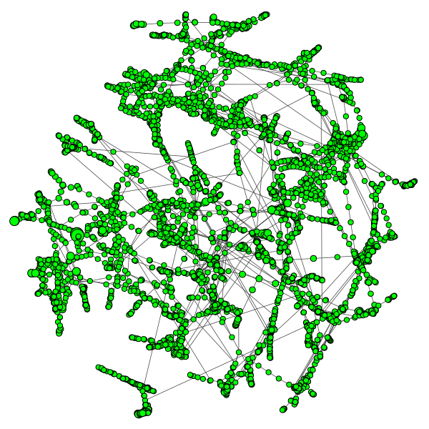
Screenshot
We also produce graph representations of the network.
Green nodes correspond to satisfied nodes
Red nodes correspond to unsatisfied nodes with not enough electricity supplied to them

Slide 10
Results
The results could help predict for a given network whether a removal of an edge or a node would constitute a failure of the network
We can also see which edges are especially occupied in a given network i.e. which edges operate at peak bandwidth
Moreover, we can investigate what the performance of a network is as edge or node capacity decreases
This would allow us to develop more robust networks

Slide 11
Summary
Understanding where critical points of an electrical supply network are is crucial to its resiliency
We developed a simulation that predicts US power grid’s behavior when a node is removed or its capacity decreased
The approach uses load balancing of a graph as the main tool
The model run with random capacities but same topology shows that the design of network’s capacities has a big impact on the network’s resiliency

