Slide 1
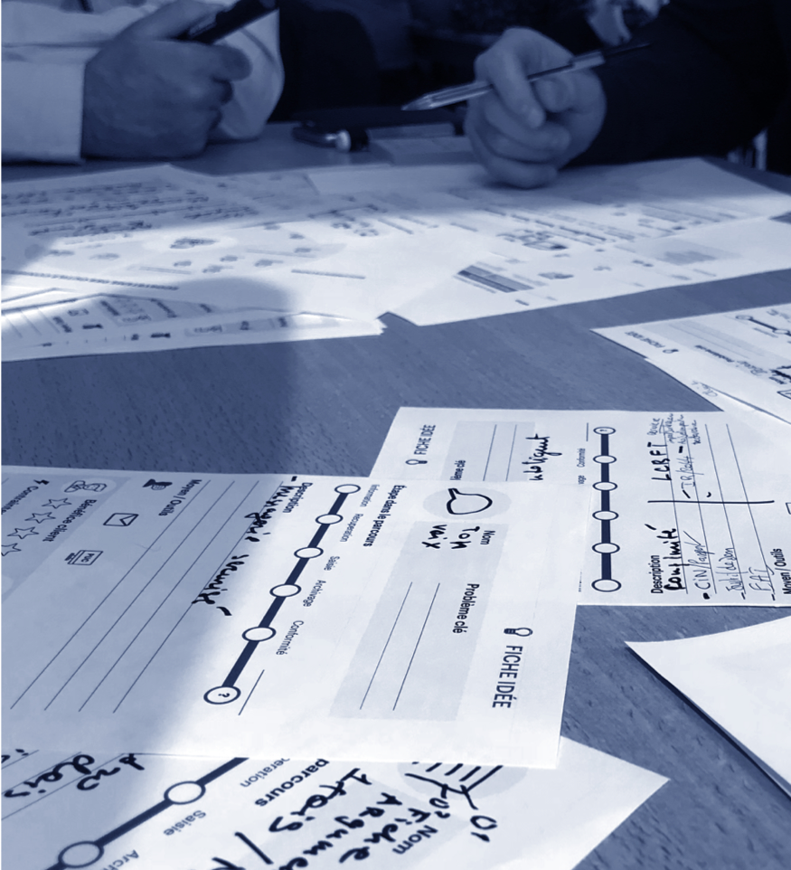
Functional programming in the JS ecosystem
Version 01 • Février 2020
Notes:
Rappeler que tout ce qui est amené dans cette presentation est sujet à débat et ne pretends pas apporter de solutions universelle à l’utilization des principes fonctionnels.

Slide 2
Contents
01.
02.
03.
04.
Principles of the functional paradigm
Application of FP principles in JS
Isolation of side effects
Some helpful tools
p.03–06
p.07–12
p.13–17
p.18–19

Slide 3
Principles of the functional paradigm
01.

Slide 4
functional programming: ‘’ Declarative paradigm of programmation in which functions are first-class citizens. ’’
OCaml docs
Notes:
Expliquer brièvement le terme “Déclaratif”: Paradigme de prog. reposant sur des composants logiciels dénués de contexte et d’êtats internes

Slide 5
Functions are pure
They are of fixed arity
They do not have any context
They do not produce side effects

Slide 6
Advantages
of functional programming
No mutations of external context, thus less race conditions
Code describes WHAT the program does, not HOW, thus is easier to refactor and to read
Functions do few tasks (ideally 1), thus are easier to test, and to reuse across the project, or even across different codebases

Slide 7
Application of FP principles in JS
02.
Notes:
Rappeler que les principes et procédés suivants ne peuvent et ne doivent pas être appliqués aveuglément.
Ce sont simplement des principes utilisables même dans des contextes très impératifs et qui peuvent améliorer la logique, la propreté, et la lisibilité du code.

Slide 8

Currying
i.e. make n unary functions out of one function accepting n arguments.
Notes:
Évoquer la memoization
https://carbon.now.sh/?bg=rgba(171%2C184%2C195%2C0)&t=dracula&wt=none&l=javascript&ds=false&dsyoff=20px&dsblur=68px&wc=false&wa=true&pv=56px&ph=56px&ln=false&fl=1&fm=Hack&fs=14px&lh=133%25&si=false&es=2x&wm=false&code=const%2520enormousProductsDataSet%2520%253D%2520%255B%250A%2520%2520%2520%2520%257B%250A%2520%2520%2520%2520%2520%2520name%253A%2520%2522Brioche%2520Pasquier%2522%252C%250A%2520%2520%2520%2520%2520%2520category%253A%2520%2522Viennoiseries%2522%252C%250A%2520%2520%2520%2520%2520%2520creationDate%253A%25201517516185%250A%2520%2520%2520%2520%257D%252C%250A%2520%2520%2520%2520%257B%250A%2520%2520%2520%2520%2520%2520name%253A%2520%2522Danonino%2520%25C3%25A0%2520la%2520fraise%2522%252C%250A%2520%2520%2520%2520%2520%2520category%253A%2520%2522Yaourts%2522%252C%250A%2520%2520%2520%2520%2520%2520creationDate%253A%25201643746585%250A%2520%2520%2520%2520%257D%250A%2520%2520%2520%2520%252F%252F%2520and%2520a%2520TRILLION%2520more%2520items%250A%255D%253B%250A%250A%252F%252F%2520%253D%253D%253D%253D%253D%253D%253D%253D%253D%253D%253D%253D%253D%2520%252F%252F%250A%252F%252F%2520WITHOUT%2520CURRYING%250A%252F%252F%2520%253D%253D%253D%253D%253D%253D%253D%253D%253D%253D%253D%253D%253D%2520%252F%252F%250A%250Aconst%2520orderProductsOfCategoryByCreationDate%2520%253D%2520(%250A%2520%2520%2520%2520products%252C%250A%2520%2520%2520%2520category%252C%250A%2520%2520%2520%2520ordering%2520%253D%2520%2522asc%2522%250A%2520%2520)%2520%253D%253E%2520%257B%250A%2520%2520%2520%2520%252F%252F%2520expensive%2520operation%2520for%2520a%2520huge%2520dataset%250A%2520%2520%2520%2520const%2520filteredProducts%2520%253D%2520products.filter(p%2520%253D%253E%2520p.category%2520%253D%253D%253D%2520category)%253B%250A%2520%2520%250A%2520%2520%2520%2520return%2520filteredProducts.sort((a%252C%2520b)%2520%253D%253E%250A%2520%2520%2520%2520%2520%2520ordering%2520%253D%253D%253D%2520%2522asc%2522%250A%2520%2520%2520%2520%2520%2520%2520%2520%253F%2520a.creationDate%2520-%2520b.creationDate%250A%2520%2520%2520%2520%2520%2520%2520%2520%253A%2520b.creationDate%2520-%2520a.creationDate%250A%2520%2520%2520%2520)%253B%250A%257D%253B%250A%2520%2520%250A%252F%252F%2520repetition%2520of%2520all%2520arguments%2520for%2520each%2520call%252C%2520call%2520to%2520expensive%2520filtering%2520for%2520each%2520call...%2520%253A%252F%250AorderProductsOfCategoryByCreationDate(enormousProductsDataSet%252C%2520%2522Viennoiseries%2522%252C%2520%2522asc%2522)%253B%250AorderProductsOfCategoryByCreationDate(enormousProductsDataSet%252C%2520%2522Viennoiseries%2522%252C%2520%2522desc%2522)%253B%250A%250A%250A%250A%250A%252F%252F%2520%253D%253D%253D%253D%253D%253D%253D%253D%253D%253D%253D%253D%253D%2520%252F%252F%250A%252F%252F%2520%2520WITH%2520CURRYING%250A%252F%252F%2520%253D%253D%253D%253D%253D%253D%253D%253D%253D%253D%253D%253D%253D%2520%252F%252F%250A%250Aconst%2520orderProductsOfCategoryByCreationDate%2520%253D%2520products%2520%253D%253E%2520category%2520%253D%253E%2520%257B%250A%2520%2520%2520%2520%252F%252F%2520expensive%2520operation%2520for%2520a%2520huge%2520dataset%250A%2520%2520%2520%2520const%2520filteredProducts%2520%253D%2520products.filter(p%2520%253D%253E%2520p.category%2520%253D%253D%253D%2520category)%253B%250A%2520%2520%250A%2520%2520%2520%2520return%2520(ordering%2520%253D%2520%2522asc%2522)%2520%253D%253E%250A%2520%2520%2520%2520%2520%2520filteredProducts.sort((a%252C%2520b)%2520%253D%253E%250A%2520%2520%2520%2520%2520%2520%2520%2520ordering%2520%253D%253D%253D%2520%2522asc%2522%250A%2520%2520%2520%2520%2520%2520%2520%2520%2520%2520%253F%2520a.creationDate%2520-%2520b.creationDate%250A%2520%2520%2520%2520%2520%2520%2520%2520%2520%2520%253A%2520b.creationDate%2520-%2520a.creationDate%250A%2520%2520%2520%2520%2520%2520)%253B%250A%257D%253B%250A%250A%252F%252F%2520expensive%2520filtering%2520of%2520products%2520is%2520made%2520here%252C%2520only%2520once%250Aconst%2520orderYaourtsByCreationDate%2520%253D%2520curry(orderProductsOfCategoryByCreationDate)(%250A%2520%2520%2520%2520enormousProductsDataSet%252C%250A%2520%2520%2520%2520%2522Yaourts%2522%250A)%253B%250A%250A%252F%252F%2520no%2520repetition%252C%2520no%2520filtering%2520for%2520each%2520call%250AorderYaourtsByCreationDate()%253B%250AorderYaourtsByCreationDate(%2522desc%2522)%253B%250A%2520%2520

Slide 9
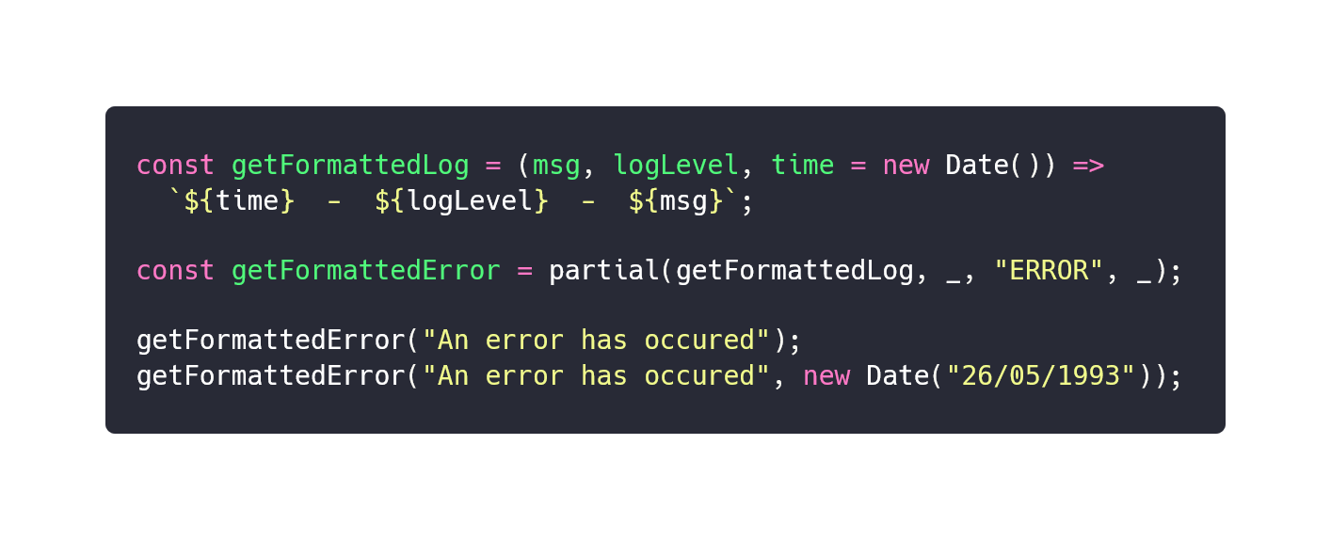
Partial application
i.e. fixing arguments of a function to produce a new one of smaller arity.
Notes:
https://carbon.now.sh/?bg=rgba(171%2C184%2C195%2C0)&t=dracula&wt=none&l=javascript&ds=false&dsyoff=20px&dsblur=68px&wc=false&wa=true&pv=56px&ph=56px&ln=false&fl=1&fm=Hack&fs=14px&lh=133%25&si=false&es=2x&wm=false&code=const%2520getFormattedLog%2520%253D%2520(msg%252C%2520logLevel%252C%2520time%2520%253D%2520new%2520Date())%2520%253D%253E%250A%2520%2520%2560%2524%257Btime%257D%2520%2520-%2520%2520%2524%257BlogLevel%257D%2520%2520-%2520%2520%2524%257Bmsg%257D%2560%253B%250A%250Aconst%2520getFormattedError%2520%253D%2520partial(getFormattedLog%252C%2520_%252C%2520%2522ERROR%2522%252C%2520_)%253B%250A%250AgetFormattedError(%2522An%2520error%2520has%2520occured%2522)%253B%250AgetFormattedError(%2522An%2520error%2520has%2520occured%2522%252C%2520new%2520Date(%252226%252F05%252F1993%2522))%253B
Differences:
La currification force l’unarité et facilite la composition
Avec la currification, une partie de la function est execute, on peut ainsi stocker ou memorize des traitements couteux

Slide 10
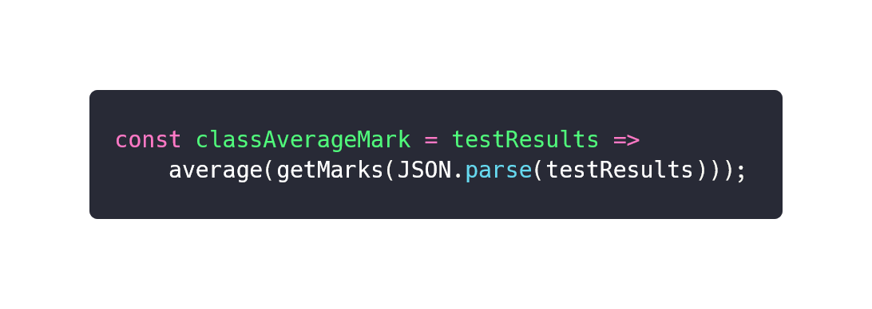
Function composition
i.e. combining multiple functions to create more complicated ones, by flowing the result of each function call to the subsequent.

Slide 11
Memoization
i.e. memoirizing the result of a fonction call to prevent costs of further calls.
Notes:
Évoquer la memoization
https://carbon.now.sh/?bg=rgba(171%2C184%2C195%2C0)&t=dracula&wt=none&l=javascript&ds=false&dsyoff=20px&dsblur=68px&wc=false&wa=true&pv=56px&ph=56px&ln=false&fl=1&fm=Hack&fs=14px&lh=133%25&si=false&es=2x&wm=false&code=const%2520enormousProductsDataSet%2520%253D%2520%255B%250A%2520%2520%2520%2520%257B%250A%2520%2520%2520%2520%2520%2520name%253A%2520%2522Brioche%2520Pasquier%2522%252C%250A%2520%2520%2520%2520%2520%2520category%253A%2520%2522Viennoiseries%2522%252C%250A%2520%2520%2520%2520%2520%2520creationDate%253A%25201517516185%250A%2520%2520%2520%2520%257D%252C%250A%2520%2520%2520%2520%257B%250A%2520%2520%2520%2520%2520%2520name%253A%2520%2522Danonino%2520%25C3%25A0%2520la%2520fraise%2522%252C%250A%2520%2520%2520%2520%2520%2520category%253A%2520%2522Yaourts%2522%252C%250A%2520%2520%2520%2520%2520%2520creationDate%253A%25201643746585%250A%2520%2520%2520%2520%257D%250A%2520%2520%2520%2520%252F%252F%2520and%2520a%2520TRILLION%2520more%2520items%250A%255D%253B%250A%250A%252F%252F%2520%253D%253D%253D%253D%253D%253D%253D%253D%253D%253D%253D%253D%253D%2520%252F%252F%250A%252F%252F%2520WITHOUT%2520CURRYING%250A%252F%252F%2520%253D%253D%253D%253D%253D%253D%253D%253D%253D%253D%253D%253D%253D%2520%252F%252F%250A%250Aconst%2520orderProductsOfCategoryByCreationDate%2520%253D%2520(%250A%2520%2520%2520%2520products%252C%250A%2520%2520%2520%2520category%252C%250A%2520%2520%2520%2520ordering%2520%253D%2520%2522asc%2522%250A%2520%2520)%2520%253D%253E%2520%257B%250A%2520%2520%2520%2520%252F%252F%2520expensive%2520operation%2520for%2520a%2520huge%2520dataset%250A%2520%2520%2520%2520const%2520filteredProducts%2520%253D%2520products.filter(p%2520%253D%253E%2520p.category%2520%253D%253D%253D%2520category)%253B%250A%2520%2520%250A%2520%2520%2520%2520return%2520filteredProducts.sort((a%252C%2520b)%2520%253D%253E%250A%2520%2520%2520%2520%2520%2520ordering%2520%253D%253D%253D%2520%2522asc%2522%250A%2520%2520%2520%2520%2520%2520%2520%2520%253F%2520a.creationDate%2520-%2520b.creationDate%250A%2520%2520%2520%2520%2520%2520%2520%2520%253A%2520b.creationDate%2520-%2520a.creationDate%250A%2520%2520%2520%2520)%253B%250A%257D%253B%250A%2520%2520%250A%252F%252F%2520repetition%2520of%2520all%2520arguments%2520for%2520each%2520call%252C%2520call%2520to%2520expensive%2520filtering%2520for%2520each%2520call...%2520%253A%252F%250AorderProductsOfCategoryByCreationDate(enormousProductsDataSet%252C%2520%2522Viennoiseries%2522%252C%2520%2522asc%2522)%253B%250AorderProductsOfCategoryByCreationDate(enormousProductsDataSet%252C%2520%2522Viennoiseries%2522%252C%2520%2522desc%2522)%253B%250A%250A%250A%250A%250A%252F%252F%2520%253D%253D%253D%253D%253D%253D%253D%253D%253D%253D%253D%253D%253D%2520%252F%252F%250A%252F%252F%2520%2520WITH%2520CURRYING%250A%252F%252F%2520%253D%253D%253D%253D%253D%253D%253D%253D%253D%253D%253D%253D%253D%2520%252F%252F%250A%250Aconst%2520orderProductsOfCategoryByCreationDate%2520%253D%2520products%2520%253D%253E%2520category%2520%253D%253E%2520%257B%250A%2520%2520%2520%2520%252F%252F%2520expensive%2520operation%2520for%2520a%2520huge%2520dataset%250A%2520%2520%2520%2520const%2520filteredProducts%2520%253D%2520products.filter(p%2520%253D%253E%2520p.category%2520%253D%253D%253D%2520category)%253B%250A%2520%2520%250A%2520%2520%2520%2520return%2520(ordering%2520%253D%2520%2522asc%2522)%2520%253D%253E%250A%2520%2520%2520%2520%2520%2520filteredProducts.sort((a%252C%2520b)%2520%253D%253E%250A%2520%2520%2520%2520%2520%2520%2520%2520ordering%2520%253D%253D%253D%2520%2522asc%2522%250A%2520%2520%2520%2520%2520%2520%2520%2520%2520%2520%253F%2520a.creationDate%2520-%2520b.creationDate%250A%2520%2520%2520%2520%2520%2520%2520%2520%2520%2520%253A%2520b.creationDate%2520-%2520a.creationDate%250A%2520%2520%2520%2520%2520%2520)%253B%250A%257D%253B%250A%250A%252F%252F%2520expensive%2520filtering%2520of%2520products%2520is%2520made%2520here%252C%2520only%2520once%250Aconst%2520orderYaourtsByCreationDate%2520%253D%2520curry(orderProductsOfCategoryByCreationDate)(%250A%2520%2520%2520%2520enormousProductsDataSet%252C%250A%2520%2520%2520%2520%2522Yaourts%2522%250A)%253B%250A%250A%252F%252F%2520no%2520repetition%252C%2520no%2520filtering%2520for%2520each%2520call%250AorderYaourtsByCreationDate()%253B%250AorderYaourtsByCreationDate(%2522desc%2522)%253B%250A%2520%2520

Slide 12
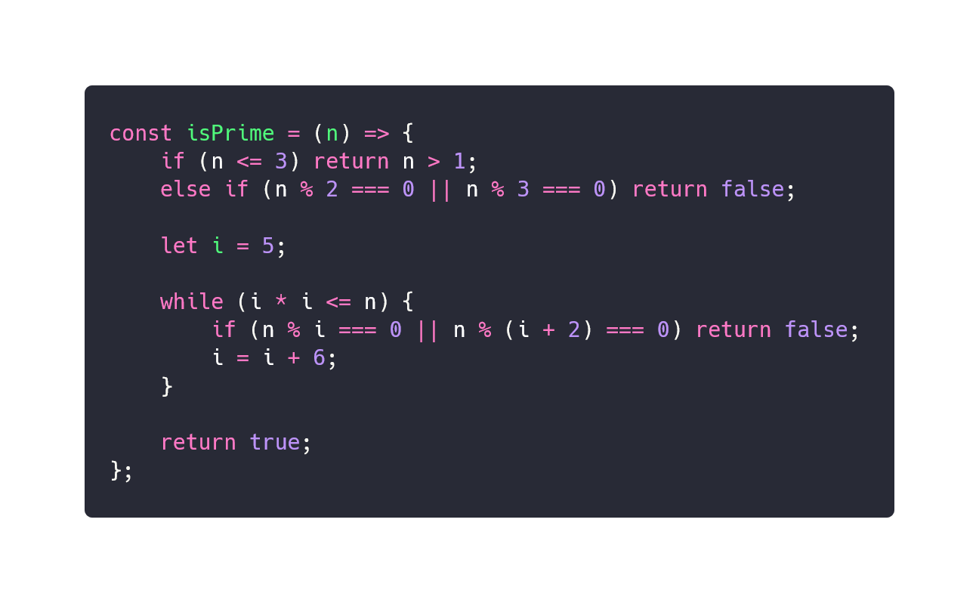
Recursive functions
isPrime - loop version
Notes:
loopVersion: https://carbon.now.sh/?bg=rgba(171%2C184%2C195%2C0)&t=dracula&wt=none&l=javascript&ds=false&dsyoff=20px&dsblur=68px&wc=false&wa=true&pv=56px&ph=56px&ln=false&fl=1&fm=Hack&fs=14px&lh=133%25&si=false&es=2x&wm=false&code=const%2520isPrime%2520%253D%2520(n)%2520%253D%253E%2520%257B%250A%2509if%2520(n%2520%253C%253D%25203)%2520return%2520n%2520%253E%25201%253B%250A%2520%2520%2520%2520else%2520if%2520(n%2520%2525%25202%2520%253D%253D%253D%25200%2520%257C%257C%2520n%2520%2525%25203%2520%253D%253D%253D%25200)%250A%2520%2520%2520%2520%2520%2520%2520%2520return%2520false%253B%250A%250A%2520%2520%2520%2520let%2520i%2520%253D%25205%253B%250A%250A%2520%2520%2520%2520while%2520(i%2520*%2520i%2520%253C%253D%2520n)%2520%257B%250A%2520%2520%2520%2520%2509if%2520(n%2520%2525%2520i%2520%253D%253D%253D%25200%2520%257C%257C%2520n%2520%2525%2520(i%2520%252B%25202)%2520%253D%253D%253D%25200)%250A%2520%2520%2520%2520%2520%2520%2520%2520%2520%2520%2520%2520return%2520false%253B%250A%2520%2520%2520%2520%2520%2520%2520%2520i%2520%253D%2520i%2520%252B%25206%253B%250A%2520%2520%2520%2520%257D%250A%250A%2520%2520%2520%2520return%2520true%253B%250A%257D%253B

Slide 13
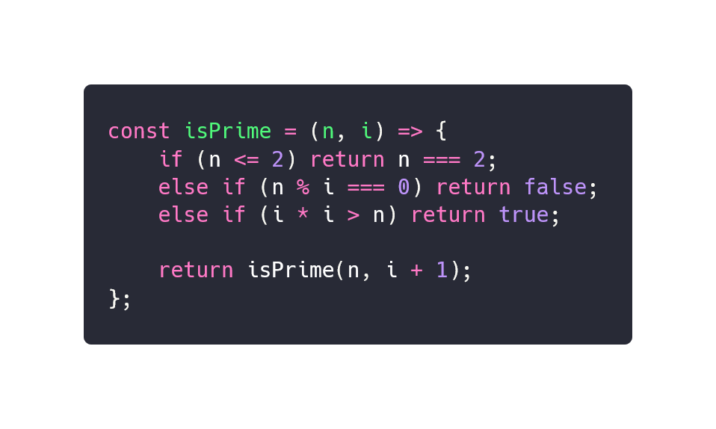
Recursive functions
isPrime - recursive version
Notes:
Rappeler que quand il s’agit de loop sur des tableaux, l’utilisations des fonctions chainées des Array JS est recommandée.
https://carbon.now.sh/?bg=rgba(171%2C184%2C195%2C0)&t=dracula&wt=none&l=javascript&ds=false&dsyoff=20px&dsblur=68px&wc=false&wa=true&pv=56px&ph=56px&ln=false&fl=1&fm=Hack&fs=14px&lh=133%25&si=false&es=2x&wm=false&code=const%2520isPrime%2520%253D%2520(n%252C%2520i)%2520%253D%253E%2520%257B%250A%2509if%2520(n%2520%253C%253D%25202)%2520return%2520n%2520%253D%253D%253D%25202%253B%250A%2520%2520%2520%2520else%2520if%2520(n%2520%2525%2520i%2520%253D%253D%253D%25200)%2520return%2520false%253B%250A%2509else%2520if%2520(i%2520*%2520i%2520%253E%2520n)%2520return%2520true%253B%250A%2520%2520%250A%2520%2520%2520%2520return%2520isPrime(n%252C%2520i%2520%252B%25201)%253B%250A%257D%253B

Slide 14
Isolation of side effects
03.

Slide 15
Example: OpenWeather2DOM
01. fetch Bordeaux’s temp,
02. convert it to Celsius,
03. multiply by a random number, (¯\_(ツ)_/¯)
04. insert result into the DOM.

Slide 16
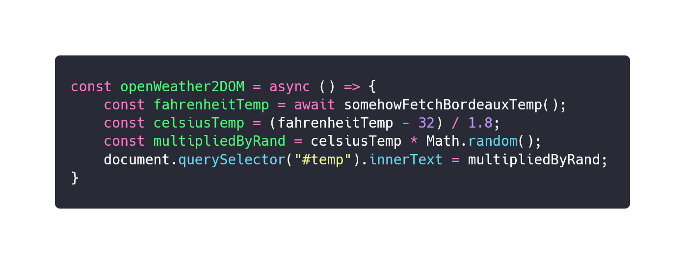
Example: OpenWeather2DOM
❌ One single impure function: hard to test, hard to reuse…
Notes:
https://carbon.now.sh/?bg=rgba(171%2C184%2C195%2C0)&t=dracula&wt=none&l=javascript&ds=false&dsyoff=20px&dsblur=68px&wc=false&wa=true&pv=56px&ph=56px&ln=false&fl=1&fm=Hack&fs=14px&lh=133%25&si=false&es=2x&wm=false&code=const%2520openWeather2DOM%2520%253D%2520async%2520()%2520%253D%253E%2520%257B%250A%2520%2520%2520%2520const%2520fahrenheitTemp%2520%253D%2520await%2520somehowFetchBordeauxTemp()%253B%250A%2520%2520%2520%2520const%2520celsiusTemp%2520%253D%2520(fahrenheitTemp%2520-%252032)%2520%252F%25201.8%253B%250A%2520%2509const%2520multipliedByRand%2520%253D%2520celsiusTemp%2520*%2520Math.random()%253B%250A%2520%2520%2520%2520document.querySelector(%2522%2523temp%2522).innerText%2520%253D%2520multipliedByRand%253B%250A%257D

Slide 17
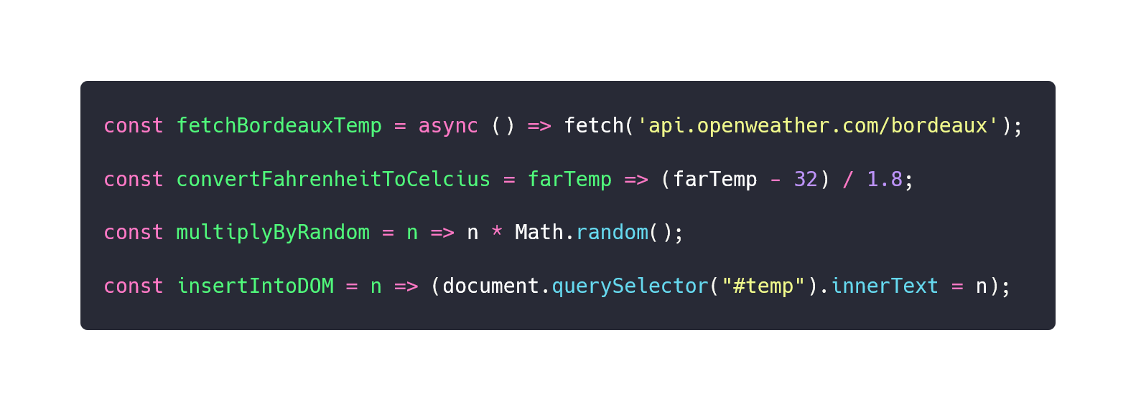
Example: OpenWeather2DOM
✔️ Isolation of side effects / impure functions from pure functions: easier to test, reuse, and mock.
Notes:
https://carbon.now.sh/?bg=rgba(171%2C184%2C195%2C0)&t=dracula&wt=none&l=javascript&ds=false&dsyoff=20px&dsblur=68px&wc=false&wa=true&pv=56px&ph=56px&ln=false&fl=1&fm=Hack&fs=14px&lh=133%25&si=false&es=2x&wm=false&code=import%2520%257B%2520somehowFetchBordeauxTemp%2520%257D%2520from%2520%2522.%252Fopen-weather-utils%2522%253B%250A%250Aconst%2520convertFahrenheitToCelcius%2520%253D%2520farTemp%2520%253D%253E%2520(farTemp%2520-%252032)%2520%252F%25201.8%253B%250A%250Aconst%2520multiplyByRandom%2520%253D%2520n%2520%253D%253E%2520n%2520*%2520Math.random()%253B%250A%250Aconst%2520insertIntoDOM%2520%253D%2520n%2520%253D%253E%2520(document.querySelector(%2522%2523temp%2522).innerText%2520%253D%2520n)%253B

Slide 18
Some helpful tools
04.
Notes:
TS
ESLint Plugin FP
RamdaJS
Lodash/FP
ImmerJS / ImmutableJS

Slide 19






TypeScript
ESLint +
eslint-plugin-fp
Introduces static typing as every common functional language have.
Helps following functional principles by applying a dozen of rules.
RamdaJS or Lodash/FP
ImmerJS or
ImmutableJS
Provides many functional programming utility functions like curry, partial or compose.
Helps maintaining immutability by providing natively immutable data structures (for ImmutableJS), or data production helpers (for ImmerJS).

Slide 20

Thanks for listening. Questions ?

