Slide 1
Predicting Overdose Risk From Opioid Prescriptions
Matt Dubow

Slide 2
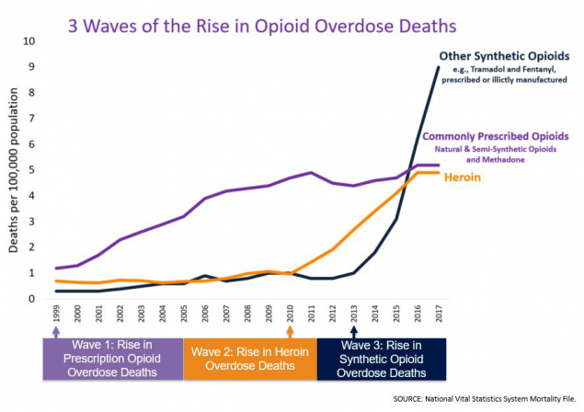
Sobering Statistics
America’s Opioid Crisis:
700,000+ drug overdoses 1999-2017¹
~68% of the 70,000 drug overdoses in 2017 from opioids¹
130 die every day from opioid overdose²
US economic cost of $78 Billion³
Sources:
1: https://www.cdc.gov/drugoverdose/epidemic/index.html
2: https://wonder.cdc.gov/
3: https://usafacts.org/articles/opioid-addiction-deaths-and-treatment-latest-analysis-data/

Slide 3
Statement of Purpose
Calculate an individual’s overdose risk, given their demographic background and location
Identify the primary factors in this risk
Look for evidence of “Second Wave” - rise of Heroin overdoses

Slide 4
Sources of Data
Records of opioid purchases by legal distributors 2006-12, compiled by the Washington Post: https://www.kaggle.com/paultimothymooney/pain-pills-in-the-usa
Statistics on opioid overdose from the Multiple Cause of Death dataset, part of the CDC Wonder database of health statistics: https://wonder.cdc.gov/mcd.html
Demographic data from the 2010 U.S. Census, separated by race, age, gender: https://factfinder.census.gov/faces/nav/jsf/pages/index.xhtml

Slide 5
Data Cleaning
For prescription dataset, zip codes and transaction dates were saved as integers
Convert to “strings” (text) and add zeros to the front
For overdose data, two problems:
Requests to CDC Wonder database have a small file limit
Merge several subsets of data together
County data includes “County” and state abbreviation as part of name, e.g. “Jefferson County, AL”
Remove this extra info to match prescription data
For demographic data:
Convert demographic numbers from raw population to percentage of population (normalization)
Age groups saved as separate rows
Use Pandas function “pivot table” to move to columns
Extra county and state information, as with overdose data

Slide 6
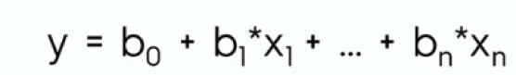
Machine Learning
model | target | n_features | features | test accuracy | training accuracy
Linear Regression | death rate | 1 | prescription rate | 0.205 | 0.149
Linear Regression | death rate | 2 | prescription rate, year | 0.007 | 0.0099
Linear Regression | death rate | 1521 | county, state (dummy variables) | 0.003 | 0.005
Linear Regression with PCA | death rate | 1521 | county, state (dummy variables) | 0.346 | 0.341
Linear Regression | death rate | 249 | demographic data | 0.432 | 0.525
Linear Regression | death rate | 250 | demo data, prescription rate | 0.484 | 0.553
Linear Regression with PCA | death rate | 1522 | county, state, prescription rate | 0.351 | 0.343
Linear Regression, no PCA | death rate | 1522 | county, state, prescription rate | -3.68E+23 | 0.724
Linear Regression, no PCA | death rate | 1770 | county, state, demo data | 0.031 | 0.038
Linear Regression with PCA | death rate | 1770 | county, state, demo data | 0.392 | 0.409
Linear Regression with PCA | death rate | 1771 | county, state, prescription rate, demo data | 0.391 | 0.411
Data on opioid overdoses very sparse, especially in rural areas
Need to use machine learning models to predict death rate from demographic features
Start with basic algorithm - Sklearn’s Linear Regression
For county and state data, use Principal Component Analysis (PCA)
Reduces data dimensionality
Demographic data and prescription rate both important, but don’t interact well with location data

Slide 7
Machine Learning - New Methods
Try best features with different algorithms
All algorithms use Search Functions
Run models many times with different parameters to find best options
Random Forest
Creates many decision trees and averages them together
Lasso and Ridge
Similar to Linear Regression
Shrink certain features to reduce overfitting
Lasso reduces unimportant features to 0
None of these models as accurate as Linear Regression
model | target | n_features | features | test accuracy | training accuracy
Random Forest | death rate | 250 | demo data, prescription rate | -0.0009 | -
Lasso Linear | death rate | 250 | demo data, prescription rate | 0.368 | -
Ridge | death rate | 250 | demo data, prescription rate | 0.422 | -
Random Forest with Randomized Search CV | death rate | 250 | demo data, prescription rate | -0.0009 | -

Slide 8
Machine Learning - Serendipity
Shift in approach:
Use number of deaths as target, rather than death rate
Allows use of population totals as a feature
Best-performing model:
Simple Linear Regression with demographic data, prescription rate, and population as features
model | target | n_features | features | test accuracy | training accuracy
Linear Regression | deaths | 251 | demo data, prescription rate, population | 0.908 | 0.914
Lasso Linear | deaths | 251 | demo data, prescription rate, population | 0.864 | -
Ridge | deaths | 251 | demo data, prescription rate, population | 0.871 | -
Linear Regression with PCA | deaths | 1772 | county, state, prescription rate, demo data, population | 0.912 | 0.889

Slide 9
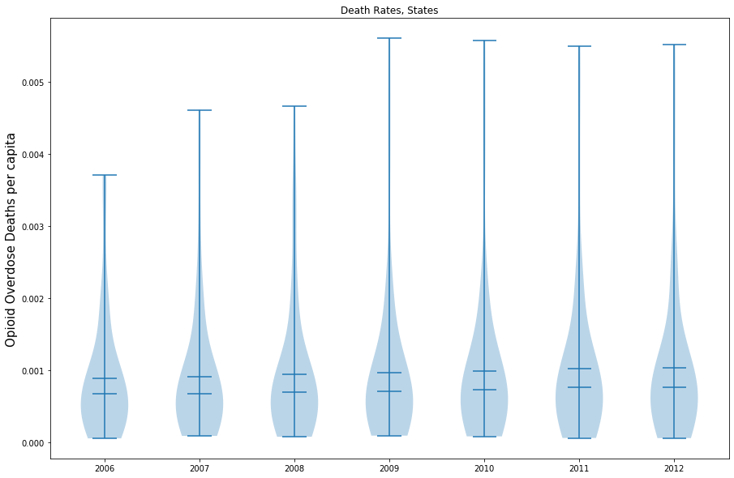
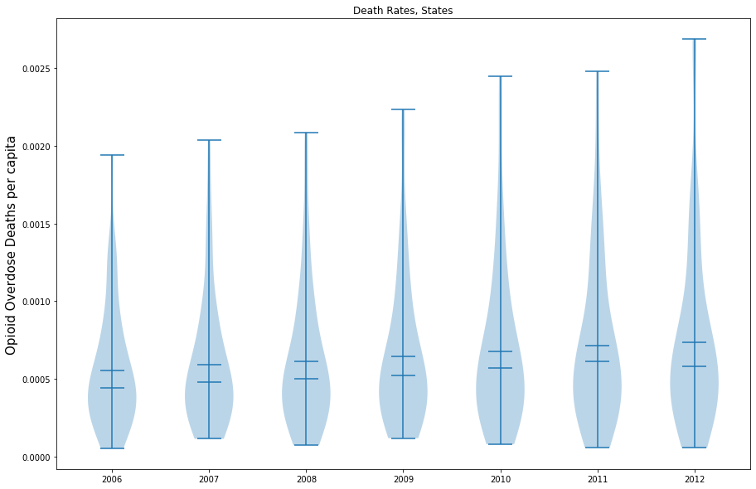
Choosing a Model
Linear Regression
Problems with using the basic Linear Regression Model:
Model may predict negative death totals
Can “clip” the output by setting the lower limit as zero
New output seems unrealistic
Advantages of Lasso algorithm:
Can guarantee positive predictions
Easy feature selection
Unimportant features reduced to 0
Lasso may be less accurate, but more useful for this situation
Lasso

Slide 10
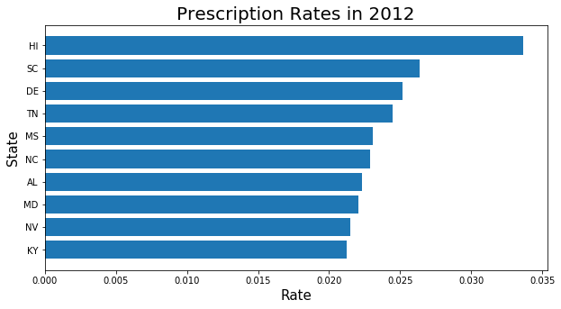
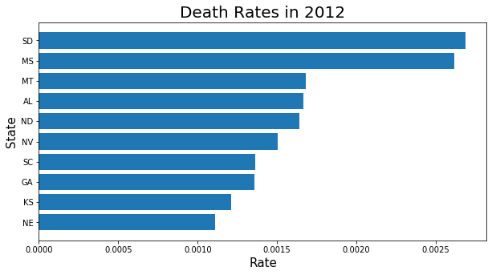
Top States
Seems to be a rural, Southern tendency both for prescriptions and overdoses

Slide 11
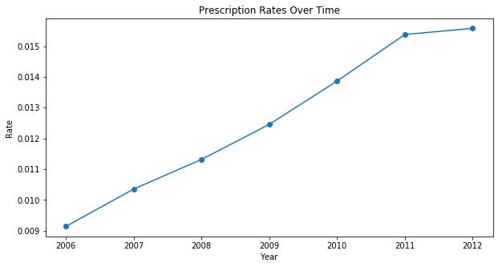
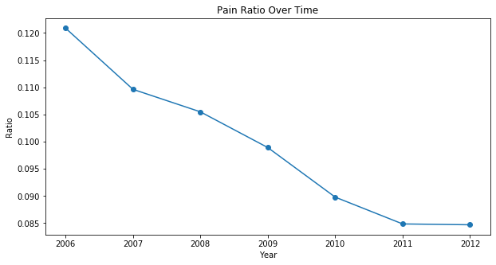
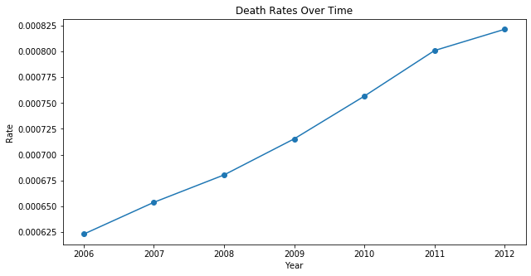
Analyzing Trends
Prescription rates and death rates both steadily increasing
“Pain Ratio”
death rate over prescription rate, a measure of how deadly the prescriptions are
Decreases over time
May account for “Second Wave” of growing heroin abuse

Slide 12
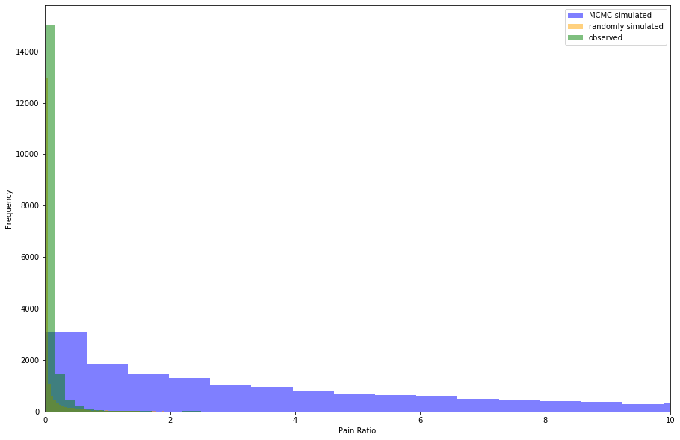
How Deadly Are They?
Hypothesis: Given the number of prescriptions across the United States, pain pills are actually less deadly than expected
Testing: Simulate pain ratios and compare to see how likely the observed dataset is to occur
Methods:
Randomly sampling values in the range of the original observations
Markov Chain Monte Carlo
Randomly generates a large number of samples from the original distribution and tends towards values with higher probability
Conclusion:
Fewer than 5% of the MCMC values are as small as the observed values
Fail to reject original hypothesis

Slide 13
Finding Key Features
Easy to do with a Lasso model
Unimportant features reduce to 0
Sklearn allows direct examination of feature coefficients
Most important feature: prescription rate
Population also important
Some demographic features
black male population from ages 0 to 4, male Pacific Islanders ages 15 to 19, indigenous females ages 45 to 49, white males 85 and up, and the total population ages 80 to 84
Model may be using these features to understand whole demographic picture

Slide 14
Conclusion
Model able to predict death rates at about 80% accuracy
Some evidence of “Second Wave” seen
Prescription rate and population totals most important factors in predicting overdose risk, along with some demographic features

