Slide 1
Chapter 1
Introduction

Slide 2
Chapter 1.1
What is GIS?

Slide 3
What is GIS
Information systems: an association of people, machines, data, and procedures working together to collect, manage, and distribute information of importance to individuals or organizations
Geographic information system (GIS): a computer-based information system that enables capture, modeling, storage, retrieval, sharing, manipulation, and presentation of geographically referenced data
Geospatial data: geographically referenced data

Slide 4

The shape of GIS
Databases elements
Data Processing element
Data storage and retrieval element
Data sharing element
Data presentation element
Spatial reasoning element
Accuracy, precision, and reliability
Spatiotemporal element

Slide 5

Data and information
Context: the structure of interrelationships between data and how data is collected, processed, used, and understood within an application
  Understanding the data model and the limitations of data, are elements of the context for data
Data is only useful, taking on value as information, within its context
information = data + context

Slide 6
Chapter 1.2
GIS functionality

Slide 7
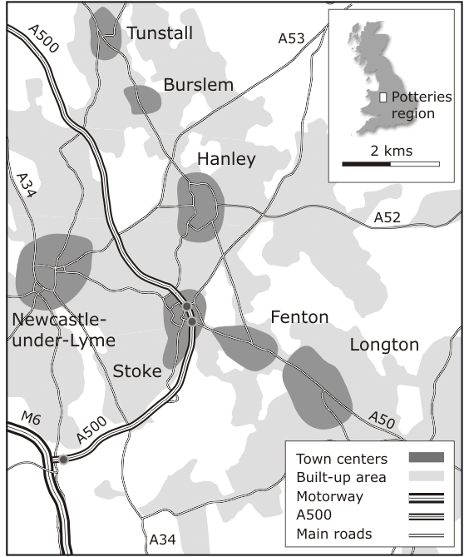
Functionality
Example: “The Potteries”
The Potteries comprise six pottery towns
The region developed during the English industrial revolution
Local communities produced high quality ware from conditions of poverty

Slide 8
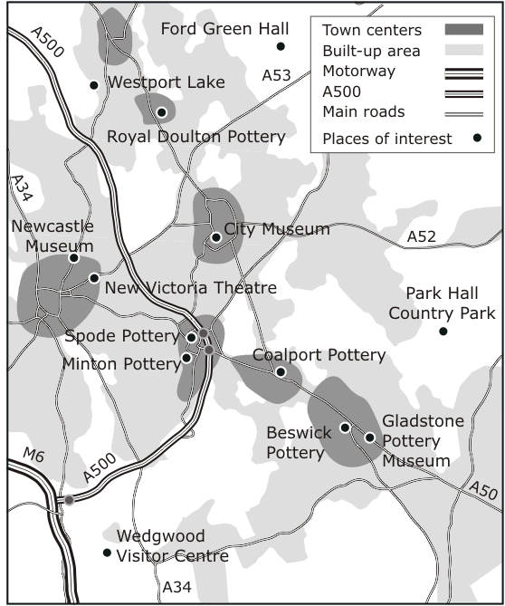
Functionality: resources inventory
Locally important tourist industry, based upon the industrial heritage of the area
A GIS can draw together data on cultural and recreational facilities within the region, and combine this data with details of local transport infrastructure and hotel accommodation
Places of interest in the Potteries region

Slide 9
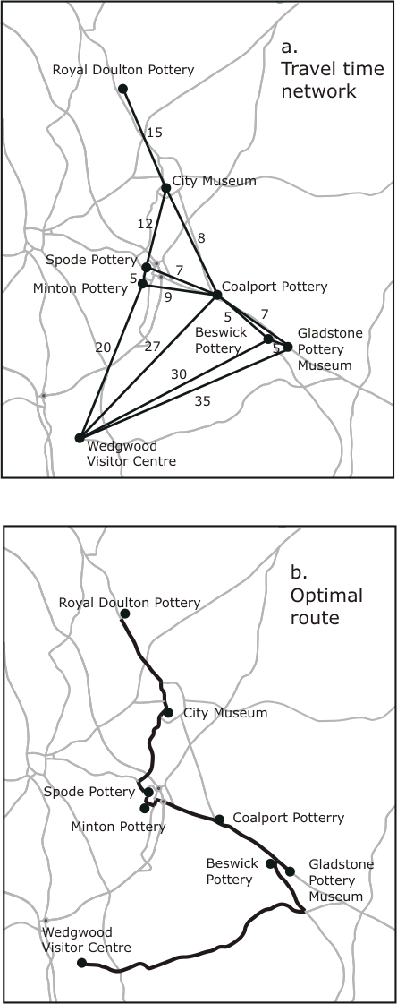
Functionality: network analysis
We want to find a route using the major road network, visiting each pottery (and the City Museum) only once, while minimizing the traveling time
A travel-time network between potteries is the required data set
Derived from average times on the main roads shown on the map

Slide 10
Functionality: network analysis
Traveling salesperson algorithm
  Construct a minimal weight route through a network that visits each node at least once
  Could be dynamic; assigning weights to the edges of the network and calculating optimal routes depending upon changeable road conditions

Slide 11
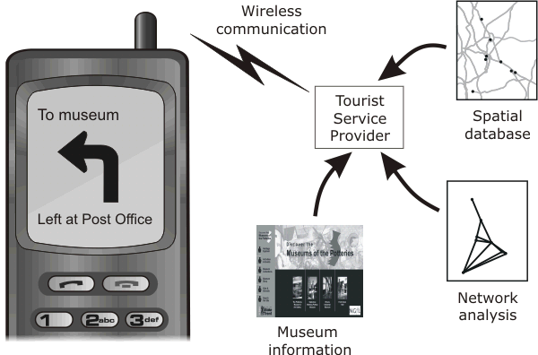
Functionality: distributed data
Data from different sources must be integrated, processed, and transmitted to the tourist before they can receive navigation directions and information about local attraction

Slide 12
Functionality: terrain analysis
Local communities are often interested in the visual impact of proposed new opencast coal mining sites
Visibility analysis can be used to evaluate visual impact
  Measuring the size of the local population within a given viewshed (a map of all the points visible from some location)
Terrain analysis is usually based upon data sets of topographic elevation at point locations

Slide 13
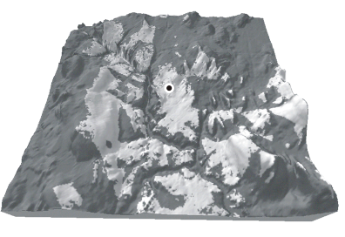
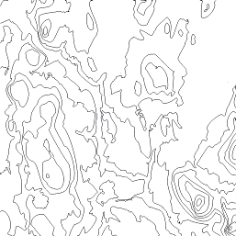
Functionality: terrain analysis
Contour map
Perspective projection draped by the viewshed
Darker shaded regions give the area from which the marked point would not be visible

Slide 14
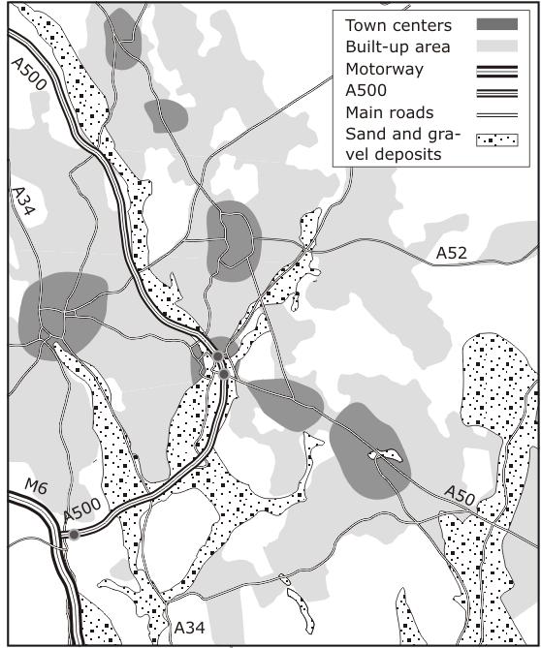
Functionality: layer-based analysis
Determining the potential of different locations for sand and gravel extraction
  Drawing together and analyzing data from variety of sources
    Geological data,
    urban structure,
    water table level,
    transportation network,
    land prices, and
    land zoning
Locations of sand and gravel deposits in the Potteries region

Slide 15


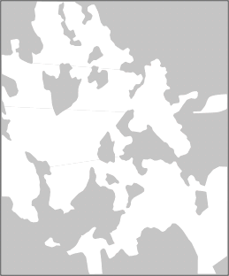

Functionality: layer-based analysis
Query: find all locations that are within 0.5 km of a major road, not in a built-up area, and on a sand/gravel deposit
0.5 km buffer of major roads (not including the motorway
Known sand and gravel deposits
Shaded areas indicate locations that are not built up
Overlay of the three other layers giving area that satisfies the query

Slide 16
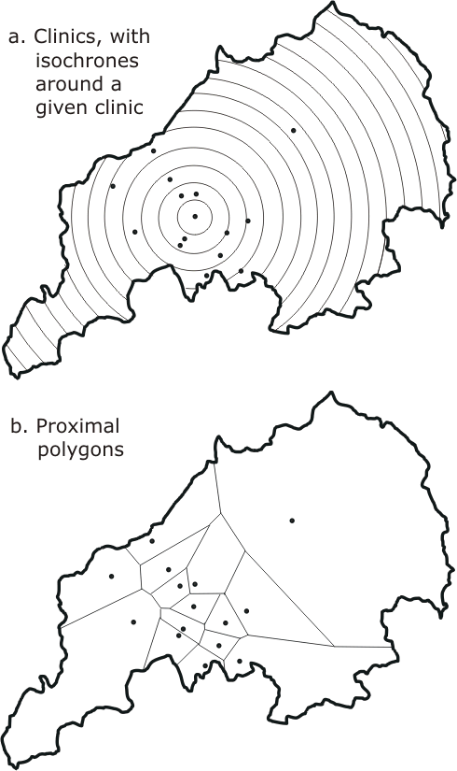
Functionality: location analysis
Locating a clinic in the Potteries
  Construct the “neighborhood” of clinics, based upon positions of nearby clinics and travel times
  We can then support decisions to relocate, close, or create a new clinic

Slide 17
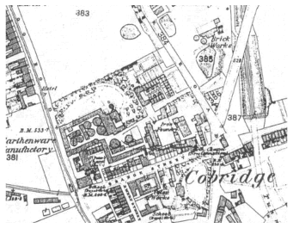
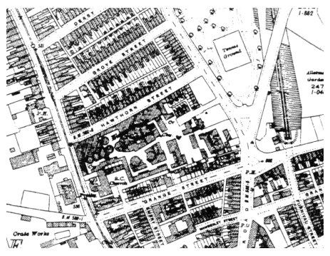
Functionality: spatiotemporal information
Spatiotemporal questions:
  Which streets have changed name
  Which streets have changed spatial reference
  In what year is the existence of the Cobridge Brick Works last recorded in the system
1878
1924
Source: Ordnance Survey

Slide 18
Chapter 1.3
Data and databases

Slide 19
Review: bits and bytes
Data stored in a computer system is measured in bits
  each bit records one of two possible states
    0 (off, false)
    1 (on, true)
  Bits are amalgamated into bytes
    Each byte represents a single character
    A character may be encoded using 7 bits with an extra bit used as an error check
    Each byte allows for 2⁷ = 127 possible character combinations
    Two-byte characters allow for 2¹⁶ = 65536 different character combinations

Slide 20
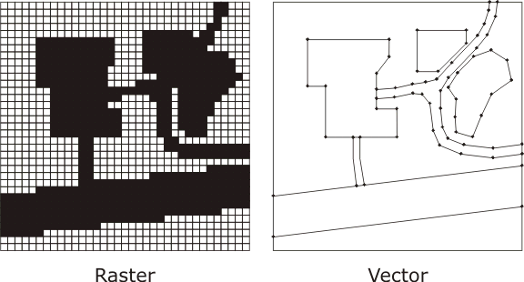
Spatial data
Raster data is structured as an array or grid of cells, referred to as pixels
Vector is a finite straight line segment defined by its end points. The locations of end-points are given with respect to some coordination of the plane

Slide 21
Spatial Data
Raster
  Natural structures to use in computers as programming languages commonly support array handling and operations
  Inefficient in terms of usage of computer storage
Vector
  More efficient in its use of computer storage as only points of interest need be stored
  Assume a hard edged boundary model of the world

Slide 22
Database as data store
Database: a repository of data that is logically related, but possibly physically distributed over several sites
A database is created and maintained using a database management system (DBMS)
For a database to be useful it must be:
  Reliable
  Correct and consistent
  Technology proof
  Secure

Slide 23
Data capture
Data capture: the process of collecting data from observations of the physical environment
Sensors are a primary source of data for a GIS and are used to measure some feature of the geographic environment
Legacy data (such as paper maps) are a secondary source of data
  Automatic conversion
  Manual conversion

Slide 24
Data modeling
The process of developing a database is essentially a process of model building
  Application domain model: describes the core requirements of users in a particular application domain, based on an initial study
  Conceptual model: tailored to a particular type of implementation
  Physical computational model: the result of a process of programming and system implementation
Secondary modeling tasks
  System maintenance
  System documentation

Slide 25
Data retrieval and analysis
To retrieve data from a databases we may perform a query:
  Retrieve names and addresses of all opencast coal mines in Staffordshire
    Data may be retrieved by a simple look up and match
  Retrieve names and addresses of all employees of Wedgwood Pottery who earn more than half the sum earned by the managing director
    Numerical comparison

Slide 26
Spatial data retrieval and analysis
Query: is there any correlation between:
  The location of vehicle accidents (as recorded on a hospital database); and
  Designated “accident black spots” for the area?
Satisfying this query will require the integration of both spatial and non-spatial information
Performance
  Spatial data is notoriously large and often hierarchically structured
  Geospatial data is often embedded in the Euclidean plane, therefore spatial storage structures and access methods are required

Slide 27
Data Presentation
A report generator is a standard feature of a DBMS that allows data from a database to be laid out in a clear human-readable format
Many databases also support business graphics
Map- based presentation is a distinctive feature of a GIS
Some DBMSs and GISs provide tools for data mining
  Highly flexible presentation capabilities

Slide 28
Data distribution
Distributed database: multiple databases connected by a digital communication network
Data may be more appropriately associated with one site rather than another
  Greater degree of autonomy and easier update and maintenance
Increased reliability
  Failure at one site will not mean failure of the entire system
Improved performance
  Access to local sites from local users will be more efficient
More intricate structure to support
  Must handle queries where the data is fragmented across sites, and maintain the consistency of data

Slide 29
Chapter 1.4
Hardware support

Slide 30
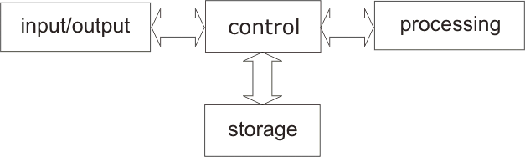
Von Neumann Architecture
A computer system can be thought of as comprising four major subsystems:
Processing Storage | Control Input/output

Slide 31
Processing and control
Processing of data in the computer hardware is handled by the central processing unit (CPU)
  Executes machine instructions by fetching data into special registrars and then performing computer arithmetic upon them
  Operations are performed upon data sequentially
    Retrieving stored data,
    Executing the appropriate operation, and then
    Returning the results to storage
  The CPU and other components in the computer are connected by communication wires, called a bus
CPU is made up of
  arithmetic/logic unit (ALU)
    Responsible for actual processing function
  the control unit
    Responsible for the control function, managing and allocating resources

Slide 32
Storage devices
Primary storage: can be directly manipulated by the CPU
CPU and control unit requires their own local memory
  This memory is the fastest and most expensive type of storage
Other types of primary storage are referred to as main memory
  RAM (volatile)
  ROM (non-volatile)
  Flash memory

Slide 33
Storage devices
Secondary storage: can be accessed only indirectly by the CPU (via input/output controllers)
  Based upon magnetic or optical technology
  Cheaper than primary storage
  Non volatile
  Blocks of data are found using direct access
    using a unique physical address
  Precise read/write location is found using sequential access
    After reaching the desired block, the data from the block is scanned in sequence

Slide 34
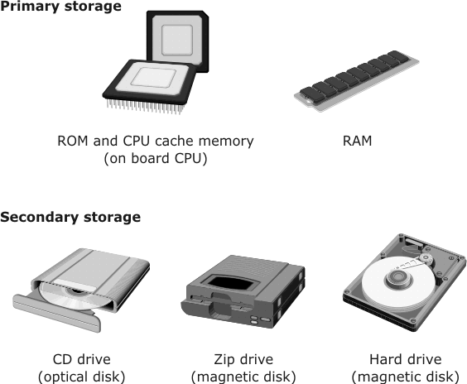
Storage devices

Slide 35
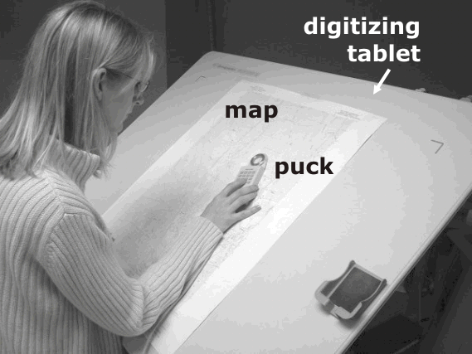
Human input devices
Digitizing
Keyboard
Pointing devices
  Mouse,
  Touchpad,
  Joysticks
Digitizers
  Needed for legacy
  data capture
Scanners
Microphone in combination with speech recognition system

Slide 36
Human output devices
Hard copy (physical permanence)
  Printers
  Plotters
Soft copy (transient and intangible)
  Computer screen
  Sound from audio devices

Slide 37
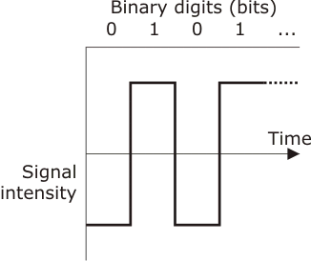
Digital networks
Most communication networks are digital:
series of bits is transmitted using signal bursts at different intensities corresponding to the binary values 0 and 1

Slide 38
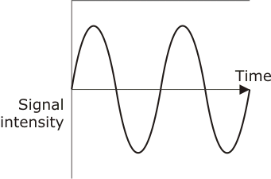
Analog networks
Older data communication technology sometimes uses analog signals:
Signal strength can vary continuously like a sine wave

Slide 39
Electromagnetic radiation
All communication networks use electromagnetic (EM) radiation to propagate signals
  The frequency and wavelength of EM radiation affect its transmission properties
  The range of wavelengths or frequencies available for data transmission is called the bandwidth
  Higher bandwidth means greater data transmission capacity
  Media used for data transmission
    Copper (conventional phone lines)
    Fiber-optic cables
    Earths Atmosphere (wireless)

Slide 40
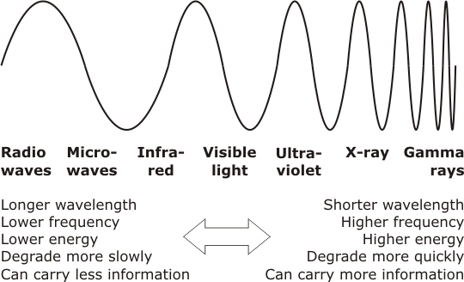
Magnetic spectrum
Radio waves, microwaves, infrared, and visible light can all be used for computer networks
High-frequency ultraviolet, X-rays, and gamma rays are not used for data transmission

