Slide 1
Chapter 10
Time

Slide 2
Chapter 10.1
Introduction:
“A brief history of time”

Slide 3
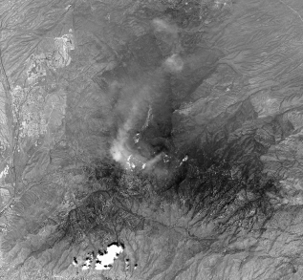
Spatiotemporal phenomena
Dynamic geographic entities are characterized not only by spatial and attribute components, but also by temporal references
A spatiotemporal information system must manage data about time-varying real-world entities
Wildfire in Tuscon, Arizona, June 2003 (NASA ASTER image)

Slide 4

Static and snapshot representations
Stage zero: Static representations
  A single state of the world
  Usually the most recent in time for which the data was captured
Stage one: the snapshot metaphor
  A collection of timestamped states
  A sequence of snapshots
  Models of time:
    Linear, branching and cyclical structures

Slide 5
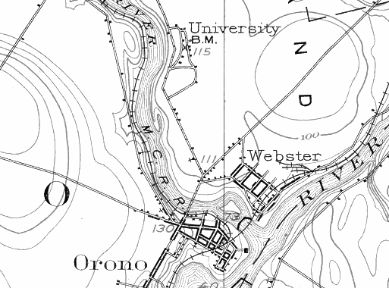
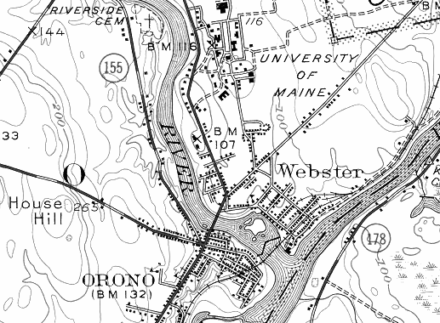
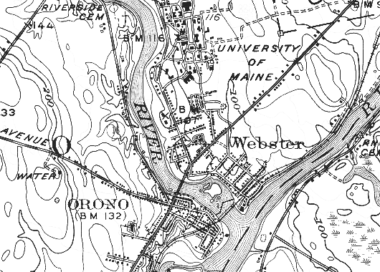
Snapshot

Slide 6
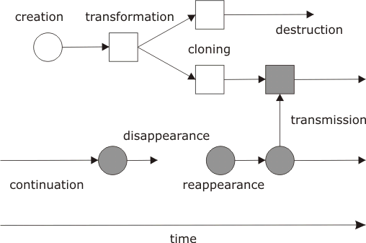
Object lifeline
Stage two: Object lifelines
  Designed to explicitly represent changes of state in a single object and interactions between different objects

Slide 7
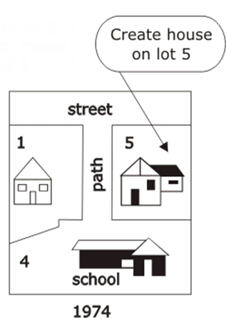
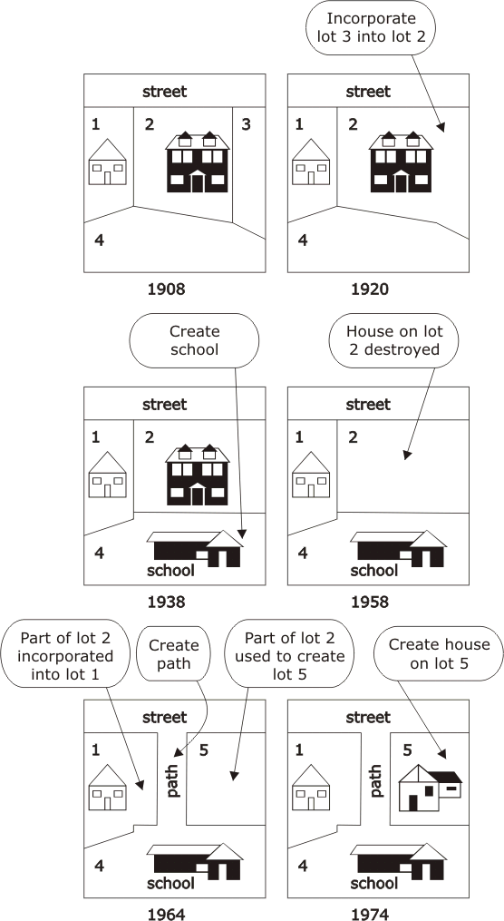
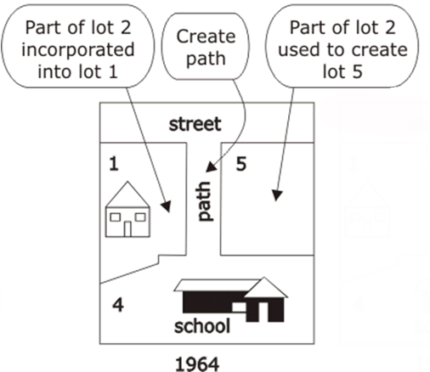
Object lifeline

Slide 8

Object lifeline
Different types of changes that may occur in an object’s lifeline:
  Creation and destruction
  Disappearance and reappearance
  Spatial change
  Aspatial change
  Transmission
  Fission and fusion
  Mereological change
  Typological change

Slide 9
Events, actions, and processes
Stage three: Events, actions and processes
  Events, actions and processes are allowed to become explicit entities
  Some questions that can be asked of an occurrent include:
    Is it a type or an instance?
    Can it be counted
    Is it performed by an agent?
    How is it situated in time; what are its boundaries?
    Does it have a purpose?
    Does it have a cause or effect?
    Does it consume resources?
    Does it have attributes, relationships?
    Is it in a partonomic hierarchy or taxonomic hierarchy?
    What is its level of detail?

Slide 10
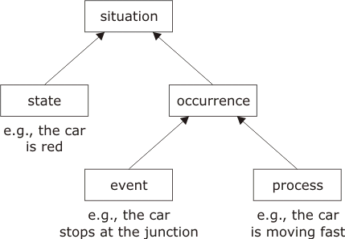
Classifications of events and processes: Mourelatos

Slide 11
Classifications of events and processes: count nouns/mass nouns
 | Continuants | Occurrent
Count noun | Thing (e.g., “lake”) | Event (e.g., “race”)
Mass noun | Stuff (e.g., “water”) | Process (e.g., “running”)

Slide 12
Chapter 10.2
Temporal information systems

Slide 13
Valid and transaction time
Transaction time: the time when the timestamped data was entered in the database
Valid time: the time when the event relating to the capturing of the data actually occurred in the world
Time(s) needed to be represented in the information depends on the application domain
If both times are needed, then we require a bitemporal information system
  Require more complex data structures and query languages

Slide 14
Transaction time
Transaction time monotonically increases with the life of the information system
  Transaction times cannot be changed
A transaction time information system maintains the history of system activity
  Capability to rollback to previous states
  Each state of the system is called a version
  At any time a transaction time information system has access to the current state and all previous versions

Slide 15
Valid time
Valid time does not necessarily increases with the life of the information system
  Possible that the real-world event to which T₁ refers is later than that described by the data in T₂
  Valid times can be changed retroactively
A valid time information system maintains the history of the real world activity
  Capability to query current, past, and possible future states of the real-world objects in its database

Slide 16
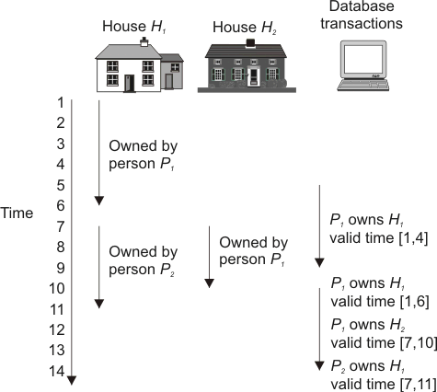
Tuple timestamping
A bitemproal timestamp is a sequence of ordered pairs (x,y), where x is a transaction time interval and y is a valid time interval
  During time period x the database recorded the information in a particular tuple as being valid during time period y

Slide 17
Tuple timestamping
HouseID | PersonID | Time
H₁ | P₁ | ([5,9],[1,4]) ([10,15],[1,6])
H₂ | P₁ | ([10,15],[7,10])
H₁ | P₂ | ([10,15],[7,11])

Slide 18
Attribute timestamping
Attribute timestamping: temporal information is associated directly with the attribute values to which it refers
May violate normal form, as attributes may not be atomic
HouseID | PersonID
H₁([5,9],[1,4]),([10,14],[1,11]) | P₁([5,9],[1,4]),([10,14],[1,6]) P₂([10,14],[7,11])
H₂ ([10,14],[7,10]) | P₁([10,14],[7,10])

Slide 19
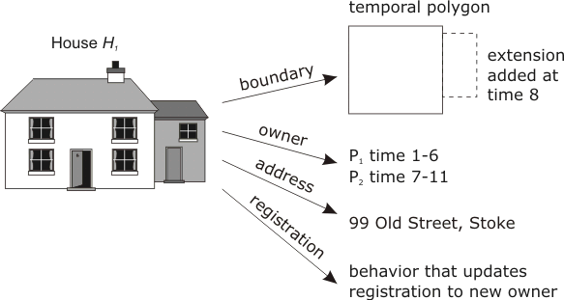
Timestamping in object-oriented databases

Slide 20
Chapter 10.3
Spatiotemporal information systems

Slide 21
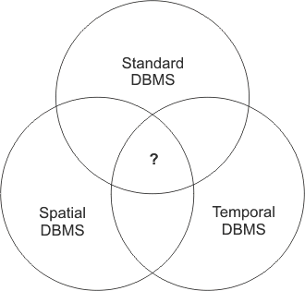
Spatiotemporal database technology
Spatiotemporal database technology consists of at least the following components:
It is not immediately clear whether spatiotemporal database technology requires any more than simply the union of these three technologies

Slide 22
Time and the timeline
Temporal literals (used as the basis of timestamping) may be:
  Time instants (points of the timeline)
  Time intervals (intervals on the timeline
Time line may be modeled as isomorphic to:
  Real numbers (continuous time)
  Rational numbers (dense time)
  Integers (discrete time)
Computational approaches to time usually assume a discrete time model, in accordance with the discrete nature of computation
This is considered linear time

Slide 23



Time and the timeline
Other models of time include:
  Branching time
  Cyclic time
Branching Time (backwards)
Branching Time
(forwards)
Cyclic time

Slide 24
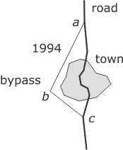
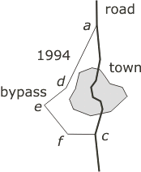
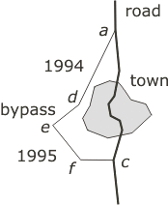
Bitemporal spatial models
Bitemporal spatial representation of the construction of a by pass around a town
(valid times)
1993
1994
1995
(transaction times)

Slide 25
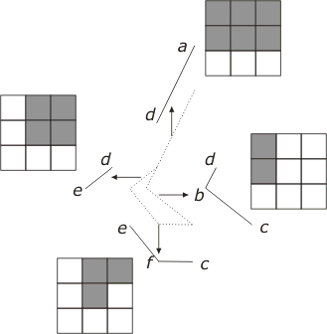
Bitemporal array
Existence of line segment ef (from previous example) as a bitemporal array
  Shaded cells indicate bitemporal timestamps associated with the road segment
1995
Valid time
1994
1993
1993
1994
1995
Transaction time

Slide 26
Chapter 10.4
Indexes and queries

Slide 27
Indicators of an access method
As for purely spatial queries, the important indicators for an access method are:
  space required for the data
  amount of processing overhead required on database update
  time taken to retrieve data for a query
Storing each temporal snapshot is usually not practical as we would quickly run out of space
Solution is to concentrate on storing change

Slide 28
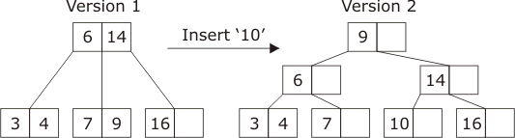
Transaction time: B-tree index
Create a new B-Tree for every change in the database
Using multiple B-Trees for transaction time databases is prohibitively inefficient in terms of storage space

Slide 29
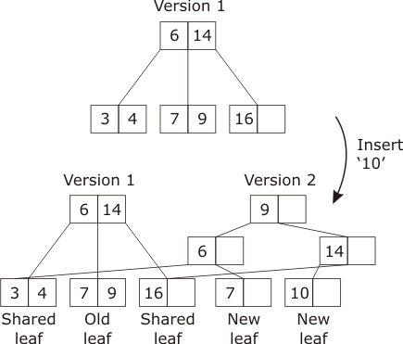
Transaction time: Overlapping B-tree
Duplicates only those nodes where some value has changed
Note: only stores transaction times at the roots, therefore it requires a further index for the root nodes

Slide 30
Transaction time: Multiversion B-tree
Explicitly represents the insertion and deletion of objects into the database
Each object, when it is created, is timestamped with the temporal reference interval [t_{C}, NOW]
  t_{C} is the time the creation transaction is made, and
  NOW is a variable holding the current transaction time
If an object is deleted the timestamp is modified to (t_{C}, t_{D}] where t_{D} is the time the deletion transaction is made
We are then able to cluster data within the tree
  Alive: timestamp of the form [t_{C}, NOW]
  Dead: timestamp of the form [t_{C}, t_{D}]

Slide 31
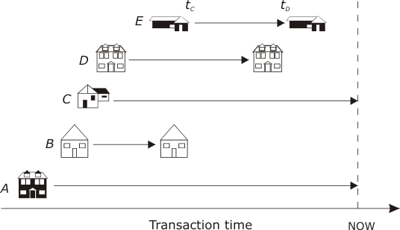
Transaction time: Multiversion B-tree
Evolution of a transaction time database, where object creation and deletion are explicitly represented

Slide 32
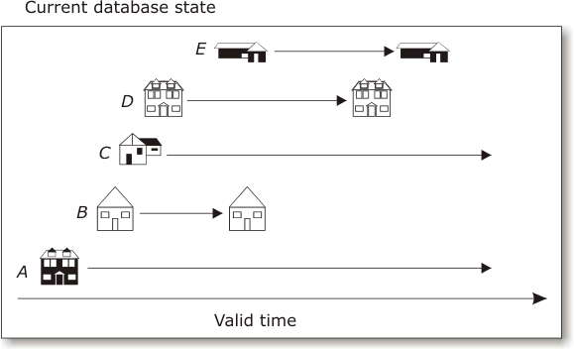
Valid time database
Holds a dynamic collection of objects
  Each attribute is a collection of interval timestamped values (attribute histories)
  Database evolution is not stored, therefore update has a permanent effect

Slide 33
Valid time: segment tree
Structures a collection of linear (time) intervals so that it becomes efficient to retrieve all intervals enclosing a given point
Allows efficient queries of the type:
  Given a time t, retrieve all objects that were valid at time t
A static structure, as the set of interval end- points is given in advance
  New intervals whose end-points are in the given set may be dynamically inserted into the tree structure by labeling appropriate nodes
  Intervals may be deleted from the structure

Slide 34
Example
Suppose we have a finite set of time intervals
A[1,10], B[3,15], C[4,7], D[4,9], E[6,15],
F[8,12], G[10,14], H[16,22], I[18,20], J[10,19]
Sequence the boundary points in ascending order
1,3,4,6,7,8,9,10,12,14,16,18,19,20,22
These points become labels for the leaves of a binary tree
  Each segment is now split into maximal chunks and distributed as labels of nodes in the tree

Slide 35
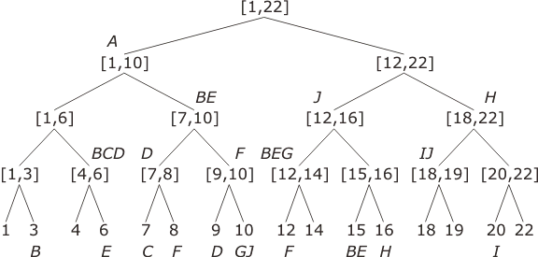
Example continued
Start
Add A to result list
Search for intervals containing the point 5
Result list:
A
, B, C, D

Slide 36
Bitemporal indexes
Treat valid and transaction time as independent dimensions of a minimum bounding box (MMB)
Use R-Tree to index each bitemproal MBB
Advantage: simple
Disadvantage: considerable overlapping between different bitemporal MBBs
  Inefficient queries as a particular time coordinate may lie within several different bitemporal MMBs

Slide 37
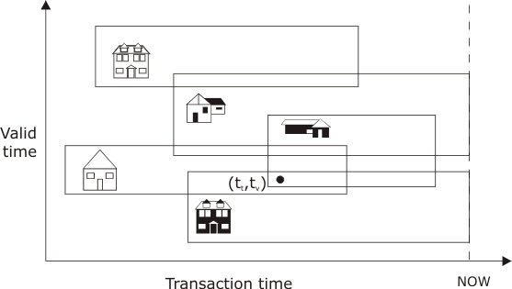
Bitemporal MMBs

Slide 38
Bitemporal indexes
We could use two R-tree indexes
  One to store objects that are alive (transaction time)
  One to store objects that are dead (transaction time)
This reduces the amount of overlapping, as it is only necessary to store the first element of the transaction timestamp in the “ alive” R-tree
By definition, the second element will be NOW for all objects in the alive R- tree

Slide 39
Spatiotemporal
Most spatiotemporal indexes are based on merging spatial and temporal indexes, by treating time as another spatial dimension
  For a single temporal dimension and two spatial dimensions spatiotemporal data can be represented and stored as three-dimensional spatiotemporal objects
  An R-tree might be used to index the minimum bounding cuboid for the spatiotemporal data
Disadvantage: overlap problem

Slide 40
Historical R-tree (HR-tree)
Uses a similar approach to the overlapping B-tree
  Spatial data is indexed as a conventional R-tree
  Now versions introduce new root nodes that share unchanged leaves
Goes a step further than overlapping B-tree
  Allows explicit representation of both insertion times and deletion times for spatiotemporal objects

Slide 41
Queries
Must answer the following questions:
  What was the state of the world or database at a particular location and given time?
  Where was the world or database in a particular state at a given time?
  When was the world or database in a particular state at a given location?
Point and range queries may take values from spatial, temporal, or attribute domains
  Point: we specify a single value of an attribute, a point location, or an instant in time
  Range: allow the specification of a value of a collection type attribute, extended location, or temporal period

Slide 42
Queries
Most complex and demanding queries involve a combination of spatial, temporal, and attribute points and ranges
Performance for such queries will depend heavily on the actual index used
An emerging standard for temporal databases query languages is temporal SQL (TSQL2)
Spatial functions will also be required to extent TSQL2 to a spatiotemporal query language
Example
“Retrieve the locations of all salespersons within 100 miles of Boston Headquarters in April”

