Slide 1
Chapter 2
Fundamental database concepts

Slide 2
What you will learn
What is a database?
Why use a database?
What is a relational database?
Why does spatial data present problems for relational databases?
How do you develop a database?
What is object-orientation, and how is it relevant to databases?
Summary

Slide 3
Section 2.1
Introduction to databases

Slide 4
What is a database?
A database is a collection of data organized in such a way that a computer can efficiently store and retrieve data
  A repository of data that is logically related
A database is created and maintained using a general-purpose piece of software called a database management system (DBMS)
Introduction
to databases

Slide 5
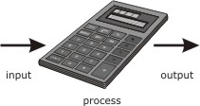
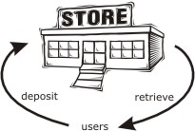
The database approach
Before databases, computers were primarily used to convert data between different formats
  “The computer as a giant calculator”
Databases treat computers as useful repositories of data
  “The computer as data repository”
Most applications (including GIS) require a balance of processing and storage
Introduction
to databases

Slide 6
Databases in a nutshell
In order to be effective, databases must offer the following functions:
All these functions are managed by the DBMS
  Reliability
  Integrity
  Security
  User views
  User interface
  Data independence
  Self-describing
  Concurrency
  Distributed capabilities
  High performance
Introduction
to databases

Slide 7
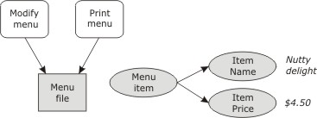
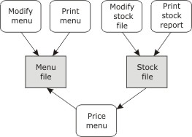
Nutty Nuggets #1
We might write a program to organize the stock for the “Nutty Nuggets” restaurant
As time continues, this program will become more complex, offering more functions
Introduction
to databases
Stage 1
Stage 2

Slide 8
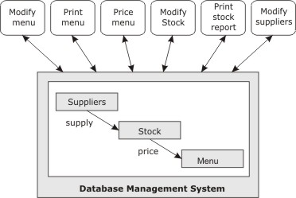
Nutty Nuggets #2
Key problems with the previous approach are:
  Loss of integrity
  Loss of independence
  Loss of security
Stage 3, the database, solves these problems
Introduction
to databases
Stage 3

Slide 9
Common database applications
Home/office database
  Simple applications (e.g., Nutty Nuggets)
Commercial database
  Store the information for businesses (e.g. customers, employees)
Engineering database
  Used to store engineering designs (e.g. CAD)
Image and multimedia database
  Store image, audio, video data
Geodatabase
  Store a combination of spatial and non-spatial data
Introduction
to databases

Slide 10
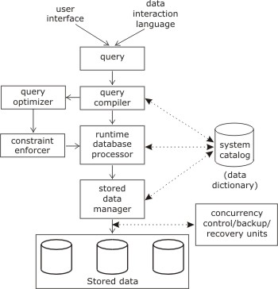
Elements of a DBMS
Query language
Query compiler
Runtime database processor
Constraint enforcer
Stored data manager
System catalog/data dictionary
Introduction
to databases

Slide 11
Transaction management
A transaction is an atomic unit of interaction between user and database
  Insertion of data
  Modification of data
  Deletion of data
  Retrieval of data
Transaction management must support
  Concurrency (multiple users accessing the same data at the same time)
  Recovery management (retrieval of a valid database state following system failure)
Introduction
to databases

Slide 12
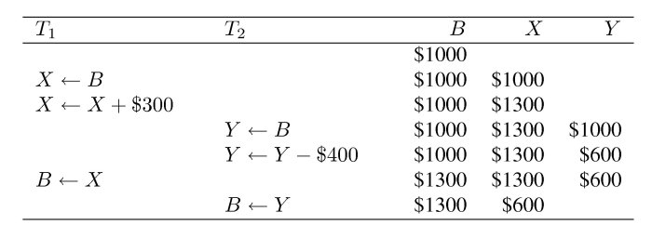
Concurrency: Lost update
Lost update can occur when atomic transactions are incorrectly interleaved
Introduction
to databases

Slide 13
Section 8.2
Relational databases

Slide 14
Database architectures
Most databases today are either:
  Relational; or
  Object-oriented (especially useful for spatial data)
Early database systems were based on the hierarchical model
  Efficient storage, but limited expressiveness
The network model was used to overcome lack of expressiveness in hierarchical databases
  But led to highly complex database system
The deductive model is an active research area today
  Stores rules in addition to facts
Relational
databases

Slide 15
The relational model
A relational database is a collection of relations, often just called tables
Each relation has a set of attributes
The data in the relation is structured as a set of rows, often called tuples
Each tuple consists of data items for each attribute
Each cell in a tuple contains a single value
A relational database management system (RDBMS) is the software that manages a relational database
Relational
databases

Slide 16
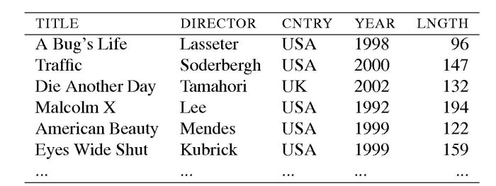
Example relation
Relation
Attribute
Relational
databases
Tuple
Data item

Slide 17
Relations
A relation scheme is the set of attribute names and the domain (data type) for each attribute name
A database scheme is a set of relation schemes
In a relation:
  Each tuple contains as many values as there are attributes in the relation scheme
  Each data item is drawn from the domain for its attribute
  The order of tuples is not significant
  Tuples in a relation are all distinct from each other
In most relational systems, data items are atomic
  A relation that contains only atomic items is said to be in first normal form (1NF)
The degree of a relation is its number of columns
The cardinality of a relation is the number of tuples
Relational
databases

Slide 18
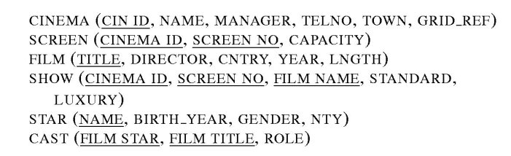
Relation scheme
A candidate key is an attribute or minimal set of attributes that will uniquely identify each tuple in a relation
One candidate key is usually chose as a primary key
Relational
databases

Slide 19
Operations on relations
There are five fundamental relational operators: union, difference, product, project, and restrict
Three derived relational operators are also important: intersection, divide, and join
Together, these operations and the way they are combined is called relational algebra combined
The relational model is said to be closed, because relational operators take one or more relations as input and return a relation
Relational
databases

Slide 20
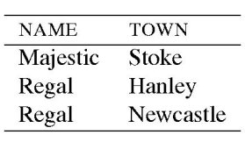
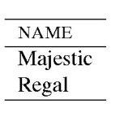
Project operator
The project operator is unary
  It outputs a new relation that has a subset of attributes
  Identical tuples in the output relation are coalesced
Relational
databases
project NAME

Slide 21
Restrict and join operators
The restrict operator is unary
  It outputs a new relation that has a subset of tuples
  A condition specifies those tuples that are required
The join operator is binary
  It outputs the combined relation where tuples agree on a specified attribute (natural join)
Join is the most time-consuming of all relational operators to compute
  In general, relational operators may not be arbitrarily reordered
  Query optimization aims to find an efficient way of processing queries, for example reordering to produce equivalent but more efficient queries
Relational
databases

Slide 22
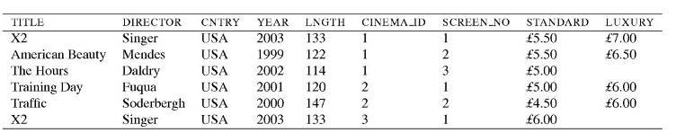
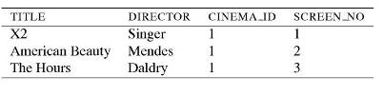
Relational operator example
Join relations SHOW and FILM
using FILM_NAME and TITLE
Relational
databases
Restrict using CINEMA_ID=1
Project TITLE, DIRECTOR, CINEMA_ID, and SCREEN_NO
For full database
see book web site:
http://worboys.duckham.org

Slide 23
Relational databases and spatial data
Several issues prevent unmodified databases being useful for spatial data
  Structure of spatial data does not naturally fit with tables
  Performance is impaired by the need to perform multiple joins with spatial data
  Indexes are non-spatial in a conventional relational database
An extensible RDBMS offers some solutions to these problems with
  user defined data types
  user-defined operations
  user-defined indexes and access methods
  active database functions (e.g., triggers)
Relational
databases

Slide 24
Section 8.3
Database development

Slide 25
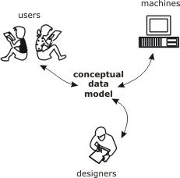
Conceptual data model
A conceptual data model provides a model of the proposed system that is independent of implementation details
An effective conceptual model will
  provide a means for communication between analysts, designers and users
  aid the design of the system
  provide basic reference material for implemented system
Database
development

Slide 26

Entity relationship model #1
The entity relationship model is a conceptual data modeling technique where
  An entity type represents a collection of similar objects
  An entity instance is an occurrence of a particular entity
  An attribute type is a property associated with an entity
An attribute type that serves to uniquely identify an entity type is called an identifier
  Identifiers are usually underlined
attribute type
entity type
Database
development
identifier

Slide 27
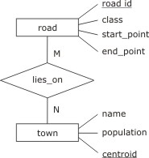
Entity relationship model #2
Entity types are connected using relationships
  A relationship type connects one or more entity types
  A relationship occurrence is a particular instance of a relationship
Relationships may have their own attributes independent of entities
Entity, attribute, and relationship types are shown in an entity relationship diagram (E-R diagram)
relationship
type
Database
development

Slide 28
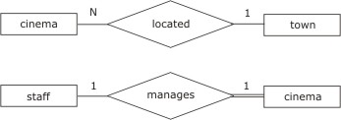
Entity relationship model #3
Relationship types may be
  many-to-many: e.g., a town may have many road, which in turn may pass through many towns
  many-to-one: e.g., a town may have many cinemas, but a cinema can be located in at most one town
  one-to-one: e.g., a cinema may have one manager who manages only one cinema
These constraints constitute cardinality conditions
Database
development

Slide 29
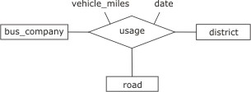
Entity relationship model #4
In addition to cardinality conditions, relationships may also have participatory conditions:
  optional or mandatory (indicated with a double line)
A relationship from an entity to itself is called involutory
A relationship connecting three entities is called a ternary relationship
Database
development

Slide 30
Extended entity relationship model
The extended entity relationship model (EER) adds further features:
  An entity type E₁ is a subtype of E₂ if every occurrence of E₁ is also an occurrence of E₂. In this case, E₂ is a supertype of E₁
  The operation of forming subtypes is called specialization; the inverse operation of forming supertypes is called generalization
For specialization (and conversely for generalization)
  A subtype has the same identifying attribute(s) as the supertype
  A subtype has all the attributes of the supertype, and possibly some more
  A subtype enters into all the relationships in which the supertype is involved, and possibly some more.
Subtypes and supertypes are organized into an inheritance hierarchy
Database
development

Slide 31
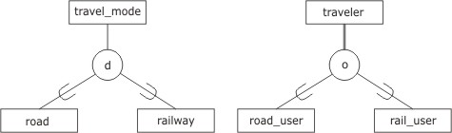
Extended entity relationship model
Subtypes may be:
  disjoint: where no occurrence of one subtype is an occurrence of another
  overlapping: subtypes are not disjoint
EER uses an extended diagrammatic notation to represent specialization/generalization constructs
Database
development
supertype
disjoint
overlapping
subtype

Slide 32
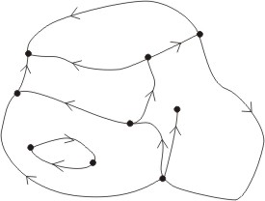
EER for spatial information #1
E-R or EER can be used to model spatial entities
Most vector-based GIS use a similar structure
Database
development
node
directed arc
area

Slide 33
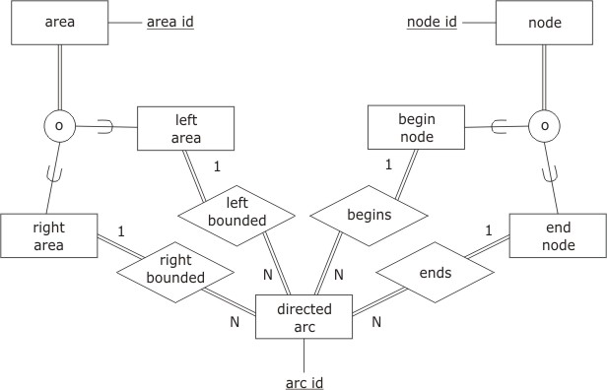
EER for spatial information #2
Database
development

Slide 34
Relational database design
An E-R model can be transformed into a relational database scheme
Advantageous features for a relational database scheme are:
  Lack of redundancy (redundant data wastes space and causes integrity problems)
  Fast access to data
There usually exists a balance between space (lack of redundancy) and speed (fast access to data)
  Many relations leads to lower redundancy, but more joins (slower speed)
  Fewer relations leads to fewer joins (slower speed), but greater redundancy (and integrity problems)
Database
development

Slide 35
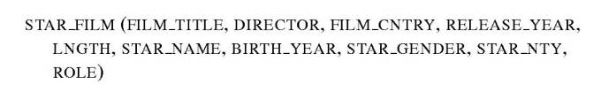
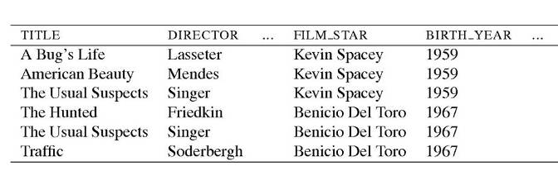
Redundancy
For example, the following relation and relation scheme will be able achieve fast access but involves considerable redundancy
Database
development

Slide 36
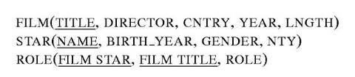
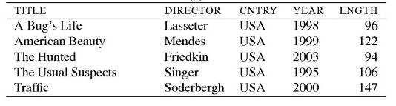

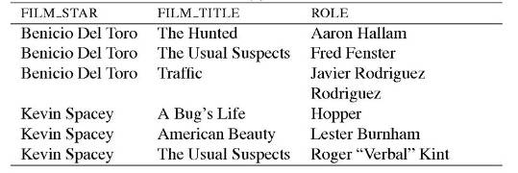
Removing redundancy
Database
development

Slide 37

Building relational schemes
Another guideline is to ensure relations are in first normal form, a process known as normalization
A first pass at building a relational scheme from an E-R model is to:
  Convert each entity into a relation
  Convert each relationship into a relation
However, not all relationships will require a relation
  For entities in a mandatory many to one relation, we can always opt to define a single joined relation in the relation scheme, known as posting the foreign key
Database
development

Slide 38
Section 8.4
Object-orientation

Slide 39
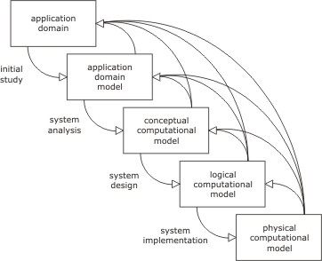
Object-orientation
The stages of the system development process (chapter 1) present a problem
  Information may be lost at each stage of the development process, termed impedance mismatch
Object-orientation aims to minimize impedance mismatch, bringing low-level system constructs closer to high-level conceptual constructs
Object
orientation

Slide 40
Foundations of object-orientation
The object is at the core of object-orientation
Objects have attributes that model the static, data-oriented aspects of a system (similar to tuples in a relation)
  The totality of attribute values constitutes the state of an object
Objects also have operations that model the behavior of a system
  Behaviors are also called methods
Objects with similar behaviors are grouped into classes
  The set of behaviors for a object form an interface
object = state + behavior
Object
orientation

Slide 41
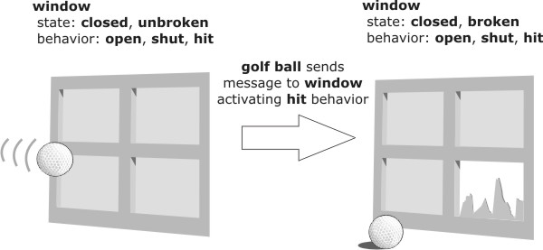
Example of object-orientation
Object
orientation

Slide 42
Features of object-orientation
The four main features of object-orientation from a modeling perspective are:
  Reduces complexity: decomposes complex phenomena into simpler objects
  Combats impedance mismatch: object-orientation can be applied at every level of system development
  Promotes reuse: System development is more efficient if constructed from collections of well-understood components
  Metaphorical power: Objects in object-orientation are metaphors for physical objects, making the modeling process easier
In addition, four key constructs are closely associated with object-orientation: identity, encapsulation, inheritance, and association
Object
orientation

Slide 43
Identity and encapsulation
An object has an identity that is independent of its attribute values
  Even if an object changes all its attribute values, it retains its identity
  Identity is immutable, created with an object and destroyed only when that object is destroyed
Objects hide the internal mechanisms of their behavior from the external access to that behavior, called encapsulation
  What behaviors an object exhibits are separated from how those behaviors are achieved
  Encapsulation promotes reuse, because changes to an object’s internal mechanisms will not affect the object’s external interface
Object
orientation

Slide 44
Inheritance and polymorphism
Classes may be organized into an inheritance hierarchy that allows objects to share common properties
  A class that provides more specialized behaviors is a subclass
  A class that provides more generalized behaviors is a superclass
Inheritance allows objects to perform different roles within specific contexts, termed polymorphism
  Inclusion polymorphism is where a subclass is substituted for a superclass
  Overloading is where subclasses implement their own specialized versions of general behaviors
There exists two types of inheritance:
  Single inheritance: each class may have zero or one superclasses
  Multiple inheritance: each class may have zero or more superclasses (requires some protocol for resolving behavioral conflicts)
Object
orientation

Slide 45
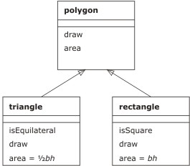
Class diagram
superclass
behavior
(single) inheritance
subclass
Object
orientation
overloading
(polymorphism)

Slide 46
Association
An association groups objects together to in order to model phenomena with complex internal structure
Aggregation is a type of association concerned with part/whole relationships (e.g. a wheel is “part of” a car)
  Aggregation relationships will form a hierarchy often referred to as a partonomy
An association is homogenous if it is formed from objects all of the same class. E.g., a soccer team is a homogenous association (aggregation)
An association is ordered where the ordering of component objects is important. E.g., a polyline might be a linear ordering of points
Object
orientation

Slide 47
Object-oriented modeling #1
Object-oriented modeling comprises defining the classes, attributes, behaviors, associations, and inheritance for a system
  Attributes for a class can be defined in a similar way to E-R modeling
Behaviors for a class fall into three categories
  Constructors are behaviors that are activated when an object is created, while destructors are activated when an object is destroyed
  Accessors are behaviors that may be used to examine the state of an object
  Transformers are behaviors that change the state of an object
Object
orientation

Slide 48
Object-oriented modeling #2
Defining associations and inheritance relationships is an iterative and application-dependent process
As a rule of thumb:
  Inheritance relationships can be detected by using the connection “is a” in a sentence with two classes. E.g., ‘a car “is a” vehicle’
  Aggregation relationships can be detected using “part of” in a sentence. E.g., ‘a steering wheel is “part of” a car’
Object
orientation

Slide 49
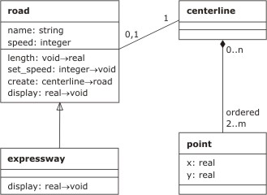
Class diagrams
transformer
association
aggregation
Object
orientation
constructor
accessor
attribute

Slide 50
Object-oriented DBMS
A DBMS that utilizes an object-oriented data model is called an object-oriented DBMS (OODBMS)
In addition to OO constructs, several other features are needed by OODBMS
  Scheme management (ability to create and change class schemes)
  Automatic query optimization
  Storage and access management
  Transaction management
There exists technical problems with achieving these features:
  System complexity means that there are no longer a few simple operators, like in relational systems
  Encapsulation means that internal state may be hidden from DBMS
As a result, performance for OODBMS is lower that for RDBMS
Hybrid object-relational DBMS (ORDBMS) use a combination of relational data management and object-oriented “shell” for mediating user access to the DBMS
Object
orientation

