Slide 1
Chapter 3
Fundamental spatial concepts

Slide 2

Geometry and invariance
Geometry: provides a formal representation of the abstract properties and structures within a space
Invariance: a group of transformations of space under which propositions remain true
  Distance- translations and rotations
  Angle and parallelism- translations rotations, and scalings

Slide 3
3.1
Euclidean space

Slide 4
Euclidean Space
Euclidean Space: coordinatized model of space
  Transforms spatial properties into properties of tuples of real numbers
  Coordinate frame consists of a fixed, distinguished point (origin) and a pair of orthogonal lines (axes), intersecting in the origin
Point objects
Line objects
Polygonal objects

Slide 5
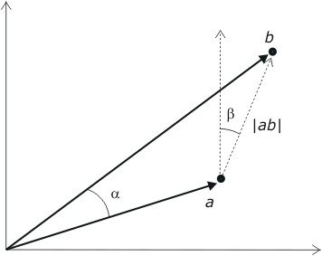


Points
A point in the Cartesian plane R² is associated with a unique pair of real number a = (x,y) measuring distance from the origin in the x and y directions. It is sometimes convenient to think of the point a as a vector.
  Scalar: Addition, subtraction, and multiplication, e.g.,
  (x₁, y₁) − (x₂, y₂) =
  (x₁ − x₂, y₁ − y₂)
  Norm:
  Distance: ja bj = jja-bjj
  Angle between vectors:

Slide 6
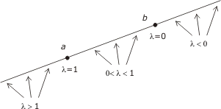
Lines
The line incident with a and b is defined as the point set
{λa + (1 −λ )b | λ 2 R}
The line segment between a and b is defined as the point set {λa + (1 −λ )b | λ 2 [0, 1]}
The half line radiating from b and passing through a is defined as the point set {λa + (1 − λ)b | λ ¸ 0}

Slide 7
Polygonal objects
A polyline in R² is a finite set of line segments (called edges) such that each edge end-point is shared by exactly two edges, except possibly for two points, called the extremes of the polyline.
If no two edges intersect at any place other than possibly at their end-points, the polyline is simple.
A polyline is closed if it has no extreme points.
A (simple) polygon in R² is the area enclosed by a simple closed polyline. This polyline forms the boundary of the polygon. Each end-point of an edge of the polyline is called a vertex of the polygon.
A convex polygon has every point intervisible
A star-shaped or semi-convex polygon has at least one point that is intervisible

Slide 8
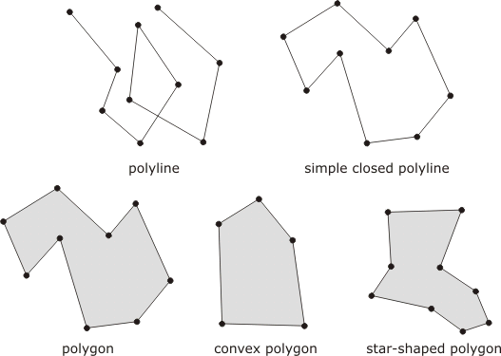
Polygonal objects

Slide 9
Polygonal Objects
Monotone chain: there is some line in the Euclidean plane such that the projection of the vertices onto the line preserves the ordering of the list of points in the chain
Monotone polygon: if the boundary can be split into two polylines, such that the chain of vertices of each polyline is a monotone chain
Triangulation: partitioning of the polygon into triangles that intersect only at their mutual boundaries

Slide 10
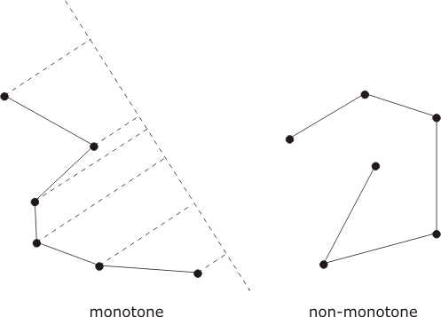
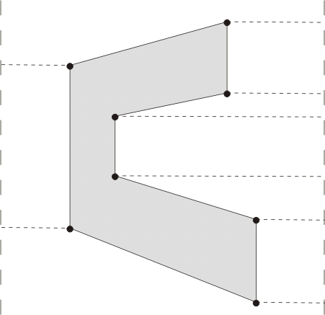
Polygon objects
monotone polyline

Slide 11
Transformations
Transformations preserve particular properties of embedded objects
  Euclidean Transformation
  Similarity transformations
  Affine transformations
  Projective transformations
  Topological transformation
Some formulas can be provided
  Translation: through real constants a and b
    (x,y) ! (x+a,y+b)
  Rotation: through angle θ about origin
    (x,y) ! (x cosθ - y sinθ, x sinθ + y cosθ)
  Reflection: in line through origin at angle θ to x-axis
    (x,y)! (x cos2θ + y sin2θ, x sin2θ - y cos2θ)

Slide 12
3.2
Set-based geometry of space

Slide 13
Sets
The set based model involves:
  The constituent objects to be modeled, called elements or members
  Collection of elements, called sets
  The relationship between the elements and the sets to which they belong, termed membership
    We write s 2 S to indicate that an element s is a member of the set S

Slide 14
Sets
A large number of modeling tools are constructed:
  Equality
  Subset: S 2 T
  Power set: the set of all subsets of a set, P(S)
  Empty set; ;
  Cardinality: the number of members in a set #S
  Intersection: S Å T
  Union: S [ T
  Difference: S\T
  Complement: elements that are not in the set, S’

Slide 15
Distinguished sets
Name | Symbol | Description
Booleans | B | Two-valued set of true/false, 1/0, or on/off
Integers | Z | Positive and negative numbers, including zero
Reals | R | Measurements on the number line
Real Plane | R² | Ordered pairs of reals
Closed interval | [a,b] | All reals between a and b 9 including a and b)
Open interval | ]a,b[ | All reals between a and b (excluding a and b)
Semi-open interval | [a,b[ | All reals between a and b (including a and excluding b)

Slide 16
Relations
Product: returns the set of ordered pairs, whose first element is a member of the first set and second element is a member of the second set
Binary relation: a subset of the product of two sets, whose ordered pairs show the relationships between members of the first set and members of the second set
Reflexive relations: where every element of the set is related to itself
Symmetric relations: where if x is related to y then y is related to x
Transitive relations: where if x is related to y and y is related to z then x is related to z
Equivalence relation: a binary relation that is reflexive, symmetric and transitive

Slide 17
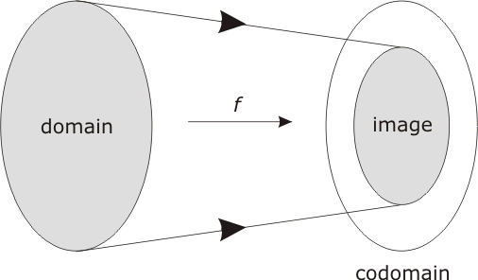
Functions
Function: a type of relation which has the property that each member of the first set relates to exactly one member of the second set
  f: S ! T

Slide 18
Functions
Injection: any two different points in the domain are transformed to two distinct points in the codomain
Image: the set of all possible outputs
Surjection: when the image equals the codomain
Bijection: a function that is both a surjection and an injection

Slide 19
Inverse functions
Injective function have inverse functions
Projection
  Given a point in the plane that is part of the image of the transformation, it is possible to reconstruct the point on the spheroid from which it came
  Example:
    A new function whose domain is the image of the UTM maps the image back to the spheroid

Slide 20
Convexity
A set is convex if every point is visible from every other point within the set
Let S be a set of points in the Euclidean plane
Visible:
  Point x in S is visible from point y in S if either
    x=y or;
    it is possible to draw a straight-line segment between x and y that consists entirely of points of S

Slide 21
Convexity
Observation point:
  The point x in S is an observation point for S if every point of S is visible from x
Semi-convex:
  The set S is semi-convex (star-shaped if S is a polygonal region) if there is some observation point for S
Convex:
  The set S is convex if every point of S is an observation point for S

Slide 22
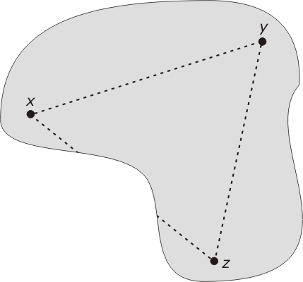
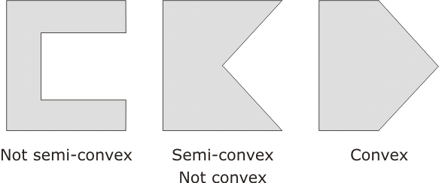
Convexity
Visibility between points x, y, and z

Slide 23
3.3
Topology of Space

Slide 24
Topology
Topology: “study of form”; concerns properties that are invariant under topological transformations
Intuitively, topological transformations are rubber sheet transformations
Topological | A point is at an end-point of an arc
 | A point is on the boundary of an area
 | A point is in the interior/exterior of an area
 | An arc is simple
 | An area is open/closed/simple
 | An area is connected
Non-topological | Distance between two points
 | Bearing of one point from another point
 | Length of an arc
 | Perimeter of an area

Slide 25
Point set topology
One way of defining a topological space is with the idea of a neighborhood
Let S be a given set of points. A topological space is a collection of subsets of S, called neighborhoods, that satisfy the following two conditions:
  T1 Every point in S is in some neighborhood.
  T2 The intersection of any two neighborhoods of any point x in S contains a neighborhood of x
Points in the Cartesian plane and open disks (circles surrounding the points) form a topology

Slide 26
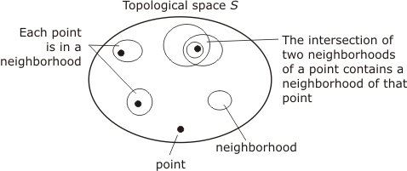
Point set topology

Slide 27

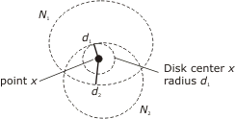
Usual topology
Usual topology: naturally comes to mind with Euclidean plane and corresponds to the rubber-sheet topology

Slide 28
Travel time topology
Let S be the set of points in a region of the plane
Suppose:
  the region contains a transportation network and
  we know the average travel time between any two points in the region using the network, following the optimal route
Assume travel time relation is symmetric
For each time t greater than zero, define a t-zone around point x to be the set of all points reachable from x in less than time t

Slide 29
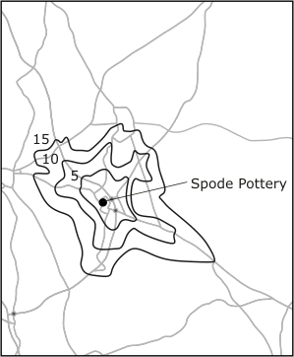
Travel time topology
Let the neighborhoods be all t-zones around a point
T1 and T2 are satisfied

Slide 30
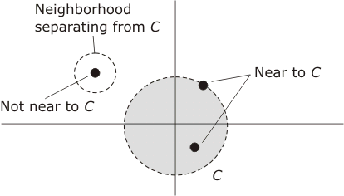
Nearness
Let S be a topological space
Then S has a set of neighborhoods associated with it. Let C be a subset of points in S and c an individual point in S
Define c to be near C if every neighborhood of c contains some point of C

Slide 31
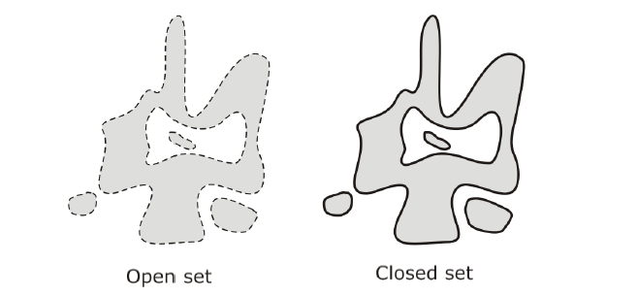
Open and closed sets
Let S be a topological space and X be a subset of points of S.
  Then X is open if every point of X can be surrounded by a neighborhood that is entirely within X
    A set that does not contain its boundary
  Then X is closed if it contains all its near points
    A set that does contain its boundary

Slide 32
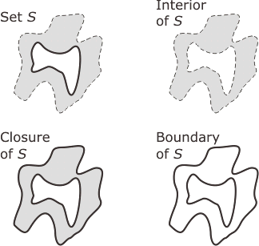
Closure, boundary, interior
Let S be a topological space and X be a subset of points of S
The closure of X is the union of X with the set of all its near points
  denoted X⁻
The interior of X consists of all points which belong to X and are not near points of X⁰
  denoted X°
The boundary of X consists of all points which are near to both X and X⁰. The boundary of set X is denoted ϑX

Slide 33
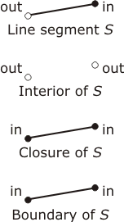
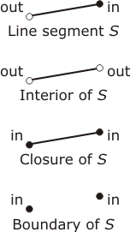
Topology and embedding space
2-space
1-space

Slide 34
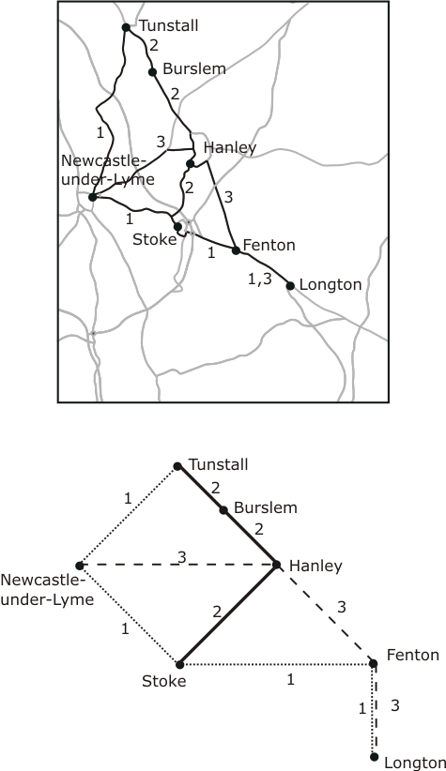
Topological invariants
Properties that are preserved by topological transformations are called topological invariants

Slide 35
Connectedness
Let S be a topological space and X be a subset of points of S
Then X is connected if whenever it is partitioned into two non-empty disjoint subsets, A and B,
  either A contains a point near B, or B contains a point near A, or both
A set in a topological space is path-connected if any two points in the set can be joined by a path that lies wholly in the set

Slide 36
Connectedness
A set X in the Euclidean plane with the usual topology is weakly connected if it is possible to transform X into an unconnected set by the removal of a finite number of points
A set X in the Euclidean plane with the usual topology is strongly connected if it is not weakly connected

Slide 37
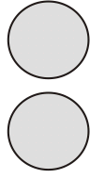
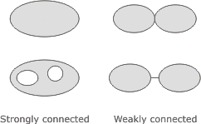
Connectedness
disconnected

Slide 38
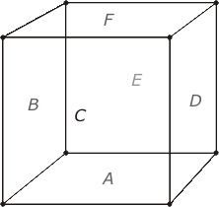
Combinatorial topology
Euler’s formula:
  Given a polyhedron with f faces, e edges, and v vertices, then: f – e +v =2

Slide 39
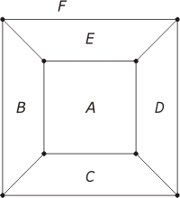
Combinatorial topology
Remove a single face from a polyhedron and apply a 3-space topological transformation to flatten the shape onto the plane
Modify Euler’s formula for the sphere to derive Euler’s formula for the plane
  Given a cellular arrangement in the plane, with f cells, e edges, and v vertices, f – e + v = 1

Slide 40

Simplexes and complexes
0-simplex: a set consisting of a single point in the Euclidean plane
1-simplex: a closed finite straight-line segment
2-simplex: a set consisting of all the points on the boundary and in the interior of a triangle whose vertices are not collinear

Slide 41
Simplexes and complexes
Simplicial complex: simple triangular network structures in the Euclidean plane (two-dimensional case)
A face of a simplex S is a simplex whose vertices form a proper subset of the vertices of S
A simplicial complex C is a finite set of simplexes satisfying the properties:
    A face of a simplex in C is also in C
    The intersection of two simplexes in C is either empty or is also in C

Slide 42
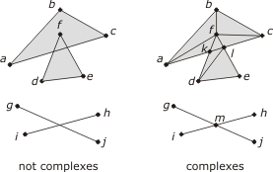
Simplexes and complexes

Slide 43
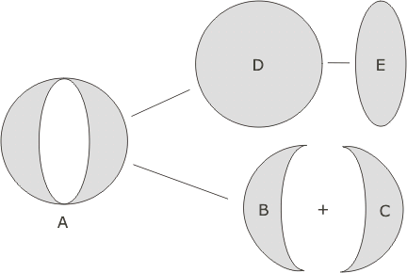
Problem with combinatorial topology
The more detailed connectivity of the object is not explicitly given. Thus there is no explicit representation of weak, strong, or simple connectedness
The representation is not faithful, in the sense that two different topological configurations may have the same representation

Slide 44
Combinatorial map
Assume that the boundary of a cellular arrangement is decomposed into simple arcs and nodes that form a network
Give a direction to each arc so that traveling along the arc the object bounded by the arc is to the right of the directed arc
Provide a rule for the order of following the arcs:
  After following an arc into a node, move counterclockwise around the node and leave by the first unvisited outward arc encountered

Slide 45
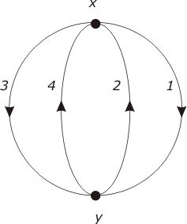
Combinatorial map

Slide 46
3.4
Network spaces

Slide 47
Abstract graphs
A graph G is defined as a finite non-empty set of nodes together with a set of unordered pairs of distinct nodes (called edges)
  Highly abstract
  Represents connectedness between elements of the space
Directed graph
Labeled graph

Slide 48
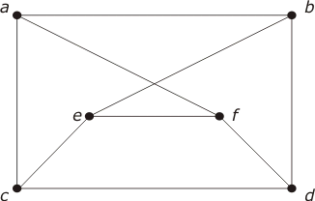
Abstract graphs
Connected graph
Edges
Path
Cycle
Nodes
Degree
Isomorphic
Directed/ non-directed

Slide 49
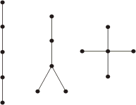
Tree
Connected graph
Acyclic
Non-isomorphic

Slide 50
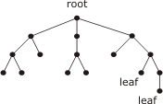
Rooted tree
Root
Immediate descendants
Leaf

Slide 51
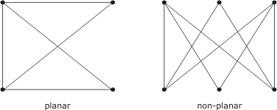
Planar graphs
Planar graph: a graph that can be embedded in the plane in a way that preserves its structure

Slide 52
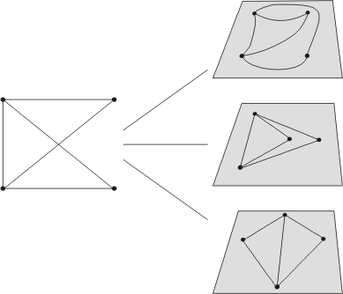
Planar graphs
There are many topologically inequivalent planar embeddings of a planar graph in the plane
Euler’s formula: f− e + v =1

Slide 53
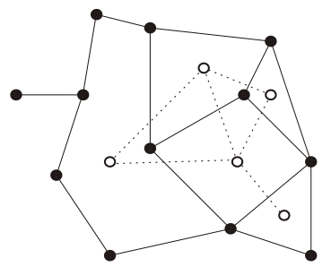
Dual G*
Obtained by associating a node in G* with each face in G
Two nodes in G* are connected by an edge if and only if their corresponding faces in G are adjacent

Slide 54
3.5
Metric spaces

Slide 55
Definition
A point-set S is a metric space if there is a distance function d, which takes ordered pairs (s,t) of elements of S and returns a distance that satisfies the following conditions
  For each pair s, t in S, d(s,t) >0 if s and t are distinct points and d(s,t) =0 if s and t are identical
  For each pair s,t in S, the distance from s to t is equal to the distance from t to s, d(s,t) = d(t,s)
  For each tripe s,t,u in S, the sum of the distances from s to t and from t to u is always at least as large as the distance from s to u

Slide 56
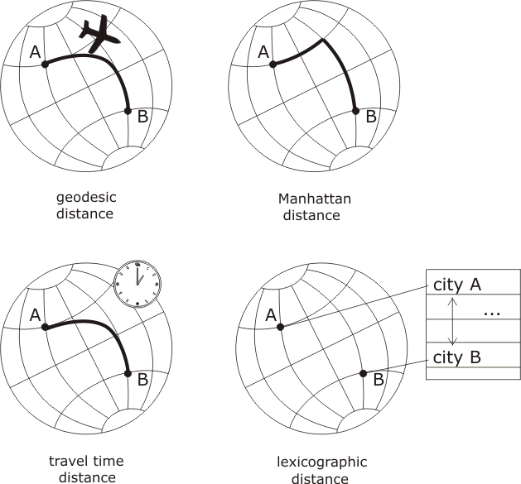
Distances defined on the globe
Metric space
Metric space
Quasimetric
Metric space

Slide 57
3.6
Fractal geometry

Slide 58
Fractal geometry
Scale dependence: appearance and characteristics of many geographic and natural phenomena depend on the scale at which they are observed
Straight lines and smooth curves of Euclidean geometry are not well suited to modeling self-similarity and scale dependence
Fractals: self-similar across all scales
  Defined recursively, rather than by describing their shape directly

Slide 59
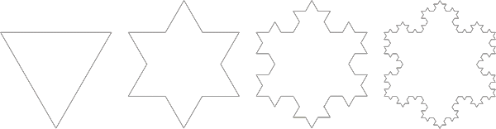
Koch snowflake

Slide 60
Fractal dimensions
Self-affine fractals: constructed using affine transformations within the generator, so rotations, reflections, and shears can be used in addition to scaling
Fractal dimension: an indicator of shape complexity;
  Lies somewhere between the Euclidean dimensions of the shape and its embedding space
  A shape with a high fractal dimension is complex enough to nearly fill its embedding space (space filling)

