Slide 1
Chapter 4
Models of geospatial information

Slide 2
Ontology
Ontology: the study of general classifications of, and relationships between, those things that exist in the world
A basic ontological distinction is the division of the world into entities that have identities (objects) and entities that occur in time (events)
Objects or continuants, may be categorized as substances, parts of substances, aggregates of substances, locations for substances, and properties of substances
  The Earth constitutes a substance; the surface of the Earth is part of the Earth; the solar system is an aggregate of planets; the USA is a location; and the Earth’s total land area is a property of the Earth

Slide 3
Modeling
We are interested in modeling parts of the geographic world
An understanding of basic ontological distinctions can help us avoid some basic modeling mistakes such as:
  Failing to distinguish real-world entities from information system entities
  Failing to distinguish substances from their properties
Example
A forest, the location of the forest, and the land-cover type “forested” fall in distinct ontological categories

Slide 4


Ontology vs. Modeling
Key distinctions:
  Ontology aims to develop general taxonomies of what exists
  Data modeling aims to develop classifications within a particular application domain
Examples:
  The distinction between substance and property is not a data modeling issue
  The decision to represent a road in a navigation system as a polyline or as an area is a data modeling question

Slide 5
Models
Model: an artificial construction in which parts of one domain, the source domain, are represented in another domain, the target domain
  Purpose is to simplify and abstract away from the source domain
  Constituents of the source domain are translated by the model into the target domain
  Insight, results and computations in the target domain may then be interpreted in the source domain.
  Usefulness is determined by how closely the model can simulate the source domain, and how easy it is to move between the two domains

Slide 6
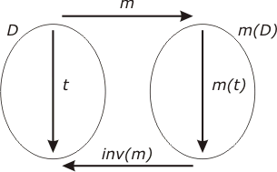
Morphism
Morphism: a function from one domain to another that preserves some of the structure in the translation
Example
Cartography and wayfinding:
  The geographic world is the source domain, modeled by a map (target domain)

Slide 7
Types of models
Field-based model: treats geographic information as collections of spatial distributions
  Distribution may be formalized as a mathematical function from a spatial framework to an attribute domain
  Patterns of topographic altitudes, rainfall, and temperature fit neatly into this view.
Object-based model: treats the space as populated by discrete, identifiable entities each with a geospatial reference
  Buildings or roads fit into this view

Slide 8
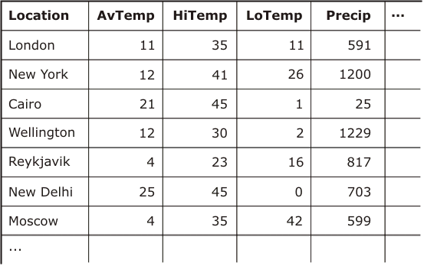
Relational model
Tuples recording annual weather conditions at different locations
  The field-based and object-based approaches are attempts to impose structure and pattern on such data.

Slide 9
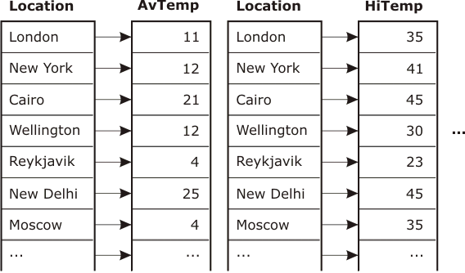
Field-based approach
Treats information as a collection of fields
  Each field defines the spatial variation of an attribute as a function from the set of locations to an attribute domain

Slide 10
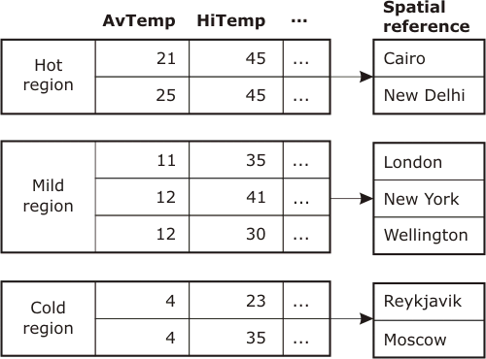
Object-based approach
Clumps a relation as single or groups of tuples
  Certain groups of measurements of climatic variables can be grouped together into a finite set of types

Slide 11
Spatial framework
Spatial framework: a partition of a region of space, forming a finite tessellation of spatial objects
In the plane, the elements of a spatial framework are polygons
Must be a finite structure for computational purposes
  Often the application domain will not be finite and sampling is necessary
  Imprecision is introduced by the sampling process

Slide 12
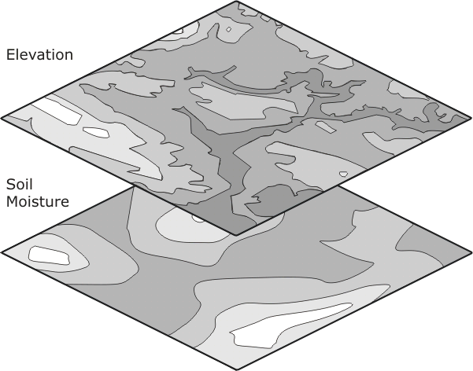
Layers
Layer: the combination of the spatial framework and the field that assigns values for each location in the framework
  There may be many layers in a spatial database

Slide 13
Spatial fields
If the spatial framework is a Euclidean plane and the attribute domain is a subset of the set of real numbers;
  The Euclidean plane plays the role of the horizontal xy-plane
  The spatial field values give the z-coordinates, or “heights” above the plane
Regional Climate Variations
Imagine placing a square grid over a region and measuring aspects of the climate at each node of the grid. Different fields would then associate locations with values from each of the measured attribute domains.

Slide 14
Properties of the attribute domain
The attribute domain may contain values which are commonly classified into four levels of measurement
  Nominal attribute: simple labels; qualitative; cannot be ordered; and arithmetic operators are not permissible
  Ordinal attribute: ordered labels; qualitative; and cannot be subjected to arithmetic operators, apart from ordering
  Interval attributes: quantities on a scale without any fixed point; can be compared for size, with the magnitude of the difference being meaningful; the ratio of two interval attributes values is not meaningful
  Ratio attributes: quantities on a scale with respect to a fixed point; can support a wide range of arithmetical operations, including addition, subtraction, multiplication, and division

Slide 15
Continuous and differentiable fields
Continuous field: small changes in location leads to small changes in the corresponding attribute value
Differentiable field: rate of change (slope) is defined everywhere
Spatial framework and attribute domain must be continuous for both these types of fields
Every differentiable field must also be continuous, but not every continuous field is differentiable

Slide 16
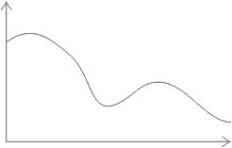
One dimensional examples
Fields may be plotted as a graph of attribute value against spatial framework
Continuous and differentiable; the slope of the curve can be defined at every point

Slide 17
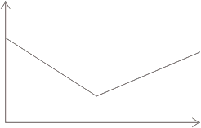
One dimensional examples
The field is continuous (the graph is connected) but not everywhere differentiable. There is an ambiguity in the slope, with two choices at the articulation point between the two straight line segments.
Continuous and not differentiable; the slope of the curve cannot be defined at one or more points

Slide 18
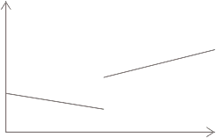
One dimensional examples
The graph is not connected and so the field in not continuous and not differentiable.
Not continuous and not differentiable

Slide 19
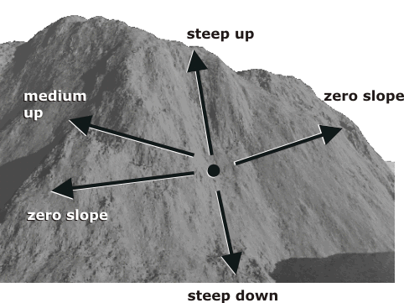
Two dimensional examples
The slope is dependent on the particular location and on the bearing at that location

Slide 20
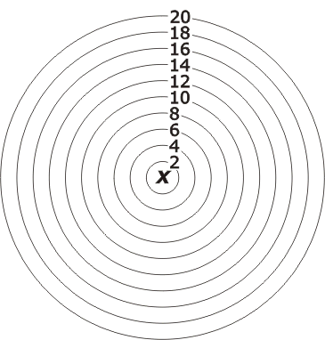
Isotropic fields
A field whose properties are independent of direction is called an isotropic field
Consider travel time in a spatial framework
  The time from
  X to any point Y is
  dependent only
  upon the distance
  between X and Y
  and independent
  of the bearing of
  Y from X

Slide 21
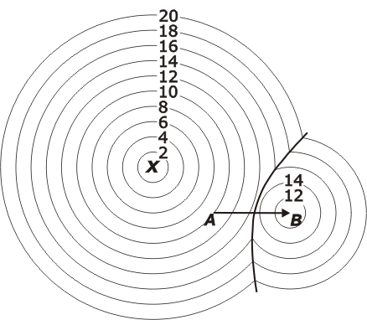
Anisotropic fields
A field whose properties are dependent on direction is called an anisotropic field.
Suppose there is a high speed link AB
  For points near
  B it would be better,
  if traveling from
  X, to travel to A,
  take the link,
  and continue on
  from B to the
  destination
  The direction to
  the destination is
  important

Slide 22
Spatial autocorrelation
Spatial autocorrelation is a quantitative expression of Tobler’s first law of geography (1970)
  “Everything is related to everything else, but near things are more related than distant thing”
  Spatial autocorrelation measures the degree of clustering of values in a spatial field

Slide 23
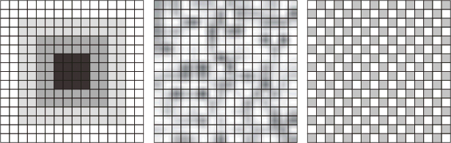
Autocorrelation
If like values
tend to cluster together,
then the field exhibits
high positive spatial
autocorrelation
If there is no apparent relationship between attribute value and location then there is zero spatial autocorrelation
If like values tend to be located away from each other, then there is negative spatial autocorrelation

Slide 24
Operations on fields
A field operation takes as input one or more fields and returns a resultant field
The system of possible operations on fields in a field-based model is referred to as map algebra
Three main classes of operations
  Local
  Focal
  Zonal

Slide 25
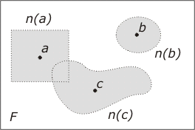
Neighborhood function
Given a spatial framework F, a neighborhood function
n is a function that associates with each location x a set of locations that are “near” to x

Slide 26
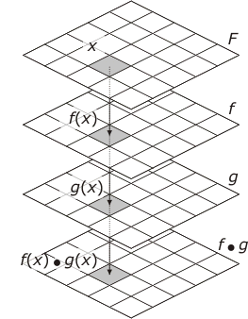
Local operations
Local operation: acts upon one or more spatial fields to produce a new field
The value of the new field at any location is dependent on the values of the input field function at that location
  ● is any binary operation

Slide 27
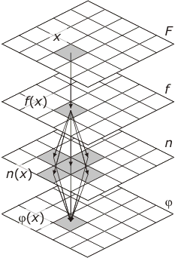
Focal operations
Focal operation: the attribute value derived at a location x may depend on the attributes of the input spatial field functions at x and the attributes of these functions in the neighborhood n(x) of x

Slide 28
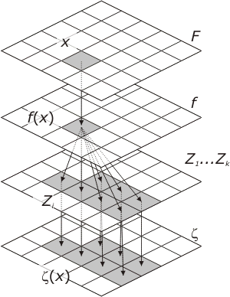
Zonal operations
Zonal operation: aggregates values of a field over a set of zones (arising in general from another field function) in the spatial framework
For each location x:
  Find the Zone Z_{i} in which x
  is contained
  Compute the values of the
  field function f applied to each point in Z_{i}
  Derive a single value ζ(x)
  of the new field from the
  values computed in step 2

Slide 29
Entity and literals
Object-based models decompose an information space into objects or entities
An entity must be:
  Identifiable
  Relevant (be of interest)
  Describable (have characteristics)
The frame of spatial reference is provided by the entities themselves
Literals have an immutable state that cannot be created, changed, or destroyed

Slide 30
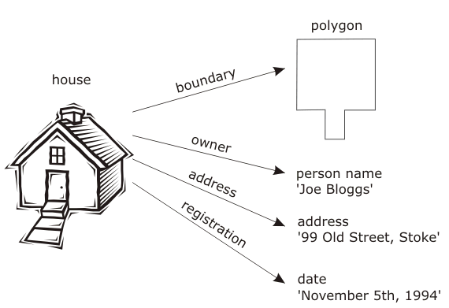
House object
  Has several attributes, such as registration date, address, owner and boundary, which are themselves objects

Slide 31
House object
  The actual values of these attributes are literals
    If the house is registered to a new owner, we may change the registration attribute to a new date, however, the date November 5th, 1994” still exists as a date

Slide 32
Spatial objects
Spatial objects are called “spatial” because they exist inside “space”, called the embedding space
A set of primitive objects can be specified, out of which all others in the application domain can be constructed, using an agreed set of operations
Point-line-polygon primitives are common in existing systems

Slide 33
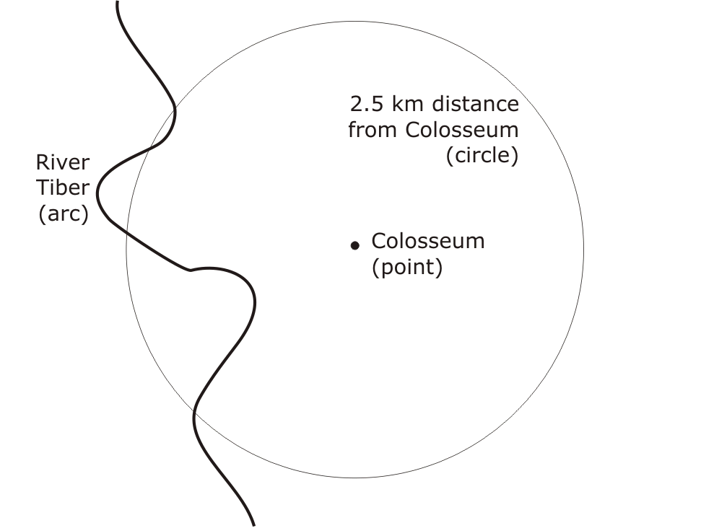
GIS analysis
For Italy’s capital city, Rome, calculate the total length of the River Tiber which lies within 2.5 km of the Colosseum
  First we need to model the relevant parts of Rome as objects
  Operation length will act on arc, and intersect will apply to form
  the piece of the arc in common
  with the disc

Slide 34
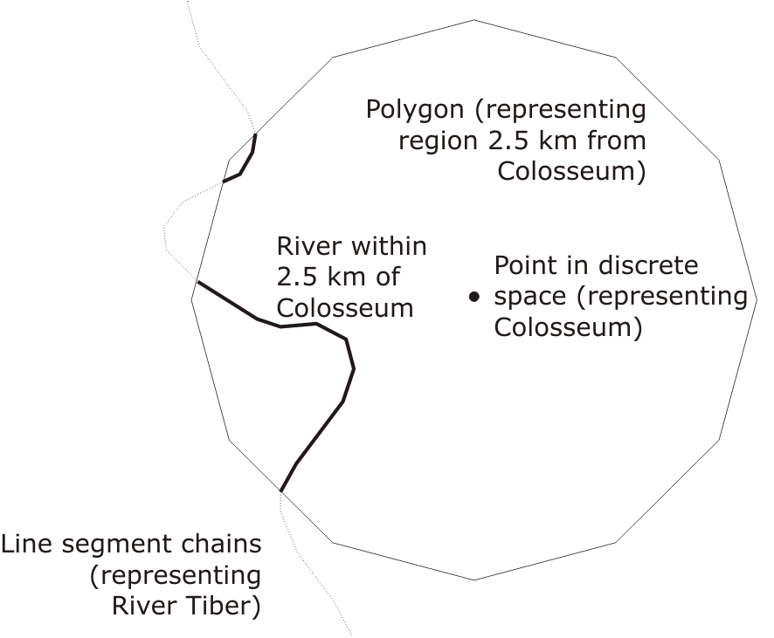
GIS analysis
A process of discretization must convert the objects to types that are computationally tractable
A circle may be represented as a discrete polygonal area, arcs by chains of line segments, and points
may be embedded in some
discrete space

Slide 35
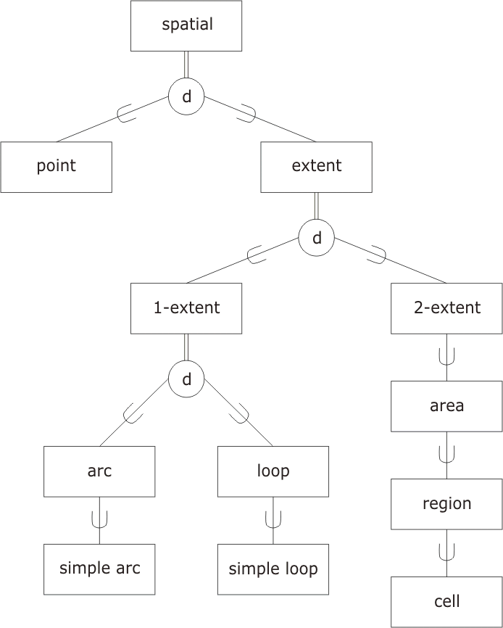
Spatial object types in the Euclidean plane
The most general spatial object type spatial is at the top of the hierarchy
Spatial type is the disjoint union of types point and extent
Class extent may be specialized by dimension into types 1- extent and 2- extent
Two sub types of the one dimensional extents are described as arc and loop, specializing to simple arc and simple loop when there are no self-crossings

Slide 36

Spatial object types in the Euclidean plane
The fundamental areal object is area
A connected area is a region
A region that is simply connected is a cell

Slide 37
Topological spatial operations
Object types with an assumed underlying topology are point, arc, loop and area
Operations:
  boundary, interior, closure and connected are defined in the usual manner
  components returns the set of maximal connected components of an area
  extremes acts on each object of type arc and returns the pair of points of the arc that constitute its end points
  is within provides a relationship between a point and a simple loop, returning true if the point is enclosed by the loop

Slide 38
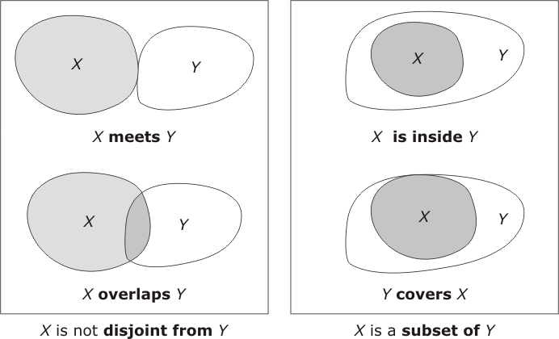
Topological spatial operations for areas
  X meets Y if X and Y touch externally in a common portion of their boundaries
  X overlaps Y if X and Y impinge into each other’s interiors

Slide 39
Topological spatial operations for areas
  X is inside Y if X is a subset of Y and X, Y do not share a common portion of boundary
  X covers Y if Y is a subset of X and X, Y touch externally in a common portion of their boundaries

Slide 40
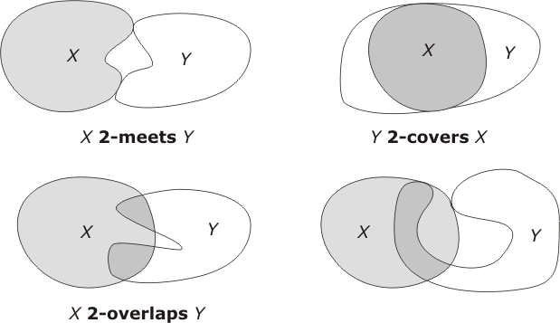
Topological spatial operations
There are an infinite number of possible topological relationships that are available between objects of type cell

Slide 41
Euclidean spatial operations
Operation centroid returns the center of gravity of an areal object as an object of type point
Distances and angles are defined between the point elements of the space
Measurements between objects of different dimensions
Some ambiguities exist in finding the distance of a town form a motorway.
Do we mean the town center or the town as an area? Are we measuring distance along roads, as the crow flies, or by some other means?
These ambiguities must be resolved before the question can be answered properly.

Slide 42
Operations on spatial objects
All of these spatial operations can be thought of as operations on spatial literals. The operands are not affected by the application of the operation
  For example, calculating the length of an arc cannot affect the arc itself
Another class of spatial operation acts upon spatially referenced objects, and alters the state of those objects
  Create
  Destroy
  Update

Slide 43
Formal theories of spatial objects
It is possible to provide formal theories for spatial relationships that have very general interpretations
Set in a logical framework, with definition of terms, well-formed formulas, and axioms
E.G.: Clarks calculus of individuals
  Focus is a binary connection relation between regions
  C(X,Y) = “region X is connected to region Y”
  The connection relation satisfies the following axioms:
    For each region X, C(X,X)
    For each pair of regions X,Y, if C(XY) then C(Y,X)
Many of the set-oriented and topological relations between spatial objects may be constructed using just these two axioms

