Slide 1
Chapter 5
Representation and algorithms

Slide 2
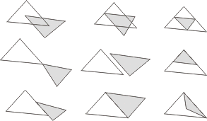
Computing with geospatial data
Traditional computing depends upon 1D data
Moving to 2D data is a bigger jump than it might seem
Disjoint
Touching externally
Overlapping
Touching internally
Nested
Equal

Slide 3
Algorithms
An algorithm is a specification of a computational process required to perform some operation
For a given algorithm, we are usually interested in how efficient it is. Efficient algorithms require less computing resources when actually implemented
The efficiency of an algorithm is usually measured in terms of the time the algorithm uses, called time complexity or the amount of storage space required, called space complexity
  For example, the time required to compute the breadth first search for any graph G = (V, E) is proportional to |V|, the number of input nodes
We use the “big-oh” notation to classify algorithms according to time complexity
  O(n) stands for the set of algorithms that have a time complexity that is at most linearly proportional to n

Slide 4
Complexity
1 | 0.0 | 1.0 | 0 | 2.0
25 | 3.1 | 5.0 | 625 | 3.3 X10⁷
50 | 3.9 | 7.1 | 2500 | 1.1 X10¹⁵
75 | 4.3 | 8.6 | 5625 | 3.8 X10²²
100 | 4.6 | 10.0 | 10000 | 1.3 X10³⁰
Approximate values of common functions
O(1) | Constant time | Very fast
O(log_{e}n) | Logarithmic time | Fast
O(n) | Linear time | Moderate
O(n logn) | Sub-linear time | Moderate
O(n^{k}) | Polynomial time | Slow
O(k^{n}) | Exponential time | Intractable
Common time complexity orders

Slide 5
Chapter 5.2
The discrete Euclidean plane

Slide 6
Geometric domains
Geometric domain is a triple <G,P,S>, where:
  G, the domain grid, is a finite connected portion of the discrete Euclidean plane, Z²
  P is a set of points in Z²
  S is a set of line segments in Z²
Subject to the following closure conditions:
  Each point of P is a point in the domain grid G
  Any line segment in S must have its end-points as members of P
  Any point in P that is incident with a line segment in S must be one of its end-points
  If any two line segments in S intersect as a point, then that point must be a member of P

Slide 7
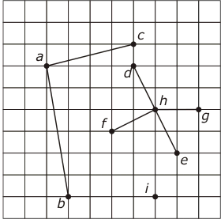
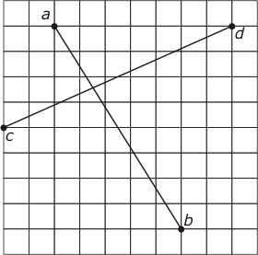
Grid structures
A structure that forms a geometric domain
A structure that does not form a geometric domain

Slide 8
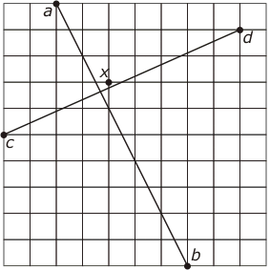
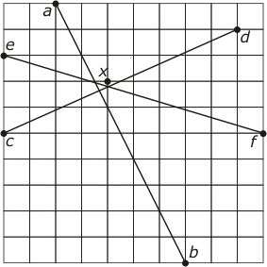
Discretization
Discretization: moving data from a continuous to a discrete domain (some precision will be lost)

Slide 9
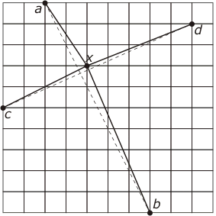
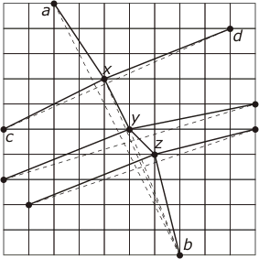
Discretization
The chain axyzb has strayed well away from the original line segment ab

Slide 10
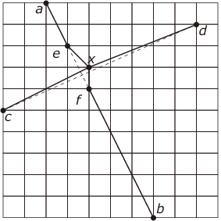
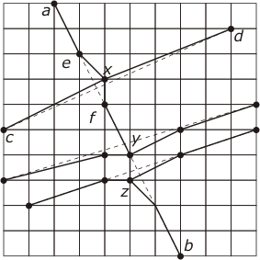
Green-Yao Algorithm
The drifting line problem can be solved using the Green-Yao algorithm

Slide 11
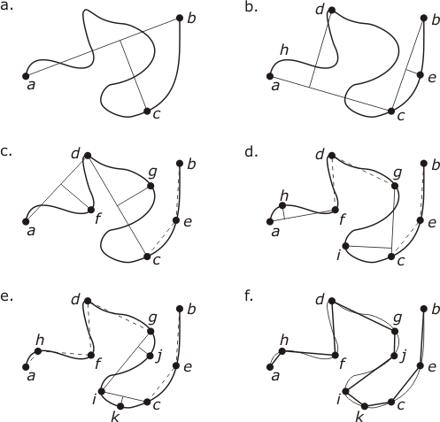
Discretizing arcs
Line simplification: reducing the level of detail in the representation of a polyline, while still retaining its essential geometric character

Slide 12
Chapter 5.3
The spatial object domain

Slide 13
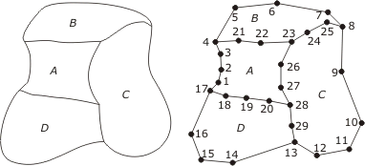
Spaghetti
Spaghetti data structure represents a planar configuration of points, arcs, and areas
Geometry is represented as a set of lists of straight-line segments
There is NO explicit representation of the topological interrelationships of the configuration, such as adjacency

Slide 14
Spaghetti- example
Each polygonal area is represented by its boundary loop
Each loop is discretized as a closed polyline
Each polyline is represented as a list of points
  A:[1,2,3,4,21,22,23,26,27,28,20,19,18,17]
  B:[4,5,6,7,8,25,24,23,22,21]
  C:[8,9,10,11,12,13,29,28,27,26,23,24,25]
  D:[17,18,19,20,28,29,13,14,15,16]

Slide 15
NAA: node arc area
Each directed arc has exactly one start and one end node.
Each node must be the start node or end node (maybe both) of at least one directed arc.
Each area is bounded by one or more directed arcs.
Directed arcs may intersect only at their end nodes.
Each directed arc has exactly one area on its right and one area on its left.
Each area must be the left area or right area (maybe both) of at least one directed arc.

Slide 16
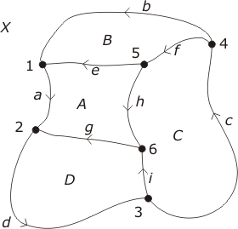
NAA: planar decomposition
Arc | Begin | End | Left | Right
a | 1 | 2 | A | X
b | 4 | 1 | B | X
c | 3 | 4 | C | X
d | 2 | 3 | D | X
e | 5 | 1 | A | B
f | 4 | 5 | C | B
g | 6 | 2 | D | A
h | 5 | 6 | C | A
i | 3 | 6 | D | C

Slide 17
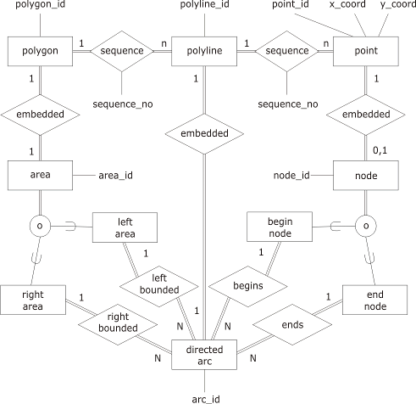
NAA: planar decomposition
ARC(ARC ID, BEGIN_NODE, END_NODE, LEFT_AREA, RIGHT_AREA)
POLYGON(AREA ID, ARC ID, SEQUENCE_NO)
POLYLINE(ARC ID, POINT ID, SEQUENCE_NO)
POINT(POINT ID, X_COORD,Y_COORD)
NODE(NODE ID, POINT_ID)

Slide 18
DCEL: doubly connected edge list
Omits details of the actual embedding
Focuses on the topological relationships embodied in the entities node, arc (edge), and area (face)
One table provides the information to construct:
  The sequence (cycle) of arcs around the node for each node in the configuration; and
  The sequence (cycle) of arcs around the area for each node in the configuration
Every arc has a unique next arc and a unique previous arc

Slide 19
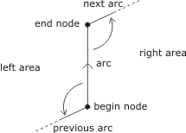
DCEL: doubly connected edge list
Arc ID | BEGIN NODE | END NODE | LEFT AREA | RIGHT AREA | PREVIOUS ARC | NEXT ARC
a | 1 | 2 | A | X | e | d
b | 4 | 1 | B | X | f | a
c | 3 | 4 | C | X | I | b
d | 2 | 3 | D | X | g | c
e | 5 | 1 | A | B | h | b
f | 4 | 5 | C | B | c | e
g | 6 | 2 | D | A | I | a
h | 5 | 6 | C | A | f | g
i | 3 | 6 | D | C | d | h

Slide 20
Algorithms
Counterclockwise sequence of arcs surrounding node n
Input: Node n
1: find some arc x which is incident with n
2: arc Ã x
3: repeat
4: store arc in sequence s
5: if begin_node(arc) = n then
6: arc Ã previous_arc (arc)
7: else
8: arc Ã next_arc(arc)
9: until arc = x
Output: Counterclockwise sequence of arcs s

Slide 21
Algorithms
Clockwise sequence of arcs surrounding area X
Input: Area X
1: find some arc x which bounds X
2: arc Ã x
3: repeat
4: store arc in sequence s
5: if left_area(arc) = X then
6: arc Ã previous_arc (arc)
7: else
8: arc Ã next_arc(arc)
9: until arc = x
Output: Clockwise sequence of arcs s

Slide 22
Object-DCEL
Based upon the combinatorial map
Faithful to homeomorphism and cyclic reordering of the arcs around a polygon
Relies on the notions of strong and weak connectivity
  Decomposes an areal object into its strongly connected components
Requirement: provide a method that will allow the specification of unique and faithful representations of complex weakly connected areal objects

Slide 23
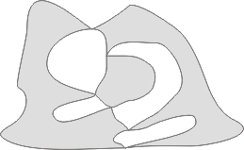
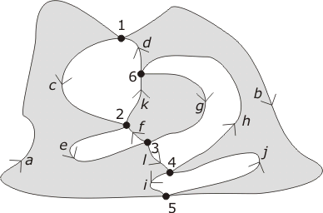
Object-DCEL
Construct the direction of the arcs so that the object’s area is always to the right of each arc

Slide 24
Object- DCEL
The weakly connected areal object may be represented in object-DCEL form as a table
Arc boundaries of the strongly connected cells that are components of the weakly connected object, can be retrieved by following the sequences of arc to next arc until we arrive back at the starting arcs
ARC ID | BEGIN NODE | NEXT ARC
a | 5 | c
b | 1 | j
c | 1 | e
d | 6 | b
e | 2 | l
f | 3 | k
g | 6 | f
h | 4 | d
i | 4 | a
j | 5 | h
k | 2 | g
l | 3 | i
Sequence
[a,c,e,l,i]
[f,k,g]
[b,j,h,d]

Slide 25








Holes and islands
1 hole
No hole
2 holes
1 hole
1 hole
1 island
No hole
No islands
2 holes
1 island
1 hole
No islands

Slide 26
Chapter 5.4
Representations of field-based models

Slide 27
Regular tessellated representations
Tessellations: a partition of the plane as the union of a set of disjoint areal objects
Regular polygon: a polygon with all edges the same length and all internal angles equal
Vertex figure: the polygon formed by joining in order the mid points of all edges incident with the vertex
Regular tessellation: a tessellation of a surface for which all the participating polygons and vertex figures are regular and equal
Square grid is most commonly used regular tessellation
  Provides the raster representation of spatial data

Slide 28
Irregular tessellated representations
Irregular tessellation: a tessellation for which the participating polygons are not all regular and equal
TIN (triangulated irregular networks) is the most commonly used irregular tessellations
The irregularity of a TIN allows the resolution to vary over the surface, capturing finer details where required
Useful notion is duality of planar graphs (discussed in Chapter 3), where faces become nodes and nodes become faces

Slide 29
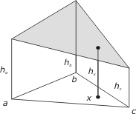
Interpolating height h_{x}
Point x is inside or on the boundary of the triangle abc,
x = αa + βb + γc
Where α , β , and γ are scalar coefficients that can be uniquely determined, such that:
α + β + γ = 1
The height h_{x} can now be found by using
h_{x} = αh_{a} + βh_{b} + γh_{c}

Slide 30
Delaunay triangulation
Delaunay triangulation: constituent triangles in a Delaunay triangulations are “as nearly equilateral as possible”
  Each circumcircle of a constituent triangle does not include any other triangulation point within it
Proximal polygon: A region R_{p} around a point p with the property that every location in R_{p} is nearer to p than to any other point
Voronoi diagram: the dual of a Delaunay triangulations
  The set of proximal polygons constitutes a Voronoi diagram

Slide 31
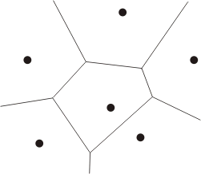
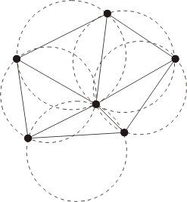
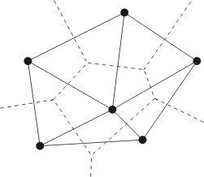
Delaunay triangulation
Delaunay triangulation
Voronoi diagram
Circumcircles of a Delaunay triangulation

Slide 32

Properties of Delaunay triangulations
Given an initial point set P for which no sets of three points are collinear (to avoid degenerate cases)
  The Delaunay triangulation is unique
  The external edges of the triangulation from the convex hull of P (i.e., the smallest convex set containing P)
  The circumcircles of the triangles contain no members of P in their interior
  The triangles in a Delaunay triangulation are best-possible with respect to regularity (closest to equilateral)

Slide 33
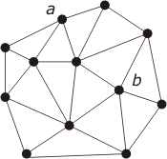
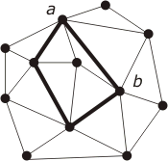
Triangulation of polygons
Constrained Delaunay triangulation: constrained to follow a given set of edges
Delaunay triangulation
Constrained triangulation includes the edge ab, which is not part of the Delaunay triangulation

Slide 34
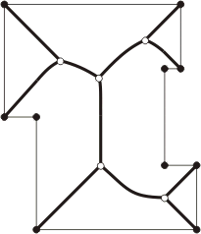
Medial axis of a polygon
Medial axis: the Voronoi diagram computed for the line segments that make up the boundary of that polygon

Slide 35
Tessellation of the sphere
Regular tessellation of the sphere correspond to the five Platonic solids of antiquity:
  Tetrahedron
    Four spherical triangles (with internal angle of 120°) bounded by parts of great circles
    Three triangles meet at each vertex
  Cube
  Octahedron
    Initially eight triangular facets, each having an internal angle of 90°
    Four triangles meet at each vertex
  Dodecahedron
  Icosahedrons

Slide 36
Chapter 5.5
Fundamental geometric algorithms

Slide 37



Distance and angle between points
Length of a line segment can be computed as the distance between successive pairs of points
The bearing, θ, of q from p is given by the unique solution in the interval [0,360[ of the simultaneous equations:

Slide 38
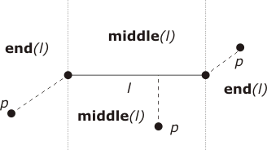
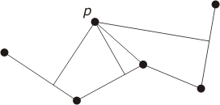
Distance from point to line
Distance from a point to a line implies minimum distance
For a straight line segment, distance computation depends on whether p is in middle(l) or end(l)
For a polyline, distance to each line segment must be calculated
A polygon calculation is as for polyline (distance to boundary of polygon)

Slide 39

Area
Let P be a simple polygon (no boundary self-intersections) with vertex vectors:
(x₁, y₁), (x₂, y₂), ..., (x_{n}, y_{n})
where (x₁, y₁) = (x_{n}, y_{n})
Then the area is:
In the case of a triangle pqr

Slide 40

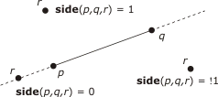
Area of a simple polygon
Note that the area may be positive or negative
In fact, area(pqr) = -area(qpr)
If p is to the left of qr then the area is positive, if p is to the right of qr then the area is negative

Slide 41


Centroid
The centroid of a polygon (or center of gravity) of a (simple) polygonal object
(P = (x₁, y₁), (x₂, y₂), ..., (x_{n}, y_{n})
where (x₁, y₁) = (x_{n}, y_{n}))
is the point at which it would balance if it were cut out of a sheet of material of uniform density:

Slide 42
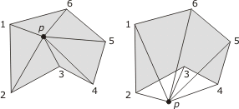
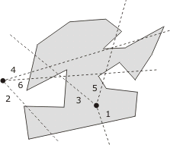
Point in polygon
Determining whether a point is inside a polygon is one of the most fundamental operations in a spatial database
Semi-line algorithm: checks for odd or even numbers of intersections of a semi-line with polygon
Winding algorithm: sums bearings from point to polygon vertices

Slide 43

Collinearity and point on segment
Boolean operation colinear(a,b,c) determine whether points a, b and c lie on the same straight line
  Colinear(a,b,c) = true if and only if side (a,b,c) =0
Operation point_on_segment(p,l) returns the Boolean value true if p2 l
(line segment l having end-points q and r)
    Determine whether p, q, r are collinear
    If yes, then p 2 l if and only if p 2 (minimum bounding box) MMB (l)

Slide 44
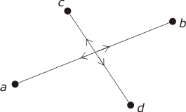

Segment intersection
Two line segments ab and cd can only intersect if a and b are on opposite sides of cd and c and d are on opposite sides of ab
Therefore two line segments intersect if the following inequalities hold

Slide 45

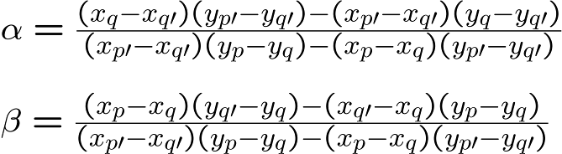
Point of intersection
Intersecting line segments l and l⁰ in parametric form:
Means that there exists an α and β such that:
Which solving for α and β give:

Slide 46
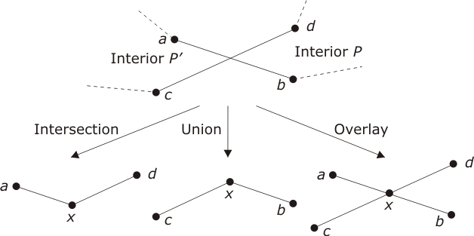
Intersection, union and overlay of polygons

Slide 47
Triangulation algorithms: Delaunay
Input: n points p₁, …, p_{n} in the Euclidean plane 1: sort the n input points into ascending order of x-coordinates, with ties sorted by y-coordinate 2: divide the points into two roughly equal halves L and R 3: if jLj > 3 then 4: recursively apply triangulation algorithm on L to create T(L); similarly if jRj > 3 recursively create T(R) 5: else 6: if jLj = 2(i.e., L = {l₁,l₂}) then 7: create T(L) containing edge l₁l₂;similarly for T(R) 8: if jLj = 3 (i.e., L = {l₁,l₂,l₃}) then 9: create T(L) containing triangle l₁l₂l₃;similarly for T(R) 10: merge T(L) and T(R) by triangulating R(L) [ T(R) Output: Delaunay triangulation T of points p₁,…,p_{n}

Slide 48
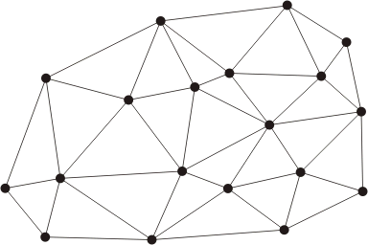
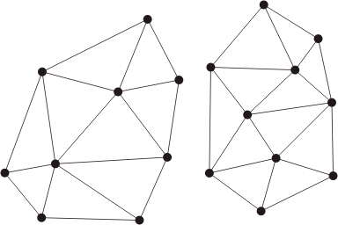
Delaunay triangulation (merge)
a. unmerged
b. merged

Slide 49
Chapter 5.6
Vectorization and rasterization

Slide 50
Vectorization
Converting data from raster to vector format
Steps for vectoriazation
  Thresholding- form a binary image from a raster
  Smoothing- remove random noise
  Thinning- thin lines so that they are one pixel in width
  Chain coding- transform the thinned raster image into a collection of chains of pixels each representing an arc
  Transform each chain of pixels into a sequence of vectors

Slide 51
Thinning
Zhang-Suen erosion algorithm for raster thinning
Input m x n binary raster(0 = white,1=black)
1. repeat
2: for all points p in the raster do
3: if 2 · N(p)· 6 and T(p) = 1 and p_{N}¢ p_{S}¢ p_{E} =0 and p_{W}¢ p_{E}¢ p_{S} =0 then mark p
4: if there are no marked point then halt
5: else set all marked points to value 0
6: for all points p in the raster do
7: if 2 · N(p)· 6 and T(p) = 1 and p_{N}¢ p_{S}¢ p_{E} =0 and p_{W}¢ p_{E}¢ p_{N} =0 then mark p
8: set all marked points to value 0
9: until there are no marked points
10:Output:m x n thinned binary raster (black is thinned)

Slide 52
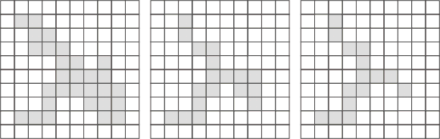
Example
Successive stages of an erosion

Slide 53
Chapter 5.7
Network representation and algorithms

Slide 54
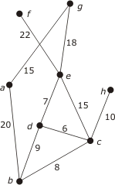
Network representation
 | a | b | c | d | e | f | g | h
a | 0 | 20 | 0 | 0 | 0 | 0 | 15 | 0
b | 20 | 0 | 8 | 9 | 0 | 0 | 0 | 0
c | 0 | 8 | 0 | 6 | 15 | 0 | 0 | 10
d | 0 | 9 | 6 | 0 | 7 | 0 | 0 | 0
e | 0 | 0 | 15 | 7 | 0 | 22 | 18 | 0
f | 0 | 0 | 0 | 0 | 22 | 0 | 0 | 0
g | 15 | 0 | 0 | 0 | 18 | 0 | 0 | 0
h | 0 | 0 | 10 | 0 | 0 | 0 | 0 | 0
Adjacency matrix
Graph
{(ab,20), (ag,15), (bc,8), (bd,9), (cd,6),
(ce,15), (ch,10), (de,7), (ef,22), (eg,18)}
Set of labeled edges

Slide 55
Network representation
a | (b,20), (g,15)
b | (a,20), (c,8), (d,9)
c | (b,8), (d,6), (e,15), (h,10)
d | (b,9), (c,6), (e,7)
e | (c,15), (d,7), (f,22), (g,18)
f | (e,22)
g | (a,15), (e,18)
h | (c,10)
Adjacency list
Good balance between storage efficiency and computational efficiency

Slide 56
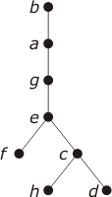
Depth first traversals
Input: Adjacency matrix M, starting node s
1. stack SÃ [s], visited set V Ã ;
2: while S is not empty do
3: remove the first node x from S
4: add x to V
5: for each node y 2 M adjacent to x do
6: if y∉ V and y ∉ S then add y to the beginning of S
n | S | V
1 | [b] | { }
2 | [a,c,d] | {b}
3 | [g,c,d] | {b,a}
4 | [e,c,d] | {b,a,g}
5 | [f,c,d] | {b,a,g,e}
6 | [c,d] | {b,a,g,e,f}
7 | [h,d] | {b,a,g,e,f,c}
8 | [d] | {b,a,g,e,f,c,h}
9 | [ ] | {b,a,g,e,f,c,h,d}

Slide 57
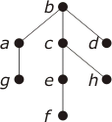
Breadth first traversals
Input: Adjacency matrix M, starting node s
1. queue QÃ [s], visited set V Ã ;
2: while Q is not empty do
3: remove the first node x from Q
4: add x to V
5: for each node y 2 M adjacent to x do
6: if y∉ V and y ∉ Q then add y to the end of Q
n | Q | V
1 | [b] | {}
2 | [a,c,d] | {b}
3 | [c,d,g] | {b,a}
4 | [d,g,e,h] | {b,a,c,}
5 | [g,e,h] | {b,a,c,d,g}
6 | [e,h] | {b,a,c,d,g,}
7 | [h,f] | {b,a,c,d,g,e}
8 | [f] | {b,a,c,d,g,e,h}
9 | [ ] | {b,a,c,d,g,e,h,f}

Slide 58
Shortest path-Dijkstra’s algorithm
Input: Undirected simple connected graph G = (N,E), starting node s 2 N, weighting function w : E! R⁺, target weighting function t :N ! R⁺
1: initialize t(n) Ã ∞ for all n 2 N, visited node set V Ã {s}
2: set t(s) Ã 0
3: for all n 2 N such that edge sn 2 E do
4: set t(n) Ã w(sn)
5: while N ≠ V do
6: find, by sorting, n 2 N \ V such that t(n) is minimized
7: add n to V
8: for all m 2 N \ V such that edge nm 2 E do
9: t(m) Ã min(t(m),t(n) + w(nm))
Output: Graph weights t : N ! R⁺
Time complexity O(n²)

Slide 59
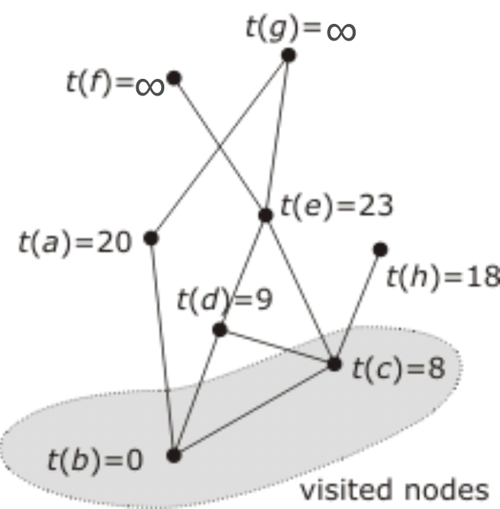
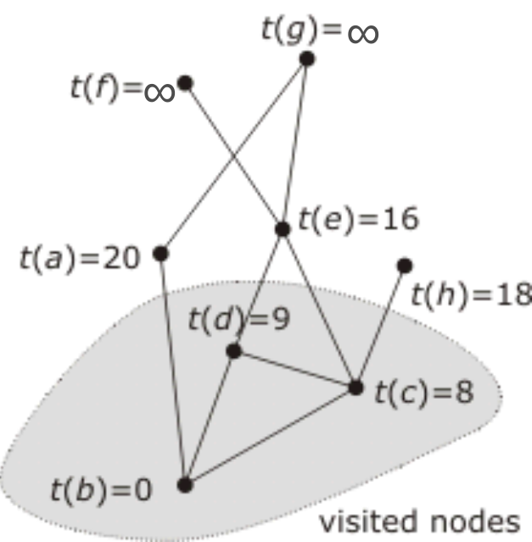
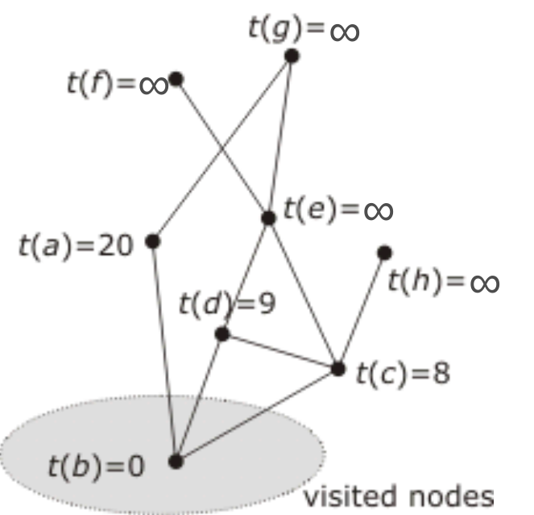
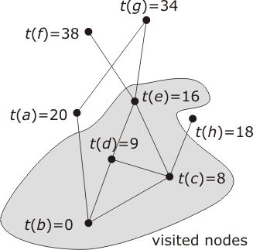
Dijkstra’s algorithm
Second iteration
Third iteration
Fourth iteration
First iteration

Slide 60

Shortest path- A* algorithm
Goal directed
At each iteration it preferentially visits those nodes that are closest to the destination node
  Requires an evaluation function
    Euclidean distance
Improvement on Dijkstra's algorithm for average case time complexity when:
  Computing goal-directed shortest paths
  where a suitable evaluation function exists

Slide 61
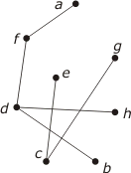
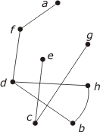
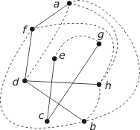
Transitive closure
Augments the edge set of a network by placing and edge between two nodes if they are connected by some path
Deciding whether two nodes are connected is a matter of searching through the edges of the transitive closure of the network

Slide 62
Traveling salesperson algorithm
Computes the round-trip traversal of an edge-weighted network
  Visits all nodes in such a way that the total weight for the traversal is minimized
Heuristic methods, such as at each stage visiting the nearest unvisited node, allow good approximations in reasonable time
Is a member of a class of problems termed NP-complete

