Slide 1
Chapter 6
Structures and Access Methods

Slide 2

Physical Data Management
Databases typically organize data into files, each containing a collection of records
The atomic unit of data on a disk is a block
The time taken to read or write a block has three components:
  Seek time: the time taken for mechanical movement of the read heads
  Latency: the time taken to rotate the disks into the correct position
  Transfer time: the time taken to transfer the block to/from the CPU
Performance
Database structures that lessen seek time and latency improve performance.

Slide 3
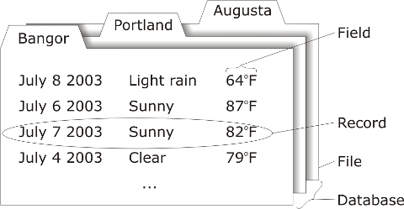
File Organization
Field: a named place for a data item in a record (cf. attribute)
Record: a sequence of fields related to a single logical entity (cf. tuple)
File: a sequence of records usually of the same type (cf. relation)
Database: a collection of related files

Slide 4
Ordered and Unordered Files
In unordered files new records are inserted in the next physical location on the disk
  Insertion is very efficient
  Retrievals require search through every record in sequence: linear search with time complexity O(n)
  Deletion causes “holes” to appear in sequence
In ordered files each record is inserted in the order of the values of one or more of its fields
  Slows the insertion of new records
  Allows efficient binary search with time complexity O(log₂ n) on indexed field, but not on other fields

Slide 5
Binary Search Algorithm
Input: An ordered file with an ordering field, placed on n disk blocks (labeled 1 to n), and a search value V
low ← 1;
high ← n;
while high ≥ low do
mid ← (low + high) div 2
read block mid into memory
if V < value of ordering field in first record of block mid then
high ← mid-1
else
if V > value of ordering field in last record of block mid then
low ← mid+1
else
linear search block mid for records with value V in their ordering field, possibly proceeding to next block(s), then halt
Output: Records from the file with value V in their ordering field

Slide 6
Indexes
Physical file organization alone cannot solve all storage and retrieval problems
An index is an auxiliary structure specifically designed to speed retrieval of records
Indexes trade space for speed
A single-level index is an ordered file with two records:
  An index field containing the ordered values of the indexing field in the data file
  A pointer field containing the address of the disk blocks that have a particular index value
Retrieving a record, based on an indexed search condition, requires binary search of the (ordered) index file

Slide 7
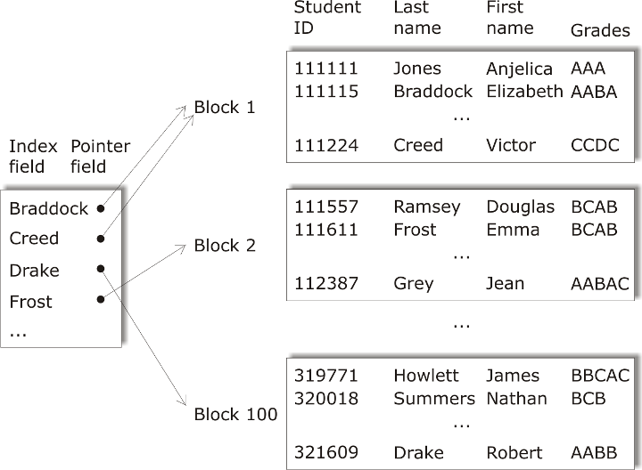
Student File Indexed by Last Name

Slide 8
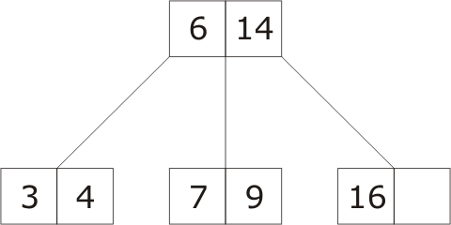
B-Trees
Maintaining index structure can be difficult
A B-tree indexes linearly ordered data that may change frequently
B-trees remain balanced, in that branches of the tree remain of equal length through modification
Each node in a B-tree contains pointers to indexed records
Additionally, internal nodes contain pointers to immediate descendents
The value for a descendent node is within the range set by the parent node

Slide 9
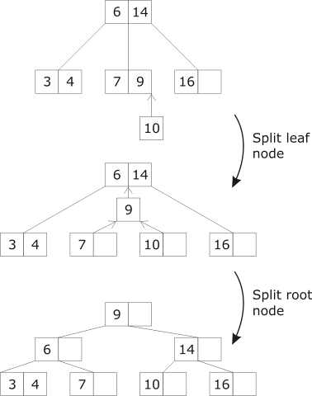
Modifying a B-Tree
◊
Search: Begin search at root, continue until exact match or leaf is encountered
Insert:
  Search to find position for new index record.
  If space, no restructuring required
  If overflow for non-root node, split node and promote middle value
  If overflow for root node, split node and demote extreme values
Delete: similar to insert
3

Slide 10
B-Tree
B-Tree Properties
A B-tree is completely balanced (path from root to leaf is constant) at all stages in its evolution
Search time is bounded by the length of the path, and so is O(log n)
Insertion and deletion of records require O(log n) time
Each node is guaranteed to be at least half full (or almost half full with odd fan-out ratios) at all stages in a B-tree’s evolution
B+-trees, where pointers to records are only stored at leaf nodes, are more often used in practice
1

Slide 11
Spatial Indexes
Previous examples have concerned multi-dimensional data where dimensions are essentially independent
Although spatial dimensions are orthogonal, there is dependency between them in terms of the Euclidean metric
Id | Site | East | North
1 | Newcastle Museum | 14 | 58
2 | Waterworld | 31 | 65
3 | Gladstone Pottery Museum | 74 | 23
4 | Trentham Gardens | 20 | 00
5 | New Victoria Theater | 18 | 55
6 | Beswick Pottery | 66 | 25
7 | Coalport Pottery | 54 | 36
8 | Spode Pottery | 37 | 43
9 | Minton Pottery | 36 | 39
10 | Royal Doulton Pottery | 31 | 87
11 | City Museum | 41 | 62
12 | Westport Lake | 17 | 92
13 | Ford Green Hall | 53 | 99
14 | Park Hall Country Park | 86 | 44

Slide 12
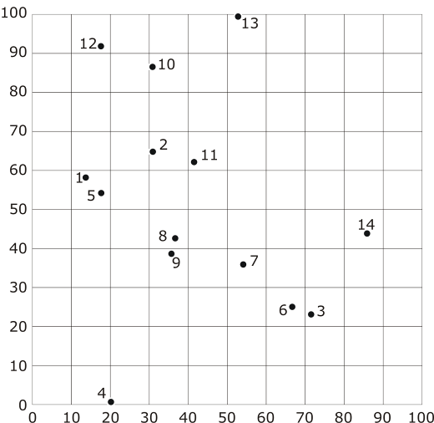
Potteries Example

Slide 13
Spatial Queries
Point query: retrieve all records with spatial references located at a particular point
Range query: retrieve all records with spatial references located within a given range (spatial ranges may be any shape, but are often rectangular)
Example
Non spatial query: Retrieve the point location of Trentham Gardens
Spatial point query: Retrieve any site at location (37, 43)
Spatial range query: Retrieve any site in the rectangle defined by (20, 20)–(40, 50)

Slide 14
Potteries Indexes
East | Site
14 | Newcastle Museum
17 | Westport Lake
18 | New Victoria Theater
20 | Trentham Gardens
31 | Waterworld
31 | Royal Doulton Pottery
36 | Minton Pottery
37 | Spode Pottery
41 | City Museum
53 | Ford Green Hall
54 | Coalport Pottery
66 | Beswick Pottery
74 | Gladstone Pottery Msm
86 | Park Hall Country Park
North | Site
00 | Trentham Gardens
23 | Gladstone Pottery Msm
25 | Beswick Pottery
36 | Coalport Pottery
39 | Minton Pottery
43 | Spode Pottery
44 | Park Hall Country Park
55 | New Victoria Theater
58 | Newcastle Museum
62 | City Museum
65 | Waterworld
87 | Royal Doulton Pottery
92 | Westport Lake
99 | Ford Green Hall

Slide 15
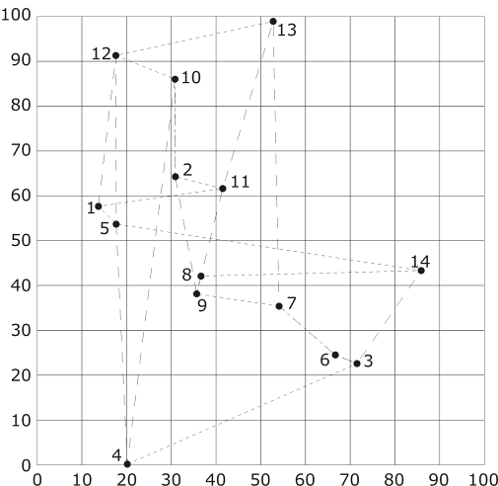
Potteries Indexes

Slide 16
Two- Dimensional Ordering
From one to two dimensions
The main problem facing multidimensional spatial data structures is that data storage is essentially one-dimensional
Many common indexes assume a grid-based representation (tile indexes)
Tile indexes aim to provide a path through the grid that visits each cell
Indexes differ in how well they preserve proximity, i.e., cells that are spatially close are close in the index

Slide 17
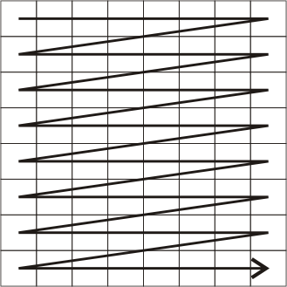
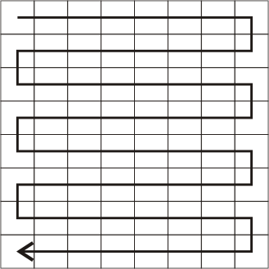
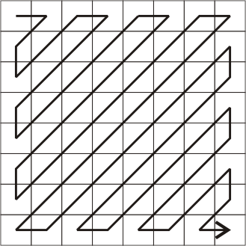
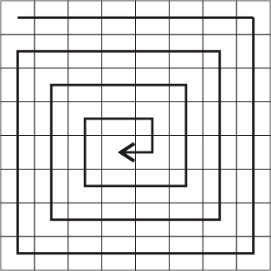
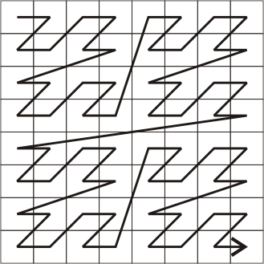
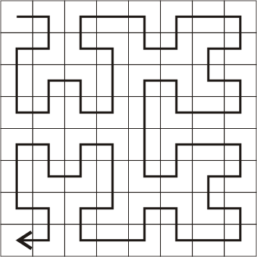
Common Tile Indexes
Row
Row-Prime
Cantor Diagonal
Spiral
Morton
Peano-Hilbert

Slide 18
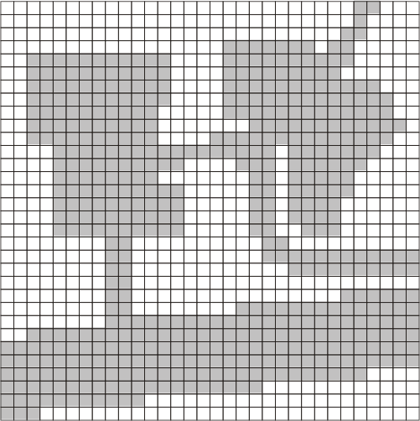
Introduction to Raster Structures
Rasters provide a fixed grid for storing data
Cells are addressed using the row and column number
Rasters may be used to represent a range of computable spatial objects, including:
  A point represented by a single cell
  A strand or polyline represented by a sequence of neighboring cells
  A connected area represented by a continuous collection of cells
Rasters may be stored as arrays, which are natural computable structures, but can be wasteful in terms of space

Slide 19
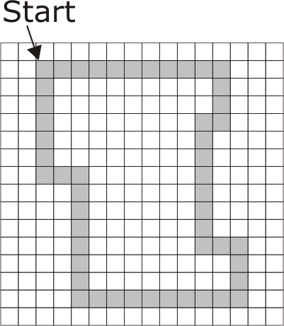
Freeman Chain Coding
Freeman chain coding uses the numbers 0 to 7 arranged clockwise around the 8 directions N = 0, NE = 1, E = 2, SE = 3, S = 4, SW = 5, W = 6, NW = 7
Example
[2, 2, 2, 2, 2, 2, 2, 2, 2, 2, 4, 4, 4,
6, 4, 4, 4, 4, 4, 4, 4, 2, 2, 4, 4,
4, 6, 6, 6, 6, 6, 6, 6, 6, 6, 0, 0,
0, 0, 0, 0, 0, 6, 6, 0, 0, 0, 0, 0, 0]

Slide 20
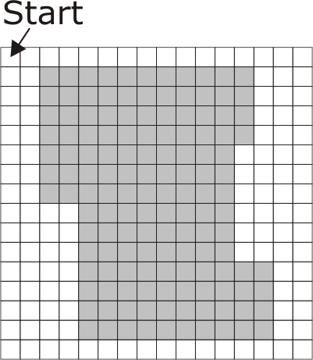
Run Length Encoding
Run length encoding (RLE) counts the length of “runs” of consecutive cells of the same value
RLE relies on an underlying tile index: different tile indexes lead to different RLEs
Example
[18, 11, 5, 11, 5, 11, 5, 11, 5, 10,
6, 10, 6, 10, 8, 8, 8, 8, 8,
8, 8, 10, 6, 10, 6, 10, 6, 10, 18]

Slide 21
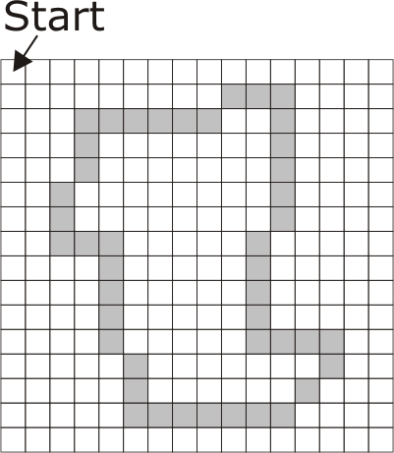
FCE and RLE
Freeman chain encodings can be combined with run length encoding. E.g.,
[2, 2, 2, 2, 2, 2, 2, 2, 2, 2, 4, 4, 4,
6, 4, 4, 4, 4, 4, 4, 4, 2, 2, 4, 4,
4, 6, 6, 6, 6, 6, 6, 6, 6, 6, 0, 0,
0, 0, 0, 0, 0, 6, 6, 0, 0, 0, 0, 0, 0]
Becomes
[2, 10, 4, 3, 6, 1, 4, 7, 2, 2,
4, 3, 6, 9, 0, 7, 6, 2, 0, 6]

Slide 22
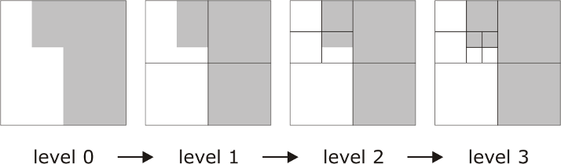
Region Quadtrees
Quadtree is a tree structure where every non-leaf node has exactly four descendents
Region quadtrees recursively subdivide non-homogenous square arrays of cells into four equal sized quadrants
Decomposition continues until all squares bound homogenous regions

Slide 23

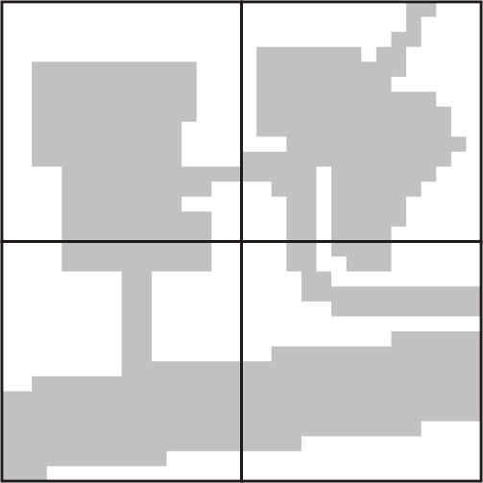


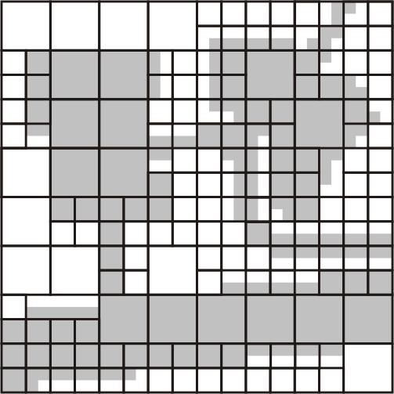
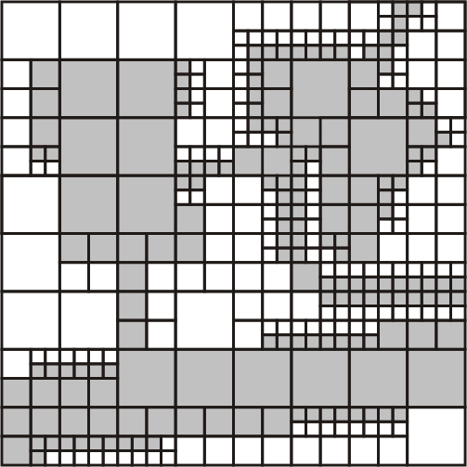
Region Quadtrees

Slide 24
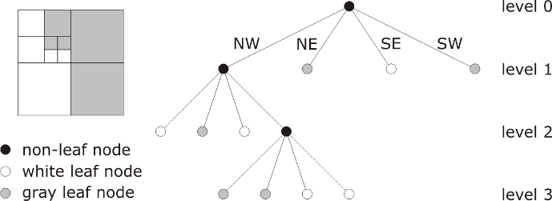
Region Quadtrees
Quadtrees take full advantage of the spatial structure, adapt to variable spatial detail
Inefficient for highly inhomogeneous rasters
Very sensitive to changes in the embedding space (e.g., translation, rotation)

Slide 25
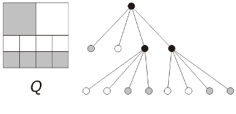
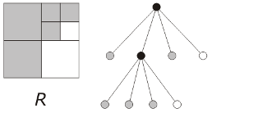
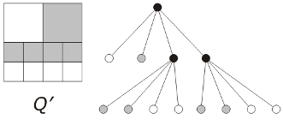
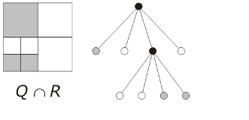
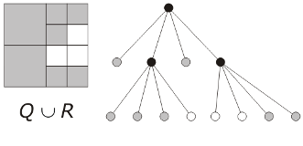
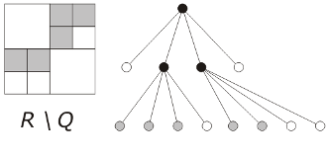
Quadtree Operations

Slide 26
Quadtree Intersection Algorithm
Input: Binary quadtrees Q, R
q ← root of Q, r ← root of R
queue L ← [(q, r )]
while L is not empty do
remove the first node pair (x, y) from L
if x or y is a white leaf then
add white leaf to output quadtree S
if x is a non-white leaf then
add y and all subnodes to output quadtree S
if y is a non-white leaf then
add x and all subnodes to output quadtree S
if x and y are non-leaf nodes then
add a new non-leaf node to output quadtree S
for pairwise descendants x' of x and y ' of y do
add (x ', y ') to the end of L
Output: A binary quadtree S that represents the intersection Q ∩R

Slide 27
Summary
Physical file organization affects database performance
Indexes are needed to go beyond the limitations of physical file organization
Non-spatial indexes, like B-trees, are inadequate for storing spatial data
The key issue in spatial indexes is representing two dimensional data in a one-dimensional index

Slide 28
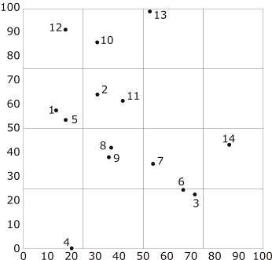
Grid Structures: Fixed Grid
Partition of planar region into equal sized cells
Points sharing the same cell (bucket) are stored together
Improves range query performance
Partition size depends on:
  Number of points; and
  Magnitude of average range query.
Poor performance with non-uniform point distribution

Slide 29
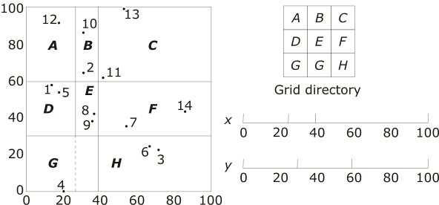
Grid Structures: Grid File
Extends fixed grid with arbitrary subdivision positions, accounting for point distribution

Slide 30
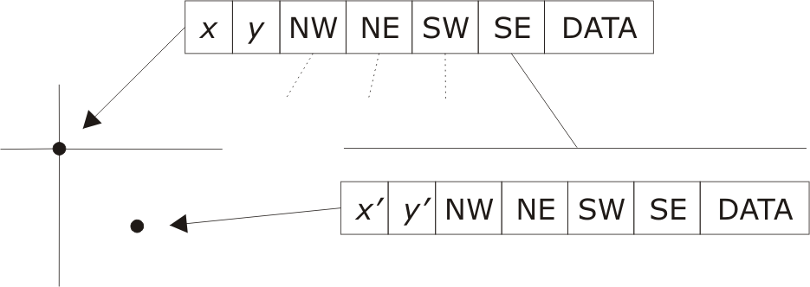
Point Quadtree
Combination of grid approach with multidimensional binary search tree
Each non-leaf node has four descendents
Each quadrant partition is centered on a data point
Quadtree build time is O(n log n); search time is O(log n)

Slide 31
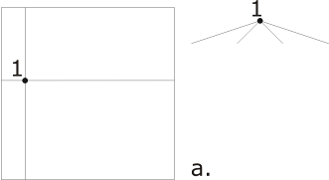
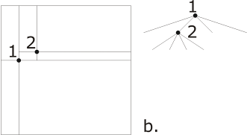
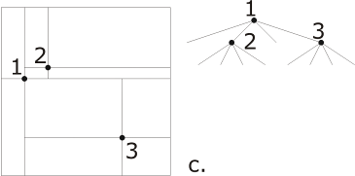
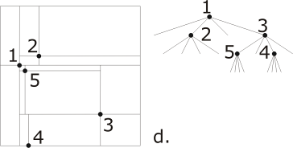
Point Quadtree

Slide 32
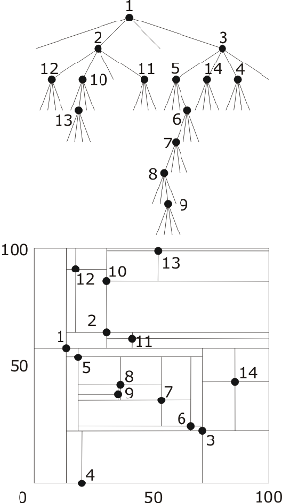
Point Quadtree

Slide 33
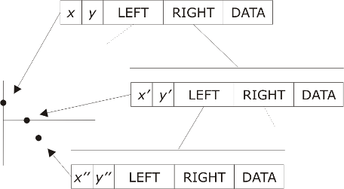
2D Tree
Point quadtree leads to exponential increase in descendents in k dimensions
2D tree is a binary tree that trades tree breadth for depth
Compares point alternately with respect to each dimension
Structure depends on order of point insertion

Slide 34
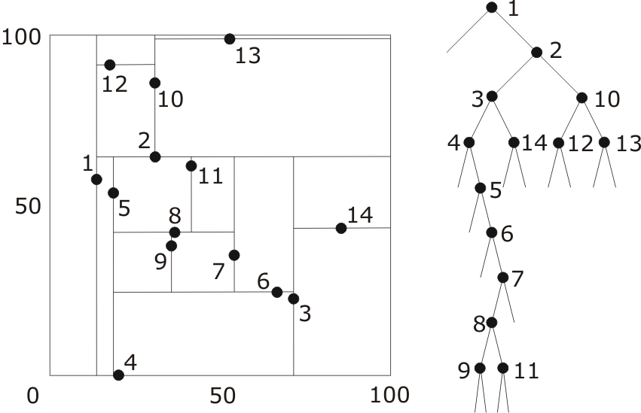
2D Tree

Slide 35
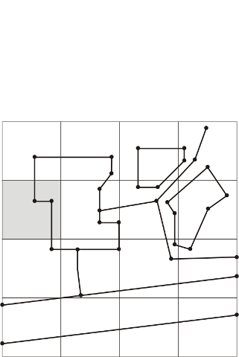
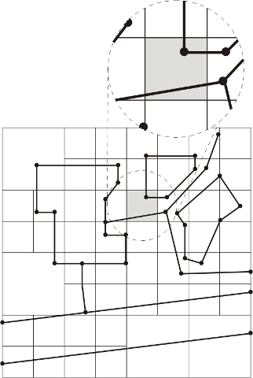
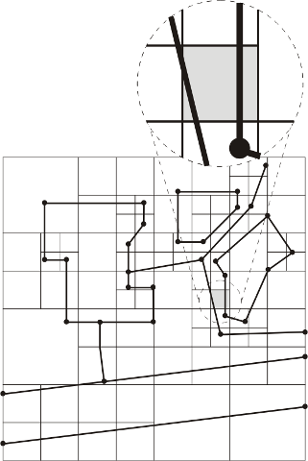
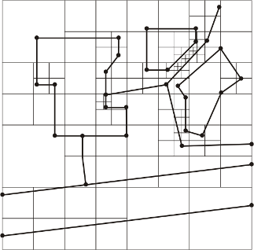
PM(PM₁) Quadtree
Divides region into quadtree, such that all edges and vertices are separated into distinct leaf nodes
  Each leaf node contains at most one vertex
  Leaves containing a vertex contain only edges incident with that vertex
  Leaves not containing a vertex contain only one edge

Slide 36
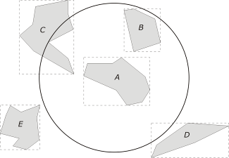
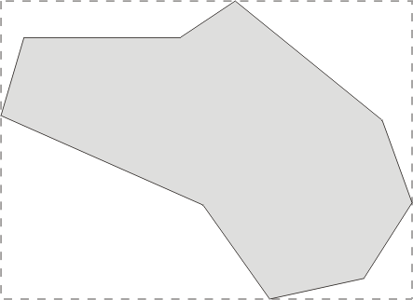
Rectangles and Minimum Bounding Boxes
Minimum bounding box (MBB/MBR): the smallest rectangle bounding a shape with its axes parallel to the sides of the Cartesian frame
Using MBB, some queries may be answered without retrieving the geometry of an object
E.g., find all objects which lie entirely within a specified region

Slide 37
R-Tree
Multidimensional dynamic spatial data structure similar to the B-tree
Leaf nodes represent actual rectangles to be indexed
Internal nodes represent smallest axes-parallel rectangle containing all descendents
Rectangles at any level may overlap
Good subdivisions:
  Minimize the total area of containing rectangles
  Minimize the total area of overlap of containing rectangles
Overlap is critical: point and range searches are inefficient with large overlap (R+-tree aims to eliminate overlaps)

Slide 38
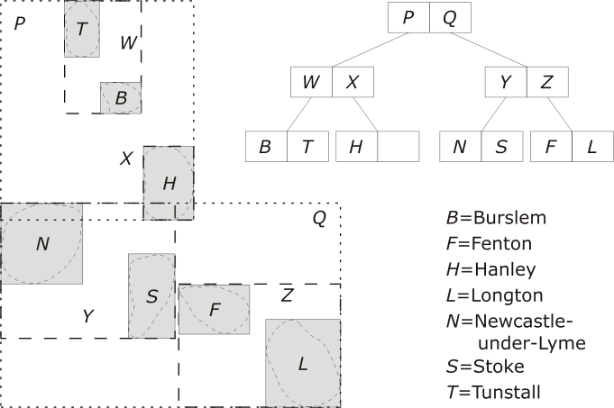
R-Tree

Slide 39
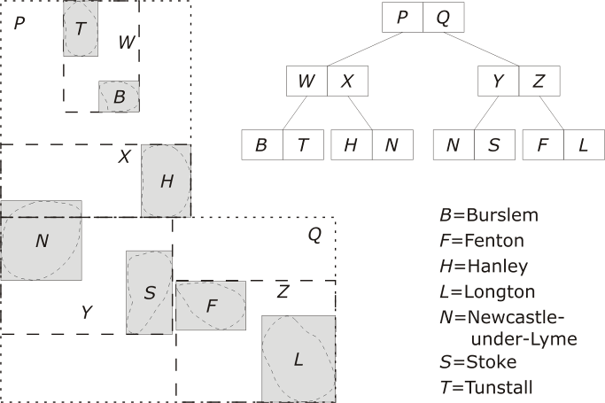
R⁺-Tree

Slide 40
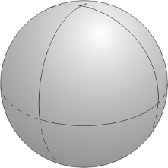
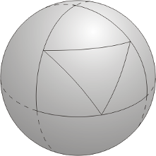
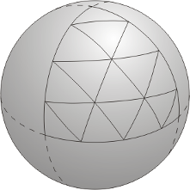
QTM
Spherical tessellations provide closer approximation to surface of the Earth
Octahedral tessellation is the only regular tessellation that can be oriented with vertices at the poles and edges at the equator
Quaternary triangular mesh (QTM) approximates the surface of the globe

Slide 41
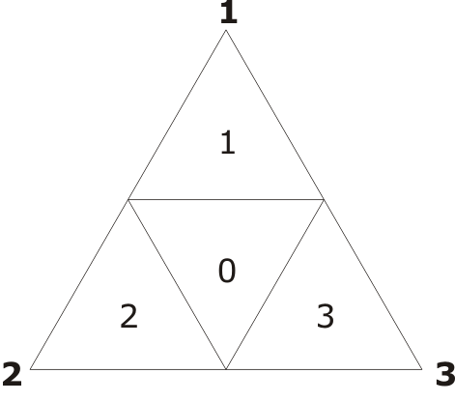
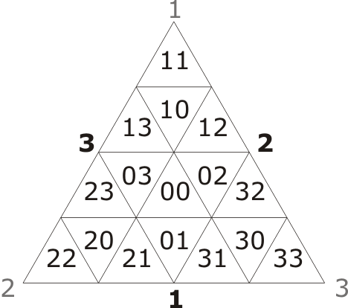
QTM

Slide 42

QTM

Slide 43
Summary
Point data structures must balance independence from embedding of points (e.g., grid file) and efficient indexes for inhomogeneous point distributions (e.g., point quadtree)
MBBs provide useful spatial descriptors of a complex spatial object, which can be indexed in place of the object itself.
R-tree and related indexes are amongst the most important spatial indexes in practical GIS

