Slide 1
Chapter 7
Architectures

Slide 2
Definitions
Architecture: the overall structure and organization of the different parts of the information system
Modularity: the extent to which an information system can be constructed from independent software units with standardized or clearly defined functions
Interoperability: the ability of two or more information systems to share data, information, or processing capabilities
GIS
Modularity and interoperability are two important characteristics that can be used to distinguish different GIS architectures

Slide 3
Chapter 7.1
Hybrid, integrated, and composable architectures

Slide 4
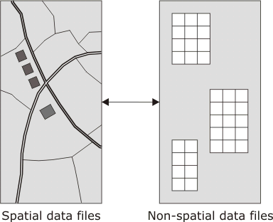
Hybrid
Hybrid GIS architecture: manages geospatial data independently and in different software modules from the non-spatial data

Slide 5
Hybrid
Typically based on a georelational model
  Spatial data stored in a set of system files
  Non spatial data stored in a relational database
  Records in the spatial files are linked to tuples in the non- spatial relational database using a set of common keys
Advantages
  Modular
Disadvantages
  Maintaining database integrity, security and reliability more difficult
  Separating the storage of data into separate modules, when the modules are performing similar functions

Slide 6
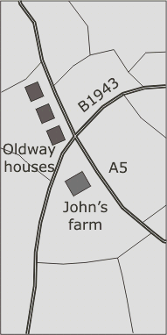

Integrated architecture
Integrated architecture: all data are stored in a single database
  Object-oriented databases
  Relational databases
  Object-relational database technology

Slide 7
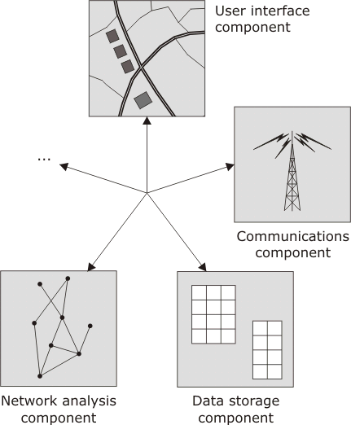
Composable GIS architecture
Component: a software module that uses a standardized mechanism for interacting with other software modules
Composable system: complex software applications can be assembled from software components

Slide 8
Chapter 7.2
Syntactic and semantic heterogeneity

Slide 9

Data sharing
Exchanging, sharing and integrating data is fundamental for any GIS architecture
Barriers to Data sharing
  Syntactic heterogeneity
    When two or more information systems use incompatible encoding of formats for information
    Data must be converted into compatible formats (a technical issue)
  Semantic heterogeneity
    When two or more information systems use different or incompatible meanings
    Difficult to reconcile

Slide 10
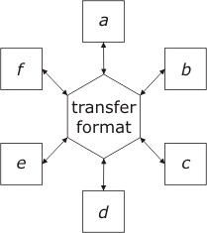
Transfer formats and standards
Transfer formats address syntactic heterogeneity by providing a standard intermediate format for data conversion
Can address semantic heterogeneity issues by including a data dictionary
  E.G.: Spatial Data Transfer Standard (SDTS)
  Information can be shared between information communities

Slide 11
Spatial Data Infrastructures (SDI)
SDI: strategies for sharing and coordinating geospatial data
  Reduce costs of spatial data transfer
  Based on the use of particular transfer formats
  National initiatives include:
    USA (National Spatial Data Infrastructure, NSDI)
    Australia (Australian Spatial Data Infrastructure, ADSI)
    Canada (Canadian Geospatial Data Infrastructure, CGDI)
    India (National Geospatial Data Infrastructure, NGDS)

Slide 12
XML
Heterogeneity
Heterogeneity is a natural consequence of the wide variety of different information communities that use geospatial data. Consequently, standard transfer formats cannot eliminate all barriers to data sharing.
Extensible Markup Language (XML): a standard meta-language used for defining other languages and transfer formats
  Geography Markup Language (GML)

Slide 13
Chapter 7.3
Distributed systems

Slide 14

Distributed systems
Transfer formats
  Excludes sharing the processing of the data
  Asynchronous
Distributed systems: a collection of multiple information systems connected via a digital communication network that can synchronously co-operate in order to complete a computing task

Slide 15
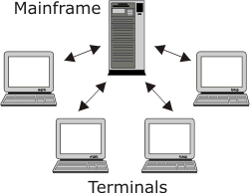
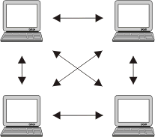
High level distributed system architecture
Mainframe network architecture connects multiple terminals to a central computer server
Peer to peer network architecture, appealing for data sharing applications

Slide 16
Client-server systems
Server: an information system that can offer a particular service to other information systems on the network
Client: is an information system that consumes these services
Clients request a service from a server, which then responds with the appropriate resource
  E.G.: surfing the WWW
Different from main frame and peer to peer
Client may consume services from multiple different servers
Distinction between the role of client and server

Slide 17
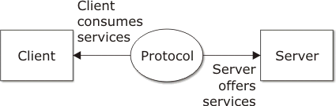
Protocol and interface
The services provided by a server are defined by a server’s interface
Protocol is a standard format for communication
  Web browsers use Hypertext transfer protocol (HTTP) to communicate with web servers
Two tier client server; every information system in the architecture is either a client of a server

Slide 18
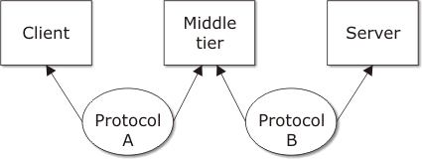
Multi-tier
Multi- tier client server; an intermediate “ middle tier” acts as both a client and a server

Slide 19
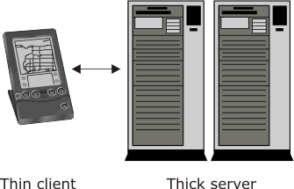
Server side strategy
Server performs the bulk of the computation needed to complete a task

Slide 20
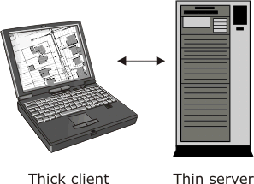
Client side strategy
Client performs the bulk of the computation needed to complete a task

Slide 21
Distributed component systems
Individual components or objects interoperate as part of a decentralized client-server architecture
Closely related to the peer to peer architecture
Server skeleton: interface defining what services a server component offers
Client Stub: interface defining what services a client component consumes

Slide 22
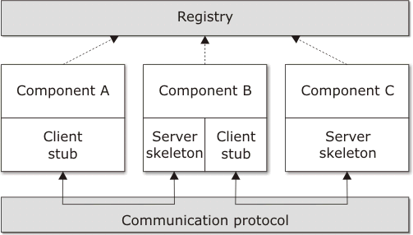
Distributed component systems
Servers register their services with a registry,
Clients access registry to find compatible services
Standard protocol is used for communication

Slide 23
Chapter 7.4
Distributed databases

Slide 24

Centralized database
Three tier client-server distributed system architecture for a mapping website
  Spatial database server stores geospatial data
  Web browser client provides a user interface to the geospatial data
  The web server makes the data available on the WWW

Slide 25
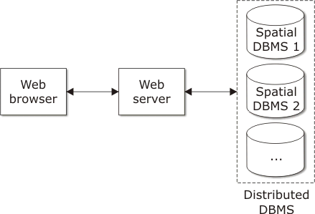
Distributed database
Logically related data stored at different sites, connected by a computer network

Slide 26
Advantages
For large, geographically dispersed data sets, distributed databases offer several potential advantages:
  Decentralization
  Availability and reliability
  Performance
  Modularity

Slide 27
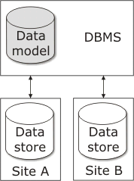
Distributed DBMS
DDBMS: The software system that manages a distributed database
  Homogeneous
  Heterogeneous
Homogeneous: uses a single data model and DBMS software

Slide 28
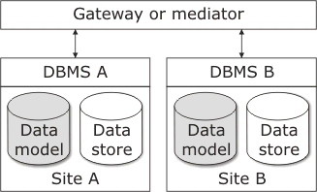
Distributed DBMS
Heterogeneous: maintains multiple different data models and/or DBMS at different sites.
Unified access to the database is provided through a gateway interface

Slide 29
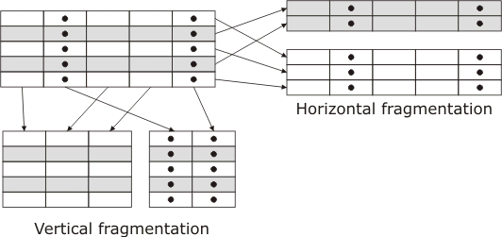
Relational distributed databases
Fragmentation: occurs when a relation is divided into sub-relations
  Horizontal fragmentation
  Vertical fragmentation

Slide 30
Relational distributed databases
Replication: occurs when data fragments are duplicated across different database units
  Improves reliability and performance
    Queries may be answered using data from a single site
  More complex
    Inconsistencies may result from updates

Slide 31
Summary
Distributed spatial databases
Distributed spatial databases have the potential to improve data sharing, modularity, reliability and performance for geographically dispersed spatial data.
However, distributed databases may not be practical in some application for the following reasons:
  Complexity
  Security
  Integrity

Slide 32
Chapter 7.5
Location-aware computing

Slide 33
Location- aware computing
Context aware computing: the use of sensors and other sources of information about a user’s context to provide more relevant information and services
Location- aware computing: utilize information about a user’s current location to provide more relevant information and services to that user
Pervasive- computing: describes the idea that networked computers embedded throughout everyday objects can become unseen personal assistants
Mobile computing: primarily concerned with information systems that can move around with us

Slide 34
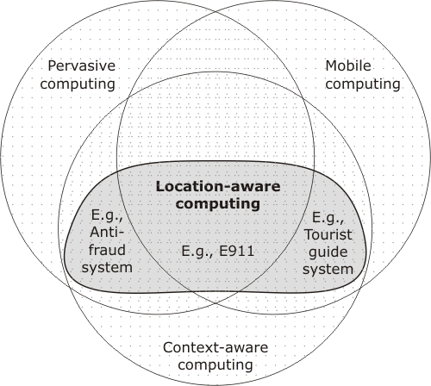
Location aware computing
Location-aware, context aware, pervasive and mobile computing, have a large overlap

Slide 35
Location aware computing
Alters the way we interact with GIS
Interact with the geographic environments about which we are receiving information
New possibilities arising from technical developments:
  Increase in the number and variety of computing devices
  Wireless communication networks
  Sensors capable of determining a mobile user's location

Slide 36
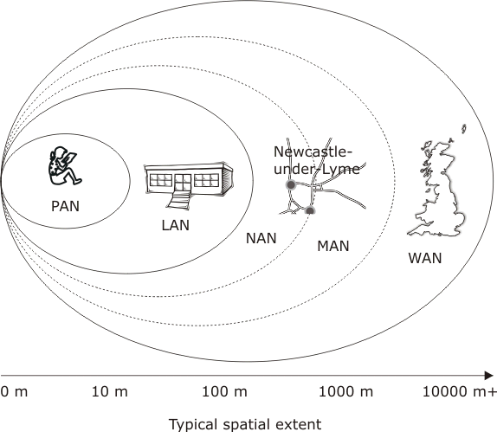
Wireless computer networks
Wireless WAN (wide area network)
Wireless LAN (local area networks)
  Neighborhood area networks (NANs)
  Metropolitan area networks (MANs)
Wireless PAN (personal area network)

Slide 37
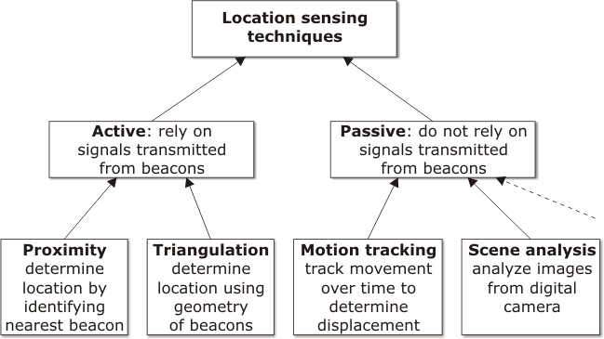
Location sensors
Cell phones
GPS
Speed and direction sensors
Digital camera

Slide 38
GPS
Radio wave signals, transmitted from GPS satellites, are used to calculate the distance from each satellite to a receiver
  Radio wave signals transmit exact time and that satellite’s position
  Distance is determined by time it takes the signal to reach the receiver
Lateration is used to calculate position
  The process of computing the position based on distance from other known locations

Slide 39
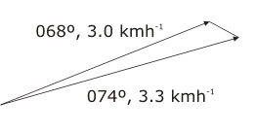
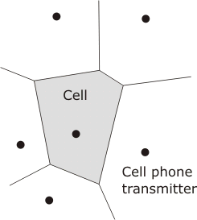
Sensor accuracy and precision
Accuracy: the closeness of data from a sensor to the correct values(s)
Error propagation: relatively small measurement errors compounding over time
Precision: the level of detail of the data generated by a sensor
Inaccuracy in motion tracking
Imprecision in cell phone location

Slide 40
Integrating technologies
GPS can achieve high levels of accuracy and precision, however:
  Obtaining an initial fix can be slow,
  Signals can not be received inside or in the shadow of obstacles, such as buildings
Combine GPS and motion tracking technologies
  When GPS signals are blocked for short periods, tracking the speed and orientation of the object in motion can fill in the gaps
Combine GPS and proximity-based location sensing
  Results in greater precision than proximity-based location sensing, at greater speed than GPS based location sensing

Slide 41
Location based services
Location-based services (LBS): specific applications that require location-aware computing to operate
Classified according to their functional characteristics:
  Positioning
  Tracking
  Mobile resource allocation
Additional features required by many LBS
  Collaborative; groups of interacting users
  Integrating other non-locational contextual data

Slide 42
Location Based Services
Summary
  Inherently distributed
  Architecture with high levels of modularity and interoperability
  Multiple independent computing devices that can integrate and process information from a variety of sources
    Databases
    Sensors
    Mobile computers
  Distributed component and peer- to peer network architectures are well suited to LBS

Slide 43
Privacy
Data protection: protecting digital information about individuals
  Collect and use personal data for specific purposes
  Collect personal data with the consent of the individuals involved
  Ensure that personal data is secure, accurate and available to the individuals it concerns
Compromise is needed between protecting individual’s right to privacy and enabling new technologies to be developed
Challenge: how do we protect an individual’s privacy when using location-aware services

Slide 44
Privacy and LBS
An individuals location can be used to infer other personal information about that individual
  What an individual is doing
  Interests of the individual
Mobile location-aware systems do not always give a good indication of an individuals location
May not be evident to a user when a location-aware sensor is collecting information about their location

Slide 45
Privacy and LBS
In an emergency most of us would be grateful for technology that could automatically inform the emergency services of our location
However, we might feel our privacy and safety were being compromised if this information were to be broadcast to anyone who wanted to know

