Slide 1
Chapter 8
Interfaces

Slide 2
What you will learn
Human computer interaction
Cartography
Scientific visualization
Interface design
User tasks in GIS
Interface application areas
Summary

Slide 3
What you will learn
Interface applications for GIS
Developing and assessing interfaces
Summary
Cartography
HCI
GeoViz

Slide 4
Section 8.1
HCI

Slide 5
Human-computer interaction
Human-computing interaction (HCI) concerns the study of the design, evaluation, and implementation of the interfaces between computing devices and people
HCI also often refers to the interaction itself
HCI has three components: the human, the interaction, and the computer
HCI

Slide 6
Human-computer interaction
HCI tackles questions concerning how people interact with computers
  Are computers intuitive or complicated?
  Are computers rewarding or frustrating?
  How can computers be made accessible to everybody (eg different physical abilities, different languages etc.)?
  To what extent can computer interaction be standardized?
  Are computers “user-friendly”?
  What does it mean to be “user-friendly”?
HCI

Slide 7
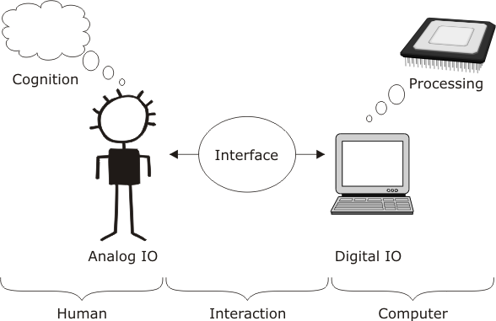
Human-computer interaction
HCI

Slide 8
Input/output
Humans and computers are able to send and receive information in different modes, termed IO channels
Input to computer is output from human and vice versa
  Input usually refers to input to computer
  Display usually refers to output from computer
The same IO channel can be used by to send information in both directions
  E.g. I can see at the same time as being seen
Systems that use more than one IO channel at a time are referred to as multimodal
HCI

Slide 9
IO channels
Humans have five senses that receive information from outside the body termed exteroceptors
  Visual sense (sight)
  Auditory sense (sound)
  Sense of touch (haptic)
  Sense of smell (olfactory)
  Sense of taste (gustatory)
Most humans rely primarily on visual sense
Auditory and haptic senses also widely used in HCI (why not other senses?)
HCI

Slide 10
IO channels
Humans have two other senses important for HCI that receive information from inside the body termed proprioceptors
  Sense of balance (vesibular)
  Kinesthesia (ability to sense our own bodily movements and tensions)
Proprioceptors are important in many interfaces (e.g. flight simulator)
Other IO channels may be developed in the future, e.g. Kevin Warwick and his work on neural interfaces http://www.kevinwarwick.com/
HCI

Slide 11

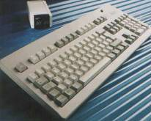


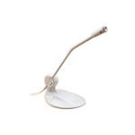
Input devices
There exist a wide range of common devices for achieving input
  Keyboard, mouse, digitizer, microphone, …
HCI

Slide 12
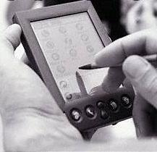
Advanced input devices
Some devices are not quite so common
  Touch screens, handwriting recognition
Eye tracking (using infrared sensors) and gesture tracking (e.g. using magnetic sensors or computer vision) are two advances input systems
HCI

Slide 13
Display devices
Many common display devices
  Monitors and VDUs, speakers, printers
Display devices are commonly separated into
  Hard copy, which has physical permanence
  Soft copy, which is transient and intangible
Advanced display devices being developed continually
  E-paper/E-ink
  Retinal display
HCI

Slide 14
Analog and digital IO
Computers are machines that store and process digital information
Humans are organisms that send and receive information in a continuously varying analog format
Any input device must convert from human analog information to computerized digital information
  Similarly, display devices must convert from digital to analog information
HCI

Slide 15
Explicit and implicit input
Most conventional computer systems rely primarily on explicit input
  For example typed into a keyboard or spoken into a microphone
Increasingly context-aware systems (e.g. location-based services) make use of implicit input
  For example, a user arriving at a bus stop is interpreted as a implicit input
HCI

Slide 16
Human-computer interaction
HCI

Slide 17
Cognition and processing
GISs exist to support human information processing capability
  E.g. calculating areas, lengths, angles, overlays, …
Humans are able to exceed computer information processing capabilities in many areas
  Human information processing referred to as cognition
Two general areas in which humans outperform computers: reasoning and problem solving
HCI

Slide 18
Reasoning I
Process by which information is used to infer new information about a problem domain
Inference | Form | Example
Deductive | rule + case => result | All y’s are z’s x is a y x is a z
Inductive | case + result => rule | x is a y x is a z All y’s are z’s
Abductive | rule + result => case | All y’s are z’s x is a z x is a y
HCI

Slide 19
Reasoning II
Deductive reasoning is valid
  Deductive inference guarantees the if the premises are true so it the conclusion
Inductive and abductive reasoning are unreliable
  Cannot guarantee true conclusions even with true premises
Deductive reasoning is limited to application of rules to examples
Inductive and abductive reasoning are important for generating hypotheses
HCI

Slide 20
Reasoning III
Humans rely on inductive and abductive inference, as well as deduction
Humans regulate inherent unreliability of these reasoning modes
  Using contextual knowledge
  Using belief revision
Computers rely primarily on deductive inference
  Although some AI techniques use induction and abduction
HCI

Slide 21
Problem solving I
Where reasoning involves inference about a familiar problem domain
  Problem solving refers to the ability to design solutions to problems in unfamiliar problem domains
Humans use at least three types of problem solving techniques
  Heuristics
  Analogy and metaphor
  Learning
HCI

Slide 22
Problem solving II
Heuristics: using informed trial and error based on rules of thumb
  E.g. Chess openings (develop your pieces, gain control of the center of the board)
Analogy and metaphor: adapting solutions from one problem domain to another
  E.g Object-orientation (treating software modules as physical objects)
Learning: improving performance by acquiring skills over time with repeated exposure to a problem
  E.g. Multiply 1496 by 20
HCI

Slide 23
Human-computer interaction
HCI

Slide 24
Dialog
Dialog: process of interaction between agents whereby agents cooperate to resolve conflicts and complete some task
  Human-human dialog (conversation, highly unstructured)
  Human-computer dialog (HCI, much more structures)
  Computer-computer dialog (topic of computer architectures, highly structured)
HCI

Slide 25
User interface
User interface: the structures and mechanisms that mediate the dialog between a computer and a human user
  Computer-computer dialogs may have interfaces (e.g. object-oriented interfaces)
A balance of two key features is needed for an effective user interface
  Expressive: ability to achieve specific tasks efficiently
  Intuitive: ease of use, degree of effort required to learn
HCI

Slide 26
Intuitive interface
Don Norman (1988) The Design of Everyday Things is a classic text on what intuitive actually means
  Visibility: extent to which features of an interface a prominent and easy to interpret
  Affordances: properties of an object that facilitate some action: “button is for pressing”
  Mappings: similar to metaphors, where properties and affordances conform to “natural” patterns (e.g. “up” cursor in a GIS)
  Feedback: sending information back to a user about what has been achieved
HCI

Slide 27
Basic user interface styles
Five commonly encountered user interface paradigms:
Interface style
Command entry Menu Forms WIMP Natural language
Expressive
Intuitive

Slide 28
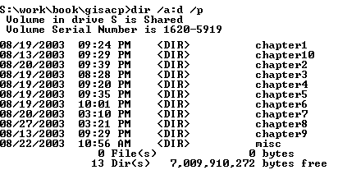
Interface styles: command entry
Command entry: human user issues commands directly to the computer
Many different options customize commands (expressive)
Requires user to learn large numbers of commands and options (not intuitive)
HCI

Slide 29
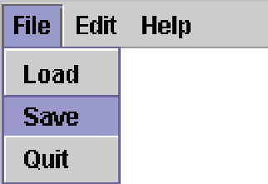
Interface styles: menu interface
Menu interface: commands organized into logical groups (more intuitive than command entry)
A submenu can be used to present further related list of sub-functions or options
Menu structure limits range of options (less expressive than command entry)
HCI

Slide 30
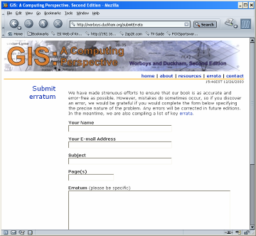
Interface styles: form interface
Form interface: presents specific questions to which a user must respond in order to perform some task
Intuitive, since users are led step by step through interaction
Not expressive, since form allows access to only a few specialized commands
HCI

Slide 31
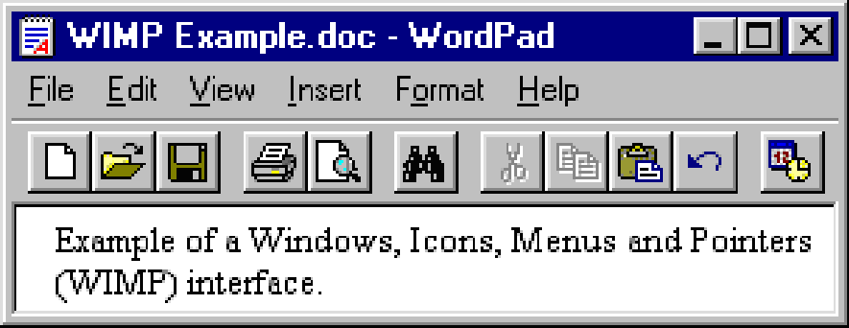
Interface styles: WIMP
WIMP interfaces are familiar as they are the basis of most desktop-computer operating systems
WIMP: stands for windows, icons, menus, pointers
HCI

Slide 32
Interface styles: WIMP II
Windows: independent containers for particular processes and applications
Icons: small pictures that provide a metaphor for particular idea or process
Menus: defined previously
Pointers: mechanism for pointing at a feature of interest and accessing some function related to that feature
Groups of windows in the WIMP interface are often organized according to the desktop metaphor
  Suggesting a likeness between objects in the user interface and in an office desktop (more intuitive)
HCI

Slide 33
Metaphors
Metaphor: In human language, a word or phrase denoting on idea or object in place of another, in order to make figurative comparison (“a sea of troubles”)
More generally “a pervasive mode of understanding by which we project patterns from one domain of experience in order to structure another domain of a different kind” (Johnson 1987)
A metaphor is therefore like a model
HCI

Slide 34
Interface styles: natural language
Most humans use natural language to communicate with one another.
Natural language is potentially both intuitive and expressive
However, natural languages are also ambiguous, e.g.
  “Time flies like an arrow”
  “Fruit flies like a banana”
Note: all interface styles except WIMP are independent of IO channel (may be visual, audible, or haptic)
HCI

Slide 35
Review: HCI
Key components of HCI are the human, computer, interaction
IO occurs over different channels; IO devices must convert between digital and analog information
Computers support human cognition; human cognition exceeds computer processing in at least two areas, reasoning and problem solving
User interfaces mediate the interaction (dialog) between humans and computers. User interfaces must achieve a balance between expressiveness and intuitiveness
HCI

Slide 36
Section 8.2
Cartographic Interfaces

Slide 37
Cartography
Art, science, technology, and history of maps and map making
Maps have 2 core functions
  Storage and recording (spatial aspect)
  Presentation and analysis (graphical aspect)
These functions are separate in a GIS…
  Storage: database
  Presentation: interface
… but are conflated by maps
Cartography

Slide 38
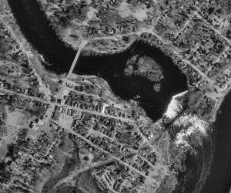
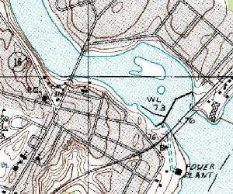
Abstraction in maps
Maps are effective at presentation because they provide an abstract representation of the geographical world
  Allows users to focus on salient relationships not irrelevant details
Cartography
Aerial photo (source USGS)
Topographic map (source USGS)

Slide 39
Abstraction in maps
Cartography

Slide 40
Abstraction
Three primary mechanisms for cartographic abstraction
  Simplification: providing only a limited amount of detail about the world
  Classification: providing information only on certain types of features
  Symbolization: using coherent graphical symbols to represent features
Cartographic generalization is the process of generating maps using appropriate levels of abstraction
Cartography

Slide 41
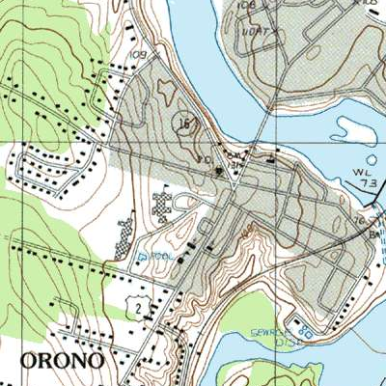
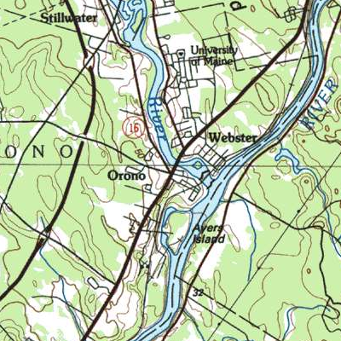
Cartographic generalization
1:24K (Source USGS)
1:100K (Source USGS)
Cartography

Slide 42
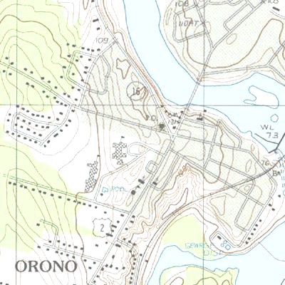
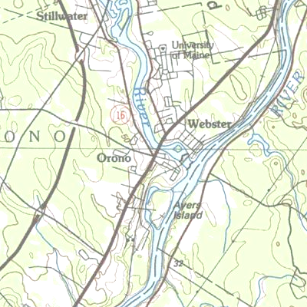
Elimination and simplification
1:24K (Source USGS)
1:100K (Source USGS)
Cartography

Slide 43
Visual variables
The key element of cartographic symbolism are the six visual variables
  * Position * Shape
  * Size * Orientation
  * Color * Pattern
At its most basic level visual variables allow different features to be discerned apart
In addition, variations in each visual variable may be commonly associated with particular information (messages)
Cartography

Slide 44
Position
Position is location of features on a map
  Position is largely prescribed by geographic location
  Often geographic location can be distorted to highlight important relationships
Cartography
N
Ayville
Ayville
Beeton
Beeton
Ayville is (roughly)
north of Beeton
Ayville and Beeton are
connected by the blue line

Slide 45
Size
In general, size indicates greater quantity or importance
In terms of quantity, area carries the value message
  A square with 2cm sides indicates 4 times as much “stuff” as a square with 1cm sides
Cartography
E.g. Ayville has
a greater population
(roughly 4 times greater)
than Beeton
Ayville
Beeton

Slide 46
Orientation
Orientation typically indicates relative orientation, direction of flow or movement
Cartography
Ayville
Beeton
E.g. Flow at Ayville is perpendicular to Beeton

Slide 47
Color
Color is often modeled as three components (HSV model)
  Hue (e.g. “redness” or
  “greeness”)
  Saturation or chroma (color
  purity, how washed out a color is)
  Value (color intensity: lightness
  or darkness)
Other color models also exist, e.g. RGB (display devices), CMYK (cyan, magenta, yellow, black: printing), CIE (international standard based on physics)
Cartography

Slide 48
Color
Many hues have particular associations
Value is often used like size to indicate quantity or importance
Saturation is often used in combination with value, but may also be used independently to control the prominence of symbols
Cartography
Hue: some islands…
…some lakes

Slide 49
Shape
Shape may be used simply to distinguish symbols (abstract symbols)
Shape may also be used iconically (mimetic symbols)
  Recall, an icon is a small picture that provides a metaphor for particular idea or process
Cartography
Abstract symbols
Mimetic symbols

Slide 50
Pattern
Pattern comprises
  Texture: density of symbols, for example used to communicate relative concentrations
  Focus: crispness of symbols, for example used to communicate relative certainty
  Pattern: arrangement of symbols, for example, whether ordered or random
Cartography

Slide 51
Map metaphor
GIS interfaces often employ map-like symbolization and characteristics
  Referred to as the map metaphor
The map metaphor has the advantages that it
  Draws upon established cartographic techniques
  Helps make GIS more intuitive for user familiar with conventional maps, just as desktop metaphor used in WIMP interfaces
However, maps are easy to misinterpret and misrepresent information
Cartography

Slide 52
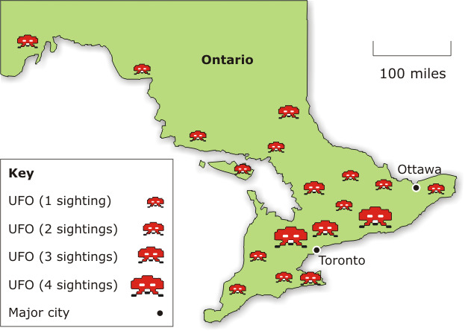
“How to Lie with Maps”
Cartography

Slide 53
Limitations of the map metaphor
Despite being relatively intuitive and expressive map metaphor has four key limitations
  Maps are static and poor at representing change and evolution
  Maps are two-dimensional and ill-suited to complex three-dimensional phenomena
  Maps are based on visual IO and do not take advantage of auditory, haptic etc
  Maps offer only limited opportunities for feedback
Cartography

Slide 54
Review: cartographic interfaces
Maps are a well-established form of abstract visual communication
Simplification, classification, and symbolization are three types of mechanism that may be used in cartographic abstraction
Symbolization can be summarized based on the six visual variables
The map metaphor is widely used for GIS interfaces, which has advantages (e.g. may be intuitive) and disadvantages (e.g. offers limited opportunities for user interaction)
Cartography

Slide 55
Section 8.3
Geovisualization

Slide 56
Visual and verbal thinking
Evidence suggests that humans use two fundamentally different types of thought process:
  Verbal thinking is important for reading and writing, conversation, logical thought
  Visual thinking is important for reasoning about groupings, parts, and spatial configurations of objects
    Compare the size of a soccer ball with a basketball
    Compare the green of an Xmas tree with the green of a traffic light
    Compare 15.5 and 23.7
    Compare “cat” with “catastrophe”
Visualization

Slide 57
Visual and verbal thinking
Woodland
x=2
while x<=128 do x=2*x
Scrub
Forest
x=2
Evergreen
Forest
Visualization
x<=128?
x=2*x
Forest is a subclass of woodland
Woodland is a superclass of scrub
Evergreen forest is a subclass of forest
no
yes
end

Slide 58
Visual and verbal thinking
Scientific visualization is the process of using information systems to represent and interact with information in a way that enhances visual thinking
  Visual thinking does not entail visual IO
Geovisualization is a branch of scientific visualization that deals with geographic information
  Gain insight to geographic problems, sometimes termed geographic thinking
Visualization

Slide 59
Cartography cube (Maceachren 1994)
discover
Geo-
visual-
ization
goals
Visualization
present
Carto-
graphy
private
audience
public
low
interactivity
high

Slide 60
Cartography cube (Maceachren 1994)
Interactivity is the degree to which users can manipulate and redefine a map
  E.g. Changing scale, classification, symbols
Goals is the degree to which a map is designed to help users discover new information
  E.g. Understanding the underlying geomorphological processes for a region
Audience is the degree to which a map is targeted at a specialized audience
  E.g. Today, most maps exist on a computer screen for a fraction of a section
Visualization

Slide 61
Geovisualization
Geovisualization emphasizes the dynamic, interactive, and multimedia capabilities of computers, extending the map metaphor
  Animated interfaces
  Three-dimensional interfaces
  Non-visual interfaces
  Feedback
Visualization

Slide 62
Animation
Animation: displaying a sequence of static images to convey the impression of motion or change over time
Each static image within a sequence is called a scene
Animation can be used for highlighting (discerning apart features) and for depiction of change
  Chronological change (time series)
  Spatial change (fly-by)
  Attribute change (re-expression)
Visualization

Slide 63
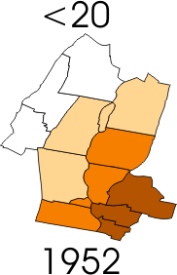
Chronological and attribute change
Percentage of population
in each age cohort
Very low
Low
High
Very low
Visualization
Very high
Low
High
Very high
Population per
unit area by year

Slide 64
Dynamic visual variables
Animation is composed of sequences of static scenes, so static visual variables all operate in animation
Additionally, there are six dynamic counterparts
  Moment
  Duration
  Frequency
  Magnitude
  Order
  Synchronization
Visualization

Slide 65

Moment
Point in time at which event occurs
Analogous to position in visual variables
Visualization

Slide 66

Duration
Length of time between each static scene
Gives animation its “pace”
Visualization

Slide 67
Frequency
How often a phenomenon occurs
Analogous to pattern in visual variables
Visualization

Slide 68


Magnitude
Size of changes between consecutive scenes
Large magnitude = jumpy animations
Small magnitude = smooth animations
Ratio of magnitude: duration = rate of change
Visualization

Slide 69
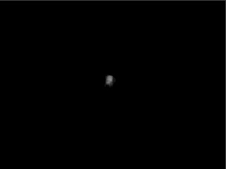
Order and synchronization
Order is the sequence in which scenes occur
Synchronization is the relationship between two or more phenomena (“meta-order”)
Order and synchronization are particularly important in communicating causality
Visualization

Slide 70
Three-dimensional displays
Most visual displays (maps and computer screens) have two spatial dimensions
Geographic phenomena have three spatial dimensions
  E.g. topography
Several cartographic techniques exist for displaying depth, including
  Hill shading
  Contours
  Hypsometric maps
Visualization

Slide 71
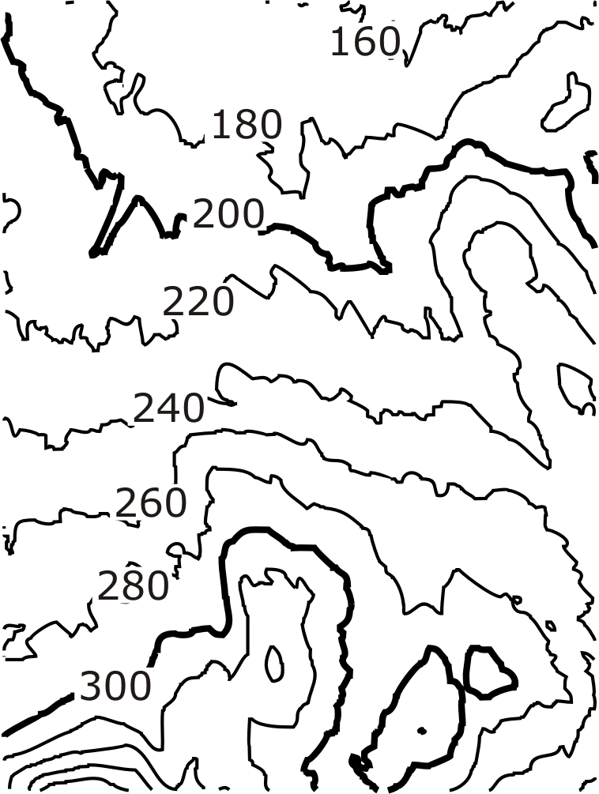
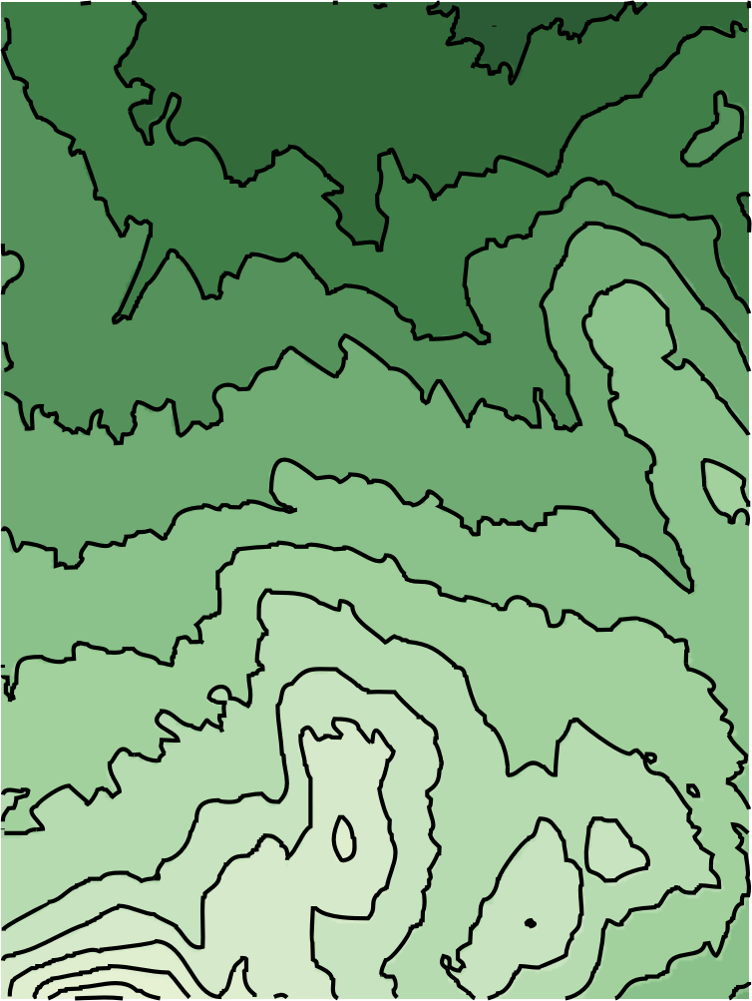
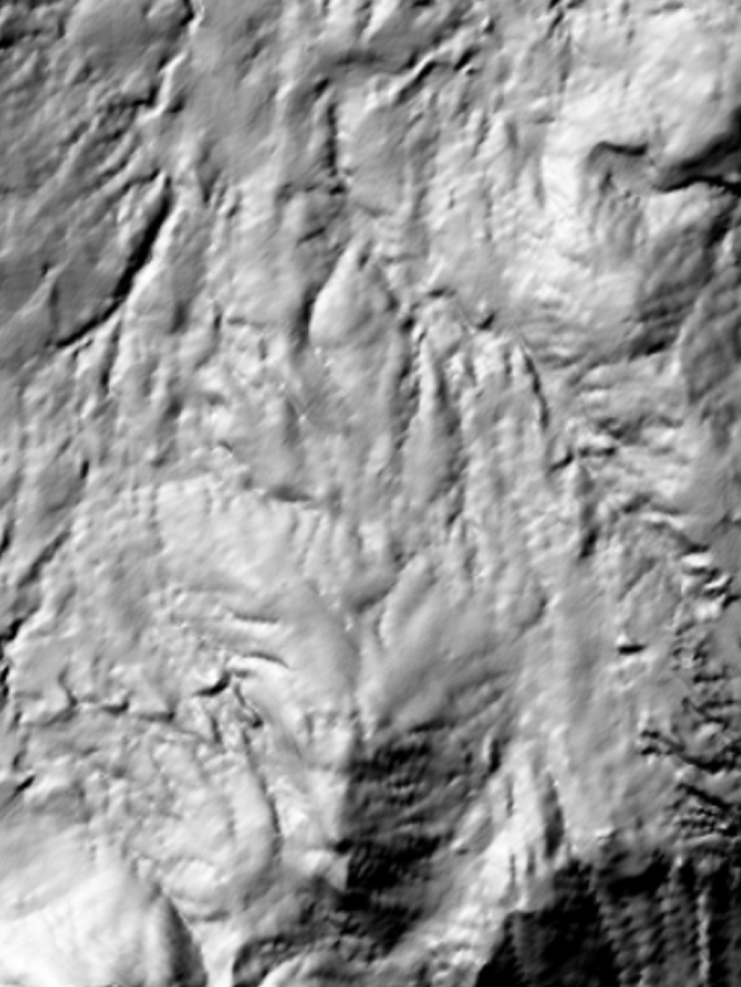
Terrain surface representations I
Visualization

Slide 72
Terrain surface representations Ia
Visualization

Slide 73
Terrain surface representations II
Contour and hypsometric maps
  Abstract view of a three-dimensional surface
  Expressive for those who are already familiar with this style of map
Hill shading
  Northwest illumination required for best effects
  May be used in combination with contour and hypsometric techniques
All three techniques are only useful for surfaces (not for truly three dimensional objects)
Visualization

Slide 74
Depth cues I
Human vision relies on a range of depth cues in order to determine distance to objects
Depth cues can be exploited in two-dimensional computer displays
  E.g. Shading as seen in hill shading
  Also
    Relative size Linear perspective
    Interposition Texture gradient
    Blur Motion parallax
    Eye convergence Stereoscopic depth
Visualization

Slide 75
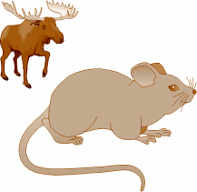


Depth cues II
Relative size: familiar objects with smaller relative size appear further away
Linear perspective: parallel lines appear to converge into the distance
Interposition or occlusion: distant objects may be partially obscured by nearer objects
Visualization

Slide 76

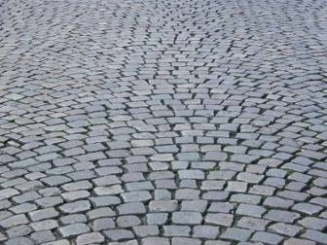
Depth cues III
Blur or depth of focus: objects nearer or farther than the point of focus tend to be blurred
Texture gradient: similar to relative size and linear perspective, surface texture tends to get finer into distance
Visualization
Image: www.freeimages.co.uk

Slide 77
Depth cues IV
Motion parallax: Apparent “velocity gradient” in motion, for example looking out of the window of a moving train
Shading: e.g. hill shading, shadows provide strong impression of height above plane
Visualization
Notes:
This slide relies on Office XP functions and will not work effectively in earlier Office versions

Slide 78
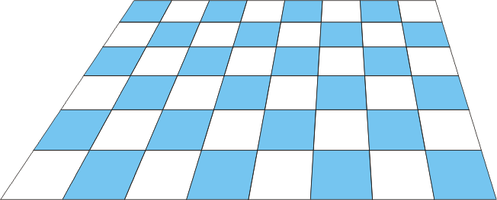

Depth cues IV
Motion parallax: Apparent “velocity gradient” in motion, for example looking out of the window of a moving train
Shading: e.g. hill shading, shadows provide strong impression of height above plane
Visualization
Notes:
This slide relies on Office XP functions and will not work effectively in earlier Office versions

Slide 79
Depth cues IV
Motion parallax: Apparent “velocity gradient” in motion, for example looking out of the window of a moving train
Shading: e.g. hill shading, shadows provide strong impression of height above plane
Visualization
Notes:
This slide relies on Office XP functions and will not work effectively in earlier Office versions

Slide 80
Depth cues V
All depth cues so far operate with only one eye working: they are monocular
  A range of software systems exist to render three-dimensional scenes using monocular depth cues
Some depth cues require both eyes: they are binocular
  Retinal disparity: our eyes receive slightly different views of the world
  Convergence: movement of eyes to fixate on nearby objects
Stereoscopic displays sends precisely controlled images to each eye
  Perceptual difficulties and requirement for specialized hardware make stereoscopic displays less common
Visualization

Slide 81
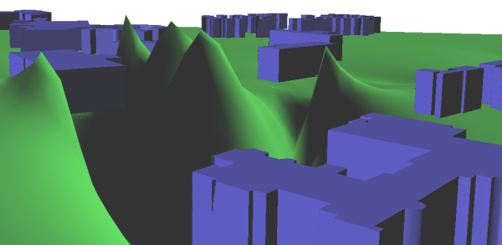
Displaying 3D phenomena
Surfaces, such as topography, are an obvious application of 3-D displays
However, not all (or any) of the displayed dimensions need to be geographic
In relation to geographic information, third dimension is often used for attribute information
Visualization

Slide 82
Non-visual displays
Vision is the primary sense for most people
  Many people have some form of visual impairment
  In many situations, such as driving, it may be hazardous to distract visual attention
Two secondary senses used in HCI
  Hearing
  Haptic
Visualization

Slide 83
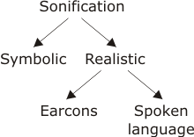
Sound
Process of representing data using sound is termed sonification
Sounds may be symbolic or realistic
Sound symbols are abstract sounds used to represent and distinguish information
Realistic sounds are separated into two categories
  Earcons: sounds that
  provide a metaphor for
  data or a process
  Spoken language

Slide 84
Sound symbols
Sound is inherently temporal so many of the dynamic visual variables have audible counterparts
  Duration, order, frequency (periodic recurrence of sounds), rate of change
In addition symbolic sound has
  Pitch and loudness
  E.g. Geiger counter frequency, pitch, loudness
Visualization

Slide 85
Realistic sounds
Earcons: e.g. sound of paper being scrunched up to accompany delete operation
Spoken language: e.g. speech synthesis systems, interactive voice response (IVR) phone menus
  Text-to-speech systems are widely available and realistic, e.g. Rhetorical systems
  Speech recognition and natural language generation are long term research questions
Visualization

Slide 86
Spatial sound
Our sense of hearing allows us to locate the source of sounds in three dimensions
Depth cues in sound similar to vision
  Discrepancies in sound to each ear (similar to retinal disparity) allow two dimensional sound depth
  Head movements increase to three dimensions
  Loudness and timbre offer other depth cues
Human spatial acuity is lower for hearing than for vision
Visualization

Slide 87
Haptic displays
Common in certain specialized domains
  Braille displays and embossers for visually impaired
  Vibrating mobile phones
  Computer game controllers
Haptic displays almost always used as secondary IO channel
Using multimodal interfaces carries several information
  Operate with wider variety of users (e.g. hearing or visually impaired users)
  Operate in wider variety of conditions (e.g. driving)
  Allow complimentary information to be displayed on different channels (increasing efficiency and decreasing errors)
Visualization

Slide 88
Feedback
Feedback is the process of accepting and responding to a user’s actions with information about what a user has done and what has been achieved
Feedback is a key process in promoting reasoning and problem solving
  Users can test and refine hypotheses
Feedback requires rapid response time
  0.1s instantaneous
  1s uninterrupted thought
  10s limit of feedback
Visualization

Slide 89
Dynamic query
Dynamic query: A user continuously varies the selection criteria and simultaneously views the results of that query
  Zooming: changing level of detail
  Panning: changing viewpoint
  Focusing: changing threshold value used in query
  Brushing: viewing associated information simply by pointing
Linked views: where changes to one data set are reflected in all related views
Visualization

Slide 90
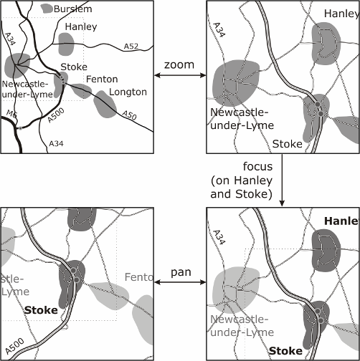
Dynamic query: example
Visualization

Slide 91
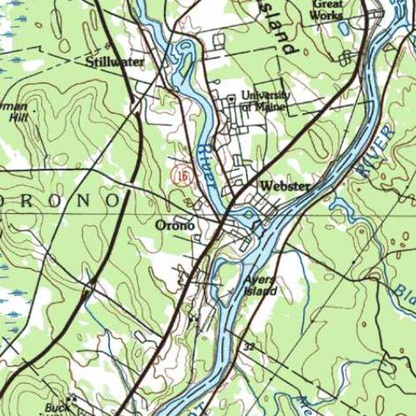
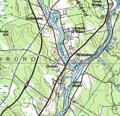
Dynamic query: example
Visualization

Slide 92
Feedback metaphors
Combining feedback with other advanced interfaces styles can lead to more expressive and intuitive interfaces
  In particular promoting reasoning and problem solving
In particular, combination of feedback and 3D interfaces can provide a virtual navigation environment
  Humans remember and structure space using specialized techniques
  Navigation metaphor can provide a powerful analogy for non-geographic navigation
Visualization

Slide 93
Review
Visualization concerns engaging a user's visual thinking capability
Visual thinking is a key component in understanding spatial information
Animation, 3D displays, non-visual displays, and feedback are four visualization techniques that extend conventional maps
Spatial metaphors, like navigation, can form intuitive and expressive interface styles
Visualization

Slide 94
Section 8.4
Developing GIS
Interfaces

Slide 95
GIS tasks
Presentation (display)
Querying (goal-driven retrieval)
Browsing (relationship-driven retrieval)
Editing (changes or corrections)
Integration (combining or conflating)
Analysis (processing to reveal hidden relationships)
Decision making (evaluating and choosing between different courses of action)
Problem solving (designing solutions for new problems and unfamiliar domains)
Increased
need to
engage in
geographic
thinking
Interface
design

Slide 96
Matching tasks to interfaces
Usability: interface must enable users to efficiently complete desired task
Interface styles and use of geovisualization techniques should be matched to desired task
Examples of poor matches:
  In-car navigation system that allows users to explore many options, or uses complex visual interfaces
  Planning system for a new bypass road that provides a simple “build” or “don’t build” answer, with a route if “build”
Interface
design

Slide 97
Collaborative spatial decision making
CSCW (computer supported cooperative work) concerns the study of systems for collaborative work (groupware)
Spatial decision making often needs to be collaborative, as many stakeholders are affected by decision
For non-specialist stakeholders
  map-based displays, menu driven interfaces and commands may be less intuitive
  three-dimensional displays, sketch interfaces are likely to be more intuitive
Interface
design

Slide 98
Usability engineering
Developing usable interfaces is not an exact science: experience and judgment play a part
Usability engineering: process of interface development to maximize usability
  System life-cycle
  Empirical usability assessment
  Usability engineering techniques
Interface
design

Slide 99
Measurable interface goals I
Time to learn: how long does it take for expected users to learn how to use a system?
Speed of performance: how quickly can users carry out benchmark tasks?
Rate of errors by users: how many and what kinds of errors do people make in carrying out benchmark tasks? How easy is it to correct errors when they occur?
Retention over time: how well do users maintain their knowledge after an hour, a day, a week?
Subjective satisfaction: how much did users enjoy, or at least not dislike, performing particular tasks?
Interface
design

Slide 100
Measurable interface goals II
Ideal would be to perform perfectly in every category of measurable benchmarks, but that is often impossible
  lengthy learning times can lead to very high speed performance, perhaps using macros and complex abbreviations
  very low error rates can sometimes be achieved but only using lengthy learning times or low speed performance
  systems that are very easy to learn may not need high retention rates
Generally there needs to be a compromise between the different benchmark categories
The compromise will depend in part on the different application areas
Interface
design

Slide 101
Prototyping
Prototypes can reveal problems that are hard to detect with “pen and paper” designs
  Throw away: used simply to test ideas
  Evolutionary: used as a preliminary for actual system
Informal and low-cost usability engineering techniques
Interface
design

Slide 102
Design rationale
Design rationale
  Why did I do that?
  Explains why a system is the way it is
  Forces the designer to justify decisions, consider alternatives
  Can be written, or diagrammatic (eg issue-based information system, IBIS)
Argument
Argument
Supports
Objects to
Position
Position
Relates to
Relates to
Interface
design
Issue
Questions
Specializes
Sub-issue
Sub-issue

Slide 103
Design analysis: GOMS
GOMS
  Goals: User goals, what the user wants to achieve
  Operators: Basic low level actions a user can take
  Methods: A way of achieving a goal
  Selection: Choice of method is not random, GOMS aims to predict what method is used
Design analysis techniques are in general the most formal and specialized usability engineering techniques
Interface
design

Slide 104
Review
Usability is a key concept in interfaces that must be considered throughout system development process
Empirical assessment of usability can be achieved using measurable benchmarks
In order of increasing formality, three types of usability engineering techniques are:
  Prototyping
  Design rationale
  Design analysis
Interface
design

