Slide 1
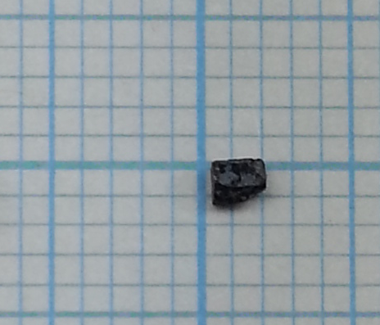
Bi₂Fe₄O₉ single crystal
Orthorhombic
SG: Pbam
a=7.94
b=8.44
c=6.01
Shiny surface is normal to (110).
(001)
(110)
#1-2 : 15 mg
Magnetization measurements were performed at ISSP, Japan.
H //(110) & H//(001)

Slide 2
Bi2Fe4O9

Slide 3
M(H) at various T (H//110)

Slide 4
M derivative-H

Slide 5
Phase diagram (peak of dM/dH)

