Slide 1
Introduction to Matlab and Python
Notes:
1

Slide 2
Why?
Horace and SpinW are both written in Matlab, but we have recently created wrappers so that they can be run from Python (without a Matlab license).
The translation between the two languages is not perfect so you need to be aware of the features of each and the differences between the two.
Both Horace and SpinW are primarily command-line interface (CLI) programs.
We will use Jupyter notebooks to access this CLI.

Slide 3
Matlab
In Matlab, the basic data type is an array:
Numeric arrays (elements are numbers)
Strings (character arrays)
Cell arrays (mixed type elements, equivalent to Python list)
[] used to construct numeric or character arrays
{} used to construct cell arrays
, or space used to delimit elements
; operator used to delimit rows
() used to index arrays or call a function.
% is used for comments
>> row_1d = [1 2 3 4] % or [1,2,3,4]
>> column_1d = [1;2;3;4]
>> array_2d = [1,2,3; 4,5,6; 7,8,9]
>> string = 'abc'
>> string = ['xyz' num2str(5)] % 'xyz5'
>> cell_array = {'a', [1,2,3], 'xyz'}

Slide 4
Python
In Python the basic data type is an object, with properties which can make it behave like different types:
Scalars (int, float, complex, bool)
Sequences (list, tuple, range, str)
Maps (dict)
The [] operator is used to construct lists or to index containers (sequences or maps).
The () operator is used to construct tuples or to call a function.
, must be used to delimit elements of a sequence or map
# is used for comments
The equivalent to a Matlab array is a numpy array.
>>> row_vec = np.array([1,2,3,4])
>>> column_vec = np.array([[1],[2],[3],[4]])
>>> array_2d = np.array([[1,2,3], [4,5,6], [7,8,9]])
>>> string = 'abc'
>>> string = f'xyz{num2str(5)}' # 'xyz5'
>>> listobj = ['a', [1,2,3], 'xyz']

Slide 5
libpymcr wrapper
We’re using a library (libpymcr) to automatically convert between Matlab and Python types but because of the differences, it has several conventions.
Python (nested) lists and ranges of numeric types and consistent shapes are automatically converted to Matlab numeric arrays.
Python lists of different types (e.g. strings and numbers) and tuples are converted to Matlab cell-arrays
Matlab functions are accessed using a Matlab object:
>>> from pace_neutrons import Matlab
>>> m = Matlab()
>>> m.eig([[1,2,3], [4,5,6], [7,8,9]])
>>> m.disp('abc')

Slide 6
libpymcr wrapper
Indexing uses the Python [] operator (not the Matlab () operator).
Indexing is 0-based using Python convention (not 1-based as in Matlab).
Calling a function (even with no arguments) requires the () operator (unlike in Matlab).
Must use , to separate elements (space as an element separator is not valid)
>>> mag = m.magic(3)
>>> mag[0,0] # equivalent to Matlab mag(1,1)
>>> m.ver()

Slide 7
libpymcr wrapper
Matlab objects are wrapped by a Python wrapper so that methods and properties can be accessed in Python using the dot . operator.
Any overloaded operations are also supported if it is supported in Matlab.
Matlab also allows class methods to be called as functions if the first argument is a class instance. Python does not support this but libpymcr does.
>>> horace_obj = m.d2d()
>>> mult_h = horace_obj * 2
>>> sin_h = m.sin(horace_obj) # Pure Python: horace_obj.sin()
>>> m.plot(horace_obj)

Slide 8
jupyter
Finally, there are some extra “magic” commands for Jupyter.
Matlab plots can be either “inline” or “windowed”
Inline means that an image of the plot is captured as soon as it is plotted and this is stored in the cell, and the plot window is closed
Windowed means that the Matlab plot window is kept open for you to manipulate it but the image of the plot will not be saved.
Invoked using the % operator in Jupyter.
For “inline” images, can also specify default image width, height and resolution.
This can also be done per cell.
%matlab_plot_mode inline
%matlab_plot_mode windowed
%matlab_plot_mode inline –w 400 –h 400 –r 300 # Default fig size
%matlab_fig –w 600 –h 200 –r 150 # Per cell fig size

Slide 9
gotchas
For people used to Matlab, there are a few “gotchas” with Python
Indices count from zero.
range sequence does not include end value
The automatic conversion in libpymcr only happens if you call a Matlab function / class (e.g. a Python list of numbers stays a list if you call a Python function on it).
You must use () to call a function.
>>> a[0] # Instead of a(1) in Matlab
>>> list(range(0,4)) # gives 0,1,2,3
>>> m.swpref().setpref('usemex', 1) # swpref.setpref in Matlab

Slide 10
Questions so far?

Slide 11

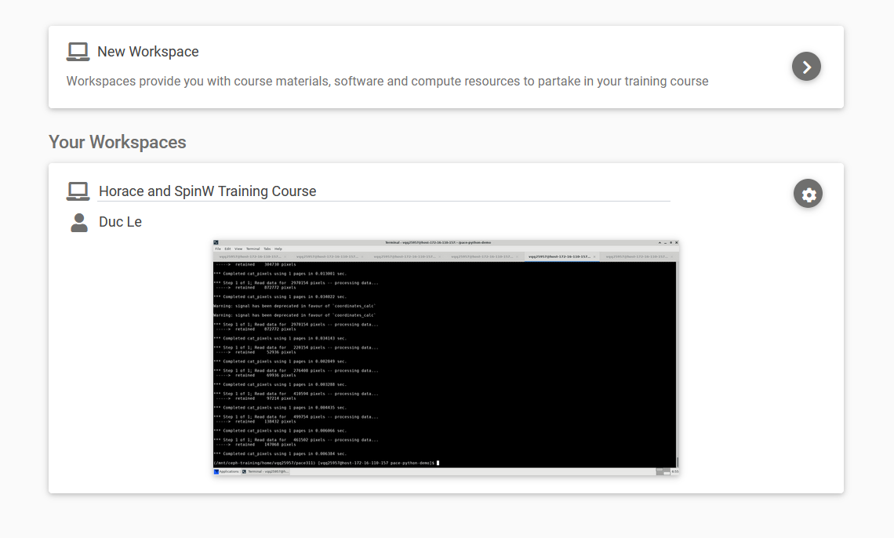
IDaaS
You should have received an email with a link of the form:
https://training.analysis.stfc.ac.uk//auth/login?ticket=<xx>
This is the only way to log into the training system.
Once logged in, create a “workspace”:
Launch it

Slide 12
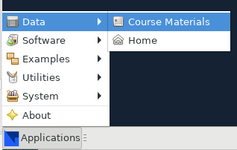
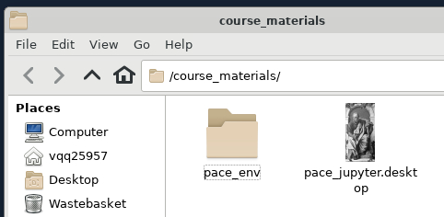
IDaaS
(If you find the desktop screen too small, you can use your browser zoom facility to zoom out and the desktop will resize)
Go to “Applications” -> Data -> Course Materials
Double-click the “pace_jupyter” icon

Slide 13
IDaaS
Go back to the course_materials folder and copy the matlab.ipynb file to your home folder then open it in Jupyter.

