Slide 1
Single crystal inelastic neutron data analysis with Horace
Notes:
1

Slide 2
Horace
Recap – basic tasks using Horace:
Creating a 4D S(Q,ω) dataset (sqw file) from runs at different angles
Viewing / plotting this data in particular (Q,ω) regions
Fitting the data
← gen_sqw
← cut_sqw
← multifit

Slide 3
gen_sqw
gen_sqw (spe_files, par_file, sqw_file, efix, emode, alatt, angdeg, u, v, psi, omega, dpsi, gl, gs)
spe_files – cell array (list) of reduced data file names
par_file – detector parameter file (not usually used)
sqw_file – output sqw file name
efix – fixed energy (E_{i} for direct geometry)
emode – 1 for direct, 2 for indirect
alatt – [a,b,c] lattice parameters
angdeg – [alpha,beta,gamma] lattice angles (in degrees)
u, v – vectors defining the horizontal scattering plane
psi – a vector of rotation angles about the vertical axis (in degrees)
omega, dpsi, gl, gs – sample misalignment angles (in degrees)
GL
u
Ω
ψ
n
GS
v

Slide 4
gen_sqw_powder
gen_sqw_powder(spe_files, par_file, sqw_file, efix, emode)
spe_files – cell array (list) of reduced data file names
par_file – detector parameter file (not usually used)
sqw_file – output sqw file name
efix – fixed energy (E_{i} for direct geometry)
emode – 1 for direct, 2 for indirect
alatt – [a,b,c] lattice parameters
angdeg – [alpha,beta,gamma] lattice angles (in degrees)
u, v – vectors defining the horizontal scattering plane
psi – a vector of rotation angles about the vertical axis (in degrees)
omega, dpsi, gl, gs – sample misalignment angles (in degrees)

Slide 5
cut_sqw
w = cut_sqw(data_source, proj, p1_bin, p2_bin, p3_bin, p4_bin)
data_source – a filename (string) or a sqw object in memory
proj – a projection object (more details next)
p1_bin, p2_bin, p3_bin – vector defining binning along u, v, w
p4_bin – vector defining binning along energy axis
u, v, w are defined by the projection proj.
Bins can be either 1, 2, or 3 numbers:
[bin_size] – 1 number rebin full limit of data in this axis with new bin_size
[lo, hi] – integrate over this axis between lo and hi limits.
[lo, bin_size, hi] – rebin this axis between lo and hi limits with new bin_size

Slide 6
Horace projections
Recap – 2 types of coordinates systems used by Horace:
u and v vectors defining the horizontal plane in generating the data
u, v (and optional w) vectors defining Q-axes for cuts
A projection is used to define 3 vectors u, v, w which define the 3 Q axes for cuts/plots.
A projection is a class with properties:
u – the first axis
v – the second axis
w – the third axis
type – a string of 3 letters: ‘r’=r.l.u., ‘a’=absolute (Å⁻¹)
nonorthogonal – true or false (default: false)
nonorthogonal=true means u1=u, u2=v, u3=w
nonorthogonal=false means u1=u; u2 ⊥ u1 in plane of u,v; u3 ⊥ u,v
← “projection”

Slide 7
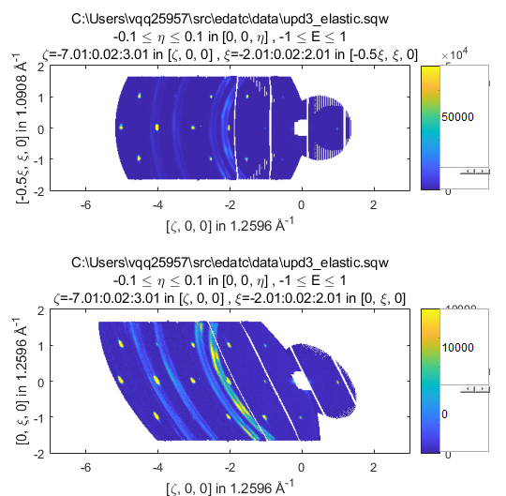
Nonorthogonal projections
Matlab graphs can only have orthogonal plot axes.
Using nonorthogonal=true gives a distorted view
nonorthogonal=false
nonorthogonal=true

Slide 8
Generic projections
Horace recently introduced non-rectilinear projections – this means you can (in principle, in future) make cuts along an arbitrary direction in (Q, E) space.
But currently, the non-rectilinear projections allowed are:
Spherical projection (docs)
Cylindrical projection (docs)
Still relatively new – if you’re interested let me know.

Slide 9
Questions so far?

Slide 10
Sample misalignment corrections
https://pace-neutrons.github.io/Horace/unstable/manual/Correcting_for_sample_misalignment.html
bragg_positions() – make cuts and fit Bragg peaks automatically
bragg_positions_view() – function to view Bragg peak fits
refine_crystal() – function to calculate a transformation matrix to convert from original (hkl) to corrected (hkl) from the Bragg position fits
change_crystal() – applies the correction matrix to data in memory
change_crystal_horace() – applies correction matrix to sqw file
crystal_pars_correct() – calculate “correct” lattice parameters / angles and misalignment orientation (dpsi, gl, gs) from correction matrix
uv_correct() – calculate u and v vectors defining the true horizontal plane.

Slide 11
Advanced Plotting
https://pace-neutrons.github.io/Horace/unstable/manual/Plotting.html
Horace 1D and 2D plots are not quite standard Matlab plots and use their own syntax based on the (now defunct) “Genie” program
plot(object) – object can be sqw or dnd. Replaces current plot if it exists
acolor, aline, amark – alter default color, line, marker (applies to next plot)
lx, ly, lz – sets limits in x, y, z directions (z=color axis in 2D)
keep_figure – next plot command will create a new figure window.
make_current – next plot command will replace current plot in figure window.
pl, pm, pe, pp – 1D, overplots line, markers, errors or points (markers+errors)
pd, ph – 1D only, overplots data (markers+errors+line) or histogram
ds – 2D, plots a contour map of the data

Slide 12
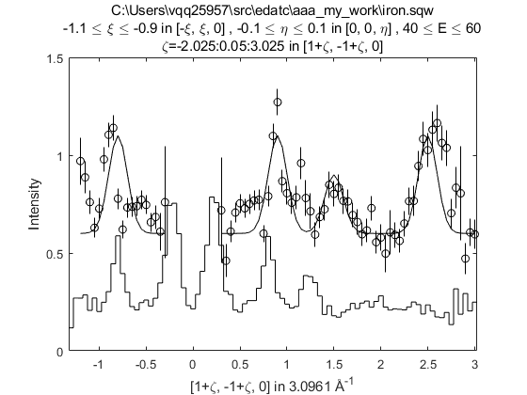
Advanced Plotting
pl, pm, pe, pp – 1D, overplots line, markers, errors or points (markers+errors)
pd, ph – 1D only, overplots data (markers+errors+line) or histogram

Slide 13
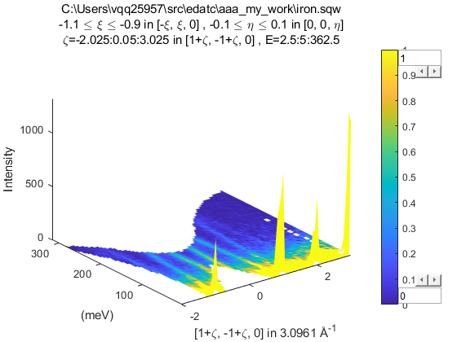
Advanced Plotting
ds – 2D, plots a contour map of the data

Slide 14
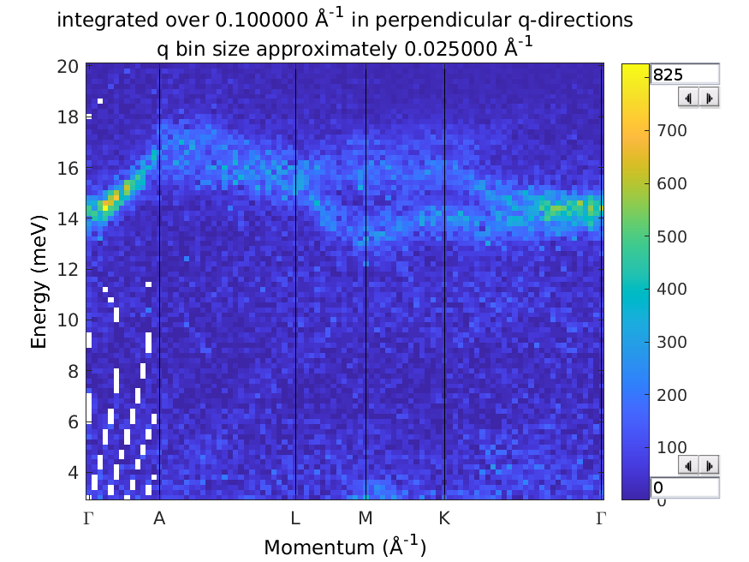
Advanced Plotting
spaghetti_plot – function to plot data along particular Q directions
spaghetti_plot([0,0,-3; 0,0,-3.5; -0.5,0,-3.5; -0.5,0,-3; -2/3 1/3 -3; 0 0 -3], 'upd3_ei25.sqw', 'labels',{'\Gamma','A','L','M','K','\Gamma'}, 'ebin',[3,0.2,20], 'qbin',0.025, 'qwidth',0.1)

Slide 15
Questions so far?

Slide 16
Background Subtraction
Binary operations like minus only works between two objects:
If both are sqw, they must have the exact same set of pixels
If both are dnd, they must be the same dimension/size
If one is sqw and one is dnd, they must have the same dimension/bin size
For two objects of the same type, there is a 1-to-1 correspondence between bins/pixels of both objects – operation applied to signal, errors propagated in quadrature.
If one object is a dnd and the other is sqw, the dnd object is treated as if it has the same pixels as the sqw object but all the pixels in the same bin have the same signal value.
Common subtraction methods:
Measure at different temperatures (e.g. [low T] – [high T])
Subtract empty sample / instrument
Subtract separate sample (e.g. phonon blank)
Subtract equivalent Q region where signal is low
(e.g. [low Q]- [high Q] for magnetism)
most
common
← sqw-sqw
← sqw-sqw
← sqw-sqw
← sqw-dnd
least

Slide 17
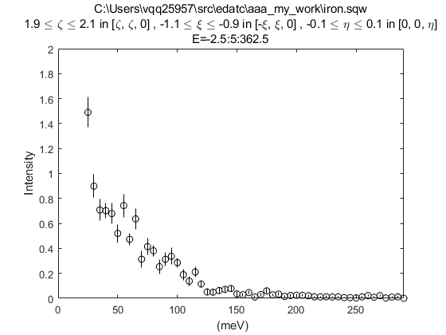
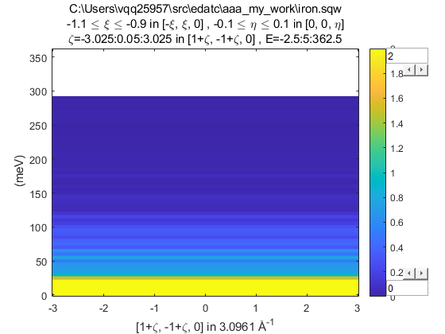
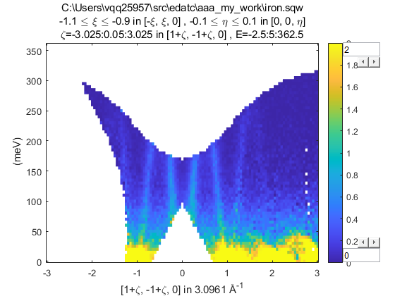
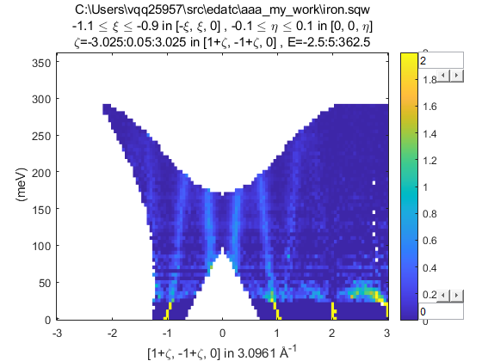
Background Subtraction
For the demo / worksheet we only have one dataset so will use the somewhat contrived final method.
Use the replicate function to convert a 1D cut to 2D slice
The can subtract the original 2D slice:

Slide 18
Symmetrisation
symmetrise_sqw(w_in, v1, v2, offset)
Can be use to fold data in a plane defined by v1 and v2, combining data into one side, for improving low statistics.
Only works on sqw objects in memory.
To symmetrise a full sqw file, need to do it in gen_sqw using the transform_sqw option:
https://pace-neutrons.github.io/horace-docs/3.5.0/Symmetrising_etc.html#symmetrising-whole-data-files

Slide 19
Data Diagnostics
The sqw file is created from a series of measurements – but sometimes something goes wrong during these (e.g. motor/sample gets stuck, get temperature spike, sample comes loose/shifts, etc)
Can use the run_inspector to split a sqw cut and view the resulting contribution from each input reduced (SPE/NXSPE) file.
After figuring out problematic runs, can gen_sqw again, or use split and join on in-memory objects.
https://pace-neutrons.github.io/horace-docs/3.5.0/Data_diagnostics.html

Slide 20
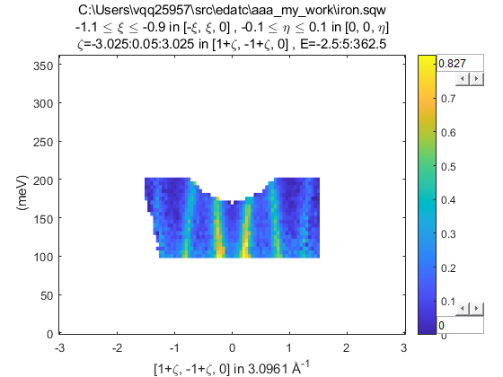
Masking
Alternatively, can mask out small sections of the data:
mask(w_in, mask_array)
mask_array = mask_points(w_in, 'keep', range)
mask_array = mask_points(w_in, 'remove', range)
range is a vector [lo_x1,hi_x1, lo_x2,hi_x2, ... , lo_xn,hi_xn]
mask_array is a logical array same size as the binned data. 1 or true indicates to keep that bin, 0 or false will be masked. The mask_points function can be used to generate such an array.
>> plot(mask(w1, mask_points(w1, 'keep', [-1.5,1.5, 100,200])))
https://pace-neutrons.github.io/horace-docs/3.5.0/Reshaping_etc.html#mask

Slide 21
Questions so far?

Slide 22
Simulating Data
3 ways of creating a synthetic workspace in Horace:
func_eval(w_in, @fun, par)
sqw_eval(w_in, @sqwfun, par)
disp2sqw_eval(w_in, @dispfun, par, fwhm)
@ indicates a function handle in Matlab
func_eval passes the plot axes coordinates (e.g. defined by a projection) to the function – used for basic functions like gaussians or lorentzian peaks, or linear background etc.
sqw_eval and disp2sqw_eval pass the (Q,E) coordinates to the user function and are used for theoretical model of scattering
@sqwfun should return the scattering function S(Q,E)
@dispfun should return the dispersion E(Q) and the corresponding weight S at that value of energy (returns 2 outputs). Horace then performs a simple energy convolution with a Gaussian of width fwhm to get S(Q,E).

Slide 23
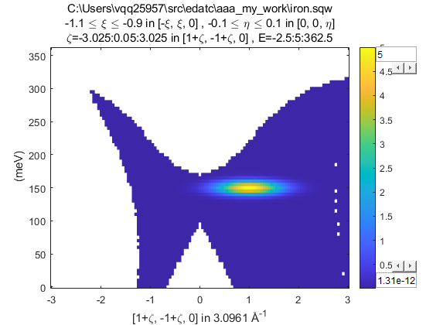
Simulating Data
3 ways of creating a synthetic workspace in Horace:
func_eval(w_in, @fun, par)
sqw_eval(w_in, @sqwfun, par)
disp2sqw_eval(w_in, @dispfun, par, fwhm)
Example of a @fun for func_eval:
function out = fun(x, y, par)
xc = par(1); yc = par(2);
sigx = par(3); sigy = par(4);
out = par(5) * exp(-(x-xc).^2./(2*sigx)-(y-yc).^2./(2*sigy));
end
plot(func_eval(w1, @fun, ...
[1,150,0.2,50,5]));
← 2D function – takes 2 coordinates

Slide 24
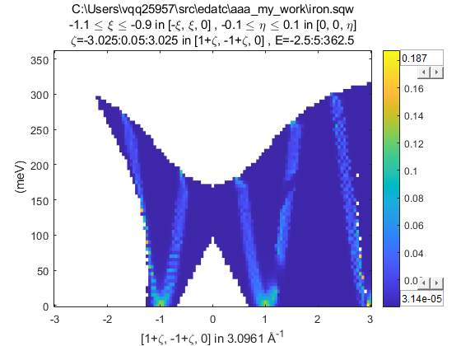
Simulating Data
3 ways of creating a synthetic workspace in Horace:
func_eval(w_in, @fun, par)
sqw_eval(w_in, @sqwfun, par)
disp2sqw_eval(w_in, @dispfun, par, fwhm)
Example of a @sqwfun for sqw_eval:
function out = sqwfun(h,k,l,en,par)
JS = par(1); Gam = par(2);
omega = JS * (1-cos(pi*h));
out = par(3) * Gam ./ ((en - omega).^2 + Gam.^2);
end
plot(sqw_eval(w1, @sqwfun, ...
[200,5,1]));
← always takes h,k,l,en coordinates

Slide 25
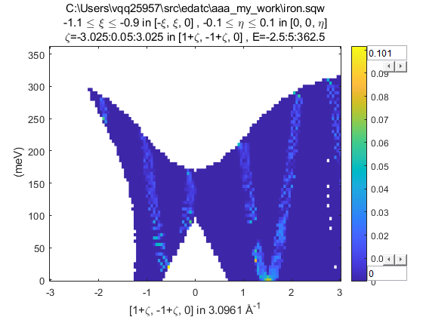
Simulating Data
3 ways of creating a synthetic workspace in Horace:
func_eval(w_in, @fun, par)
sqw_eval(w_in, @sqwfun, par)
disp2sqw_eval(w_in, @dispfun, par, fwhm)
Example of a @dispfun for sqw_eval:
function [w,s] = dispfun(h,k,l,par)
JS = par(1);
w = JS * (1-sin(pi*h));
s = par(2) + w*0;
end
plot(…
disp2sqw_eval(w1, @dispfun,...
[200,1]));
← always takes h,k,l coordinates
returns 2 values w and s

Slide 26
Simulating Data
func_eval, sqw_eval, disp2sqw_eval can be used to generate simulated data.
All require an input sqw or dnd object to provide the coordinates
And a user defined function specified by a handle (prefix @)
sqw_eval and disp2sqw_eval will pass to the functions
the (Q,E) coordinates of the bin centres if given a dnd object
the (Q,E) coordinates of every pixel if given a sqw object
So calculations with a sqw will be more accurate but take longer

Slide 27
Questions so far?

Slide 28
Recap
3 ways of creating a synthetic workspace in Horace:
func_eval(w_in, @fun, par)
sqw_eval(w_in, @sqwfun, par)
disp2sqw_eval(w_in, @dispfun, par, fwhm)
function out = fun(x, y, par)
xc = par(1); yc = par(2); sigx = par(3); sigy = par(4);
out = par(5) * exp(-(x-xc).^2./(2*sigx)-(y-yc).^2./(2*sigy));
end

Slide 29
Recap
3 ways of creating a synthetic workspace in Horace:
func_eval(w_in, @fun, par)
sqw_eval(w_in, @sqwfun, par)
disp2sqw_eval(w_in, @dispfun, par, fwhm)
function out = sqwfun(h,k,l,en,par)
JS = par(1); Gam = par(2);
omega = JS * (1-cos(pi*h));
out = par(3) * Gam ./ ((en - omega).^2 + Gam.^2);
end

Slide 30
Recap
3 ways of creating a synthetic workspace in Horace:
func_eval(w_in, @fun, par)
sqw_eval(w_in, @sqwfun, par)
disp2sqw_eval(w_in, @dispfun, par, fwhm)
3 different function signatures depending on the evaluation mechanism
These three types of functions can also be used for fitting
func_eval → multifit
sqw_eval → multifit_sqw
disp2sqw_eval → multifit_sqw and disp2sqw
function [w,s] = dispfun(h,k,l,par)
w = par(1) * (1-sin(pi*h));
s = par(2) + w*0;
end

Slide 31
multifit
multifit is the Horace fitting class.
https://pace-neutrons.github.io/horace-docs/3.5.0/Multifit.html
Uses the Levenberg-Marquardt algorithm
Designed to fit multiple cuts simultaneously
Expects user-defined model functions in the form func(x1,x2,x3,…,pars)
Can also have non-Matlab fit functions (e.g. Fortran, C/C++, Python)
Beta: work-in-progress contact me for details
Accepts up to two model functions: “foreground” and “background”.
Has the concept of a “local” and “global” model functions:
“global”: parameters are the same for all input cuts
By default “foreground” model function is “global”
“local”: parameters for each cut is different
By default “background” model function is “local”
Can specify “bindings” (or “ties”) between model/background parameters
https://pace-neutrons.github.io/horace-docs/3.5.0/Multifit.html#binding-parameters

Slide 32
multifit
multifit has two types of syntax
“legacy” function-style syntax:
>> [w_fit, fitpars] = multifit(w_in, @fun, init_par)
Object oriented syntax:
>> mfobj = multifit(w_in)
>> mfobj = mfobj.set_fun(@fun)
>> mfobj = mfobj.set_pin(init_par)
>> [w_fit, fitpars] = mfobj.fit()
Object-oriented syntax is highly recommended for complex multi-cut fits with background and bindings between model/background parameters.

Slide 33
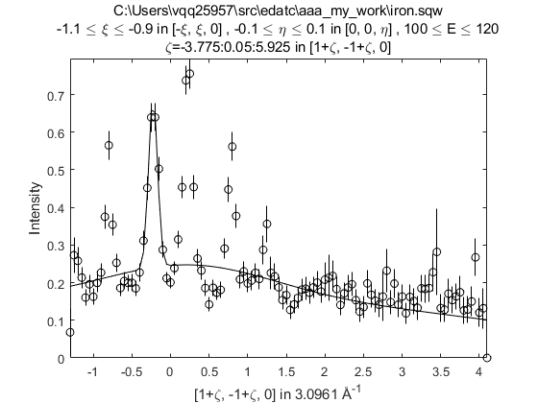
A simple fit
Make a 1D cut and fit a set of Gaussians to it.
>> w1 = cut_sqw('iron.sqw', projaxes([1,1,0], [-1,1,0], 'type', 'rrr'), 0.05, [-1.1,-0.9], [-0.1, 0.1], [100,120])
>> [wf, fp] = multifit(w1, @mgauss, [0.4 -0.8 0.1 0.4 -0.2 0.1 0.4 0.2 0.1])
>> plot(w1); pl(wf)

Slide 34
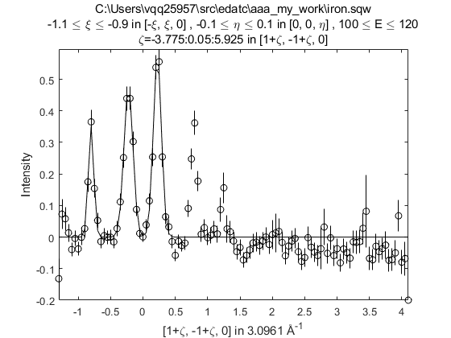
A simple fit
Make a 1D cut and fit a set of Gaussians to it.
>> w1 = cut_sqw('iron.sqw', projaxes([1,1,0], [-1,1,0], 'type', 'rrr'), 0.05, [-1.1,-0.9], [-0.1, 0.1], [100,120])
>> [wf, fp] = multifit(w1-0.2, @mgauss, [0.4 -0.8 0.1 0.4 -0.2 0.1 0.4 0.2 0.1])
>> plot(w1-0.2); pl(wf)

Slide 35
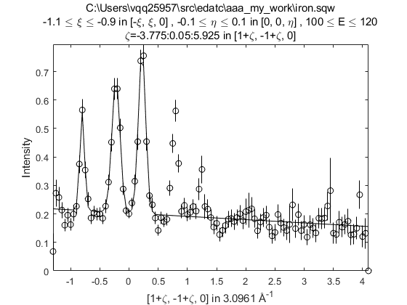
A simple fit
Make a 1D cut and fit a set of Gaussians to it.
>> w1 = cut_sqw('iron.sqw', projaxes([1,1,0], [-1,1,0], 'type', 'rrr'), 0.05, [-1.1,-0.9], [-0.1, 0.1], [100,120])
>> [wf, fp] = multifit(w1, @mgauss, [0.4 -0.8 0.1 0.4 -0.2 0.1 0.4 0.2 0.1], @linear_bg, [0.2 0])
>> plot(w1); pl(wf)

Slide 36
A simple fit
Make a 1D cut and fit a set of Gaussians to it.
>> w1 = cut_sqw('iron.sqw', projaxes([1,1,0], [-1,1,0], 'type', 'rrr'), 0.05, [-1.1,-0.9], [-0.1, 0.1], [100,120])
>> mf = multifit(w1); mf = mf.set_fun(@mgauss); mf = mf.set_pin([0.4 -0.8 0.1 0.4 -0.2 0.1 0.4 0.2 0.1]);
>> mf = mf.set_bfun(@linear_bg); mf = mf.set_bpin([0.2 0]);
>> [wf, fp] = mf.fit(); plot(w1); pl(wf)
Object-oriented syntax

Slide 37
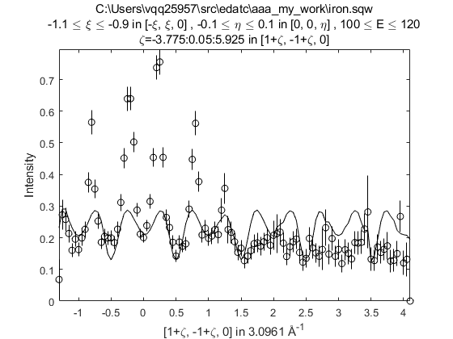
S(Q,E) model fit
Now try to fit the same dataset with a S(Q,E) model
>> w1 = cut_sqw('iron.sqw', projaxes([1,1,0], [-1,1,0], 'type', 'rrr'), 0.05, [-1.1,-0.9], [-0.1, 0.1], [100,120])
>> [wf, fp] = multifit_sqw(w1, @my_disp, [200, 0.4, 0.1])
>> plot(w1); pl(wf)
my_disp.m
function out = my_disp (qh, qk, ql, en, par)
om = par(1)*abs(cos(pi*qh));
out = par(2)*exp(-((om-en).^2)./(2*par(3)));
end

Slide 38
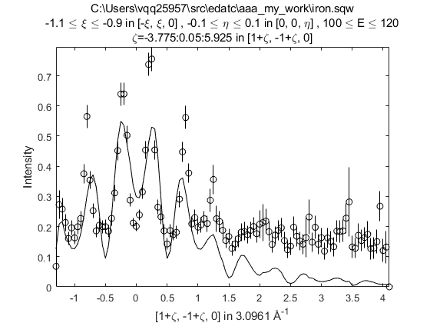
S(Q,E) model fit
Now try to fit the same dataset with a S(Q,E) model
>> w1 = cut_sqw('iron.sqw', projaxes([1,1,0], [-1,1,0], 'type', 'rrr'), 0.05, [-1.1,-0.9], [-0.1, 0.1], [100,120])
>> ff_fun = MagneticIons('Fe0').getFF_calculator(w1);
>> [wf, fp] = multifit_sqw(w1, @my_disp_ff, {[200, 0.4, 0.1] ff_fun})
>> plot(w1); pl(wf)
my_disp_ff.m
function out = my_disp (qh, qk, ql, en, par, ff_fun)
om = par(1)*abs(cos(pi*qh));
out = par(2)*exp(-((om-en).^2)./(2*par(3)));
out = out .* ff_fun(qh,qk,ql,en)';
end

Slide 39
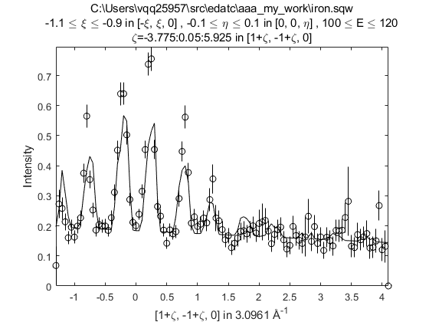
S(Q,E) model fit
Now try to fit the same dataset with a S(Q,E) model
>> w1 = cut_sqw('iron.sqw', projaxes([1,1,0], [-1,1,0], 'type', 'rrr'), 0.05, [-1.1,-0.9], [-0.1, 0.1], [100,120])
>> ff_fun = MagneticIons('Fe0').getFF_calculator(w1);
>> [wf, fp] = multifit_sqw(w1, @my_disp_ff, {[200, 0.4, 0.1] ff_fun}, @linear_bg, [0.1, 0])
>> plot(w1); pl(wf)
my_disp_ff.m
function out = my_disp (qh, qk, ql, en, par, ff_fun)
om = par(1)*abs(cos(pi*qh));
out = par(2)*exp(-((om-en).^2)./(2*par(3)));
out = out .* ff_fun(qh,qk,ql,en)';
end

Slide 40
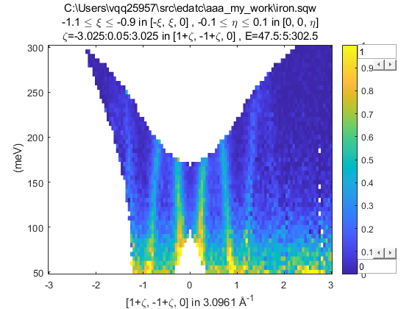
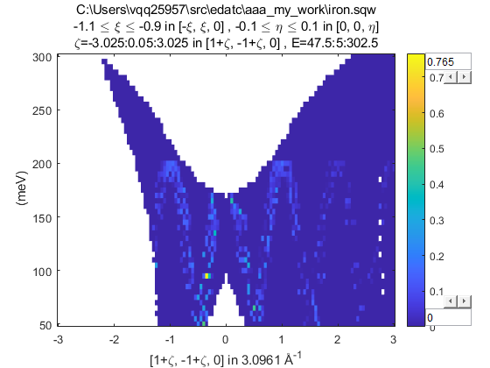
S(Q,E) model fit
Now try to fit the S(Q,E) model to a 2D dataset
>> w2 = cut_sqw('iron.sqw', projaxes([1,1,0], [-1,1,0], 'type', 'rrr'), [-3,0.05,3], [-1.1,-0.9], [-0.1, 0.1], [50,5,300])
>> ff_fun = MagneticIons('Fe0').getFF_calculator(w2);
>> wf2 = multifit_sqw(w2, @my_disp_ff, {[200, 0.4, 0.1] ff_fun});
>> plot(w2); keep_figure; plot(wf2)

Slide 41
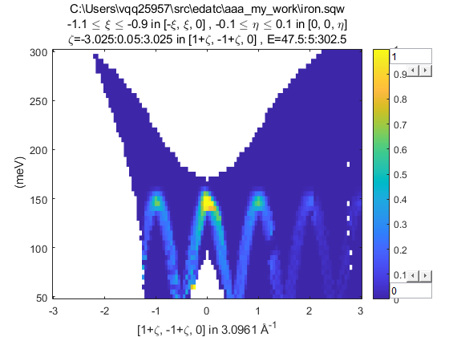
S(Q,E) model fit
What about evaluating the 1D fit parameters of the S(Q,E) model in 2D?
>> w1 = cut_sqw('iron.sqw', projaxes([1,1,0], [-1,1,0], 'type', 'rrr'), 0.05, [-1.1,-0.9], [-0.1, 0.1], [100,120])
>> w2 = cut_sqw('iron.sqw', projaxes([1,1,0], [-1,1,0], 'type', 'rrr'), [-3,0.05,3], [-1.1,-0.9], [-0.1, 0.1], [50,5,300])
>> ff_fun = MagneticIons('Fe0').getFF_calculator(w2);
>> [wf, fp] = multifit_sqw(w1, @my_disp_ff, {[200, 0.4, 0.1] ff_fun})
>> wf2 = sqw_eval(w2, @my_disp_ff, {fp.p ff_fun});
>> plot(w2); keep_figure; plot(wf2)
Dispersion model is incorrect!

Slide 42
S(Q,E) model fit
Now try to fit the S(Q,E) model to an array of 1D dataset
>> proj = projaxes([1,1,0], [-1,1,0], 'type', 'rrr');
>> en=80:20:160; for i = 1:numel(en); wc(i) = cut_sqw('iron.sqw', proj, 0.05, [-1.1,-0.9], [-0.1, 0.1], [-10 10]+en(i)); end
>> ff_fun = MagneticIons('Fe0').getFF_calculator(wc(1));
>> [wf, fp] = multifit_sqw(wc, @my_disp_ff, {[200, 0.4, 0.1] ff_fun}, @linear_bg, [0.1, 0])
>> for i = 1:numel(en); plot(wc(i)); pl(wf(i)); ly(0,1); keep_figure; end

Slide 43
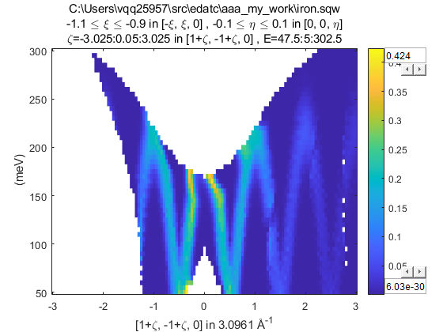
S(Q,E) model fit
Evaluating the 1D fitted parameters on the 2D plot?
>> proj = projaxes([1,1,0], [-1,1,0], 'type', 'rrr');
>> en=80:20:160; for i = 1:numel(en); wc(i) = cut_sqw('iron.sqw', proj, 0.05, [-1.1,-0.9], [-0.1, 0.1], [-10 10]+en(i)); end
>> ff_fun = MagneticIons('Fe0').getFF_calculator(wc(1));
>> [wf, fp] = multifit_sqw(wc, @my_disp_ff, {[200, 0.4, 0.1] ff_fun}, @linear_bg, [0.1, 0])
>> wf2 = sqw_eval(w2, @my_disp_ff, {fp.p ff_fun});
>> plot(w2); keep_figure; plot(wf2)

Slide 44
Fitting summary
Use multifit for functions which needs the plot axes (defined by the projection) – e.g. peak or linear functions
These functions are dimension specific (e.g. need different functions for 1D, 2D, 3D datasets)
User multifit_sqw for functions which needs the (h,k,l,en) coordinates – e.g. dispersion models
Can fit multiple cuts simultaneously
Can fit (sum of) two model functions (“foreground” and “background”) together.
By default, foreground functions have “global” parameters (same for all cuts), and background functions have “local” parameters (different for each cut)

Slide 45
Questions so far?

Slide 46

Resolution Convolution
The measured intensity at the detector is:
has contributions from:
Moderator time width
View aperture size / guide divergence
Chopper opening time width
Sample size
Detector size / detector width (time)
Often the resolution function is approximated as Gaussian
The asymmetry of the moderator pulse means this is not valid for ToF spectrometers
But Horace can still calculate a 4D Gaussian for you if you want…
In Horace, the convolution (integration) is computed numerically using the Monte Carlo method.
most
important
(for ToF direct
spectrometers)
least

Slide 47
Resolution Convolution Details
The contributions to the resolution function can be expressed in 11 variables:
t_{m} – time deviation at the moderator
y_{a}, z_{a} (or γ_{y}, γ_{z}) – the coordinates of the neutron at the aperture (or neutron guide divergences)
TobyFit was designed when neutron guides did not exist. Guide divergence broadening is approximated by a large aperture (beam-port window)
t_{ch} – time deviation at the chopper
x_{s}, y_{s}, z_{s} – neutron coordinate at the sample
x_{d}, y_{d}, z_{d}, t_{d} – neutron coordinate at the detector
These 11 deviations from the ideal case (bin centre or pixel coordinate) are sampled randomly producing a vector Y
The distributions from which Y is sampled depends on the sample and instrument
There is a linear transformation which maps Y to the sample frame coordinates (Q,E)
(δQ, δE) = T B Y
where the T and B matrices are given in Toby’s thesis, Appendix A (eq. A.66 and Table A1 respectively)
The (Q+δQ, E+δE) vector is then passed to the sqw model function.
T. G. Perring, High Energy Magnetic Excitations in Hexagonal Cobalt, Ph.D. Thesis, University of Cambridge, 1991
RAL Technical Report RALT-028-94

Slide 48

Resolution Convolution
So:
Is transformed into:
where (Q₀,E₀) is the coordinate of each pixel – that is I(Q₀,E₀) is the calculated intensity of each pixel
By default N=10 (mc_points) is used because there are a lot of pixels and they overlap significantly.
But this means that it takes 10x longer for the resolution calculation than without…

Slide 49
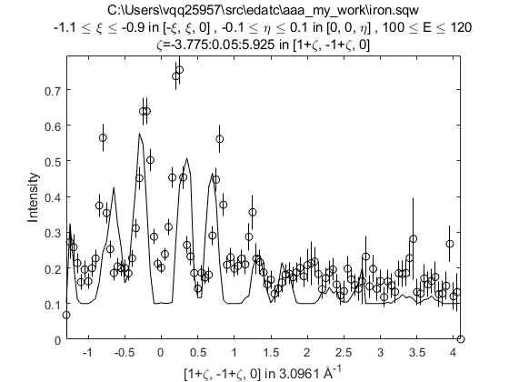
Resolution Convolution
Use the tobyfit class to calculate or fit with resolution convolution
First need to define a sample (IX_sample) and instrument on the workspace to be fitted or simulated.
>> w1 = cut_sqw('iron.sqw', projaxes([1,1,0], [-1,1,0], 'type', 'rrr'), 0.05, [-1.1,-0.9], [-0.1, 0.1], [100,120]);
>> xdir = [1,0,0]; ydir = [0,1,0]; ei = 401; freq = 600; chop_type = 's';
>> w1 = set_sample(w1, IX_sample(xdir, ydir, 'cuboid', [0.03,0.03,0.03]));
>> w1 = set_instrument(w1, maps_instrument(ei, freq, chop_type));
>> ff_fun = MagneticIons('Fe0').getFF_calculator(w1);
>> tf = tobyfit(w1);
>> tf = tf.set_fun(@fe_sqw_ff);
>> tf = tf.set_pin({[200 200 0.1] ff_fun});
>> tf = tf.set_bfun(@linear_bg);
>> tf = tf.set_bpin([0.1 0]);
>> wsim = tf.simulate()
>> plot(w1); pl(wsim)
Need to use object oriented interface
but otherwise exact same syntax as for
multifit

Slide 50
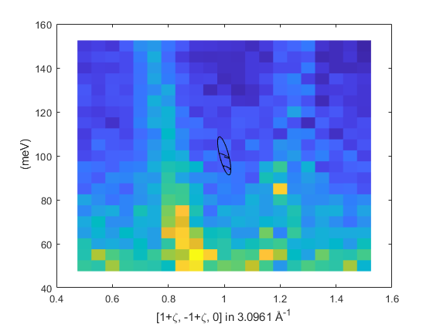
Resolution Convolution
Finally, can use the resolution_plot function to plot a resolution ellipsoid on a 2D cut (only 2D cuts).
>> w1 = cut_sqw('iron.sqw', projaxes([1,1,0], [-1,1,0], 'type', 'rrr'), [0.5,0.05,1.5], [-1.1,-0.9], [-0.1, 0.1], [50,5,150]);
>> xdir = [1,0,0]; ydir = [0,1,0]; ei = 401; freq = 600; chop_type = 's';
>> w1 = set_sample(w1, IX_sample(xdir, ydir, 'cuboid', [0.03,0.03,0.03]));
>> w1 = set_instrument(w1, maps_instrument(ei, freq, chop_type));
>> cov = resolution_plot(w1)
cov is the covariance matrix
This uses the Gaussian approximation

