Slide 1
Linear Spin Wave Calculations with SpinW part II
Notes:
1

Slide 2
Overview
Spin-spin correlation tensor
Polarised neutron intensities
Twinned crystals

Slide 3
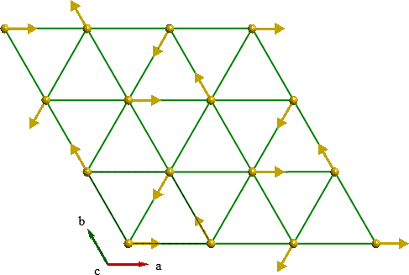
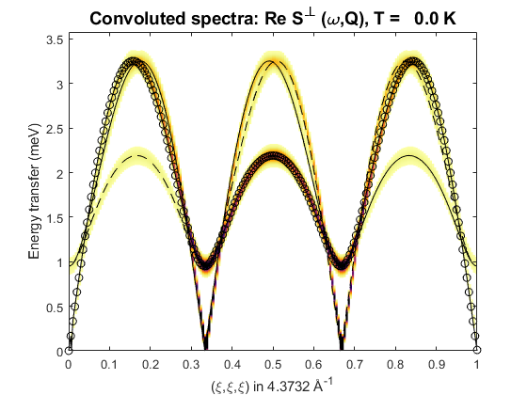
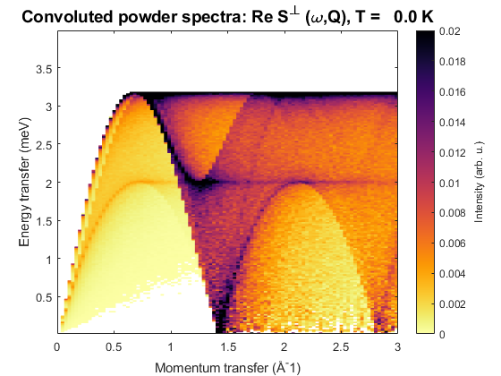
Recap
tri = spinw;
tri.genlattice('lat_const', [4 4 6], 'angled', [90 90 120]);
tri.addatom('r', [0 0 0], 'S', 2, 'label', 'MCr3', 'color', 'gold');
tri.genmagstr('mode', 'helical', 'S', [1; 0; 0], ...
'n', [0 0 1], 'k', [1/3 1/3 0])
tri.addmatrix('label', 'J', 'value', 1)
tri.gencoupling();
tri.addcoupling('mat', 'J', 'bond', 1);
spec = tri.spinwave({[0,0,0], [1,1,1], [1,0,0] 200});
spec = sw_egrid(spec);
sw_plotspec(spec, 'dE', 0.1)
modQ = linspace(0,3,100);
spec = tri.powspec(modQ, 'nRand', 10000, 'Evect', linspace(0,4,200));
figure; sw_plotspec(spec)

Slide 4
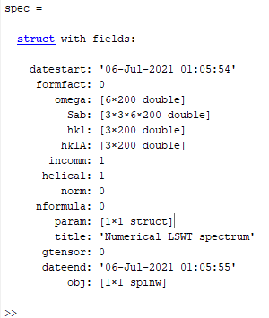
Spin-spin correlation function
spinwave returns a spectrum struct
Initially only has Sab – a 3x3xMxN array, M=# modes, N=# Q-pts.
Use sw_neutron to calculate interesting cross-sections.
sw_egrid internally calls sw_neutron to calculate Sperp – the component of S perpendicular to Q which is measured in unpolarised neutron scattering.

Slide 5
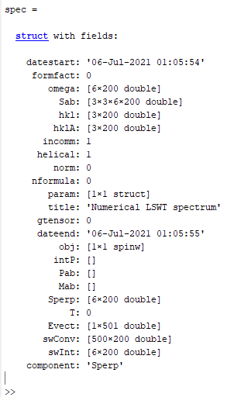
Spin-spin correlation function
spinwave returns a spectrum struct
Initially only has Sab – a 3x3xMxN array, M=# modes, N=# Q-pts.
Use sw_neutron to calculate interesting cross-sections.
sw_egrid internally calls sw_neutron to calculate Sperp – the component of S perpendicular to Q which is measured in unpolarised neutron scattering.
But can use either sw_egrid or sw_neutron with the 'component' option to calculate other quantities.

Slide 6
Spin-spin correlation function
Can calculate and plot:
Individual components of S^{αβ} or their sum. E.g.
Polarised neutron cross-sections – first have to run sw_neutron with the 'pol',true option and to define the horizontal scattering plane.
This is because polarised cross-sections use the Blume-Maleyev coordinate system where x||Q, z is vertical and y⊥(x,z).
Can specify the horizontal plane either by a u and v matrix (like Horace) – these are reciprocal lattice vectors. Or, can specify the direction of the plane normal in the SpinW Cartesian coordinate system: x||a, z⊥(a,b) and y⊥(x,z).
sw_plotspec(sw_egrid(spec, 'component', 'Sxx+Syy'), 'dE', 0.1)
spec = sw_neutron(spec, 'pol', true, 'uv', {[1,0,0], [0,1,0]})
sw_plotspec(sw_egrid(spec, 'component', 'Pz'), 'dE', 0.1)
spec = sw_neutron(spec, 'pol', true, 'n', [0,0,1])
sw_plotspec(sw_egrid(spec, 'component', 'Pz'), 'dE', 0.1)

Slide 7
Spin-spin correlation function
Can calculate and plot:
'Pa' – a=x,y,z – half polarized intensity with incident beam polarised along a certain direction
'Pab' – a,b=x,y,z – xyz polarized intensity σ^{αβ} with incident and scattered beam polarized along the specified direction
'Mab' – a,b=x,y,z – magnetisation component along the specified direction.
sw_plotspec(sw_egrid(spec, 'component', 'Pz'), 'dE', 0.1)
sw_plotspec(sw_egrid(spec, 'component', 'Pyy'), 'dE', 0.1)
sw_plotspec(sw_egrid(spec, 'component', 'Myz-Mzy'), 'dE', 0.1)

Slide 8
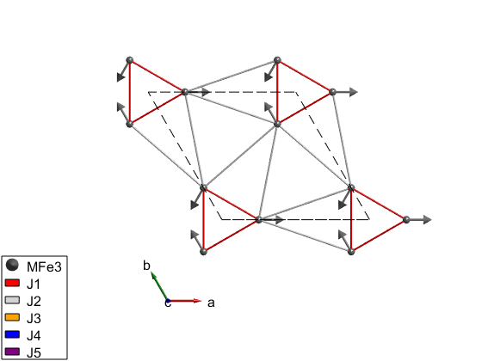
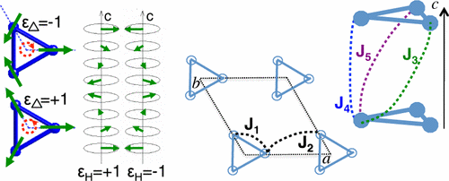
Polarised neutron example
System is iron-langasite Ba₃NbFe₃Si₂O₁₄. (SpinW tutorial 15)
Loire et al., Phys. Rev. Lett., 106 207201 (2011)

Slide 9
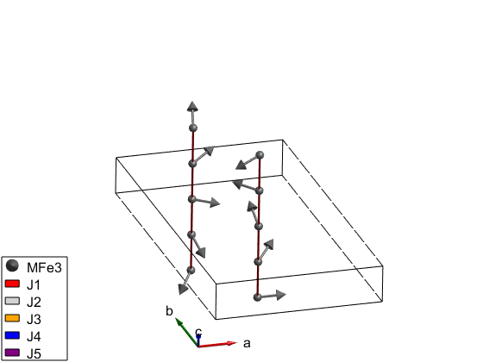
Polarised neutron example
System is iron-langasite Ba₃NbFe₃Si₂O₁₄. (SpinW tutorial 15)
Loire et al., Phys. Rev. Lett., 106 207201 (2011)

Slide 10
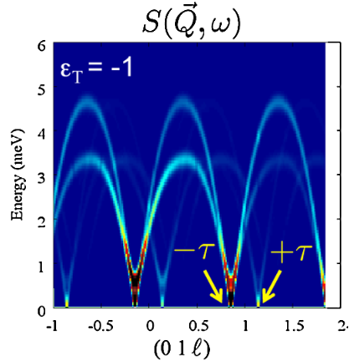
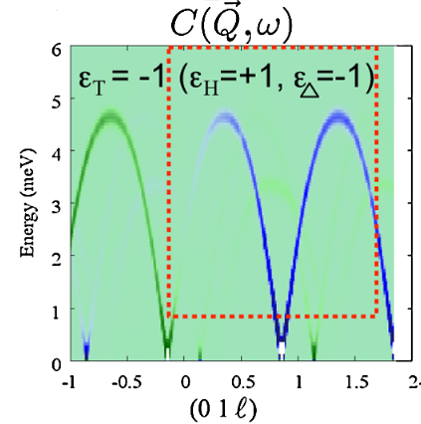
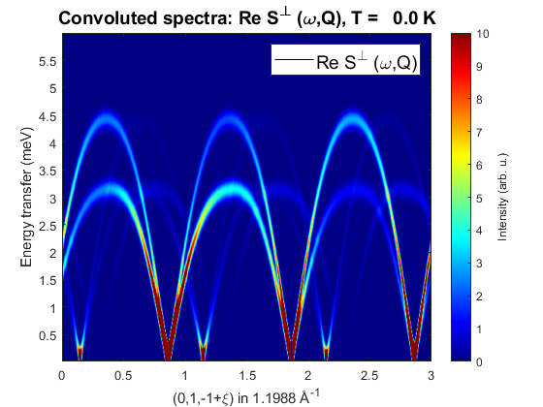
Polarised neutron example
System is iron-langasite Ba₃NbFe₃Si₂O₁₄. (SpinW tutorial 15)
banbSpec = banb.spinwave({[0 1 -1] [0 1 2] 500});
banbSpec = sw_neutron(banbSpec,'pol',true,'uv',{[0 1 0] [0 0 1]});
figure
banbSpec = sw_egrid(banbSpec,'component','Sperp', ...
'Evect',linspace(0,6,500));
sw_plotspec(banbSpec,'mode','color','dE',0.25,'axLim',[0 10]);
colormap(jet)
Loire et al., Phys. Rev. Lett., 106 207201 (2011)

Slide 11
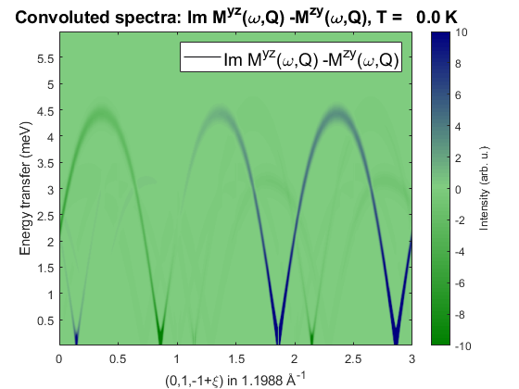
Polarised neutron example
System is iron-langasite Ba₃NbFe₃Si₂O₁₄. (SpinW tutorial 15)
banbSpec = banb.spinwave({[0 1 -1] [0 1 2] 500});
banbSpec = sw_neutron(banbSpec,'pol',true,'uv',{[0 1 0] [0 0 1]});
figure
banbSpec = sw_egrid(banbSpec,'component','-Myz+Mzy', ...
'Evect',linspace(0,6,500));
sw_plotspec(banbSpec,'mode','color','dE',0.25,'axLim',[-10 10],'imag',true);
colormap(makecolormap([0 0.5 0],[0.5 0.8 0.5],[0 0 0.5],81));
Loire et al., Phys. Rev. Lett., 106 207201 (2011)

Slide 12
Questions so far?

Slide 13
Twinned Crystals
Spin-spin correlation tensor
Polarised neutron intensities
Twinned crystals

Slide 14
Twinned Crystals
Twinned crystals can be handled by using addtwin:
Example for a cut integrating over energy, with a model of Pr(Ca,Sr)Mn₂O₇
pcsmo.addtwin('axis', [0 0 1], 'phid', 90)
nQ = 101; Qhv = linspace(-2,2,nQ); Qkv = linspace(-2,2,nQ); Qlv = 0;
nE = 201; Ev = linspace(0,100,nE);
Ecut = [34 36];
[Qh, Qk, Ql] = ndgrid(Qhv,Qkv,Qlv);
spec = pcsmo.spinwave([Qh(:) Qk(:) Ql(:)]', 'sortMode', false, 'hermit', false);
spec = sw_egrid(spec,'component','Sperp','Evect',Ev);
spec = sw_instrument(spec,'dE',5);
spec3D = reshape(spec.swConv,nE-1,nQ,nQ);
Eidx = find(Ev>Ecut(1) & Ev<Ecut(2));
figure;
cut1 = squeeze(sum(spec3D(Eidx,:,:),1))/numel(Eidx)/(Ev(2)-Ev(1));
imagesc(Qhv/2,Qkv/2,cut1);
xlabel('Qh'); ylabel('Qk');

Slide 15
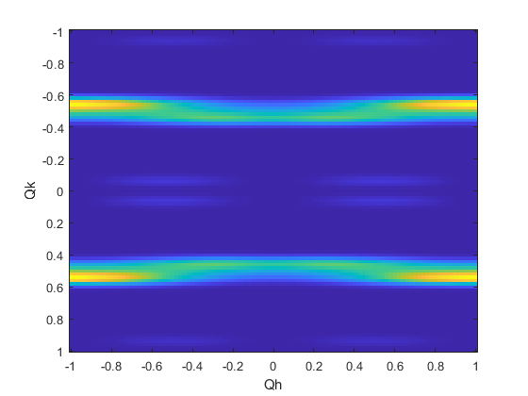
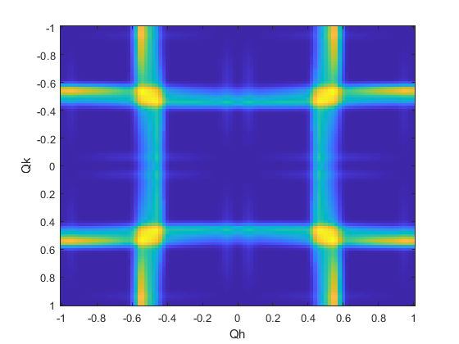
Twinned Crystals
Twinned crystals can be handled by using addtwin:
Example for a cut integrating over energy, with a model of Pr(Ca,Sr)Mn₂O₇
pcsmo.addtwin('axis', [0 0 1], 'phid', 90)
nQ = 101; Qhv = linspace(-2,2,nQ); Qkv = linspace(-2,2,nQ); Qlv = 0;
nE = 201; Ev = linspace(0,100,nE);
Ecut = [34 36];
[Qh, Qk, Ql] = ndgrid(Qhv,Qkv,Qlv);
spec = pcsmo.spinwave([Qh(:) Qk(:) Ql(:)]', 'sortMode', false, 'hermit', false);
spec = sw_egrid(spec,'component','Sperp','Evect',Ev);
spec = sw_instrument(spec,'dE',5);
spec3D = reshape(spec.swConv,nE-1,nQ,nQ);
Eidx = find(Ev>Ecut(1) & Ev<Ecut(2));
figure;
cut1 = squeeze(sum(spec3D(Eidx,:,:),1))/numel(Eidx)/(Ev(2)-Ev(1));
imagesc(Qhv/2,Qkv/2,cut1);
xlabel('Qh'); ylabel('Qk');
Without twin calculation
Twin calculation

Slide 16
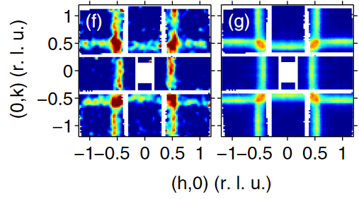
Twinned Crystals
Twinned crystals can be handled by using addtwin:
Example for a cut integrating over energy, with a model of Pr(Ca,Sr)Mn₂O₇
pcsmo.addtwin('axis', [0 0 1], 'phid', 90)
nQ = 101; Qhv = linspace(-2,2,nQ); Qkv = linspace(-2,2,nQ); Qlv = 0;
nE = 201; Ev = linspace(0,100,nE);
Ecut = [34 36];
[Qh, Qk, Ql] = ndgrid(Qhv,Qkv,Qlv);
spec = pcsmo.spinwave([Qh(:) Qk(:) Ql(:)]', 'sortMode', false, 'hermit', false);
spec = sw_egrid(spec,'component','Sperp','Evect',Ev);
spec = sw_instrument(spec,'dE',5);
spec3D = reshape(spec.swConv,nE-1,nQ,nQ);
Eidx = find(Ev>Ecut(1) & Ev<Ecut(2));
figure;
cut1 = squeeze(sum(spec3D(Eidx,:,:),1))/numel(Eidx)/(Ev(2)-Ev(1));
imagesc(Qhv/2,Qkv/2,cut1);
xlabel('Qh'); ylabel('Qk');
Without twin calculation
Twin calculation

Slide 17
Questions so far?

Slide 18
day4_spinw1.ipynb

