Slide 1
Fitting powder INS data with SpinW
Notes:
1

Slide 2
Overview
There’s a new fitting interface for powder data.
Can be used to fit full 2D data or a set of 1D slices.
Still a work in progress but if you have a system and you want to try it out – let us know!

Slide 3
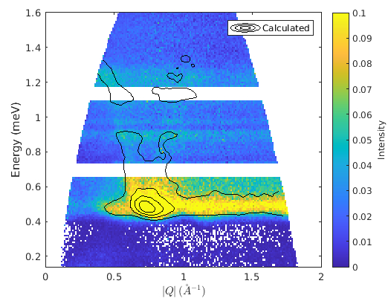
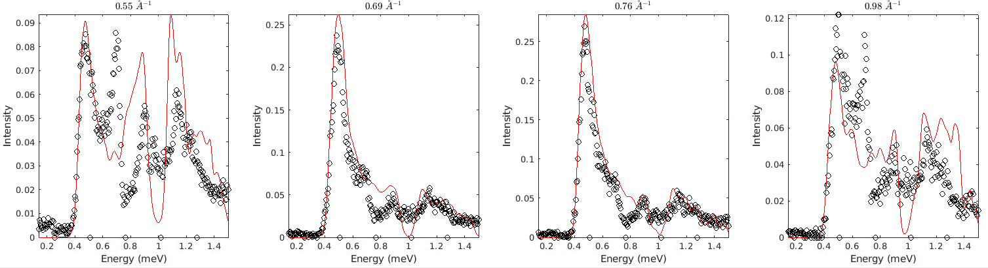
SpinW v4
fitpow = sw_fitpowder(sw_obj, cuts, fit_func, [J1 J2 D], 'independent');
fitpow.set_caching(true);
fitpow.powspec_args.dE = eres;
fitpow.powspec_args.fastmode = false;
fitpow.powspec_args.neutron_output = true;
fitpow.sw_instrument_args = struct('dQ', dQ, 'ThetaMin', 3.5, 'Ei', Ei);
fitpow.estimate_constant_background();
fitpow.estimate_scale_factor();
fitpow.set_model_parameter_bounds(1:3, [-1 0 -0.2], [0 1 0.2]) % Force J1 to be ferromagnetic to agree with structure
% fix slope and set initial const background
fitpow.set_bg_parameter_bounds(2, 0.0, []) % Set lb of constant bg = 0
fitpow.fix_bg_parameters(1); % fix slopes of background to 0
fitpow.cost_function = "Rsq"; % "Rsq" or "chisq"
fitpow.optimizer = @ndbase.simplex; % @ndbase.lm or @ndbase.pso
result = fitpow.fit();
fitpow.plot_results(result);
Above is a complex test system measured on LET with 8 exchange parameters… probably a bit too much to fit.

Slide 4
Questions so far?

Slide 5
SpinW Demonstration
day4_spinw2.ipynb

