Slide 1

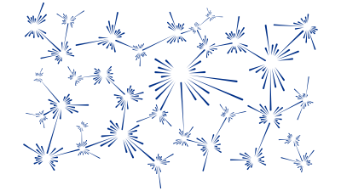
Modelling lattice dynamics with CASTEP and Euphonic
M. D. Le
India-RAL Neutron and Muon Science Meeting
Notes:
The abstract pattern can be removed or repositioned if required. Be careful to ‘Send to Back’ so that it does not obscure any important information.

Slide 2
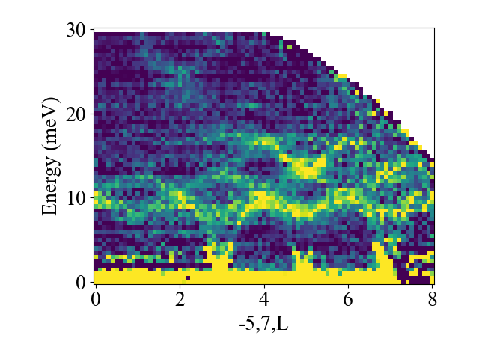
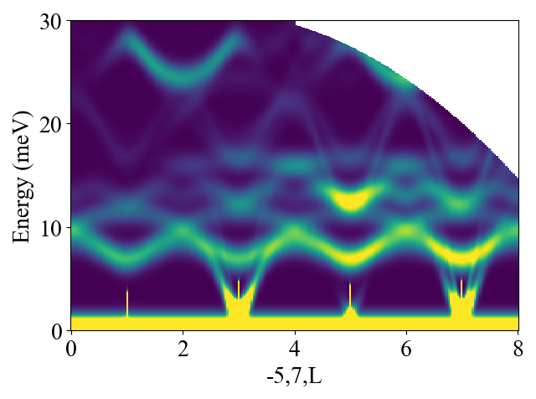
Contents
What and why phonons?
One phonon cross section
Measuring single crystals
Measuring powders
Incoherent approximation

Slide 3
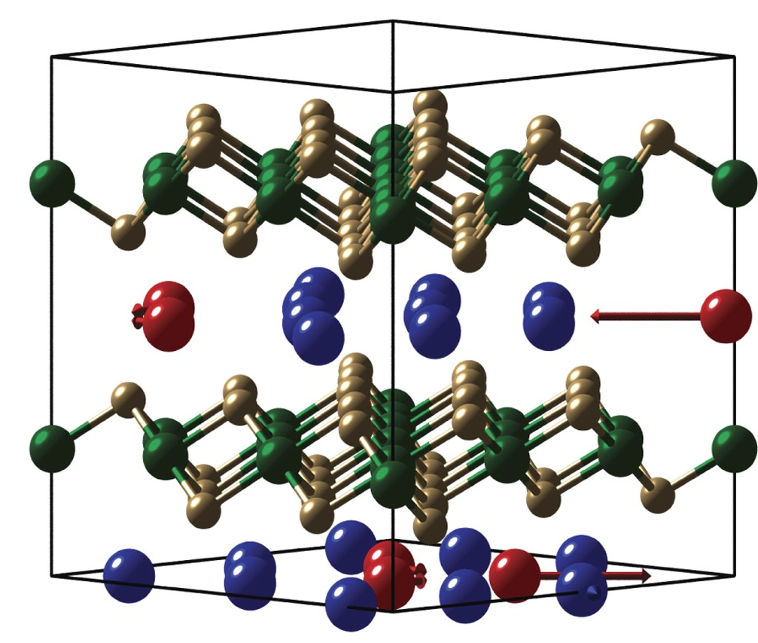
Why Phonons?
Not just background!
Lattice dynamics is important for
Bonding
Heat transfer
Phase transitions
Some superconductors

Slide 4
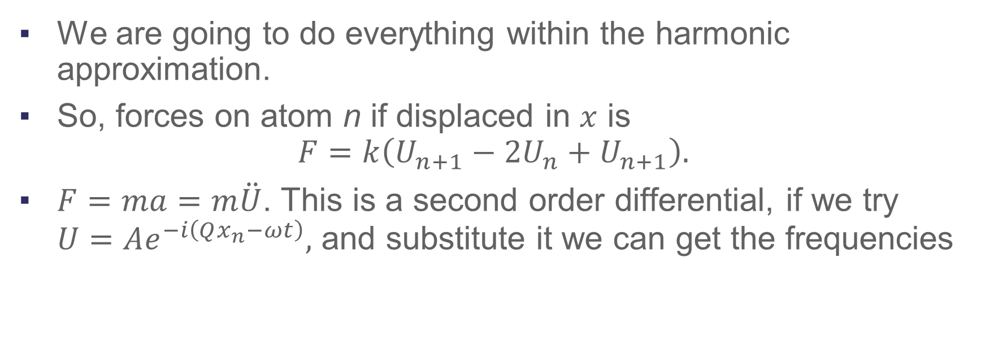
Phonons an overview
We are going to do everything within the harmonic approximation.
So, forces on atom n if displaced in $x$ is
$$F=k\left(U_{n+1}−2U_{n}+U_{n+1}\right).$$
$F=ma=m\ddot{U}$. This is a second order differential, if we try $U=Ae^{−i\left(Qx_{n}−ωt\right)},$ and substitute it we can get the frequencies

Slide 5
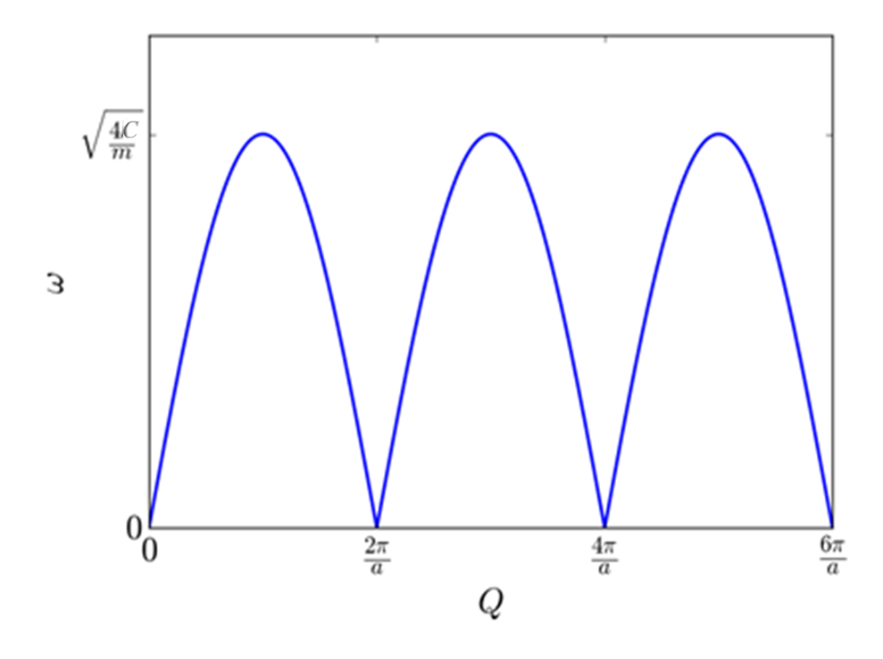
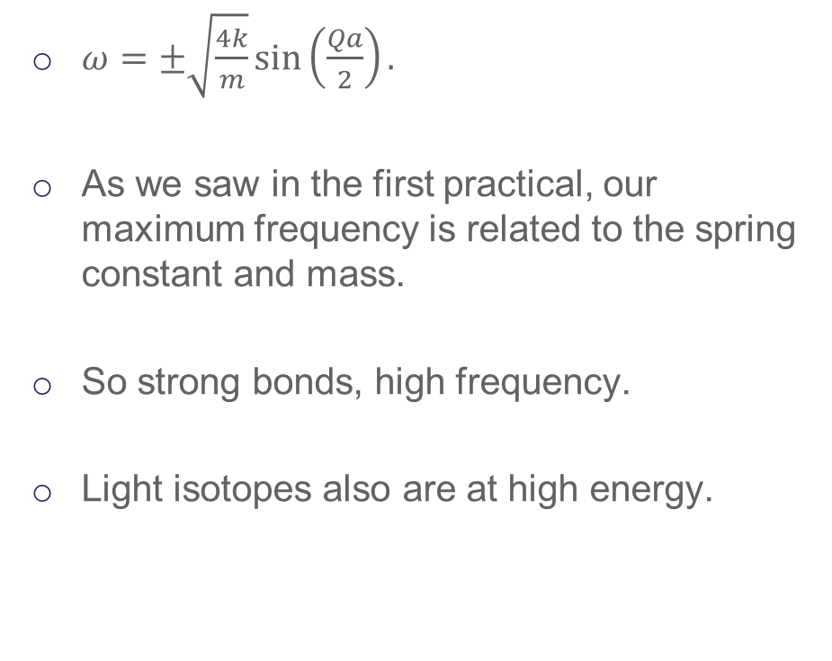
Phonons: an overview
$ω=±\sqrt{\frac{4k}{m}}\sin\left(\frac{Qa}{2}\right).$
As we saw in the first practical, our maximum frequency is related to the spring constant and mass.
So strong bonds, high frequency.
Light isotopes also are at high energy.

Slide 6
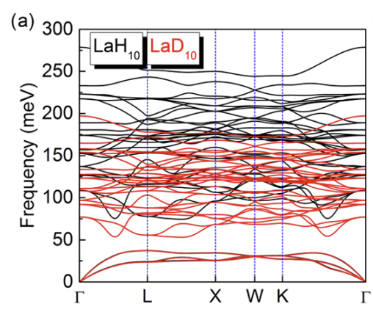
Phonons: an overview
For more atoms per unit, or if we include more spring constants between further neighbour atoms, we get more modes.
This could be calculated relatively accurately with density functional theory (DFT)

Slide 7
Now to neutrons!

Slide 8
One phonon coherent scattering
$$I\left(\overset{⃑}{Q},E\right)=\frac{Nℏ}{2}\sum_{ν}{\frac{1}{ω\left(\overset{⃑}{Q},ν\right)}}{\left|\sum_{j}{\frac{b_{j}}{m_{j}^{1/2}}}\left[\overset{⃑}{Q}∙\overset{⃑}{e_{j}}\left(\overset{⃑}{k},ν\right)\right]e^{i\overset{⃑}{Q}∙\overset{⃑}{R_{j}}}T_{j}\left(\overset{⃑}{Q}\right)\right|}^{2}$$
$×\left(\begin{aligned}\left[n\left(ω\left(\overset{⃑}{Q},ν\right),T\right)+1\right]δ\left(E+ℏω(\overset{⃑}{Q},ν)\right)+ \\ \left[n\left(ω\left(\overset{⃑}{Q},ν\right),T\right)\right]δ\left(E−ℏω(\overset{⃑}{Q},ν)\right)\end{aligned}\right).$

Slide 9
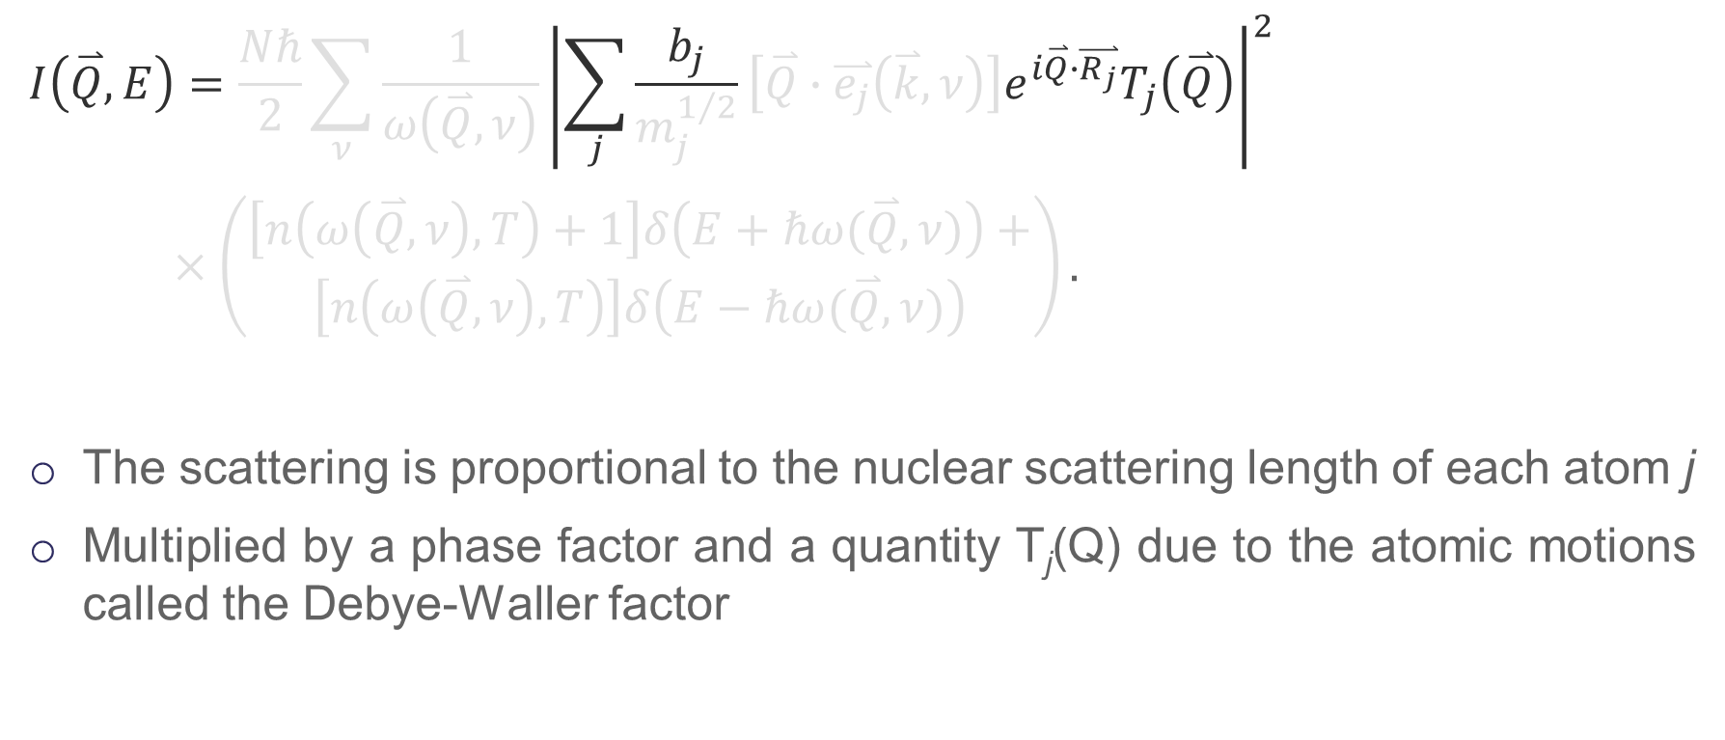
One phonon coherent scattering
$$I\left(\overset{⃑}{Q},E\right)=\frac{Nℏ}{2}\sum_{ν}{\frac{1}{ω\left(\overset{⃑}{Q},ν\right)}}{\left|\sum_{j}{\frac{b_{j}}{m_{j}^{1/2}}}\left[\overset{⃑}{Q}∙\overset{⃑}{e_{j}}\left(\overset{⃑}{k},ν\right)\right]e^{i\overset{⃑}{Q}∙\overset{⃑}{R_{j}}}T_{j}\left(\overset{⃑}{Q}\right)\right|}^{2}$$
$×\left(\begin{aligned}\left[n\left(ω\left(\overset{⃑}{Q},ν\right),T\right)+1\right]δ\left(E+ℏω(\overset{⃑}{Q},ν)\right)+ \\ \left[n\left(ω\left(\overset{⃑}{Q},ν\right),T\right)\right]δ\left(E−ℏω(\overset{⃑}{Q},ν)\right)\end{aligned}\right).$
The scattering is proportional to the nuclear scattering length of each atom j
Multiplied by a phase factor and a quantity T_{j}(Q) due to the atomic motions called the Debye-Waller factor

Slide 10
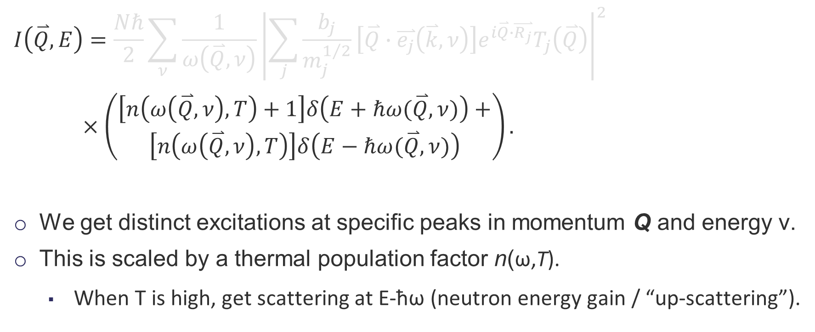
One phonon coherent scattering
$$I\left(\overset{⃑}{Q},E\right)=\frac{Nℏ}{2}\sum_{ν}{\frac{1}{ω\left(\overset{⃑}{Q},ν\right)}}{\left|\sum_{j}{\frac{b_{j}}{m_{j}^{1/2}}}\left[\overset{⃑}{Q}∙\overset{⃑}{e_{j}}\left(\overset{⃑}{k},ν\right)\right]e^{i\overset{⃑}{Q}∙\overset{⃑}{R_{j}}}T_{j}\left(\overset{⃑}{Q}\right)\right|}^{2}$$
$×\left(\begin{aligned}\left[n\left(ω\left(\overset{⃑}{Q},ν\right),T\right)+1\right]δ\left(E+ℏω(\overset{⃑}{Q},ν)\right)+ \\ \left[n\left(ω\left(\overset{⃑}{Q},ν\right),T\right)\right]δ\left(E−ℏω(\overset{⃑}{Q},ν)\right)\end{aligned}\right).$
We get distinct excitations at specific peaks in momentum Q and energy ν.
This is scaled by a thermal population factor n(ω,T).
When T is high, get scattering at E-ħω (neutron energy gain / “up-scattering”).

Slide 11

One phonon coherent scattering
$$I\left(\overset{⃑}{Q},E\right)=\frac{Nℏ}{2}\sum_{ν}{\frac{1}{ω\left(\overset{⃑}{Q},ν\right)}}{\left|\sum_{j}{\frac{b_{j}}{m_{j}^{1/2}}}\left[\overset{⃑}{Q}∙\overset{⃑}{e_{j}}\left(\overset{⃑}{k},ν\right)\right]e^{i\overset{⃑}{Q}∙\overset{⃑}{R_{j}}}T_{j}\left(\overset{⃑}{Q}\right)\right|}^{2}$$
$×\left(\begin{aligned}\left[n\left(ω\left(\overset{⃑}{Q},ν\right),T\right)+1\right]δ\left(E+ℏω(\overset{⃑}{Q},ν)\right)+ \\ \left[n\left(ω\left(\overset{⃑}{Q},ν\right),T\right)\right]δ\left(E−ℏω(\overset{⃑}{Q},ν)\right)\end{aligned}\right).$

Slide 12
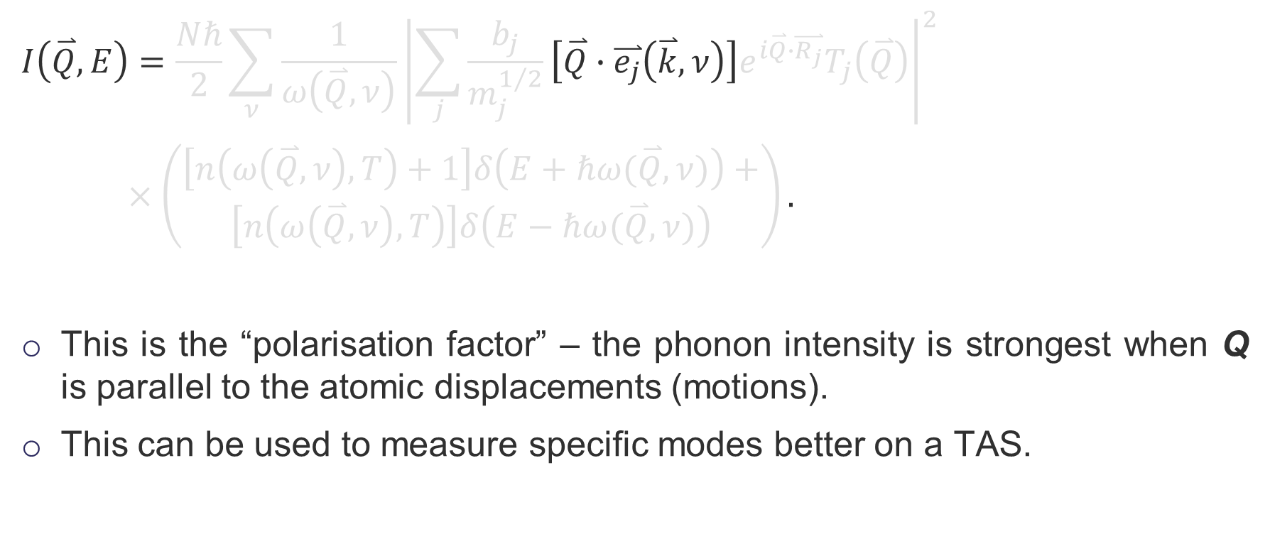
One phonon coherent scattering
$$I\left(\overset{⃑}{Q},E\right)=\frac{Nℏ}{2}\sum_{ν}{\frac{1}{ω\left(\overset{⃑}{Q},ν\right)}}{\left|\sum_{j}{\frac{b_{j}}{m_{j}^{1/2}}}\left[\overset{⃑}{Q}∙\overset{⃑}{e_{j}}\left(\overset{⃑}{k},ν\right)\right]e^{i\overset{⃑}{Q}∙\overset{⃑}{R_{j}}}T_{j}\left(\overset{⃑}{Q}\right)\right|}^{2}$$
$×\left(\begin{aligned}\left[n\left(ω\left(\overset{⃑}{Q},ν\right),T\right)+1\right]δ\left(E+ℏω(\overset{⃑}{Q},ν)\right)+ \\ \left[n\left(ω\left(\overset{⃑}{Q},ν\right),T\right)\right]δ\left(E−ℏω(\overset{⃑}{Q},ν)\right)\end{aligned}\right).$
This is the “polarisation factor” – the phonon intensity is strongest when Q is parallel to the atomic displacements (motions).
This can be used to measure specific modes better on a TAS.

Slide 13
One phonon scattering-key points
Phonons are strongest when $\overset{⃑}{Q}$ is parallel to direction of atomic motion.
Phonon intensity goes up with $Q^{2}$.
Phonons are weaker at high energy.
Strong Bragg reflections often have strong phonons around them.
Phonons can be stronger at high temperature (but care needed here).

Slide 14
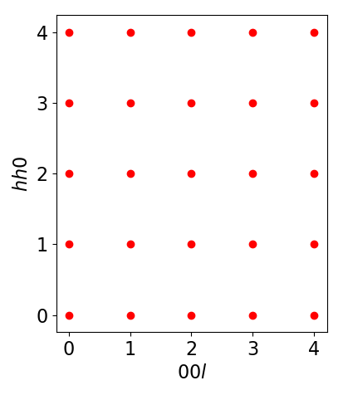
Measuring a longitudinal acoustic phonon
We want to measure a longitudinal phonon along 00L.
Which peak would be best to measure around?

Slide 15
Measuring a longitudinal acoustic phonon
We want to measure a longitudinal phonon along 00L.
Which peak would be best to measure around?
$$\overset{⃑}{Q}$$

Slide 16
Measuring a transverse acoustic phonon
What about a transverse phonon along 00l?

Slide 17
Measuring a transverse acoustic phonon
What about a transverse phonon along 00l?
$$\overset{⃑}{Q}$$

Slide 18
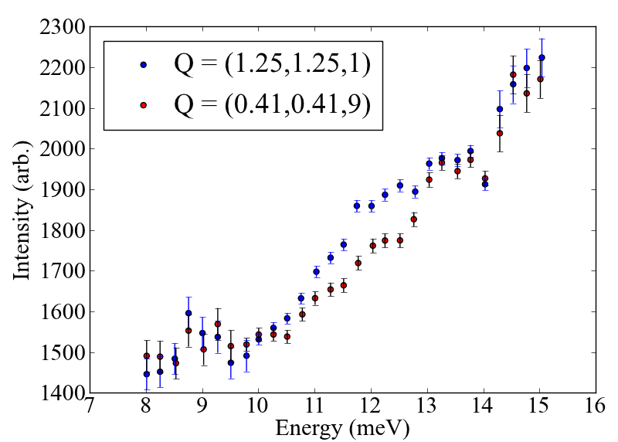
Exploiting $Q∙e$, an example
We were looking for a phonon around 12 meV.
However, the background from the cryostat/mount was huge.
Rotate sample 90°. Suppresses, phonon but background unchanged

Slide 19
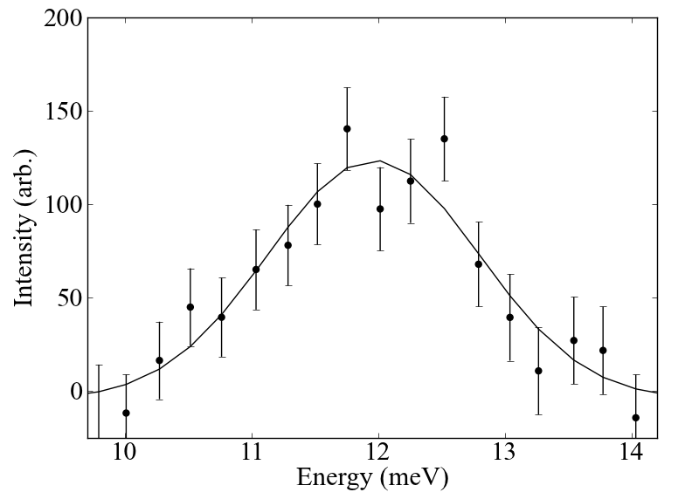
Exploiting $Q∙e$, an example
We were looking for a phonon around 12 meV.
However, the background from the cryostat/mount was huge.
Rotate sample 90°. Suppresses, phonon but background unchanged

Slide 20
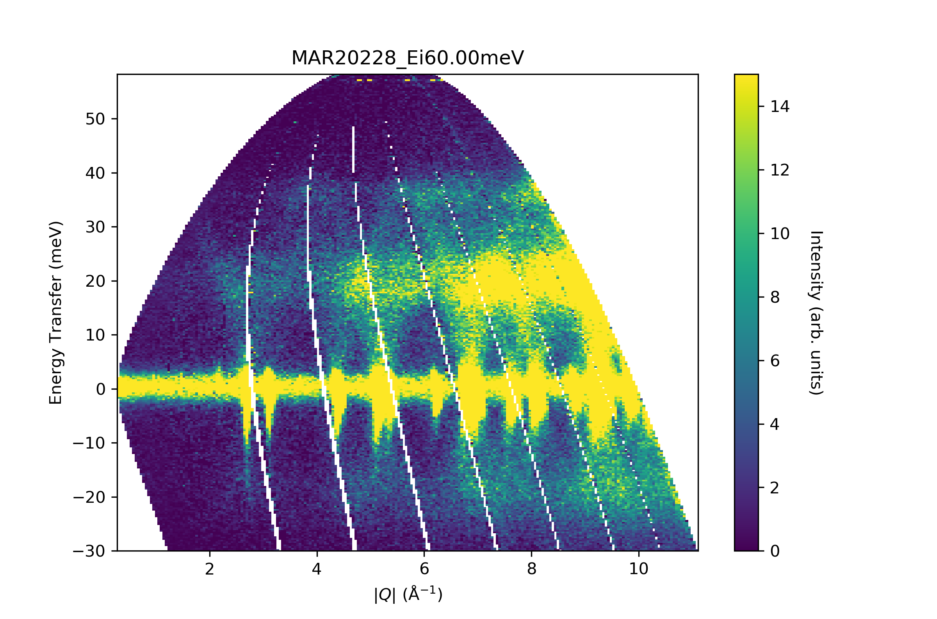
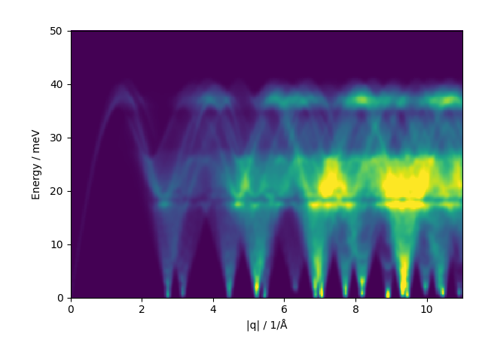
Powders!
Good news, powder experiments are simpler!
Much simpler.
With them we can extract the neutron weighted phonon density of states.
But, going beyond that is hard.

Slide 21

Powders, what are we doing?
We are averaging over a sphere at some $\left|Q\right|$.
So, for small values of $\left|Q\right|$ we are covering just a few (or even 1) Brillouin zones.

Slide 22
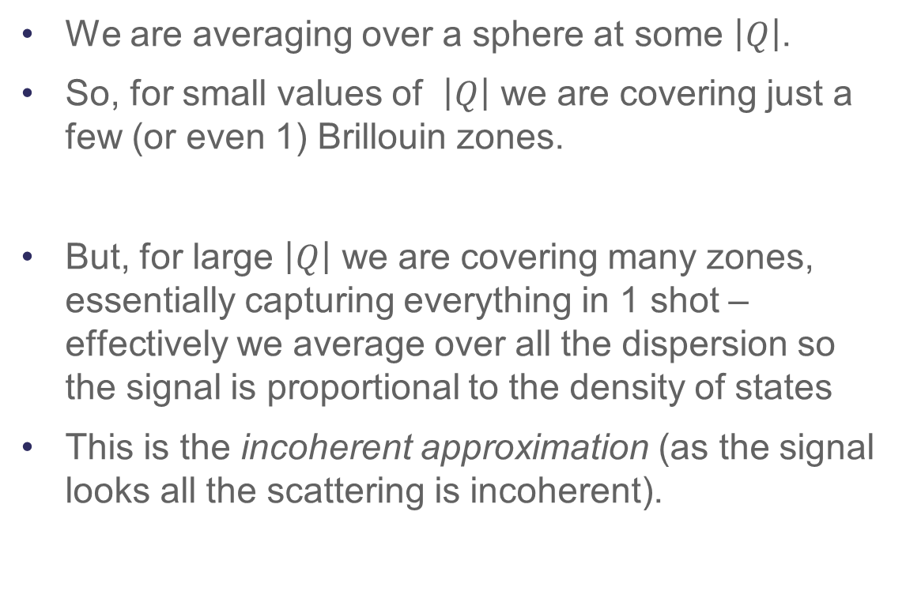
Powders, what are we doing?
We are averaging over a sphere at some $\left|Q\right|$.
So, for small values of $\left|Q\right|$ we are covering just a few (or even 1) Brillouin zones.
But, for large $\left|Q\right|$ we are covering many zones, essentially capturing everything in 1 shot – effectively we average over all the dispersion so the signal is proportional to the density of states
This is the incoherent approximation (as the signal looks all the scattering is incoherent).

Slide 23
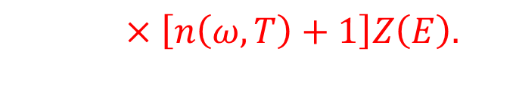
Powders, what are we doing
$$I\left(\overset{⃑}{Q},E\right)=\frac{Nℏ}{2}\sum_{ν}{\frac{1}{ω\left(\overset{⃑}{Q},ν\right)}}{\left|\sum_{j}{\frac{b_{j}}{m_{j}^{1/2}}}\left[\overset{⃑}{Q}∙\overset{⃑}{e_{j}}\left(\overset{⃑}{k},ν\right)\right]e^{i\overset{⃑}{Q}∙\overset{⃑}{R_{j}}}T_{j}\left(\overset{⃑}{Q}\right)\right|}^{2}$$
$×\left(\begin{aligned}\left[n\left(ω\left(\overset{⃑}{Q},ν\right),T\right)+1\right]δ\left(E+ℏω(\overset{⃑}{Q},ν)\right)+ \\ \left[n\left(ω\left(\overset{⃑}{Q},ν\right),T\right)\right]δ\left(E−ℏω(\overset{⃑}{Q},ν)\right)\end{aligned}\right).$
$×\left[n\left(ω,T\right)+1\right]Z\left(E\right).$

Slide 24
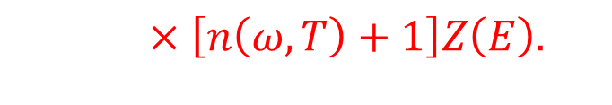
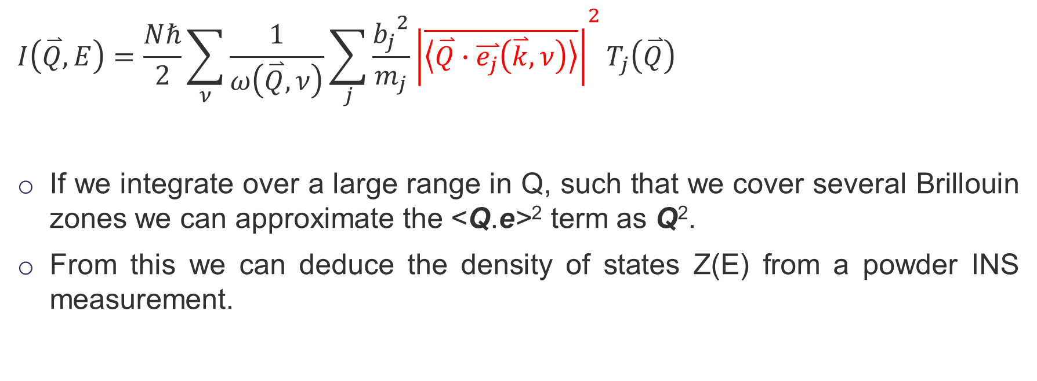
Powders, what are we doing
$$I\left(\overset{⃑}{Q},E\right)=\frac{Nℏ}{2}\sum_{ν}{\frac{1}{ω\left(\overset{⃑}{Q},ν\right)}}{\sum_{j}{\frac{{b_{j}}^{2}}{m_{j}}}\left|\overline{\left\langle \overset{⃑}{Q}∙\overset{⃑}{e_{j}}\left(\overset{⃑}{k},ν\right)\right\rangle }\right|}^{2}T_{j}\left(\overset{⃑}{Q}\right)$$
If we integrate over a large range in Q, such that we cover several Brillouin zones we can approximate the <Q.e>² term as Q².
From this we can deduce the density of states Z(E) from a powder INS measurement.
$×\left[n\left(ω,T\right)+1\right]Z\left(E\right).$

Slide 25
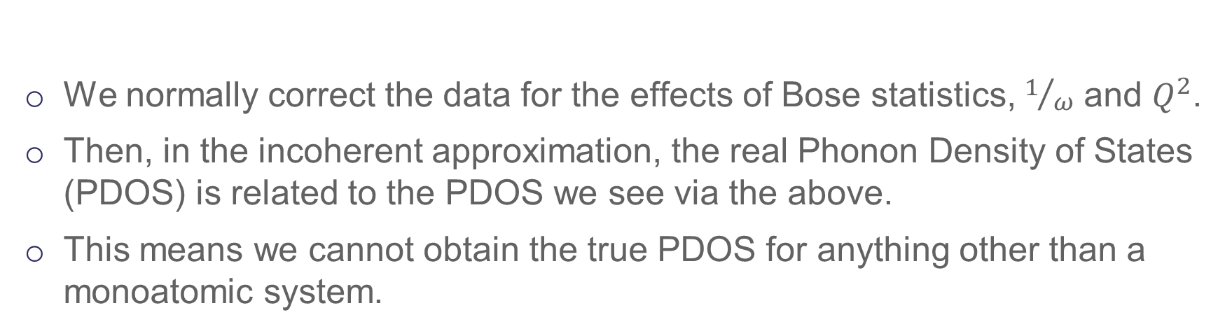
The neutron weighted phonon density of states
$${PDOS}_{neut}\left(E\right)=A\sum_{j}{\left(\frac{b_{j}^{2}}{m_{j}}\right)}{PDOS}_{j}\left(E\right),$$
We normally correct the data for the effects of Bose statistics, $1/ω$ and $Q^{2}$.
Then, in the incoherent approximation, the real Phonon Density of States (PDOS) is related to the PDOS we see via the above.
This means we cannot obtain the true PDOS for anything other than a monoatomic system.

Slide 26
Beyond the harmonic approximation
This is where all the interesting stuff happens
But, it gets tricky fast.
Phonon-phonon scattering (broadening)
Multiphonon signals (signal above the top of the dispersion)

Slide 27
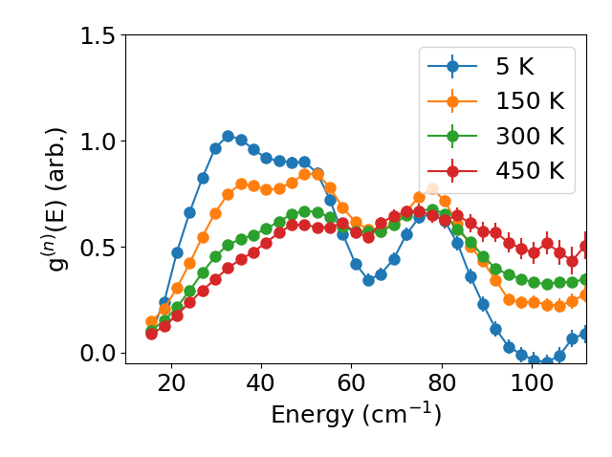
Beyond the harmonic approximation

Slide 28
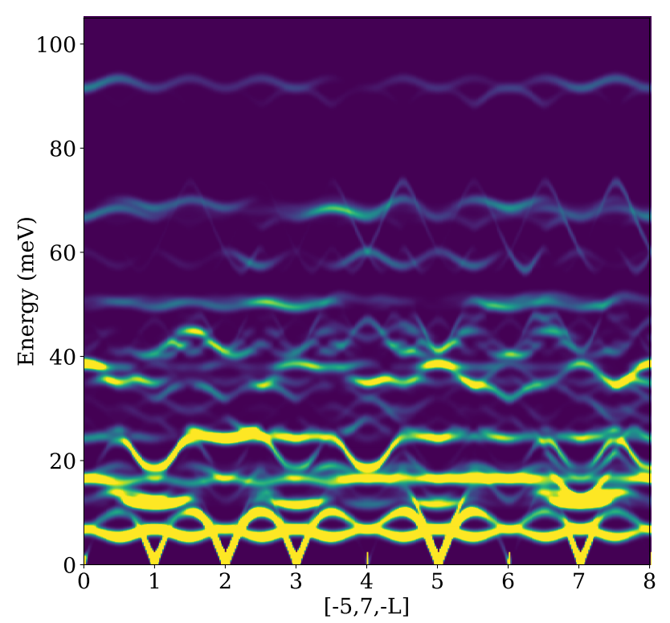
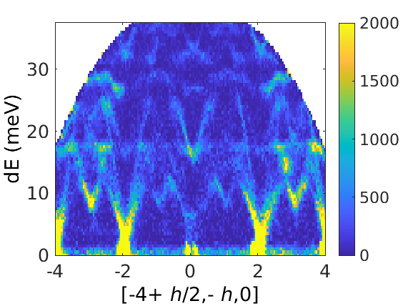
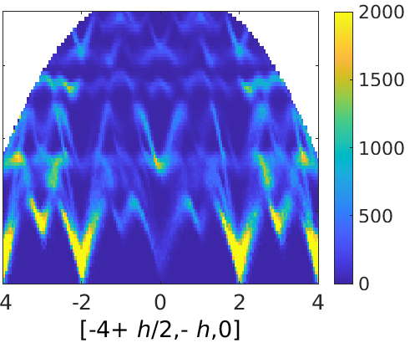
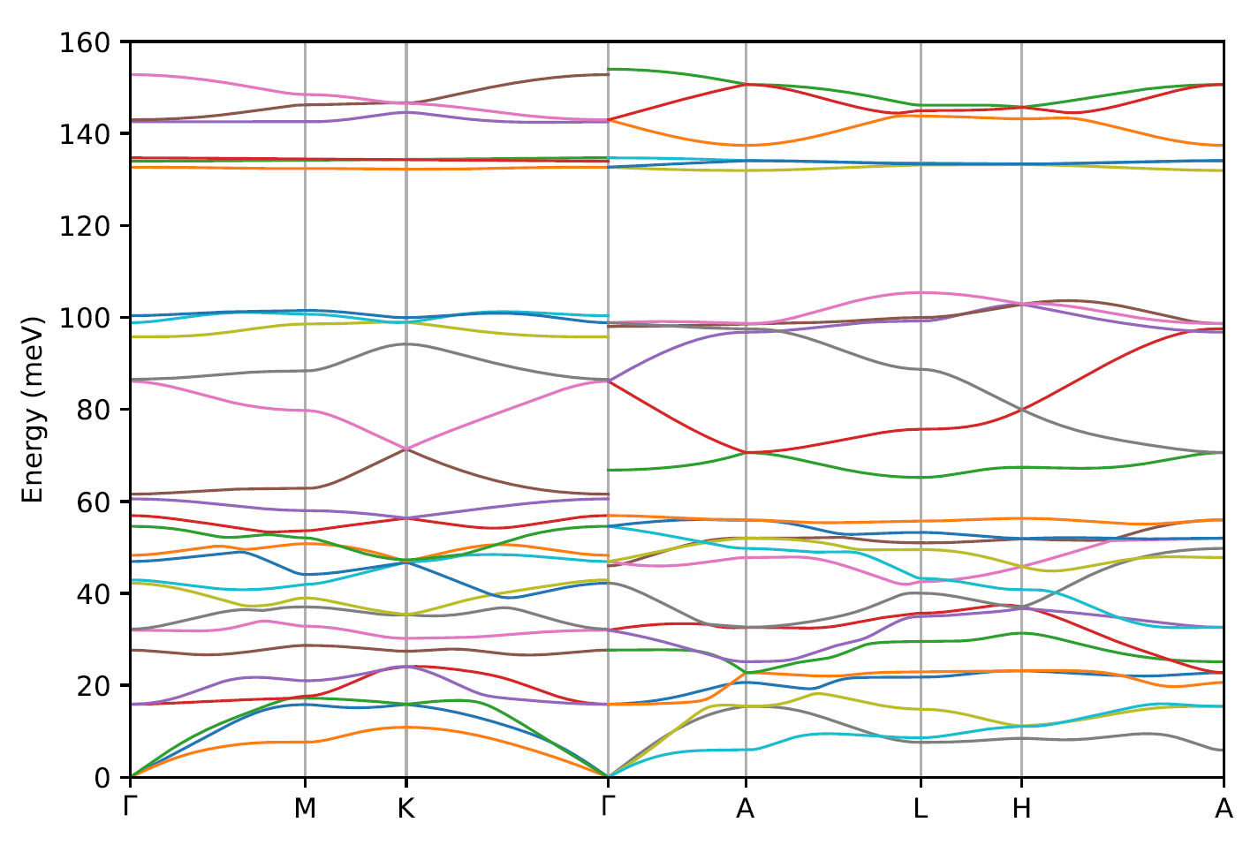
What is Euphonic?
Euphonic is a Python package that can calculate inelastic neutron scattering intensities from force constants
Horace simulation functions are provided via the Horace-Euphonic-Interface MATLAB Add-on
Aims to be efficient - a C extension is used for the most computationally expensive parts
Why simulate phonons?
Atomic vibrations can be easily related to experimental intensities
This provides a good test of theory
Notes:
Replace this guidance text with your own bullet pointed content.
For further guidance please see https://www.bdadyslexia.org.uk/advice/employers/creating-a-dyslexia-friendly-workplace/dyslexia-friendly-style-guide

Slide 29

Force Constants
Recap: For a 1D atomic chain we have the harmonic forces:
$$F=k\left(U_{n−1}−2U_{n}+U_{n+1}\right)=\frac{∂E^{harm}}{∂U_{n}}$$

Slide 30
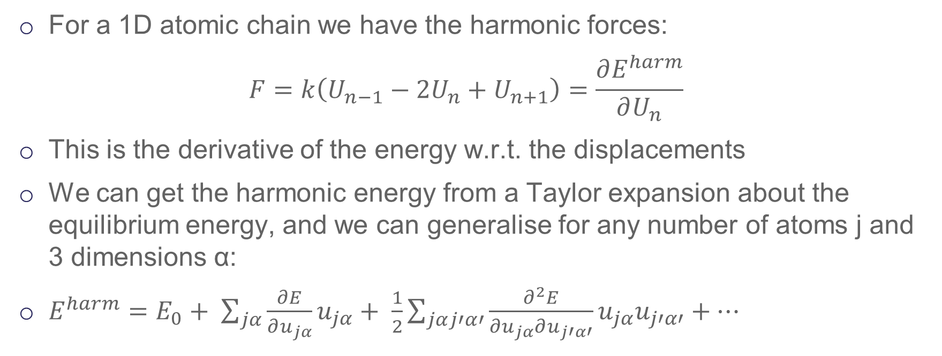
Force Constants
For a 1D atomic chain we have the harmonic forces:
$$F=k\left(U_{n−1}−2U_{n}+U_{n+1}\right)=\frac{∂E^{harm}}{∂U_{n}}$$
This is the derivative of the energy w.r.t. the displacements
We can get the harmonic energy from a Taylor expansion about the equilibrium energy, and we can generalise for any number of atoms j and 3 dimensions α:
$E^{harm}=E_{0}+ \sum_{jα}{\frac{∂E}{∂u_{jα}}u_{jα}}+ \frac{1}{2}\sum_{jαj′α′}{\frac{∂^{2}E}{∂u_{jα}∂u_{j′α′}}u_{jα}u_{j′α′}}+⋯$

Slide 31
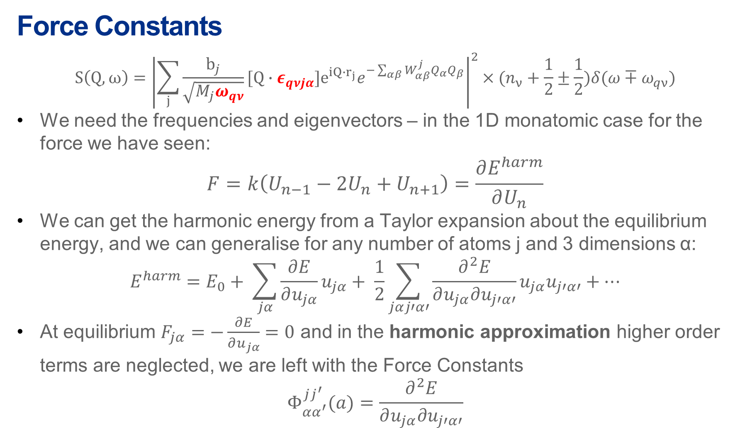
Force Constants
$$S\left(Q,ω\right)={\left|\sum_{j}{\frac{b_{j}}{\sqrt{M_{j}ω_{qν}}}[Q∙ε_{qνjα}]e^{iQ∙r_{j}}e^{−\sum_{αβ}{W_{αβ}^{j}Q_{α}Q_{β}}}}\right|}^{2}×(n_{ν}+\frac{1}{2}±\frac{1}{2})δ(ω∓ω_{qν})$$
We need the frequencies and eigenvectors – in the 1D monatomic case for the force we have seen:
$$F=k\left(U_{n−1}−2U_{n}+U_{n+1}\right)=\frac{∂E^{harm}}{∂U_{n}}$$
We can get the harmonic energy from a Taylor expansion about the equilibrium energy, and we can generalise for any number of atoms j and 3 dimensions α:
$$E^{harm}=E_{0}+ \sum_{jα}{\frac{∂E}{∂u_{jα}}u_{jα}}+ \frac{1}{2}\sum_{jαj′α′}{\frac{∂^{2}E}{∂u_{jα}∂u_{j′α′}}u_{jα}u_{j′α′}}+⋯$$
At equilibrium $F_{jα}=−\frac{∂E}{∂u_{jα}}=0$ and in the harmonic approximation higher order terms are neglected, we are left with the Force Constants
$$Φ_{αα^{′}}^{jj^{′}}(a)=\frac{∂^{2}E}{∂u_{jα}∂u_{j′α′}}$$

Slide 32
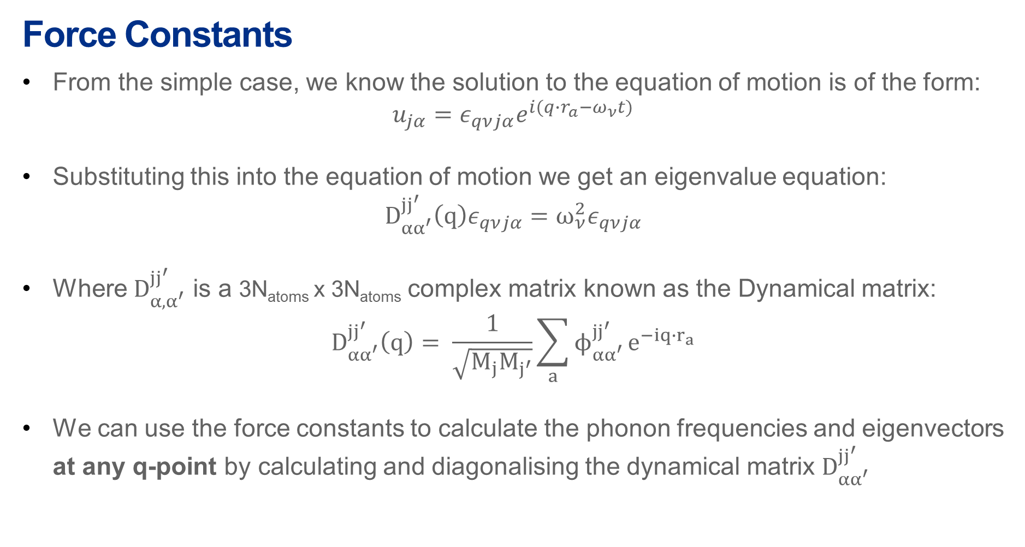
Force Constants
From the simple case, we know the solution to the equation of motion is of the form:
$$u_{jα}=ε_{qνjα}e^{i(q∙r_{a}−ω_{ν}t)}$$
Substituting this into the equation of motion we get an eigenvalue equation:
$$D_{αα^{′}}^{jj^{′} }\left(q\right)ε_{qνjα}=ω_{ν}^{2}ε_{qνjα}$$
Where $D_{α, α^{′}}^{jj^{′} }$ is a 3N_{atoms} x 3N_{atoms} complex matrix known as the Dynamical matrix:
$$D_{αα^{′}}^{jj^{′} }\left(q\right)= \frac{1}{\sqrt{M_{j}M_{j^{′}}}}\sum_{a}{ϕ_{αα^{′}}^{jj^{′} }}e^{−iq{∙r}_{a}}$$
We can use the force constants to calculate the phonon frequencies and eigenvectors at any q-point by calculating and diagonalising the dynamical matrix $D_{αα^{′}}^{jj^{′} }$
This is known as Fourier interpolation
M. T. Dove, Introduction to Lattice Dynamics, Cambridge University Press, Cambridge, 1993, 83-87
M. T. Dove, Structure and Dynamics, Oxford University Press, Oxford, 2003, Chapter 8

Slide 33

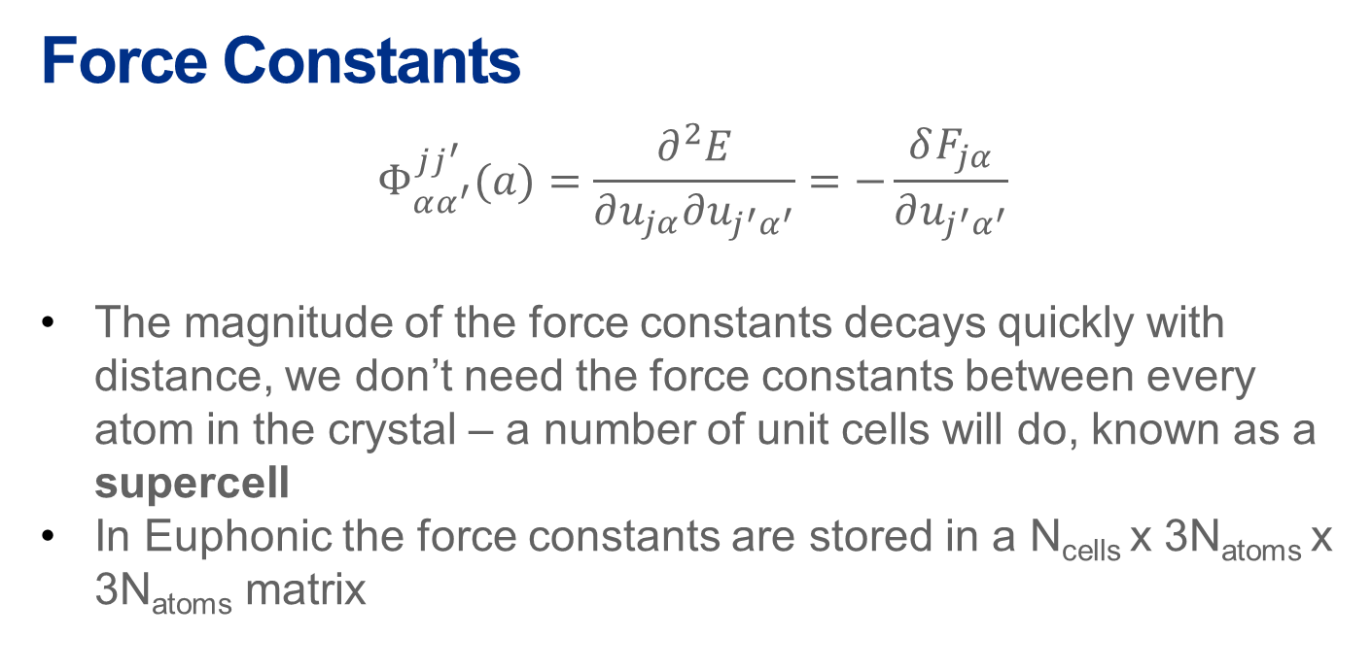
Force Constants
$$Φ_{αα^{′}}^{jj^{′}}(a)=\frac{∂^{2}E}{∂u_{jα}∂u_{j^{′}α^{′}}}=−\frac{δF_{jα}}{∂u_{j^{′}α^{′}}}$$
The magnitude of the force constants decays quickly with distance, we don’t need the force constants between every atom in the crystal – a number of unit cells will do, known as a supercell
In Euphonic the force constants are stored in a N_{cells} x 3N_{atoms} x 3N_{atoms} matrix
u_{j′α′}
j$′$
r_{a}
F_{jα}
j
Note: For polar materials the force constants decay more slowly due to long range Coulomb interactions – this requires an extra (computationally expensive) correction be applied to the force constants matrix. This also requires that the dielectric permitivitty tensor and Born charges be calculated.

Slide 34
Force Constants
Force constants can be calculated by a variety of modelling codes
Some common methods are finite displacement and density functional perturbation theory (DFPT)
Euphonic can currently read CASTEP and Phonopy force constants
Through Phonopy Euphonic also has access to force constants from a range of other computational codes
Euphonic also has its own JSON format for reading/writing force constants
CASTEP
(.castep_bin)
Euphonic
Euphonic format
(.json)
VASP
Phonopy
(phonopy.yaml)
Quantum ESPRESSO
CRYSTAL
and more…

Slide 35
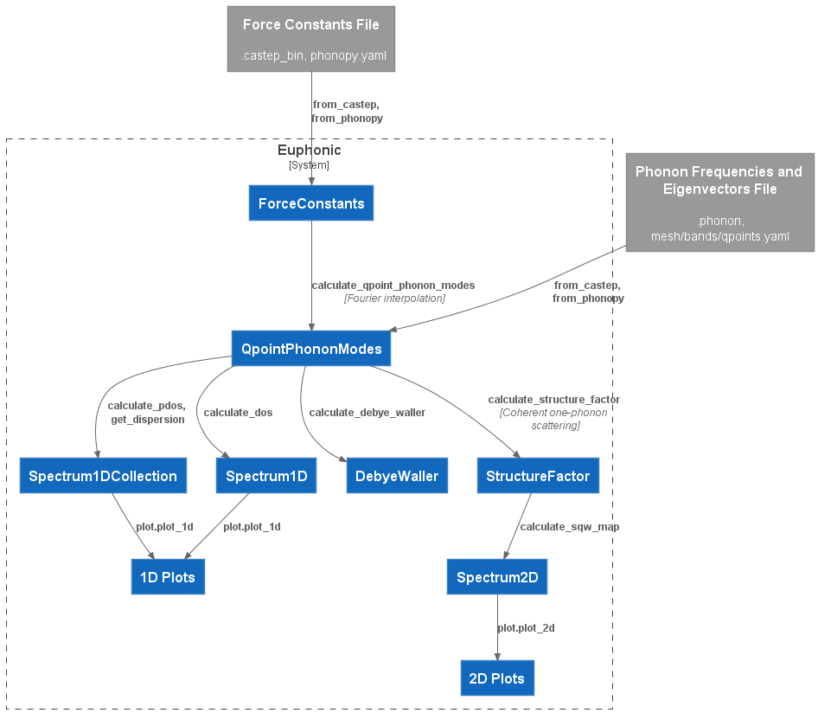
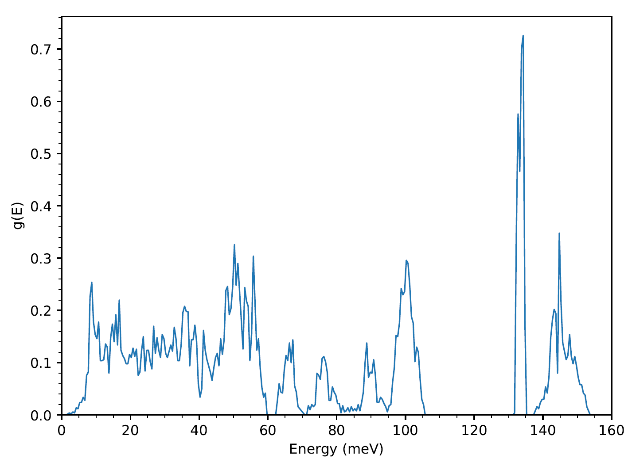
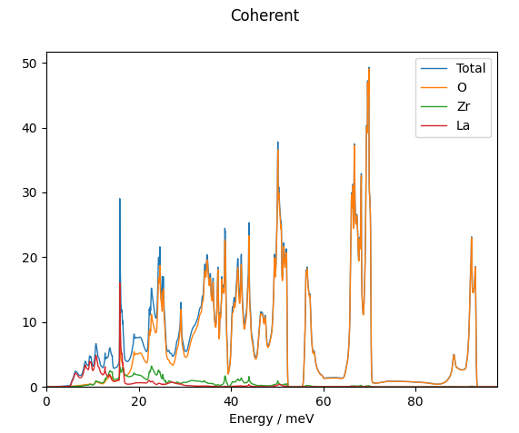
Euphonic Data Flow and Objects

Slide 36
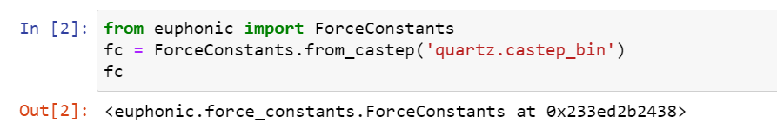
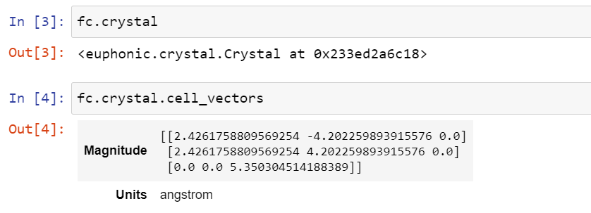
The ForceConstants object
Most important data in Euphonic is contained in an object – so that relevant metadata and functions can be easily accessed and used
For example, the force constants don’t make much sense without the crystal information, this is stored inside a Crystal object, in the crystal attribute

Slide 37
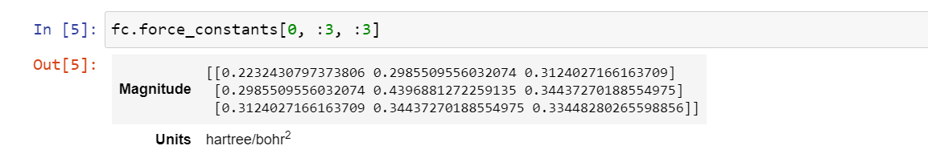
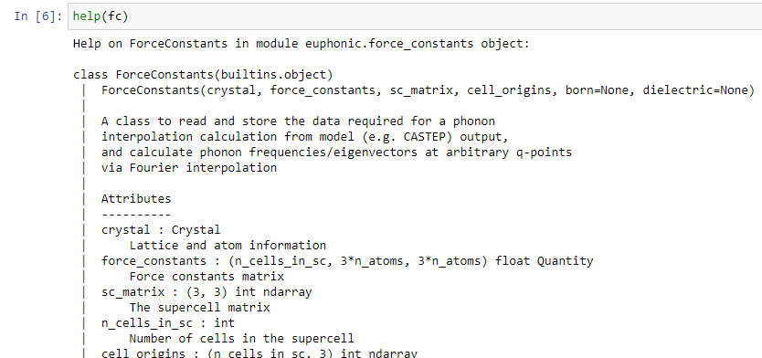
The ForceConstants object
The force constants themselves are stored inside the force_constants attribute
Help can also be accessed to view more attributes/methods on objects
…

Slide 38
Euphonic Data Flow and Objects

Slide 39
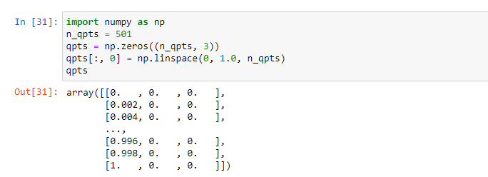

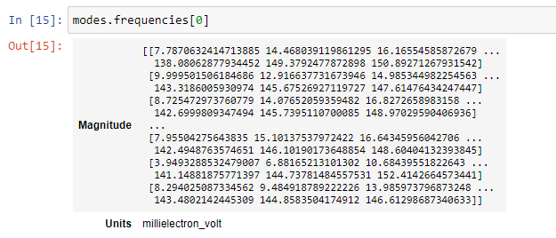
Calculating Phonon Frequencies and Eigenvectors
Phonon frequencies and eigenvectors are stored in a QpointPhononModes object. These are calculated with the ForceConstants.calculate_qpoint_phonon_modes method. This requires a shape (N, 3) Numpy array of q-points
QpointPhononModes contains both frequencies and eigenvectors

Slide 40

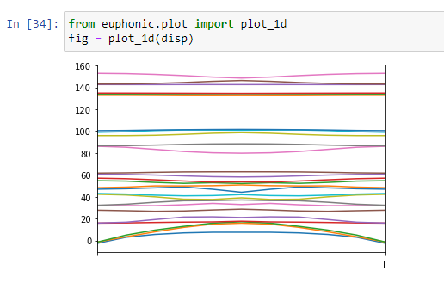
Plotting Dispersion
From a QpointPhononModes object we can get the dispersion with the with the QpointPhononModes.get_dispersion method. This converts the shape (N, 3) q-points to a length N vector that can be plotted on the X-axis and returns a Spectrum1DCollection object
A Spectrum1DCollection contains data for multiple 1D Spectra in the x_data and y_data attributes. It can be plotted easily with euphonic.plot.plot_1d, which returns a Matplotlib figure

Slide 41
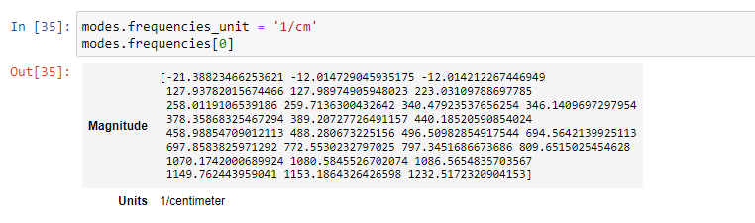
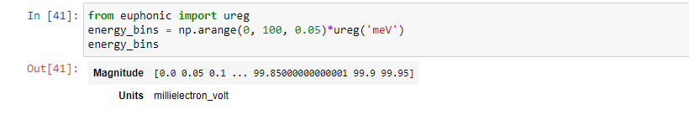
Units in Euphonic – Numpy and Pint libraries
For efficiency Euphonic makes extensive use of the Numpy library for storing and processing vector and matrix data
You may have noticed many of the previously shown quantities have both a magnitude and a unit
This is because Euphonic uses the Pint (pint.readthedocs.io) library to wrap dimensioned data as a pint.Quantity. This can wrap Numpy arrays as well as scalars
This allows units to easily be changed e.g.
Dimensioned data can also be created using euphonic.ureg, this is required for creating some things such as energy bins for use in Euphonic

Slide 42
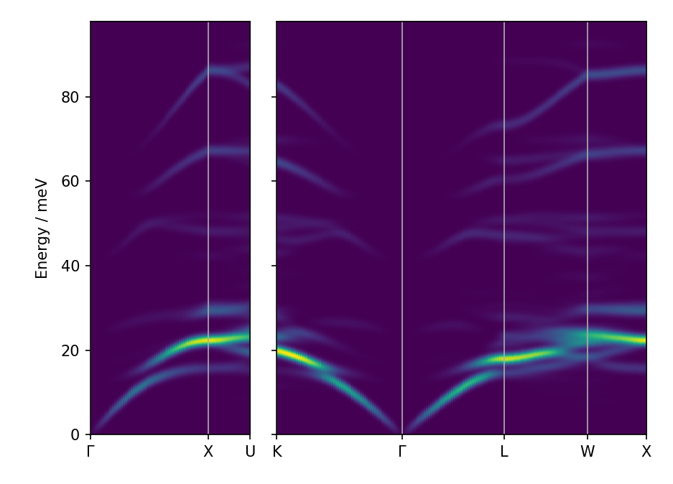
Command Line Tools
Euphonic also comes with a variety of useful command line tools for quick plotting of things such as dispersion, density of states and scattering intensities

Slide 43
Further information
Euphonic Docs: https://euphonic.readthedocs.io

Slide 44




isis.stfc.ac.uk
@ISISNeutronMuon
STFC
Notes:
The abstract pattern can be removed or repositioned if required. Be careful to ‘Send to Back’ so that it does not obscure any important information.

