Slide 1

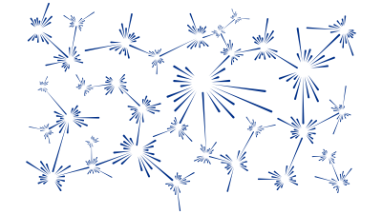
Modelling spin waves with SpinW
M. D. Le
India-RAL Neutron and Muon Science Meeting
Notes:
The abstract pattern can be removed or repositioned if required. Be careful to ‘Send to Back’ so that it does not obscure any important information.

Slide 2
Overview
Linear Spin Wave Theory
Magnetic Hamiltonian
Holstein-Primakoff expansion
Diagonalisation
Incommensurate single-k structure
SpinW
Hamiltonian parameters (exchange, anisotropy) input
Magnetic structure input
Plotting the model
Structure refinement
Dispersion calculation

Slide 3

Hamiltonian
SpinW can solve the magnetic Hamiltonian:
It uses the convention that:
Positive values of the exchange J means an antiferromagnetic interaction.
Positive values of the single ion anisotropy A means an easy-plane anisotropy.
The Hamiltonian above usually leads to magnetic ordering below a critical temperature.
Spin waves are the collective excitations of this ordered state.
General bi-linear
interactions
Single-ion
anistropy
Applied magnetic
field (Zeeman)

Slide 4
Steps in a Spin Wave Calculation
Spin waves arise from deviations of the ordered magnetic state.
We use the spin deviations as the basis states for calculating the magnetic Hamiltonian.
The Hamiltonian is then partly solved by a Fourier transform
For a ferromagnet the FT diagonalises the Hamiltonian
More generally another transformation is required to diagonalise H.
The eigenvalues of H(q) gives the magnon energies and the eigenvectors can be used to calculate the spin-spin correlation function and INS intensity.

Slide 5



Holstein-Primakoff Transformation
Express the spin operators as the ladder operators:
Map the raising / lowering operators to bosonic creation and annihilation operators taking only terms linear in
ground state is fully
saturated state.
n^{th} magnon is n^{th}
deviation from this
vs
linear spin wave theory means ignoring the terms
in blue.

Slide 6



Hamiltonian
We could now substitute the Holstein-Primakoff operators back into the Hamiltonian, but then the maths gets complicated because of the dependence of the operators on the magnetic structure (spin orientation).
Instead we define a set of 3x3 rotation matrices R_{i} which rotates all the spin to ferromagnetic alignment, e.g.:
Where S_{i}’ are all ferromagnetic.
Remembering that:
If we define two sets of vectors u_{i} formed from the first two columns of the matrix R_{i} and v_{i} formed from the third column as:
Then we have:
Where the bar indicates complex conjugation.

Slide 7


Hamiltonian
The Hamiltonian thus becomes:
The terms in curly braces can be expressed as a vector of the H-P operators (basis states), giving:
Where H_{ij} is a 2n x 2n matrix whoes matrix elements can be determined by the braced expressions above and is given in the SpinW paper.
The expression above will contain terms which mix spins at i and j – a Fourier Transform will separate this, e.g. as in:
We now Fourier transform the Hamiltonian and diagonalise it for every q point.

Slide 8
Incommensurate Structures
Remember that we introduced a rotation matrix which rotates every spin into the ferromagnetic state – actually SpinW introduces two such rotations.
The first applies to all spins within a crystalline unit cell and is used for the “incommensurate” (single-q) calculations.
The second then rotates the spins within a unit cell into the ferromagnetic state.
It turns out that for structures which can be described by a rotation from one unit cell to another, that the spin-spin correlation function (and hence INS intensity S(Q,ω)) has three branches:
At Q
At Q ± k , where k is the ordering wavevector / magnetic propagation vector
Expressions for the spin-spin correlation function can be found in the SpinW paper:
S. Toth and B. Lake, J. Phys.: Condens. Matter, 27 (2015) 166002

Slide 9
Questions so far?

Slide 10
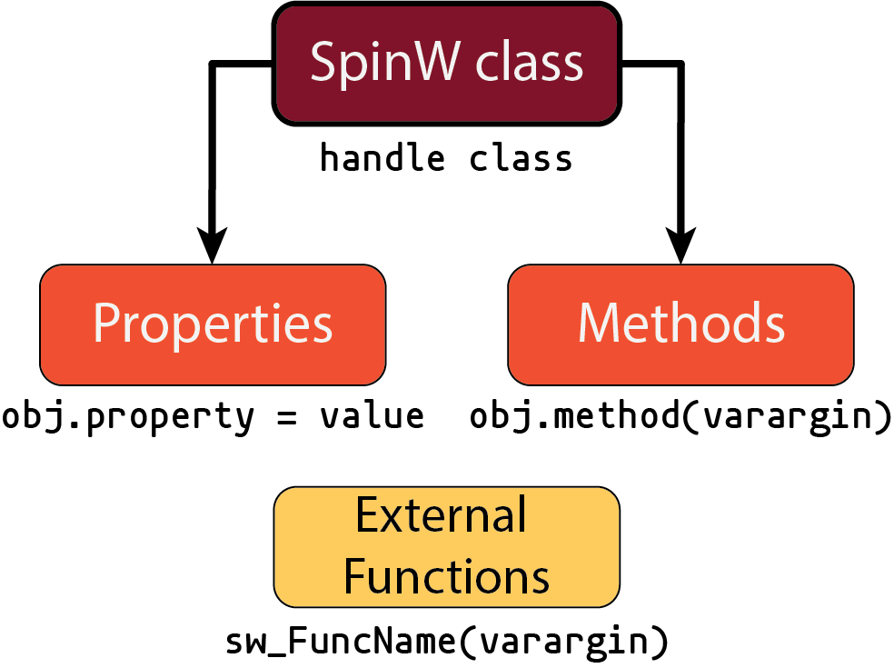
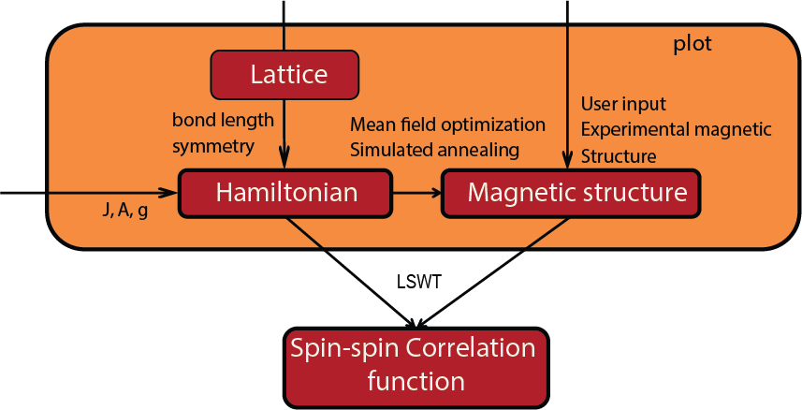
SpinW
SpinW is written as a Matlab class:
There are three main things you need to define for a calculation:
There is extensive online help/documentation
In Matlab, type:
>> help <command>
Or look at the online presentations or tutorials at spinw.org

Slide 11
SpinW
SpinW uses three coordinate systems:
Lattice units (l.u.) – defines the atomic positions; set by the unit cell parameters (a,b,c,α,β,γ)
Reciprocal lattice units (r.l.u.) – defines the momentum transfer Q and magnetic propagation k vectors.
Cartesian coordinates – defined w.r.t. lattice coordinates by x||a, z⊥(a,b) and y⊥(x,z). Used for:
J, A, g matrices (exchange, SIA, g-tensor)
Magnetic field directions
Magnetic moment (spin) directions
Components of the spin-spin correlation function.

Slide 12
SpinW – Getting Started
To start, you have to create a spinw object. You can:
Start from scratch: >> swobj = spinw();
Use a CIF or FST file: >> swobj = spinw('mycompound.cif');
Often it’s easier to start from scratch because usually you’re just interested in the magnetic atoms and can ignore everything else.
That just created a frustrated Cu square-lattice.
swobj = spinw();
swobj.genlattice('lat_const', [3,3,5], 'angled', [90 90 90]);
swobj.addatom('r', [0,0,0], 'S', 1/2, 'label', 'MCu2');
swobj.gencoupling('maxDistance', 5)
swobj.addmatrix('label', 'J1', 'value', 1);
swobj.addcoupling('mat', 'J1', 'bond', 1);
swobj.addmatrix('label', 'J2', 'value', 0.5);
swobj.addcoupling('mat', 'J2', 'bond', 2);
plot(swobj)

Slide 13
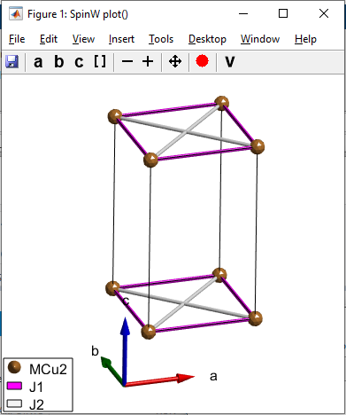
SpinW – Getting Started
To start, you have to create a spinw object. You can:
Start from scratch: >> swobj = spinw();
Use a CIF or FST file: >> swobj = spinw('mycompound.cif');
Often it’s easier to start from scratch because usually you’re just interested in the magnetic atoms and can ignore everything else.
That just created a frustrated Cu square-lattice.
swobj = spinw();
swobj.genlattice('lat_const', [3,3,5], 'angled', [90 90 90]);
swobj.addatom('r', [0,0,0], 'S', 1/2, 'label', 'MCu2');
swobj.gencoupling('maxDistance', 5)
swobj.addmatrix('label', 'J1', 'value', 1);
swobj.addcoupling('mat', 'J1', 'bond', 1);
swobj.addmatrix('label', 'J2', 'value', 0.5);
swobj.addcoupling('mat', 'J2', 'bond', 2);
plot(swobj)

Slide 14

SpinW – Getting Started
swobj.gencoupling('maxDistance', 5)
swobj.addmatrix('label', 'J1', 'value', 1);
swobj.addcoupling('mat', 'J1', 'bond', 1);
All exchange, SIA, g-tensors defined as 3x3 matrices.
The addmatrix method has the following shortcuts:
A scalar input v means the matrix is the identity times v
A vector input [M_{x},M_{y},M_{z}] defines an antisymmetric matrix:
So adding a DM interaction with a DM vector along [110] is:
swobj.addmatrix('label', 'DM', 'value', [1,1,0]);
swobj.addcoupling('mat', 'DM', 'bond', 1);

Slide 15
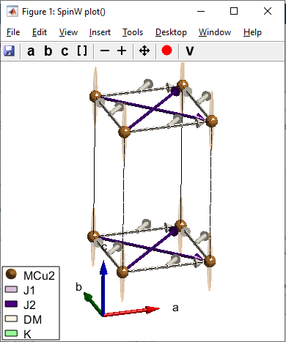
SpinW – Getting Started
Single-ion anisotropy terms can usually be specified using the Matlab diag command – given a n-element vector it returns an n x n matrix with the diagonal elements being elements of that vector, e.g.
swobj.addmatrix('label', 'K', 'value', diag([0 0 -0.1]));
swobj.addaniso('K');
plot(swobj)

Slide 16
Questions so far?

Slide 17
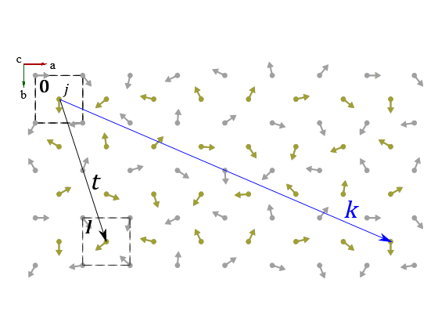

SpinW – Magnetic Structures
In SpinW, the magnetic structure is stored as a structure with fields:
Note that although SpinW uses these fields to store the magnetic structure, it can only truly handle incommensurate structures which can be represented by a rotation from one unit cell to the next.
The j^{th} moment in the l^{th} unit cell at t from the origin can be expressed as:
For a single-k structure, we omit the sum:
where Ψ is the complex basis vector and k is the propagation vector.
mag_str.F | The complex basis vector in Cartesian units
mag_str.k | The propagation vector in reciprocal lattice units
mag_str.nExt | The magnetic supercell size in lattice units

Slide 18
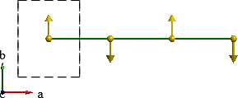
SpinW – Magnetic Structures
The supercell mode allows SpinW to describe arbitrary magnetic structures – at the cost of more intensive computation.
In this mode, every spin in every unit cell has to be specified.
E.g. 1D spin chain
Single-k incommensurate mode
Supercell mode
mag_str.N_ext = [1 1 1];
mag_str.k = [1/2 0 0];
mag_str.F = [0;
1;
0];
mag_str.N_ext = [2 1 1];
mag_str.k = [0 0 0];
mag_str.F = [0 0;
1 -1;
0 0];

Slide 19
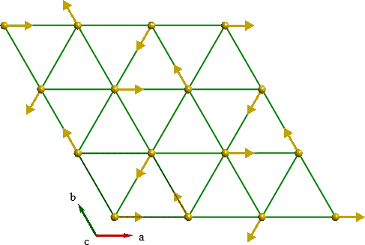
SpinW – Magnetic Structures
The supercell mode allows SpinW to describe arbitrary magnetic structures – at the cost of more intensive computation.
In this mode, every spin in every unit cell has to be specified.
E.g. triangular lattice
antiferromagnet
Single-k mode
Supercell mode
mag_str.N_ext = [1 1 1];
mag_str.k = [1/3 1/3 0];
mag_str.F = [1;
i;
0];
mag_str.N_ext = [3 3 1];
mag_str.k = [0 0 0];
mag_str.F = [1 -0.5 -0.5 -0.5 -0.5 1 -0.5 1 -0.5;
0 0.86 -0.86 0.86 -0.86 0 -0.86 0 0.86;
0 0 0 0 0 0 0 0 0];

Slide 20
SpinW – Magnetic Structures
In SpinW, the magnetic structure is stored as a structure with fields:
You can directly set these fields, but it’s usually easier to use the genmagstr method. This has several modes:
'helical' – extend a given structure by applying rotations between unit cells. Moments given either in the rotating frame notation as moments 'S' and a rotation axis 'n' or as complex vectors 'S'. Propagation vector 'k' determines the rotation angle between cells.
'fourier' – similar to 'helical' but 'S' denotes the Fourier components – useful for sinusoidal amplitude modulated structures.
'direct' – input the structure directly (every moment specified in 'S') – supercell structures usually specified by 'direct'.
'random' – spins chosen at random. Used for simulated annealing determination of structures from exchange.
'func' – generates a structure using a function (either user defined or there are built-in functions for planar and spherical single-k structures)
mag_str.F | The complex basis vector in Cartesian units
mag_str.k | The propagation vector in reciprocal lattice units
mag_str.nExt | The magnetic supercell size in lattice units

Slide 21
SpinW – Magnetic Structures
Some examples:
tri = spinw;
tri.genlattice('lat_const', [4 4 6], 'angled', [90 90 120]);
tri.addatom('r', [0 0 0], 'S', 2, 'label', 'MCr3', 'color', 'gold');
tri.genmagstr('mode', 'helical', 'S', [1; 0; 0], ...
'n', [0 0 1], 'k', [1/3 1/3 0])

Slide 22
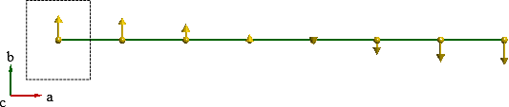
SpinW – Magnetic Structures
Some examples:
mmod = spinw;
mmod.genlattice('lat_const', [4 4 6], 'angled', [90 90 90]);
mmod.addatom('r', [0.5 0.5 0.5], 'S', 2, 'label', 'MCr3', 'color', 'y');
mmod.genmagstr('mode', 'fourier', 'S', [0; 1; 0], 'k', [0.07 0 0])

Slide 23
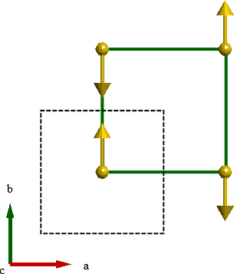
SpinW – Magnetic Structures
Some examples:
sq = spinw;
sq.genlattice('lat_const', [4 4 6], 'angled', [90 90 90]);
sq.addatom('r', [0.5 0.5 0.5], 'S', 2, 'label', 'MCr3', 'color', 'y');
sq.genmagstr('mode', 'direct', 'S', [0 0 0 0; 1 -1 -1 1; 0 0 0 0], ...
'nExt', [2 2 1])

Slide 24
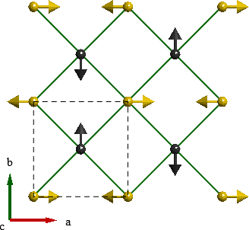
SpinW – Magnetic Structures
Some examples:
fct = spinw;
fct.genlattice('lat_const', [4 4 6], 'angled', [90 90 90]);
fct.addatom('r', [0 0 0], 'S', 2, 'label', 'MCr3', 'color', 'gold');
fct.addatom('r', [0.5 0.5 0], 'S', 2, 'label', 'MCr3', 'color', 'k');
fct.genmagstr('mode', 'func', 'func', @gm_planar, ...
'x0', [0 pi/2 1/2 1/2 1 0 0])

Slide 25
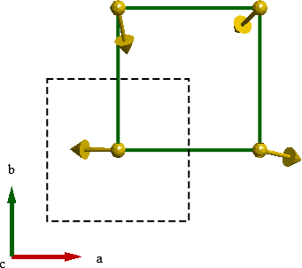
SpinW – Magnetic Structures
Some examples:
fct = spinw;
fct.genlattice('lat_const', [4 4 6], 'angled', [90 90 90]);
fct.addatom('r', [0.5 0.5 0], 'S', 2, 'label', 'MCr3', 'color', 'gold');
fct.genmagstr('mode', 'random', 'nExt', [2 2 1])

Slide 26
Magnetic Structures Optimisation
Often the initial magnetic structure you input doesn’t quite agree with the exchange parameters you put in – this will result in a “non-Hermitian Hamiltonian” error.
SpinW contains several functions to optimise the magnetic structure to minimise the classical magnetic ground state energy:
optmagsteep – optimise a magnetic structure succesively rotating each moment to the Weiss field direction.
Fast, but will not change the super-cell size or the propagation vector.
optmagk – optimises the propagation vector by finding the k which minimises the eigenvalues of the (Fourier transformed) Hamiltonian
optmagstr – nonlinear search for optimal structure (using fminsearch) but needs a function to set the structure.
anneal – performs simulated annealing using the Metropolis algorithm, can be used to calculate thermodynamic properties.

Slide 27
Questions so far?

Slide 28
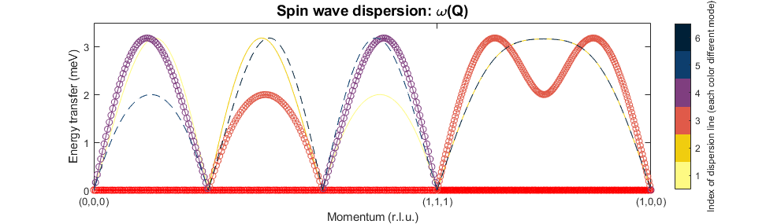
Dispersion Calculations
Once the Hamiltonian (exchange, SIA, etc) and magnetic structure is set, SpinW can calculate the spin wave dispersion and the INS spectrum:
Q can be a 3xN array of Q points to calculate at
Or a Matlab cell-array with Q points to plot along, and the number of points per segment e.g.
spec = swobj.spinwave(Q, 'parameter', 'value', ...)
spec = swobj.spinwave({[0,0,0], [1,1,1], [1,0,0] 200});
sw_plotspec(spec)

Slide 29
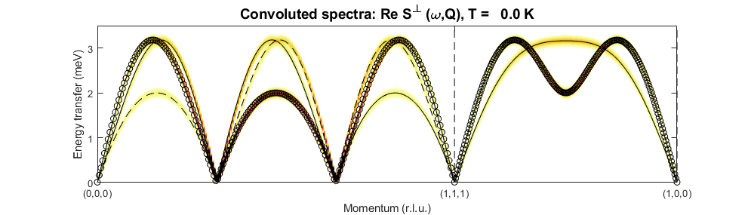
Dispersion Calculations
Use sw_plotspec to plot the spectrum returned by spinwave.
Need to use sw_egrid to bin the dispersion and calculate the INS intensity:
spec = swobj.spinwave({[0,0,0], [1,1,1], [1,0,0] 200});
spec = sw_egrid(spec);
sw_plotspec(spec, 'dE', 0.1)

Slide 30
Dispersion Calculations
The parameters which spinwave accepts include:
'formfact' – (default: false) whether to include the magnetic form factor in the calculation of the spin wave intensity.
'hermit' – (default: true) whether to use a Hermitian only algorithm to diagonalise the Hamiltonian. In cases where the magnetic structure does not match the Hamiltonian parameters, you can get a non-Hermitian Hamiltonian and if 'hermit' is true then spinwave will return an error. Set to false if you want to force the calculation – but plot the result and check that the maximum energy of the imaginary modes is low.
'optmem' – (default: 0 [auto]) how many chunks to split the input Q vectors into – SpinW runs fastest when it can load everything into memory to run through all the Q-vectors at once; but sometimes this is not possible due memory constraints; by default it checks how much free memory there is and picks a suitable number of chunks. But you can also override it if you are running out of memory or SpinW underestimates the amount of free memory.
Other parameters – type: help spinwave

Slide 31
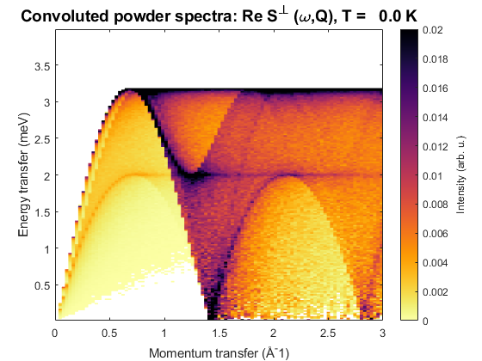
Powder Average
Use powspec instead of spinwave to calculate a powder averaged spectrum.
swobj = sw_model('triAF', 1);
modQ = linspace(0,3,100);
spec = swobj.powspec(modQ, 'nRand', 10000, 'Evect', linspace(0,4,200));
figure; sw_plotspec(spec)

Slide 32
Questions so far?

Slide 33
Overview
Spin-spin correlation tensor
Polarised neutron intensities
Twinned crystals
Simulated annealing and Monte Carlo calculations
Magnetic structure refinement
Calculating magnetisation, susceptibility

Slide 34
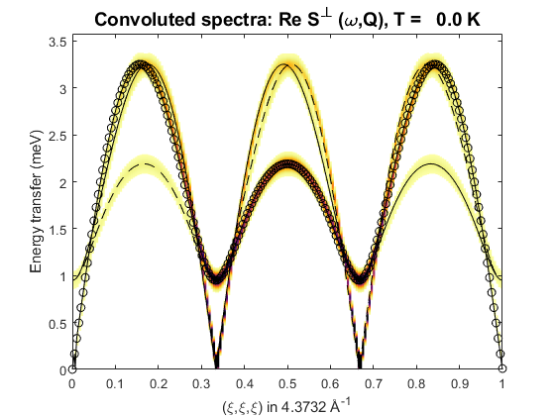
Recap
tri = spinw;
tri.genlattice('lat_const', [4 4 6], 'angled', [90 90 120]);
tri.addatom('r', [0 0 0], 'S', 2, 'label', 'MCr3', 'color', 'gold');
tri.genmagstr('mode', 'helical', 'S', [1; 0; 0], ...
'n', [0 0 1], 'k', [1/3 1/3 0])
tri.addmatrix('label', 'J', 'value', 1)
tri.gencoupling();
tri.addcoupling('mat', 'J', 'bond', 1);
spec = tri.spinwave({[0,0,0], [1,1,1], [1,0,0] 200});
spec = sw_egrid(spec);
sw_plotspec(spec, 'dE', 0.1)
modQ = linspace(0,3,100);
spec = tri.powspec(modQ, 'nRand', 10000, 'Evect', linspace(0,4,200));
figure; sw_plotspec(spec)

Slide 35
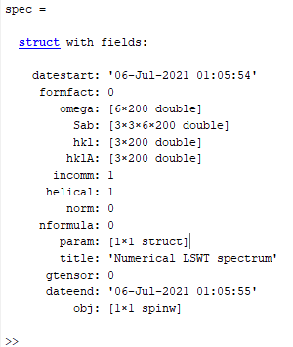
Spin-spin correlation function
spinwave returns a spectrum struct
Initially only has Sab – a 3x3xMxN array, M=# modes, N=# Q-pts.
Use sw_neutron to calculate interesting cross-sections.
sw_egrid internally calls sw_neutron to calculate Sperp – the component of S perpendicular to Q which is measured in unpolarised neutron scattering.

Slide 36
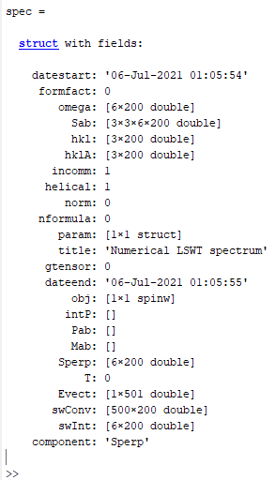
Spin-spin correlation function
spinwave returns a spectrum struct
Initially only has Sab – a 3x3xMxN array, M=# modes, N=# Q-pts.
Use sw_neutron to calculate interesting cross-sections.
sw_egrid internally calls sw_neutron to calculate Sperp – the component of S perpendicular to Q which is measured in unpolarised neutron scattering.
But can use either sw_egrid or sw_neutron with the 'component' option to calculate other quantities.

Slide 37
Spin-spin correlation function
Can calculate and plot:
Individual components of S^{αβ} or their sum. E.g.
Polarised neutron cross-sections – first have to run sw_neutron with the 'pol',true option and to define the horizontal scattering plane.
This is because polarised cross-sections use the Blume-Maleyev coordinate system where x||Q, z is vertical and y⊥(x,z).
Can specify the horizontal plane either by a u and v matrix (like Horace) – these are reciprocal lattice vectors. Or, can specify the direction of the plane normal in the SpinW Cartesian coordinate system: x||a, z⊥(a,b) and y⊥(x,z).
sw_plotspec(sw_egrid(spec, 'component', 'Sxx+Syy'), 'dE', 0.1)
spec = sw_neutron(spec, 'pol', true, 'uv', {[1,0,0], [0,1,0]})
sw_plotspec(sw_egrid(spec, 'component', 'Pz'), 'dE', 0.1)
spec = sw_neutron(spec, 'pol', true, 'n', [0,0,1])
sw_plotspec(sw_egrid(spec, 'component', 'Pz'), 'dE', 0.1)

Slide 38
Spin-spin correlation function
Can calculate and plot:
'Pa' – a=x,y,z – half polarized intensity with incident beam polarised along a certain direction
'Pab' – a,b=x,y,z – xyz polarized intensity σ^{αβ} with incident and scattered beam polarized along the specified direction
'Mab' – a,b=x,y,z – magnetisation component along the specified direction.
sw_plotspec(sw_egrid(spec, 'component', 'Pz'), 'dE', 0.1)
sw_plotspec(sw_egrid(spec, 'component', 'Pyy'), 'dE', 0.1)
sw_plotspec(sw_egrid(spec, 'component', 'Myz-Mzy'), 'dE', 0.1)

Slide 39
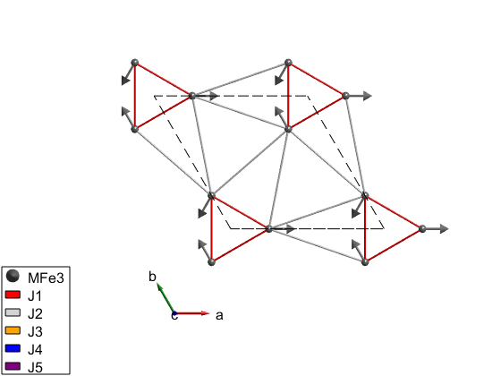
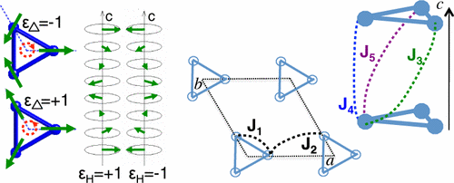
Polarised neutron example
System is iron-langasite Ba₃NbFe₃Si₂O₁₄. (SpinW tutorial 15)
Loire et al., Phys. Rev. Lett., 106 207201 (2011)

Slide 40
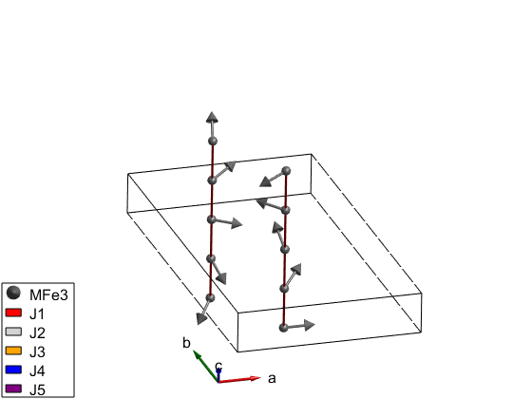
Polarised neutron example
System is iron-langasite Ba₃NbFe₃Si₂O₁₄. (SpinW tutorial 15)
Loire et al., Phys. Rev. Lett., 106 207201 (2011)

Slide 41
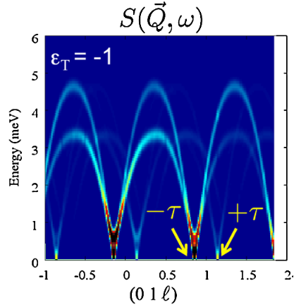
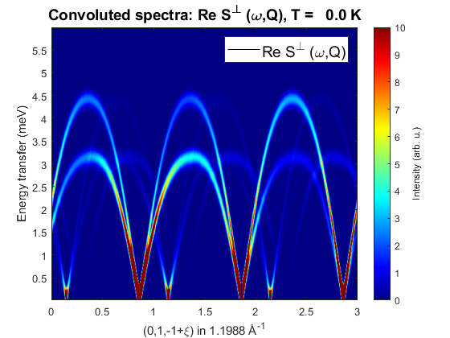
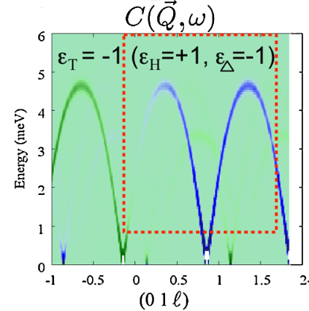
Polarised neutron example
System is iron-langasite Ba₃NbFe₃Si₂O₁₄. (SpinW tutorial 15)
banbSpec = banb.spinwave({[0 1 -1] [0 1 2] 500});
banbSpec = sw_neutron(banbSpec,'pol',true,'uv',{[0 1 0] [0 0 1]});
figure
banbSpec = sw_egrid(banbSpec,'component','Sperp', ...
'Evect',linspace(0,6,500));
sw_plotspec(banbSpec,'mode','color','dE',0.25,'axLim',[0 10]);
colormap(jet)
Loire et al., Phys. Rev. Lett., 106 207201 (2011)

Slide 42
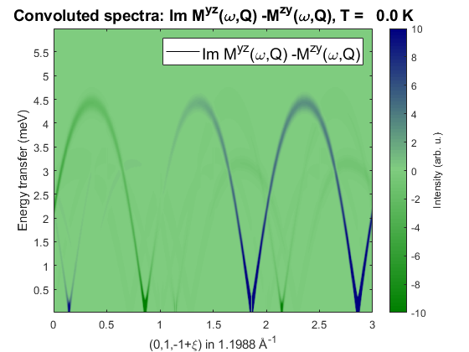
Polarised neutron example
System is iron-langasite Ba₃NbFe₃Si₂O₁₄. (SpinW tutorial 15)
banbSpec = banb.spinwave({[0 1 -1] [0 1 2] 500});
banbSpec = sw_neutron(banbSpec,'pol',true,'uv',{[0 1 0] [0 0 1]});
figure
banbSpec = sw_egrid(banbSpec,'component','-Myz+Mzy', ...
'Evect',linspace(0,6,500));
sw_plotspec(banbSpec,'mode','color','dE',0.25,'axLim',[-10 10],'imag',true);
colormap(makecolormap([0 0.5 0],[0.5 0.8 0.5],[0 0 0.5],81));
Loire et al., Phys. Rev. Lett., 106 207201 (2011)

Slide 43
Questions so far?

Slide 44
Twinned Crystals
Spin-spin correlation tensor
Polarised neutron intensities
Twinned crystals
Simulated annealing and Monte Carlo calculations
Magnetic structure refinement
Calculating magnetisation, susceptibility

Slide 45
Twinned Crystals
Twinned crystals can be handled by using addtwin:
Example for a cut integrating over energy, with a model of Pr(Ca,Sr)Mn₂O₇
pcsmo.addtwin('axis', [0 0 1], 'phid', 90)
nQ = 101; Qhv = linspace(-2,2,nQ); Qkv = linspace(-2,2,nQ); Qlv = 0;
nE = 201; Ev = linspace(0,100,nE);
Ecut = [34 36];
[Qh, Qk, Ql] = ndgrid(Qhv,Qkv,Qlv);
spec = pcsmo.spinwave([Qh(:) Qk(:) Ql(:)]', 'sortMode', false, 'hermit', false);
spec = sw_egrid(spec,'component','Sperp','Evect',Ev);
spec = sw_instrument(spec,'dE',5);
spec3D = reshape(spec.swConv,nE-1,nQ,nQ);
Eidx = find(Ev>Ecut(1) & Ev<Ecut(2));
figure;
cut1 = squeeze(sum(spec3D(Eidx,:,:),1))/numel(Eidx)/(Ev(2)-Ev(1));
imagesc(Qhv/2,Qkv/2,cut1);
xlabel('Qh'); ylabel('Qk');

Slide 46
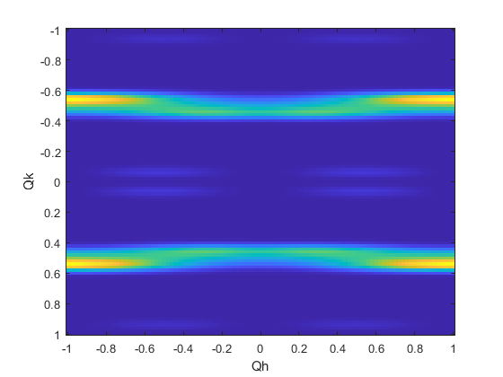
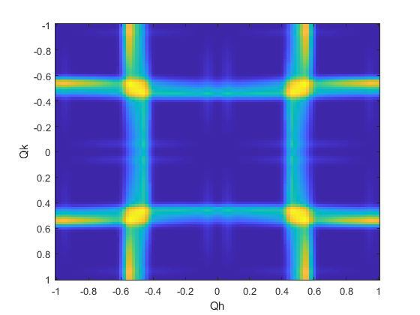
Twinned Crystals
Twinned crystals can be handled by using addtwin:
Example for a cut integrating over energy, with a model of Pr(Ca,Sr)Mn₂O₇
pcsmo.addtwin('axis', [0 0 1], 'phid', 90)
nQ = 101; Qhv = linspace(-2,2,nQ); Qkv = linspace(-2,2,nQ); Qlv = 0;
nE = 201; Ev = linspace(0,100,nE);
Ecut = [34 36];
[Qh, Qk, Ql] = ndgrid(Qhv,Qkv,Qlv);
spec = pcsmo.spinwave([Qh(:) Qk(:) Ql(:)]', 'sortMode', false, 'hermit', false);
spec = sw_egrid(spec,'component','Sperp','Evect',Ev);
spec = sw_instrument(spec,'dE',5);
spec3D = reshape(spec.swConv,nE-1,nQ,nQ);
Eidx = find(Ev>Ecut(1) & Ev<Ecut(2));
figure;
cut1 = squeeze(sum(spec3D(Eidx,:,:),1))/numel(Eidx)/(Ev(2)-Ev(1));
imagesc(Qhv/2,Qkv/2,cut1);
xlabel('Qh'); ylabel('Qk');

Slide 47
Twinned Crystals
Twinned crystals can be handled by using addtwin:
Example for a cut integrating over energy, with a model of Pr(Ca,Sr)Mn₂O₇
pcsmo.addtwin('axis', [0 0 1], 'phid', 90)
nQ = 101; Qhv = linspace(-2,2,nQ); Qkv = linspace(-2,2,nQ); Qlv = 0;
nE = 201; Ev = linspace(0,100,nE);
Ecut = [34 36];
[Qh, Qk, Ql] = ndgrid(Qhv,Qkv,Qlv);
spec = pcsmo.spinwave([Qh(:) Qk(:) Ql(:)]', 'sortMode', false, 'hermit', false);
spec = sw_egrid(spec,'component','Sperp','Evect',Ev);
spec = sw_instrument(spec,'dE',5);
spec3D = reshape(spec.swConv,nE-1,nQ,nQ);
Eidx = find(Ev>Ecut(1) & Ev<Ecut(2));
figure;
cut1 = squeeze(sum(spec3D(Eidx,:,:),1))/numel(Eidx)/(Ev(2)-Ev(1));
imagesc(Qhv/2,Qkv/2,cut1);
xlabel('Qh'); ylabel('Qk');
Without twin calculation
Twin calculation

Slide 48
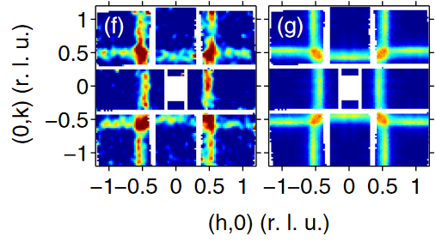
Twinned Crystals
Twinned crystals can be handled by using addtwin:
Example for a cut integrating over energy, with a model of Pr(Ca,Sr)Mn₂O₇
pcsmo.addtwin('axis', [0 0 1], 'phid', 90)
nQ = 101; Qhv = linspace(-2,2,nQ); Qkv = linspace(-2,2,nQ); Qlv = 0;
nE = 201; Ev = linspace(0,100,nE);
Ecut = [34 36];
[Qh, Qk, Ql] = ndgrid(Qhv,Qkv,Qlv);
spec = pcsmo.spinwave([Qh(:) Qk(:) Ql(:)]', 'sortMode', false, 'hermit', false);
spec = sw_egrid(spec,'component','Sperp','Evect',Ev);
spec = sw_instrument(spec,'dE',5);
spec3D = reshape(spec.swConv,nE-1,nQ,nQ);
Eidx = find(Ev>Ecut(1) & Ev<Ecut(2));
figure;
cut1 = squeeze(sum(spec3D(Eidx,:,:),1))/numel(Eidx)/(Ev(2)-Ev(1));
imagesc(Qhv/2,Qkv/2,cut1);
xlabel('Qh'); ylabel('Qk');
Without twin calculation
Twin calculation

Slide 49
Monte Carlo Simulations
Spin-spin correlation tensor
Polarised neutron intensities
Twinned crystals
Simulated annealing and Monte Carlo calculations
Magnetic structure refinement
Calculating magnetisation, susceptibility

Slide 50


Monte Carlo Simulations
SpinW has a routine for running a Monte Carlo simulated annealing calculation to:
Optimise a magnetic structure
Calculate physical properties (magnetisation, susceptibility, heat capacity)
Algorithm is:
Create a large ensemble / box of random spins using nExt
Partition this into non-interacting sublattices.
Choose a starting simulated temperature initT
Calculate the initial energy
For each spin, choose a new random orientation
Calculate the change in energy
Apply the Metropolis criteria:
Loop for nMC steps
Lower the simulated temperature T by step
determined by cool and loop until endT

Slide 51
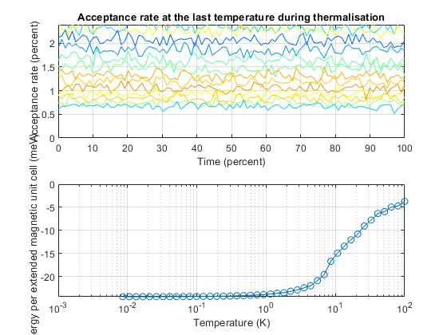
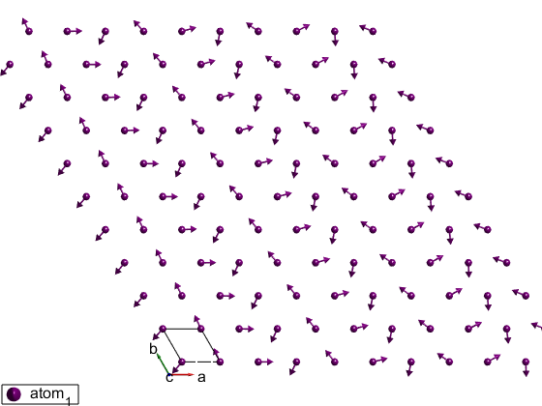
Monte Carlo Simulations
Uses the anneal method of the spinw object.
tri = sw_model('triAF', [-4 16]);
% Removes units
tri.unit.kB = 1;
tri.unit.muB = 1;
tri.field([0 0 0]);
tri.anneal('verbosity',2, 'cool',@(T)(0.8*T), 'initT', 100, 'endT', 1e-2, ...
'nMC',1e3, 'nStat',0, 'random',true, 'nExt',[50 50 1], 'spinDim', 2);

Slide 52
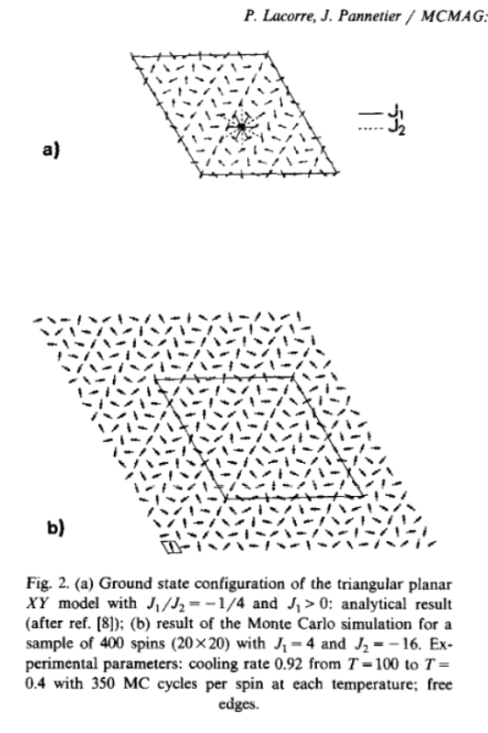
Monte Carlo Simulations
Uses the anneal method of the spinw object.
tri = sw_model('triAF', [-4 16]);
% Removes units
tri.unit.kB = 1;
tri.unit.muB = 1;
tri.field([0 0 0]);
tri.anneal('verbosity',2, 'cool',@(T)(0.8*T), 'initT', 100, 'endT', 1e-2, ...
'nMC',1e3, 'nStat',0, 'random',true, 'nExt',[50 50 1], 'spinDim', 2);

Slide 53
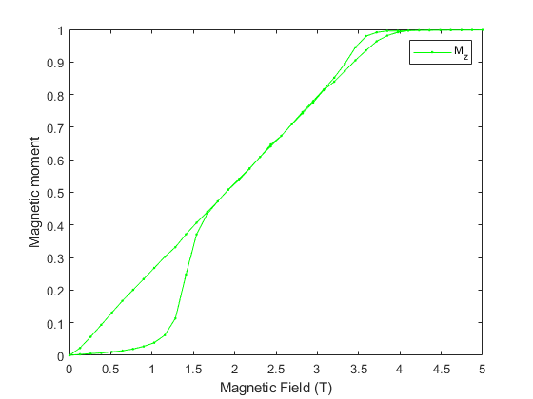
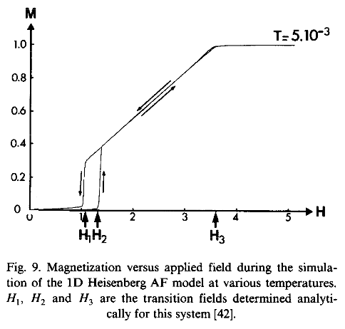
Monte Carlo Simulations
Uses the annealoop method to calculate physical properties.
hChain = sw_model('chain', 2);
hChain.addmatrix('value', diag([0 0 -0.2]), 'label', 'A'); hChain.addaniso('A')
hChain.unit.kB = 1; hChain.unit.muB = 1;
hChain.anneal('verbosity',2, 'cool',@(T)(0.8*T), 'initT', 100, 'endT', 1e-2, ...
'nMC',1e3, 'nStat',0, 'random',true, 'nExt',[150 1 1]);
fieldSweep = [linspace(0,5,40) linspace(5,0,40)];
pStat = hChain.annealloop('x' ,fieldSweep, 'func',@(obj,x)obj.field([0 0 x]), ...
'nMC',2e4 ,'nStat',1e4, 'tid',2, 'fineT', 1e-2);
M = squeeze(sum(pStat.avgM,2))/hChain.nmagext;
figure; plot(pStat.x,M(3,:),'g.-')
xlabel('Magnetic Field (T)'); ylabel('Magnetic moment'); legend('M_z')

Slide 54
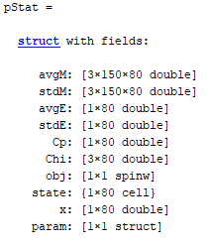
Monte Carlo Simulations
Uses the annealoop method to calculate physical properties.
hChain = sw_model('chain', 2);
hChain.addmatrix('value', diag([0 0 -0.2]), 'label', 'A'); hChain.addaniso('A')
hChain.unit.kB = 1; hChain.unit.muB = 1;
hChain.anneal('verbosity',2, 'cool',@(T)(0.8*T), 'initT', 100, 'endT', 1e-2, ...
'nMC',1e3, 'nStat',0, 'random',true, 'nExt',[150 1 1]);
fieldSweep = [linspace(0,5,40) linspace(5,0,40)];
pStat = hChain.annealloop('x' ,fieldSweep, 'func',@(obj,x)obj.field([0 0 x]), ...
'nMC',2e4 ,'nStat',1e4, 'tid',2, 'fineT', 1e-2);
M = squeeze(sum(pStat.avgM,2))/hChain.nmagext;
figure; plot(pStat.x,M(3,:),'g.-')
xlabel('Magnetic Field (T)'); ylabel('Magnetic moment'); legend('M_z')

Slide 55
Questions so far?

Slide 56
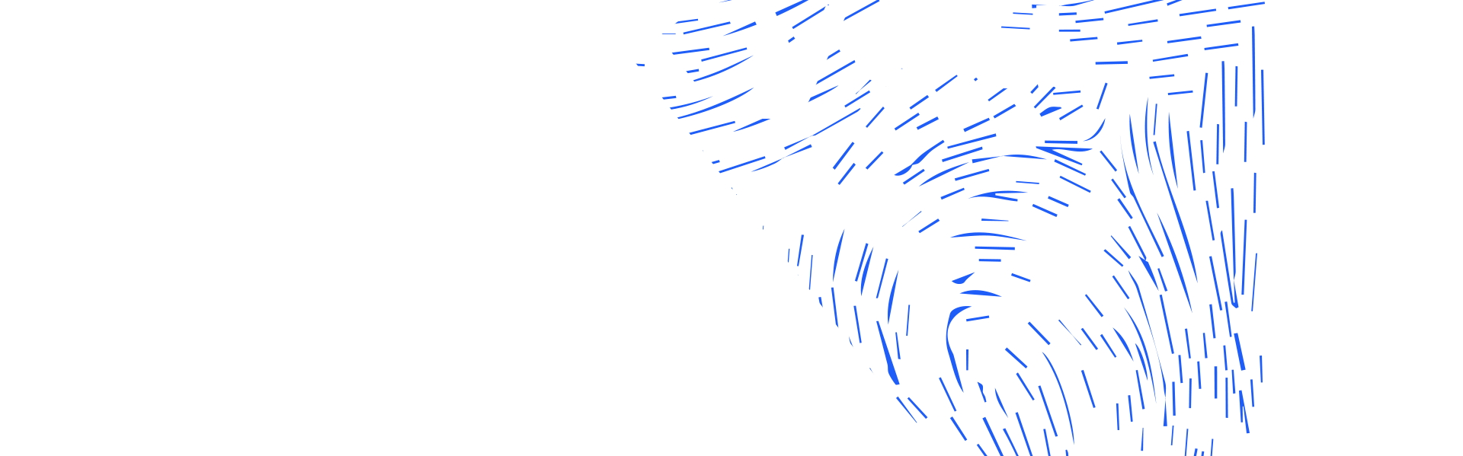
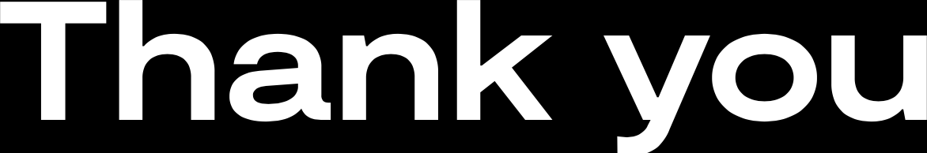
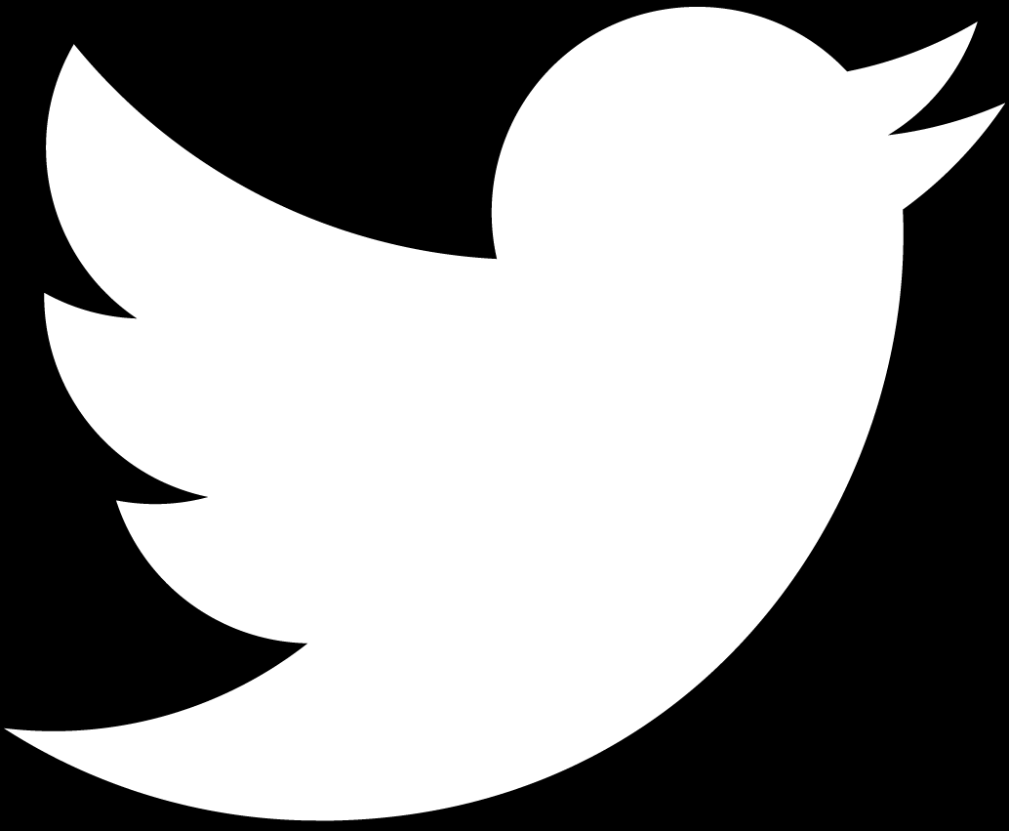
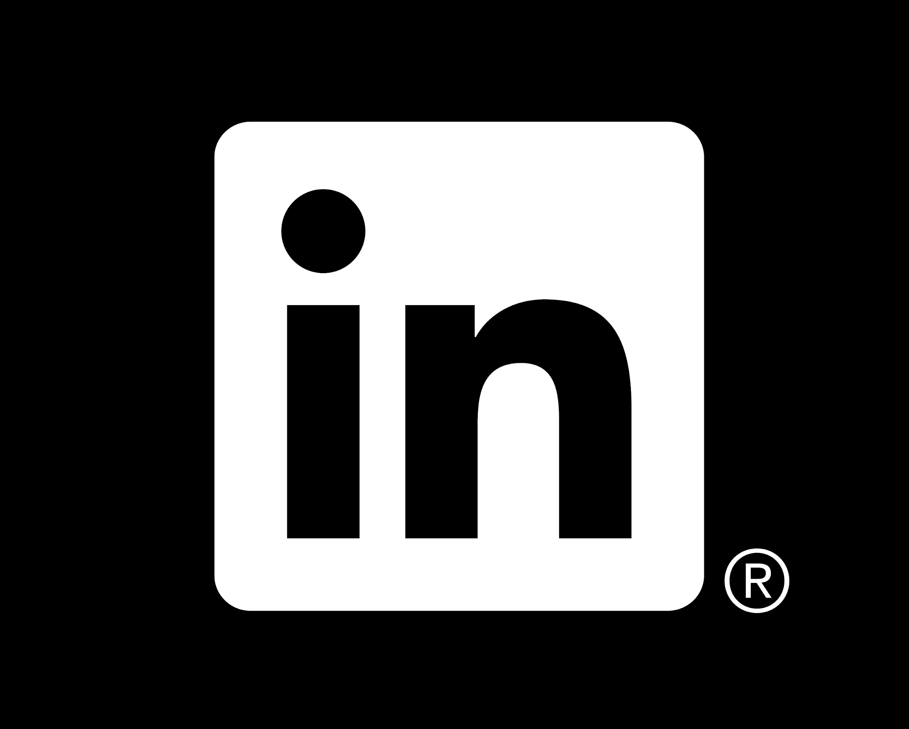
isis.stfc.ac.uk
@ISISNeutronMuon
STFC
Notes:
The abstract pattern can be removed or repositioned if required. Be careful to ‘Send to Back’ so that it does not obscure any important information.

