Slide 1

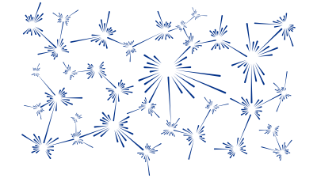
Crystal field fitting with Mantid
M. D. Le
India-RAL Neutron and Muon Science Meeting
Notes:
The abstract pattern can be removed or repositioned if required. Be careful to ‘Send to Back’ so that it does not obscure any important information.

Slide 2
Overview
Crystalline electric field theory
Broad overview
Mathematical background
The Mantid crystal field interface
Plotting INS Spectrum
Plotting physical properties
Fitting data

Slide 3
Crystal Field Theory
Electrons in atoms experience a large electric field from the nucleus which splits them into different shells and orbitals at different energies, but the energy levels within an orbital is degenerate.
In crystals, the electrons on one atom are also affected by electric fields from neighbouring atoms → this lifts the degeneracy of the orbitals.
E
m=2
m=1
3d
m=0
n=3
m=-1
m=-2
3p
3s
n=2
n=1

Slide 4
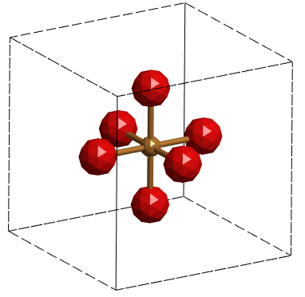
Crystal Field Theory
Electrons in atoms experience a large electric field from the nucleus which splits them into different shells and orbitals at different energies, but the energy levels within an orbital is degenerate.
In crystals, the electrons on one atom are also affected by electric fields from neighbouring atoms → this lifts the degeneracy of the orbitals.
Actual splitting depends on the symmetry of neighbours.
E
e_{g}
3d
≈eV
n=3
t_{2g}
3p
3s
n=2
n=1

Slide 5
Crystal Field Theory
Electric field only affects the orbital part of the electronic wave function
But in rare-earth ions, there is a strong spin-orbit coupling (SOC).
Unlike transition metal ions, the crystal field is weaker than the SOC so splits the mixed spin-orbit levels:
J=7/2
m_{J}=5/2
E
4f
m_{J}=3/2
4d
J=5/2
m_{J}=1/2
≈10’s meV
n=4
4p
m_{J}=-1/2
n=3
m_{J}=-3/2
4s
m_{J}=-5/2
n=2
Russel-Saunders
(LS) coupling:
Hund’s rule #3
n=1
< half-filled
> half-filled

Slide 6
Why?
In transition metals, the crystal field energy levels determine the colour of compounds. In rare earths, the energies are smaller so the wavelengths are in the IR region but are important for lasers.
The lifting of the degenerate orbital level combined with the spin-orbit coupling is the origin of the magneto-crystalline anisotropy (single-ion anisotropy) which determines the low temperature properties of magnetic materials
It is related to the high coercivity of rare earth permanent magnets
In materials like spin-ice, it can determine the effective Hamiltonian (e.g. Ising, XY, Heisenberg).
Certain crystal field ground states can lead to exotic phenomena like multipolar ordering in rare earth compounds.
The energy splitting can be quite sensitive to the local environment – can be used as a probe for local magnetic order or coordination.

Slide 7



Point Charge Model
In the point charge model, the neighbouring atoms are treated as point charges, so the potential acting on the electrons of the i^{th} atom is:
The potential can be expanded in terms of spherical harmonics:
So the Hamiltonian can be expressed as:

Slide 8
Point Charge Model
In the point charge model, the neighbouring atoms are treated as point charges, so the potential acting on the electrons of the i^{th} atom is:
The potential can be expanded in terms of spherical harmonics:
So the Hamiltonian can be expressed as:
The radial term can be separated from the angular term.
Actually the potential here is just like for the Hydrogen atom – the functions Ψ(θ,φ) are also spherical harmonics.

Slide 9
Point Charge Model
In the point charge model, the neighbouring atoms are treated as point charges, so the potential acting on the electrons of the i^{th} atom is:
The potential can be expanded in terms of spherical harmonics:
So the Hamiltonian can be expressed as:
The radial term can be separated from the angular term.
Actually the potential here is just like for the Hydrogen atom – the functions Ψ(θ,φ) are also spherical harmonics.
We use the Wigner-Eckart Theorem to express this in terms of the angular momentum states.

Slide 10

Point Charge Model
In the point charge model, the neighbouring atoms are treated as point charges, so the potential acting on the electrons of the i^{th} atom is:
The potential can be expanded in terms of spherical harmonics:
So the Hamiltonian can be expressed as:
The radial term can be separated from the angular term.
Actually the potential here is just like for the Hydrogen atom – the functions Ψ(θ,φ) are also spherical harmonics.
We use the Wigner-Eckart Theorem to express this in terms of the angular momentum states.

Slide 11


Point Charge Model
In the point charge model, there is an expression for the radial term:
But actually, it turns out to be not very accurate for most materials – instead the radial term is usually take as a fittable crystal field parameter.
In addition, it turns out that if we use the spherical harmonic operators we need imaginary parameters, so instead Hermitian combinations called Stevens Operators are used instead:
This defines a matrix whose eigenvalues are the crystal field energies and eigenvectors can be used to compute the inelastic neutron cross-sections.

Slide 12
Crystal Field Hamiltonian
The crystal field Hamiltonian:
is generally applicable – even though the point charge model is not.
This is because the spherical harmonic functions form a complete basis so it is possible to express the Hamiltonian in it and still be valid – the restrictions imposed by the symmetries of the crystal only limit the allowed angular terms (which A_{l}^{m} are non-zero).
So, the term A_{l}^{m}<r^{l}> is usually taken as a single scalar B_{l}^{m} and this is the quantity fitted to INS data.
Mathematical expressions for the O_{l}^{m} operators can be obtained by tensor operator techniques[1] or by replacing the x,y,z coordinates in the expression for spherical harmonics with J_{x} , J_{y} , J_{z} angular momentum operators[2].
[1] B.R. Judd, Operator Techniques in Atomic Spectroscopy, Princeton Univ. Press, 1998
[2] K.W.H. Stevens, Proc. Phys. Soc. A 65 (1952) 209

Slide 13
Questions so far?

Slide 14
Mantid Crystal Field Interface
Mantid includes a Python object-oriented command-line interface for calculating and fitting crystal field data.
It can handle multiple spectra and also physical properties (magnetisation, susceptibility and heat capacity) data.
For calculations it requires as input:
The ion (only trivalent rare earths are supported).
The local (point group) symmetry.
A set of crystal field parameters.
As output it can calculate:
The energy levels and eigenvectors
INS intensities for each transition / INS spectra vs temperature
Magnetic moment M(T) or M(H) [magnetisation]
Susceptibility (van Vleck formula) χ(T)
Heat capacity C_{p}(H,T)

Slide 15
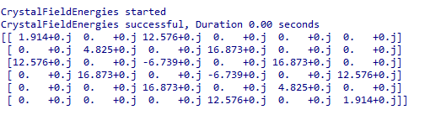
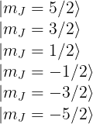
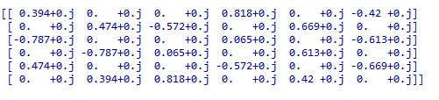
Mantid Crystal Field Interface
Starting a calculation
from CrystalField import CrystalField
cf = CrystalField('Ce', 'C2v', B20=0.37737, B22=3.9770)
cf['B40'] = -0.031
h = cf.getHamiltonian()
e = cf.getEigenvalues()
w = cf.getEigenvectors()

Slide 16

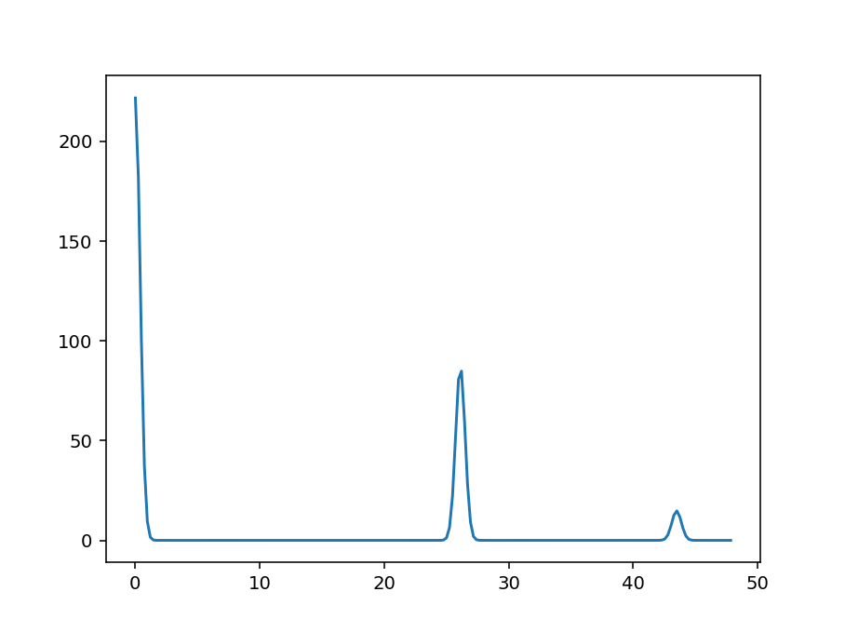
Mantid Crystal Field Interface
Calculating an INS spectrum
cf = CrystalField('Ce', 'C2v', B20=0.37737, B22=3.9770, \
B40=-0.031, Temperature=44)
cf.ToleranceIntensity = 1
print(cf.getPeakList())
cf.PeakShape = 'Gaussian'
cf.FWHM = 0.9
sp = cf.getSpectrum()
plt.plot(*sp)
plt.show()

Slide 17
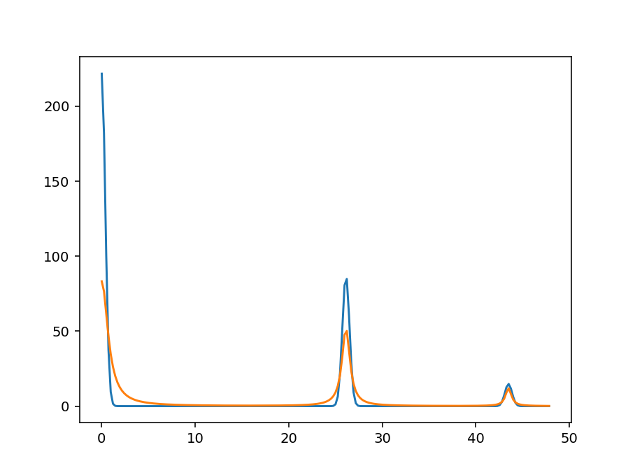
Mantid Crystal Field Interface
Including instrument resolution (FWHM vs energy from PyChop)
from PyChop import PyChop2
from CrystalField import ResolutionModel
marires = PyChop2('MARI')
marires.setChopper('S'); marires.setFrequency(400); marires.setEi(60)
rm = ResolutionModel(marires.getResolution, xstart=0.0, xend=59.0, \
accuracy=0.01)
cf = CrystalField('Ce', 'C2v', B20=0.37737, B22=3.9770, B40=-0.031, \
Temperature=44.0, ResolutionModel=rm)
plt.plot(*cf.getSpectrum())
plt.show()

Slide 18
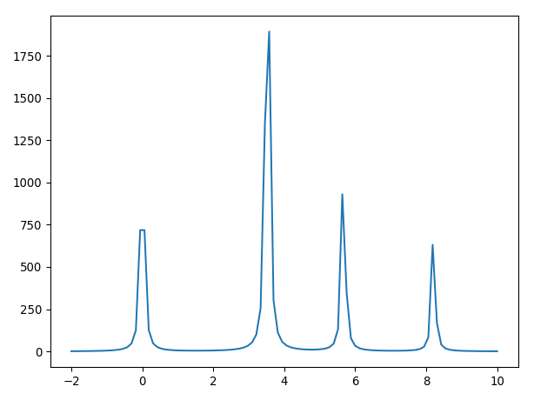
Mantid Crystal Field Interface
Materials with multiple sites
from CrystalField import CrystalField
cf_hex = CrystalField('Pr', 'D3h', B20=19e-2, B40=-5.7e-4, B60=1e-4, \
B66=-9.6e-4, Temperature=2., FWHM=0.1)
cf_cub = CrystalField('Pr', 'D3d', B40=29e-4, B60=0.8e-4, \
Temperature=2., FWHM=0.1)
cf = cf_hex + cf_cub
plt.plot(*cf.getSpectrum(np.linspace(-2,10,100)))
plt.show()

Slide 19
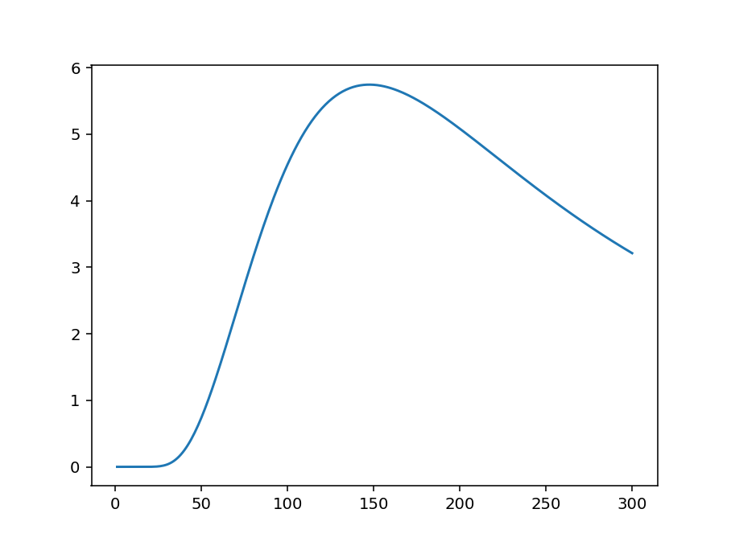
Mantid Crystal Field Interface
Physical properties calculation
import matplotlib.pyplot as plt
cf = CrystalField('Ce', 'C2v', B20=0.37737, B22=3.9770, \
B40=-0.031, Temperature=44.0)
Cv = cf.getHeatCapacity() # Calculates Cv(T) for 1<T<300K in 1K steps (default)
plt.plot(*Cv) # Returns a tuple of (x, y) values
plt.show()

Slide 20
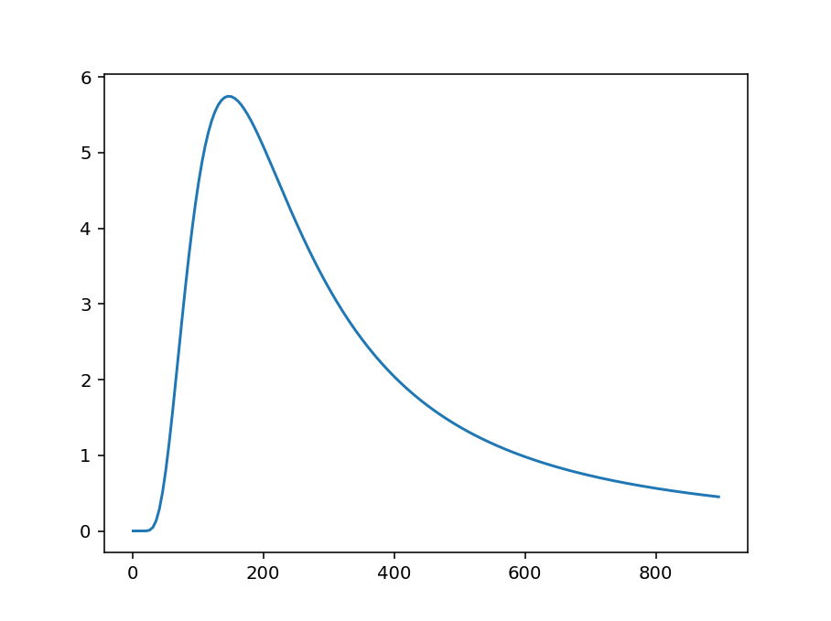
Mantid Crystal Field Interface
Physical properties calculation
import matplotlib.pyplot as plt
cf = CrystalField('Ce', 'C2v', B20=0.37737, B22=3.9770, \
B40=-0.031, Temperature=44.0)
Cv = cf.getHeatCapacity() # Calculates Cv(T) for 1<T<300K
# in 1K steps (default)
plt.plot(*Cv) # Returns a tuple of (x, y) values
plt.show()
T = np.arange(1,900,5)
plt.plot(*cf.getHeatCapacity(T))
plt.show()

Slide 21
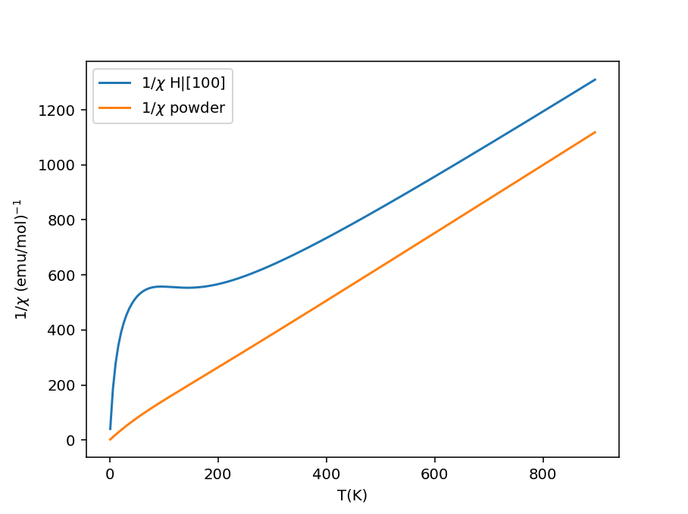
Mantid Crystal Field Interface
Physical properties calculation
chi_v = cf.getSusceptibility(T, Hdir=[1, 0, 0])
plt.plot(chi_v[0], 1/chi_v[1], label='1/$\chi$ H|[100]')
chi_v_powder = cf.getSusceptibility(T, Hdir='powder')
plt.plot(chi_v_powder[0], 1/chi_v_powder[1], label='1/$\chi$ powder')
plt.ylabel('1/$\chi$ (emu/mol)$^{-1}$'); plt.xlabel('T(K)')
plt.legend(); plt.show()
chi_v_cgs = cf.getSusceptibility(T, Hdir=[1, 1, 0], Unit='SI')
chi_v_bohr = cf.getSusceptibility(T, Unit='bohr')

Slide 22
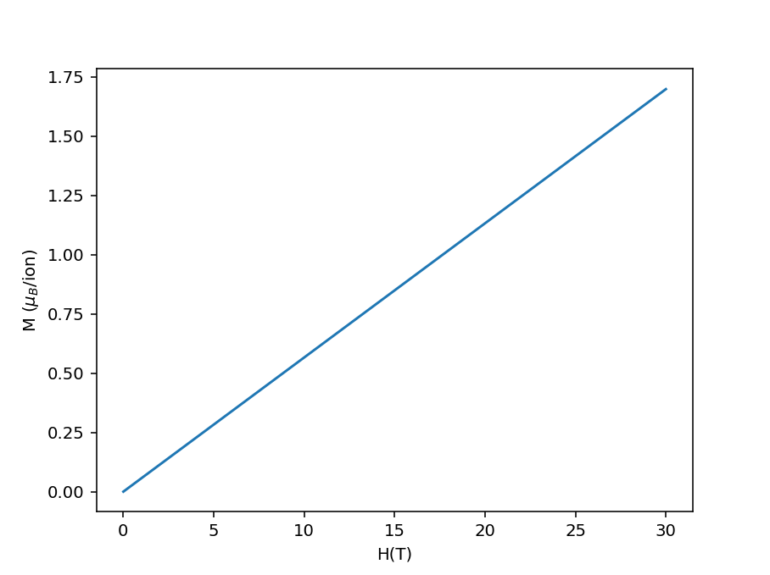
Mantid Crystal Field Interface
Physical properties calculation
# Calcs M(T) with at 0.1T field||[111] in uB/ion
moment_t = cf.getMagneticMoment(Temperature=T, Hdir=[1, 1, 1], Hmag=0.1)
H = np.linspace(0, 30, 121)
# Calcs M(H) at 10K for powder sample in uB/ion
moment_h = cf.getMagneticMoment(Hmag=H, Hdir='powder', Temperature=10)
# M(H) in Am^2/mol at 1K for H||[111]
moment_SI = cf.getMagneticMoment(H, [1, 1, 1], Unit='SI')
# M(T) in emu/mol in a field of 100G || [001]
moment_cgs = cf.getMagneticMoment(100, Temperature=T, Unit='cgs')

Slide 23
Questions so far?

Slide 24
Fitting Crystal Fields
Set up model
Set up fit
from CrystalField import CrystalField, CrystalFieldFit
# Set up the crystal field model.
cf = CrystalField('Nd', 'C2v', Temperature=5, FWHM=1, \
B20=0.19, B22=0.11, B40=-0.0004, B42=-0.002, B44=-0.012, \
B60=5.e-05, B62=0.00054, B64=-0.0006, B66=0.0008)
cf.PeakShape = 'Lorentzian'
# Scale factor if data is not in absolute units (mbarn/sr/f.u./meV) cf.IntensityScaling = 2
data_ws1 = Load('NdOs2Al10_5K35meV_Ecut_0to3ang_bp15V1.xye')
fit = CrystalFieldFit(Model=cf, InputWorkspace=data_ws1, \
MaxIterations=200)
fit.fit()
# Plots the data and print fitted parameters
plotSpectrum('fit_Workspace',[0,1,2],error_bars=False)
plt.xlim([-10,30])
plt.ylim([0,100])

Slide 25
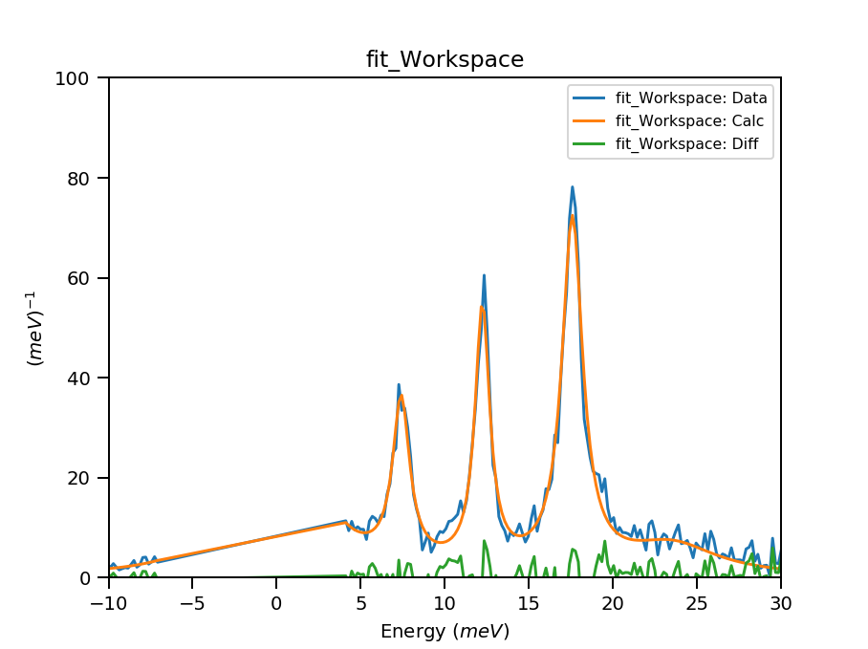
Fitting Crystal Fields
Set up model
Set up fit
from CrystalField import CrystalField, CrystalFieldFit
# Set up the crystal field model.
cf = CrystalField('Nd', 'C2v', Temperature=5, FWHM=1, \
B20=0.19, B22=0.11, B40=-0.0004, B42=-0.002, B44=-0.012, \
B60=5.e-05, B62=0.00054, B64=-0.0006, B66=0.0008)
cf.PeakShape = 'Lorentzian'
# Scale factor if data is not in absolute units (mbarn/sr/f.u./meV) cf.IntensityScaling = 2
data_ws1 = Load('NdOs2Al10_5K35meV_Ecut_0to3ang_bp15V1.xye')
fit = CrystalFieldFit(Model=cf, InputWorkspace=data_ws1, \
MaxIterations=200)
fit.fit()
# Plots the data and print fitted parameters
plotSpectrum('fit_Workspace',[0,1,2],error_bars=False)
plt.xlim([-10,30])
plt.ylim([0,100])

Slide 26
Fitting Crystal Fields
Using a Monte Carlo method to estimate initial parameters
blm = {p:np.random.rand()/10. for p in \
['B20','B22', 'B40', 'B42', 'B44','B60','B62','B64','B66']}
cf = CrystalField('Nd', 'C2v', Temperature=5, FWHM=1, **blm)
cf.PeakShape = 'Gaussian'
cf.peaks.constrainAll('0.2<Sigma<3', 5)
cf.IntensityScaling=1
fit = CrystalFieldFit(Model=cf, InputWorkspace=data_ws1)
fit.estimate_parameters(EnergySplitting=15,
Parameters=['B20','B22','B40','B42','B44','B60','B62','B64','B66'],\
Constraints='15<f1.PeakCentre<20,10<f2.PeakCentre<15',NSamples=1000)
print('Returned', fit.get_number_estimates(), 'sets of parameters.')
# The first set (the smallest chi squared) is selected by default.
# Select a different parameter set if required
fit.select_estimated_parameters(1)
print("Estimated parameters")
Blm = {}
for parname in ['B20','B22','B40','B42','B44','B60','B62','B64','B66']:
Blm[parname] = cf[parname]
print(parname+"="+str(cf[parname]))

Slide 27
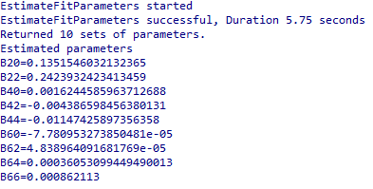
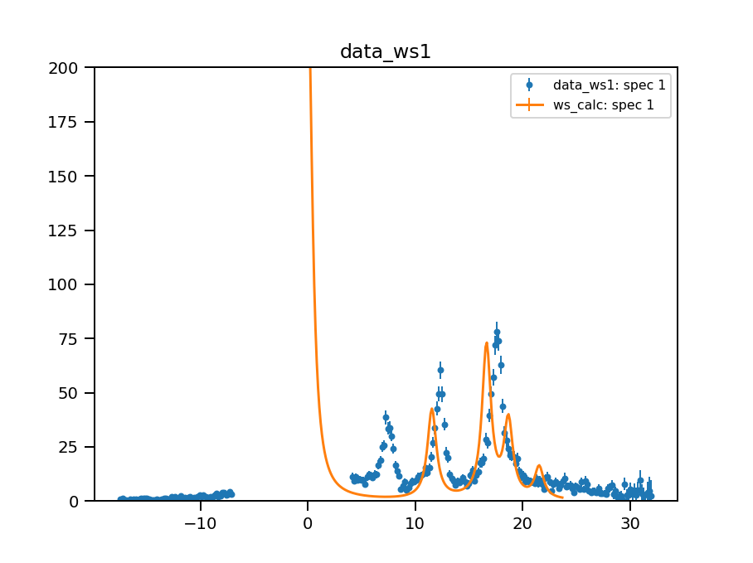
Fitting Crystal Fields
Using a Monte Carlo method to estimate initial parameters
blm = {p:np.random.rand()/10. for p in \
['B20','B22', 'B40', 'B42', 'B44','B60','B62','B64','B66']}
cf = CrystalField('Nd', 'C2v', Temperature=5, FWHM=1, **blm)
cf.PeakShape = 'Gaussian'
cf.peaks.constrainAll('0.2<Sigma<3', 5)
cf.IntensityScaling=1
fit = CrystalFieldFit(Model=cf, InputWorkspace=data_ws1)
fit.estimate_parameters(EnergySplitting=15,
Parameters=['B20','B22','B40','B42','B44','B60','B62','B64','B66'],\
Constraints='15<f1.PeakCentre<20,10<f2.PeakCentre<15',NSamples=1000)
print('Returned', fit.get_number_estimates(), 'sets of parameters.')
# The first set (the smallest chi squared) is selected by default.
# Select a different parameter set if required
fit.select_estimated_parameters(1)
print("Estimated parameters")
Blm = {}
for parname in ['B20','B22','B40','B42','B44','B60','B62','B64','B66']:
Blm[parname] = cf[parname]
print(parname+"="+str(cf[parname]))

Slide 28
Fitting Crystal Fields
Using a point charge model to estimate initial parameters
from CrystalField import PointCharge
cif_pc_model = PointCharge('ICSD_CollCode59912.cif')
print(cif_pc_model.getIons())
cif_pc_model.Charges = {'Nd':3, 'Ru':0, 'Al':0.5}
cif_pc_model.IonLabel = 'Nd'
cif_pc_model.Neighbour = 5
cif_blm = cif_pc_model.calculate()
print(cif_blm)
cf = CrystalField('Nd', 'C2v', Temperature=5, FWHM=1, **cif_blm)
ws_calc = CreateWorkspace(*cf.getSpectrum())

Slide 29
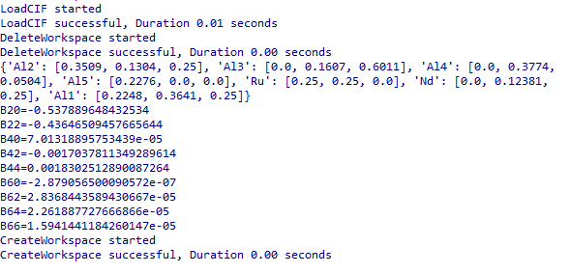
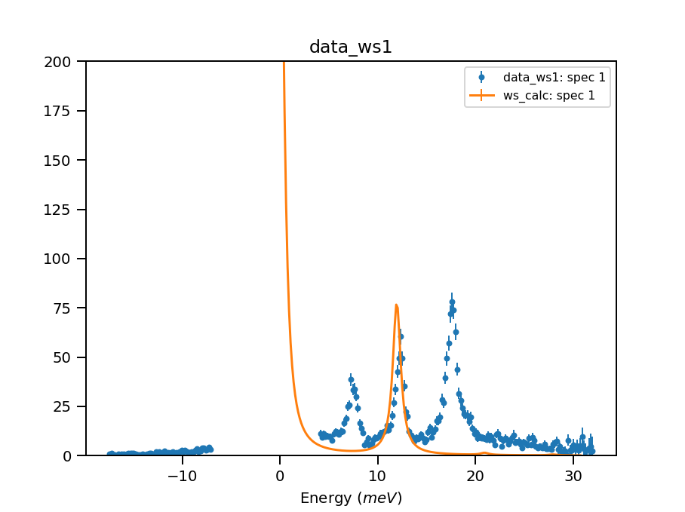
Fitting Crystal Fields
Using a point charge model to estimate initial parameters
from CrystalField import PointCharge
cif_pc_model = PointCharge('ICSD_CollCode59912.cif')
print(cif_pc_model.getIons())
cif_pc_model.Charges = {'Nd':3, 'Ru':0, 'Al':0.5}
cif_pc_model.IonLabel = 'Nd'
cif_pc_model.Neighbour = 5
cif_blm = cif_pc_model.calculate()
print(cif_blm)
cf = CrystalField('Nd', 'C2v', Temperature=5, FWHM=1, **cif_blm)
ws_calc = CreateWorkspace(*cf.getSpectrum())

Slide 30
Fitting Crystal Fields
Simultaneously fit multiple spectra
data_ws1=Load('NdOs2Al10MLa_5K_ecut_0to3ang.xye')
data_ws2=Load('NdOs2Al10MLa_150K_Ecut_0to3aangBp15.xye')
cf = CrystalField('Nd', 'C2v', *blm)
cf.Temperature = [5, 150] # Two datasets, need two sets of Temperature.
cf.PeakShape = 'Gaussian' # Need to call this to reset the peak attribs.
cf.FWHM = [0.5, 0.5] # Two datasets, need two sets of FWHM.
cf.IntensityScaling=[1,1] # Two datasets, need two sets
fit = CrystalFieldFit(Model=cf, InputWorkspace=[data_ws1, data_ws2], \
MaxIterations=100, Output='fit_ins')
fit.fit()
fig, ax = plt.subplots(2,1,subplot_kw={'projection':'mantid'})
for ii in range(2):
ax[ii].errorbar(mtd['fit_ins_Workspaces'][ii],specNum=1,fmt='.')
ax[ii].plot(mtd['fit_ins_Workspaces'][ii],specNum=2)
fig.show()

Slide 31
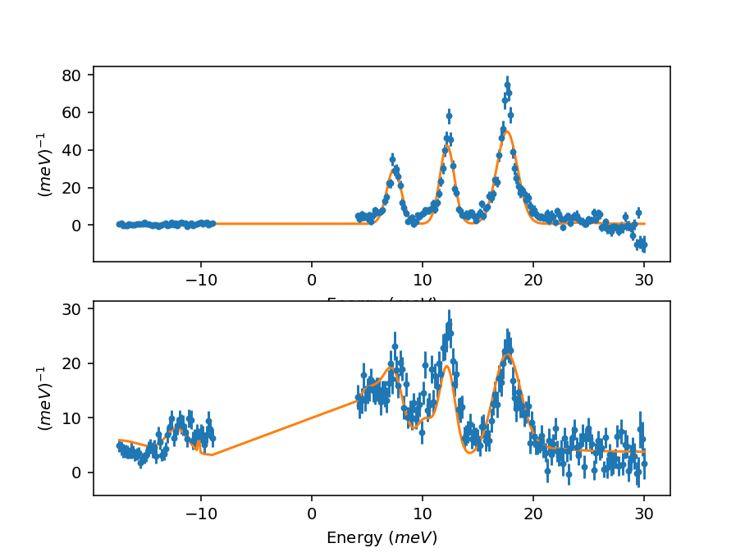
Fitting Crystal Fields
Simultaneously fit multiple spectra
data_ws1=Load('NdOs2Al10MLa_5K_ecut_0to3ang.xye')
data_ws2=Load('NdOs2Al10MLa_150K_Ecut_0to3aangBp15.xye')
cf = CrystalField('Nd', 'C2v', *blm)
cf.Temperature = [5, 150] # Two datasets, need two sets of Temperature.
cf.PeakShape = 'Gaussian' # Need to call this to reset the peak attribs.
cf.FWHM = [0.5, 0.5] # Two datasets, need two sets of FWHM.
cf.IntensityScaling=[1,1] # Two datasets, need two sets
fit = CrystalFieldFit(Model=cf, InputWorkspace=[data_ws1, data_ws2], \
MaxIterations=100, Output='fit_ins')
fit.fit()
fig, ax = plt.subplots(2,1,subplot_kw={'projection':'mantid'})
for ii in range(2):
ax[ii].errorbar(mtd['fit_ins_Workspaces'][ii],specNum=1,fmt='.')
ax[ii].plot(mtd['fit_ins_Workspaces'][ii],specNum=2)
fig.show()

Slide 32
Fitting Crystal Fields
Fitting physical properties
sus_a = Load('NdOs2Al10_sus_a.txt')
sus_b = Load('NdOs2Al10_sus_b.txt')
sus_c = Load('NdOs2Al10_sus_c.txt')
cf = CrystalField('Nd', 'C2v', *blm)
# Simultaneously fit data measured in a, b and c directions
cf.PhysicalProperty = [
PhysicalProperties('susc', Hdir=[1,0,0], Inverse=True, Unit='cgs'),
PhysicalProperties('susc', Hdir=[0,1,0], Inverse=True, Unit='cgs'),
PhysicalProperties('susc', Hdir=[0,0,1], Inverse=True, Unit='cgs')]
fit = CrystalFieldFit(Model=cf, InputWorkspace=[sus_a, sus_b, sus_c], MaxIterations=100, Output='fit_susc')
fit.fit()

Slide 33
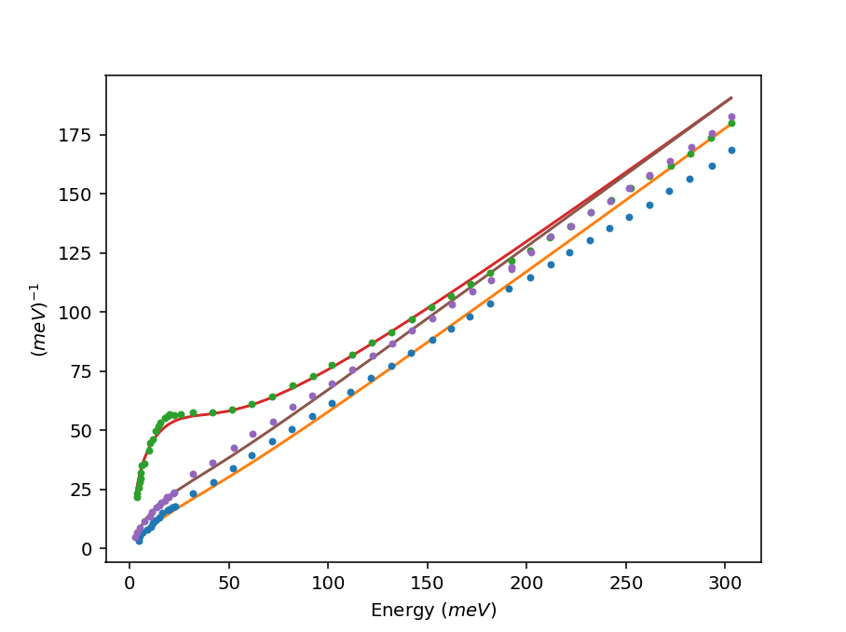
Fitting Crystal Fields
Fitting physical properties
sus_a = Load('NdOs2Al10_sus_a.txt')
sus_b = Load('NdOs2Al10_sus_b.txt')
sus_c = Load('NdOs2Al10_sus_c.txt')
cf = CrystalField('Nd', 'C2v', *blm)
# Simultaneously fit data measured in a, b and c directions
cf.PhysicalProperty = [
PhysicalProperties('susc', Hdir=[1,0,0], Inverse=True, Unit='cgs'),
PhysicalProperties('susc', Hdir=[0,1,0], Inverse=True, Unit='cgs'),
PhysicalProperties('susc', Hdir=[0,0,1], Inverse=True, Unit='cgs')]
fit = CrystalFieldFit(Model=cf, InputWorkspace=[sus_a, sus_b, sus_c], MaxIterations=100, Output='fit_susc')
fit.fit()

Slide 34
Questions so far?

Slide 35
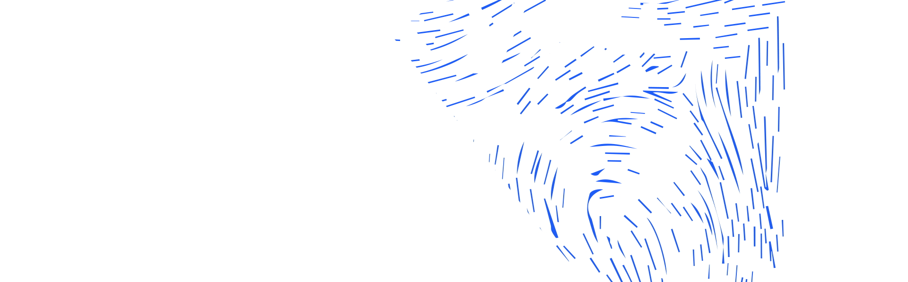
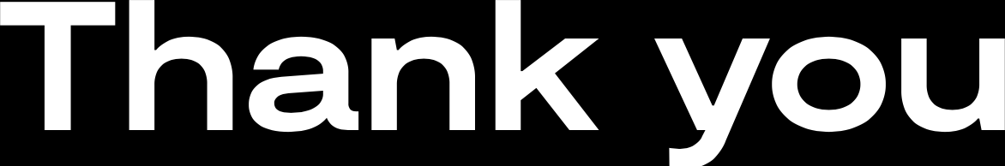
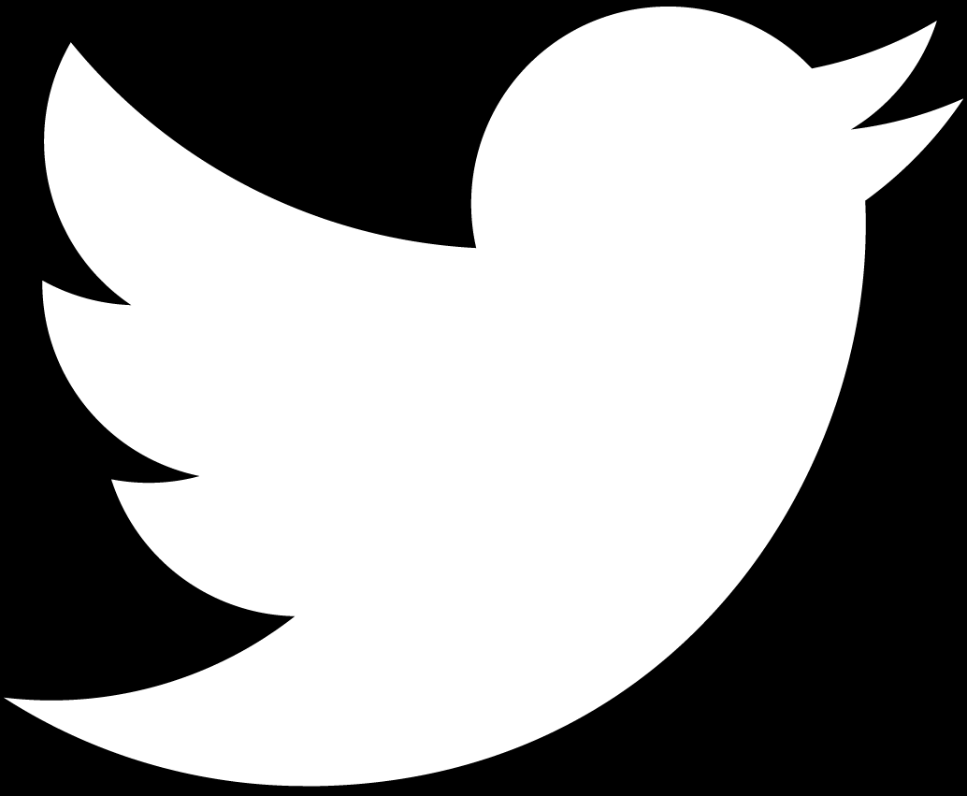
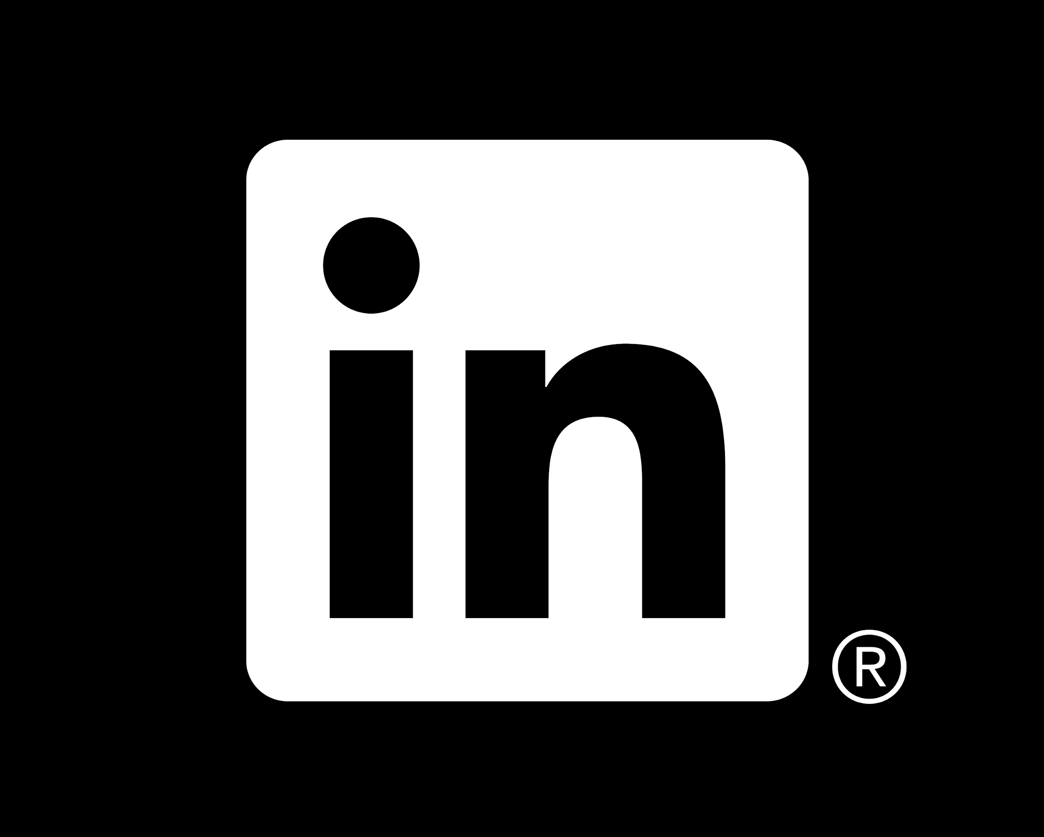
isis.stfc.ac.uk
@ISISNeutronMuon
STFC
Notes:
The abstract pattern can be removed or repositioned if required. Be careful to ‘Send to Back’ so that it does not obscure any important information.

