Slide 1
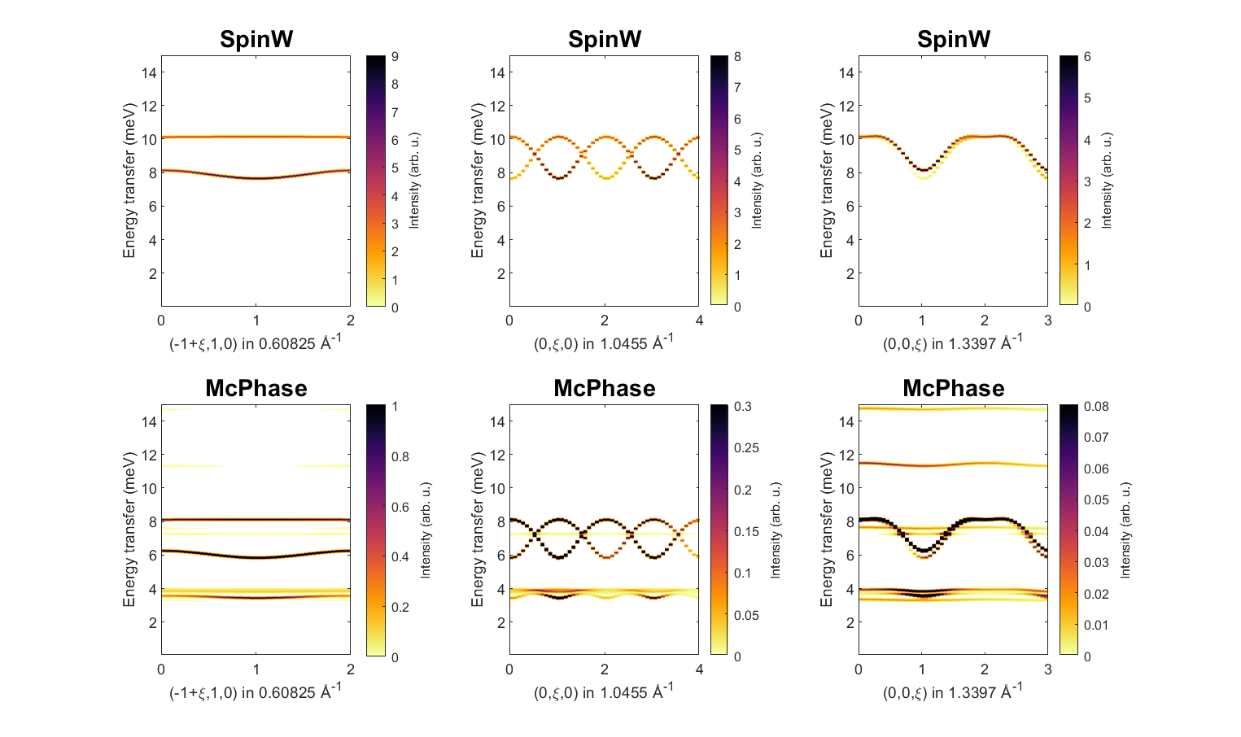
SpinW and McPhase
Manh Duc Le

Slide 2
Outline
A bit of theory…
  Linear spin wave theory (LSWT) vs Mean-field random-phase approximation (MF-RPA)
SpinW - Intro and brief demonstration
SpinW2McPhase
Examples
  Toy square lattice antiferromagnet
  LiFePO₄
  Ni₂Mo₃O₈
Gotchas
  Single-ion anisotropy
  Negative energy part
https://github.com/mducle/spinw2mcphase

Slide 3

Hamiltonian
SpinW can solve the magnetic Hamiltonian:
It uses the convention that:
  Positive values of the exchange J means an antiferromagnetic interaction.
  Positive values of the single ion anisotropy A means an easy-plane anisotropy.
The Hamiltonian above usually leads to magnetic ordering below a critical temperature.
Spin waves are the collective excitations of this ordered state.
General bi-linear
interactions
Single-ion
anistropy
Applied magnetic
field (Zeeman)

Slide 4
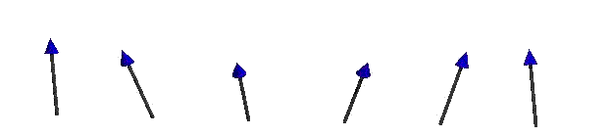
Steps in a Spin Wave Calculation
Spin waves arise from deviations of the ordered magnetic state.
We use the spin deviations as the basis states for calculating the magnetic Hamiltonian.
The Hamiltonian is then partly solved by a Fourier transform
  For a ferromagnet the FT diagonalises the Hamiltonian
  More generally another transformation is required to diagonalise H.
The eigenvalues of H(q) gives the magnon energies and the eigenvectors can be used to calculate the spin-spin correlation function and INS intensity.

Slide 5



Holstein-Primakoff Transformation
Express the spin operators as the ladder operators:
Map the raising / lowering operators to bosonic creation and annihilation operators taking only terms linear in
ground state is fully
saturated state.
n^{th} magnon is n^{th}
deviation from this
vs
linear spin wave theory means ignoring the terms
in blue.

Slide 6



Hamiltonian
We could now substitute the Holstein-Primakoff operators back into the Hamiltonian, but then the maths gets complicated because of the dependence of the operators on the magnetic structure (spin orientation).
Instead we define a set of 3x3 rotation matrices R_{i} which rotates all the spin to ferromagnetic alignment, e.g.:
Where S_{i}’ are all ferromagnetic.
Remembering that:
If we define two sets of vectors u_{i} formed from the first two columns of the matrix R_{i} and v_{i} formed from the third column as:
Then we have:
Where the bar indicates complex conjugation.

Slide 7


Hamiltonian
The Hamiltonian thus becomes:
The terms in curly braces can be expressed as a vector of the H-P operators (basis states), giving:
Where H_{ij} is a 2n x 2n matrix whoes matrix elements can be determined by the braced expressions above and is given in the SpinW paper.
The expression above will contain terms which mix spins at i and j – a Fourier Transform will separate this, e.g. as in:
We now Fourier transform the Hamiltonian and diagonalise it for every q point.

Slide 8
Incommensurate Structure
Remember that we introduced a rotation matrix which rotates every spin into the ferromagnetic state – actually SpinW introduces two such rotations.
The first applies to all spins within a crystalline unit cell and is used for the “incommensurate” (single-q) calculations.
The second then rotates the spins within a unit cell into the ferromagnetic state.
It turns out that for structures which can be described by a rotation from one unit cell to another, that the spin-spin correlation function (and hence INS intensity S(Q,ω)) has three branches:
  At Q
  At Q ± k , where k is the ordering wavevector / magnetic propagation vector
Expressions for the spin-spin correlation function can be found in the SpinW paper:
S. Toth and B. Lake, J. Phys.: Condens. Matter, 27 (2015) 166002

Slide 9
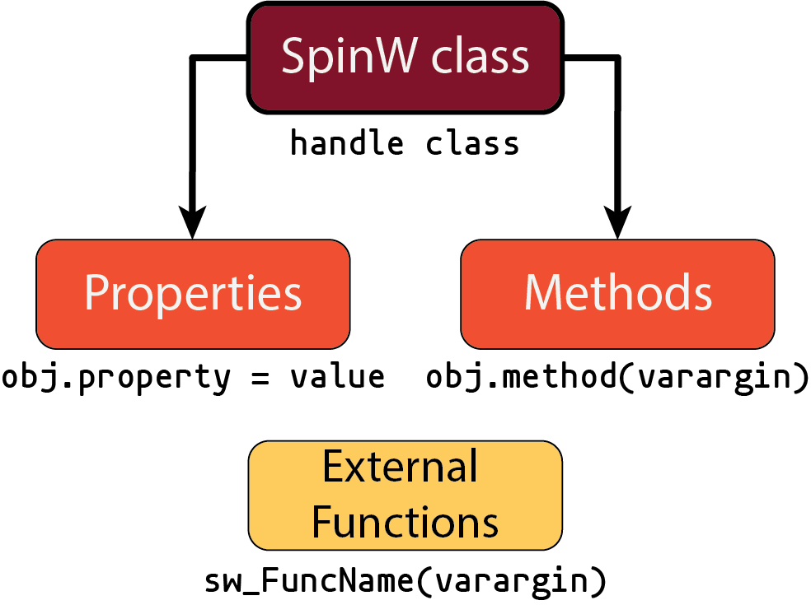
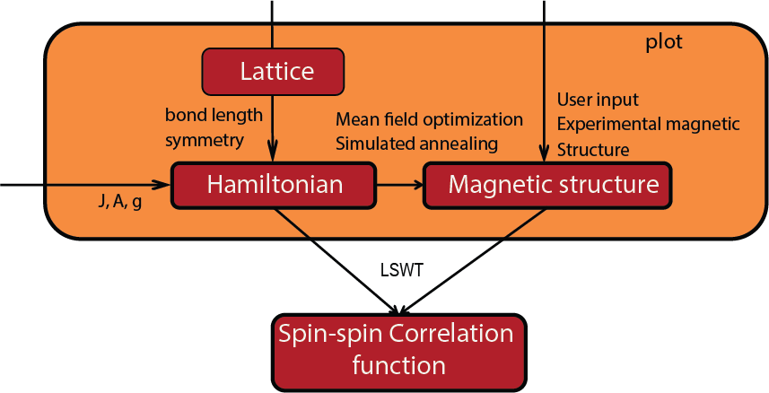
SpinW
SpinW is written as a Matlab class:
There are three main things you need to define for a calculation:
There is extensive online help/documentation
In Matlab, type:
>> help <command>
Or look at the online presentations or tutorials at spinw.org

Slide 10
SpinW – Getting Started
To start, you have to create a spinw object. You can:
  Start from scratch: >> swobj = spinw();
  Use a CIF or FST file: >> swobj = spinw('mycompound.cif');
Often it’s easier to start from scratch because usually you’re just interested in the magnetic atoms and can ignore everything else.
That just created a frustrated Cu square-lattice.
swobj = spinw();
swobj.genlattice('lat_const', [3,3,5], 'angled', [90 90 90]);
swobj.addatom('r', [0,0,0], 'S', 1/2, 'label', 'MCu2');
swobj.gencoupling('maxDistance', 5)
swobj.addmatrix('label', 'J1', 'value', 1);
swobj.addcoupling('mat', 'J1', 'bond', 1);
swobj.addmatrix('label', 'J2', 'value', 0.5);
swobj.addcoupling('mat', 'J2', 'bond', 2);
plot(swobj)

Slide 11
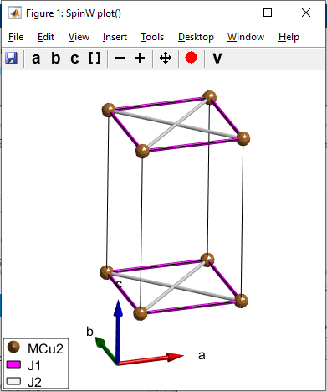
SpinW – Getting Started
To start, you have to create a spinw object. You can:
  Start from scratch: >> swobj = spinw();
  Use a CIF or FST file: >> swobj = spinw('mycompound.cif');
Often it’s easier to start from scratch because usually you’re just interested in the magnetic atoms and can ignore everything else.
That just created a frustrated Cu square-lattice.
swobj = spinw();
swobj.genlattice('lat_const', [3,3,5], 'angled', [90 90 90]);
swobj.addatom('r', [0,0,0], 'S', 1/2, 'label', 'MCu2');
swobj.gencoupling('maxDistance', 5)
swobj.addmatrix('label', 'J1', 'value', 1);
swobj.addcoupling('mat', 'J1', 'bond', 1);
swobj.addmatrix('label', 'J2', 'value', 0.5);
swobj.addcoupling('mat', 'J2', 'bond', 2);
plot(swobj)

Slide 12

SpinW – Getting Started
swobj.gencoupling('maxDistance', 5)
swobj.addmatrix('label', 'J1', 'value', 1);
swobj.addcoupling('mat', 'J1', 'bond', 1);
All exchange, SIA, g-tensors defined as 3x3 matrices.
The addmatrix method has the following shortcuts:
  A scalar input v means the matrix is the identity times v
  A vector input [M_{x},M_{y},M_{z}] defines an antisymmetric matrix:
So adding a DM interaction with a DM vector along [110] is:
swobj.addmatrix('label', 'DM', 'value', [1,1,0]);
swobj.addcoupling('mat', 'DM', 'bond', 1);

Slide 13
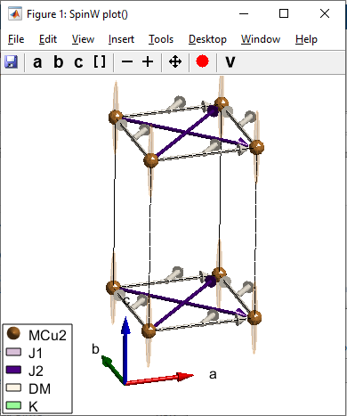
SpinW – Getting Started
Single-ion anisotropy terms can usually be specified using the Matlab diag command – given a n-element vector it returns an n x n matrix with the diagonal elements being elements of that vector, e.g.
swobj.addmatrix('label', 'K', 'value', diag([0 0 -0.1]));
swobj.addaniso('K');
plot(swobj)

Slide 14
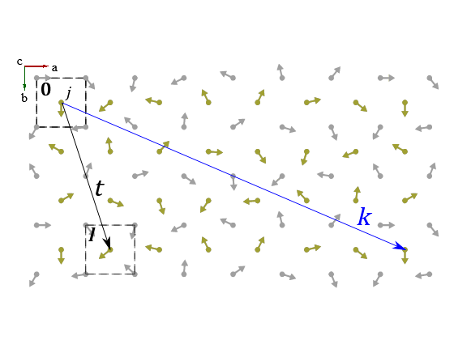

SpinW – Magnetic Structures
The j^{th} moment in the l^{th} unit cell at t from the origin can be expressed as:
For a single-k structure, we omit the sum:
where Ψ is the complex basis vector and k is the propagation vector.
In SpinW, the magnetic structure is stored as a structure with fields:
Note that although SpinW uses these fields to store the magnetic structure, it can only truly handle incommensurate structures which can be represented by a rotation from one unit cell to the next.
mag_str.F | The complex basis vector in Cartesian units
mag_str.k | The propagation vector in reciprocal lattice units
mag_str.nExt | The magnetic supercell size in lattice units

Slide 15
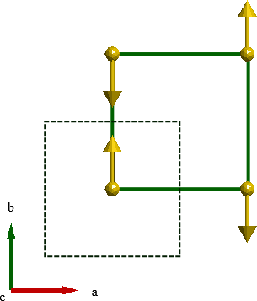
SpinW – Magnetic Structures
Some examples:
sq = spinw;
sq.genlattice('lat_const', [4 4 6], 'angled', [90 90 90]);
sq.addatom('r', [0.5 0.5 0.5], 'S', 2, 'label', 'MCr3', 'color', 'y');
sq.genmagstr('mode', 'direct', 'S', [0 0 0 0; 1 -1 -1 1; 0 0 0 0], ...
'nExt', [2 2 1], 'k', [0 0 0])

Slide 16
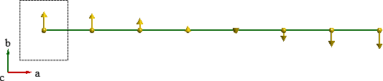
SpinW – Magnetic Structures
Some examples:
mmod = spinw;
mmod.genlattice('lat_const', [4 4 6], 'angled', [90 90 90]);
mmod.addatom('r', [0.5 0.5 0.5], 'S', 2, 'label', 'MCr3', 'color', 'y');
mmod.genmagstr('mode', 'fourier', 'S', [0; 1; 0], 'k', [0.07 0 0])

Slide 17
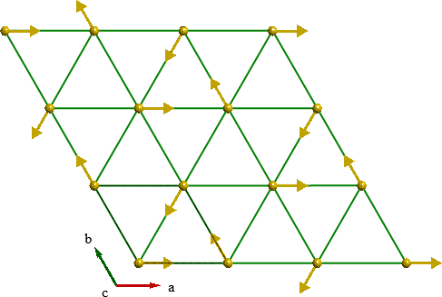
SpinW – Magnetic Structures
Some examples:
tri = spinw;
tri.genlattice('lat_const', [4 4 6], 'angled', [90 90 120]);
tri.addatom('r', [0 0 0], 'S', 2, 'label', 'MCr3', 'color', 'gold');
tri.genmagstr('mode', 'helical', 'S', [1; 0; 0], ...
'n', [0 0 1], 'k', [1/3 1/3 0])

Slide 18
Magnetic Structure Optimisation
Often the initial magnetic structure you input doesn’t quite agree with the exchange parameters you put in – this will result in a “non-Hermitian Hamiltonian” error.
SpinW contains several functions to optimise the magnetic structure to minimise the classical magnetic ground state energy:
  optmagsteep – optimise a magnetic structure succesively rotating each moment to the Weiss field direction.
    Fast, but will not change the super-cell size or the propagation vector.
  optmagk – optimises the propagation vector by finding the k which minimises the eigenvalues of the (Fourier transformed) Hamiltonian
  optmagstr – nonlinear search for optimal structure (using fminsearch) but needs a function to set the structure.
  anneal – performs simulated annealing using the Metropolis algorithm, can be used to calculate thermodynamic properties.

Slide 19
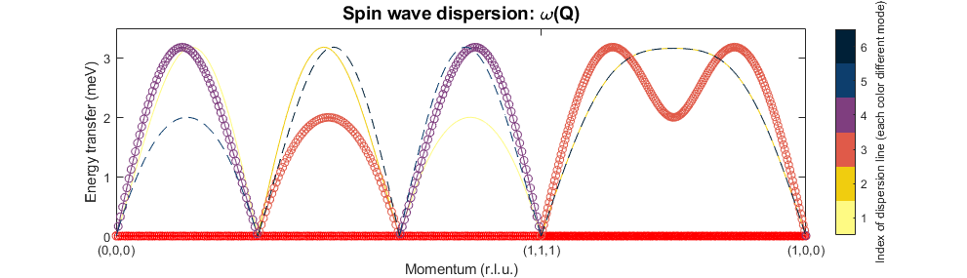
Dispersion calculations
Once the Hamiltonian (exchange, SIA, etc) and magnetic structure is set, SpinW can calculate the spin wave dispersion and the INS spectrum:
Q can be a 3xN array of Q points to calculate at
Or a Matlab cell-array with Q points to plot along, and the number of points per segment e.g.
spec = swobj.spinwave(Q, 'parameter', 'value', ...)
spec = swobj.spinwave({[0,0,0], [1,1,1], [1,0,0] 200});
sw_plotspec(spec)

Slide 20
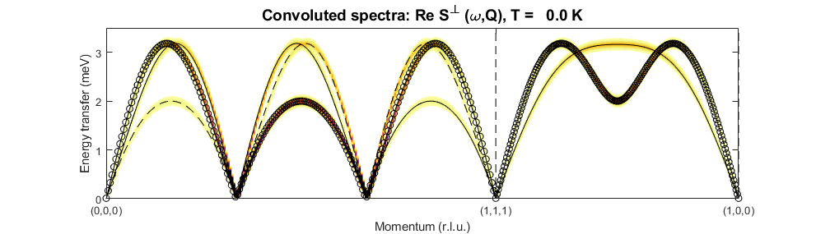
Dispersion calculations
Use sw_plotspec to plot the spectrum returned by spinwave.
Need to use sw_egrid to bin the dispersion and calculate the INS intensity:
spec = swobj.spinwave({[0,0,0], [1,1,1], [1,0,0] 200});
spec = sw_egrid(spec);
sw_plotspec(spec, 'dE', 0.1)

Slide 21
Questions so far?

Slide 22
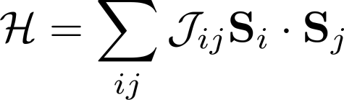
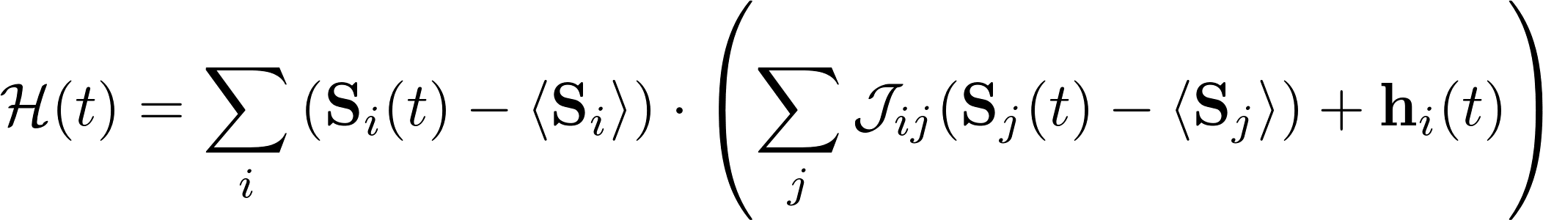

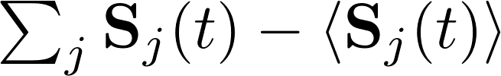

MF-RPA recap
Starting with the Hamiltonian:
Mean-field approx:
Get time dependence by transforming to Heisenberg form:
The random phase approximation is:
That is, we treat the fluctuations of the j^{th} spin away from its time-averaged (e.g. ordered) value as small, such that the sum over all the fluctuations of the j neighbouring spins (j≠ i)
(the sum over the random phase factors ) is zero.
Chapter 3, Jensen and Mackintosh, Rare Earth Magnetism (OUP 1991)

Slide 23
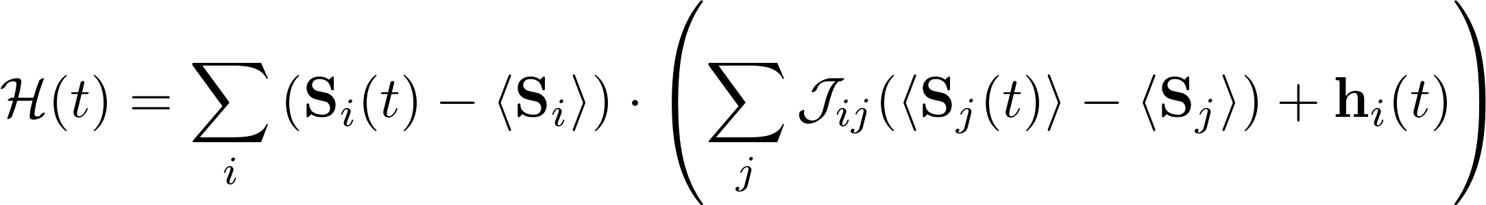


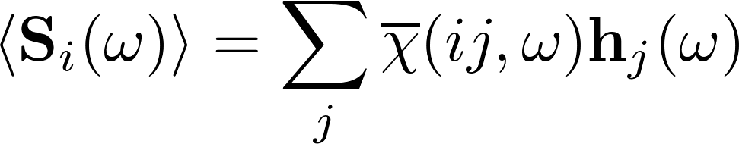
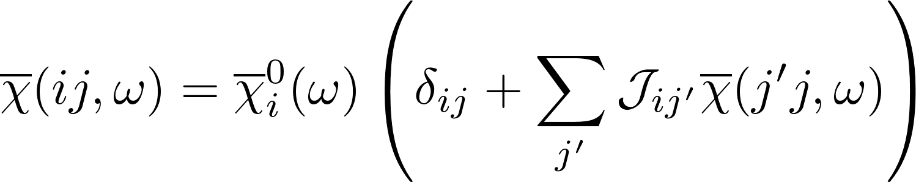
MF-RPA recap
The terms in brackets relating to the j^{th} spins are thus approximately time-independent, such that we can express the brackets as a time-dependent effective field in i only.
From linear response theory:
where (ω) indicates a Fourier transformed quantity.
However, if we had not ignored the time-dependence of the j^{th} spins, then we should obtain the two-ion response as:
where h_{j}(ω) is the perturbation due to the neighbouring spins.
These two equations must be consistent for all h_{j}(ω) which leads to the RPA equation:

Slide 24
Dynamical Matrix Diagonalisation
In McPhase, we apply a unitary transformation to the RPA equation to obtain a generalised eigenvalue equation for each Q point. (See Appendix B of Rotter et al., JPCM 24 213201 (2012))
where indicates the unitary transformation.
The terms in the first brackets is the generalised eigenvalue
equation that must be solved and is the dynamical matrix.
The eigenvalues of are the mode energies, whilst the
eigenvectors can be used to compute physical observables such as neutron scattering intensities.

Slide 25

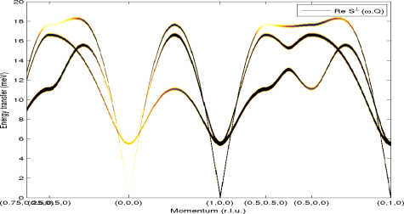
LSWT vs MF-RPA
Mean-field random phase approximation
Linear spin wave theory
MF
H-P
RPA

Slide 26
LSWT vs MF-RPA
The Holstein-Primakoff transformation maps the angular momentum ladder operators to bosonic (creation/anihilation) operators, where the vacuum state is the fully ordered state.
ground state is fully
saturated state.
n^{th} magnon is n^{th}
deviation from this
vs
linear spin wave theory means ignoring the terms
in blue.

Slide 27
LSWT vs MF-RPA
The Holstein-Primakoff transformation maps the angular momentum ladder operators to bosonic (creation/anihilation) operators, where the vacuum state is the fully ordered state.
Linear spin wave theory essentially treats only small deviations (creation/anihilation of a single magnon – going from S to S-1).
The random-phase approximation is when neighbouring spin fluctuations are assumed to be small compared to the time-averaged values (e.g. the static / ordered directions).
Thus the RPA and linear spin wave theory is equivalent as far as pair-wise interactions are concerned.
The on-site terms, however, are different in the two calculations – so single-ion effects are not equivalent.

Slide 28
Questions so far?

Slide 29
spinw2mcphase
There is a small package spinw2mcphase which contains Matlab scripts which:
  Converts a spinw object to McPhase input files.
  Runs a McPhase spectrum calculation (with both MF [mcphas] and RPA [mcdisp] steps)
The main script is mcphase_sqw.m which is designed to be a replacement for the spinw/spinwave or the spinw/horace_sqw methods.
It returns a SpinW-compatible spectrum structure which can be plotted with SpinW tools, e.g.
spec_mc = mcphase_sqw(h, k, l, spinw_object);
sw_plotspec(sw_egrid(sw_neutron(spec_mc)));

Slide 30
Set-up
In order to run McPhase, the script needs to know certain properties, including the installation location of McPhase.
It uses global variables for this to ensure that fitting can be run with engines which cannot pass these parameters.
So, you need the following preamble in your code:
global mcphasedir; mcphasedir='c:/mcphas5_3';
global workdir; workdir='mtmp';
global numproc; numproc=2;
global emin; emin=-200;
global emax; emax=200;
global temperature; temperature = 0.02;
global magfield; magfield = [0 0 1];

Slide 31
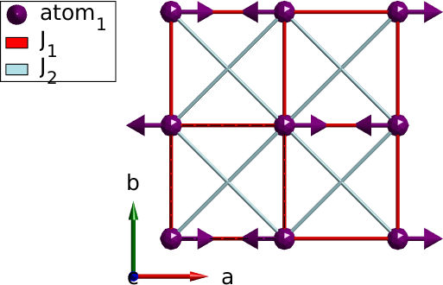
Simple example
We define a simple square lattice antiferromagnet
swobj = sw_model('squareAF', [1 0.5]);
swobj.genmagstr('mode', 'direct', ...
'S', [1 0 0], 'n', [0 0 1], 'k', [0.5 0.5 0]);

Slide 32
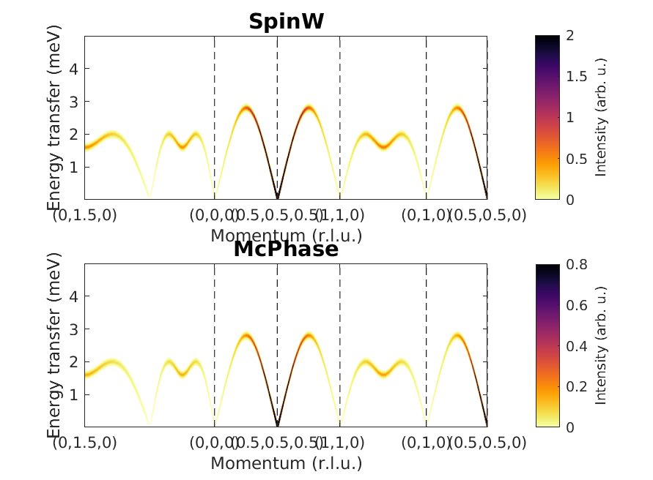
Simple example
Then calculate the spin waves with SpinW and McPhase.
qpts = {[0 1.5 0] [0 1 0] [0 0 0] [0.5 0.5 0.5] [1 1 0] [0 1 0] [0.5 0.5 0] 100};
spec = sw_egrid(sw_neutron( ...
swobj.spinwave(qpts,'hermit',true)),'Evect',0:0.01:5);
hkl = sw_qscan(qpts);
specm = sw_egrid(sw_neutron(...
mcphase_sqw(hkl(1,:), hkl(2,:), hkl(3,:), swobj)),'Evect',0:0.01:5);
figure;
subplot(211); sw_plotspec(spec,'mode','color','dE',0.1,'dashed',true); title('SpinW'); legend('off');
subplot(212); sw_plotspec(specm,'mode','color','dE',0.1,'dashed',true); title('McPhase'); legend('off');

Slide 33
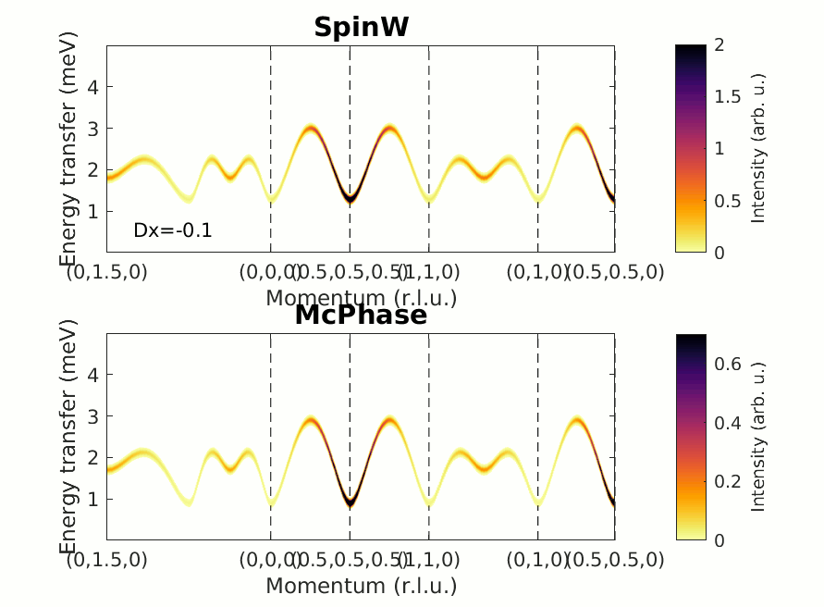
Simple example
But what if we added an easy-axis anisotropy along x?
Can see that as the magnitude of the SIA gets larger the disagreement between SpinW and McPhase gets more pronounced.
swobj = sw_model('squareAF', [1 0.3]);
swobj.genmagstr('mode', 'direct', 'S', [1 0 0], 'n', [0 0 1], 'k', [0.5 0.5 0]);
swobj.addmatrix('label', 'Dx', 'value', diag([-0.1 0 0])); swobj.addaniso('Dx')

Slide 34
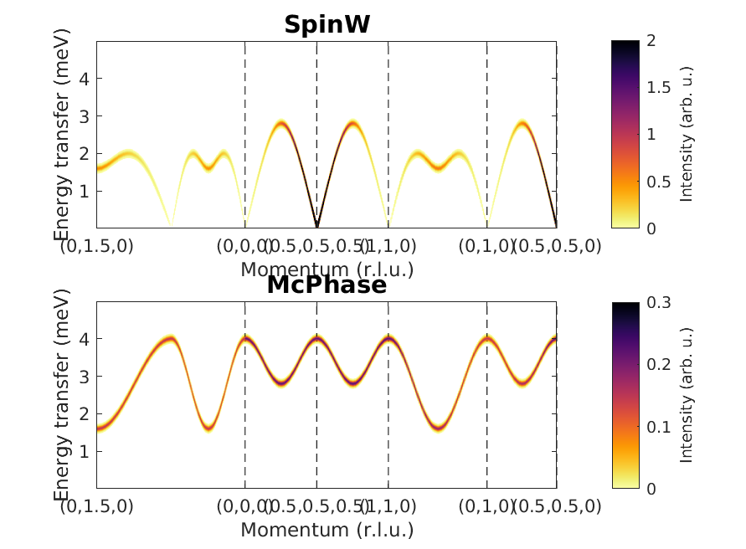
Simple example
Remember in the setup there was an emin and emax?
What if we set emin=0?
Can see that the McPhase is now completely wrong. This is because the DMD approach where each transition is included independently – to model spin waves, you need to specify both the +ve and -ve energy branches.
global emin; emin=0;
global emax; emax=200;
spec = sw_egrid(sw_neutron(swobj.spinwave(qpts,'hermit',true)),'Evect',0:0.01:5);
hkl = sw_qscan(qpts);
specm = sw_egrid(sw_neutron(mcphase_sqw(hkl(1,:), hkl(2,:), hkl(3,:), swobj)),'Evect',0:0.01:5);

Slide 35
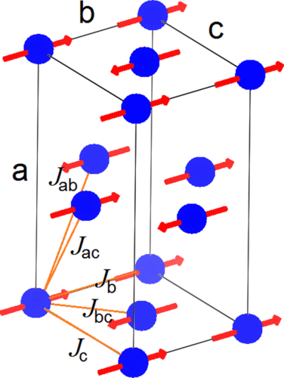
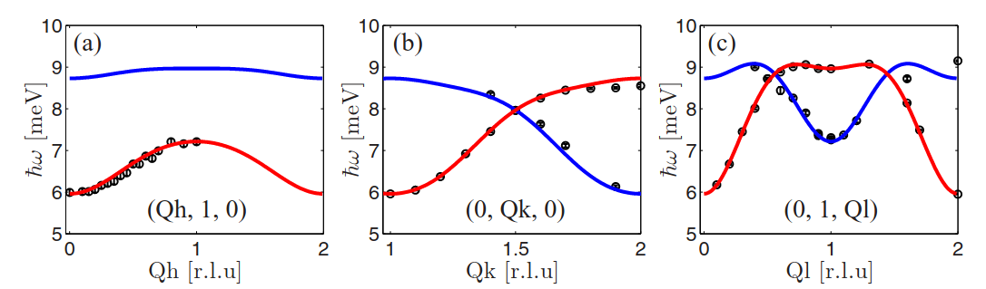
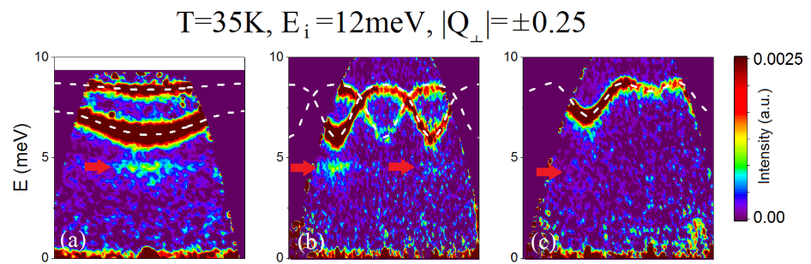
LiFePO₄ – excited state transition
Best known as a Li-ion battery cathode material but it’s also magnetically ordered (T_{N}=47 K) and is magnetoelectric!
4 Fe²⁺ ions in the magnetic unit cell, but 2 modes have zero intensity – so expect only 2 modes at all temperatures.
R. Toft-Petersen et al., PRB 92 024404 (2015)
T = 2K
Yiu et al., PRB 95 104409 (2017)

Slide 36
LiFePO₄ – excited state transition
The extra mode below the spin waves are not seen at base temperature – only at intermediate temperatures (T<T_{N}).
Thought to be transitions from the first excited state ([S-1]→[S-2])
Cannot be modelled using linear spin wave theory.
But can be included in the RPA.
example_lifepo4.m

Slide 37
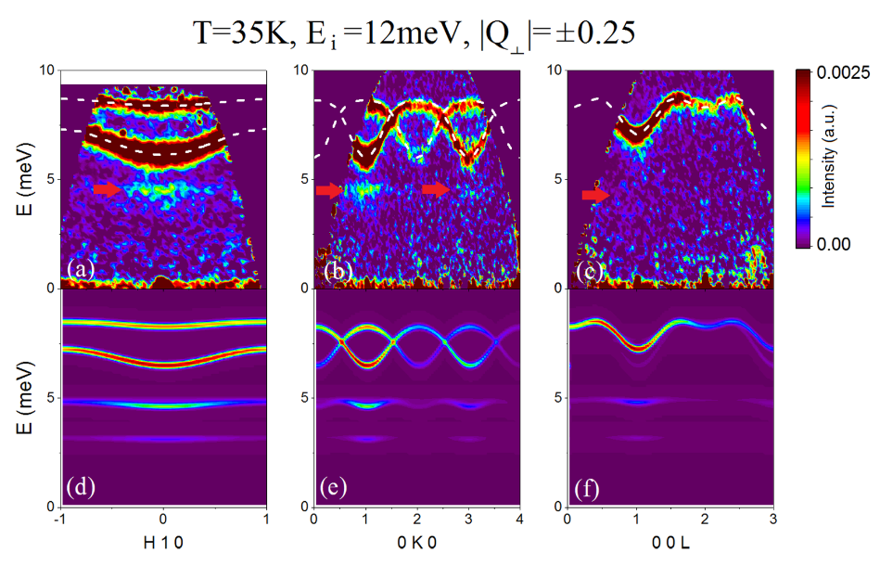
LiFePO₄ – excited state transition
The extra mode below the spin waves are not seen at base temperature – only at intermediate temperatures (T<T_{N}).
Thought to be transitions from the first excited state ([S-1]→[S-2])
Cannot be modelled using linear spin wave theory.
But can be included in the RPA.
Yiu et al., PRB 95 104409 (2017)

Slide 38
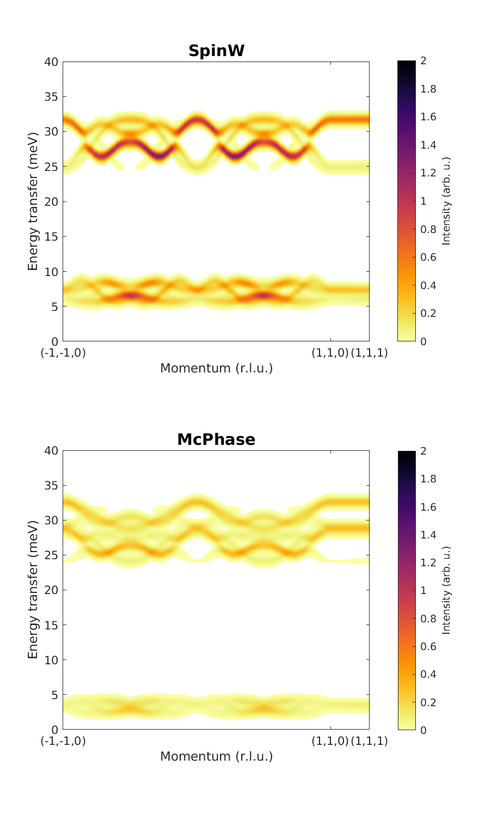
Ni₂Mo₃O₈ – point charge model
This system has two Ni²⁺ sites – one with octahedral coordination and one with tetrahedral coordination.
The two sites have extremely different SIA, leading to two widely separated bands.
This could be explained by a point charge model.
sw_obj.cache.mcphase = struct('pointcharge', ...
struct('maxdist', 3.5, ...
'atoms', ...
struct( ...
'label', {'Ni1', 'Ni2', 'Mo', 'O1', 'O2', 'O3', 'O4'}, ...
'valence', {2 2 4 -2.0 -2.0 -2.0 -2.0}, ...
'charges', {NiC NiC MoC OxC OxC OxC OxC}, ...
'r', {[2/3 1/3 0.448] [1/3 2/3 0.5116] ...
[0.144 -0.144 0.2489] [0 0 0.6839] ...
[1/3 2/3 0.1461] [0.488 -0.488 0.3659] ...
[0.1688 -1/6 0.6342]})))
Li et al., PRM 6 014405 (2022)

Slide 39
Questions?

Slide 40
Summary
Linear spin wave theory and the random phase approximation are equivalent for pair-wise spin Hamiltonians.
They treat single-ion effects differently.
LSWT restricted to “single-ion anisotropy” S_{z}² terms.
McPhase can treat sophisticated effects such as crystal fields.
Linear spin wave theory is restricted to only transitions from the ground state. RPA can include excited state transitions.
https://github.com/mducle/spinw2mcphase
Horace not yet fully supported.

