Slide 1

Seasonal Agriculture Performance Analysis
Mohammed Umair Ali
[College Name]
AICTE STU ID : [Enter your STU ID - available in your offer letter]

Slide 2

PROBLEM STATEMENT
(Agricultural activities are influenced by seasonal variations in environmental conditions, farming practices, resource availability and market conditions. As a result, agricultural performance may differ from one season to another. However, raw agricultural data does not clearly explain how agricultural performance changes across seasons or what patterns can be observed in different seasonal conditions. The problem is to analyze the given agricultural dataset and investigate seasonal differences in agricultural performance by identifying meaningful patterns, trends, relationships and variations within the available data.

Slide 3
Project Description
Analyzes 4,000 farm-level records spanning 3 cropping seasons (Kharif, Rabi, Zaid), 8 states, 10 districts and 8 crop types
Built using Python (Pandas, NumPy, Matplotlib, Seaborn, SciPy) inside a Jupyter Notebook
Covers data cleaning, exploratory data analysis, correlation analysis and one-way ANOVA hypothesis testing
Investigates how yield, environmental conditions, resource use and profitability vary by season
Delivers evidence-based, season- and crop-specific recommendations to improve farm profitability

Slide 4

WHO ARE THE END USERS?
Farmers planning seasonal crop, irrigation and resource decisions
Agricultural extension officers and Krishi Vigyan Kendras advising farmers
State agriculture departments and policymakers for planning and subsidies
Agri-fintech and crop insurance providers assessing seasonal risk
Irrigation equipment and agri-tech companies targeting adoption (e.g. drip irrigation)
Researchers and data analysts studying seasonal agricultural patterns

Slide 5

Technology Used
Language & Environment: Python 3, Jupyter Notebook
Data Handling: Pandas, NumPy
Visualization: Matplotlib, Seaborn
Statistical Analysis: SciPy (one-way ANOVA, correlation analysis)
Documentation: Jupyter Notebook (.ipynb)
Presentation: Microsoft PowerPoint

Slide 6
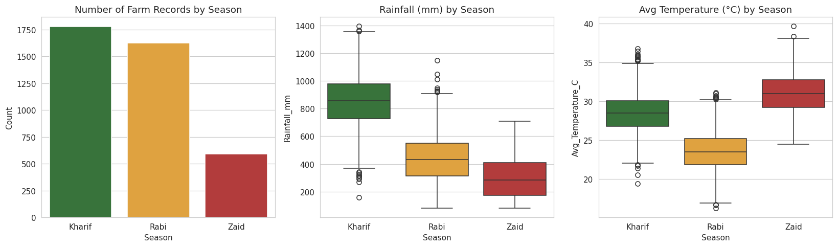
RESULTS
Kharif receives roughly 3× the rainfall of Zaid, and has the most cultivated farm records of the three seasons.

Slide 7
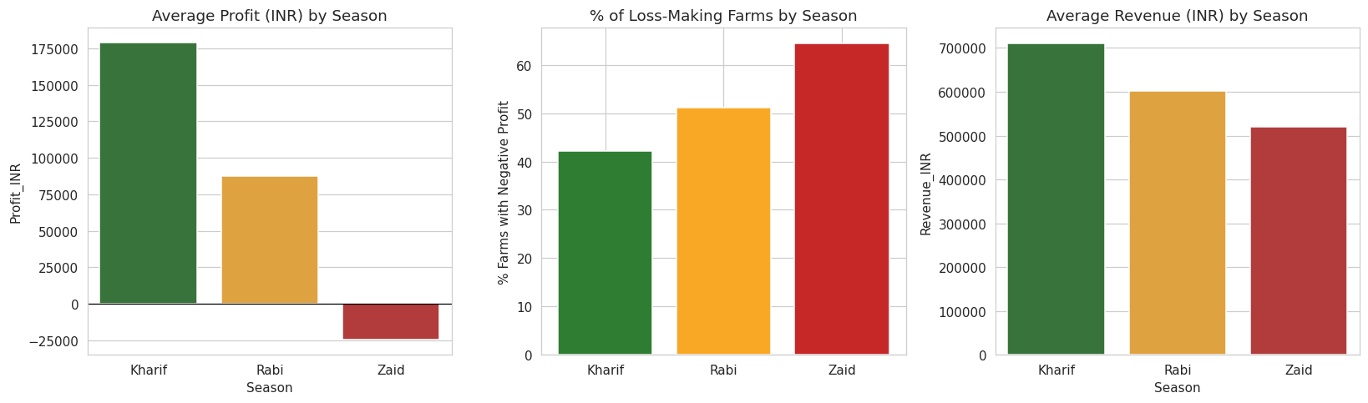
RESULTS
Kharif is the most profitable season (avg profit ₹1.79L); Zaid runs a net loss on average, with 64.5% of farms loss-making.

Slide 8
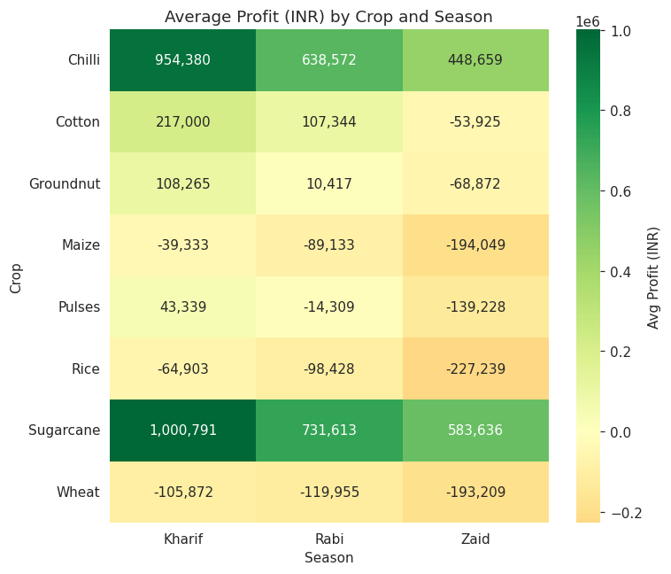
RESULTS
Sugarcane and Chilli stay profitable in every season studied; Maize, Rice and Wheat run at a loss in every season.

Slide 9
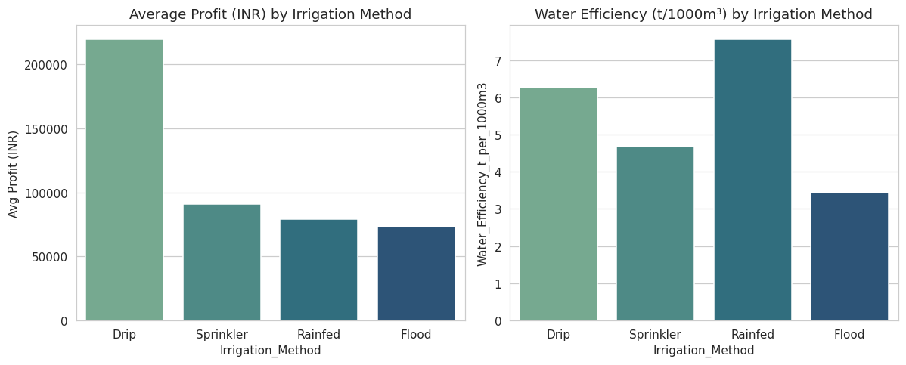
RESULTS
Drip irrigation delivers roughly 2× the average profit of Flood or Sprinkler irrigation methods.

Slide 10
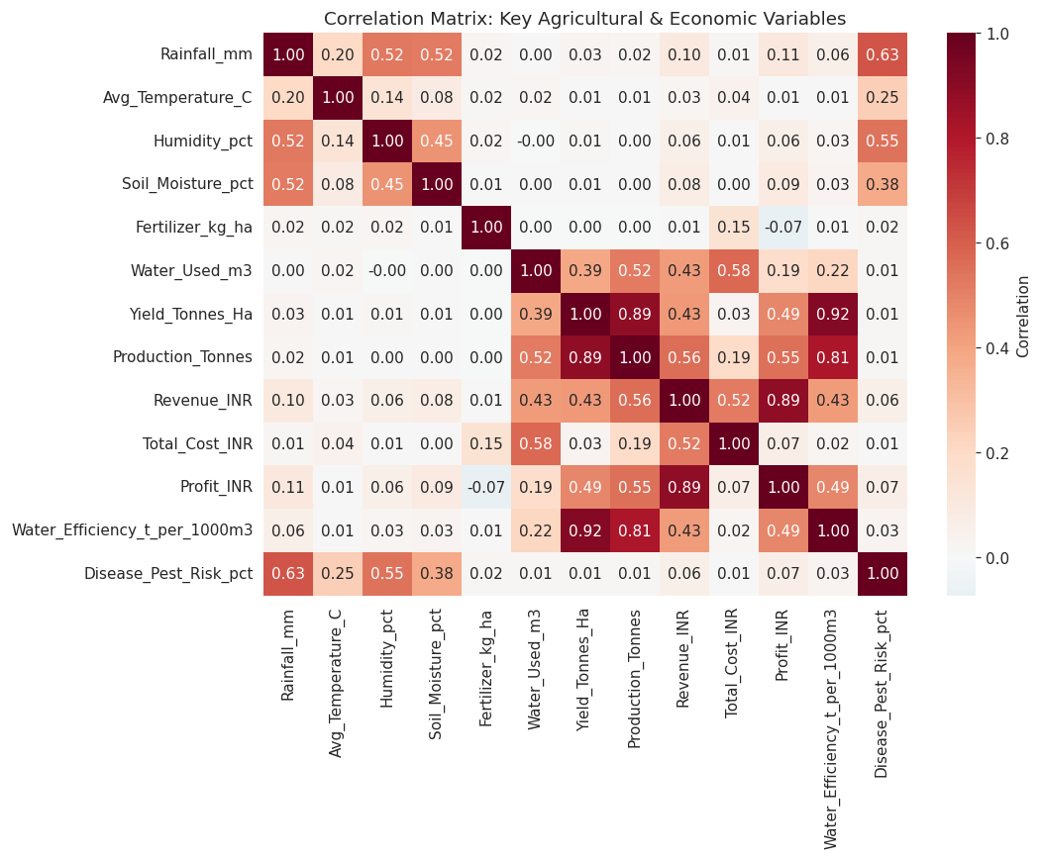
RESULTS
Profit correlates most strongly with Revenue, Production, Yield and Water Efficiency — not raw environmental inputs.

Slide 11
Future scope
Integrate real-time weather and IoT soil-sensor data for live, season-specific forecasting
Build machine learning models to predict yield and profit before a season begins
Develop a farmer-facing mobile app for season- and crop-specific recommendations
Expand coverage to more states, districts and crop varieties
Add a market price-forecasting module to help time sales around seasonal price swings
Build a policymaker dashboard to monitor seasonal agricultural performance in real time

Slide 12
GitHub Link
https://github.com/mdumair312-rgb/Seasonal-Agriculture-Performance-Analysis

Slide 13

VOIS Course completion certificate - Course name- Data Visualization

Slide 14
Thank you
.
.

