Slide 1

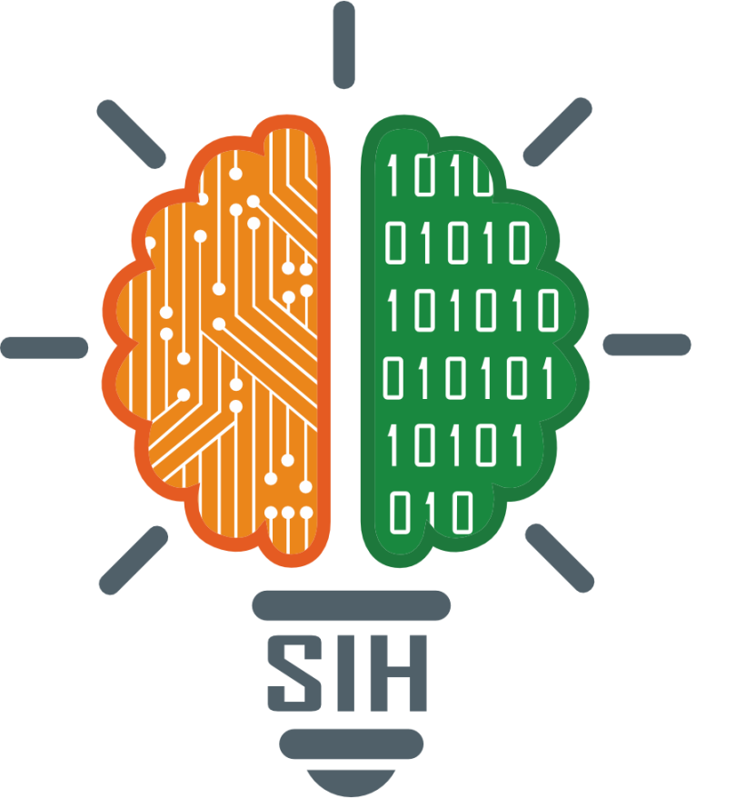
SMART INDIA HACKATHON 2025
ID - 25026
Title - Develop API code to integrate NAMASTE and CD-11 via TM2 into existing EMR systems that comply with Electronic Health Record (EHR) Standards for India.
Theme - MedTech / BioTech / HealthTech
Category- Software
Team ID -
Team Name - AyushSync

Slide 2
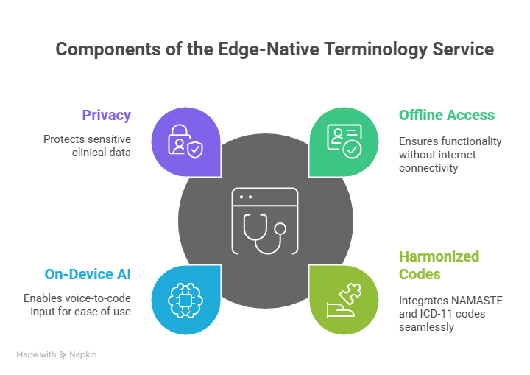

Run Anywhere, Sync When Possible
AyushSync
Our solution is an Edge-Native Terminology Service, a self-contained prototype running locally on a clinician's device, providing instant, offline access to harmonized NAMASTE and ICD-11 codes. It directly addresses the challenge of integrating traditional medicine into digital health by overcoming connectivity issues and simplifying dual-coding for EMRs. Its innovation lies in its offline-first reliability and on-device AI for voice-to-code input, offering unparalleled ease-of-use and privacy for clinicians in diverse environments.
Demo : Prototype Link

Slide 3
AyushSync
Components of a Modern Tech Stack
For a full-scale deployment, our robust offline-first architecture with its FHIR-compliant APIs and synchronization module would seamlessly integrate with a central server. This server would aggregate data from all edge devices, enabling national-level analytics and broader terminology management. We can scale our current technologies (eg, using a more robust central database, enterprise-grade AI deployment) while retaining the core edge-native benefits.
Docker and PyInstaller
Python with FastAPI
Packages the application for universal deployment
Provides a robust backend framework
Embedded SQLite
Streamlit
Creates interactive UI and demos
Ensures offline data reliability
spaCy
Distil-Whisper
Facilitates natural language processing
Enables speech- to-text functionality

Slide 4
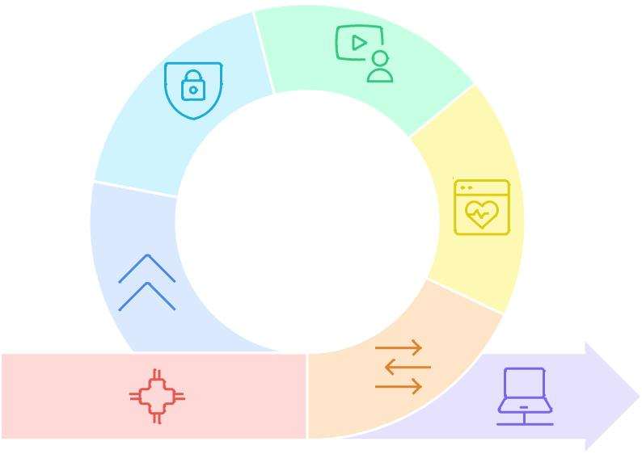
FEASIBILITY AND VIABILITY
AyushSync
Local Data
Processing
Private handling
Key Challenges & Our Strategies
Technical Risks:
Problem: AI could be slow on old clinic PCs
Our Strategy: We will use highly optimized AI models for low-spec hardware.
Clinician Adoption:
Problem: Busy doctors need to learn to use.
Our Strategy: We are focused on an intuitive design: time-saving voice commands. By making their job easier, we ensure they will want to use it.
Ecosystem Integration:
Problem: Existing EMR systems need to adopt our service.
Our Strategy: We will provide simple, developer-friendly APIs to make integration seamless.
Multi-Layered
of patient data
Security
Compliant with
data protection
act
FHIR Data
Modeling
Systems
Updater
Module
Offline-First
Approach
Secure and
resilient update
process
Unreliable
Connectivity
Store-and-
Forward Model
Continuous
Operation
Interrupted
healthcare
professional
work
Queues data,
syncs when
connected
Uninterrupted
healthcare
professional
work

Slide 5
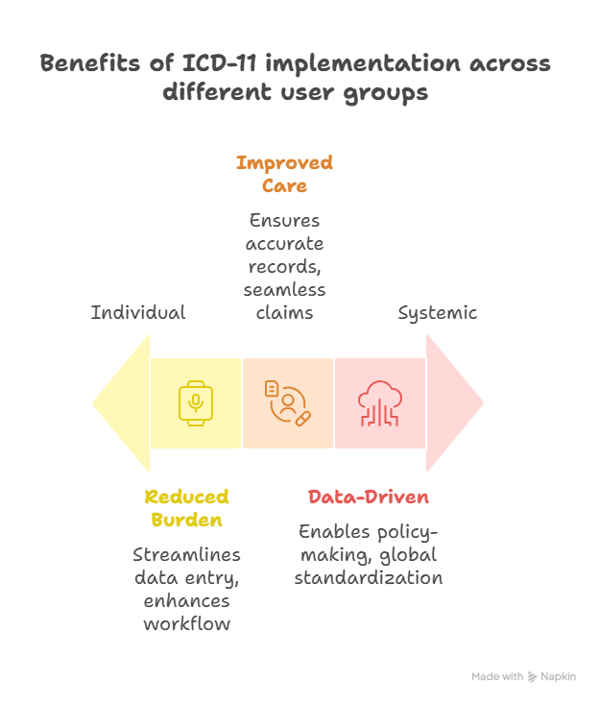
IMPACT AND BENEFITS
AyushSync
We Digitize and Scale a National Treasure. Our platform provides the critical digital infrastructure for India’s $24 billion Ayush industry a sector that has grown nearly 10x in a decade. This unlocks its full potential, supporting its $650 million+ annual export market and ensuring its place in the modern global economy.
We Deliver Healthcare Equity, Everywhere. Our offline-first model is purpose-built to serve the 70% of Indians in rural areas, overcoming connectivity barriers. By seamlessly integrating with the 500 million ABHA digital health IDs, we directly advance the government's vision for truly universal healthcare access.
We Fuel National Economic Growth. By standardizing Ayush with global codes, we directly boost two key economic engines: India’s booming $8.8 billion digital health market and its $9 billion medical tourism industry, which leverages treatment costs up to 90% lower than in the West.

Slide 6
RESEARCH AND REFERENCES
AyushSync
Ayush Market Size & Growth:
India Brand Equity Foundation (IBEF): https://www.ibef.org/industry/ayush
Press Information Bureau (PIB), Govt. of India: https://www.pib.gov.in/PressReleaseIframePage.aspx?PRID=2085331
Digital Health & Rural-Urban Divide:
NASSCOM Community: https://community.nasscom.in/communities/healthtech-and-life-sciences/disparity-parity-role-tech-rural-urban-healthcare
Custom Market Insights: https://www.custommarketinsights.com/report/india-digital-health-market/
ABHA Statistics:
Press Information Bureau (PIB) - ABDM Milestones: https://www.pib.gov.in/PressReleaseIframePage.aspx?PRID=1989763
Medical Tourism:
Wikipedia - Medical Tourism in India: https://en.wikipedia.org/wiki/Medical_tourism_in_India
Times of India Report: https://timesofindia.indiatimes.com/business/india-business/indias-low-cost-healthcare-drives-nri-medical-tourism-insurance-makes-care-affordable-report/articleshow/123782385.cms

Slide 7
Thank You
AyushSync

